Slide 1

HANDS-ON WALKTHROUGH · CRIBL STREAM
Is your Cribl Stream deployment healthy?
One tenant watches a Cribl Stream deployment end to end — its Sources, Destinations, Pipelines, Routes, Workers and Leader — from the metrics Cribl already sends to Splunk and from its Leader API, and tells you, in a Cribl operator's words, what needs attention.
Captured live on TrackMe 2.4.19 · Cribl.Cloud and self-managed lab deployments
Notes:
Hands-on walkthrough of the Cribl Stream tenant, generally available in TrackMe 2.4.19. Everything was captured live on lab deployments: a Cribl.Cloud workspace and a self-managed Leader with five Workers. In four parts: create the tenant, read and triage the findings, observe the deployment and its traffic models, and operate the tenant with policies, notifications, the AI Agent and Topology Studio.

Slide 2
THE PROBLEM
Every object in the data path is a place where data can stop
Cribl shows you the state of the moment. Someone has to keep watching it — every Destination, every Route, every Worker, every hour.
Destinations under pressure
Traffic that changes shape
Workers that drift
A Destination in backpressure or blocked, events dropped, a Source reported unhealthy: the data is late or lost before anyone looks.
A Source sending half of what it usually sends at this hour, a Route that goes quiet: nothing is broken, the volume is just wrong.
A Worker that stopped answering, runs another version than the Leader, or an old configuration; a Leader whose disk is filling up.
What a Cribl Stream tenant does
A dedicated tenant type. It reads the Cribl internal metrics your Workers already send to a Splunk metric index — in place, nothing copied — and the Cribl Leader API, read-only within a shared request budget. Sixteen built-in policies raise findings, a traffic ML model learns the normal traffic of every object and every hour, and a purpose-built workspace gives the investigation and triage workflow. TrackMe never changes anything in Cribl.
TrackMe for Splunk · Hands-on: Cribl Stream
docs.trackme-solutions.com
Notes:
Cribl Stream sits in the middle of the data path. Every Source, Route, Pipeline and Destination is a place where data can slow down, back up, be dropped or stop, and every Worker can disconnect or drift from its Worker Group. The Cribl UI shows the state of one moment; a Cribl Stream tenant keeps watching, raises findings and gives you the triage workflow.

Slide 3
THE MODEL
Two sources you already have, three jobs, findings you can act on
1
Cribl metrics
2
Leader API
3
Three jobs
4
Traffic ML models
5
Finding groups
cribl.logstream.* in a Splunk metric index: Sources, Destinations, Pipelines, Routes, worker processes.
Read-only, within a shared request budget: Worker Groups, Workers, configuration, Packs, the Leader.
Live metrics every 5 minutes, inventory every 10, model training every 30.
Per object and measurement, per hour of the day, then per weekday and hour.
16 policies raise findings; one object's findings form one Finding group.
›
›
›
›
On top of the findings
Triage the group — investigating, resolved, dismissed, Not an anomaly; assign it; notify by email; run findings actions (drilldowns, links, webhooks); ask the Cribl Stream AI Agent; see it live in Topology Studio.
A dedicated tenant type: no entities, no decision maker, no health score. Its objects are Cribl objects; one tenant per Cribl connection.
TrackMe for Splunk · Hands-on: Cribl Stream
docs.trackme-solutions.com
Notes:
The model in one picture. The live metrics job reads the newest five-minute interval of the Cribl metrics in Splunk every five minutes and evaluates the policies; the inventory job reads the configuration and the Workers from the Leader within its request budget; the model training job keeps a traffic ML model per object and measurement. Policies turn what is measured into findings, grouped per object into Finding groups.

Slide 4
THE PLAN
What we are going to do — one tenant, four parts
PART 1
PART 2
PART 3
PART 4
Setup
Findings
Observe
Operate
A Cribl connection
The Findings tab
Traffic and resources
Inventory and exclusions
The creation wizard
Finding groups and triage
Traffic ML models and tuning
Policies and notifications
The tenant card and the strip
Investigating an outlier
Workers and the Leader
The AI Agent and assistant
Collection health, day one
Assignment and webhooks
Routes, pipelines, flows
Topology Studio, Guardian
Every screen is the product as shipped, on lab deployments with real traffic.
TrackMe for Splunk · Hands-on: Cribl Stream
docs.trackme-solutions.com
Notes:
Four parts. Setup: the Cribl connection, the creation wizard, the first collection. Findings: the backlog, Finding groups, the investigation and the triage, assignment and webhooks. Observe: traffic, the traffic ML models, the machines and the data paths. Operate: inventory and exclusions, policies, notifications, the AI Agent, Topology Studio and the collection health.

Slide 5
01
PART 1 · SETUP
Connect, create, collect
A Cribl connection declared once, the four-step creation wizard, and the first collection: the tenant card, the status strip and Collection health on day one.
TrackMe for Splunk · Hands-on: Cribl Stream
Notes:
Part one: setup. A Cribl connection is declared once and serves Cribl Stream and Cribl Edge tenants. The wizard does the rest, and the first collection starts within minutes.

Slide 6
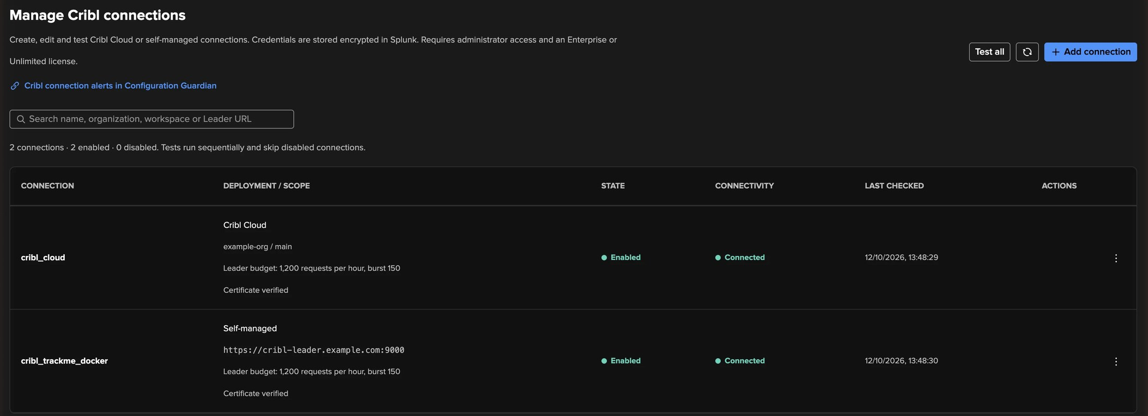
PART 1 · SETUP
A Cribl connection — declared once, read-only
1
Cribl.Cloud or self-managed
3
Leader request budget
An organisation and workspace with an API client, or a Leader URL with credentials and its TLS settings.
Every tenant on the connection shares it: TrackMe never overloads the Leader.
2
Connectivity result
4
Read access only
Each connection is tested; the result and its time are shown.
The account reads configuration and Workers; TrackMe never writes to Cribl.
TrackMe for Splunk · Hands-on: Cribl Stream
docs.trackme-solutions.com
Notes:
Configuration, Cribl connections. A connection is a Cribl.Cloud workspace with an API client ID and secret, or a self-managed Leader with a user name and password and its TLS settings. The Leader request budget is shared by every tenant that uses the connection. The account only needs read access: TrackMe never writes to Cribl.

Slide 7
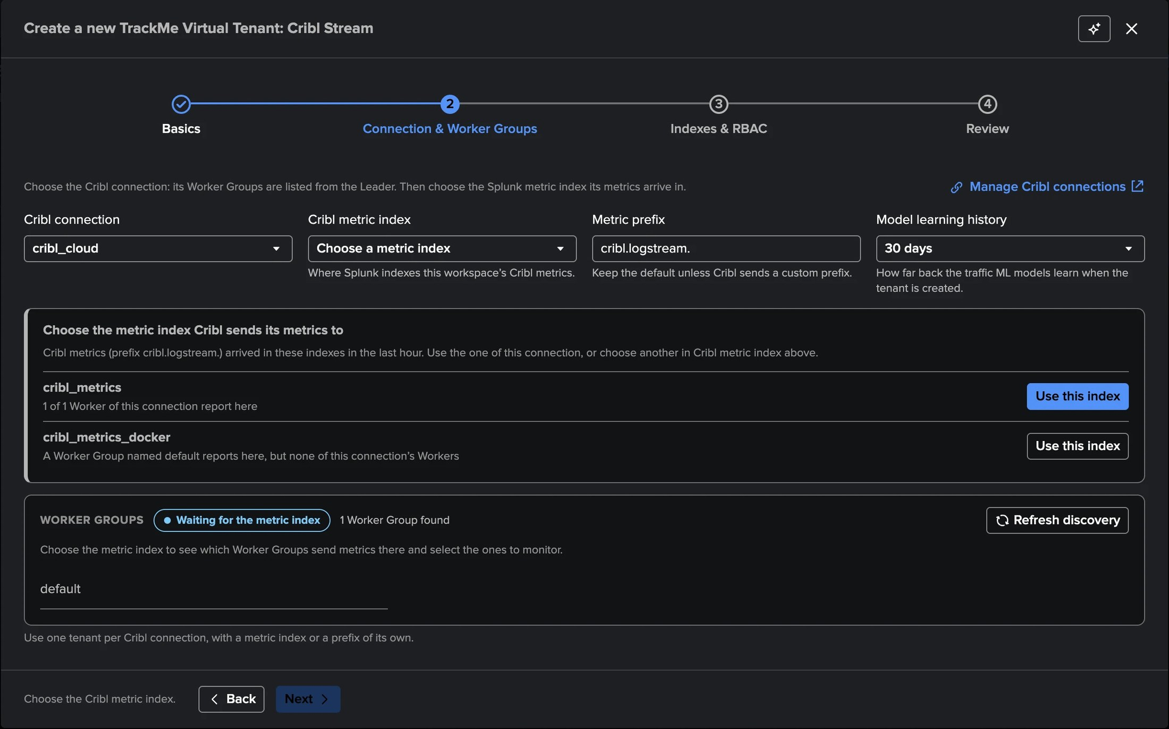
PART 1 · SETUP
Connection & Worker Groups — the step that meets Cribl
1
Cribl connection
Its Worker Groups are listed from the Leader at once.
2
Cribl metric index
TrackMe finds the metric indexes where this connection's Workers report: Use this index.
3
Metric prefix
cribl.logstream. unless the deployment renames its metrics.
4
Model learning history
From today on, 7, 14, 30 (default), 60 or 90 days of history.
5
Worker Groups
All selected; keep the ones this tenant monitors (1 to 100).
TrackMe for Splunk · Hands-on: Cribl Stream
docs.trackme-solutions.com
Notes:
Actions, Create a tracking tenant, Cribl Stream card. Step 1 is the identifier and alias. Step 2 is where TrackMe meets the deployment: the connection, the metric index that TrackMe proposes from where this connection's Workers report, the metric prefix, how much history the traffic ML models learn from at creation, and the Worker Groups. With history in the metric index the models can detect on the first day. Steps 3 and 4 are the indexes, roles and review.

Slide 8
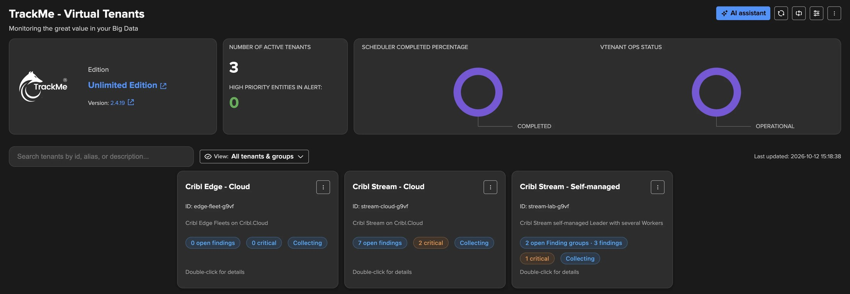
PART 1 · SETUP
The tenant card and the status strip
1
Tenant card
3
Worker Groups
5
Collect now
Open Finding groups and findings, critical ones, collection status.
The Worker Groups the tenant monitors.
Reads the newest metrics and evaluates the policies at once.
4
Jobs
2
Connection and Leader
Inventory, Live metrics and Traffic ML models with their last run.
Reachable, unavailable, rate limited or unknown; hover for the reason.
TrackMe for Splunk · Hands-on: Cribl Stream
docs.trackme-solutions.com
Notes:
On Virtual Tenants the tenant card shows the open Finding groups and findings, the critical ones and the collection status. Inside the workspace, the status strip says at a glance that the tenant is working: the connection, the Leader, the Worker Groups, the last run of each job and how many traffic ML models are detecting; Refresh, and for a TrackMe administrator of the tenant Collect now.

Slide 9
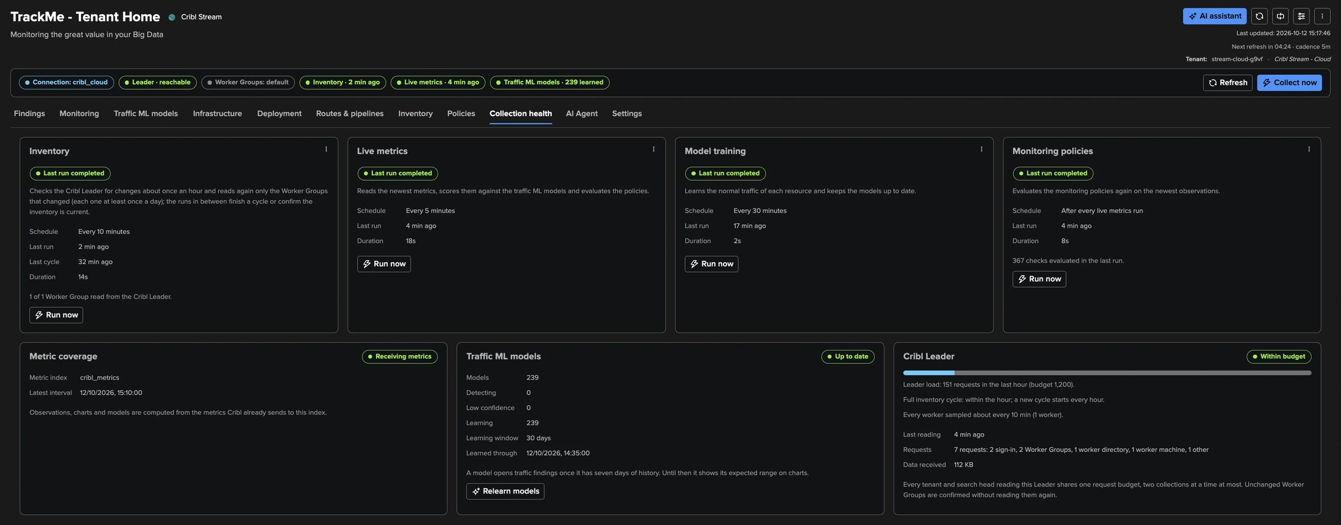
PART 1 · DAY ONE
Collection health — every job, its last run, its outcome in words
1
One card per job
3
Traffic ML models
Inventory, Live metrics, Model training, Monitoring policies, each with Run now.
Learning progress, learning window, Relearn models.
4
Cribl Leader
2
Metric coverage
Requests of the last hour against the budget, the inventory cycle.
Receiving metrics, and any Worker Group that sends none.
TrackMe for Splunk · Hands-on: Cribl Stream
docs.trackme-solutions.com
Notes:
Collection health answers: is TrackMe collecting what it should? One card per job with its last run, its outcome in words, View last run and Run now; the metric coverage; the traffic ML models with their learning progress; and the Cribl Leader card with the requests against the budget and the inventory cycle.

Slide 10
02
PART 2 · FINDINGS
Read, decide, route
The Findings tab, Finding groups and the triage, the investigation of a traffic outlier and of a Worker that went down, assignment rules and webhooks.
TrackMe for Splunk · Hands-on: Cribl Stream
Notes:
Part two: the findings. A finding is one policy applied to one measurement of one object. One object's findings form one Finding group: one row, one decision.

Slide 11
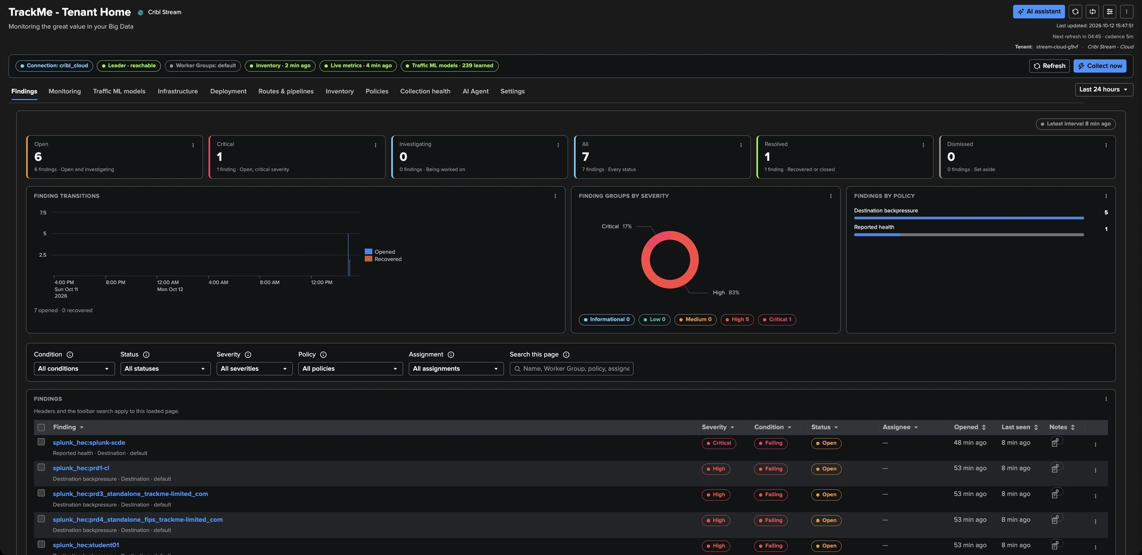
PART 2 · FINDINGS
The Findings tab — the backlog, one row per Finding group
1
Tiles
3
By severity and by policy
5
Condition and status
Open, critical, investigating, all, resolved, dismissed.
Destination backpressure and Reported health here.
What the latest evaluation measures, and your decision.
2
Finding transitions
4
Filters and search
Opened and recovered over the time range.
Condition, status, severity, policy, assignment.
TrackMe for Splunk · Hands-on: Cribl Stream
docs.trackme-solutions.com
Notes:
The Findings tab is the backlog and the tab the workspace opens on. Each finding shows its condition — Failing, Recovered, Awaiting data — and its status, the decision: Open, Investigating, Resolved, Dismissed. Severity uses the TrackMe scale from Informational to Critical. A measured recovery resolves an open finding by itself; a new failure reopens it.

Slide 12
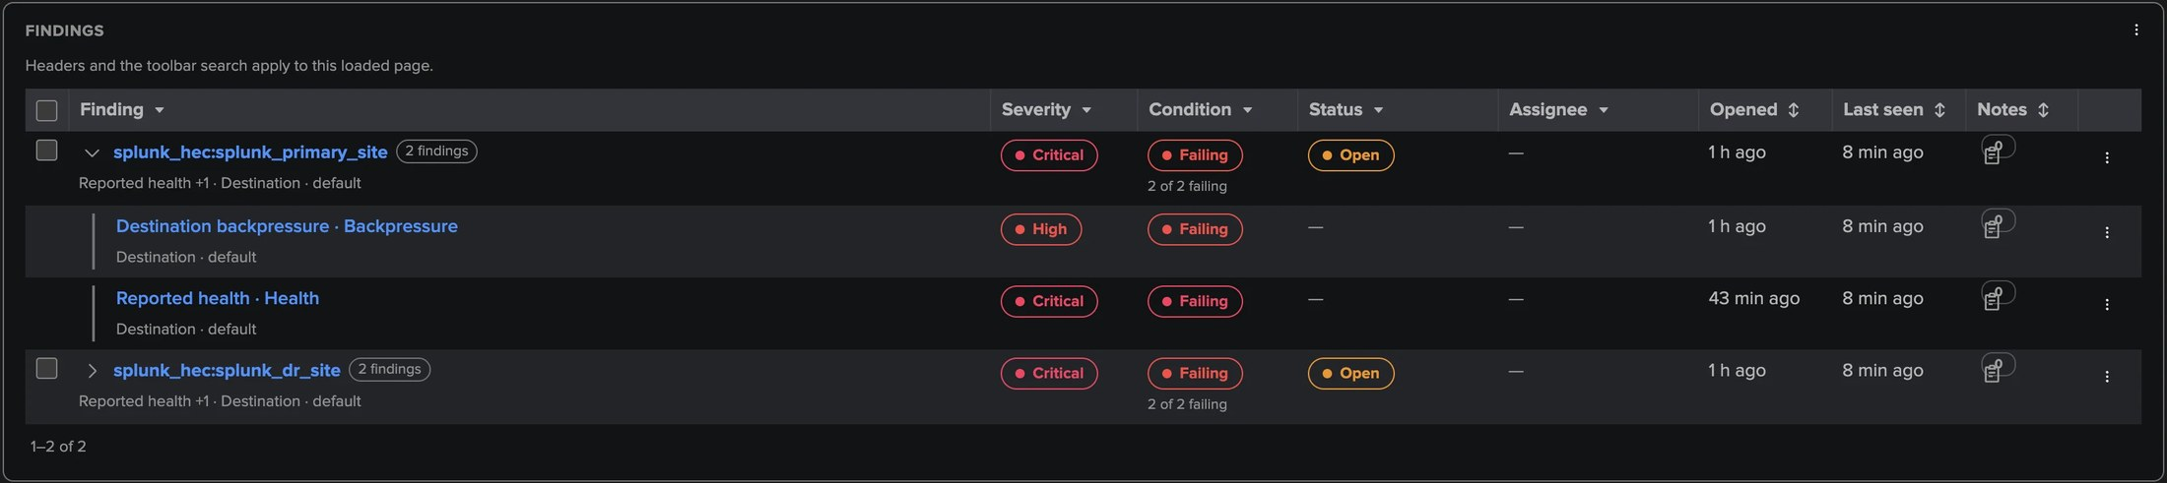
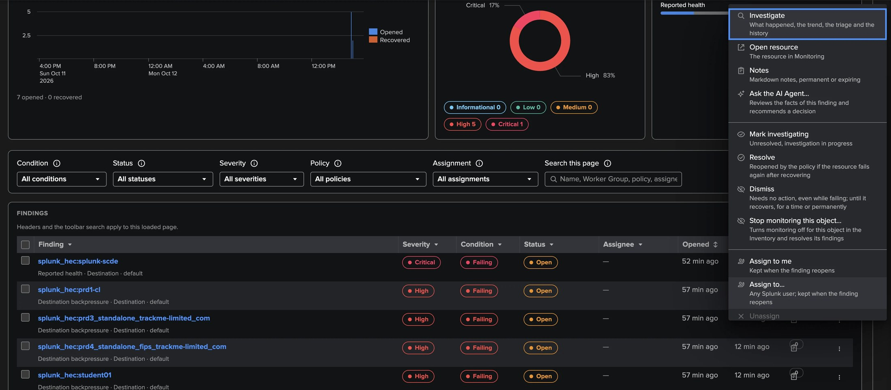
PART 2 · FINDINGS
Finding groups and the triage — one object, one decision
1
Automatic Finding groups
3
Decisions
5
Stop monitoring this object
A Worker whose CPU, memory and processes all run hot is one row.
Investigating, resolve, dismiss (until recovery, 1–90 days, permanently), reopen.
Turns monitoring off and resolves its findings in one step.
2
Group severity
4
Assign, snooze, notes
6
Forget this object
The highest of its failing members; override possible.
Snooze stops notifications without changing the status.
A removed or silent object, purged at once (administrator).
TrackMe for Splunk · Hands-on: Cribl Stream
docs.trackme-solutions.com
Notes:
One object can fail several policies at once. TrackMe groups its findings automatically into a Finding group, so you make one decision: status, assignee, snooze, dismissal and severity override live on the group. Groups can also be merged, edited or ungrouped by hand. The row menu carries Ask the AI Agent, the decisions, and two Cribl-specific actions: Stop monitoring this object and Forget this object.

Slide 13
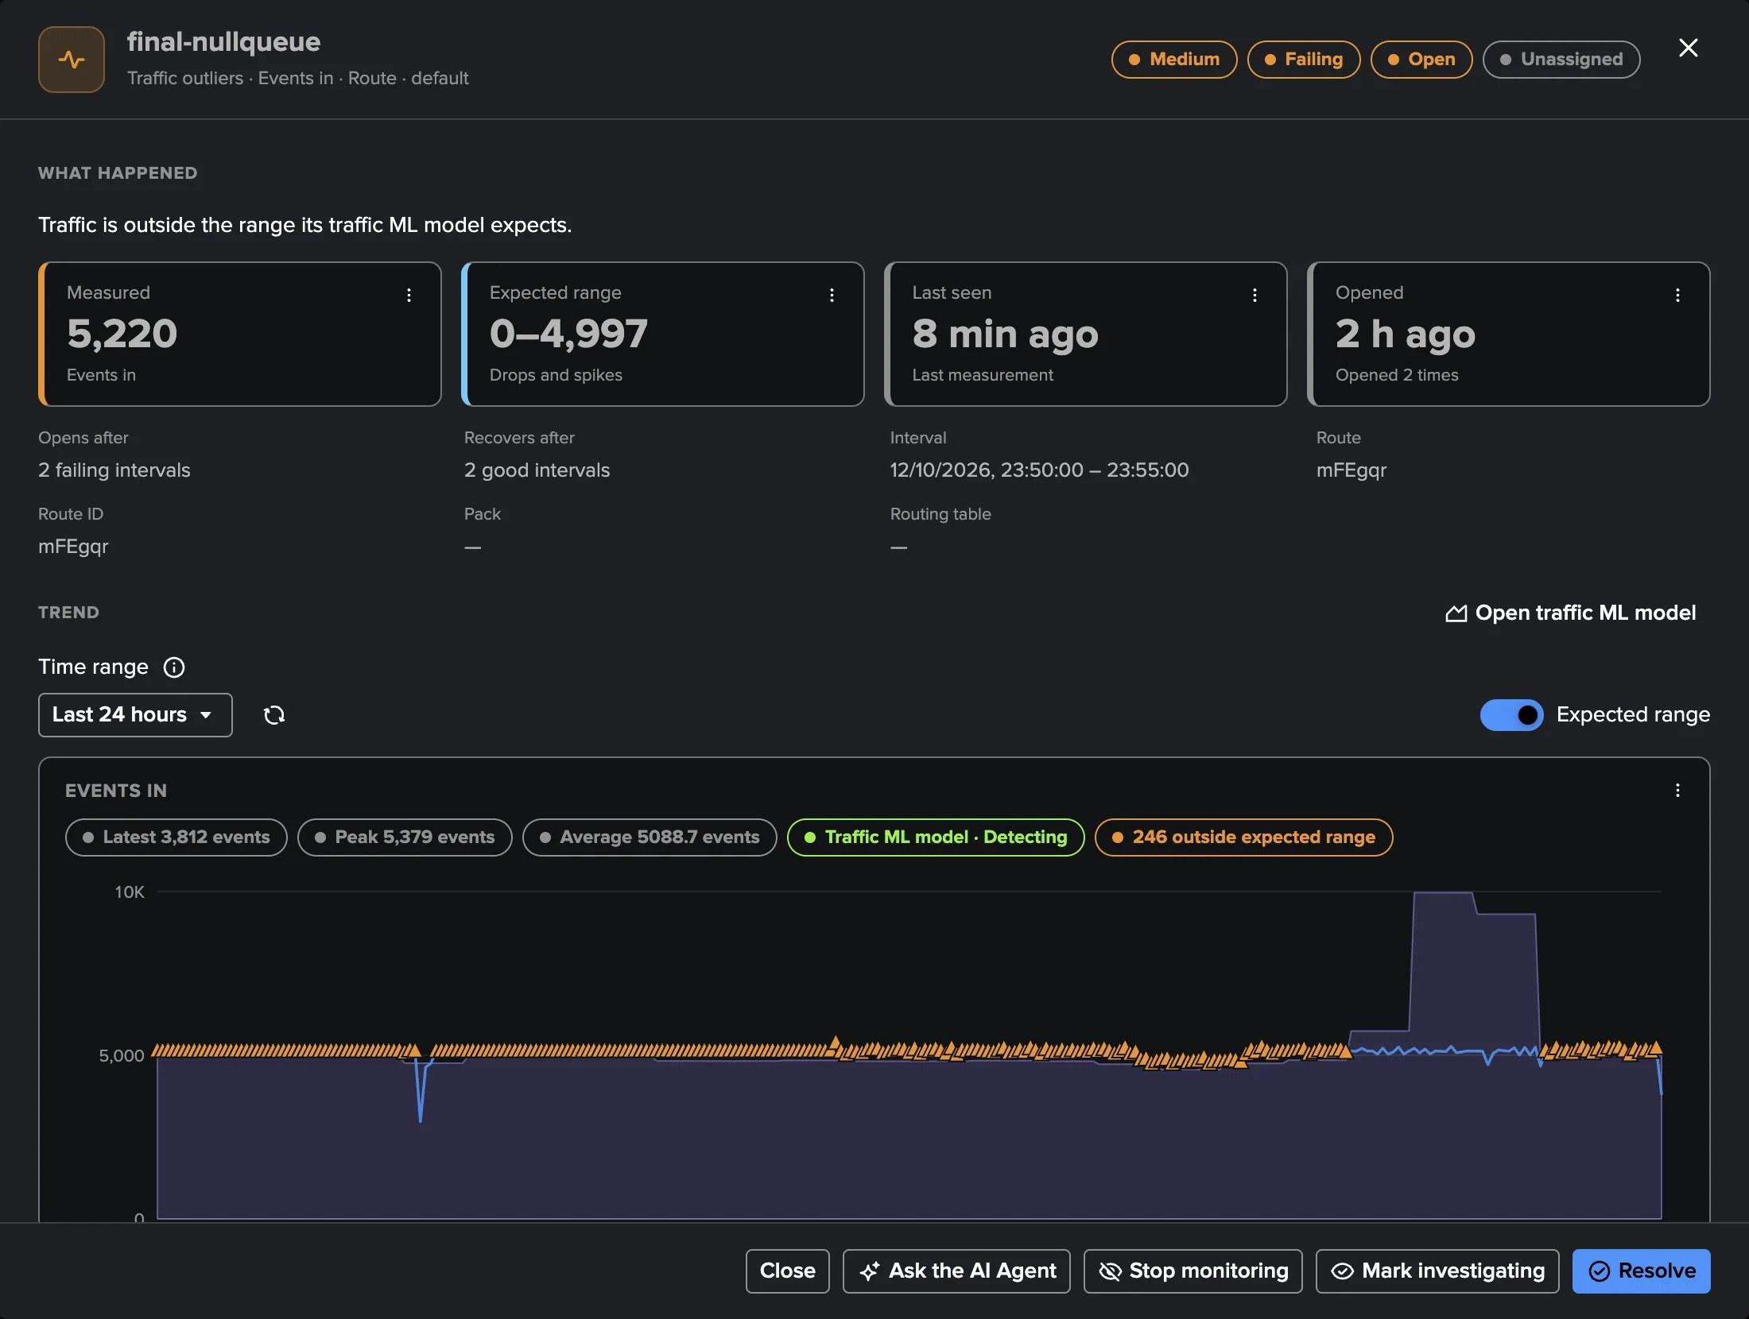
PART 2 · INVESTIGATE
Investigating a traffic outlier — what happened, against what was expected
1
What happened
A Route measured 5,220 events against an expected 0–4,997.
2
Opens and recovers
After 2 failing intervals; recovers after 2 good ones.
3
The Route
Its id, Pack and routing table, from the Leader inventory.
4
Trend with the expected range
The measurement over 24 hours with its band and the outlier points.
5
Decide here
Ask the AI Agent, Stop monitoring, Mark investigating, Resolve.
TrackMe for Splunk · Hands-on: Cribl Stream
docs.trackme-solutions.com
Notes:
Selecting a row opens the investigation drawer: what happened in plain words, the measurement against its expected range, the open and recovery rules, the object in the inventory, the trend chart with the band, notes and history. For a Worker or the Leader the chart shows the policy threshold and recovery lines instead of a band.

Slide 14
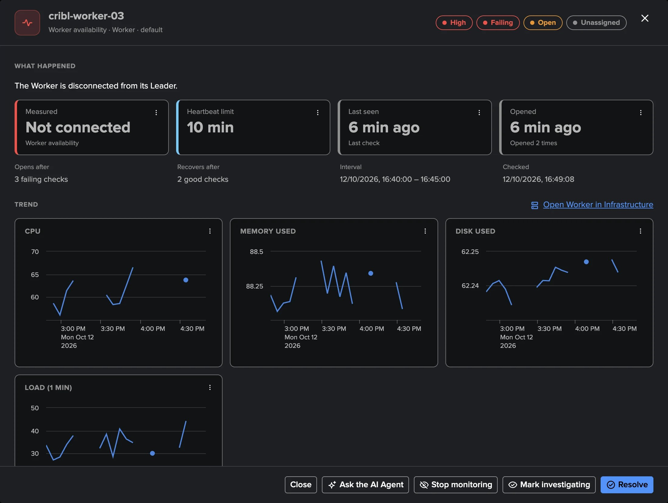
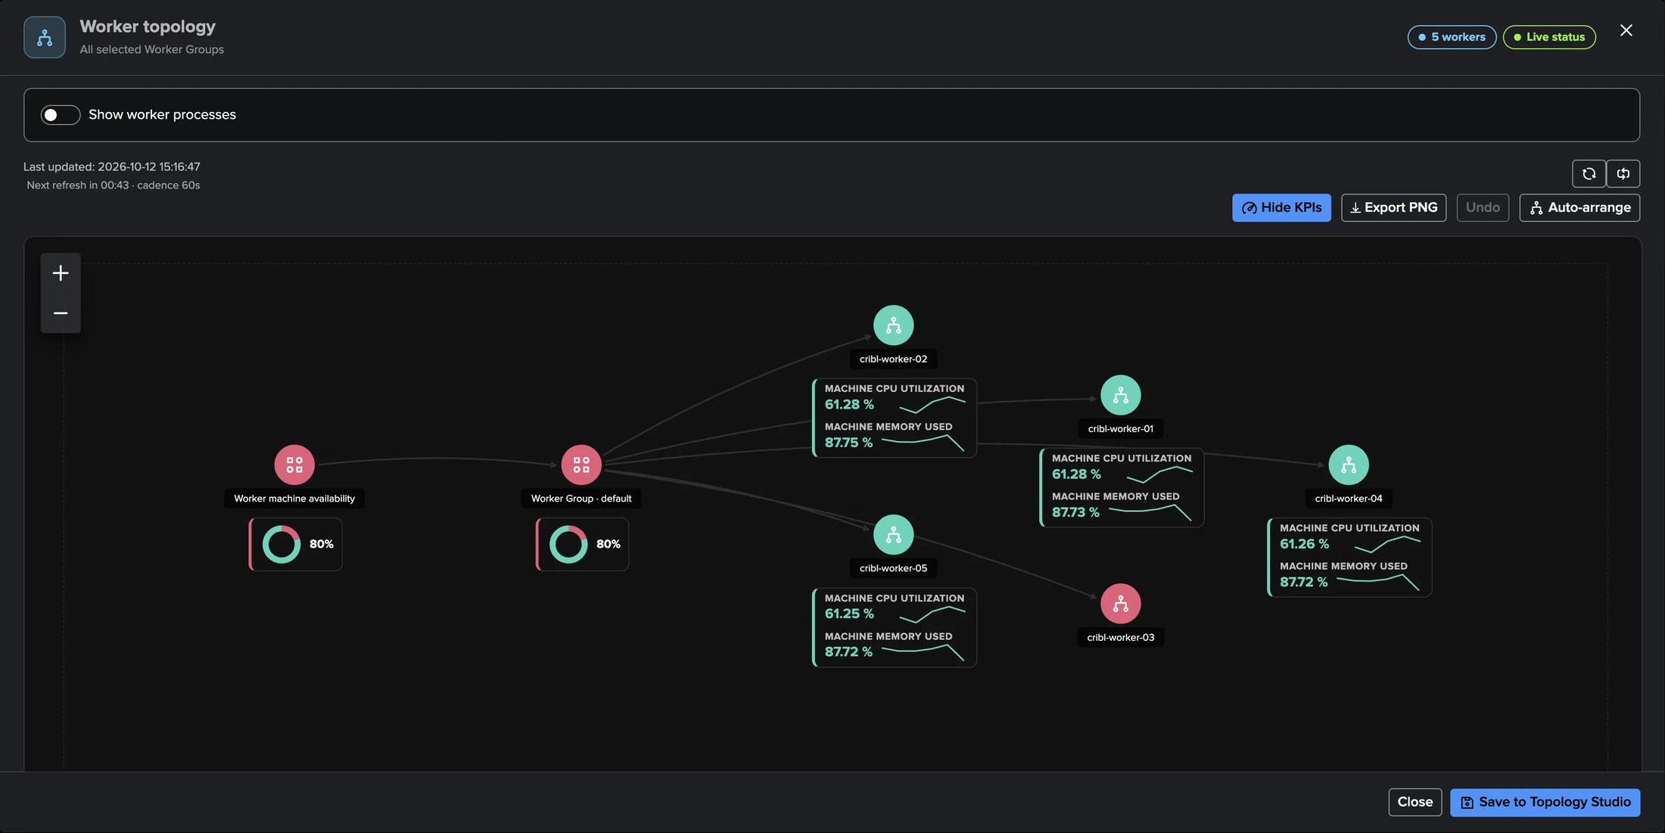
PART 2 · INVESTIGATE
A Worker goes down — the finding and the topology agree
1
Worker availability
3
Worker topology
High: disconnected, or no heartbeat for 10 minutes.
The crashed Worker red, the others green, processes shown.
2
The drawer
4
Drift and resources
The last heartbeat and the policy lines.
Version drift, configuration drift, machine CPU and disk, process CPU.
TrackMe for Splunk · Hands-on: Cribl Stream
docs.trackme-solutions.com
Notes:
From the Leader, TrackMe knows every Worker and how it should look. A Worker that stopped answering opens a High Worker availability finding. The Worker topology of the Infrastructure tab shows the same story: the crashed Worker in red with its processes. Version and configuration drift, machine CPU and disk and process CPU follow the same pattern.

Slide 15
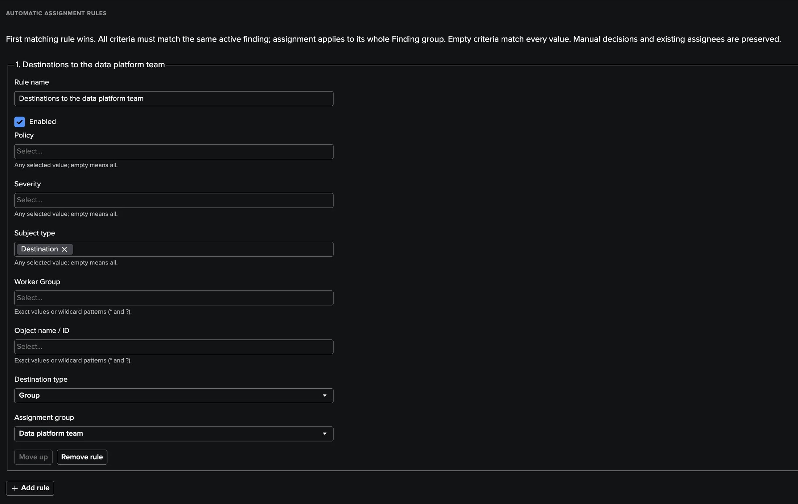
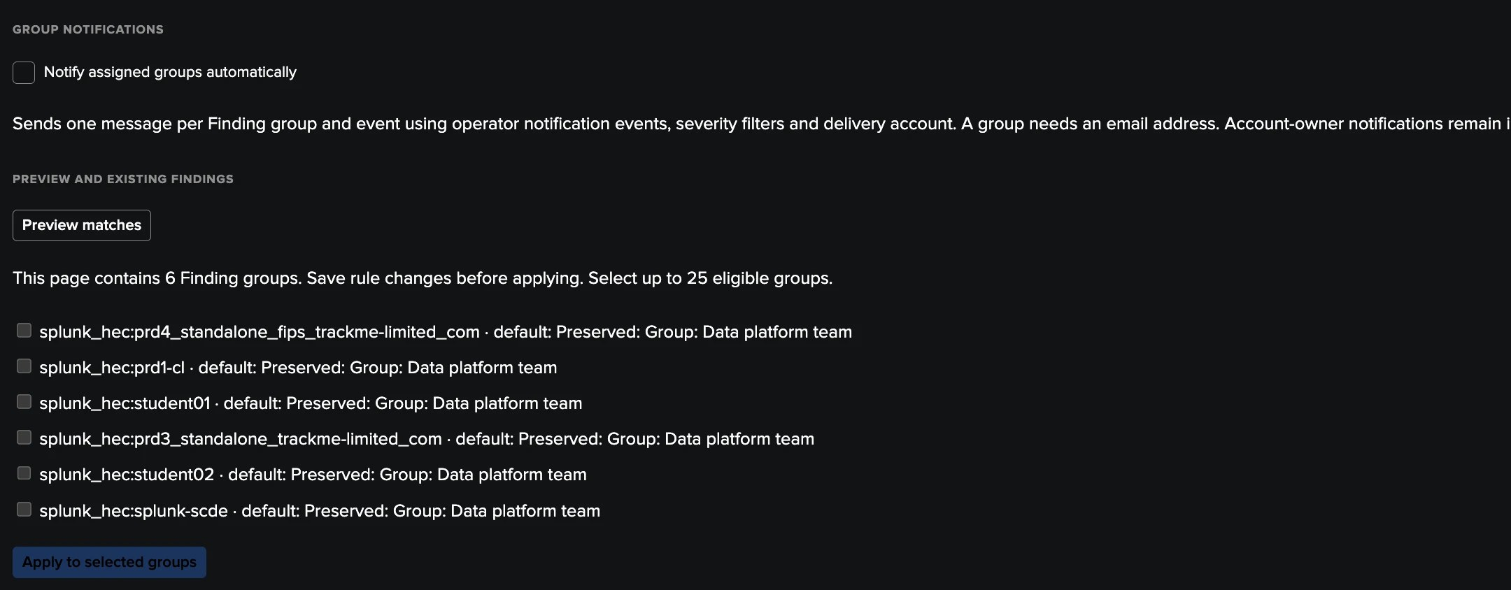
PART 2 · ROUTE
Assignment rules — the right team, automatically
1
Ordered rules
3
Preview matches
First match wins: policy, severity, subject type, Worker Group, object name.
The Finding groups a rule matches, before applying.
4
Manual decisions kept
2
An assignment group
Existing assignees are preserved; groups can be notified by email.
Destinations go to the Data platform team.
TrackMe for Splunk · Hands-on: Cribl Stream
docs.trackme-solutions.com
Notes:
Settings, Assignment. Assignment groups and ordered rules route new findings to the right team. Preview matches lists the Finding groups a rule matches, here already assigned to the Data platform team and preserved, with Apply to selected groups for the existing ones.

Slide 16
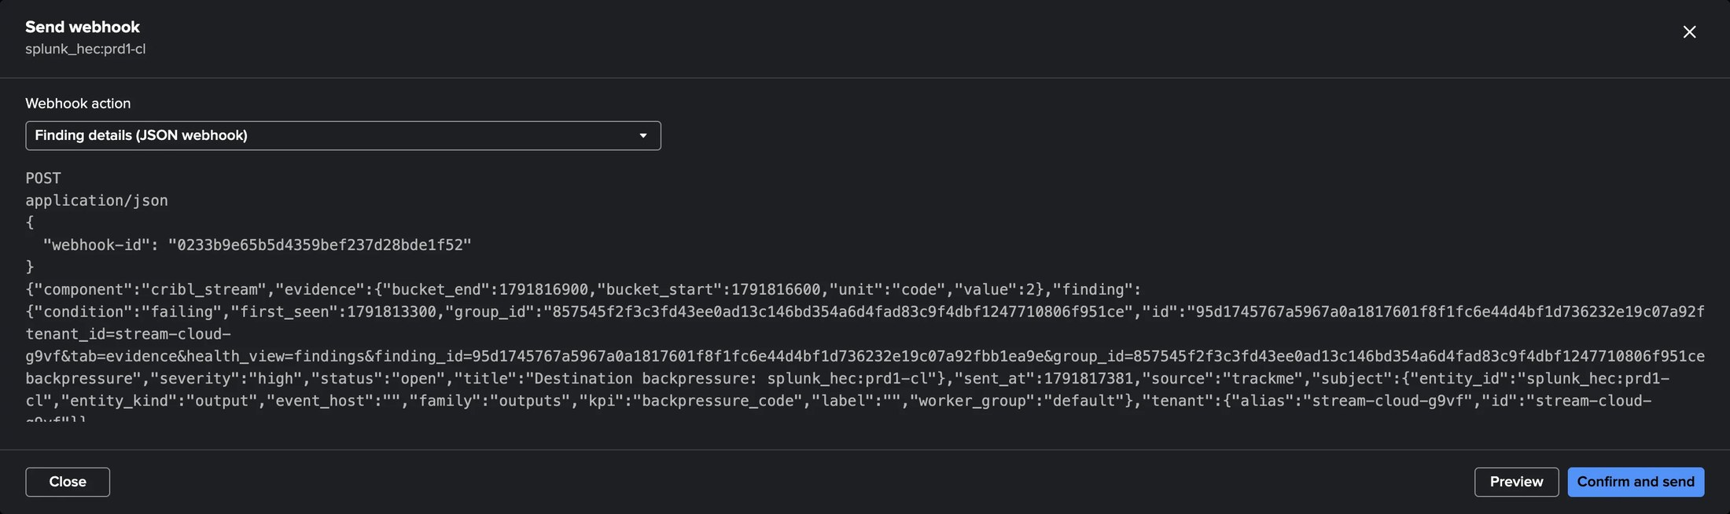
PART 2 · ROUTE
Findings actions — drilldowns, links and webhooks on every finding
1
Webhook accounts
3
Automation rules
System-wide, HTTPS only, destination-restricted.
Run an action automatically, for example on a new critical finding.
2
Per-policy actions
4
Preview, then send
The policy editor's Actions tab offers them on its findings.
The rendered payload before it leaves; the last result kept.
TrackMe for Splunk · Hands-on: Cribl Stream
docs.trackme-solutions.com
Notes:
Findings actions add drilldown searches, links and webhooks to the findings, run by hand or by automation rules, through system-wide Webhook accounts. The preview shows the payload before it is sent. The concepts are shared with the other findings tenants.

Slide 17
03
PART 3 · OBSERVE
Traffic, models, machines, data paths
Monitoring and its trends, the traffic ML models and their tuning, Expected traffic and silent objects, Workers and the Leader, Routes, Pipelines and the flow topology.
TrackMe for Splunk · Hands-on: Cribl Stream
Notes:
Part three: observing the deployment. Every figure has a menu with View chart data and Open in Search, a plain editable search that reproduces it.

Slide 18
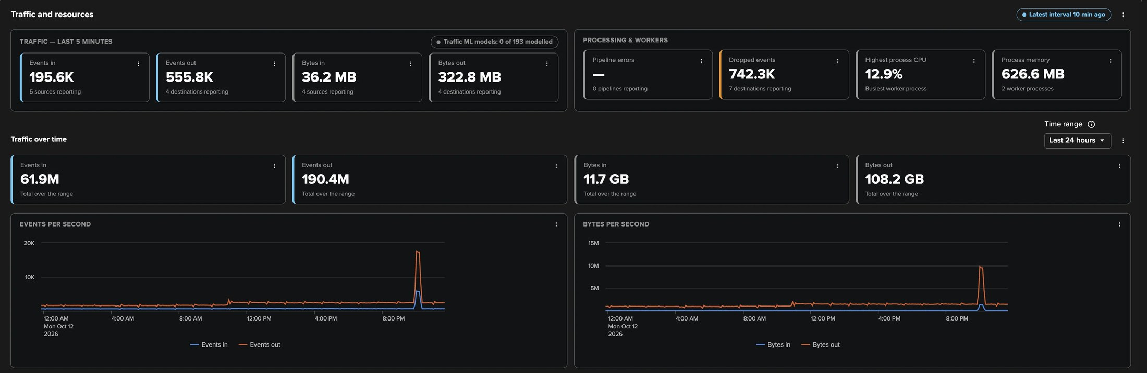
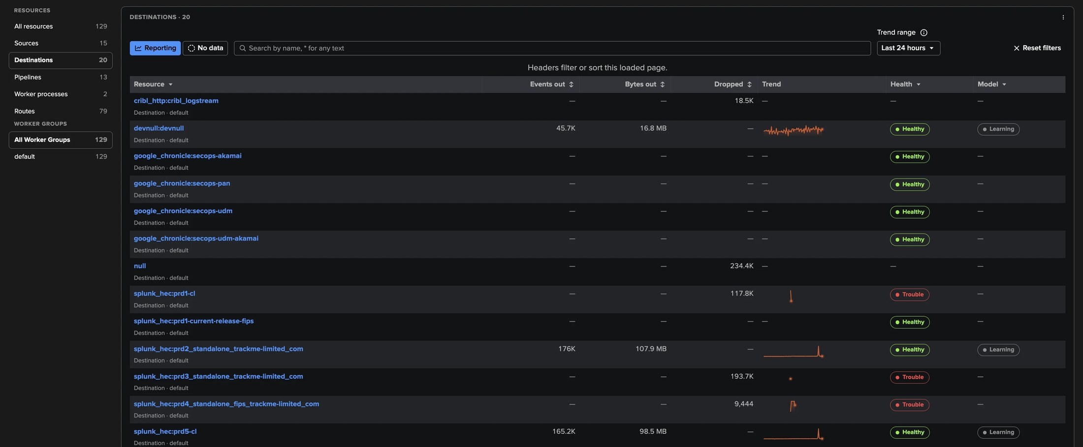
PART 3 · OBSERVE
Monitoring — the newest interval and the last 24 hours
1
Last five minutes
3
Resource tables
Events and bytes in and out, dropped events, process CPU and memory.
Each Destination with its traffic, drops, trend, health and model.
2
Traffic over time
4
Reporting / No data
Totals and per-second charts over the range.
The objects measured now, or those that stopped.
TrackMe for Splunk · Hands-on: Cribl Stream
docs.trackme-solutions.com
Notes:
Monitoring shows the newest five-minute interval of every object and the traffic over the selected range. The resource tables list each Source, Destination, Pipeline, Route and worker process with its latest values, its health, its traffic ML model and a trend; a row opens its charts with the expected range and, for a Source or Destination, its live status from the Leader.

Slide 19
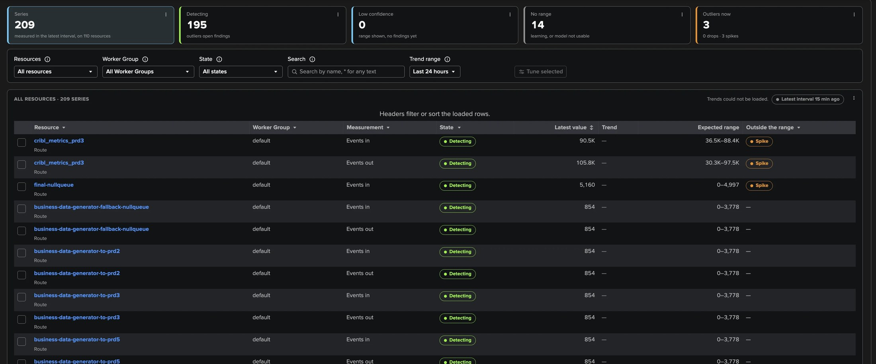
PART 3 · TRAFFIC ML MODELS
Traffic ML models — one per object and measurement
1
209 series, 195 detecting
3
Expected range and Spike / Drop
14 without a range yet; 3 outside their range now.
The models outside their range come first.
2
Learning → Low confidence → Detecting
4
Tune selected
A range from one day, findings from seven days.
Give a selection of models its own settings.
TrackMe for Splunk · Hands-on: Cribl Stream
docs.trackme-solutions.com
Notes:
Every Source, Destination, Pipeline and Route gets its own traffic ML model. A model learns per hour of the day, then per weekday and hour after four weeks, with recent days counting more, and keeps learning from the newest intervals: there is no periodic full retrain. Learning means no range yet; Low confidence draws the range without findings; Detecting opens findings through the Traffic outliers policy.

Slide 20
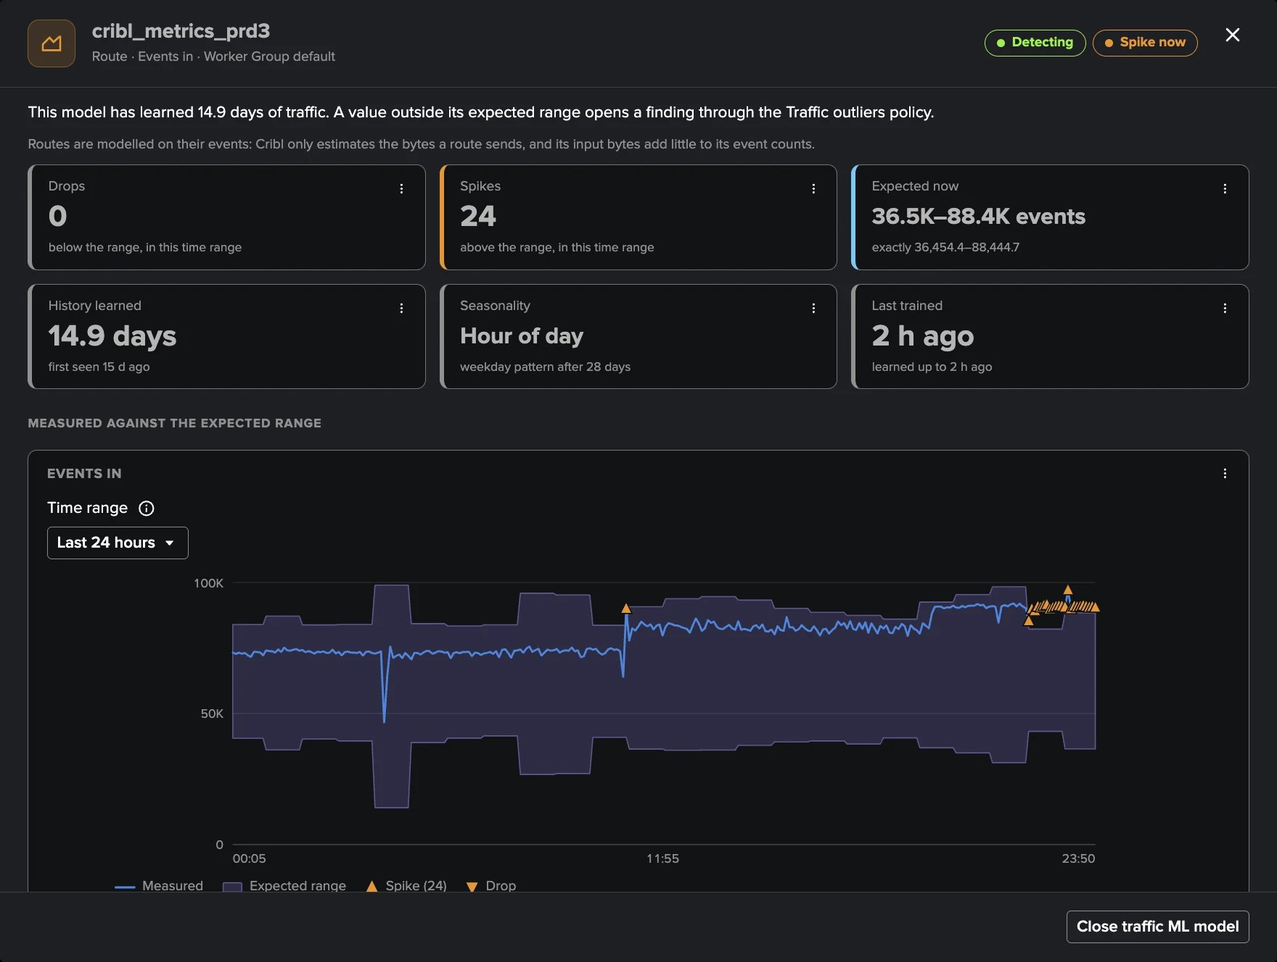
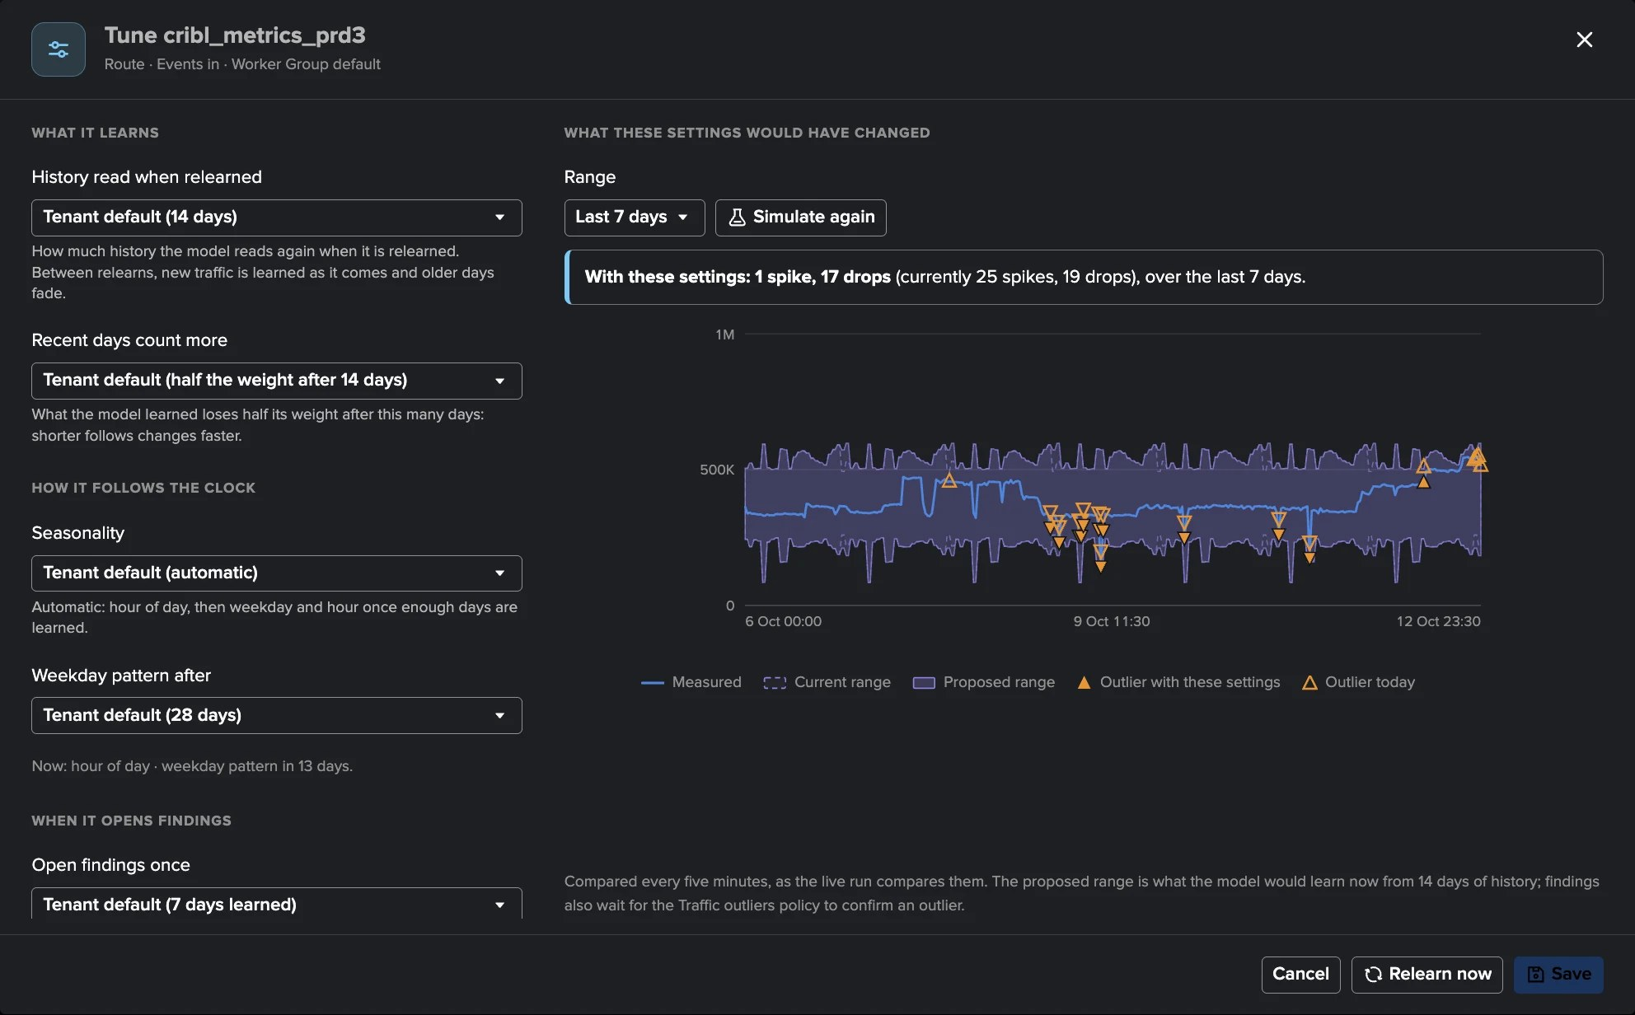
PART 3 · TRAFFIC ML MODELS
A model, and what tuning it would change — before you save
1
14.9 days learned
3
Tune model
5
Not an anomaly
Hour-of-day seasonality; weekday pattern after 28 days.
History, recent days weight, seasonality, when findings open.
An expected episode is excluded from learning and the finding dismissed.
2
Expected band and spikes
4
Live simulation
24 spikes above the range in the last 24 hours.
Current and proposed ranges over 7 days: 1 spike and 17 drops instead of 25 and 19.
TrackMe for Splunk · Hands-on: Cribl Stream
docs.trackme-solutions.com
Notes:
A model shows what it learned, its drops and spikes, its expected range, the history learned and its seasonality. Tune model gives a model or a selection its own settings, and the tuning screen simulates the current and proposed bands over 24 hours, 7 or 30 days, with the drops and spikes each would have raised, before anything is saved. Not an anomaly excludes an expected episode from what the model learns.

Slide 21
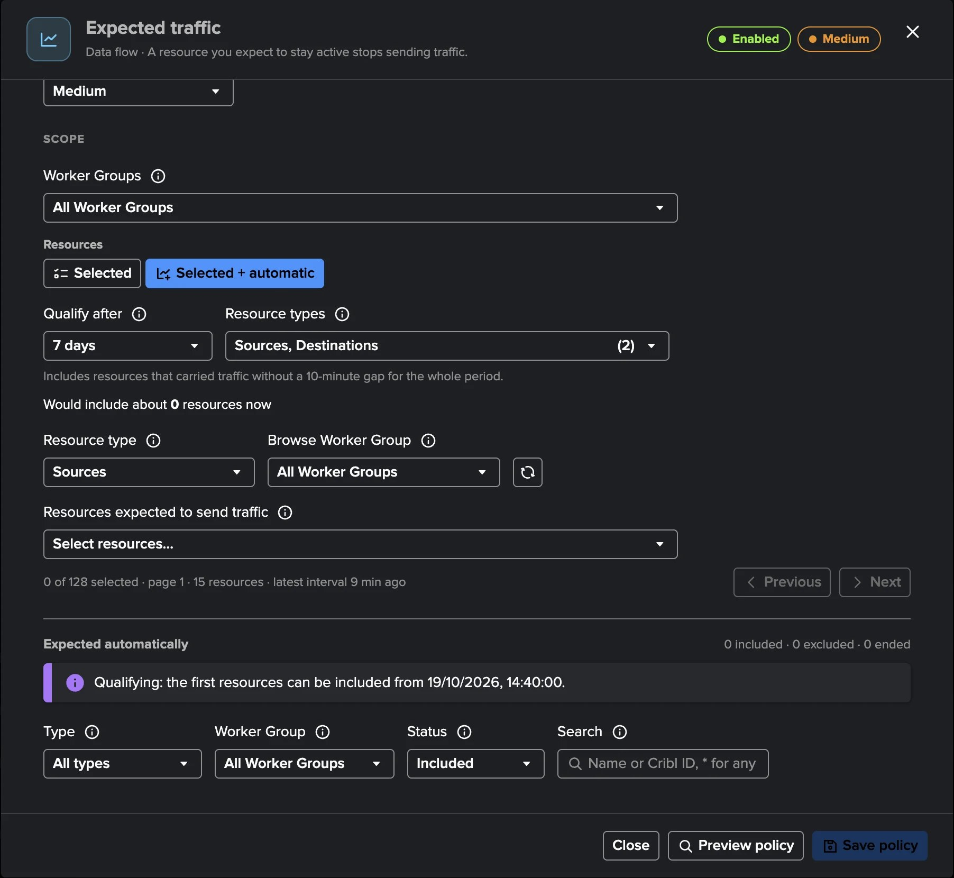
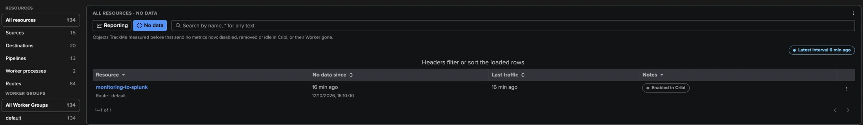
PART 3 · OBSERVE
Expected traffic and objects that stop reporting
1
Expected traffic
3
No data
A finding when an object that must never go quiet carries no traffic.
Silent objects from their second missing interval, with their last traffic.
2
Selected + automatic
Every object with steady traffic over 7 days qualifies automatically.
4
Silence counted carefully
As zero traffic only when TrackMe is sure the silence is real.
TrackMe for Splunk · Hands-on: Cribl Stream
docs.trackme-solutions.com
Notes:
Some objects must never go quiet. Expected traffic opens a finding when an expected object carries no traffic; in Selected plus automatic mode TrackMe also expects every object that carried traffic steadily over the qualifying window. TrackMe remembers every object it measured: a silent object appears under No data, and Traffic outliers counts its silence as zero traffic only when the inventory, the Worker Group and the model confirm it is real.

Slide 22
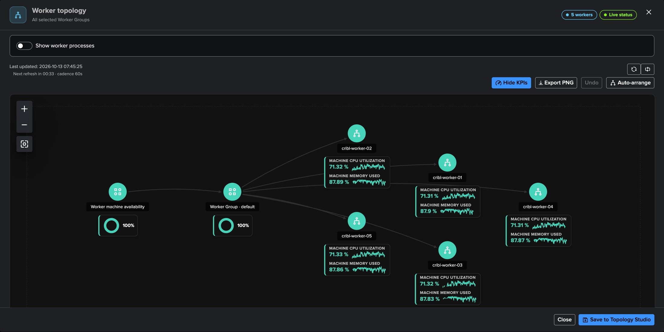
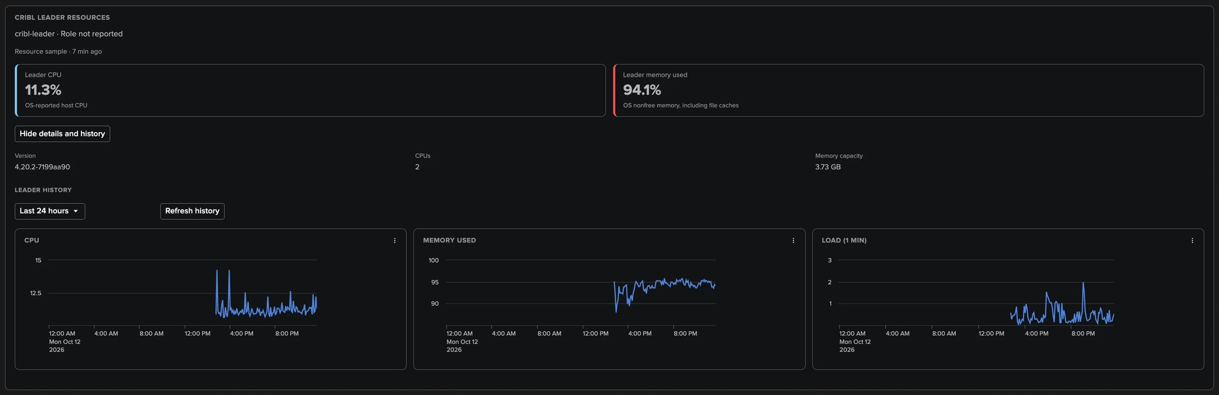
PART 3 · INFRASTRUCTURE
Workers and the Leader — the machines behind Cribl Stream
1
Worker topology
3
Leader resources
The Worker Group and its Workers with CPU, memory and disk, live.
CPU, memory and load history of each Leader node.
2
Save to Topology Studio
4
Leader availability
The map becomes a view that stays live.
A critical finding after two failed Leader API checks.
TrackMe for Splunk · Hands-on: Cribl Stream
docs.trackme-solutions.com
Notes:
Infrastructure shows the machines: the Leader nodes with their resources and history, every Worker with its heartbeat, CPU, memory, load and disk, and every worker process. Worker topology draws them as a live map, ready to save to Topology Studio. TrackMe checks the Leader API at every live run: two failed checks open a critical Leader availability finding.

Slide 23
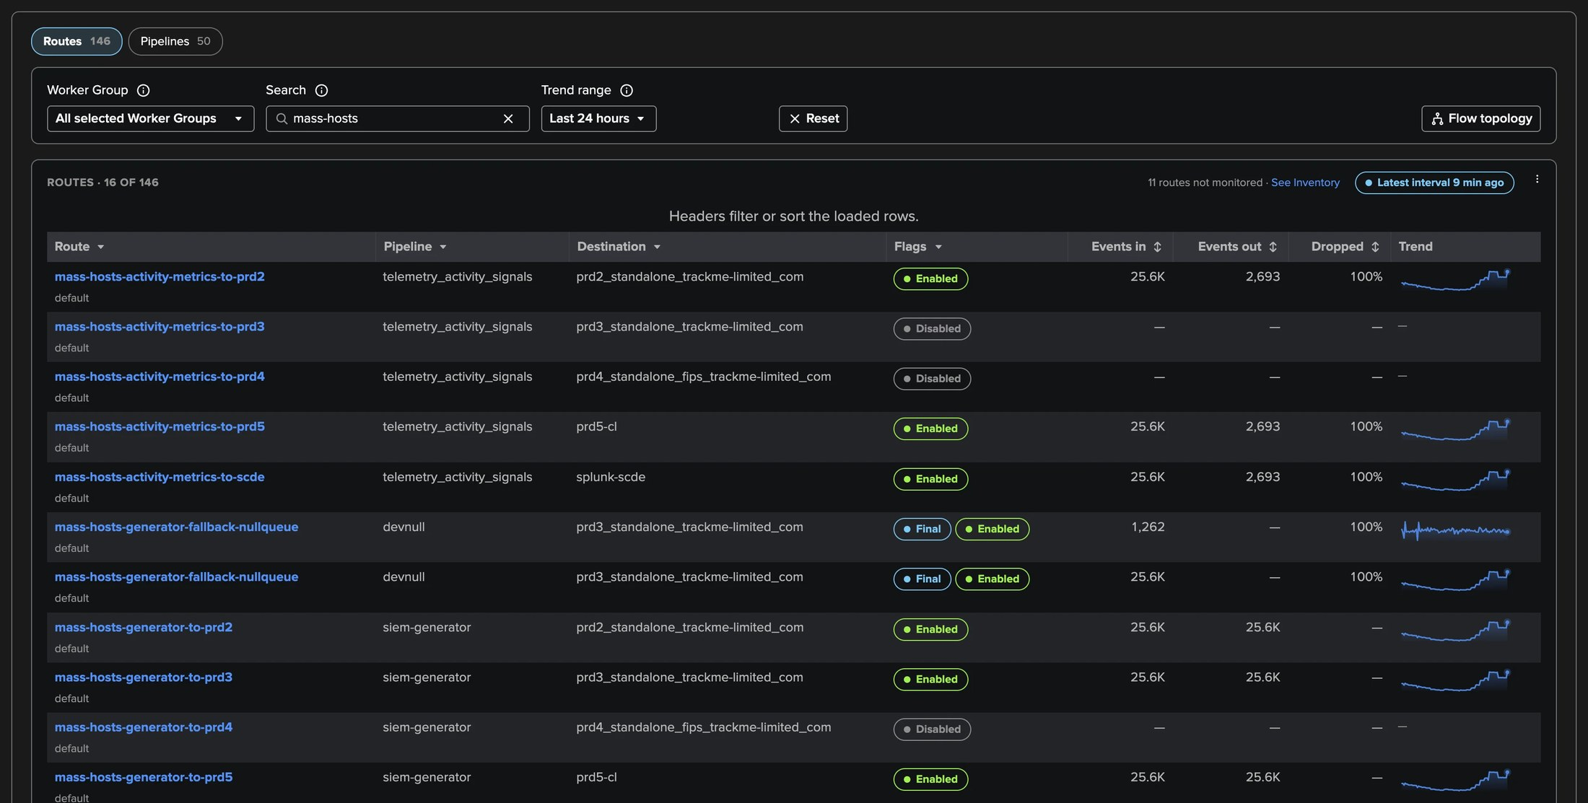
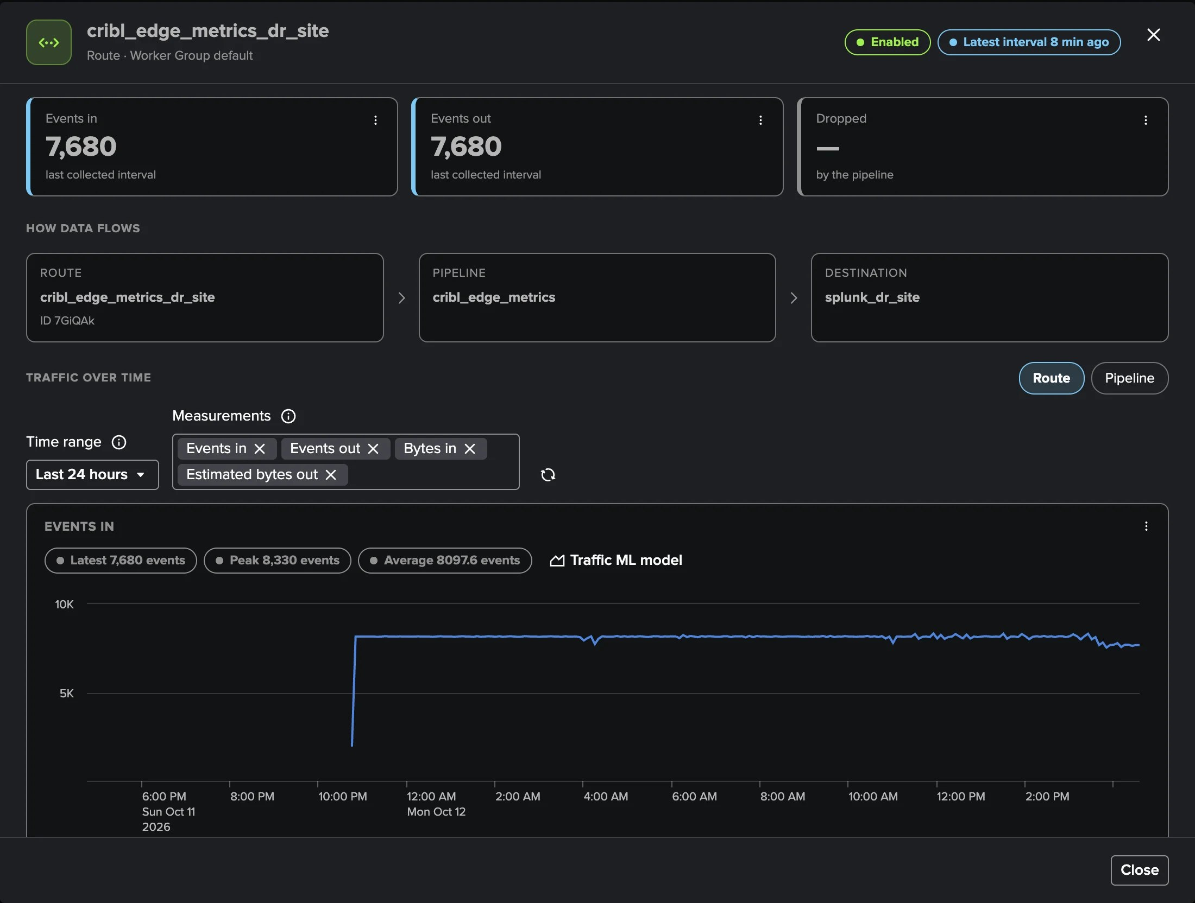
PART 3 · DATA PATHS
Routes & pipelines — how data flows, with its traffic
1
Routes
3
Search
Each Route with its Pipeline and Destination, final or not, traffic and trend.
Filter by Worker Group or name; * stands for any text.
4
Configured processing path
2
Pipelines
A Route opens its traffic with Route → Pipeline → Destination beside it.
Functions, traffic, errors and drops.
TrackMe for Splunk · Hands-on: Cribl Stream
docs.trackme-solutions.com
Notes:
Routes & pipelines shows how data flows: every Route with its Pipeline and Destination and its measured traffic, and every Pipeline with its functions, errors and drops. A Route or Pipeline opens its traffic over time with its configured processing path beside it.

Slide 24
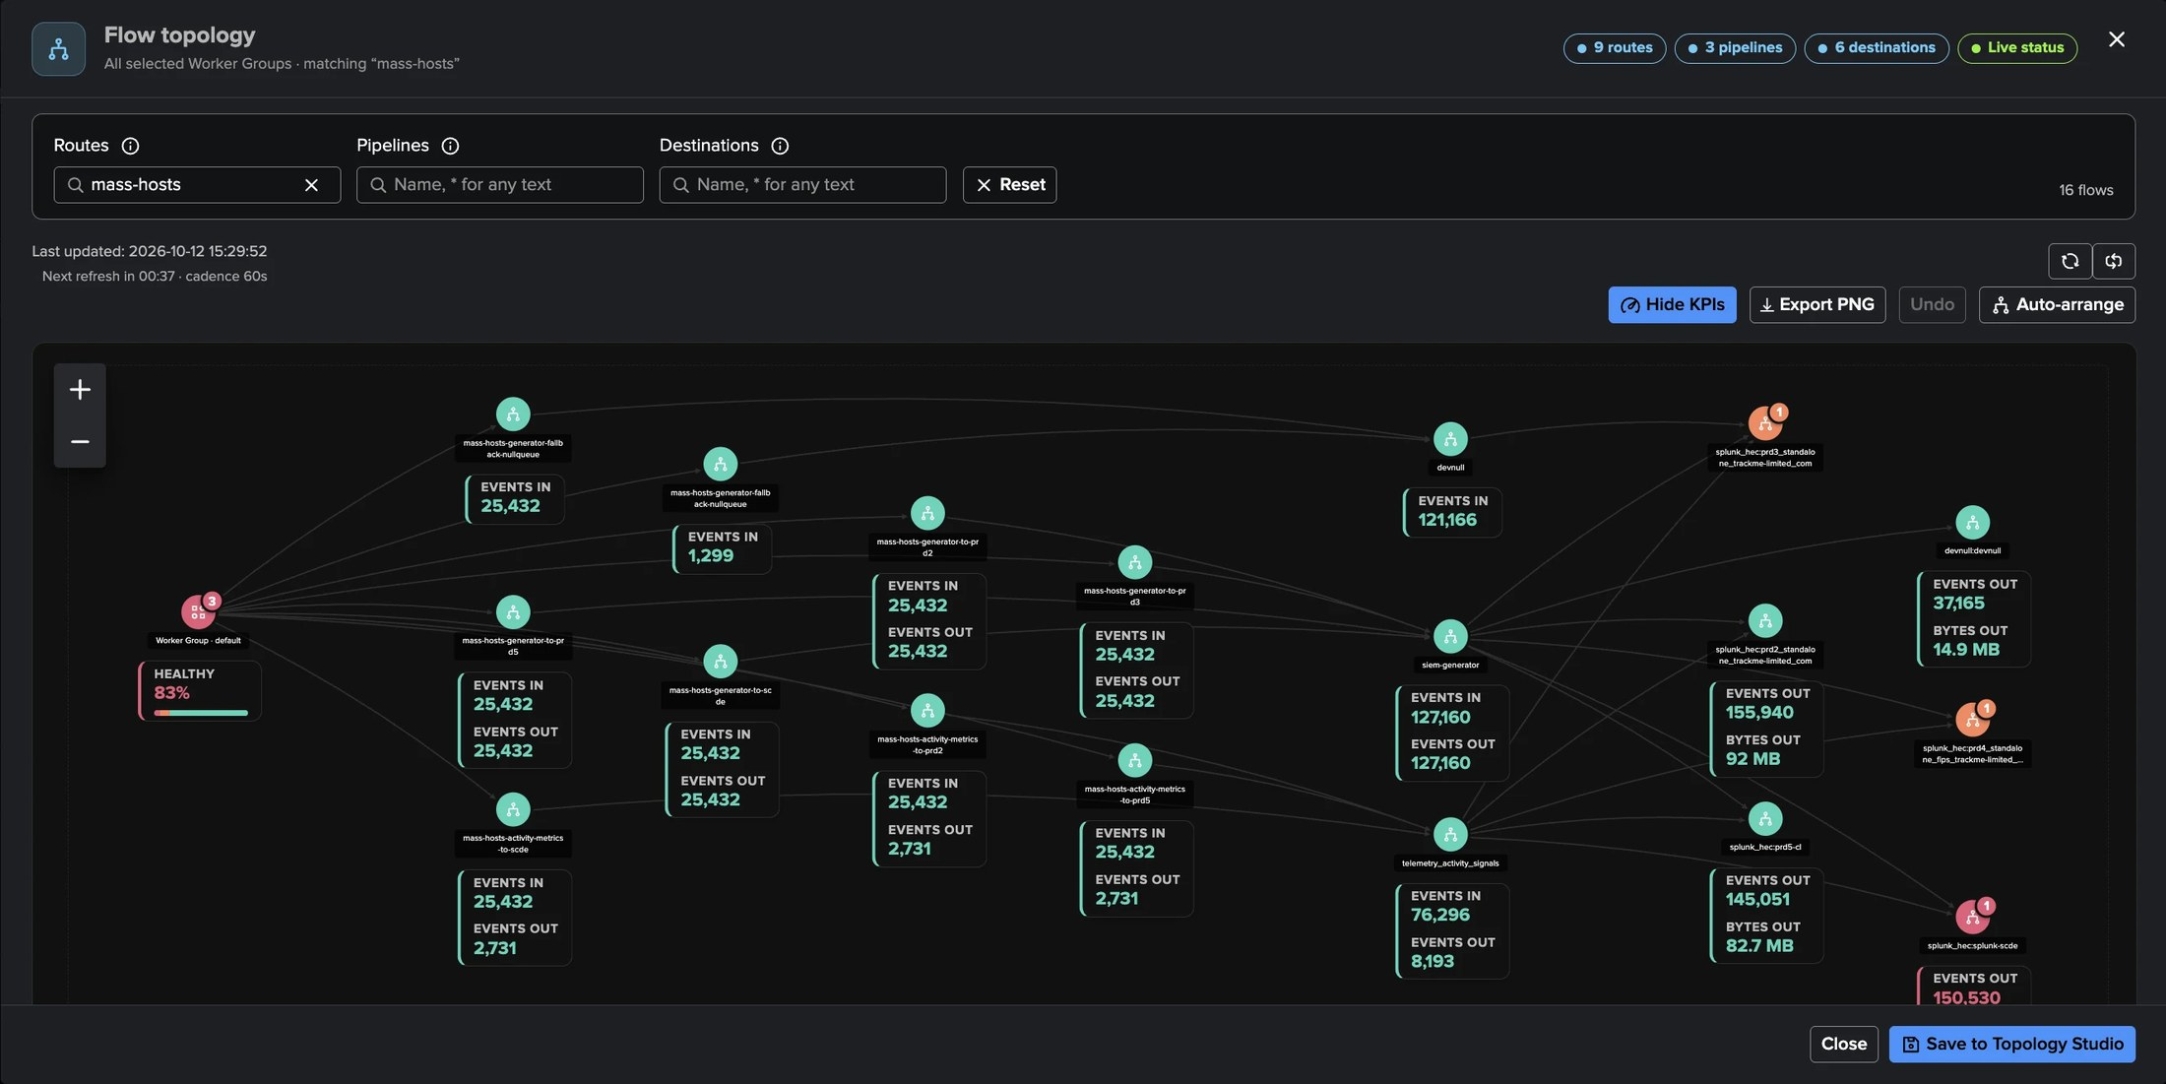
PART 3 · DATA PATHS
Flow topology — your data paths, drawn for you
1
Worker Group → Route → Pipeline → Destination
3
Nothing invented
Read from the Leader, joined with the traffic.
A link only when both ends are measured.
2
Live KPIs and findings
4
Export or save
Events, bytes and health on every node; Live status every minute.
Export PNG, or Save to Topology Studio as a live view.
TrackMe for Splunk · Hands-on: Cribl Stream
docs.trackme-solutions.com
Notes:
Flow topology draws the Routes the table selects as flows, left to right. You configure nothing: TrackMe reads each Route's Pipeline and Destination from the Leader and joins them with the traffic it measures. A Destination fed by several Routes shows once, so you see which Routes depend on a Destination under backpressure. It covers up to 200 Routes at a time.

Slide 25
04
PART 4 · OPERATE
Scope, rules, people, AI
Inventory and exclusion rules, the policy catalogue, notifications, the Cribl Stream AI Agent, Topology Studio, the AI Assistant and the Configuration Guardian.
TrackMe for Splunk · Hands-on: Cribl Stream
Notes:
Part four: operating the tenant over time.

Slide 26
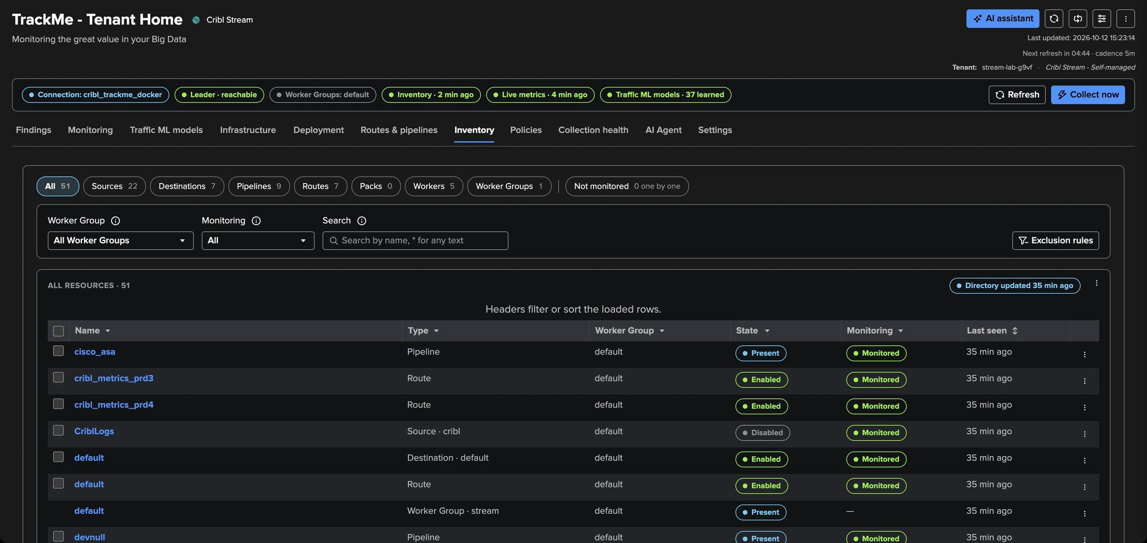
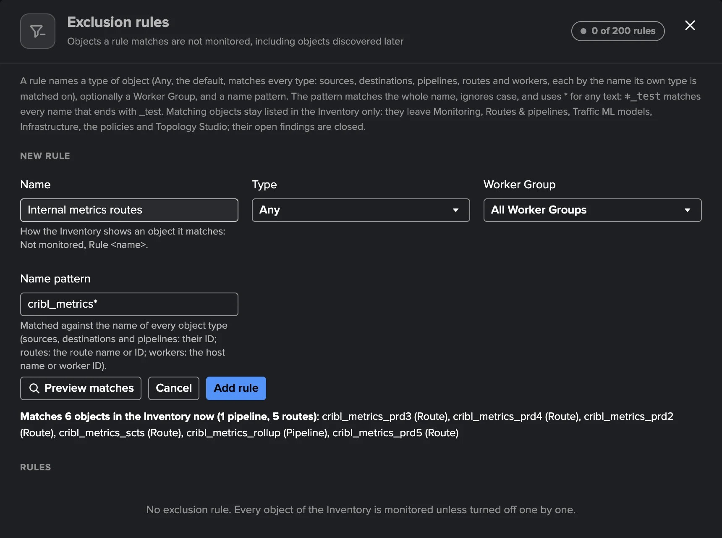
PART 4 · OPERATE
Inventory and exclusion rules — monitor what matters
1
Every object the Leader reports
3
Preview matches
Per type and Worker Group, with first and last seen.
What a rule excludes, before saving.
2
Monitoring on or off
4
Out of every tab
One by one, or with exclusion rules by type, Worker Group and name.
An excluded object leaves the policies, models and Topology Studio.
TrackMe for Splunk · Hands-on: Cribl Stream
docs.trackme-solutions.com
Notes:
The Inventory lists every object the Leader reports, with its monitoring state. Turn monitoring off for objects you do not care about — a test Route, a retired Destination, a lab Worker — one by one or with exclusion rules. An object turned off appears only in the Inventory: it leaves the other tabs, the policies, the model training and Topology Studio, and its open findings close.

Slide 27
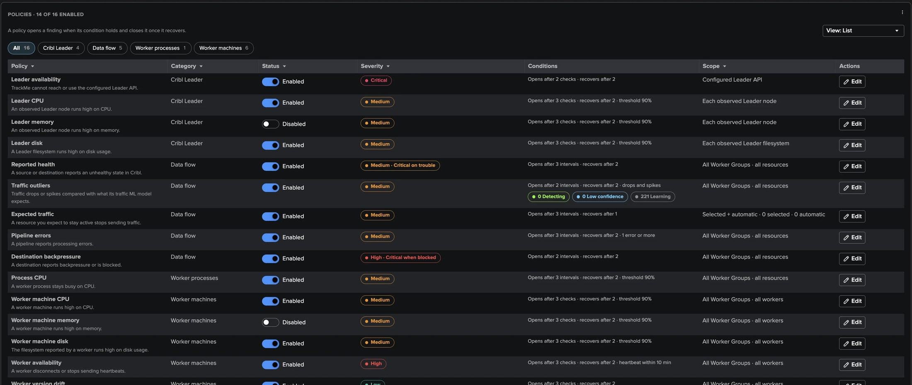
PART 4 · OPERATE
Sixteen policies in four groups — 14 on out of the box
1
Cribl Leader
3
Workers
5
Editor tabs
Availability, CPU, memory, disk.
Process CPU, machine CPU, memory and disk, availability, version and configuration drift.
General, Actions and Automations.
2
Data flow
Reported health, Traffic outliers, Expected traffic, Pipeline errors, backpressure.
4
Open and recover
Consecutive checks to open and to recover, thresholds and scope.
TrackMe for Splunk · Hands-on: Cribl Stream
docs.trackme-solutions.com
Notes:
The 16 built-in policies in four groups. Each has its enablement, its severity, how many consecutive checks open and recover a finding, its thresholds and its scope, with a preview of what it would select. Leader memory and Worker machine memory are off by default because the memory the operating system reports as used includes its file cache.

Slide 28
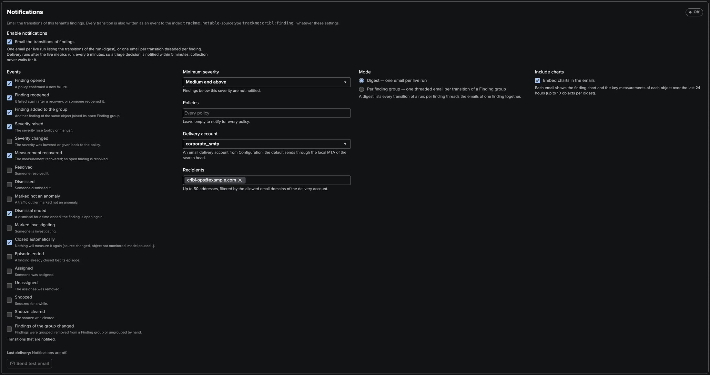
PART 4 · OPERATE
Notifications — every transition indexed, emails when you want them
1
Indexed events
Every transition in the notable index, for Splunk alerts, ES or SOAR.
2
Events and severity
Opened, reopened, escalated, recovered…; Medium and above by default.
3
Digest or per Finding group
One digest per run, or one threaded email per group.
4
Charts inline
The objects' charts in the email; Send test email.
TrackMe for Splunk · Hands-on: Cribl Stream
docs.trackme-solutions.com
Notes:
Every transition of a finding or Finding group is written to the notable index, whatever the notification settings. Email notifications are off by default; a TrackMe administrator of the tenant chooses the events, the minimum severity, the policies, the delivery account and up to 50 recipients, and the digest or per-group mode.

Slide 29
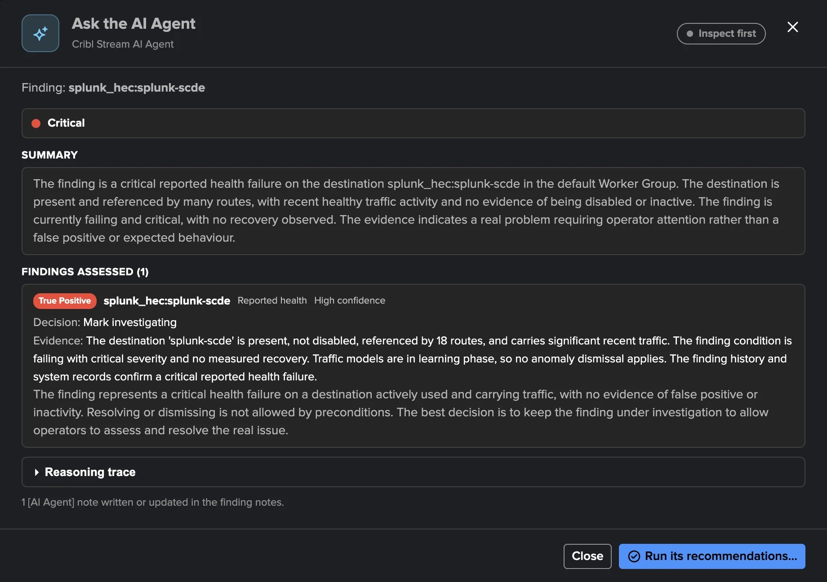
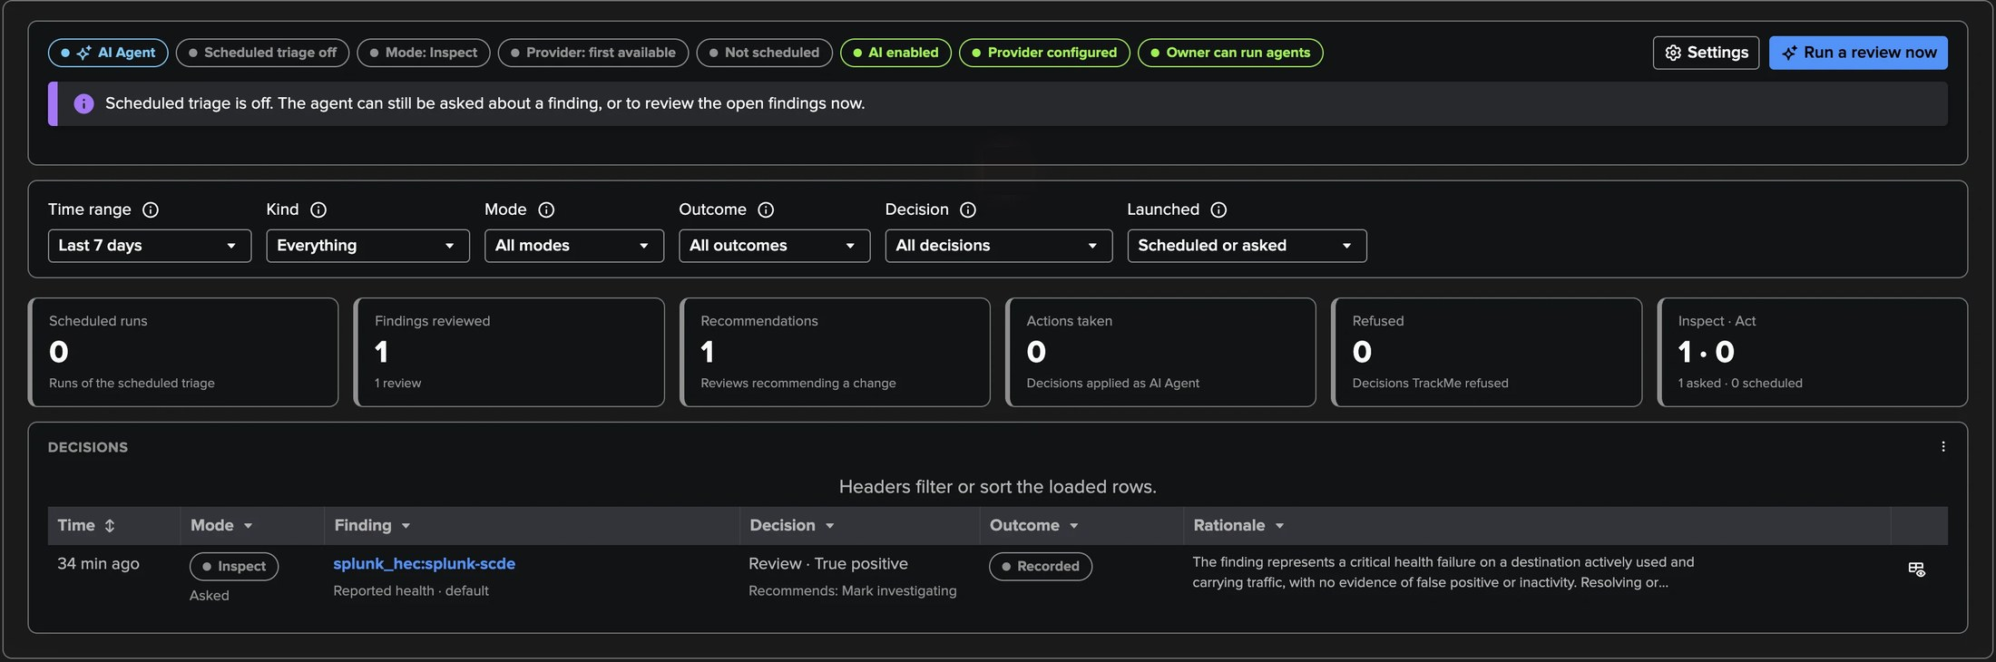
PART 4 · AI
The Cribl Stream AI Agent — facts first, then a recommendation
1
Checked facts
3
Inspect or act
First seen, disabled in Cribl, gone from the Inventory, Routes, traffic, model.
Act applies only what the tenant allows; never a permanent dismissal.
4
Decision log
2
An assessment
Every review, asked or scheduled; hourly triage off by default.
True positive, likely false positive, not in use, expected, needs investigation.
TrackMe for Splunk · Hands-on: Cribl Stream
docs.trackme-solutions.com
Notes:
The Cribl Stream AI Agent reviews findings from facts TrackMe checks: when the object was first seen, whether it is disabled in Cribl or gone from the Inventory, which Routes reference it, its traffic and its model. It recommends a decision and keeps one current AI Agent note. Act applies by default only Mark investigating, Dismiss for a time and Not an anomaly; Resolve and Stop monitoring need a proof.

Slide 30
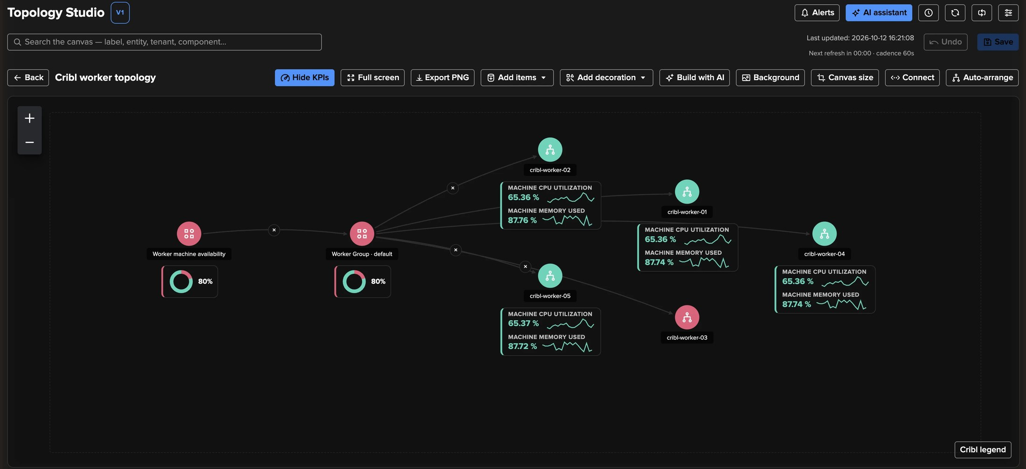
PART 4 · TOPOLOGY STUDIO
Cribl objects in Topology Studio — live, coloured by their findings
1
From the workspace
3
Live state
Flow, Worker and Process topologies saved as live views.
Red, orange, blue when snoozed, green, grey when not measured.
2
Dynamic Cribl groups and templates
4
Alerts and AI
Five templates, from Flow of a Worker Group to Problems wall.
Topology Alerts and Build with AI know Cribl objects.
TrackMe for Splunk · Hands-on: Cribl Stream
docs.trackme-solutions.com
Notes:
Cribl objects are first-class citizens of Topology Studio: Sources, Destinations, Pipelines, Routes, Workers and worker processes, dynamic Cribl groups that follow a selection, and five templates. Nodes carry their KPIs and 24-hour sparklines, and their colour follows their findings.

Slide 31
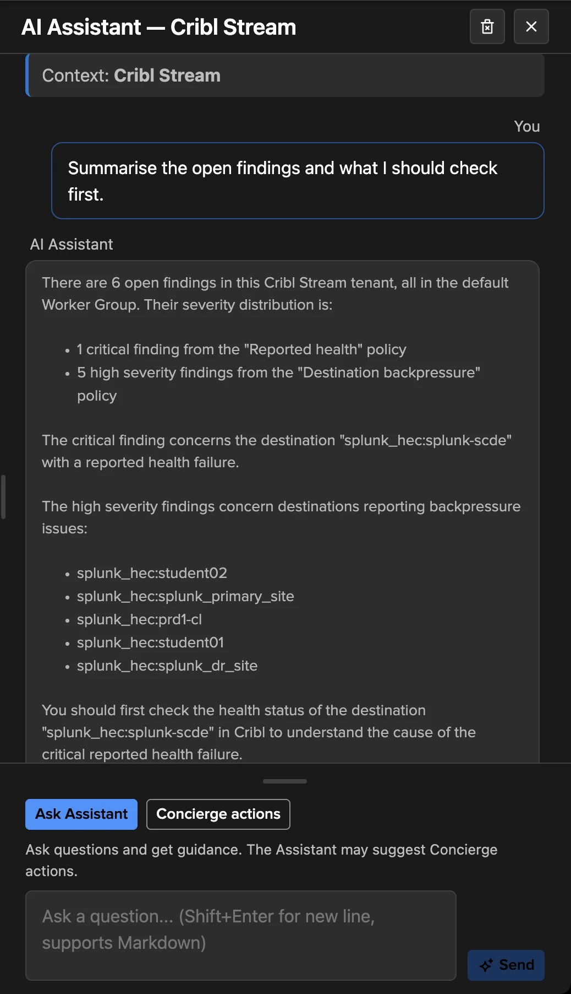
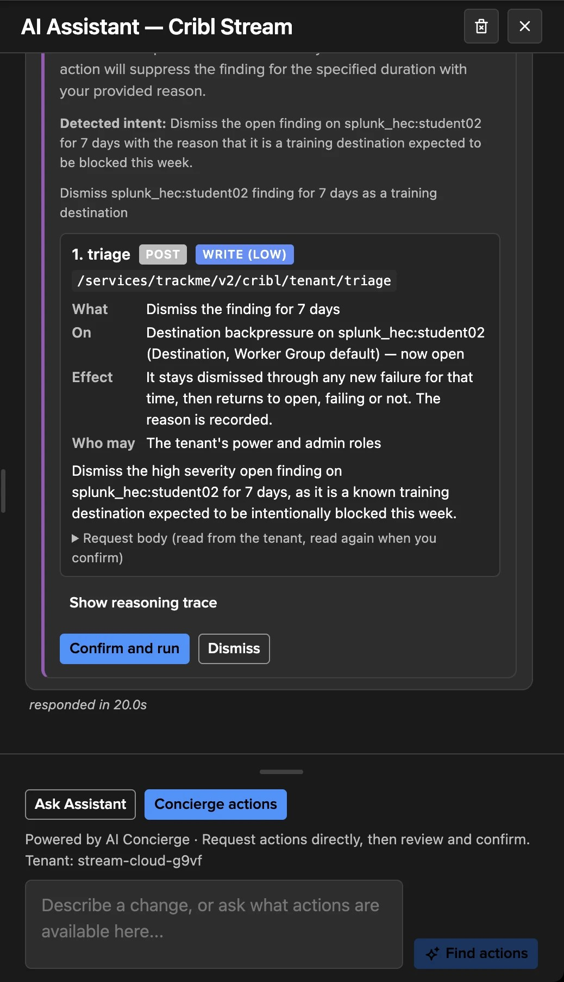
PART 4 · AI
The AI Assistant and the Concierge — ask, then confirm
1
Grounded in the tenant
Findings, traffic ML models, collection health, monitoring state, Leader load.
2
Ask why
Why a finding is open, what to check in Cribl, when a model is ready.
3
Concierge consent card
What, On, Effect, Who may — confirmed before it runs.
4
Roles kept
Policies, exclusion rules, tuning and settings stay in the workspace.
TrackMe for Splunk · Hands-on: Cribl Stream
docs.trackme-solutions.com
Notes:
The AI Assistant of a Cribl Stream tenant is grounded in its findings, models, collection health, monitoring state and Leader load. When you ask for a change it can make, it proposes an AI Concierge consent card that you confirm before anything runs: a decision on a finding, Not an anomaly, monitoring on or off for named objects, a collection job, or relearning a model. Each action keeps the role it requires.

Slide 32
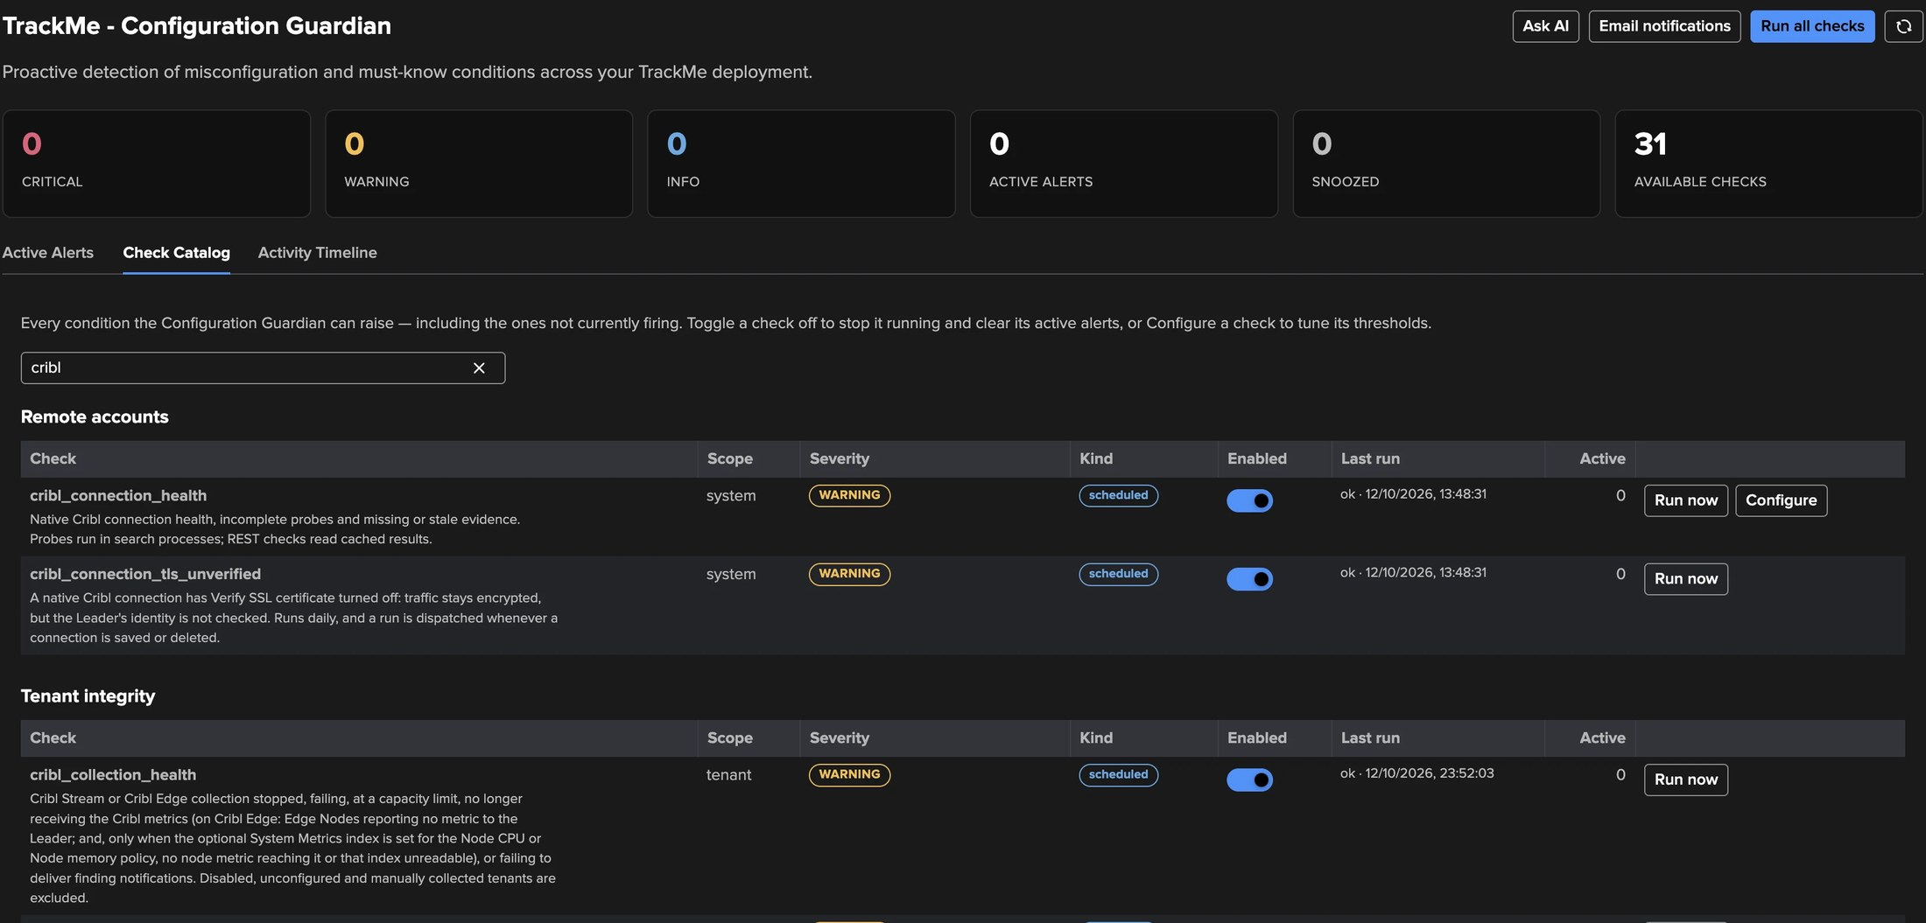
PART 4 · OPERATE
The Configuration Guardian — never trust a silent tenant
1
cribl_collection_health
3
Connections
A job not running or failing, metrics not arriving, a Worker Group sending none.
cribl_connection_health and cribl_connection_tls_unverified.
4
Each problem with its next step
2
Load and scale
And it clears itself when the condition ends.
The inventory cycle or worker sampling slowing under the Leader budget.
TrackMe for Splunk · Hands-on: Cribl Stream
docs.trackme-solutions.com
Notes:
Collection health keeps you from trusting a silent tenant. The Configuration Guardian check cribl_collection_health raises a warning when a job is not running or keeps failing, when metrics stop arriving, when the collection slows down under the Leader budget, when many objects stop together, or when notification emails fail. The Guardian also checks the Cribl connections themselves.

Slide 33
RECAP
Where we are
In four parts
Set up
Triaged
Observed
Operated
a Cribl connection, the wizard and the first collection, checked in Collection health
Finding groups decided once, an outlier and a Worker failure investigated, findings routed
traffic, traffic ML models and their tuning, Workers, the Leader and the data paths
inventory, policies, notifications, the AI Agent, Topology Studio and the Guardian
What made it work
Read what you already have
Normal, learned per object
One decision per object
Cribl's own metrics, in place, and the Leader API within its budget. Nothing installed, nothing changed in Cribl.
A traffic ML model per object and hour, explained, tunable with a simulation before saving.
Finding groups, assignment, webhooks and an AI Agent that checks facts before recommending.
TrackMe for Splunk · Hands-on: Cribl Stream
docs.trackme-solutions.com
Notes:
Recap. A tenant created on a Cribl connection, its findings grouped per object and triaged, a traffic outlier investigated against its learned range, a Worker failure seen in the finding and the topology, findings routed to a team and to a webhook, the deployment observed from its traffic to its machines and data paths, and the tenant operated with policies, notifications, the AI Agent, Topology Studio and the Guardian.

