Slide 1

HANDS-ON WALKTHROUGH · TOPOLOGY STUDIO
Your environment, as a live map
Maps built from real TrackMe entities that colour themselves with live health — generated from a tenant in a few clicks, authored by hand, alerting on the service they draw, or built from a sentence with AI.
Captured live on TrackMe 2.4.18 · Splunk Enterprise
Notes:
Hands-on walkthrough of Topology Studio. Everything in this deck was captured live on TrackMe 2.4.18 against a production-like deployment with several tenants. Four parts: generate a map from a tenant in a few clicks, build one from scratch with aggregates and auto-generated members, alert on the map, and build one from a sentence with AI. We close with a few maps that run in production.

Slide 2
THE PROBLEM
Entities tell you what is broken. A map tells you what it breaks.
Operators think in services, sites and pipelines. An entity table, however well classified, is a list — and a diagram in a wiki is out of date the day after it is drawn.
The service is invisible
Diagrams go stale
Owners want one signal
A red feed, three hosts behind it and a search that depends on it: the table shows four rows, not one broken service.
Hand-drawn maps describe last quarter. New feeds are missing, retired ones are still drawn, and nobody trusts the colours.
A service owner wants to know when the service degrades — not one alert per entity, and not a colour they have to interpret.
What Topology Studio does
Topology Studio is a canvas for YOUR view of the environment: a payment flow, a data centre, an ingestion pipeline, a business service. Every node is a real TrackMe entity from any tenant and any component, a live aggregate of many entities, or another saved view. The map colours itself with live health, is shared under RBAC, and can alert on the service it draws.
Available in every edition — Foundation, Enterprise, Unlimited and trials — including authoring and Topology Alerts.
TrackMe for Splunk · Hands-on: Topology Studio
docs.trackme-solutions.com
Notes:
TrackMe already knows the state of every feed, host, search and object. What an entity list does not tell you is which service a red entity belongs to, and whether that service is still up. Hand-drawn diagrams answer that question for a week and then go stale. Topology Studio draws the map from the entities themselves, so it can never drift from reality, and it colours itself with live health.

Slide 3
THE MODEL
A view, its nodes, its links — and live health on every one
Entity
Scoped aggregate
Auto aggregate
View node
Labels & decorations
One monitored entity — any tenant, any of the seven components — with its live colour and up to five KPIs.
Tenants × components + an optional filter. Worst member or healthy %. Dynamic membership; can draw its members.
A parent whose members are the nodes linked to it: a service built from existing blocks.
Another saved view folded into one health node — a map of maps you can drill into.
Text, shapes and images to annotate zones, tiers and flows. No health of their own.
Live
Honest
Shared
Versioned
every node polls on a 60-second cadence, with a countdown, manual refresh and pause
incomplete data reads unavailable, deleted entities read missing — never green by default
a view has Can view / Can edit role lists; tenant masking is enforced per node on the server
every save is a version with non-destructive restore; views export and import between instances
TrackMe for Splunk · Hands-on: Topology Studio
docs.trackme-solutions.com
Notes:
The vocabulary. A view is one map: an id, a display name, a category, and two role lists — who can view and who can edit. Five kinds of node. An entity node is one monitored entity with up to five KPIs. A scoped aggregate rolls a filtered set of entities up to one node: tenants and components in scope, an optional filter in the Virtual Groups syntax, worst member or healthy-percentage health; membership is dynamic, so new matching entities join automatically. An auto aggregate is a parent whose members are simply the nodes connected to it. A view node folds another saved view into one health node — a map of maps. Labels and decorations annotate. Live status refreshes every sixty seconds; a node you cannot see renders as restricted, a deleted entity as missing, never as green.

Slide 4
THE PLAN
Four ways to a map — one live view in the end
Part 1 · Generate
Part 2 · Author
Part 3 · Alert
Part 4 · AI
From Tenant Home, one click: a live map of the tenant
An empty canvas and a root aggregate
A Topology Alert on the view
Build with AI from one sentence
Hierarchy presets or a custom sequence of fields
Two child aggregates from priority and labels
Transitions only: open, update, resolve
A live preview with health
A condition such as high and critical only
Members drawn automatically, with KPIs and sparklines
The rendered map in the email
Refine the draft in plain words
Save it as a view
Links, auto-arrange, save
Run history and events
Create the view
Then a few maps that run in production: a Cribl pipeline, a public web estate, and a map of maps over the Splunk infrastructure.
TrackMe for Splunk · Hands-on: Topology Studio
docs.trackme-solutions.com
Notes:
The four parts of this walkthrough. They are not steps of one procedure: each is a way to get a live map, and in practice teams use all four. Generate a map from a tenant when the structure is already in TrackMe; author by hand when the map is your own mental model of a service; alert once the map is worth watching; ask the AI when you can describe the map faster than you can draw it.

Slide 5
01
PART 1 · GENERATE
A live map of a tenant, in a few clicks
Tenant Home turns any tenant into a structured topology: a root aggregate, one live aggregate per group, any hierarchy you like — then save it as a view.
TrackMe for Splunk · Hands-on: Topology Studio
Notes:
Part 1. The fastest way to a map: the tenant already knows its structure — indexes, tags, priorities, labels. Tenant Home generates a temporary topology from it; you pick the hierarchy, narrow it with a condition, and save it when it is right.

Slide 6
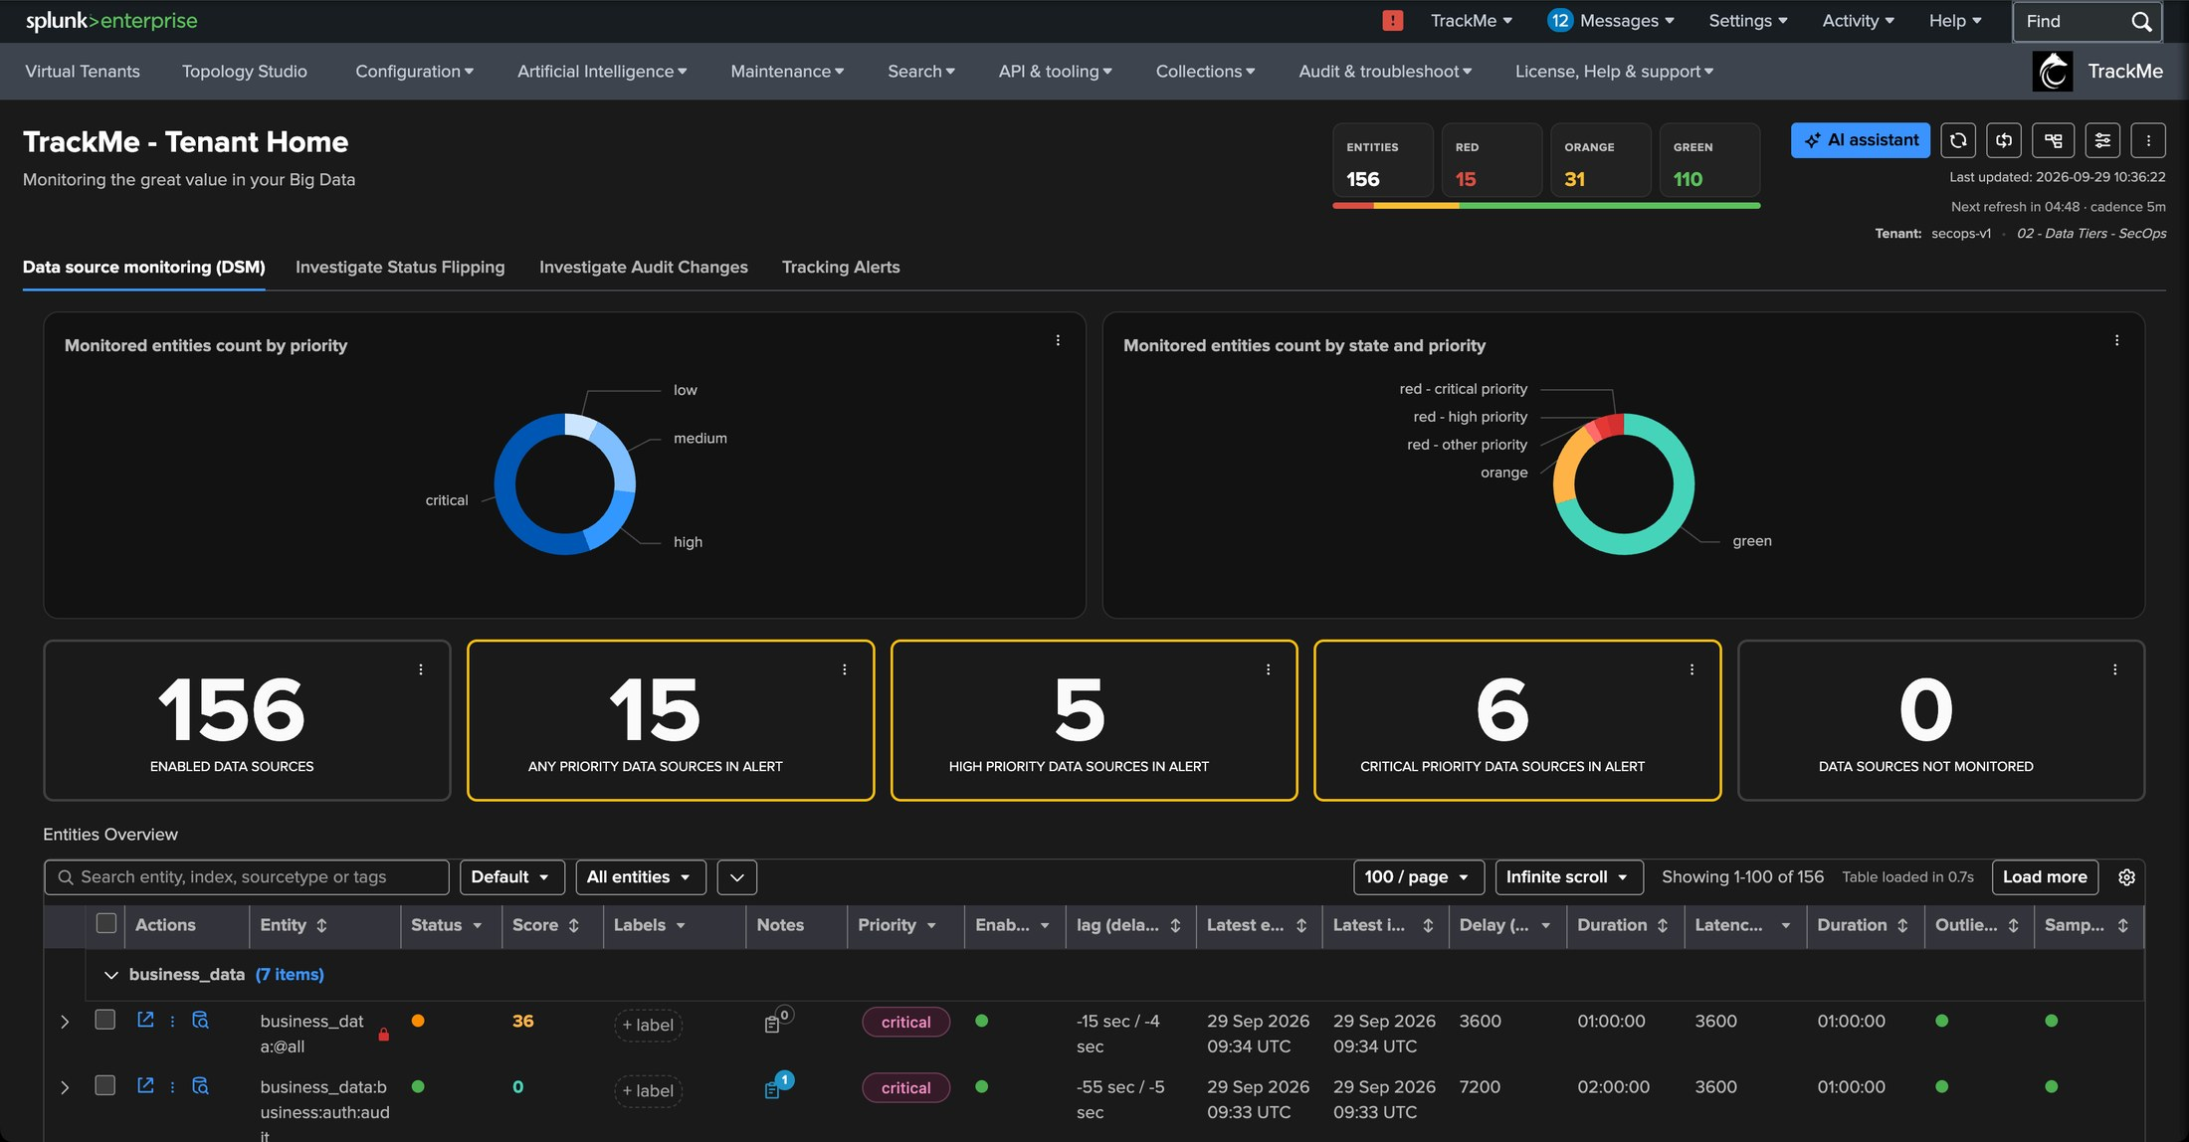
PART 1 · GENERATE
Tenant Home — the topology icon
1
Open the tenant topology
1
The icon at the top right of Tenant Home generates a topology of the component you are looking at.
2
2
The component in view
Here the data sources (DSM) of a SecOps tenant. The same works for DHM, MHM, FLX, WLK, FQM and VOL.
Nothing to prepare
No view to create, no node to place: the tenant already carries the structure — indexes, tags, priorities, labels. The generated map is temporary until you save it.
TrackMe for Splunk · Hands-on: Topology Studio
docs.trackme-solutions.com
Notes:
We start from Tenant Home of a SecOps tenant tracking a few hundred data sources. The topology icon at the top right opens a full-screen panel with three tabs: Topology Studio, Link graph and Network graph. We stay on the Topology Studio tab.

Slide 7
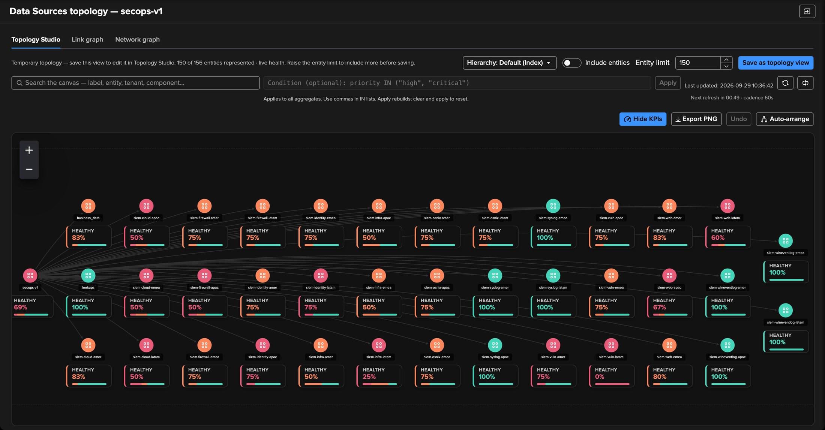
PART 1 · GENERATE
The default map — one aggregate per index
1
Temporary topology
1
Nothing is saved yet; the banner says how many entities are represented.
2
6
4
3
2
Hierarchy
Default for DSM is per index — change it with one selector.
3
Include entities · Entity limit
Aggregates only by default; entity nodes on demand, within a limit.
5
4
Condition
An optional filter applied to every generated aggregate.
5
Root aggregate
The tenant itself, with its live healthy percentage.
6
Save as topology view
Freezes membership and layout; health stays live.
TrackMe for Splunk · Hands-on: Topology Studio
docs.trackme-solutions.com
Notes:
The default hierarchy depends on the component: per index for DSM, per group for FLX, per overgroup for WLK, per datamodel for FQM, the tenant root for DHM and MHM. Every node is a live aggregate with its healthy percentage and a colour. Only monitored entities are included. Include entities adds the individual entity nodes, bounded by the entity limit — useful on small tenants, busy on large ones.

Slide 8
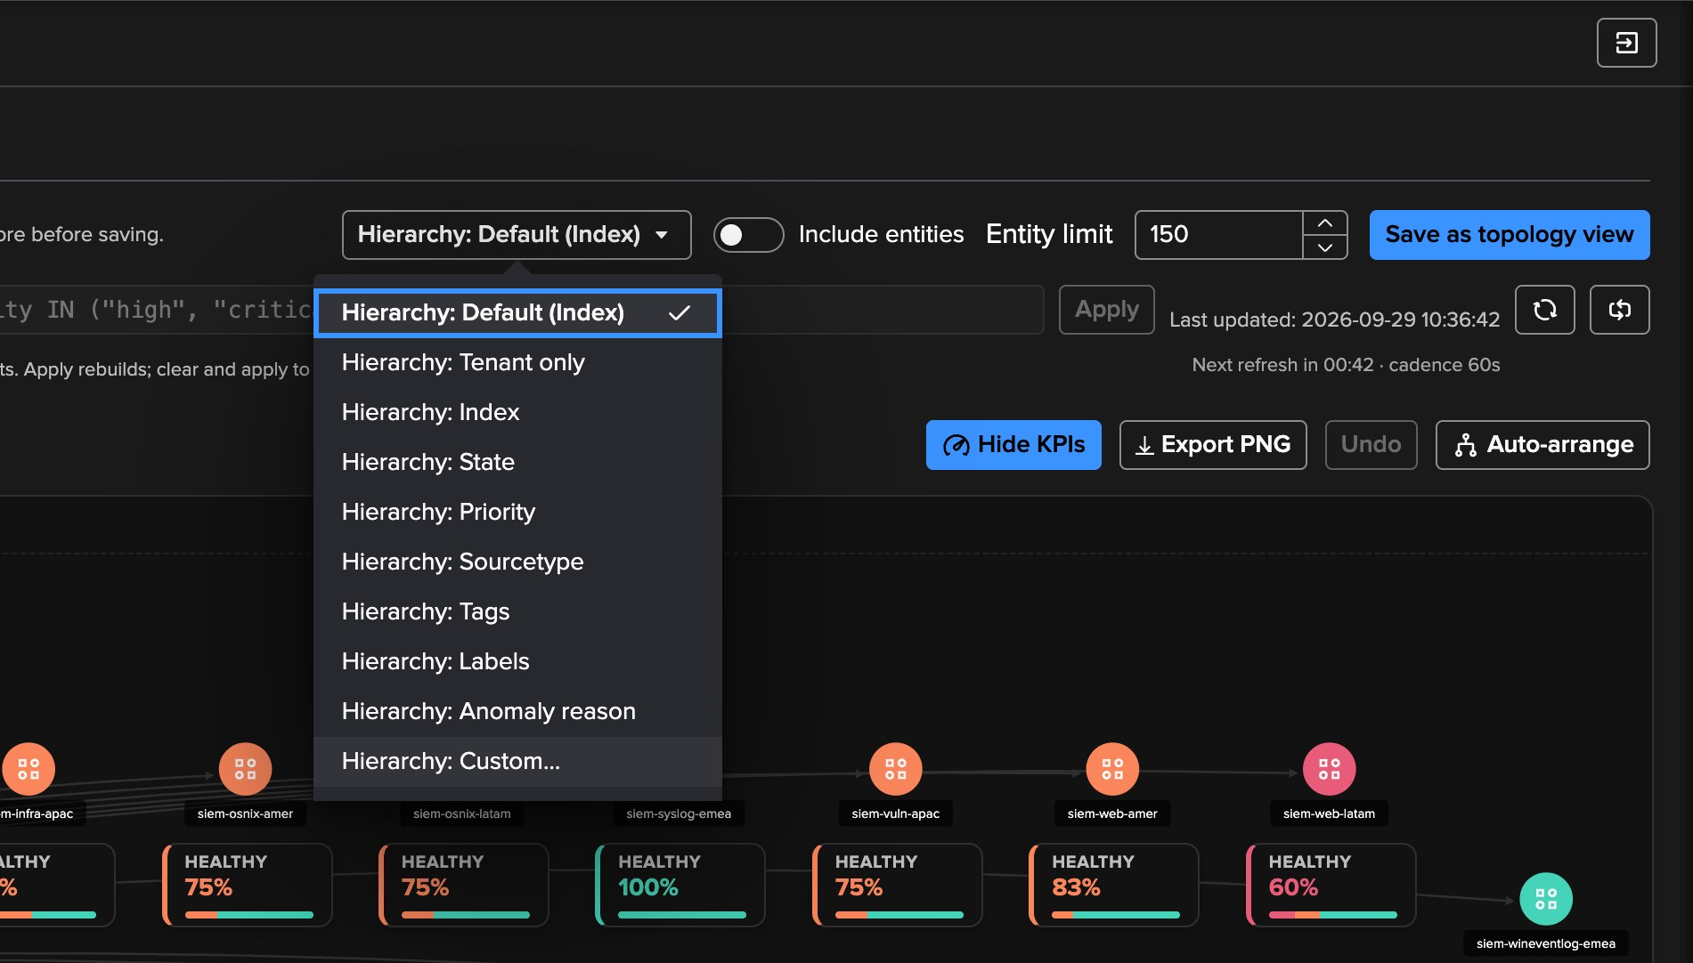
PART 1 · GENERATE
Hierarchy — presets, or your own sequence of fields
1
Presets
Default, tenant only, index, state, priority, sourcetype, tags, labels, anomaly reason — the groupings of Tenant Home.
1
2
Tags
One aggregate per tag value — the ownership view as a map.
3
Custom…
Any sequence of entity fields, from top to bottom beneath the root.
2
3
Per component
FLX offers group and subgroup, WLK overgroup and subgroup, FQM datamodel, VOL licence pool and detection direction — the presets follow the component.
TrackMe for Splunk · Hands-on: Topology Studio
docs.trackme-solutions.com
Notes:
The hierarchy selector lists the presets of the component — the same groupings as the Tenant Home table — plus Tenant only and Custom. Custom opens a dialog where you choose the fields yourself.

Slide 9
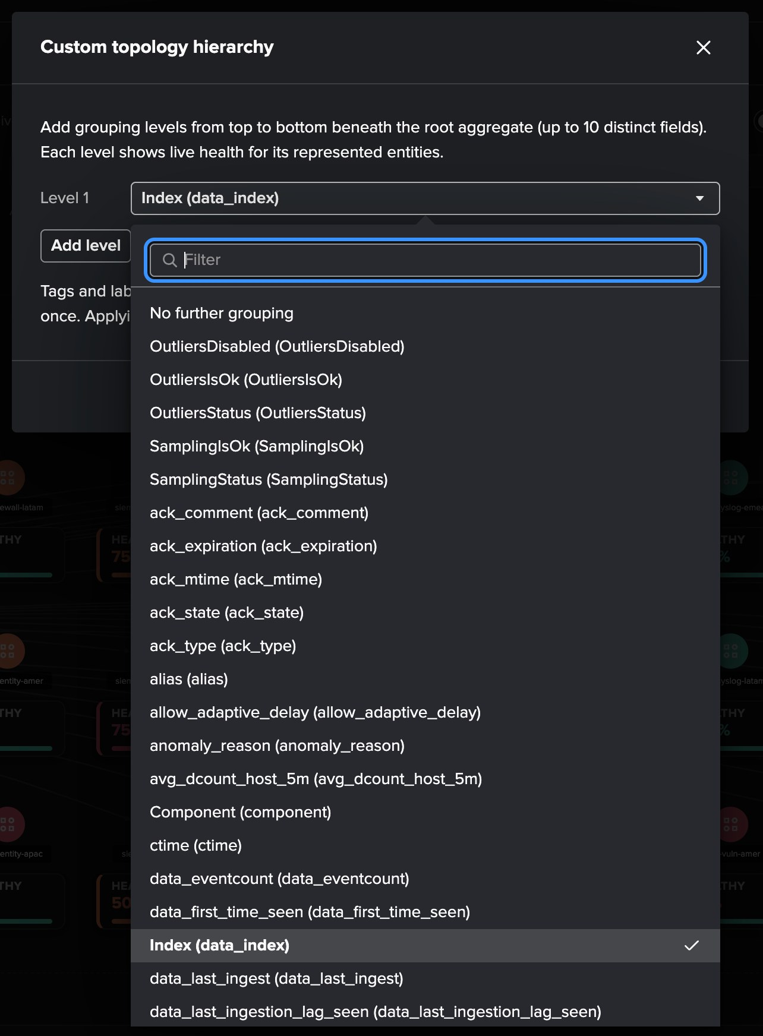
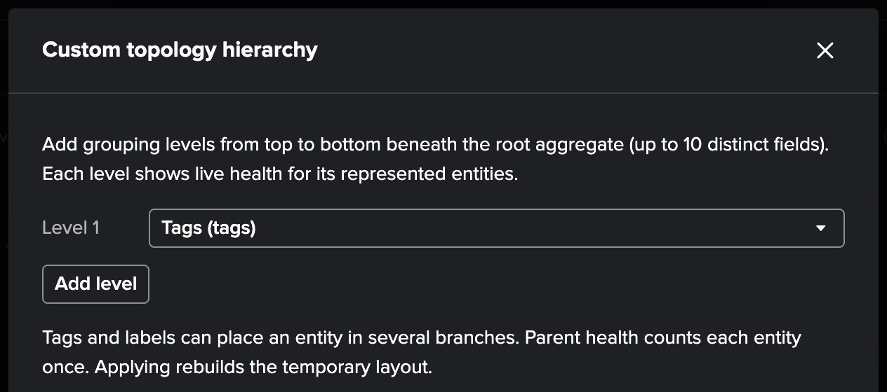
PART 1 · GENERATE
Custom hierarchy — any entity field, level by level
1
3
2
4
1
Level 1
3
Tags as level 1
Each level picks one field of the entity records.
An entity with several tags appears under each of them; parent health counts it once.
2
Every field
4
Add level
Tags, labels, priority, state, index, sourcetype — and the component’s own fields.
Up to ten levels — for example Tags, then Priority beneath.
TrackMe for Splunk · Hands-on: Topology Studio
docs.trackme-solutions.com
Notes:
The custom hierarchy dialog: grouping levels from top to bottom beneath the root aggregate, up to ten distinct fields, added on demand. Any field of the records is offered. We pick Tags as the single level. Tags and labels can place an entity in several branches; the parent health still counts each entity once. Applying rebuilds the temporary layout.

Slide 10
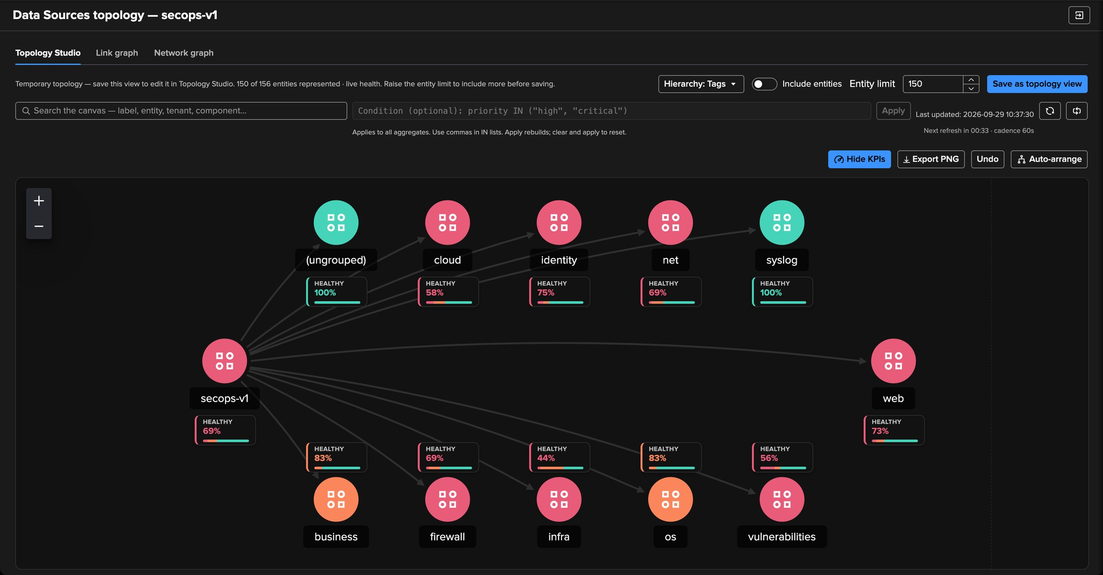
PART 1 · GENERATE
Grouped by tag — the ownership view, as a map
1
The tenant
The root aggregate over every monitored entity of the tenant.
2
One aggregate per tag
2
cloud, firewall, identity, net, web… each a live aggregate with its own colour.
3
3
(ungrouped)
1
Entities without a tag are not lost: they are grouped explicitly.
4
4
Healthy percentage
The KPI of each aggregate — hide or show KPIs from the toolbar.
Auto-arrange
Direction, spacing and canvas size in one popover; the arrangement is a single undo step.
TrackMe for Splunk · Hands-on: Topology Studio
docs.trackme-solutions.com
Notes:
With Tags as the hierarchy, the map shows the tenant as its owners see it: one node per team or technology, each with a live colour and a healthy percentage. Auto-arrange lays it out — direction top to bottom, left to right and so on, compact to spacious spacing. The ungrouped node collects entities without a tag.

Slide 11
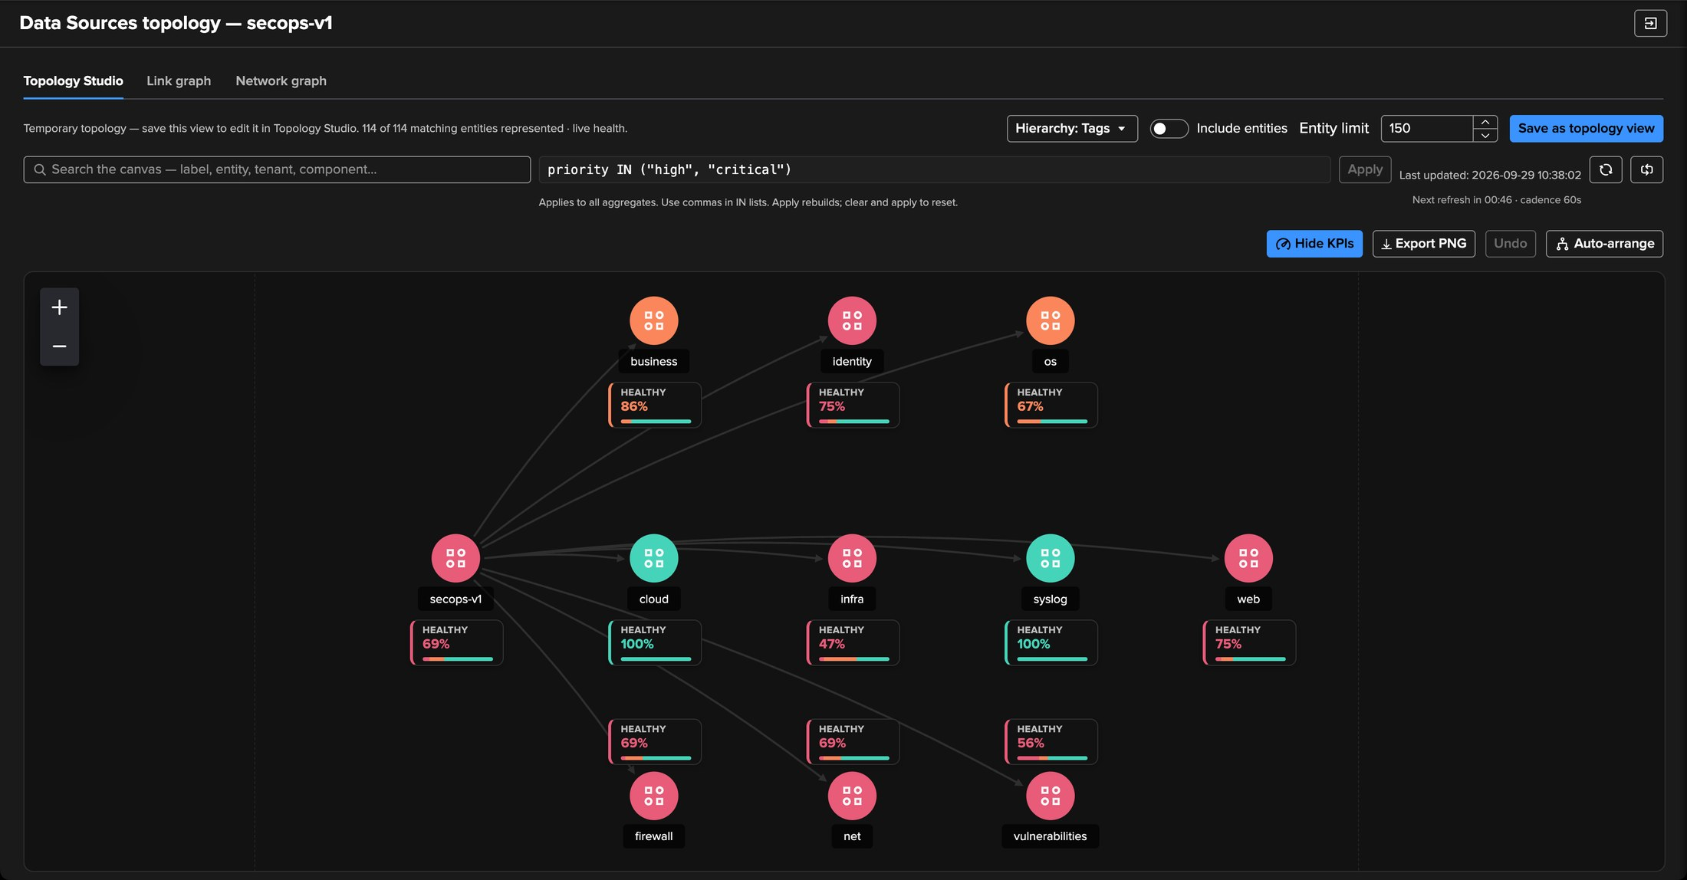
PART 1 · GENERATE
A condition — high and critical only, and the map is ready
1
priority IN ("high", "critical")
2
The filter syntax of Virtual Groups, applied to every aggregate including the root.
1
2
Matching entities
The banner counts the entities the condition keeps.
3
What matters, by owner
The low-priority noise is gone; (ungrouped) disappears with it.
3
The same syntax everywhere
field=value with wildcards, AND / OR, parentheses, IN lists — the language of Virtual Groups, ML scopes and aggregate filters.
TrackMe for Splunk · Hands-on: Topology Studio
docs.trackme-solutions.com
Notes:
The condition narrows the whole map: here high and critical priorities only. What remains is the on-call view by owner — the map a SecOps lead would put on a screen. Clear the condition and apply to reset.

Slide 12
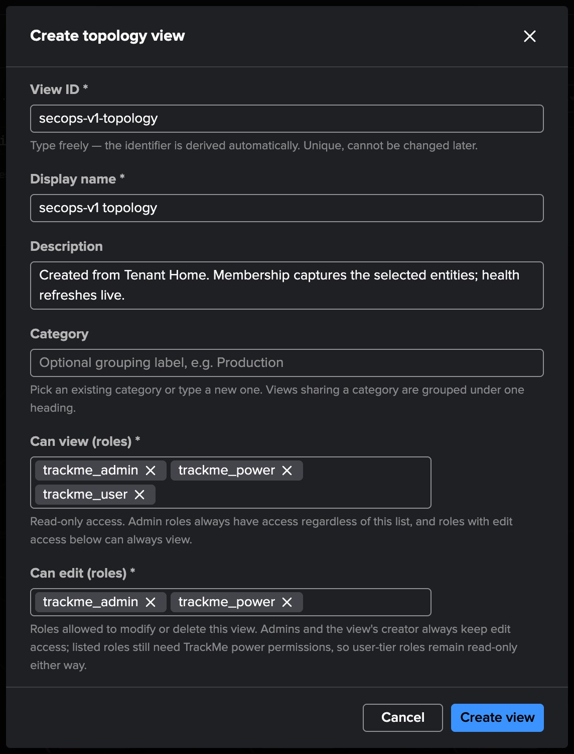
PART 1 · GENERATE
Save as topology view — a map anyone can open
1
View id and display name
The id is derived from what you type and cannot change later; the name can.
1
2
Category
Pick an existing one or type a new one; the views browser groups by category.
3
Can view (roles)
Read access. Administrators always have access.
2
4
Can edit (roles)
Write access. The creator always keeps edit access.
3
What saving freezes
4
Membership and layout are frozen; health stays live. For membership that follows the tenant, author aggregates (Part 2) — they stay dynamic.
TrackMe for Splunk · Hands-on: Topology Studio
docs.trackme-solutions.com
Notes:
Save as topology view opens the create dialog: id, display name, description, category, and the two role lists. Saving freezes the selection and the layout; the health keeps updating. When the map must follow new entities automatically, author aggregates instead — that is Part 2.

Slide 13
02
PART 2 · AUTHOR
From an empty canvas to a live service map
A root aggregate, two child aggregates from priority and labels, members drawn automatically with KPIs and sparklines — the way to map a service.
TrackMe for Splunk · Hands-on: Topology Studio
Notes:
Part 2. Authoring by hand, the way most service maps are built: start from the service, describe its parts with aggregates, and let the members draw themselves.

Slide 14
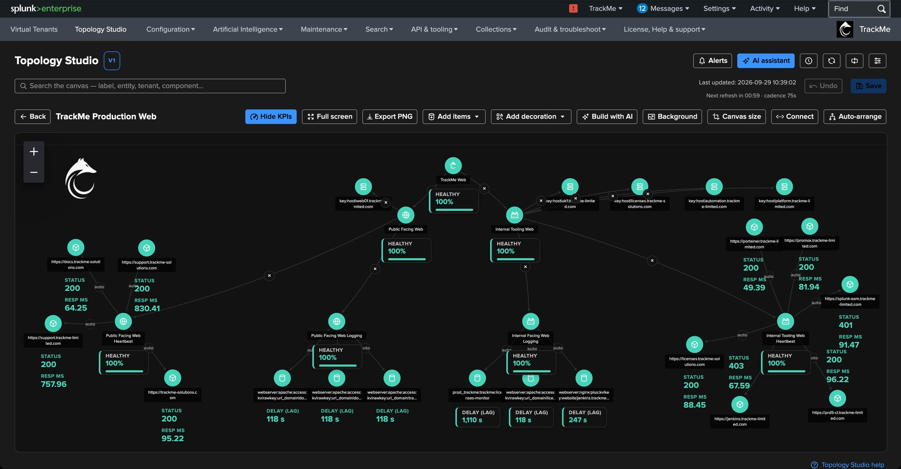
PART 2 · AUTHOR
Where we are going — a web platform on one canvas
1
The service
A root aggregate for the whole web platform.
2
Public and internal
3
Child aggregates by labels, filtered on high and critical priorities.
1
2
3
Decorations
A logo, text and shapes — purely visual.
4
4
Heartbeat members
FLX entities with HTTP status and response time KPIs.
5
Log feeds
5
DSM entities with their delay (lag) — two components on one map.
TrackMe for Splunk · Hands-on: Topology Studio
docs.trackme-solutions.com
Notes:
This is a map that runs in production: the web platform of TrackMe itself, with public and internal web services, heartbeat checks from an FLX tenant and web server logs from DSM. We now rebuild its skeleton from an empty canvas, in a few minutes.

Slide 15
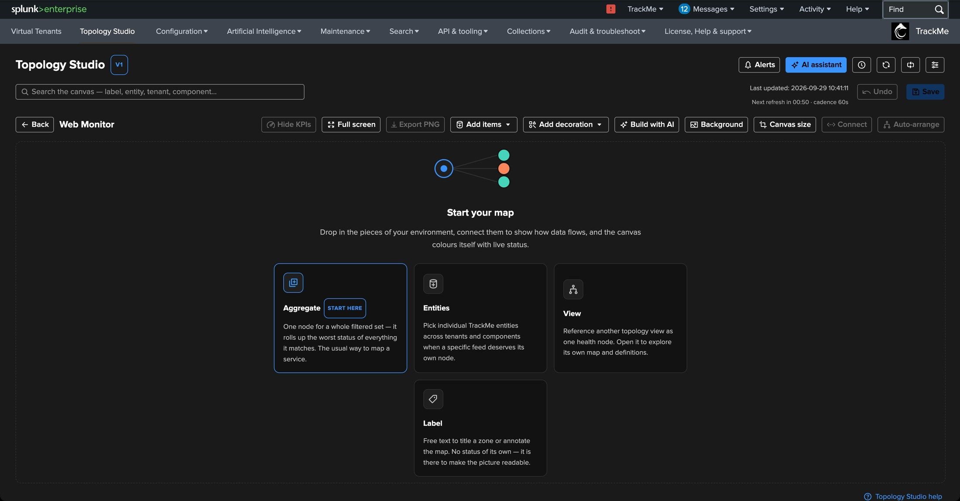
PART 2 · AUTHOR
A new view — the canvas tells you where to start
1
Aggregate — start here
One node for a whole filtered set of entities: the usual way to map a service.
2
Entities
Individual entities when a specific feed deserves its own node.
3
View
1
2
3
Another saved view as one health node.
4
Label
4
Free text to title a zone or annotate the map.
Create topology view
Views browser → Create topology view: the same dialog as in Part 1 — id, name, description, category, roles. Here: Web Monitor, category Infrastructure.
TrackMe for Splunk · Hands-on: Topology Studio
docs.trackme-solutions.com
Notes:
We create a view called Web Monitor from the views browser — the same dialog as in Part 1. An empty view opens on the Start your map guide: aggregate, entities, view or label. The guide recommends starting with an aggregate, and so do we.

Slide 16
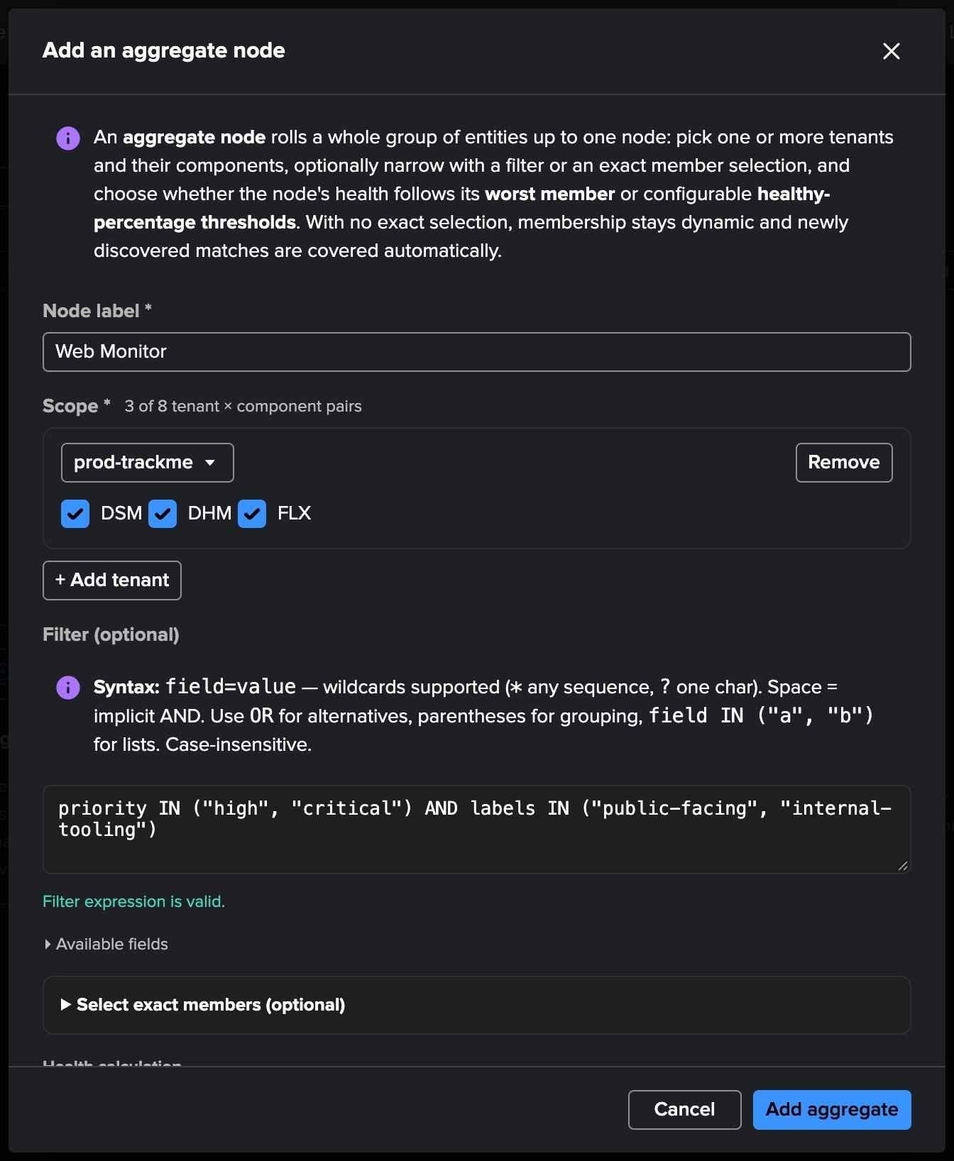
PART 2 · AUTHOR
The root aggregate — scope and filter
1
Node label
Web Monitor — the service this map is about.
2
Scope: tenant
Up to eight tenant × component pairs; add tenants for cross-tenant services.
1
3
Components
The tenant’s enabled components are pre-ticked: DSM, DHM and FLX here.
2
4
Filter
3
priority IN ("high", "critical") AND labels IN ("public-facing", "internal-tooling") — validated as you type.
5
Exact members
Optional. Without it, membership stays dynamic.
4
5
TrackMe for Splunk · Hands-on: Topology Studio
docs.trackme-solutions.com
Notes:
The aggregate dialog. The scope is one or more tenants with their components — up to eight pairs. The filter uses the same syntax as Part 1: here the high and critical entities labelled public-facing or internal-tooling. The labels come from the TrackMe label rules; priorities from the policies. Without an exact selection, entities that start matching later join the aggregate by themselves.

Slide 17
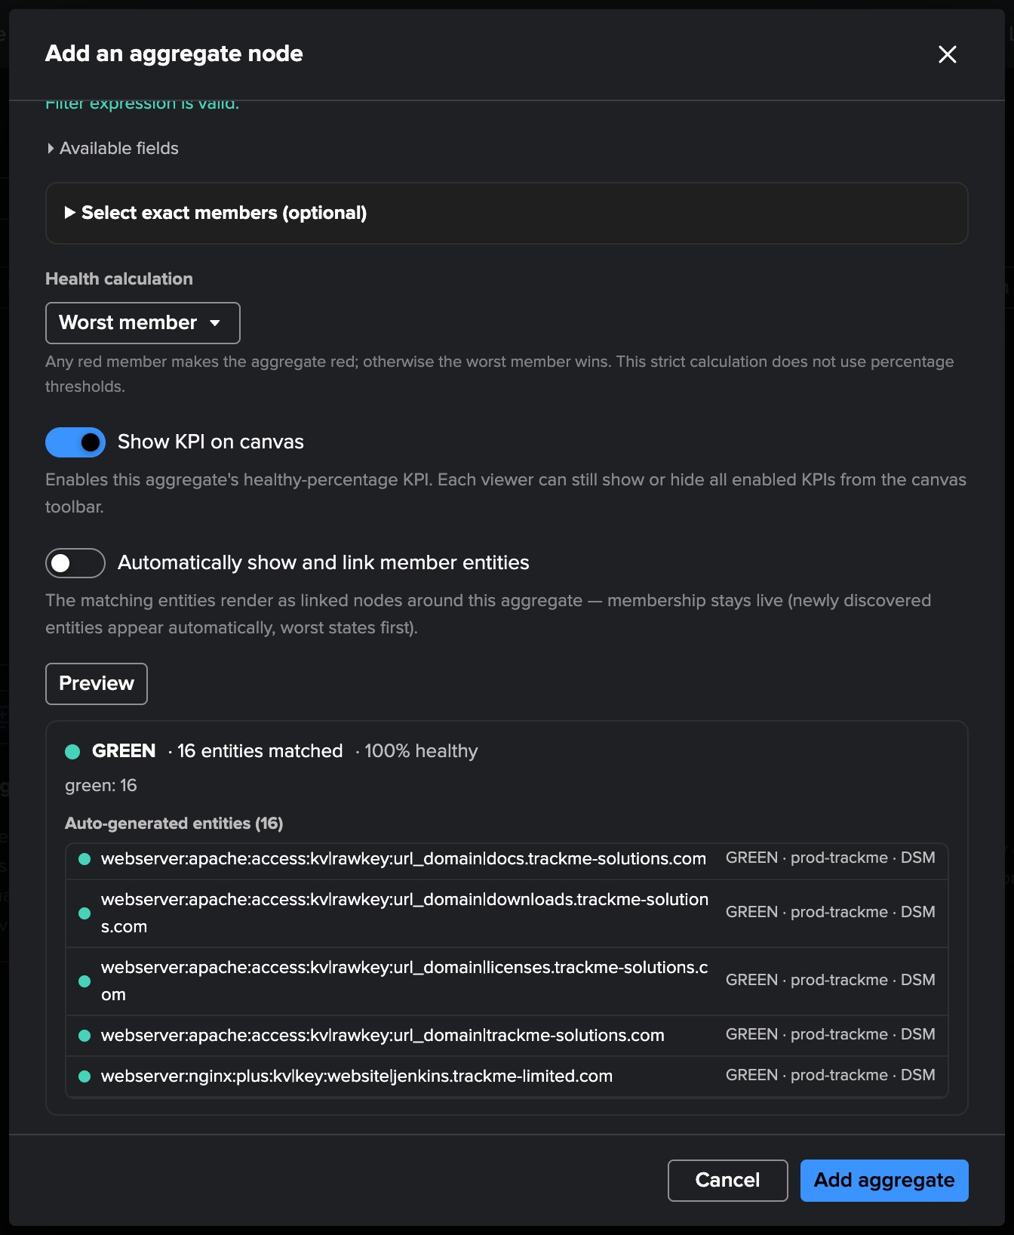
PART 2 · AUTHOR
Preview before adding — the entities it will roll up
1
Health calculation
Worst member (any red member makes it red) or healthy percentage with two thresholds.
2
Show KPI on canvas
The healthy-percentage KPI under the node.
1
3
Show and link members
2
Draw the matching entities around the aggregate — kept off on the root.
4
Preview
3
The live state and the count of matching entities.
5
The members
4
Every matching entity, with its state, tenant and component.
5
TrackMe for Splunk · Hands-on: Topology Studio
docs.trackme-solutions.com
Notes:
Health calculation: worst member is strict — one red member makes the aggregate red. Healthy percentage uses two bands, by default green from 90 percent and orange from 75. Preview shows exactly which entities the aggregate will cover, before anything is added to the canvas.

Slide 18
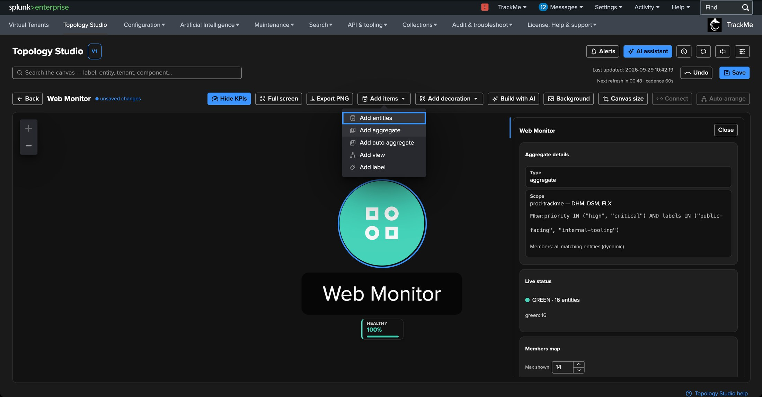
PART 2 · AUTHOR
The root is on the canvas — now its two children
1
Web Monitor
The root aggregate, green, with its healthy percentage.
2
KPI
3
HEALTHY 100% — every member is green.
1
4
3
Add items
Entities, aggregate, auto aggregate, view, label.
4
Inspector
Aggregate details, live status and a members map for the selected node.
2
Two children
Public Facing Web — labels IN ("public-facing"); Internal Tooling Web — labels IN ("internal-tooling"). Same scope, same priority filter.
TrackMe for Splunk · Hands-on: Topology Studio
docs.trackme-solutions.com
Notes:
The root sits on the canvas. We add two child aggregates with Add items → Add aggregate: Public Facing Web and Internal Tooling Web, each with the same scope and priority filter and its own label. On the children we switch on the automatic members.

Slide 19
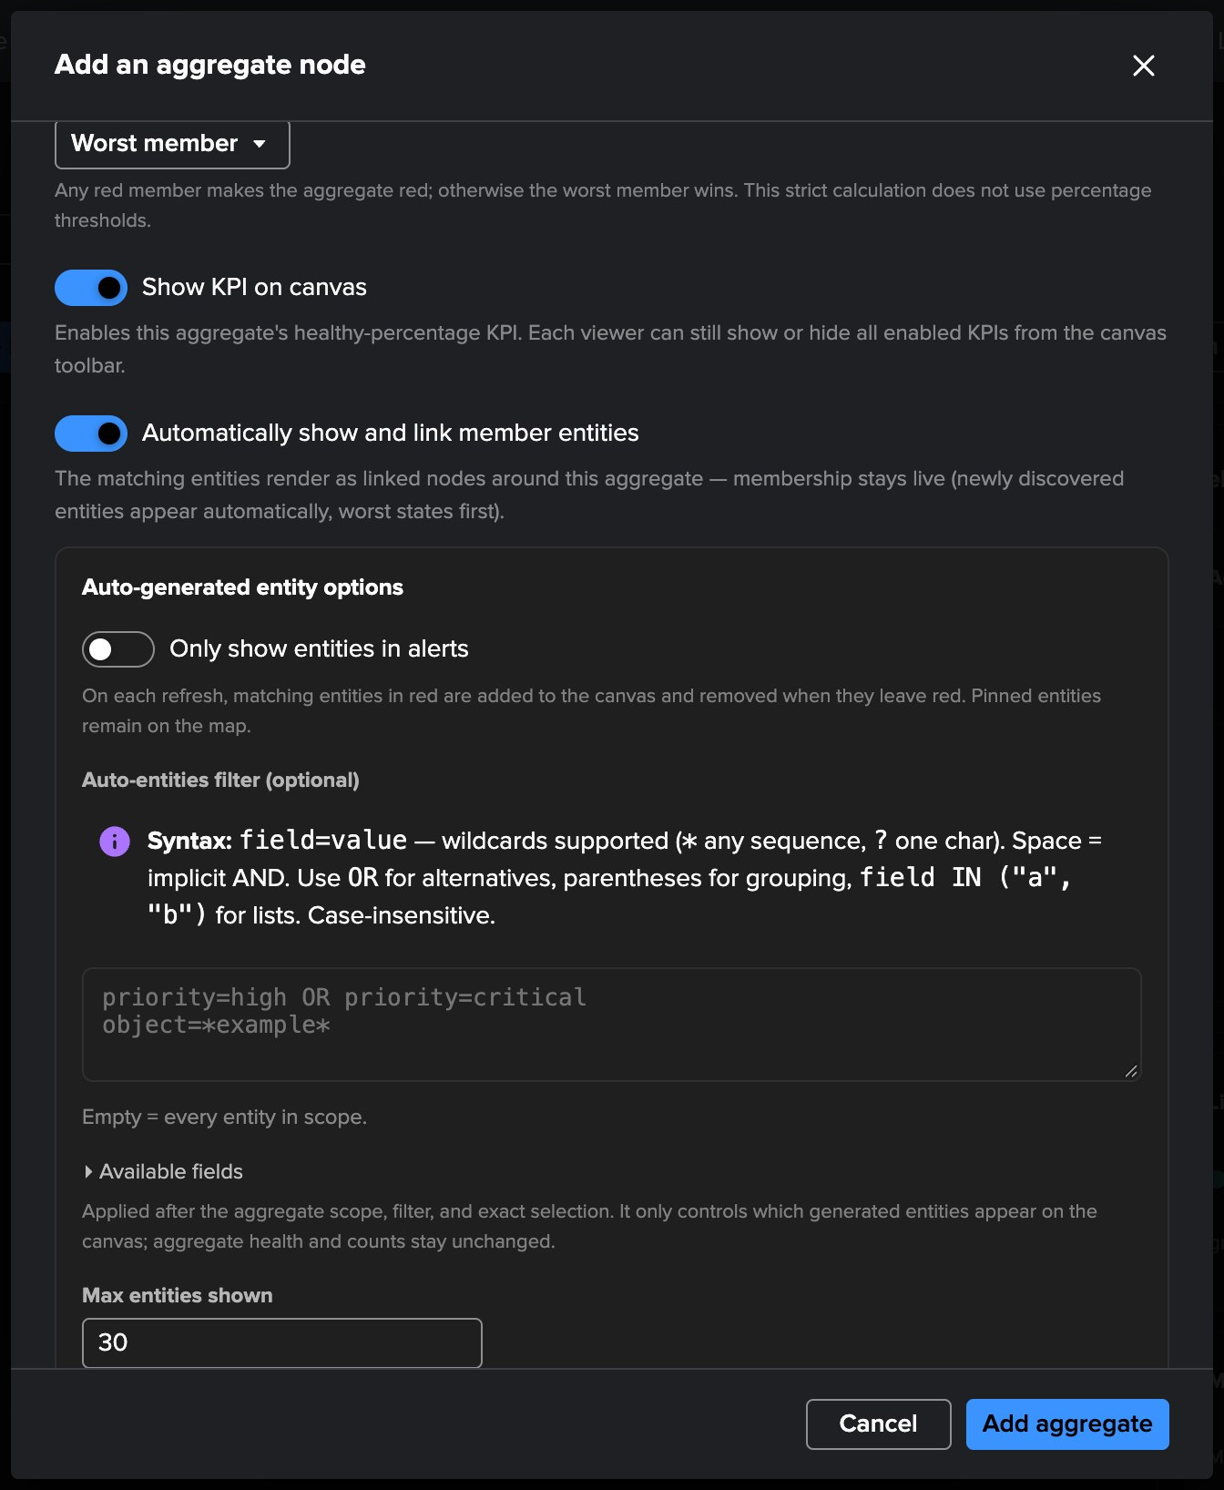
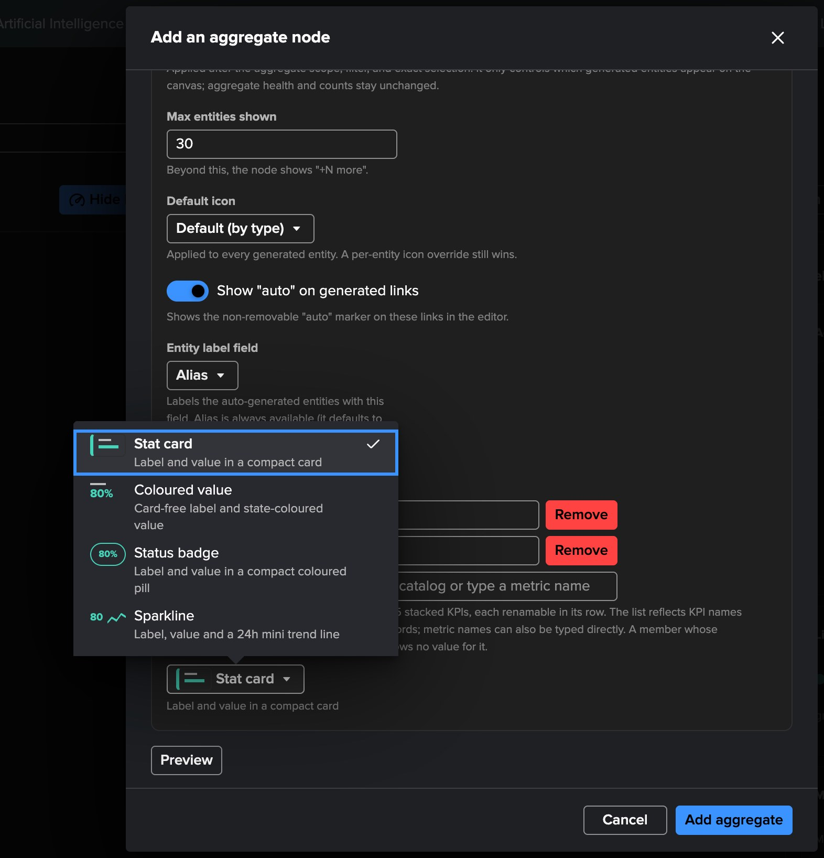
PART 2 · AUTHOR
Members drawn automatically — with KPIs and sparklines
1
Show and link members
Matching entities are drawn and linked around the aggregate.
2
Only entities in alerts
1
Optional: draw red members only.
3
Auto-entities filter
2
What is drawn — never what is measured.
3
4
Max entities shown
5
Up to 500; beyond, “+N more”.
5
Default KPIs
6
Up to five per member, from the scope’s catalog: response_time_ms, lag…
4
6
Sparkline
Label, value and a 24-hour trend.
TrackMe for Splunk · Hands-on: Topology Studio
docs.trackme-solutions.com
Notes:
The option that makes the map come alive. The aggregate draws its matching members around itself and links them — membership stays live, worst states first. Only show entities in alerts draws red members only, and removes them when they recover. The auto-entities filter decides what is drawn without changing what is measured. Default KPIs come from the catalog of the scope — here the response time of the heartbeat checks and the lag of the log feeds — and the sparkline style adds a 24-hour trend line to every member.

Slide 20
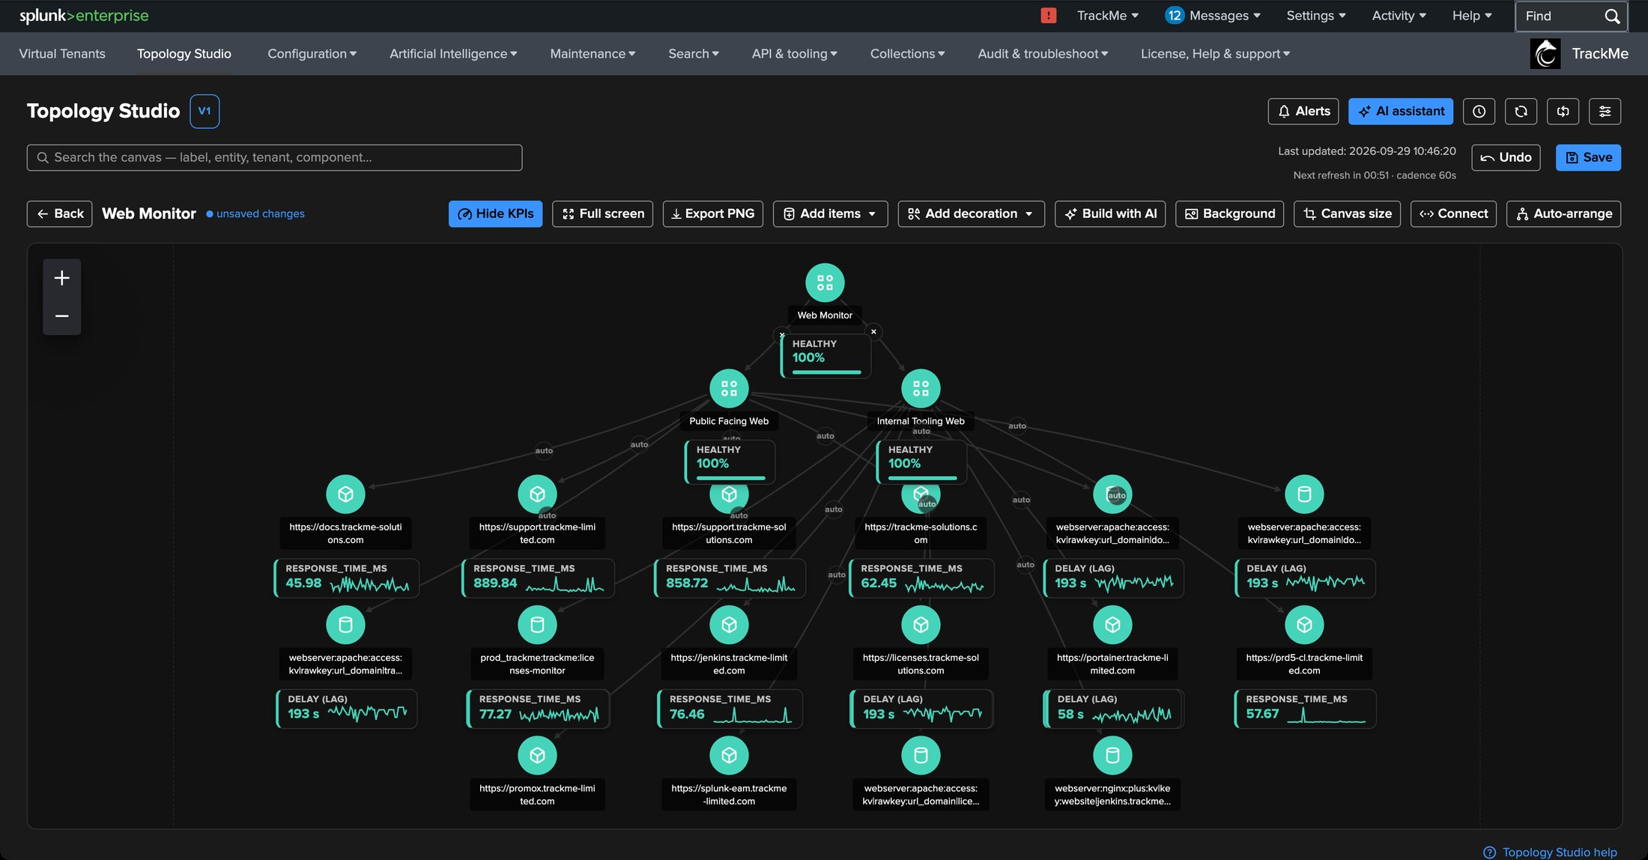
PART 2 · AUTHOR
Web Monitor — linked, arranged, alive
1
The service
Web Monitor at the top, linked to its two parts with Connect.
2
Public Facing Web
1
Its members drawn around it.
2
3
3
Internal Tooling Web
5
The same, for the internal services.
4
KPIs with sparklines
4
Response time for the heartbeat checks, delay for the log feeds.
5
“auto” links
Generated links are marked; connecting an edge to a member pins it.
Then Save
Every save is a version. Undo covers the last 25 operations.
TrackMe for Splunk · Hands-on: Topology Studio
docs.trackme-solutions.com
Notes:
Connect draws links: toggle it, click the source, then the target. Auto-arrange lays out the tree. Every member shows its KPIs with a 24-hour sparkline. Nothing is saved until you click Save — every save becomes a version you can restore.

Slide 21
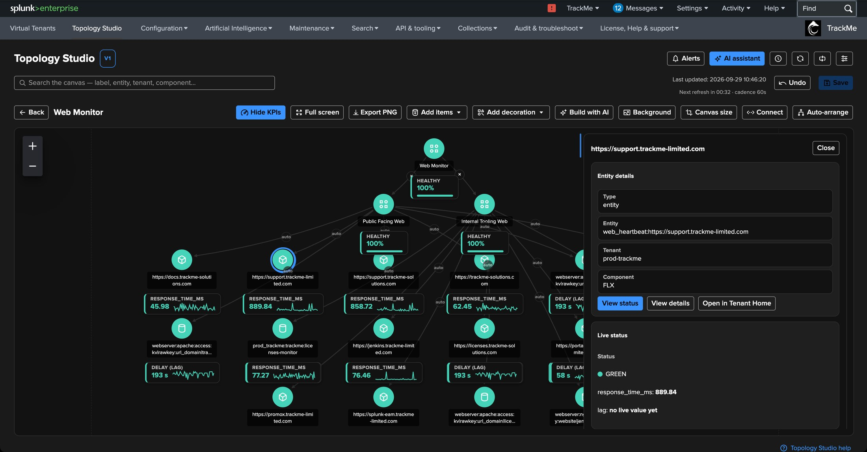
PART 2 · AUTHOR
Click any node — the inspector explains it
1
A generated member
One of the heartbeat checks of Public Facing Web.
2
Entity details
Entity, tenant and component — here an FLX entity.
2
3
View status · View details · Open in Tenant Home
1
From the map to the status message, the entity and its tenant.
3
4
Live status
State and the current value of each KPI.
4
TrackMe for Splunk · Hands-on: Topology Studio
docs.trackme-solutions.com
Notes:
The inspector is where the map becomes operational: select a member, read its details, open its status — the same status message and score breakdown as in Tenant Home — or jump to the entity in its tenant.

Slide 22
03
PART 3 · ALERT
Alert on the service the map draws
A Topology Alert evaluates the nodes of a view on a schedule and notifies on transitions only — with the rendered map in the email.
TrackMe for Splunk · Hands-on: Topology Studio
Notes:
Part 3. A map worth watching is a map worth alerting on. A Topology Alert is attached to a view and speaks only when the set of unhealthy items changes.

Slide 23
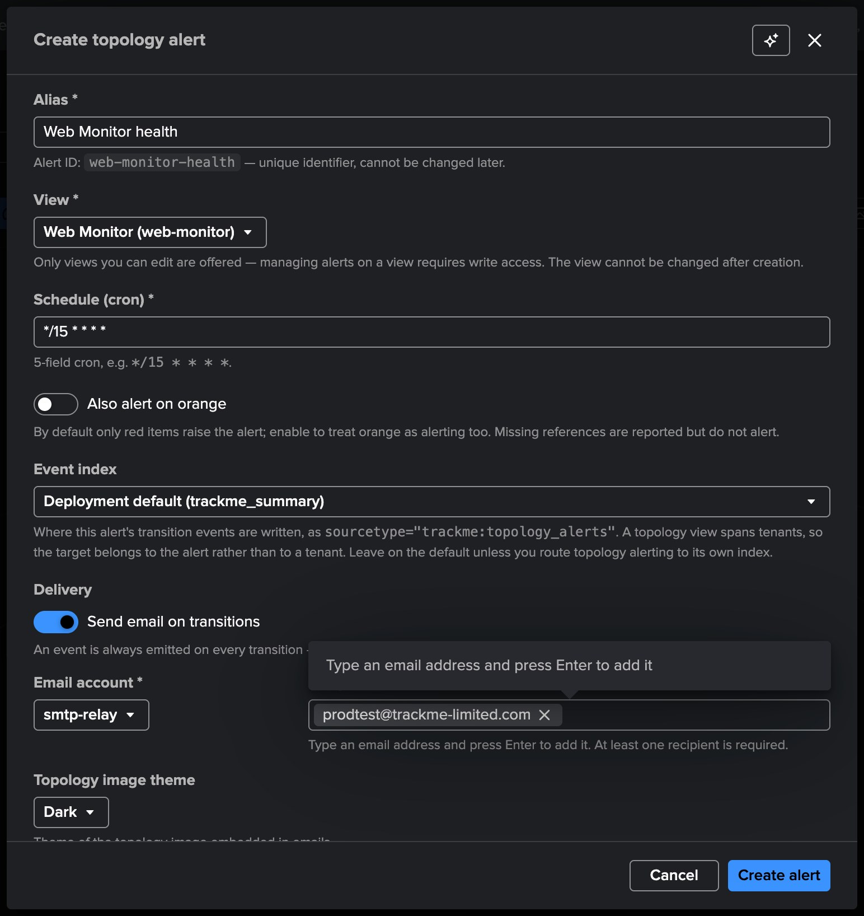
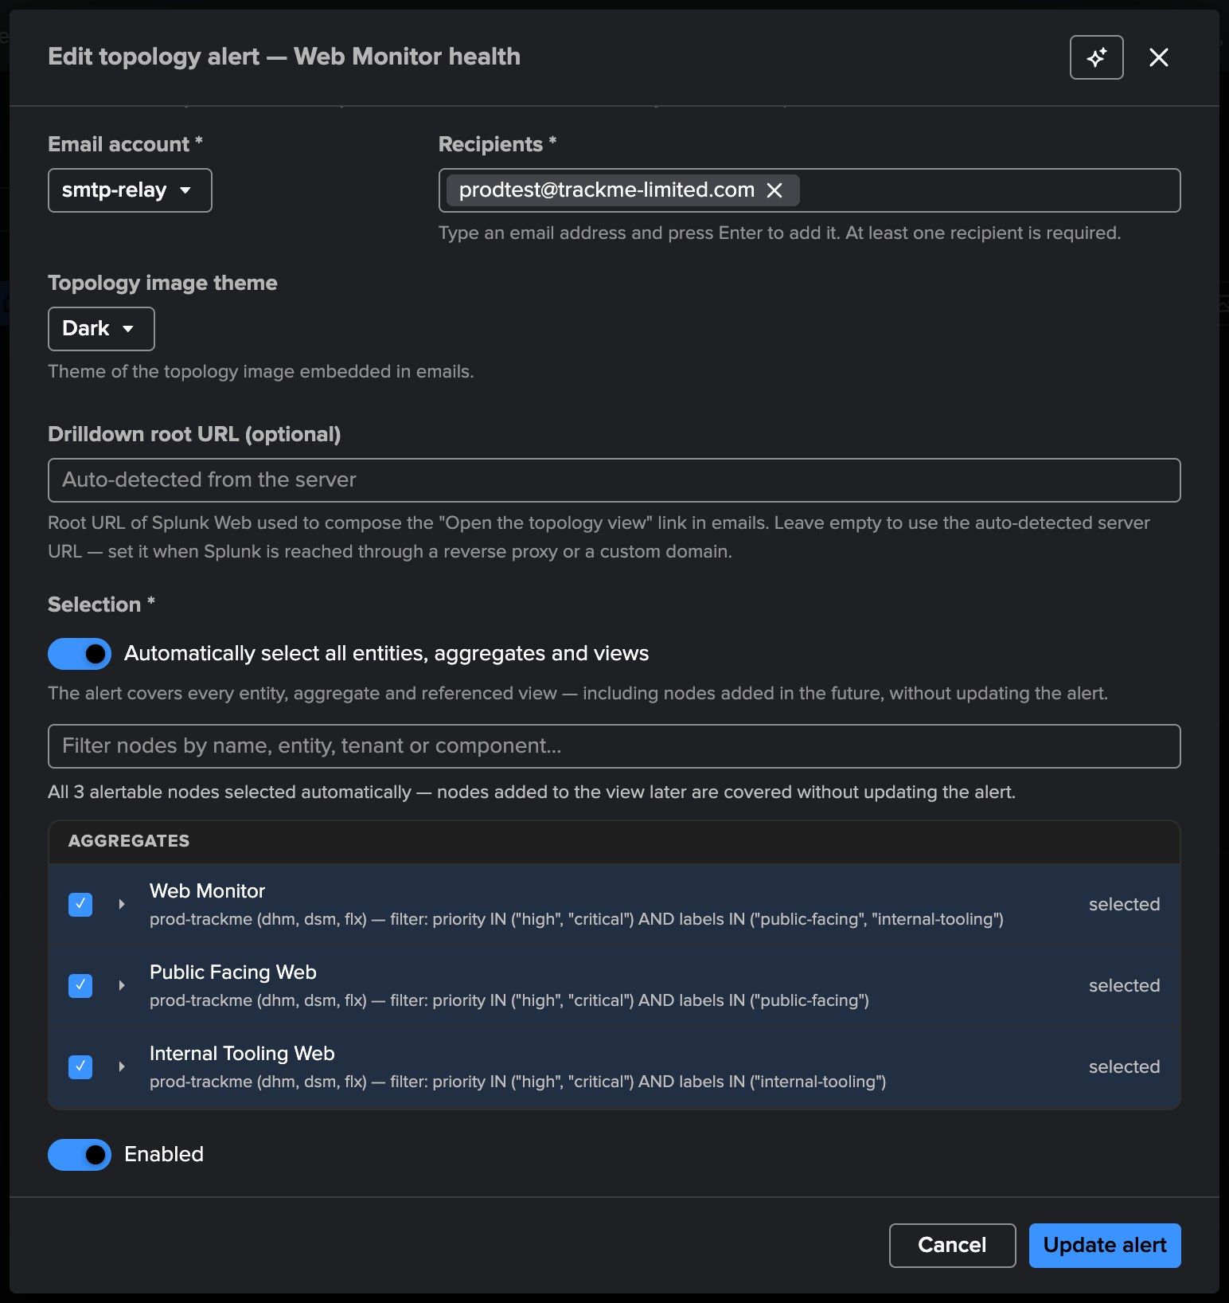
PART 3 · ALERT
A Topology Alert on Web Monitor
1
Alias
The alert id is derived from it.
1
5
2
View
2
Views you can edit only.
3
3
Schedule
4
A cron — every 15 minutes by default.
6
4
Also alert on orange
Off by default: only red opens.
5
Email on transitions
A TrackMe email account, recipients, image theme.
6
Selection
Every node, including nodes added later — or a list.
TrackMe for Splunk · Hands-on: Topology Studio
docs.trackme-solutions.com
Notes:
Alerts button in the view header, then New alert. Alias, view, schedule and whether orange counts. Every run writes a trackme:topology_alerts event on each transition; email is an extra channel with the rendered topology embedded, dark or light. The selection covers every entity, aggregate and referenced view of the map — including nodes added later — or an explicit list.

Slide 24
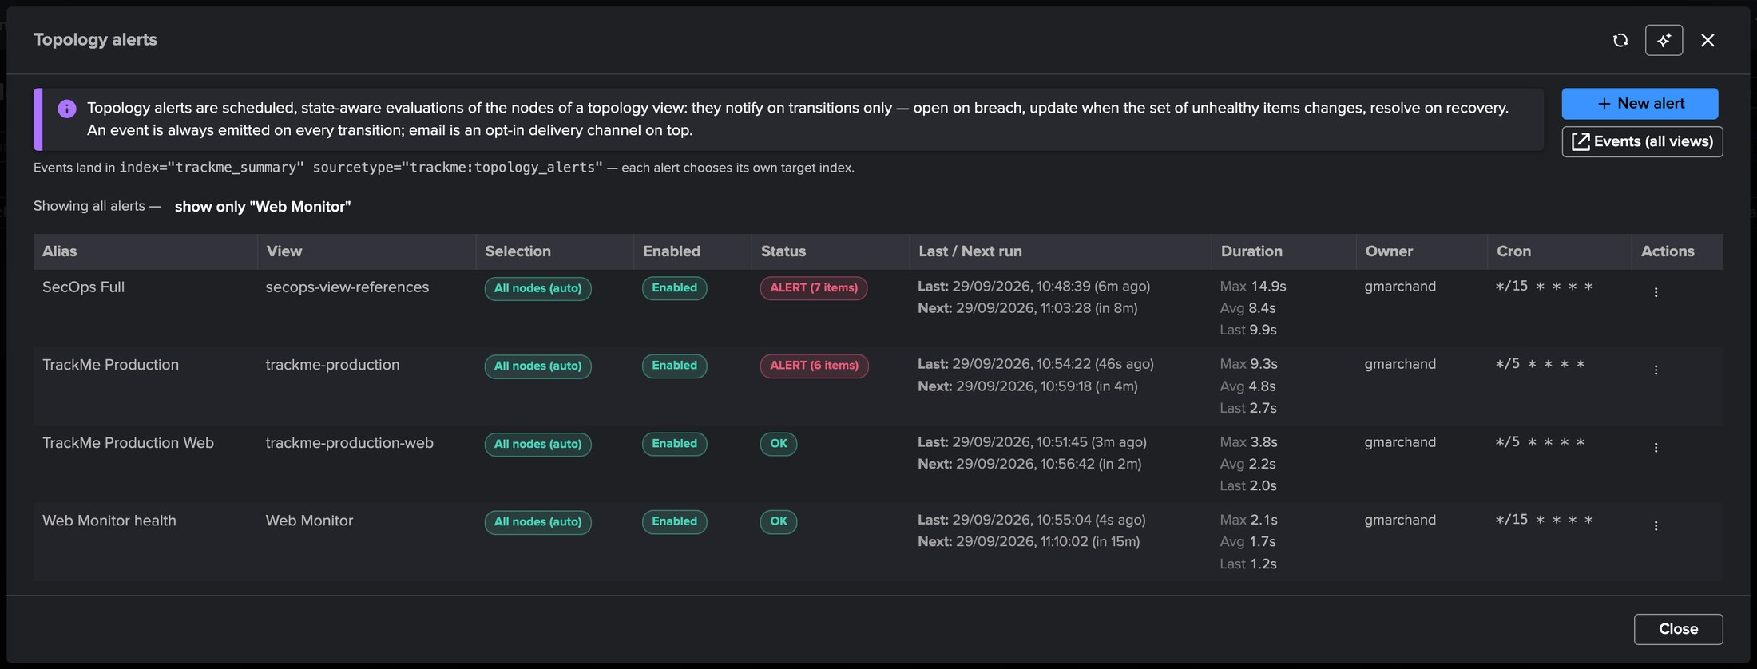
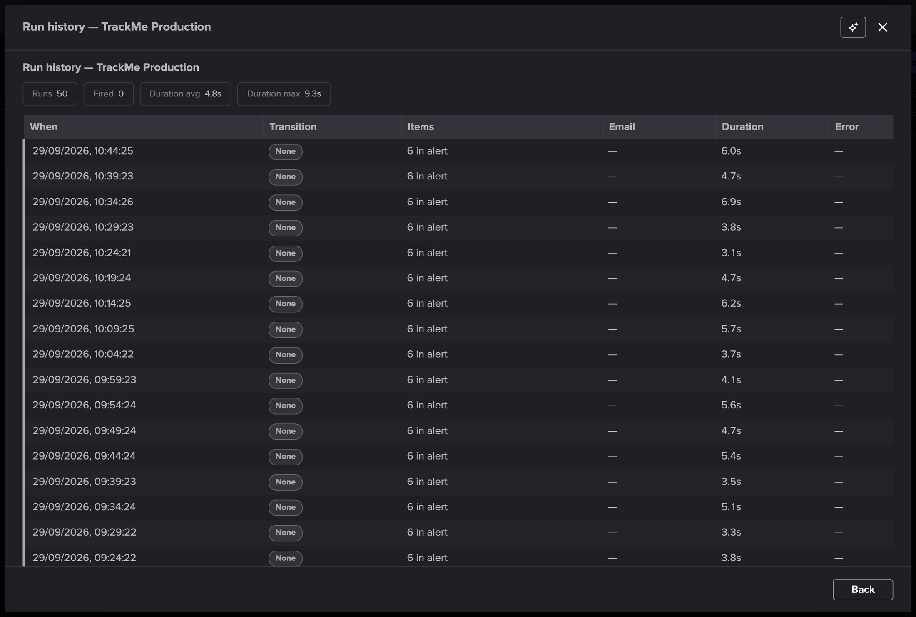
PART 3 · ALERT
Every alert, its state, its runs
4
5
6
2
1
3
1
Web Monitor health
2
ALERT (n items)
3
Last / next run
4
Events
5
Transition: None
6
Items in alert
The new alert, run once: OK.
Alerts currently open, with the number of items in alert.
Durations and schedule at a glance.
The trackme:topology_alerts events, pre-scoped.
While nothing changes, no notification — the alert stays quiet.
Recorded on every run, with email delivery and duration.
TrackMe for Splunk · Hands-on: Topology Studio
docs.trackme-solutions.com
Notes:
The alerts list for all views: two alerts are open right now, one with seven items in alert. The run history of an open alert shows the key property: transition None on every run while the set of affected items does not change — no re-notification, no noise. Row actions include Run now, Alert events, Logs, History and Ask AI.

Slide 25
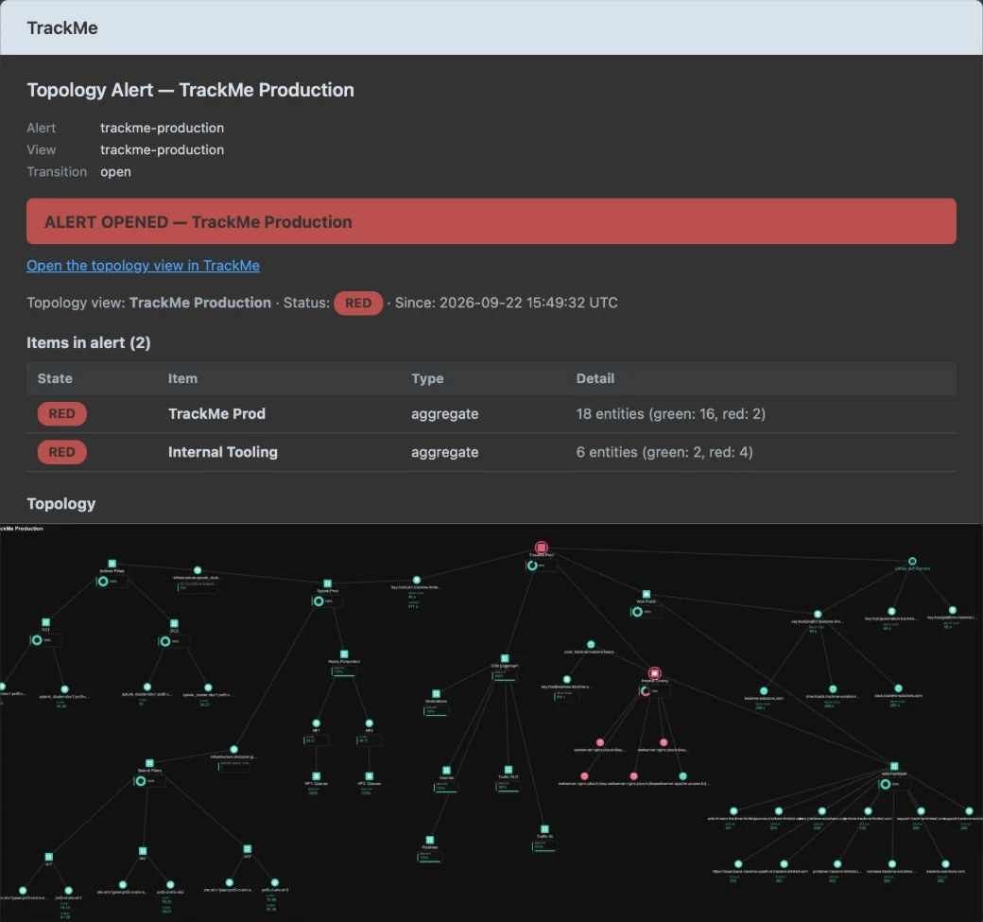
PART 3 · ALERT
The email — the map itself, where the red is
1
Alert opened
Transition open, status red, and since when.
2
Items in alert
1
Which aggregates are red, how many entities, how many of them red.
4
3
The topology
2
Rendered on the server with the same icons and KPIs — red nodes where the problem is.
4
Drilldown
Open the topology view in TrackMe, straight to the live map.
3
One thread per incident
Open, update when the set of affected items changes, resolve on recovery — never a repeat while nothing changes.
TrackMe for Splunk · Hands-on: Topology Studio
docs.trackme-solutions.com
Notes:
The email of a Topology Alert on the TrackMe Production view. When it opened, two aggregates were red; the table says which and how many entities, and the rendered map shows exactly where. The link opens the live view. An update is sent only if the set of affected items changes.

Slide 26
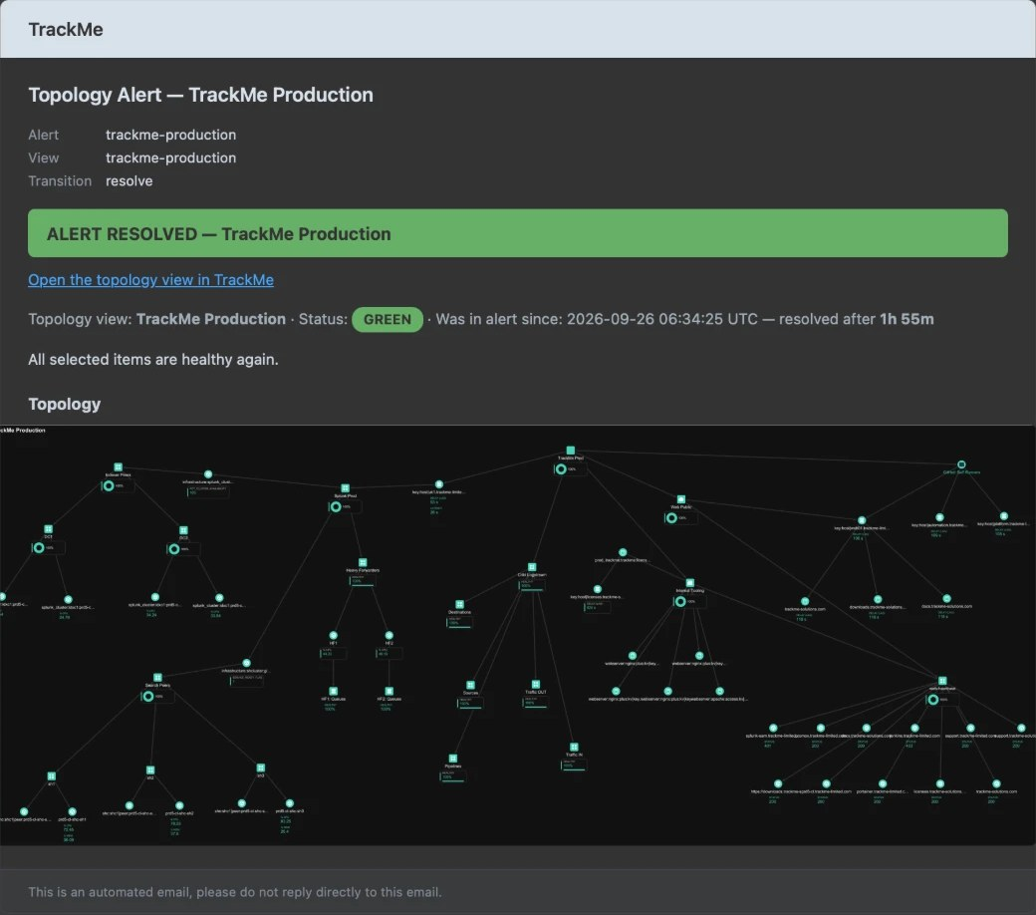
PART 3 · ALERT
Resolved — back to green, with the duration
1
Alert resolved
Transition resolve, status green.
2
How long it lasted
1
In alert since… resolved after 1h 55m — the incident duration, measured.
2
3
All green again
The same rendered map, every node back to healthy.
3
Honest by design
Missing nodes never alert; unavailable data freezes the state; a maintenance window pauses the evaluation instead of resolving it.
TrackMe for Splunk · Hands-on: Topology Studio
docs.trackme-solutions.com
Notes:
The resolution email of the same alert: back to green after one hour fifty-five. The alert state is never resolved by a data gap or a maintenance window — those freeze or pause the evaluation.

Slide 27
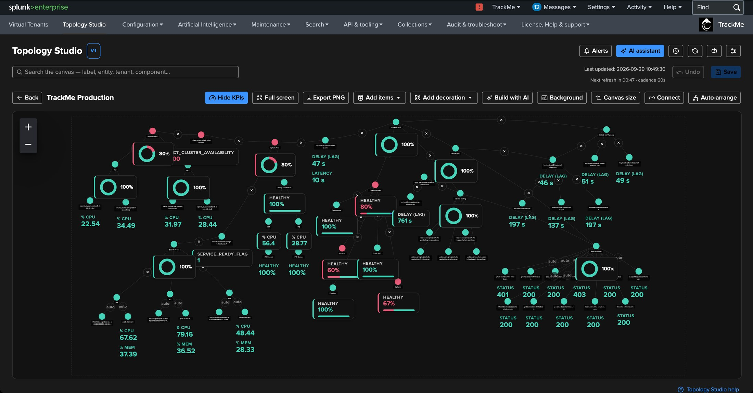
PART 3 · ALERT
The same map, live — where the red is
1
Red members
Drawn by their aggregates, worst states first.
2
Donut KPIs
1
Member-state distribution of an aggregate.
2
3
Aggregates in alert
3
Healthy percentage below the threshold.
4
Entity KPIs
4
CPU, memory, delay — the numbers behind the colours.
TrackMe for Splunk · Hands-on: Topology Studio
docs.trackme-solutions.com
Notes:
The TrackMe Production view while its alert is open: thirty-five nodes over several tenants and components. The red is where the email said it would be. The live map and the email tell the same story because they are the same map.

Slide 28
04
PART 4 · AI
Describe the map — let the AI build the draft
Build with AI turns a sentence into a live draft on a preview canvas. You refine it in plain words, then create the view. Nothing is saved until you do.
TrackMe for Splunk · Hands-on: Topology Studio
Notes:
Part 4. Build with AI. A dedicated AI builder agent reads the inventory of the tenants you select and proposes a draft, compiled and validated like a manual save.

Slide 29
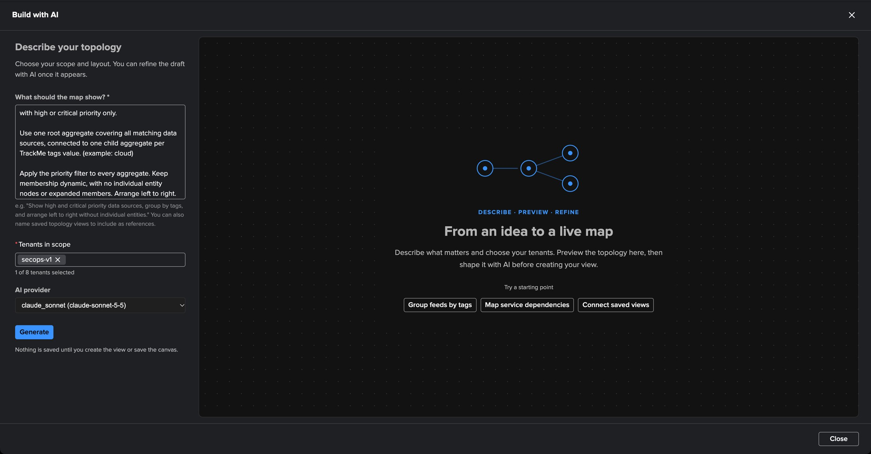
PART 4 · AI
Build with AI — one prompt, a tenant, a provider
1
What should the map show?
A “SecOps Feeds” topology for high and critical DSM entities, one root aggregate, one child per TrackMe tags value, dynamic membership, no individual entities, left to right.
1
Tenants in scope
2
Up to eight: secops-v1 here.
2
3
AI provider
Any configured provider — Claude Sonnet here.
3
4
4
Generate
The builder streams its progress; nothing is saved.
Starting points
Group feeds by tags · Map service dependencies · Connect saved views — ready prompts on the empty canvas.
TrackMe for Splunk · Hands-on: Topology Studio
docs.trackme-solutions.com
Notes:
The prompt we use in every demo: a SecOps Feeds topology for DSM entities with high or critical priority, one root aggregate, one child aggregate per TrackMe tags value, the priority filter on every aggregate, dynamic membership, no individual entities, left to right. One tenant in scope, and the provider of your choice.

Slide 30
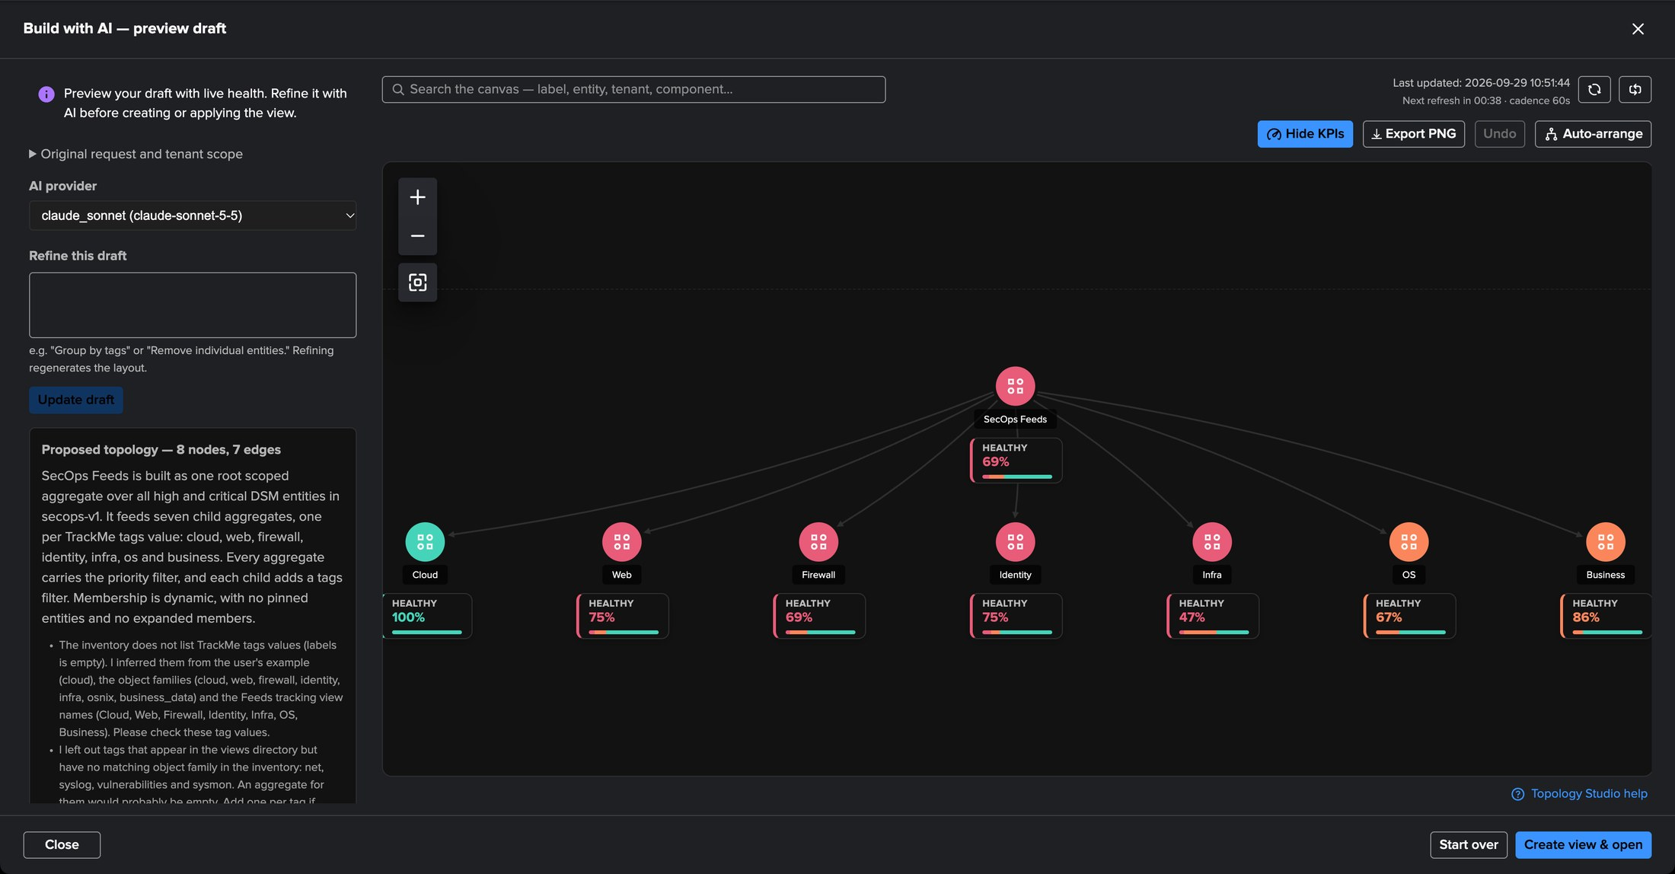
PART 4 · AI
The draft — live health, and the AI says what it assumed
1
SecOps Feeds
The root scoped aggregate over high and critical DSM entities.
2
One child per tag
4
cloud, web, firewall, identity, infra, os, business — each with the priority filter.
1
3
What it assumed
The inventory lists no tag values: it inferred them — and says so.
2
4
Refine this draft
3
Follow-up instructions in plain words.
5
Create view & open
5
Only then is anything saved.
TrackMe for Splunk · Hands-on: Topology Studio
docs.trackme-solutions.com
Notes:
The first draft arrives in about twenty seconds, on a live preview canvas with real health. The summary explains the structure and, honestly, what it had to infer: the inventory the builder receives carries priorities and labels but not tag values, so it derived them from the data source families and left out three tags it could not confirm. That is exactly what the refine box is for.

Slide 31
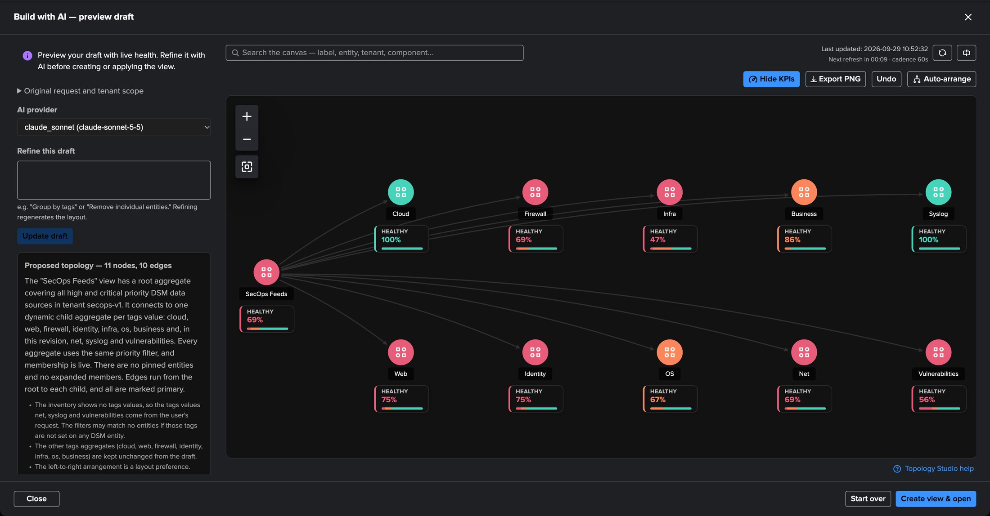
PART 4 · AI
Refine in plain words, arrange left to right
1
The root
Unchanged — refining regenerates the draft, not your intent.
3
2
net, syslog, vulnerabilities
“Also add child aggregates for the net, syslog and vulnerabilities tags values” — done.
4
1
3
Auto-arrange
Left to right, spacious: the layout direction is a canvas setting.
2
4
11 nodes, 10 edges
The updated summary of the draft.
Good to know
The builder always lays out top-down; the direction is one click in Auto-arrange. For a guaranteed split by tag, the Tenant Home hierarchy of Part 1 is the other road to the same map.
TrackMe for Splunk · Hands-on: Topology Studio
docs.trackme-solutions.com
Notes:
One refinement: add the three missing tags. The draft updates in place; a failed refinement would keep the previous draft. The builder lays the draft out top-down, so we choose left to right in Auto-arrange — one click. Note that Part 1 produced the same map from Tenant Home with the Tags hierarchy: two roads, same destination.

Slide 32
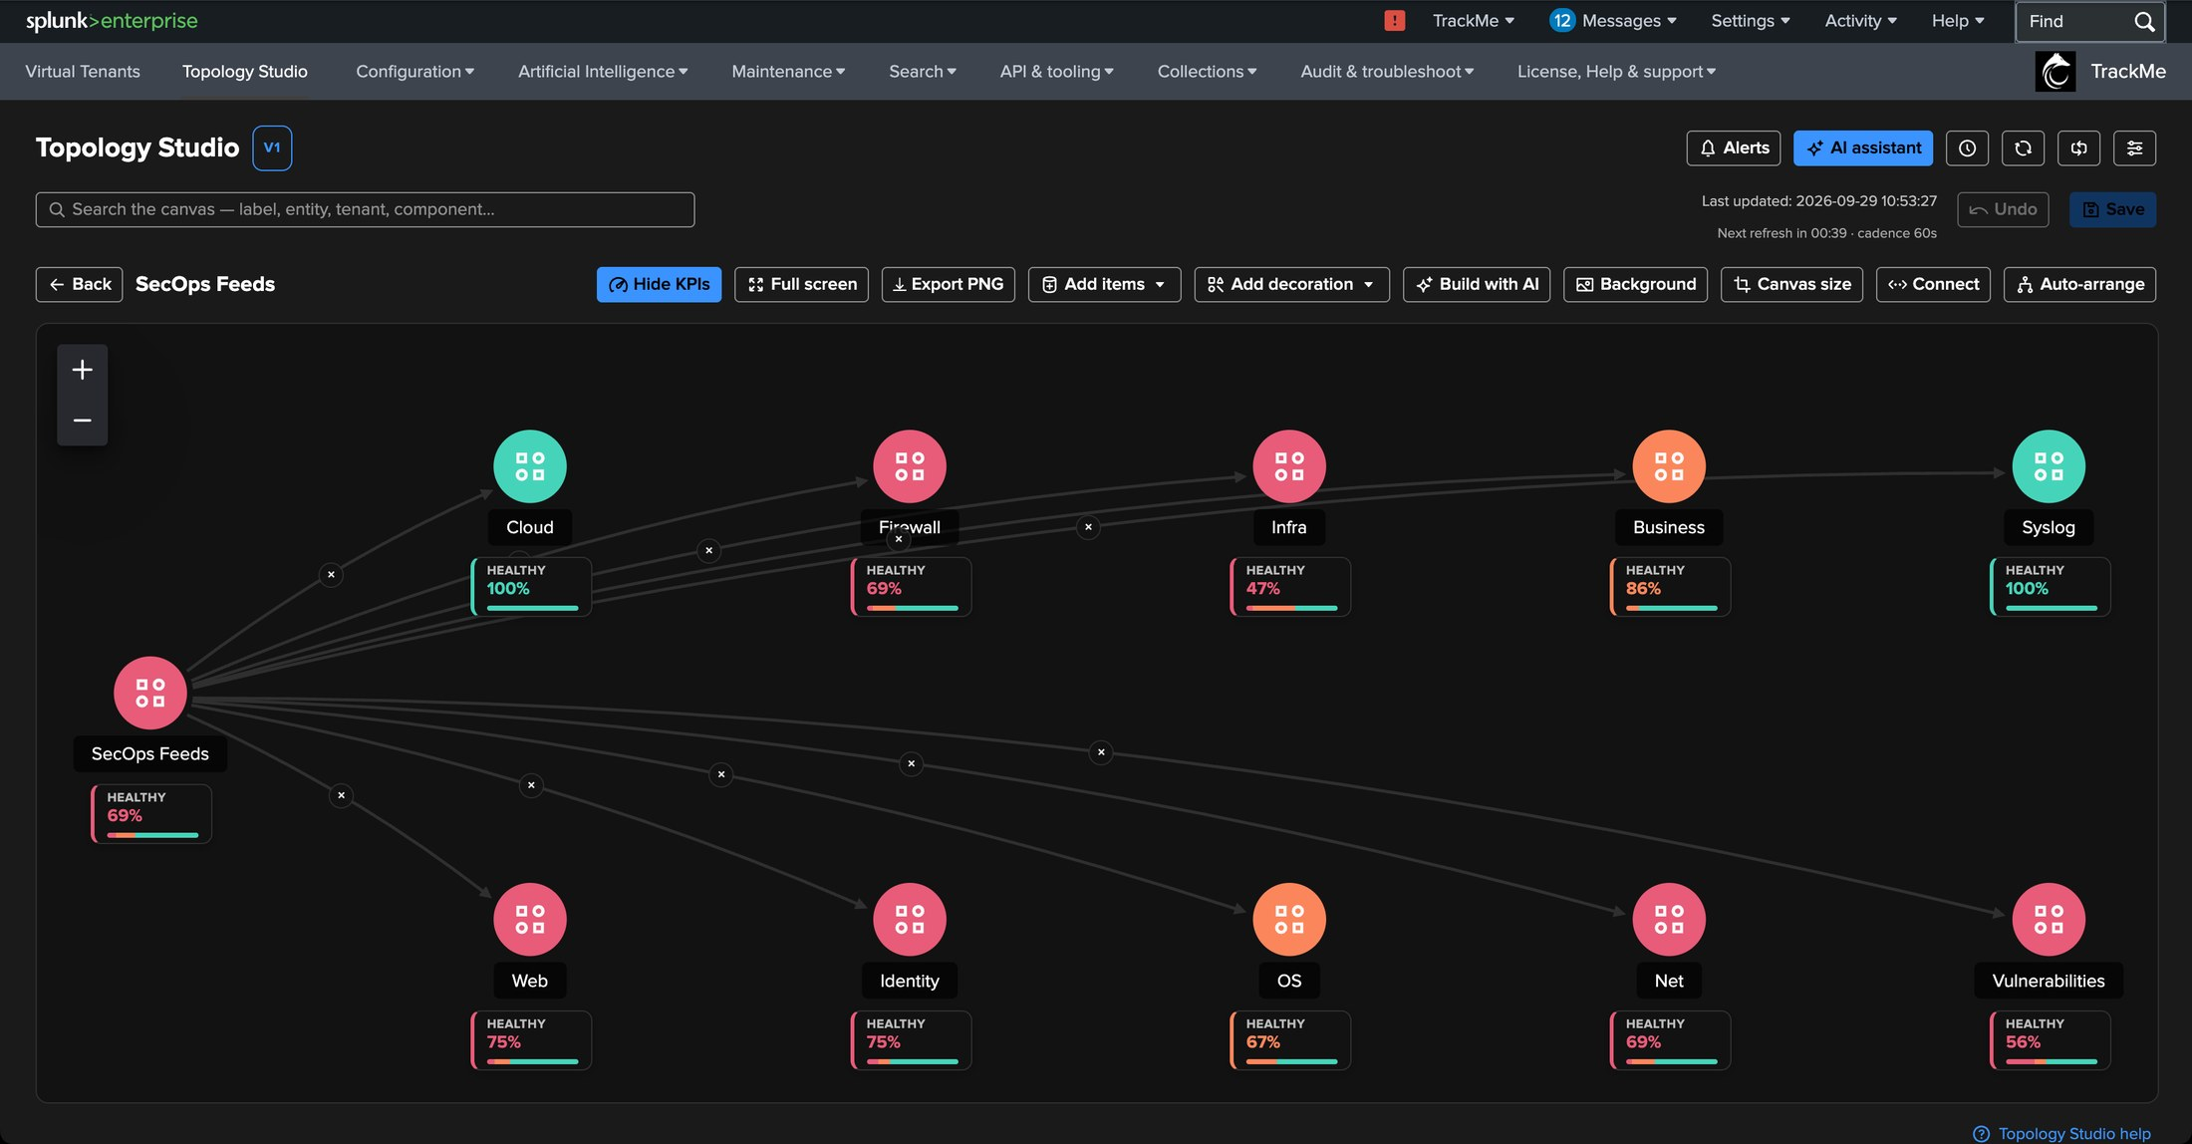
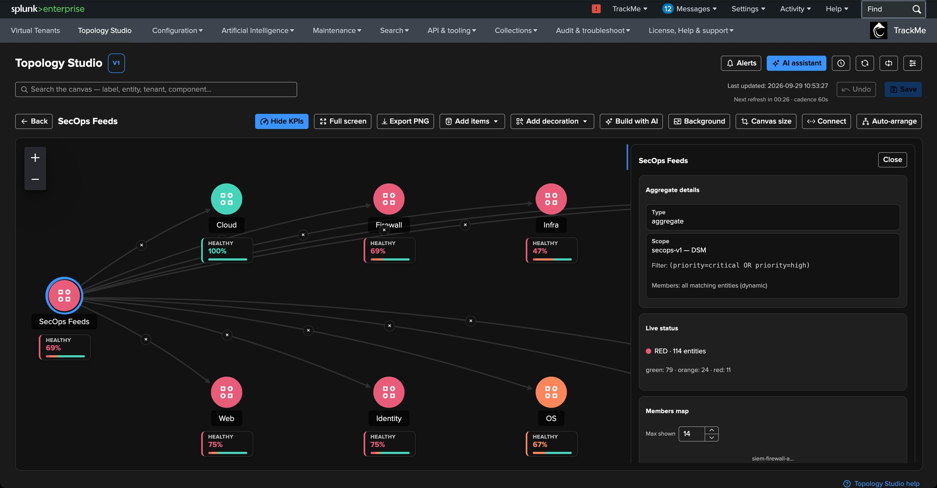
PART 4 · AI
Created — a view like any other
2
3
1
4
1
SecOps Feeds
2
Children with KPIs
3
Scope and filter
4
Live status
Saved, opened, with live health on every node.
Healthy percentage per tag.
secops-v1 · DSM · priority critical or high — dynamic membership.
The same entities as the Tenant Home map of Part 1.
TrackMe for Splunk · Hands-on: Topology Studio
docs.trackme-solutions.com
Notes:
Create view and open saves the draft as a regular view: editable, versioned, shareable, alertable. The inspector of the root shows the scope and the filter the AI wrote — and the live status covers the same entities as the map we generated from Tenant Home in Part 1.

Slide 33
05
IN PRODUCTION
Maps that run every day
A Cribl pipeline, a public web estate, and a map of maps over the Splunk infrastructure — with a drilldown from the top view to the reason.
TrackMe for Splunk · Hands-on: Topology Studio
Notes:
To close, three maps that run every day on the deployment we captured from.

Slide 34
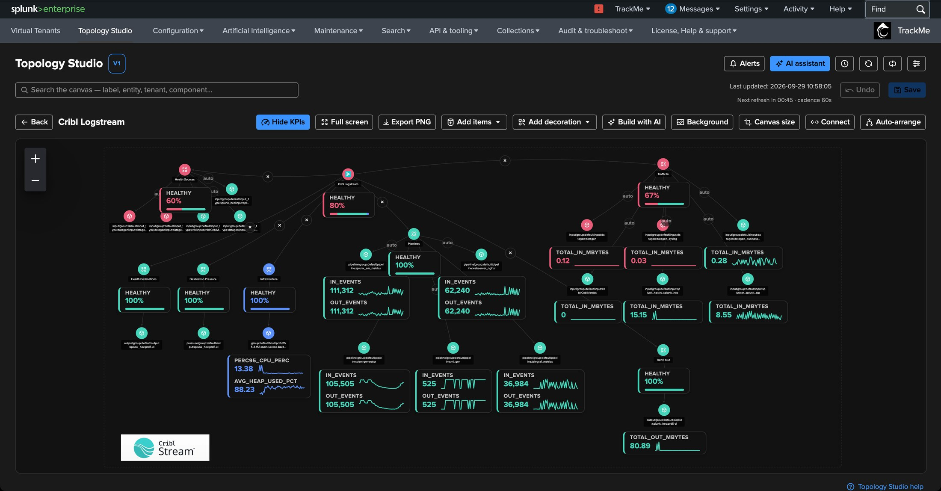
IN PRODUCTION
Cribl Stream — a pipeline, from sources to destinations
1
Aggregates by stage
Worker groups, sources and destinations as live aggregates.
2
In / out events
1
KPIs with sparklines on every route.
3
3
A destination in red
Its throughput KPI next to its colour.
4
Decoration
The vendor logo, placed on the canvas.
2
4
TrackMe for Splunk · Hands-on: Topology Studio
docs.trackme-solutions.com
Notes:
A Cribl Stream pipeline mapped from TrackMe entities: worker groups, sources, routes and destinations, with events in and out and throughput as KPIs. A red destination shows its throughput next to its colour — the map reads like the pipeline itself.

Slide 35
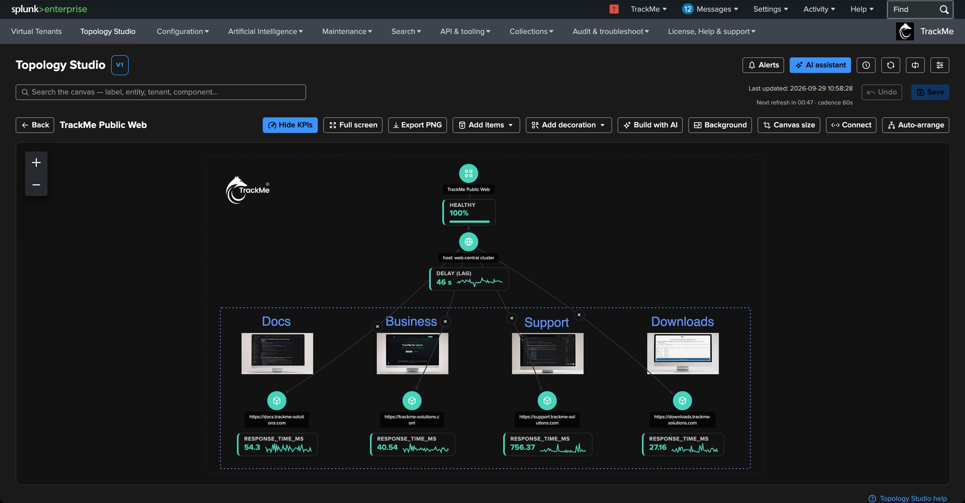
IN PRODUCTION
A public web estate — screenshots as decorations
1
The estate
One aggregate over the public web properties.
2
Image decorations
1
A screenshot of each site above its heartbeat check.
3
Shapes
A dashed zone around the web front ends.
3
2
4
Response time
Sparkline KPIs on every heartbeat.
4
TrackMe for Splunk · Hands-on: Topology Studio
docs.trackme-solutions.com
Notes:
Decorations turn a map into a picture people recognise: here a screenshot of each public site, a dashed zone and the logo. Decorations never affect health, and they appear in PNG exports and in alert emails.

Slide 36
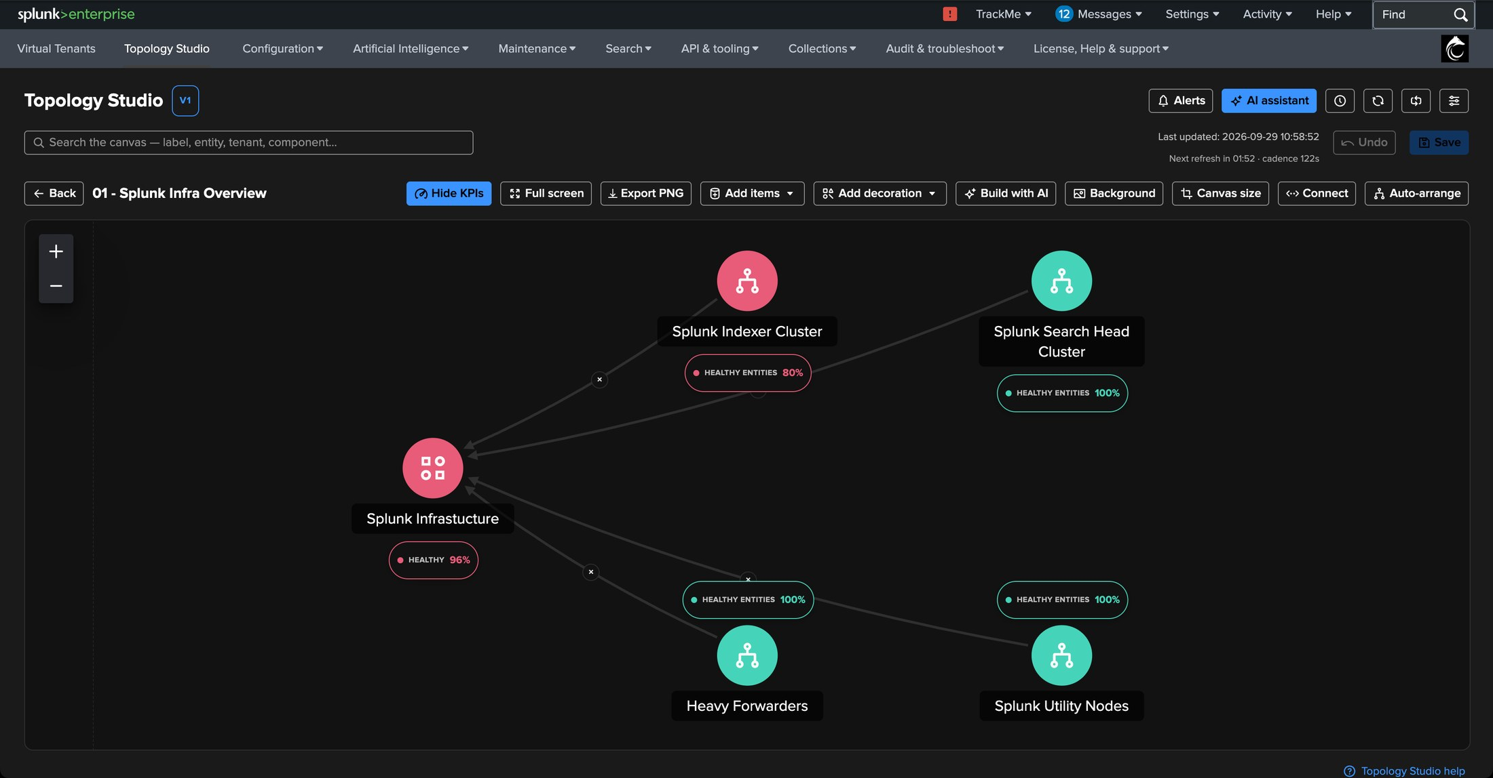
IN PRODUCTION
A map of maps — the Splunk infrastructure at a glance
1
Splunk Infrastructure
An aggregate over the whole platform.
2
A view node in red
2
3
The Splunk Indexer Cluster view, folded into one node.
4
3
Other views
Search head cluster, heavy forwarders, utility nodes — each its own map.
1
4
Healthy entities
Unique entities across the nested views, counted once.
TrackMe for Splunk · Hands-on: Topology Studio
docs.trackme-solutions.com
Notes:
The top view of the Splunk infrastructure: each node is another saved view — indexer cluster, search head cluster, heavy forwarders, utility nodes. One of them is red right now. A view node counts unique underlying entities across nested views and follows their policies.

Slide 37
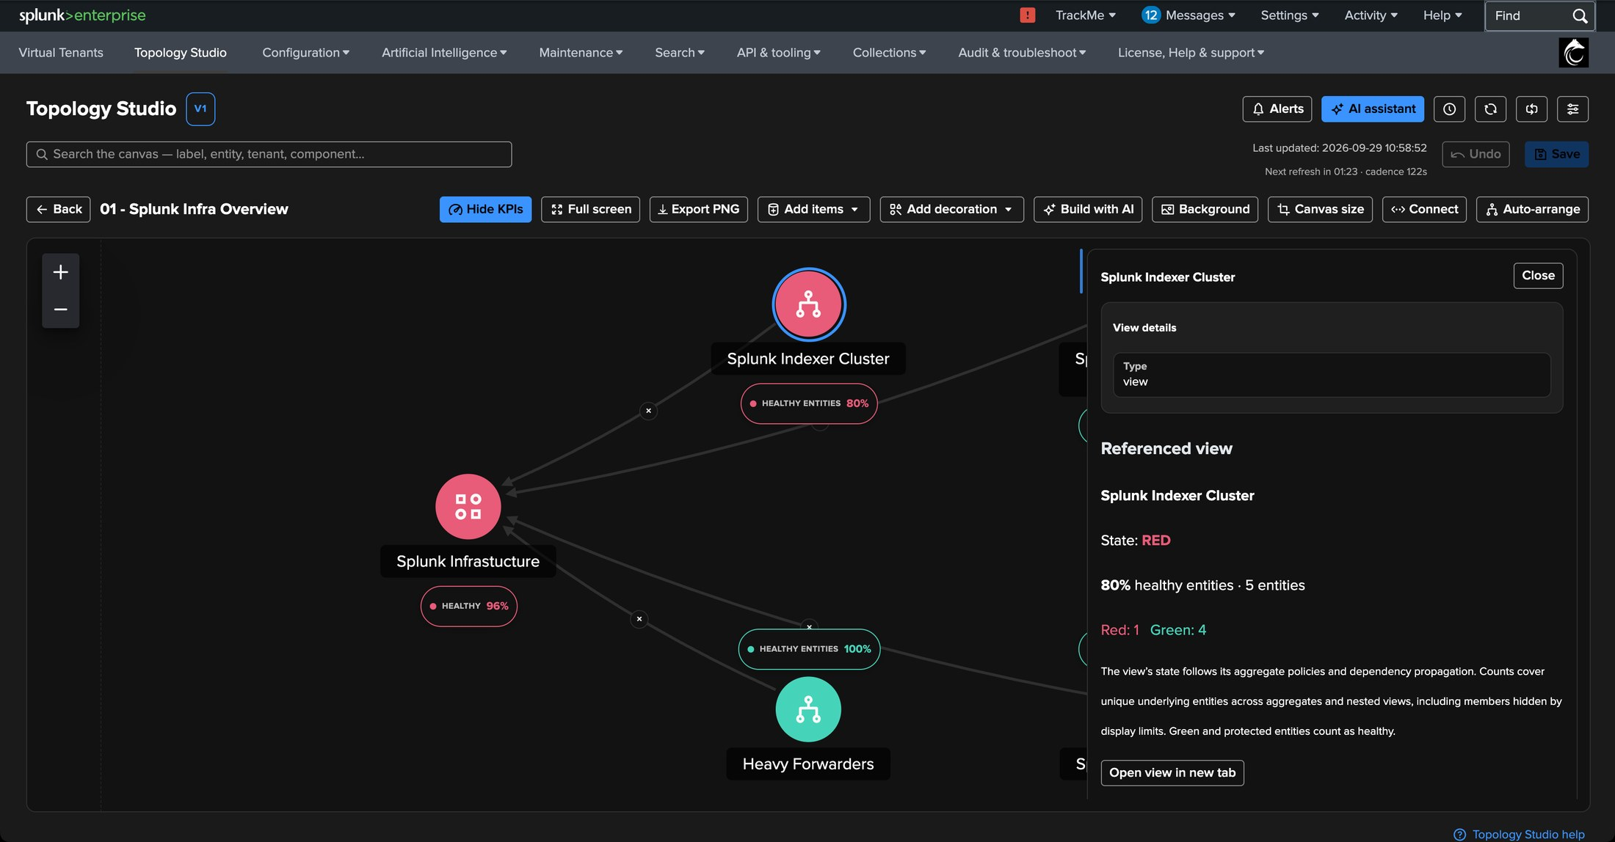
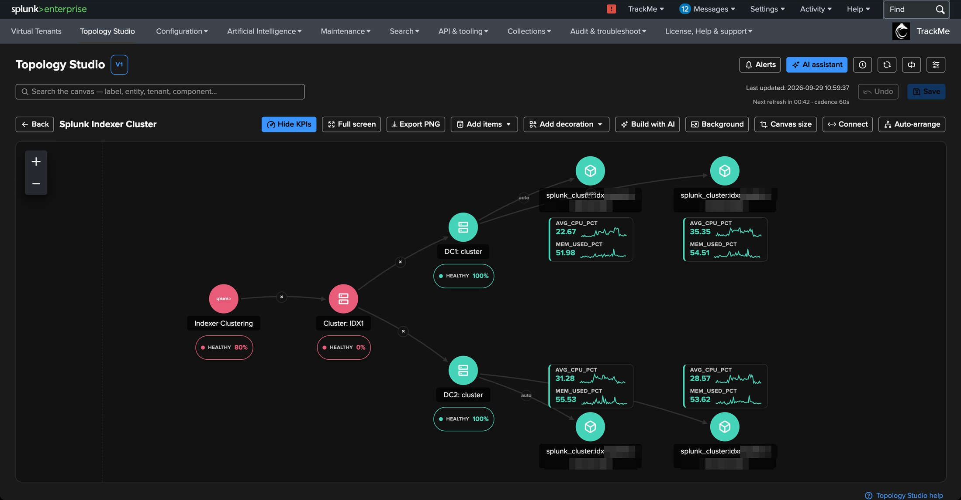
IN PRODUCTION
Drill down — from the view node to the view
1
6
2
5
3
4
1
The red view node
2
Referenced view
3
Red: 1 · Green: 4
4
Open view
5
Cluster: IDX1
6
Peers and sites
Splunk Indexer Cluster, selected.
Its state and healthy entities.
Unique entities of the nested view.
Straight into the referenced map.
The red node inside: the cluster itself.
All healthy, with CPU and memory sparklines.
TrackMe for Splunk · Hands-on: Topology Studio
docs.trackme-solutions.com
Notes:
The drilldown. Selecting the red view node shows the referenced view: red, one red entity out of five. Opening it shows the indexer cluster: both sites and every peer are healthy — the red node is the cluster itself.

Slide 38
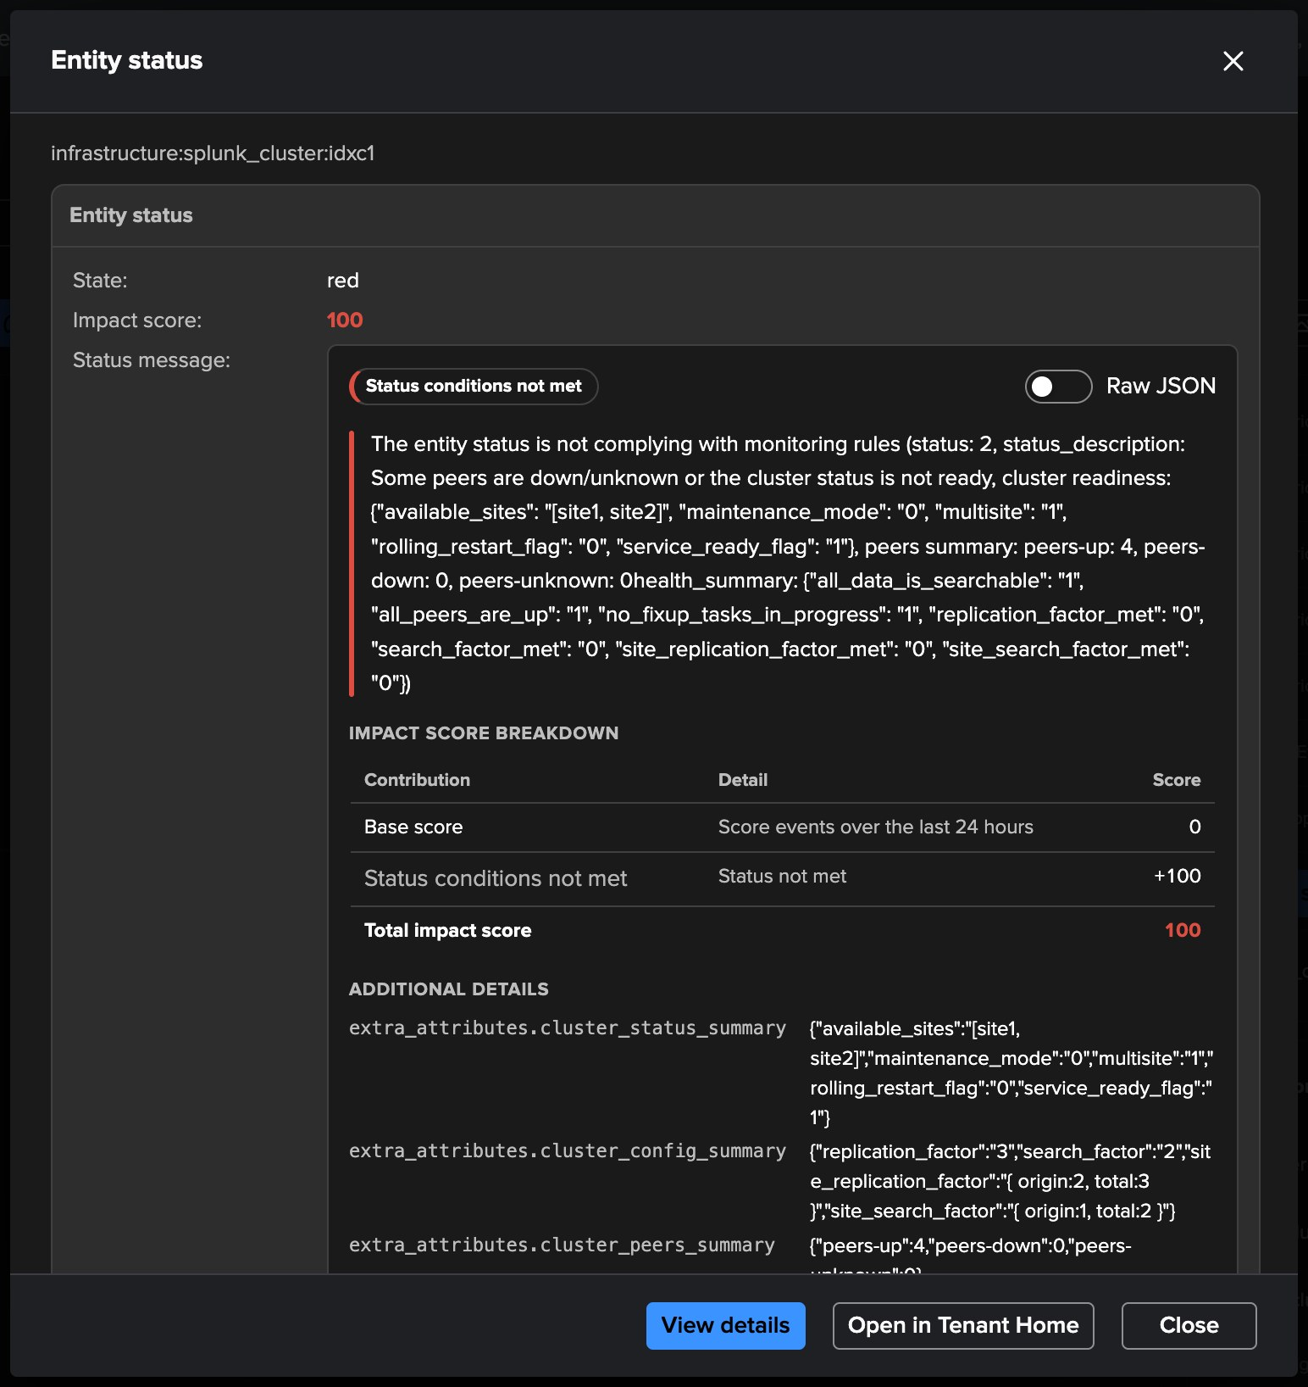
IN PRODUCTION
View status — the reason, in plain words
1
Status message
Some peers are down or the cluster is not ready: replication factor and search factor not met.
2
Impact score breakdown
3
Status conditions not met: +100 — red.
3
Raw JSON
1
The structured status behind the view.
4
Additional details
2
Cluster status, configuration and peers summaries — the evidence.
4
Three clicks
From the top view of the platform to the exact reason: view node, cluster, View status.
TrackMe for Splunk · Hands-on: Topology Studio
docs.trackme-solutions.com
Notes:
View status on the red member opens the entity status: the cluster reports that its replication and search factors are not met, and the score breakdown explains the red. From the top of the platform to the exact reason in three clicks — the same status message the alert and the AI Assistant use.

Slide 39
RECAP
Where we are
In four parts
Generated
Authored
Alerted
Built with AI
a map of a tenant from Tenant Home — per index, then per tag, narrowed to high and critical, saved as a view
Web Monitor from an empty canvas: a root aggregate, two children by label, members drawn with KPIs and sparklines
a Topology Alert on the view: transitions only, the rendered map in the email, runs and events recorded
SecOps Feeds from one prompt, refined in plain words, arranged left to right, created as a view
What made it work
Made of real entities
Membership that follows
Alerts on the service
Every node is a TrackMe entity, aggregate or view — the map cannot drift from what is monitored, and it colours itself.
Aggregates are filters, not lists: new matching entities join, retired ones leave, and members draw themselves.
Transitions only, frozen during maintenance and data gaps, with the map in the email — one signal per service.
TrackMe for Splunk · Hands-on: Topology Studio
docs.trackme-solutions.com
Notes:
Recap. Four ways to a live map: generated from a tenant, authored with aggregates and auto-generated members, alerting on the service it draws, and built from a sentence with AI — and maps of maps that take you from the top of the platform to the reason in a few clicks. What made it work: maps made of real entities, aggregates that keep membership dynamic, and alerts that speak on transitions only.

