Slide 1

HANDS-ON WALKTHROUGH · SPLUNK UF FLEET
Which forwarding agents are connected — at any fleet size?
One tenant follows the forwarding agents of a Splunk deployment and the Deployment Servers that manage them, from what Splunk already writes: the receivers' own lines, the agents' logs, the Deployment Server indexes.
Captured live on TrackMe 2.4.22 · twenty universal forwarders on four sites and five UF generations, a Deployment Server cluster
Notes:
Hands-on walkthrough of the Splunk UF Fleet tenant, generally available in TrackMe 2.4.22. Everything was captured live on a fleet of twenty universal forwarders named after their site and service, in London, Paris, New York and a development site, on five UF generations from 9.4 to 10.6, managed by a cluster of two Deployment Servers. In four parts: create the tenant, configure it, follow the fleet and its Deployment Servers, and read the findings of agents stopped on purpose.

Slide 2
THE PROBLEM
A forwarder that stops sending says nothing — until the data is missed
Thousands of agents, a few Deployment Servers, and no single place that says which agent stopped, why, and whether it is one agent or a whole site.
Agents that go quiet
Agents in trouble
Deployment Servers
A disconnected agent, an expected one missing, a whole group gone at once.
Output blocked, destinations failing, throttled, restarting in a loop, app deployments failing.
Silent, phonehomes below their usual, deployment failures, restart storms, configuration errors.
What a Splunk UF Fleet tenant does
A dedicated tenant type for the fleet of one Splunk deployment. An agent is connected when a receiver saw its connection in the connected window: the data path itself, read from the receivers' own lines. TrackMe never polls an agent, never calls its REST API, never installs anything on it; twenty-eight built-in policies judge the agents, the fleet and its groups, the Deployment Servers and the destinations.
TrackMe for Splunk · Hands-on: Splunk UF Fleet
docs.trackme-solutions.com
Notes:
A Splunk administrator asks the same fleet questions every day: how many agents do I have, on which versions and platforms, which are connected, disconnected or dormant, which agents that must stay connected are not, which are blocked, throttled, failing their destinations or their app deployments, and is each Deployment Server answering its clients at its usual pace. The Splunk UF Fleet tenant answers them with findings raised by built-in policies.

Slide 3
THE MODEL
The receivers describe the fleet — the agents are never polled
1
Source
2
Directory
3
Measure
4
Decide
5
Act
Receivers' connection lines, agents' own logs, Deployment Server indexes (Splunk 9.2+).
GUID first, host name as display; enrichment from your CMDB; groups.
Every 5 minutes: connected set, agents' troubles, Deployment Server pace and failures.
28 built-in policies on agents, groups, the fleet, Deployment Servers and destinations.
Finding groups, notifications, findings actions, the AI Agent, Topology Studio.
›
›
›
›
Agent states
Connected, disconnected, dormant after 7 days (out of every count), removal candidate after 30 days: an agent's state comes from its last connection line, never from a heartbeat you must deploy.
Built for any fleet size: aggregations over indexed terms and metric dimensions, never a search per agent; no per-agent history written.
TrackMe for Splunk · Hands-on: Splunk UF Fleet
docs.trackme-solutions.com
Notes:
The model. The receivers write a connection line for every sender; the agents forward their own logs; the Deployment Servers write their phonehomes, clients and app events. TrackMe merges the three into one agent directory, reads the connected set every five minutes, and judges the agents, the groups, the fleet and the Deployment Servers. A mass disconnection is one finding on the group, never hundreds.

Slide 4
THE PLAN
What we are going to do — one tenant, four parts
PART 1
PART 2
PART 3
PART 4
Setup
Configure
The fleet
Findings
The Splunk UF Fleet card
Enrichment from a CMDB
Agents, one agent up close
A site goes dark
Deployment Server API accounts
Groups and expected agents
Deployment Servers
An expected agent missing
Scope and discovery
Notifications
The policies
The AI Agent
Every screen is the product as shipped, on twenty universal forwarders named site-service-number.
TrackMe for Splunk · Hands-on: Splunk UF Fleet
docs.trackme-solutions.com
Notes:
Four parts. Setup: the wizard, the Deployment Server API accounts, the scope. Configure: enrichment from a CMDB, groups proposed from the Deployment Servers and the enrichment, expected agents, notifications. The fleet: the agents, one agent up close, the Deployment Servers, the policies. Findings: agents stopped on purpose, a group mass disconnect and an expected agent missing.

Slide 5
01
PART 1 · SETUP
One source, two Deployment Servers, one scope
The Splunk UF Fleet card, the Deployment Server API accounts checked as you add them, the scope of the fleet and the agent discovery.
TrackMe for Splunk · Hands-on: Splunk UF Fleet
Notes:
Part one: setup. A Splunk UF Fleet tenant reads one deployment: its local search tier, or another deployment through a TrackMe remote account.

Slide 6
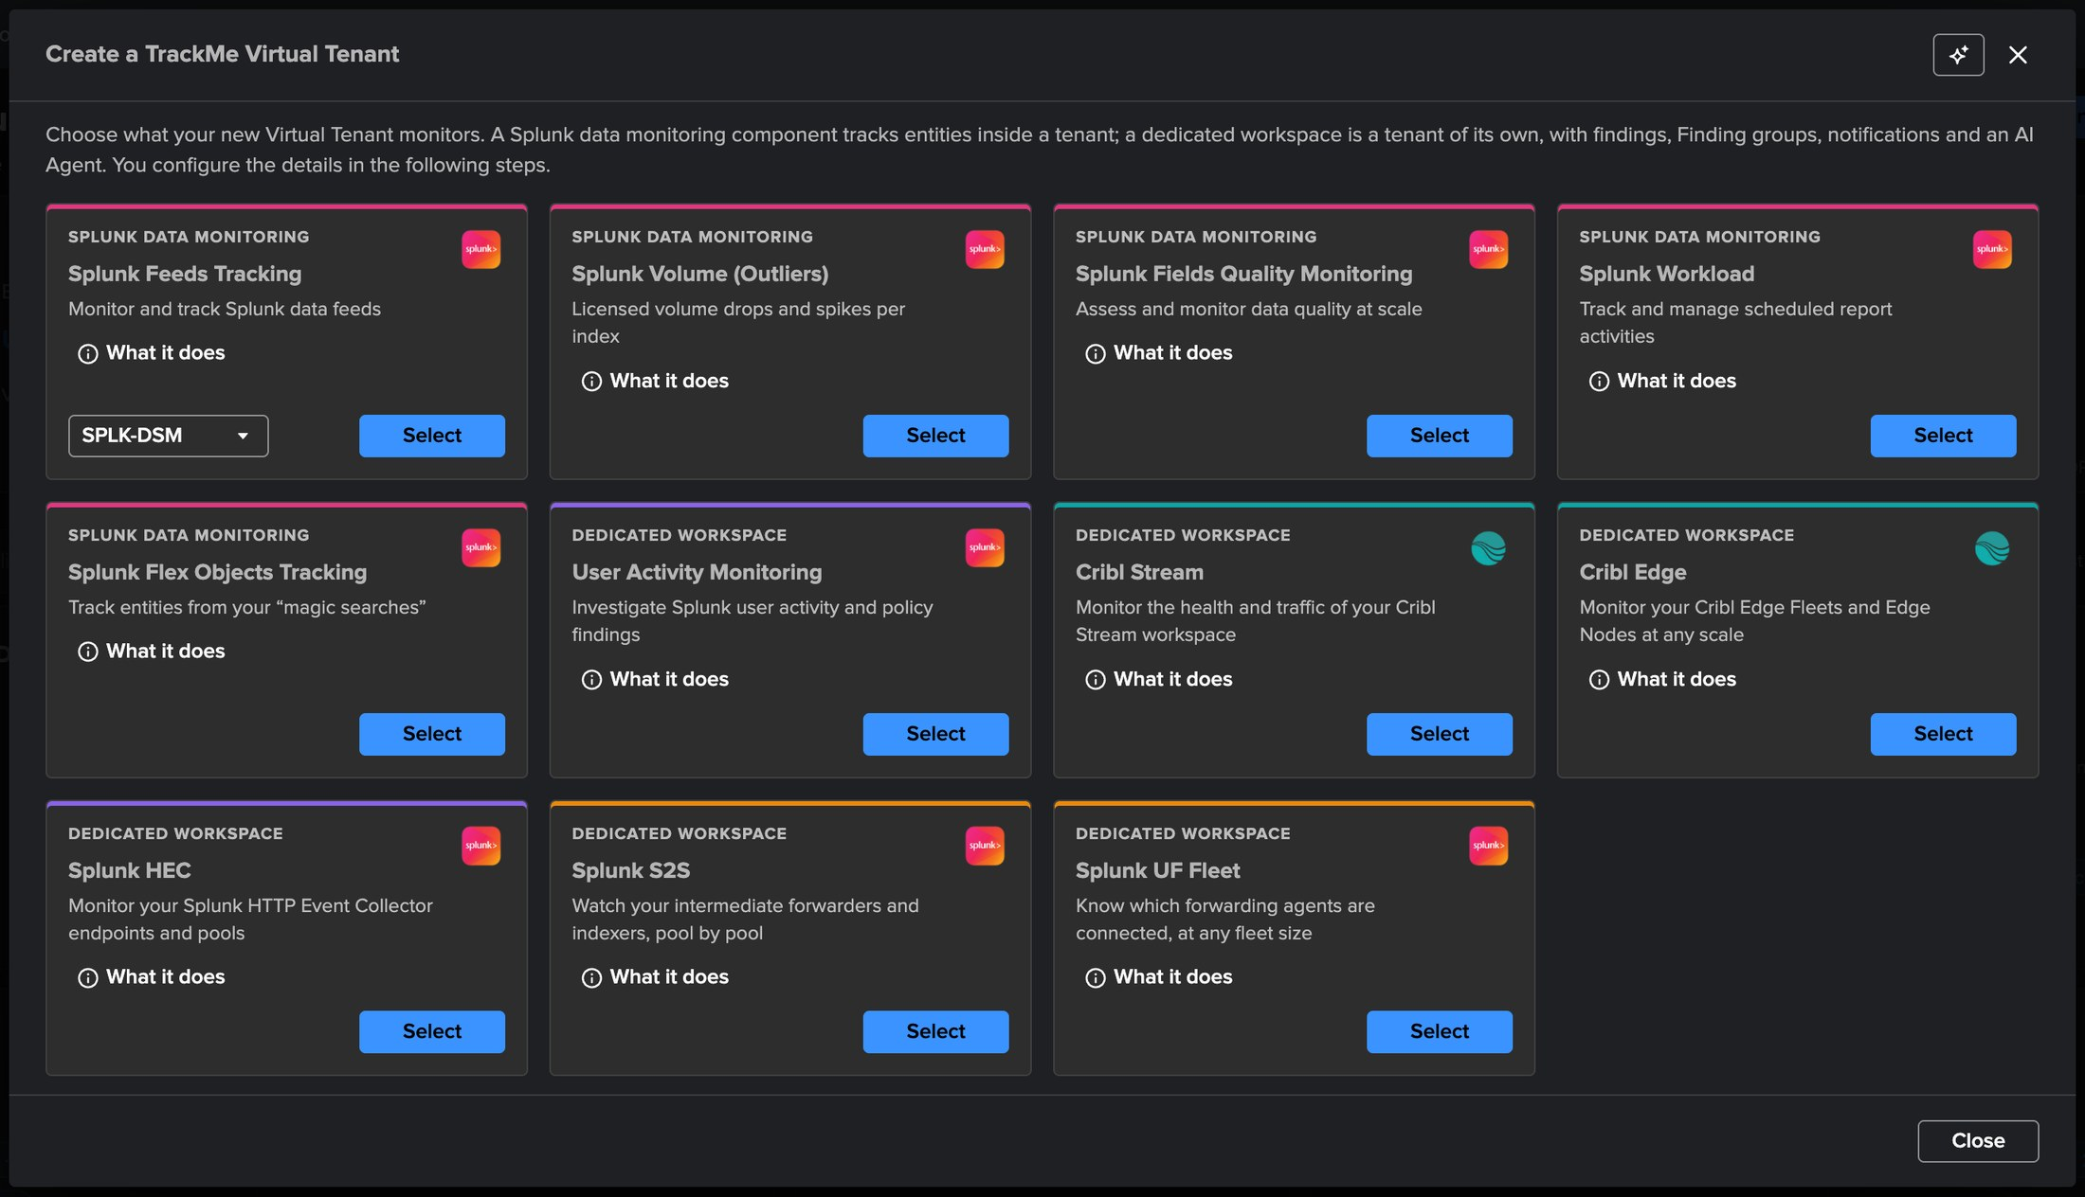
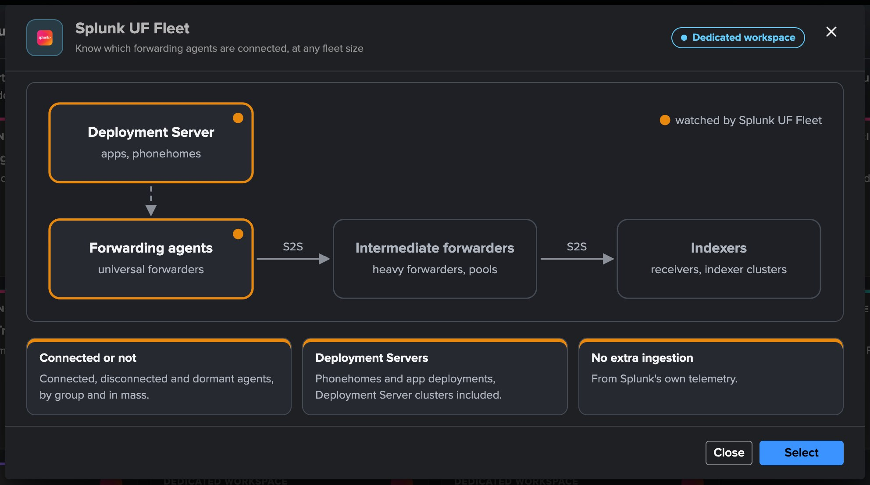
PART 1 · SETUP
A dedicated tenant — pick Splunk UF Fleet
1
The Splunk UF Fleet card
3
Four steps
Know which forwarding agents are connected, at any fleet size.
Basics, Source & scope, Indexes & RBAC, Review.
2
What it does
4
Licence
The Deployment Server and the forwarding agents, watched by Splunk UF Fleet.
Enterprise, Unlimited, the Unlimited trial or Developer; not Foundation.
TrackMe for Splunk · Hands-on: Splunk UF Fleet
docs.trackme-solutions.com
Notes:
Virtual Tenants, Actions, Create a tracking tenant, Splunk UF Fleet card. What it does draws the forwarding path with the Deployment Server and the forwarding agents watched. The receiving side, the intermediate forwarders and indexers, has its own tenant type, Splunk S2S.

Slide 7
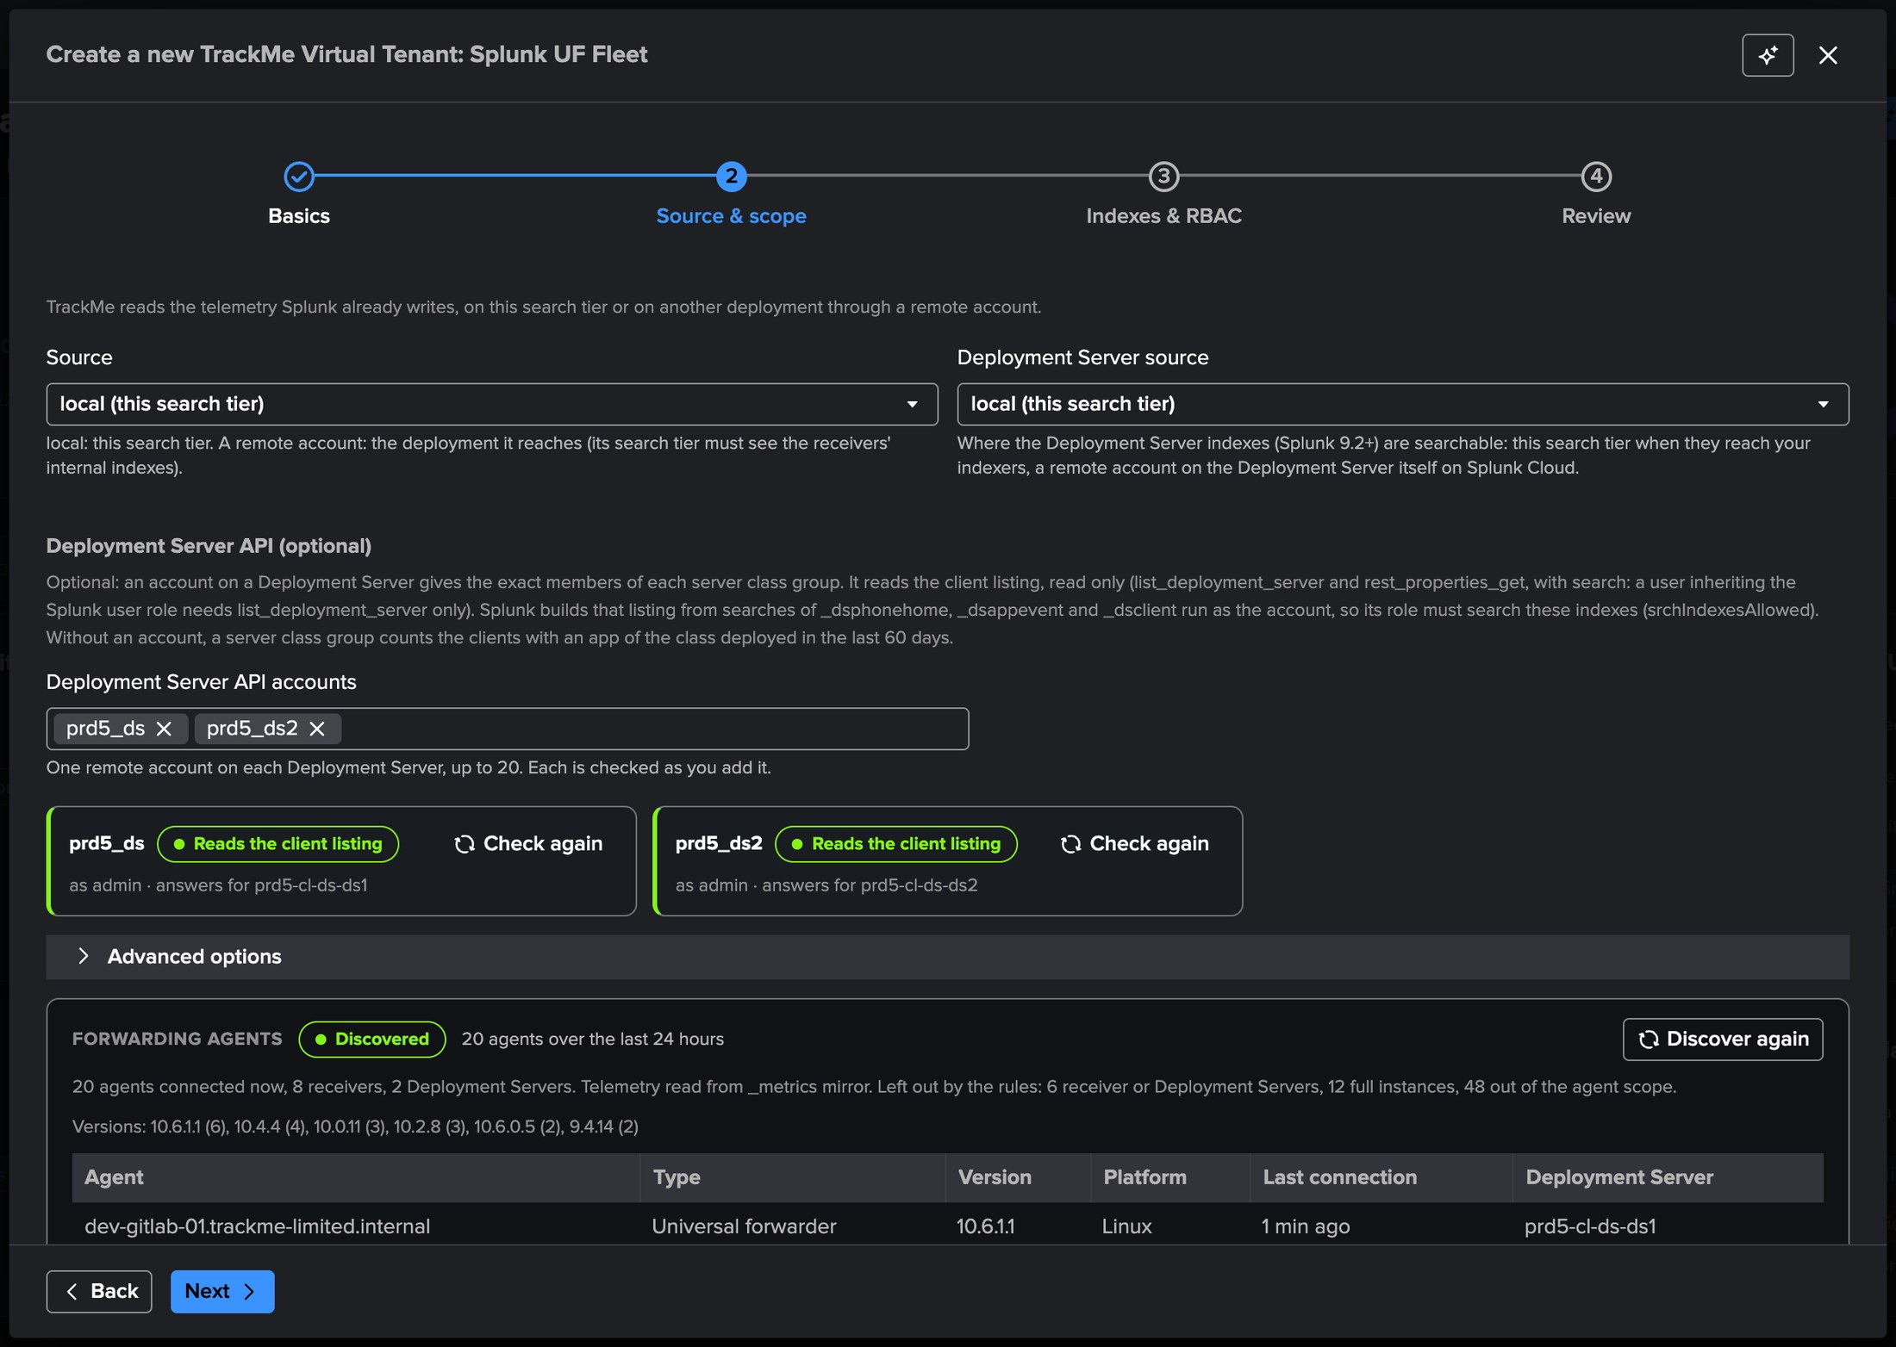
PART 1 · SETUP
Deployment Server API accounts — checked as you add them
1
Source
Where the receivers' internal logs are searched.
2
Deployment Server source
Where the _ds* indexes are searched; a remote account on the DS on Splunk Cloud.
3
API accounts (optional)
The exact members of each server class group, read only.
4
Checked at once
prd5_ds and prd5_ds2 each read the client listing and answer for their own Deployment Server.
TrackMe for Splunk · Hands-on: Splunk UF Fleet
docs.trackme-solutions.com
Notes:
Source and scope. The Deployment Server API accounts are optional: an account on a Deployment Server gives the exact members of each server class group, from its client listing. Its user needs list_deployment_server and rest_properties_get, never an admin role, and its role must search the _ds indexes: Splunk builds the client listing from them, as the account; otherwise the check reads Cannot search the DS indexes. Without one, a server class group counts the clients with an app of the class deployed in the last 60 days.

Slide 8
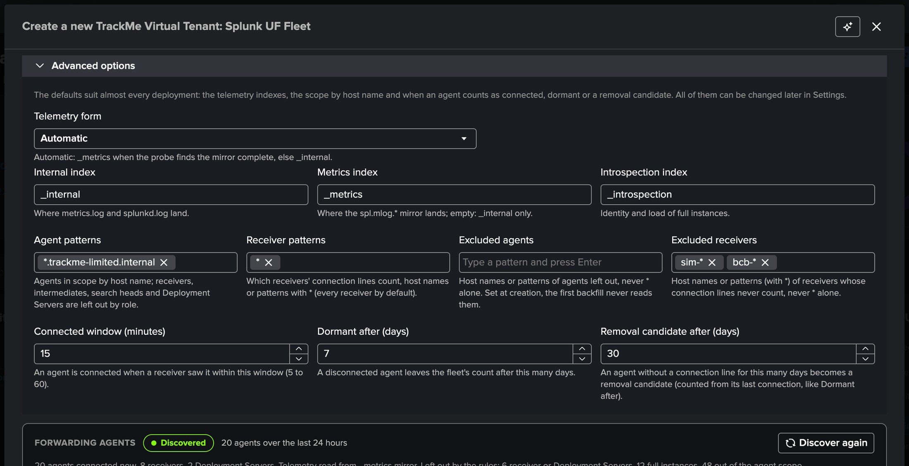
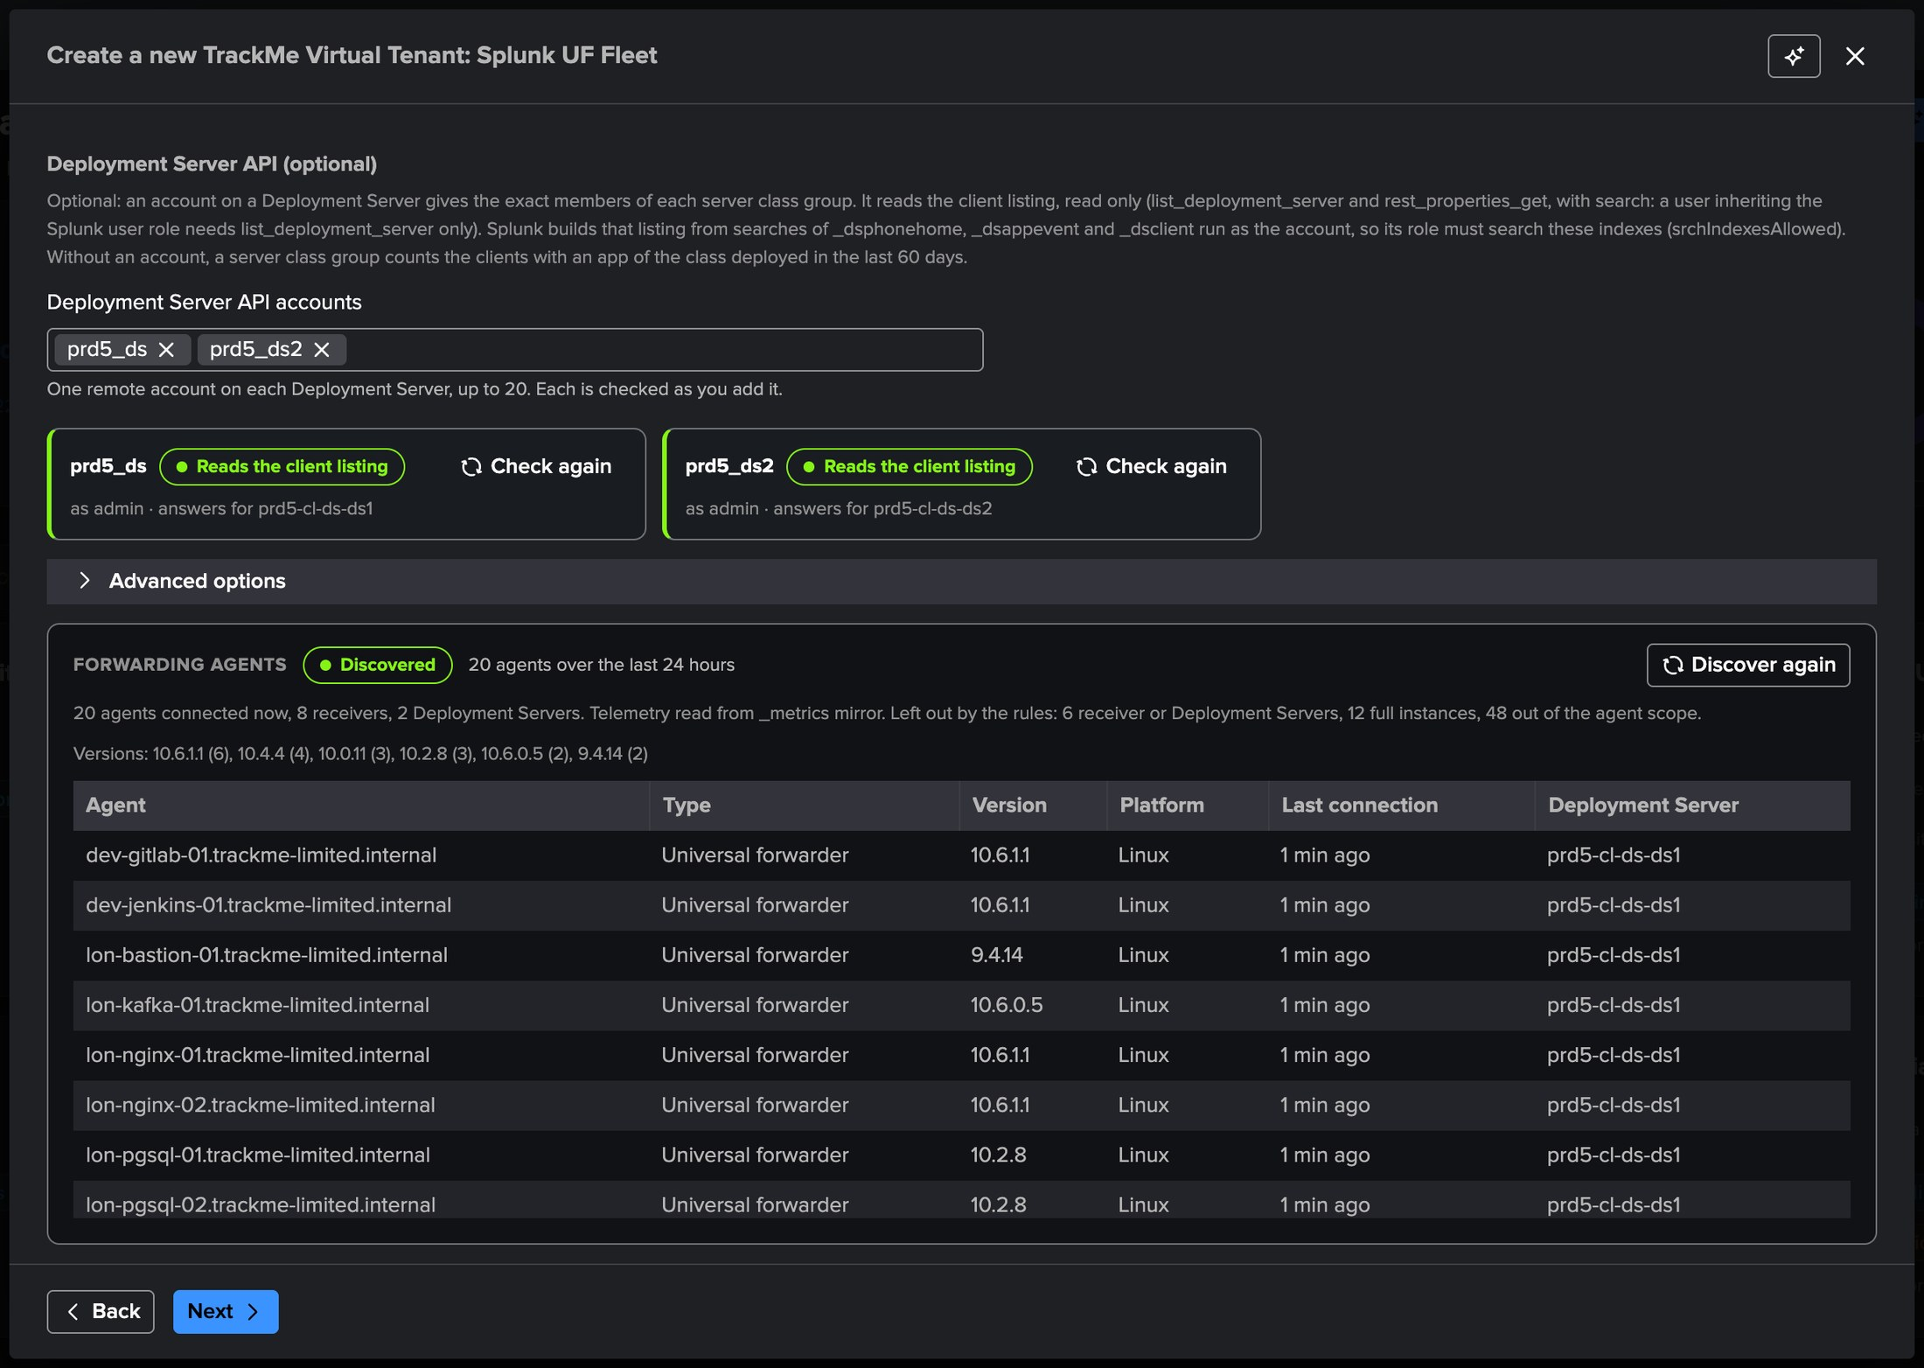
PART 1 · SETUP
Scope the fleet, then see what the tenant would collect
1
Agent patterns
3
The discovery
5
Five UF generations
A token per pattern: the corporate domain, *.trackme-limited.internal.
20 agents, all connected, 8 receivers, 2 Deployment Servers.
9.4.14 to 10.6.1.1, every agent with its Deployment Server.
2
Excluded receivers
4
Left out by the rules
sim-* and bcb-*: test receivers sharing the indexes, never read, never agents.
Receivers and Deployment Servers, full instances, agents out of scope.
TrackMe for Splunk · Hands-on: Splunk UF Fleet
docs.trackme-solutions.com
Notes:
Advanced options: the agent patterns scope the tenant to the corporate domain, and the excluded receivers leave out two families of test receivers that share the same indexes: set at creation, the first backfill never reads them. The connected window, the dormancy and the removal delays keep their defaults (15 minutes, 7 days, 30 days). The discovery runs the tenant's own rules with your rights over the last day: here twenty universal forwarders on five UF generations, all connected, and what the rules left out.

Slide 9
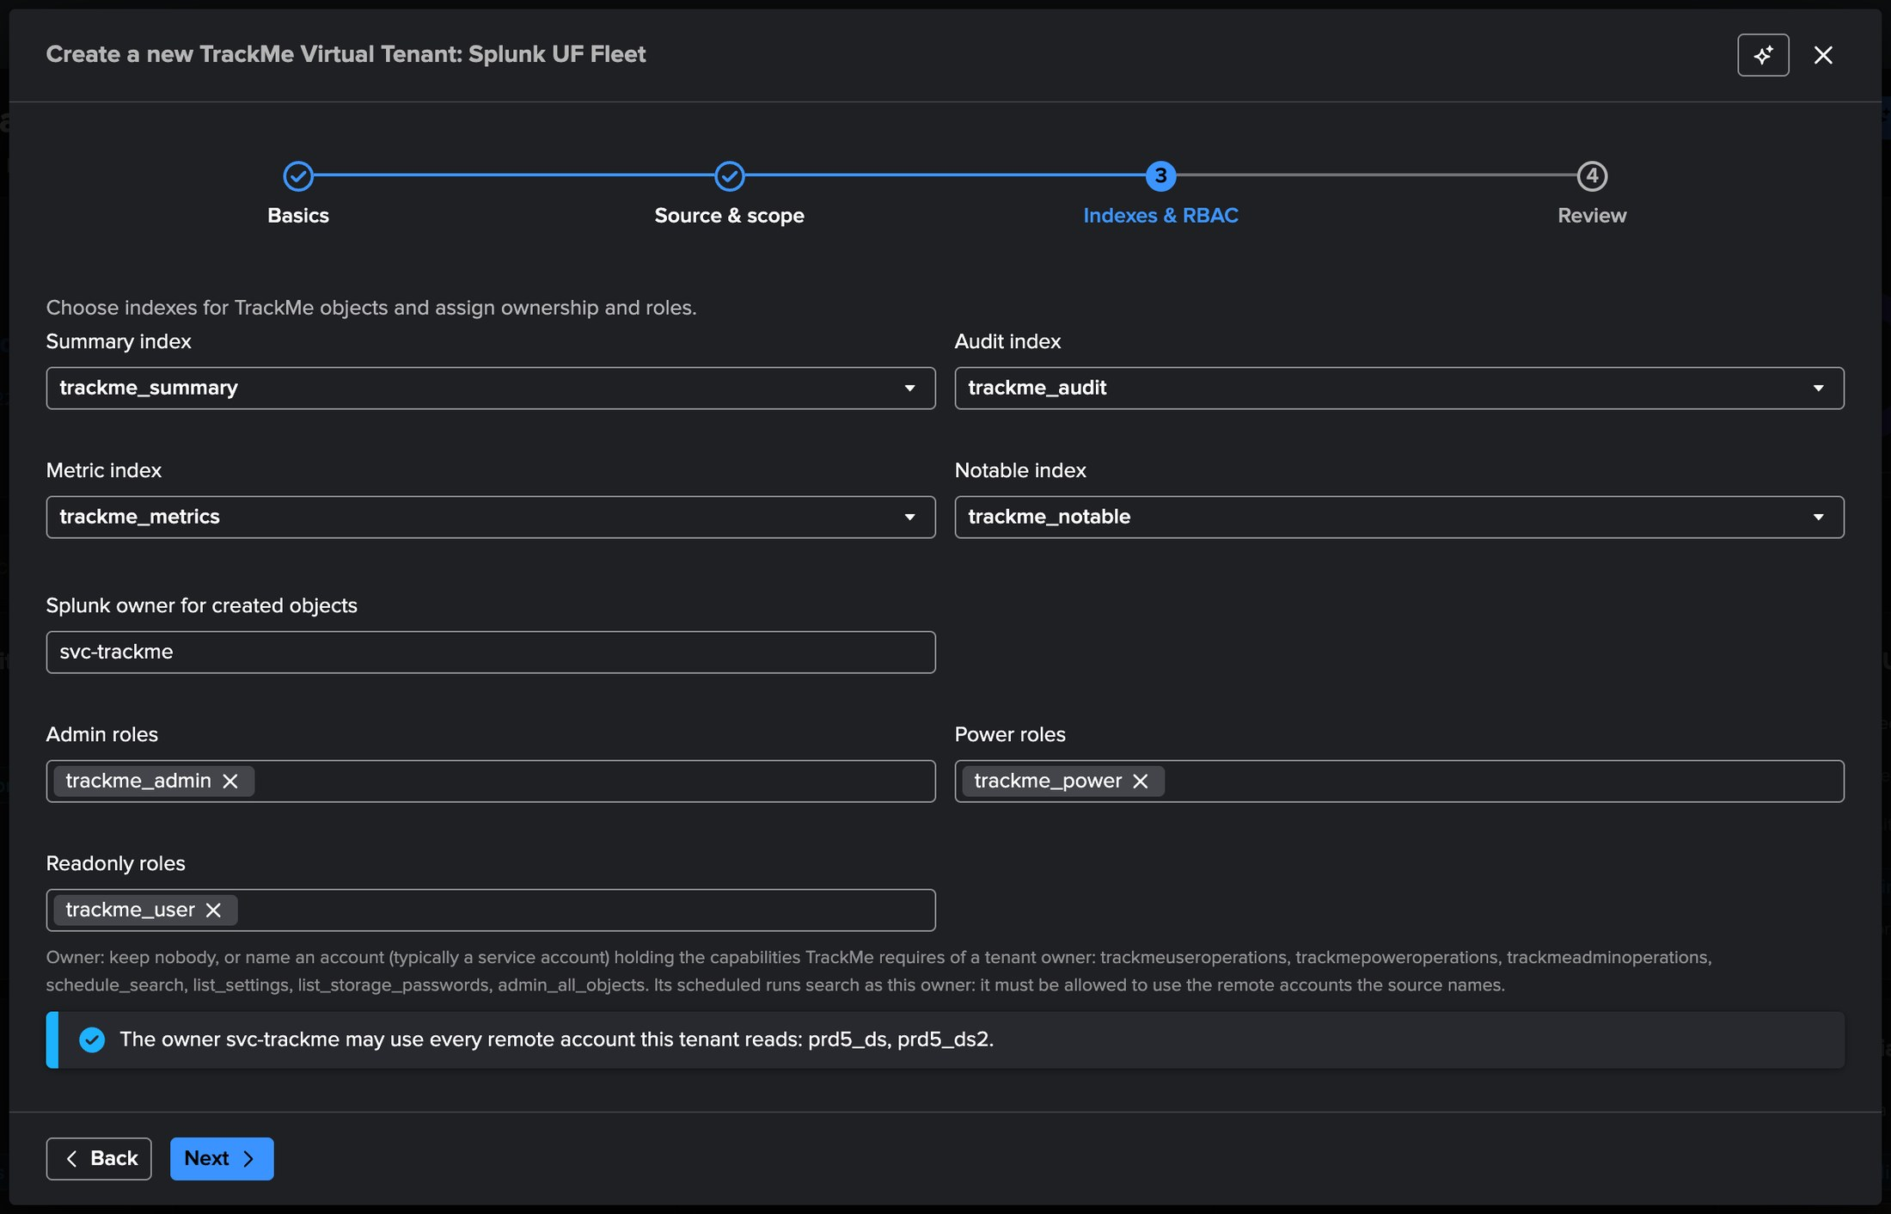
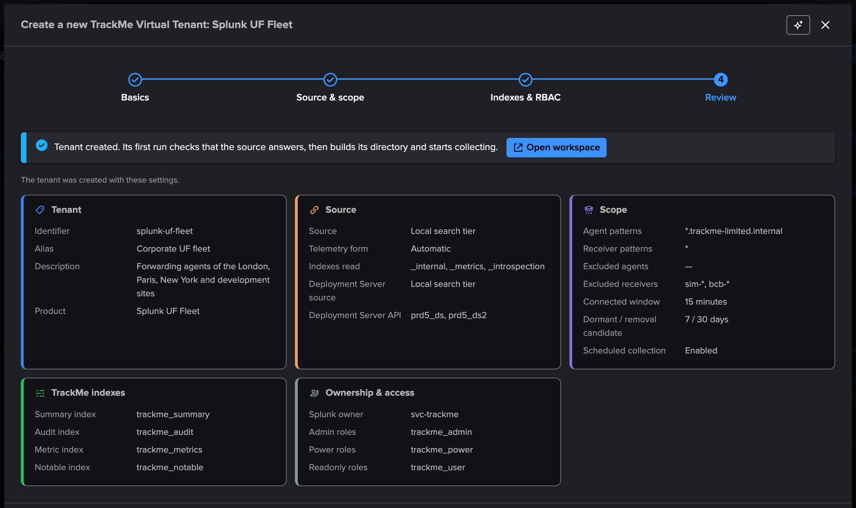
PART 1 · SETUP
A least-privilege owner — checked before the tenant exists
1
Tenant owner
3
Done
svc-trackme, a least-privilege service account: the scheduled runs search as it.
The first live run checks the source, then builds the directory.
2
Remote accounts
The wizard checks the owner may use every account the tenant reads.
TrackMe for Splunk · Hands-on: Splunk UF Fleet
docs.trackme-solutions.com
Notes:
Indexes and RBAC, then Review and Done. The owner may use every remote account the tenant reads, the Deployment Server API accounts included; otherwise the wizard names the fix before the save. The first live run starts at once.

Slide 10
02
PART 2 · CONFIGURE
From a list of agents to a fleet you can read
Enrichment from your CMDB, groups proposed from the Deployment Servers and the enrichment, the expected agents, and the notifications.
TrackMe for Splunk · Hands-on: Splunk UF Fleet
Notes:
Part two: configure the tenant. Three settings turn a list of agents into a fleet: enrichment, groups, expected agents.

Slide 11
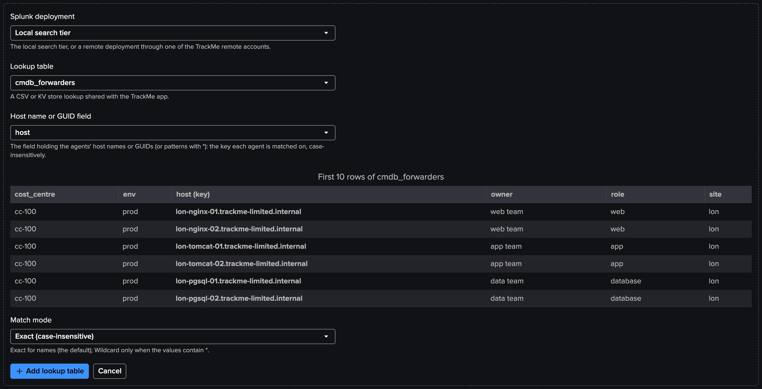
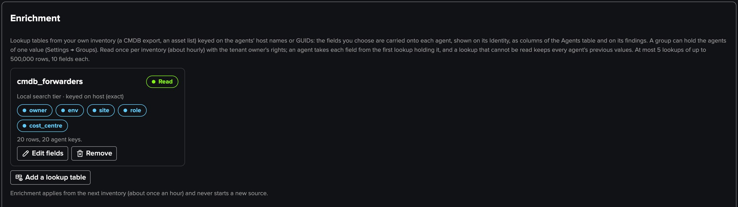
PART 2 · ENRICHMENT
Enrichment — your CMDB on every agent
1
A lookup from your inventory
3
On the findings
cmdb_forwarders, keyed on the host name, exact or wildcard.
Notifications, assignment and the AI Agent read them.
2
Fields to carry
4
Read hourly
owner, env, site, role, cost_centre: the first three are Agents columns.
As the tenant owner: Read, 20 rows and 20 agent keys; an unreadable lookup keeps the previous values.
TrackMe for Splunk · Hands-on: Splunk UF Fleet
docs.trackme-solutions.com
Notes:
Settings, Enrichment. Up to five lookup tables of up to 500,000 rows, local or through a remote account, carry fields from your own inventory onto each agent. Enrichment applies from the next inventory and never starts a new source.

Slide 12
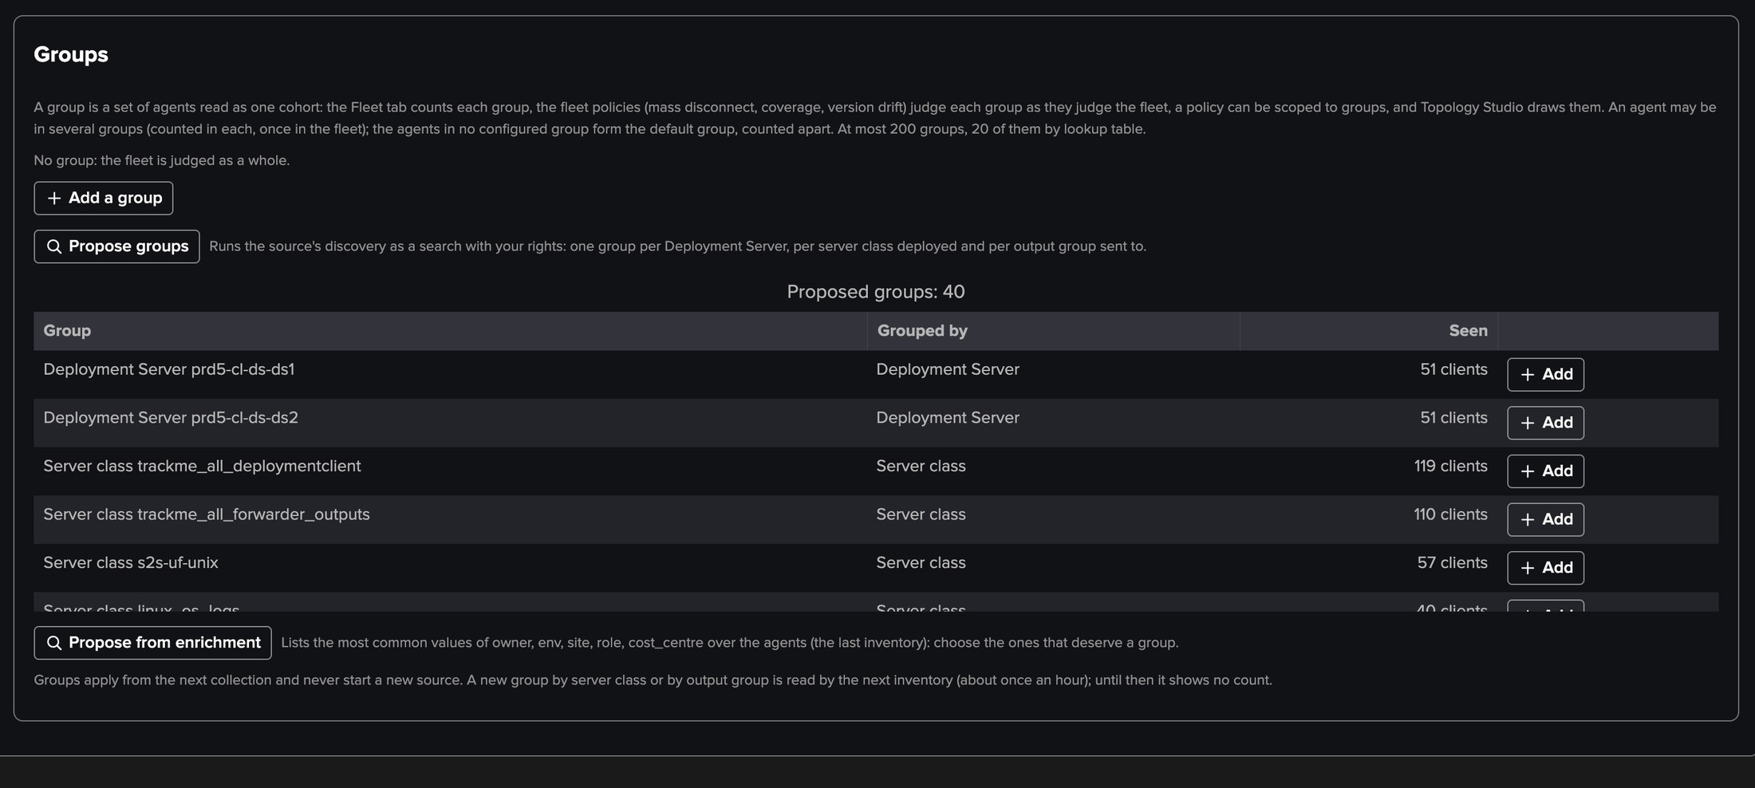
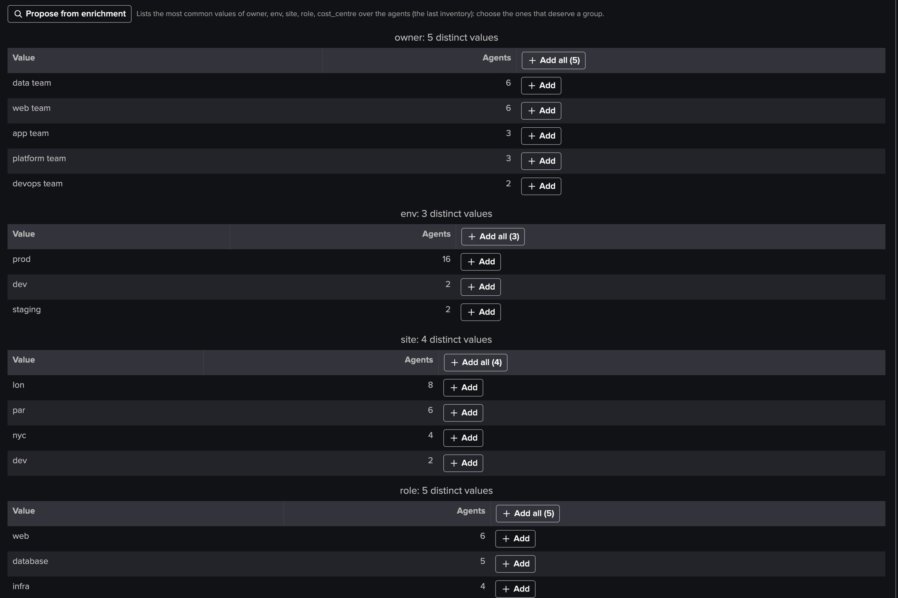
PART 2 · GROUPS
Groups — proposed from your Deployment Servers and your CMDB
1
Propose groups
3
Propose from enrichment
One per Deployment Server, server class deployed, output group sent to.
The most common values of each field: env prod, staging, dev.
2
Sites and roles
4
Judged as cohorts
The server classes site_* and role_* added, then renamed.
Mass disconnect, coverage and version drift judge every group.
TrackMe for Splunk · Hands-on: Splunk UF Fleet
docs.trackme-solutions.com
Notes:
Settings, Groups. A group reads a set of agents as one cohort: the Fleet tab counts it, the fleet policies judge it, a policy can be scoped to it, Topology Studio draws it. Here four sites and five roles from the Deployment Server classes, and three environments from the CMDB enrichment. A new group is pending until the next collection; Run now the inventory to see it at once.

Slide 13
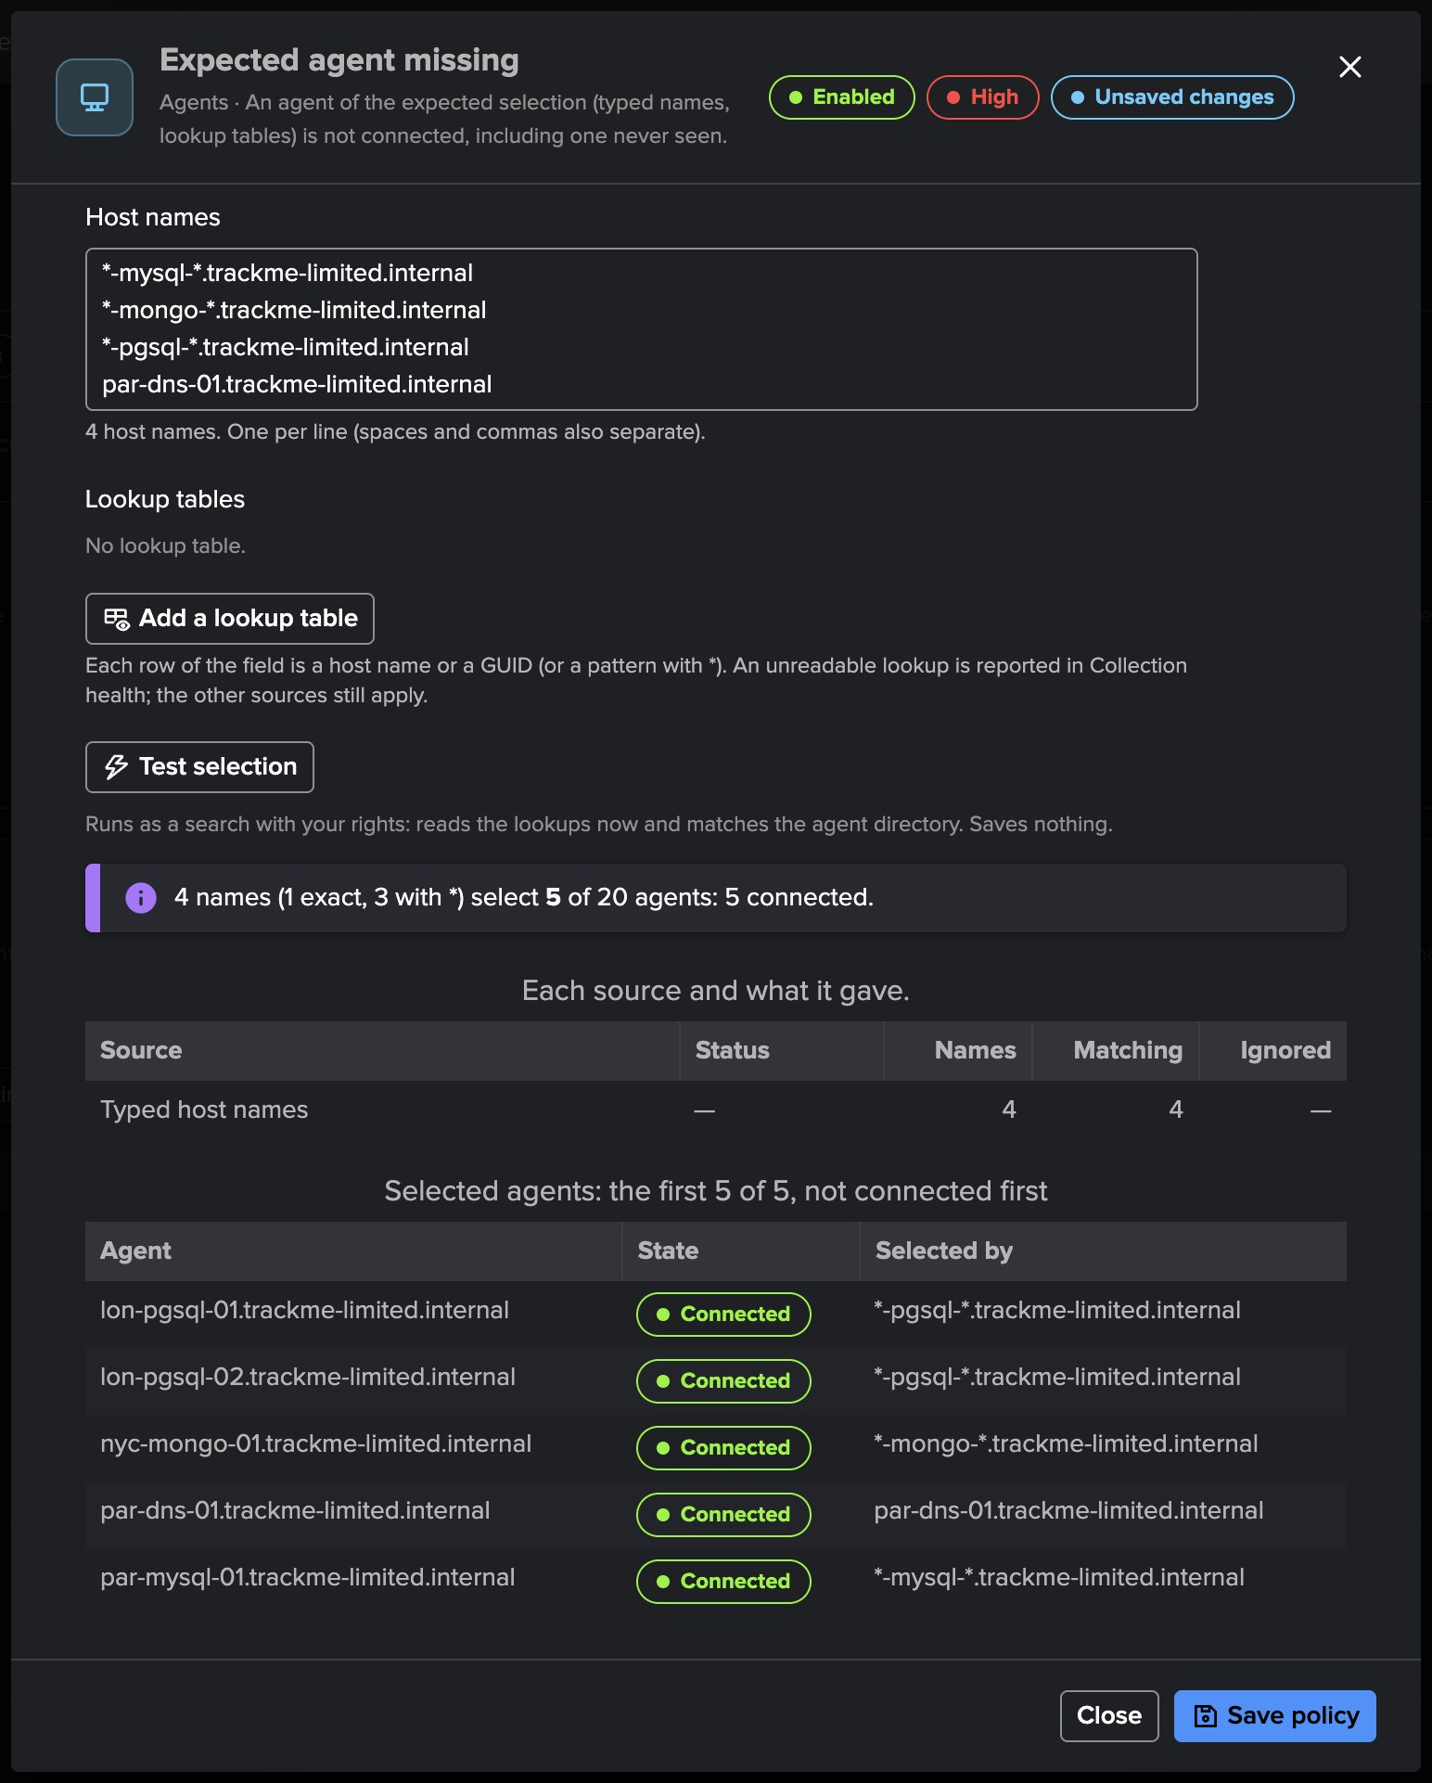
PART 2 · EXPECTED AGENTS
The agents that must always stay connected
1
Typed names and patterns
The database servers and the DNS: *-pgsql-*, *-mysql-*, *-mongo-*, par-dns-01.
2
Lookup tables
Up to 20, read again every 15 minutes as the tenant owner.
3
Test selection
4 names select 5 of 20 agents, all connected; saves nothing.
4
Never seen is missing
An exact name no agent carries is reported missing at once.
5
Add to expected
From the Agents tab; the selected agents carry a pin.
TrackMe for Splunk · Hands-on: Splunk UF Fleet
docs.trackme-solutions.com
Notes:
The expected agents are selected in the Expected agent missing policy: typed host names or GUIDs with wildcards, and lookup tables. Test selection runs as a search with your rights and shows the selected agents by state. Dormancy never closes an expected agent's finding.

Slide 14
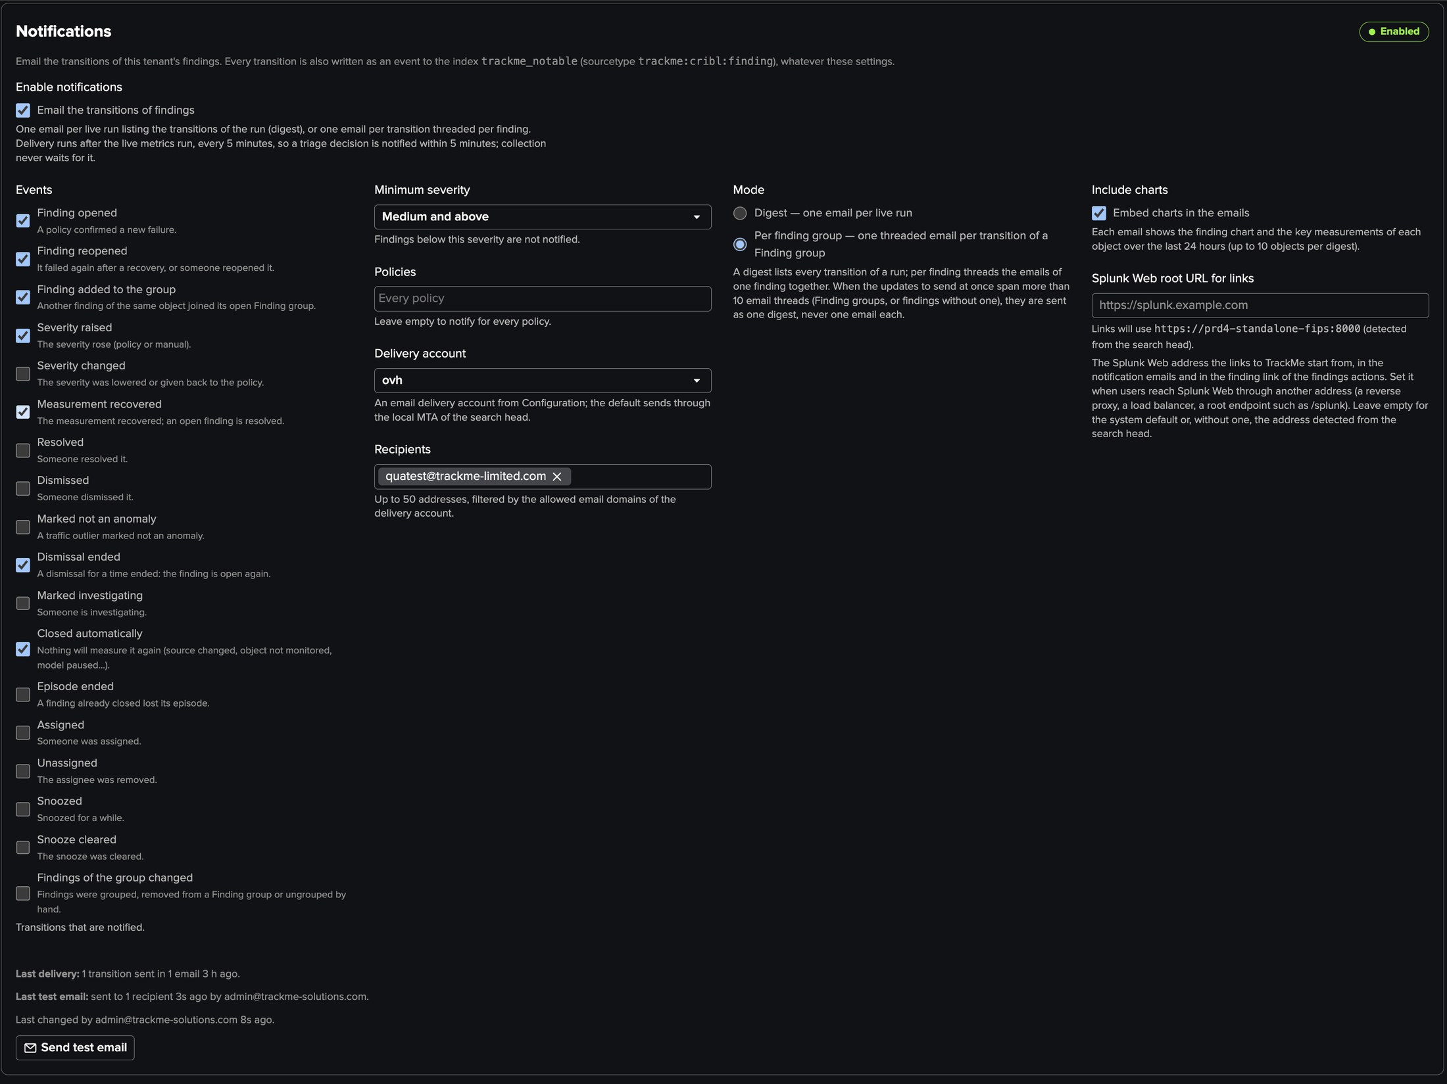
PART 2 · NOTIFICATIONS
Notifications — one threaded email per Finding group
1
Events
Opened, reopened, added to the group, severity raised, recovered…
2
Minimum severity, policies
Medium and above, every policy.
3
Delivery account, recipients
An email delivery account and up to 50 addresses.
4
Mode and charts
Per Finding group, threaded; the finding's chart embedded.
TrackMe for Splunk · Hands-on: Splunk UF Fleet
docs.trackme-solutions.com
Notes:
Settings, Notifications. One digest per live run, or one threaded email per transition of a Finding group, with the finding chart and key measurements. Every transition is also written as an event to the tenant's notable index.

Slide 15
03
PART 3 · THE FLEET
Every agent, every Deployment Server
The fleet at a glance, the agents and one agent up close, the Deployment Servers and the policies.
TrackMe for Splunk · Hands-on: Splunk UF Fleet
Notes:
Part three: the workspace.

Slide 16
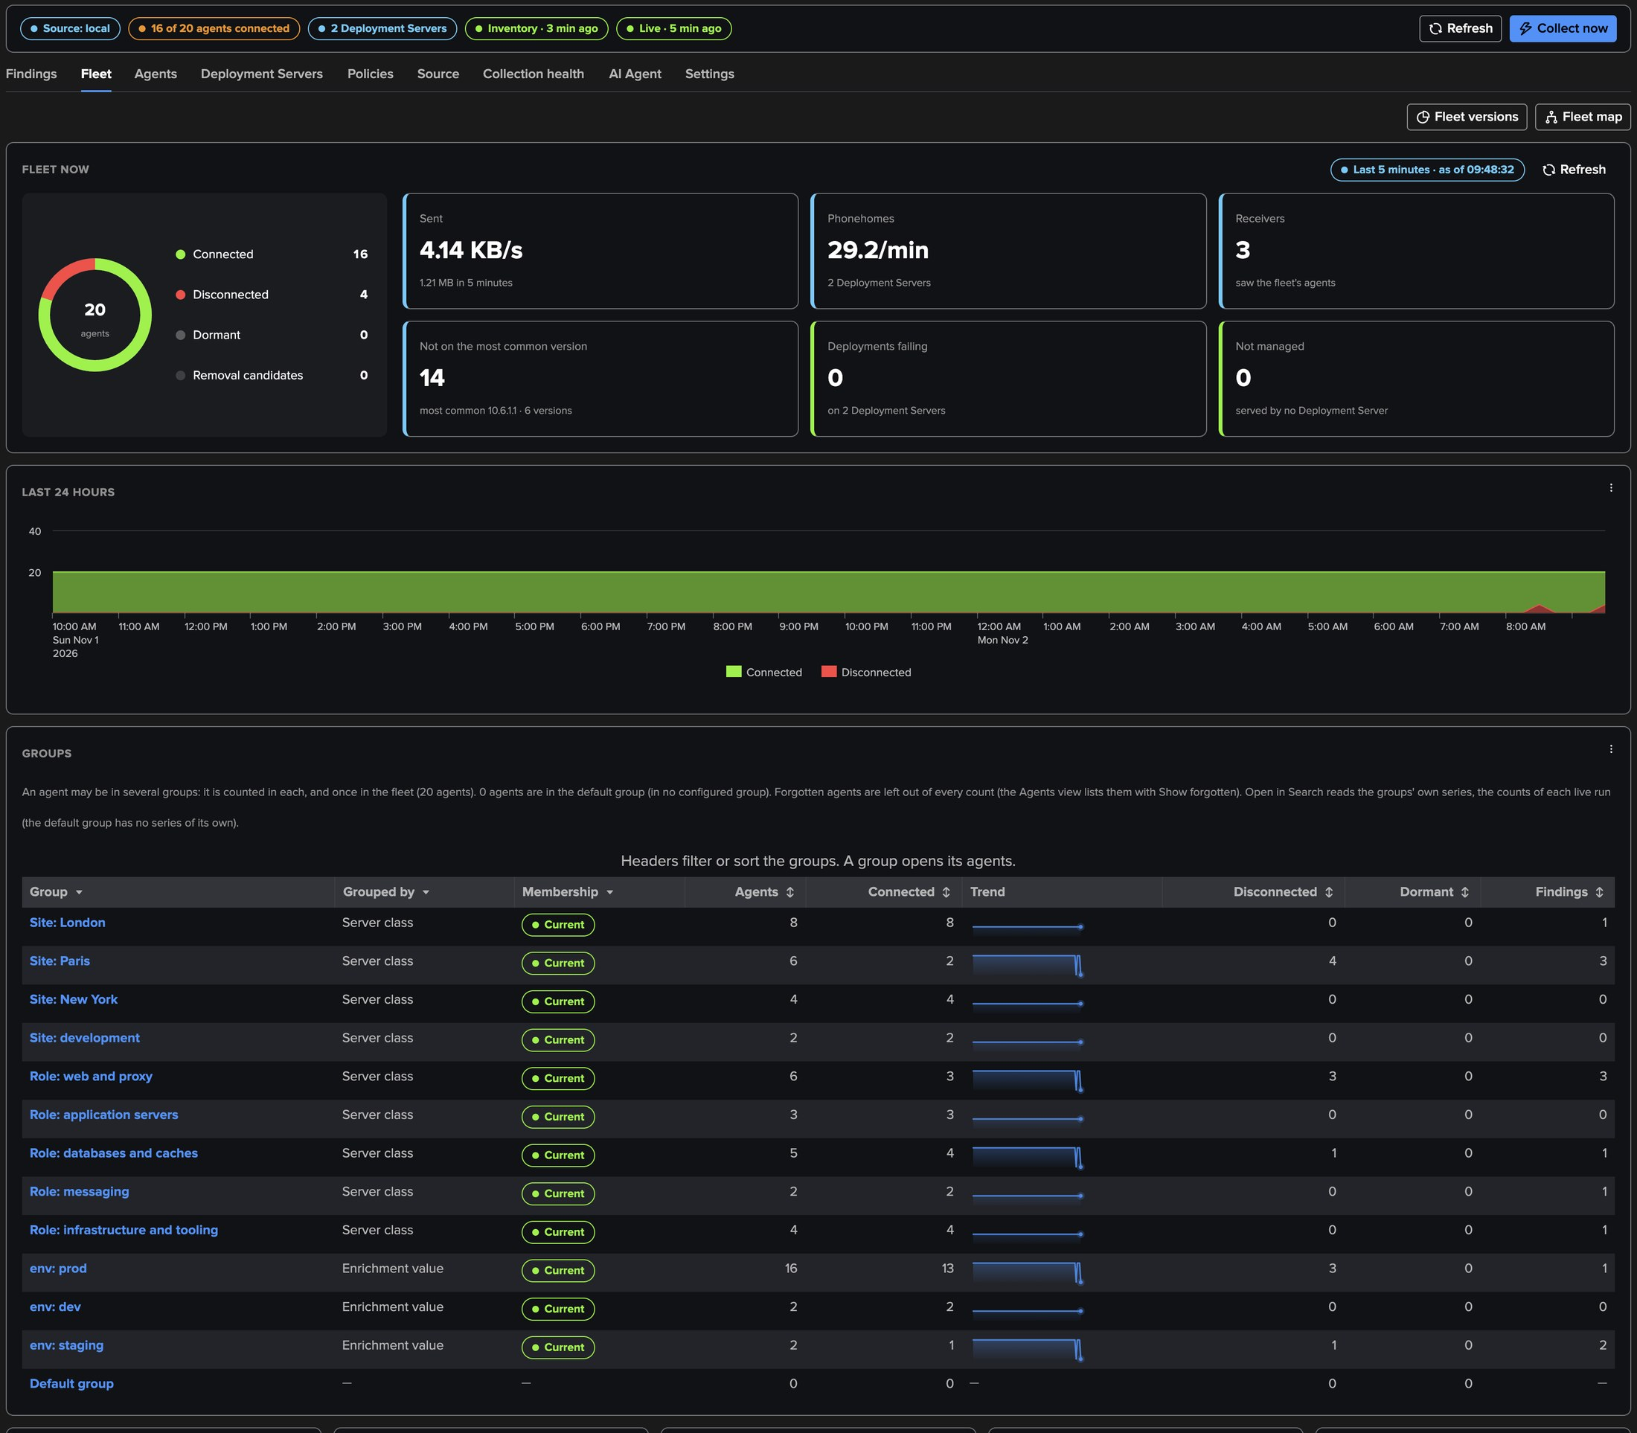
PART 3 · FLEET
The fleet — now, the last 24 hours, every group
1
Fleet now
3
Breakdowns
5
Fleet map
The agents by state; the last five minutes; versions, failing deployments, unmanaged agents.
Versions, platforms, types, agents per Deployment Server.
A generated topology of the fleet, its groups and Deployment Servers.
2
Last 24 hours
4
Groups
Connected and disconnected agents over time.
Each group's counts, its trend and its open cohort findings.
TrackMe for Splunk · Hands-on: Splunk UF Fleet
docs.trackme-solutions.com
Notes:
The Fleet tab shows every figure once: the agents by state, the last five minutes (sent, phonehomes, receivers), the fleet's management (agents not on the most common version, deployments failing, agents served by no Deployment Server), the last 24 hours, the breakdowns that open the Agents tab filtered, the groups with their membership state and counts, the recently disconnected agents and the Fleet map.

Slide 17
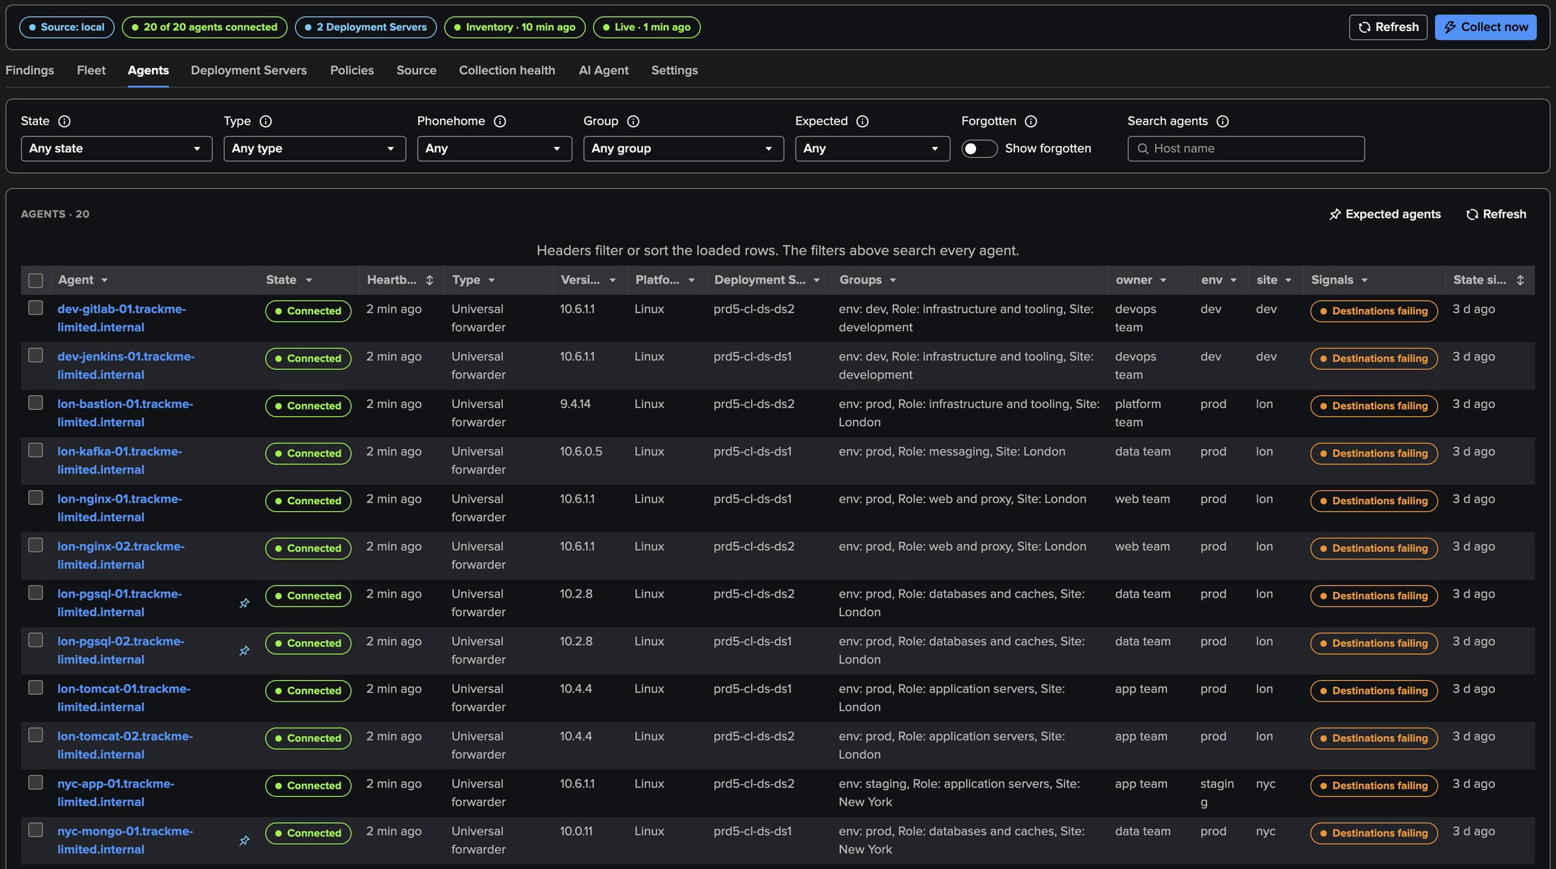
PART 3 · AGENTS
The agents — with their groups and your CMDB fields
1
Filters
3
Expected pin
5
Actions
State, type, phonehome, group, expected, host name.
The PostgreSQL servers are expected agents.
Forget an agent not connected; Add to expected; Show forgotten; rows per page.
4
Signals
2
Groups and enrichment
Destinations failing: a heavy forwarder of the receiving tier is stopped.
Site and role from the server classes; owner, env, site from the CMDB.
TrackMe for Splunk · Hands-on: Splunk UF Fleet
docs.trackme-solutions.com
Notes:
The Agents tab, paged on the server. Each agent with its state, type, version, platform, Deployment Server, groups, the first three enrichment fields and its signals. A signal pill opens its facts and evidence.

Slide 18
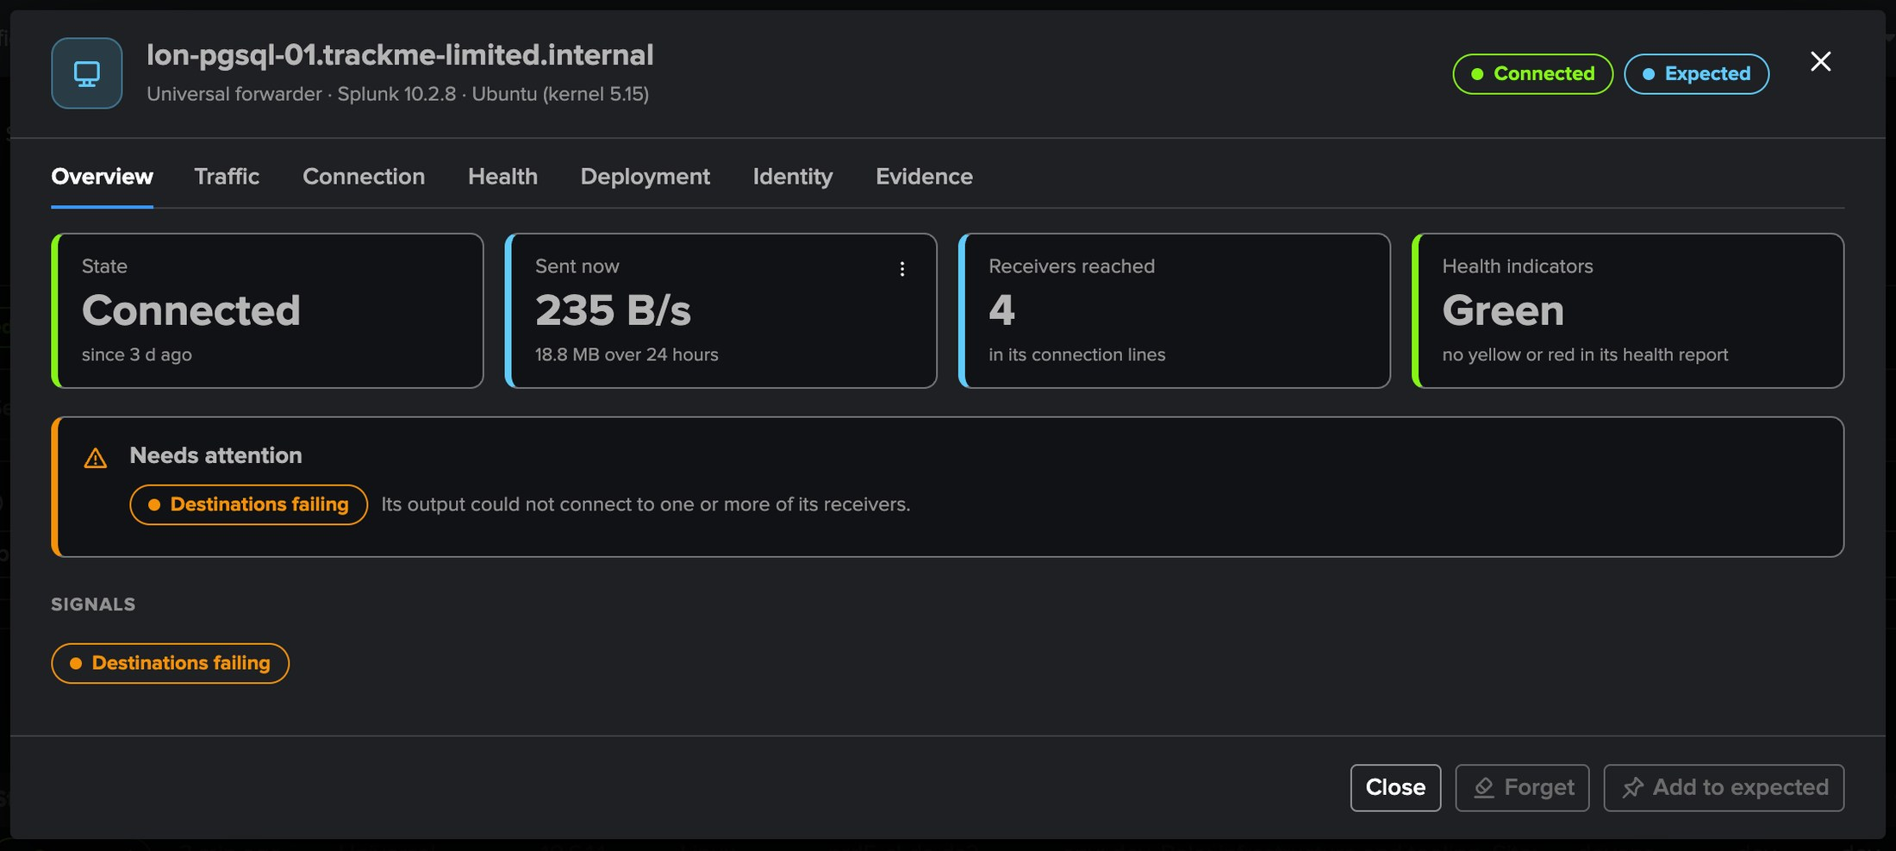
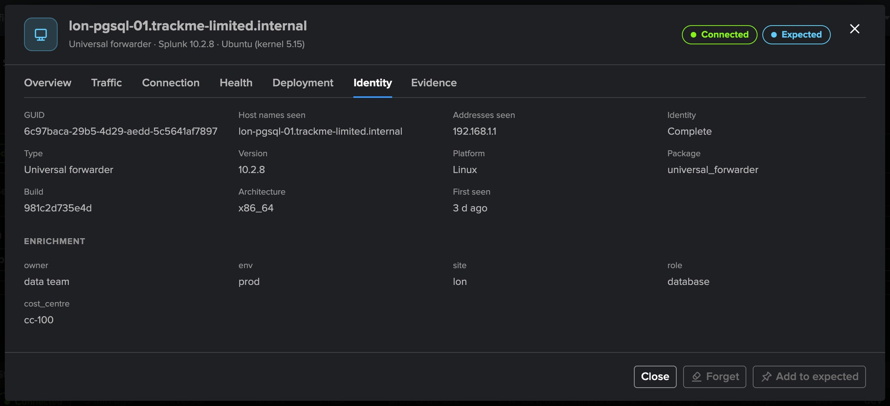
PART 3 · AGENTS
One agent up close — state, traffic, identity
1
Overview
3
Identity
Connected, sent now and over 24 hours, receivers reached, health.
GUID, host names and addresses seen, version, build, platform.
2
Needs attention
4
Enrichment
Its signals and open findings: here Destinations failing.
owner data team, env prod, site lon, role database, cost centre.
TrackMe for Splunk · Hands-on: Splunk UF Fleet
docs.trackme-solutions.com
Notes:
The agent modal: Overview, Traffic, Connection, Health, Deployment, Identity and Evidence. Its chart reads Splunk's own lines on demand: no per-agent history is written.

Slide 19
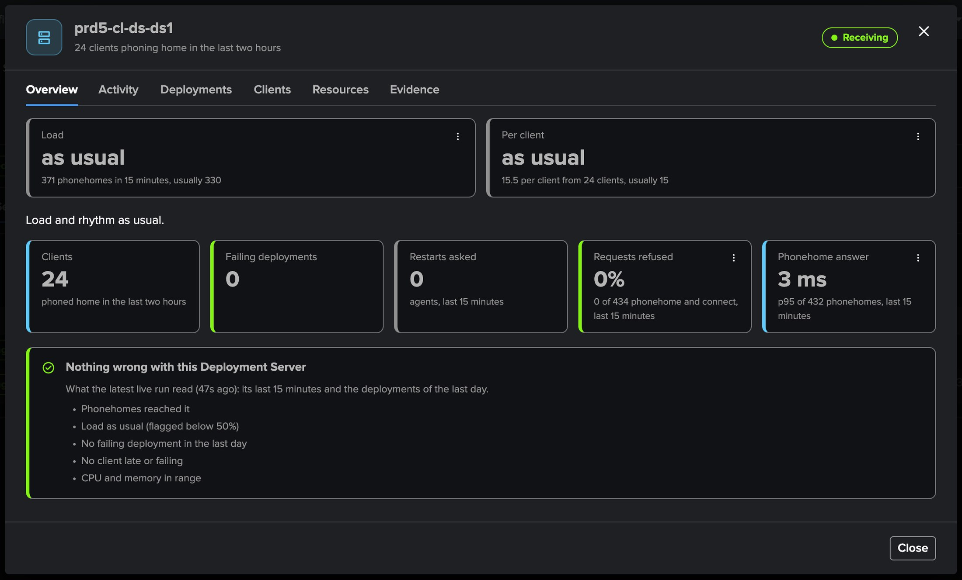
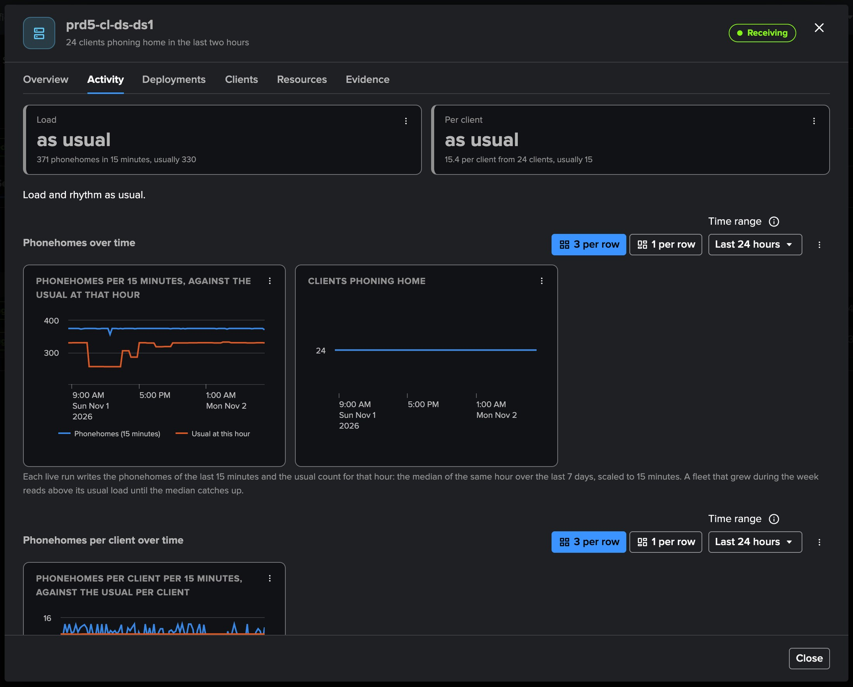
PART 3 · DEPLOYMENT SERVERS
Deployment Servers — their pace against their usual
1
Load
3
Deployments and restarts
Phonehomes against the usual for the hour: as usual.
Failing deployments, restarts asked.
2
Per client
4
Access log
The clients' rhythm against their usual.
Requests refused and the 95th percentile of the phonehome answer.
TrackMe for Splunk · Hands-on: Splunk UF Fleet
docs.trackme-solutions.com
Notes:
The Deployment Server is a first-class subject. Load and Per client read together: load up with a stable rhythm means more clients; both up, clients phoning home more often; load down with a stable rhythm, clients that left.

Slide 20
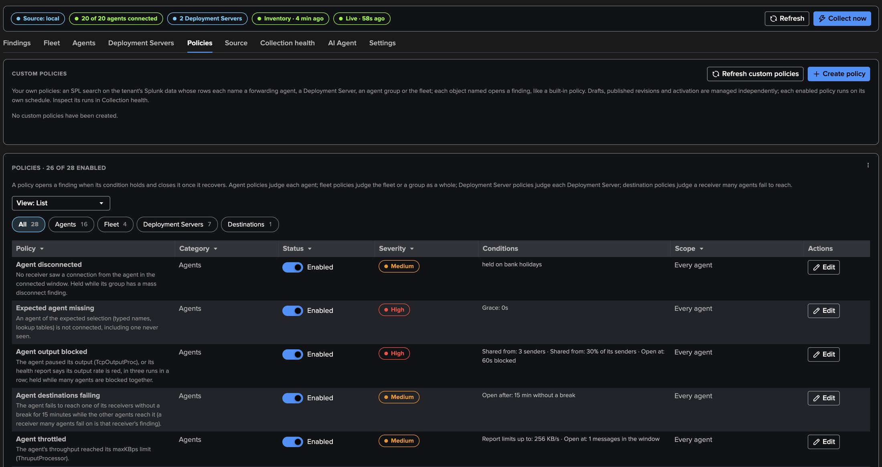
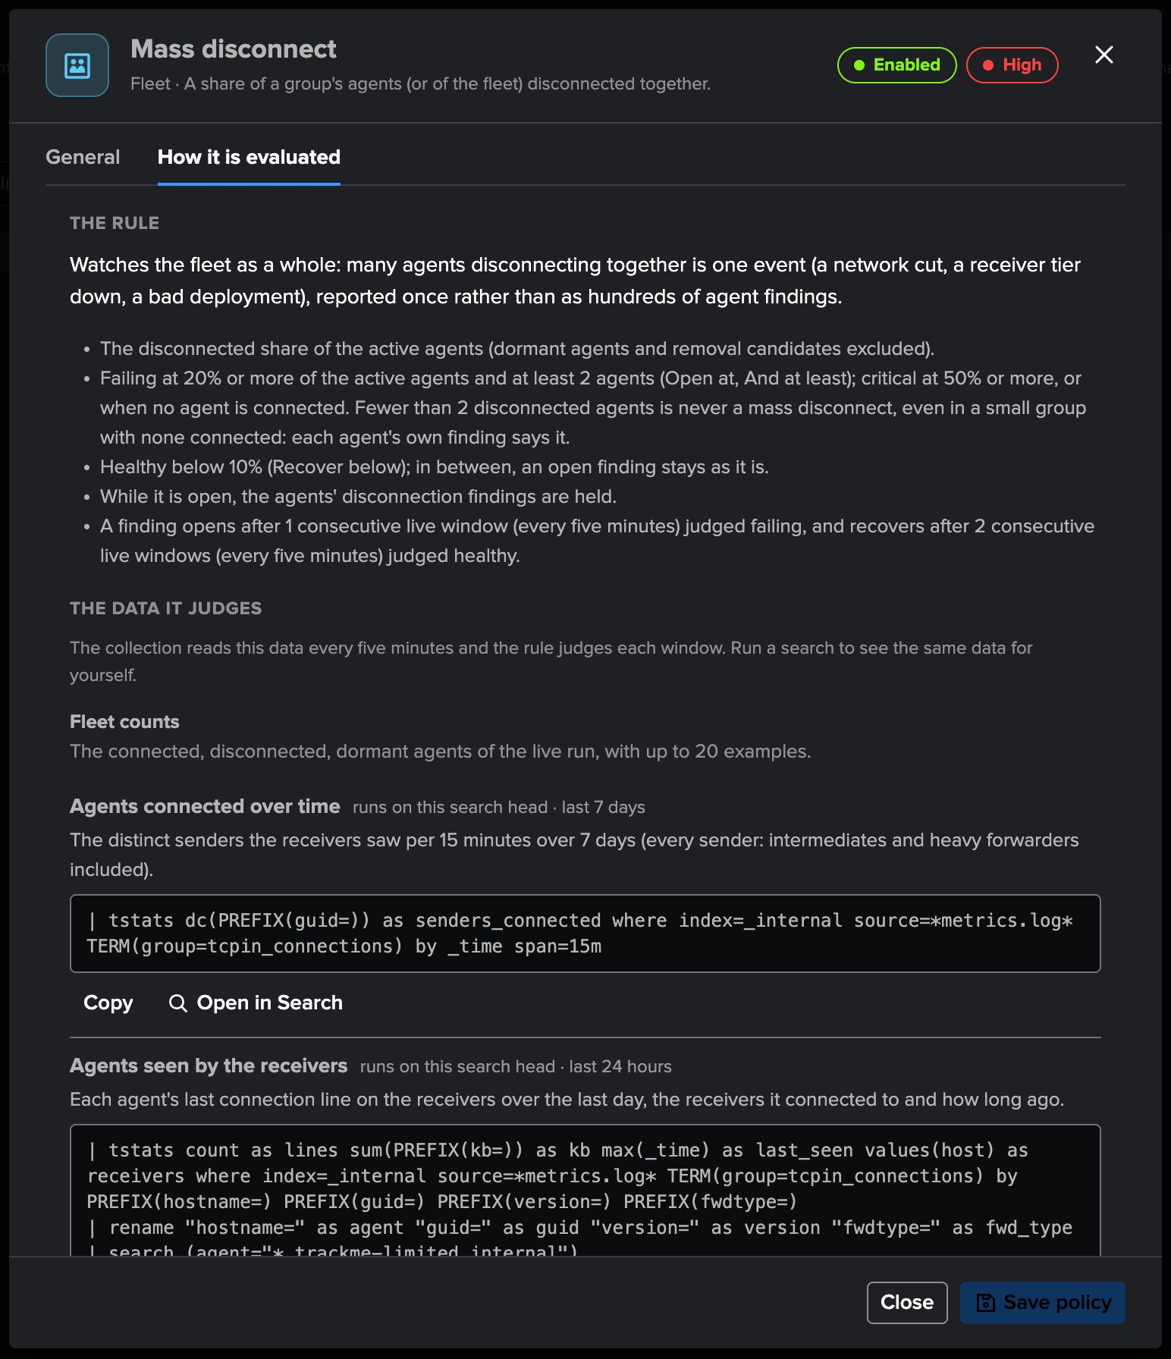
PART 3 · POLICIES
Twenty-eight policies — and how each is evaluated
1
Agents
3
Deployment Servers
Disconnected, expected missing, output, destinations, throttle, restarts, identity, versions, deployment.
Silent, phonehome drop, failures, restart storm, errors, requests, response.
2
Fleet
4
How it is evaluated
Mass disconnect, coverage, version drift, cloned images.
The rule, the data with ready-to-run searches, how to resolve.
TrackMe for Splunk · Hands-on: Splunk UF Fleet
docs.trackme-solutions.com
Notes:
The policy catalogue. Every policy has its severity, its checks to open and to recover, a scope by group, a bank holiday hold and How it is evaluated. Mass disconnect: twenty per cent of a group and at least two agents disconnected together, critical at half; the agents' own findings are held while it is open.

Slide 21
04
PART 4 · FINDINGS
A site goes dark
Agents of one site stopped on purpose: a mass disconnect per cohort, an expected agent missing, and the Splunk UF Fleet AI Agent.
TrackMe for Splunk · Hands-on: Splunk UF Fleet
Notes:
Part four: findings. Four agents of the Paris site were stopped on purpose, one of them an expected database server.

Slide 22
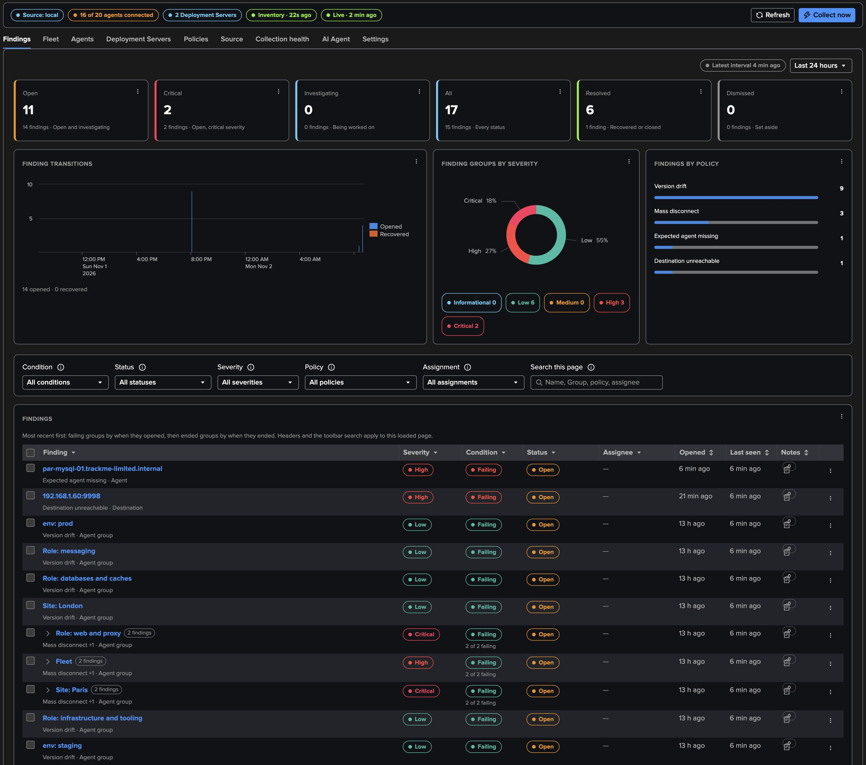
PART 4 · FINDINGS
A mass disconnect per cohort — not four agent findings
1
Site: Paris
3
One Finding group per cohort
Four of six agents disconnected: critical at 50 % and more.
Each Mass disconnect joins its cohort's group, beside its Version drift.
2
Role and fleet
4
Expected agent missing
Web and proxy (critical) and the fleet (20 %, high): each cohort it hits.
par-mysql-01: an expected agent is never held; the agents' own findings are.
TrackMe for Splunk · Hands-on: Splunk UF Fleet
docs.trackme-solutions.com
Notes:
Four agents of the Paris site stopped together. Mass disconnect opens on each cohort they are a large share of: the Paris site, critical as two thirds of it is down, the web and proxy role, and the fleet at twenty per cent. Each joins the Finding group of its cohort. The agents' own disconnection findings are held, never opened one by one. par-mysql-01 is an expected agent: Expected agent missing opens for it whatever the cohort. A heavy forwarder of the receiving tier was stopped at the same time: one Destination unreachable finding on its port, never one per agent.

Slide 23
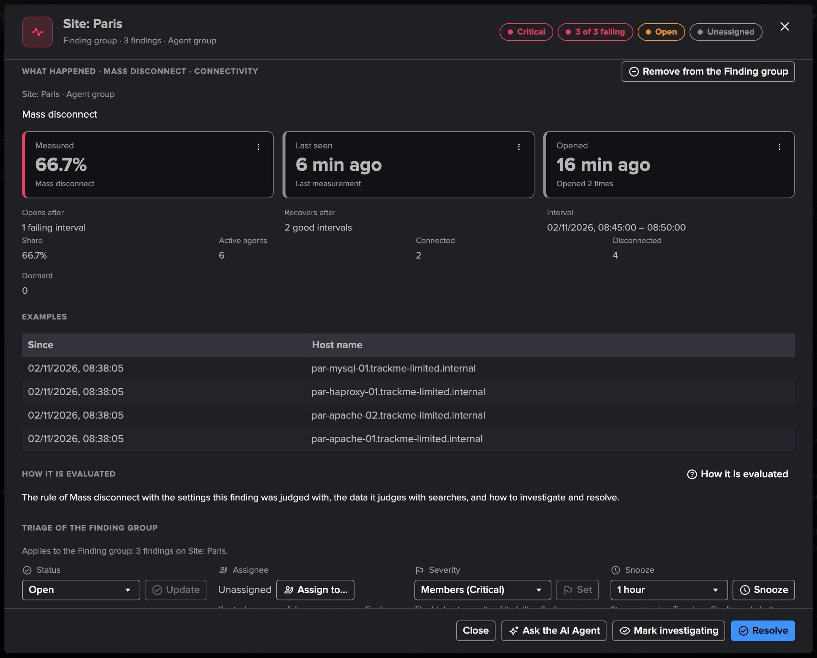
PART 4 · FINDINGS
A finding up close — what happened, triage, history
1
What happened
The measurement (66.7 % of the site), when it opened, its live window.
2
Triage
Status, assignee, severity, snooze and notes, kept when it reopens.
3
Open resource
From the row menu: the Fleet tab, an agent or its Deployment Server.
4
How it is evaluated
Every policy's rule, data and searches, in the Policies tab.
TrackMe for Splunk · Hands-on: Splunk UF Fleet
docs.trackme-solutions.com
Notes:
A finding opens with what happened, its triage and its history. When the agents reconnect, the mass disconnect recovers below ten per cent for two runs; an agent still disconnected then opens its own finding.

Slide 24
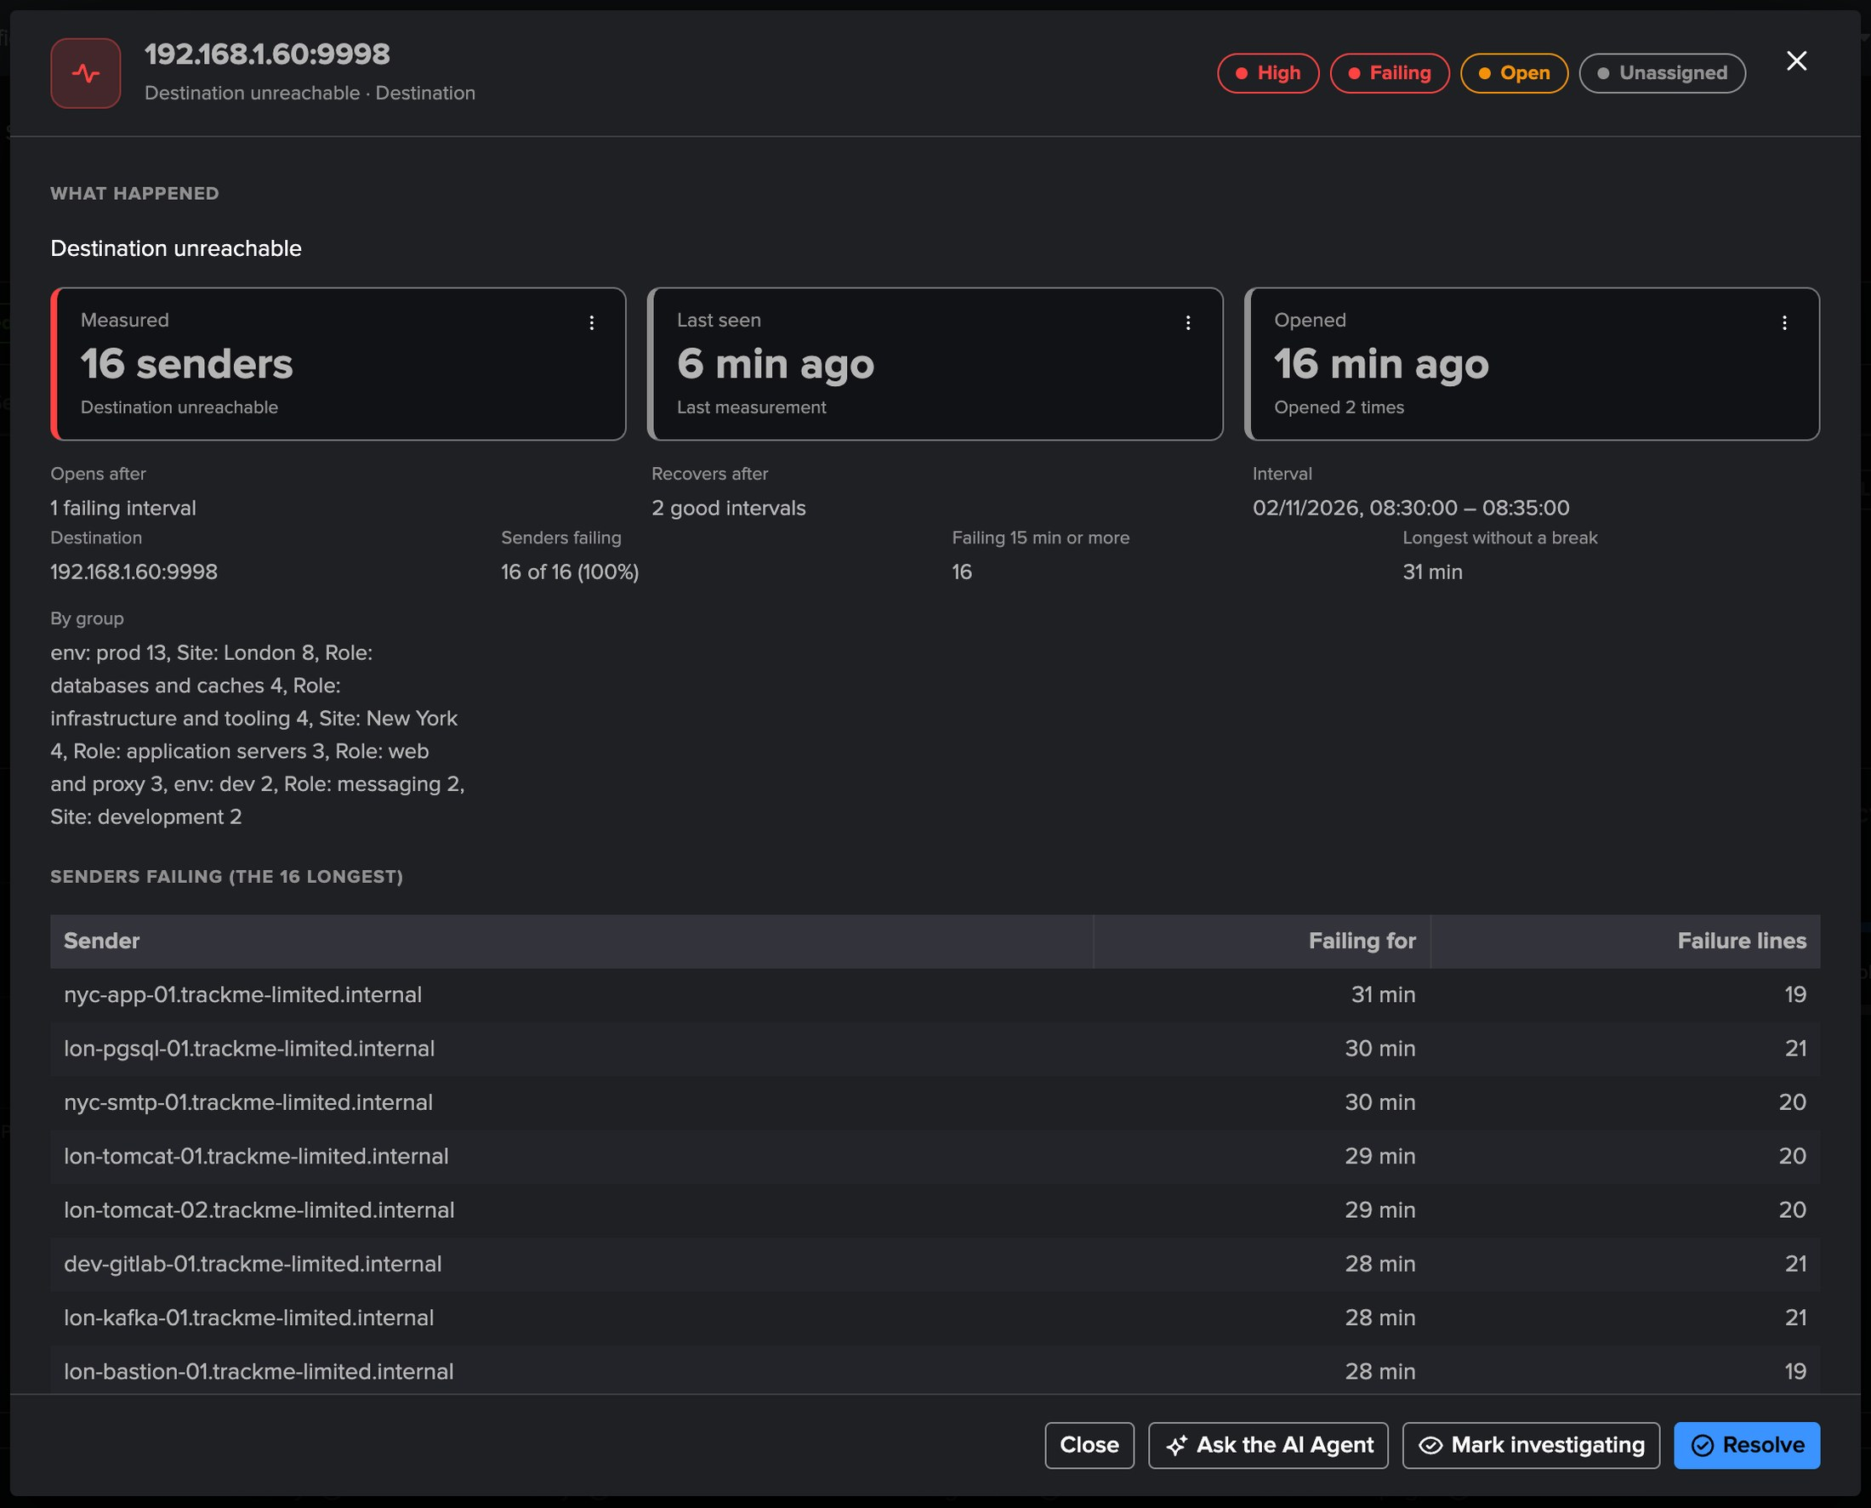
PART 4 · FINDINGS
A destination many agents fail to reach — one finding, never one per agent
1
Measured
The agents failing to reach it for 15 minutes or more: 16.
2
Every agent failing
How long without a break, and its failure lines.
3
By group
The groups the failing agents belong to: London, New York, the roles.
4
The cause is the receiver
A heavy forwarder of the receiving tier, stopped: see the Splunk S2S tenant.
TrackMe for Splunk · Hands-on: Splunk UF Fleet
docs.trackme-solutions.com
Notes:
While a heavy forwarder of the receiving tier was stopped, the agents that send to it failed to reach its port. One Destination unreachable finding opened on the receiver, listing the agents failing, how long and their groups, never one finding per agent. The receiving side of the same stop is in the Splunk S2S walkthrough.

Slide 25
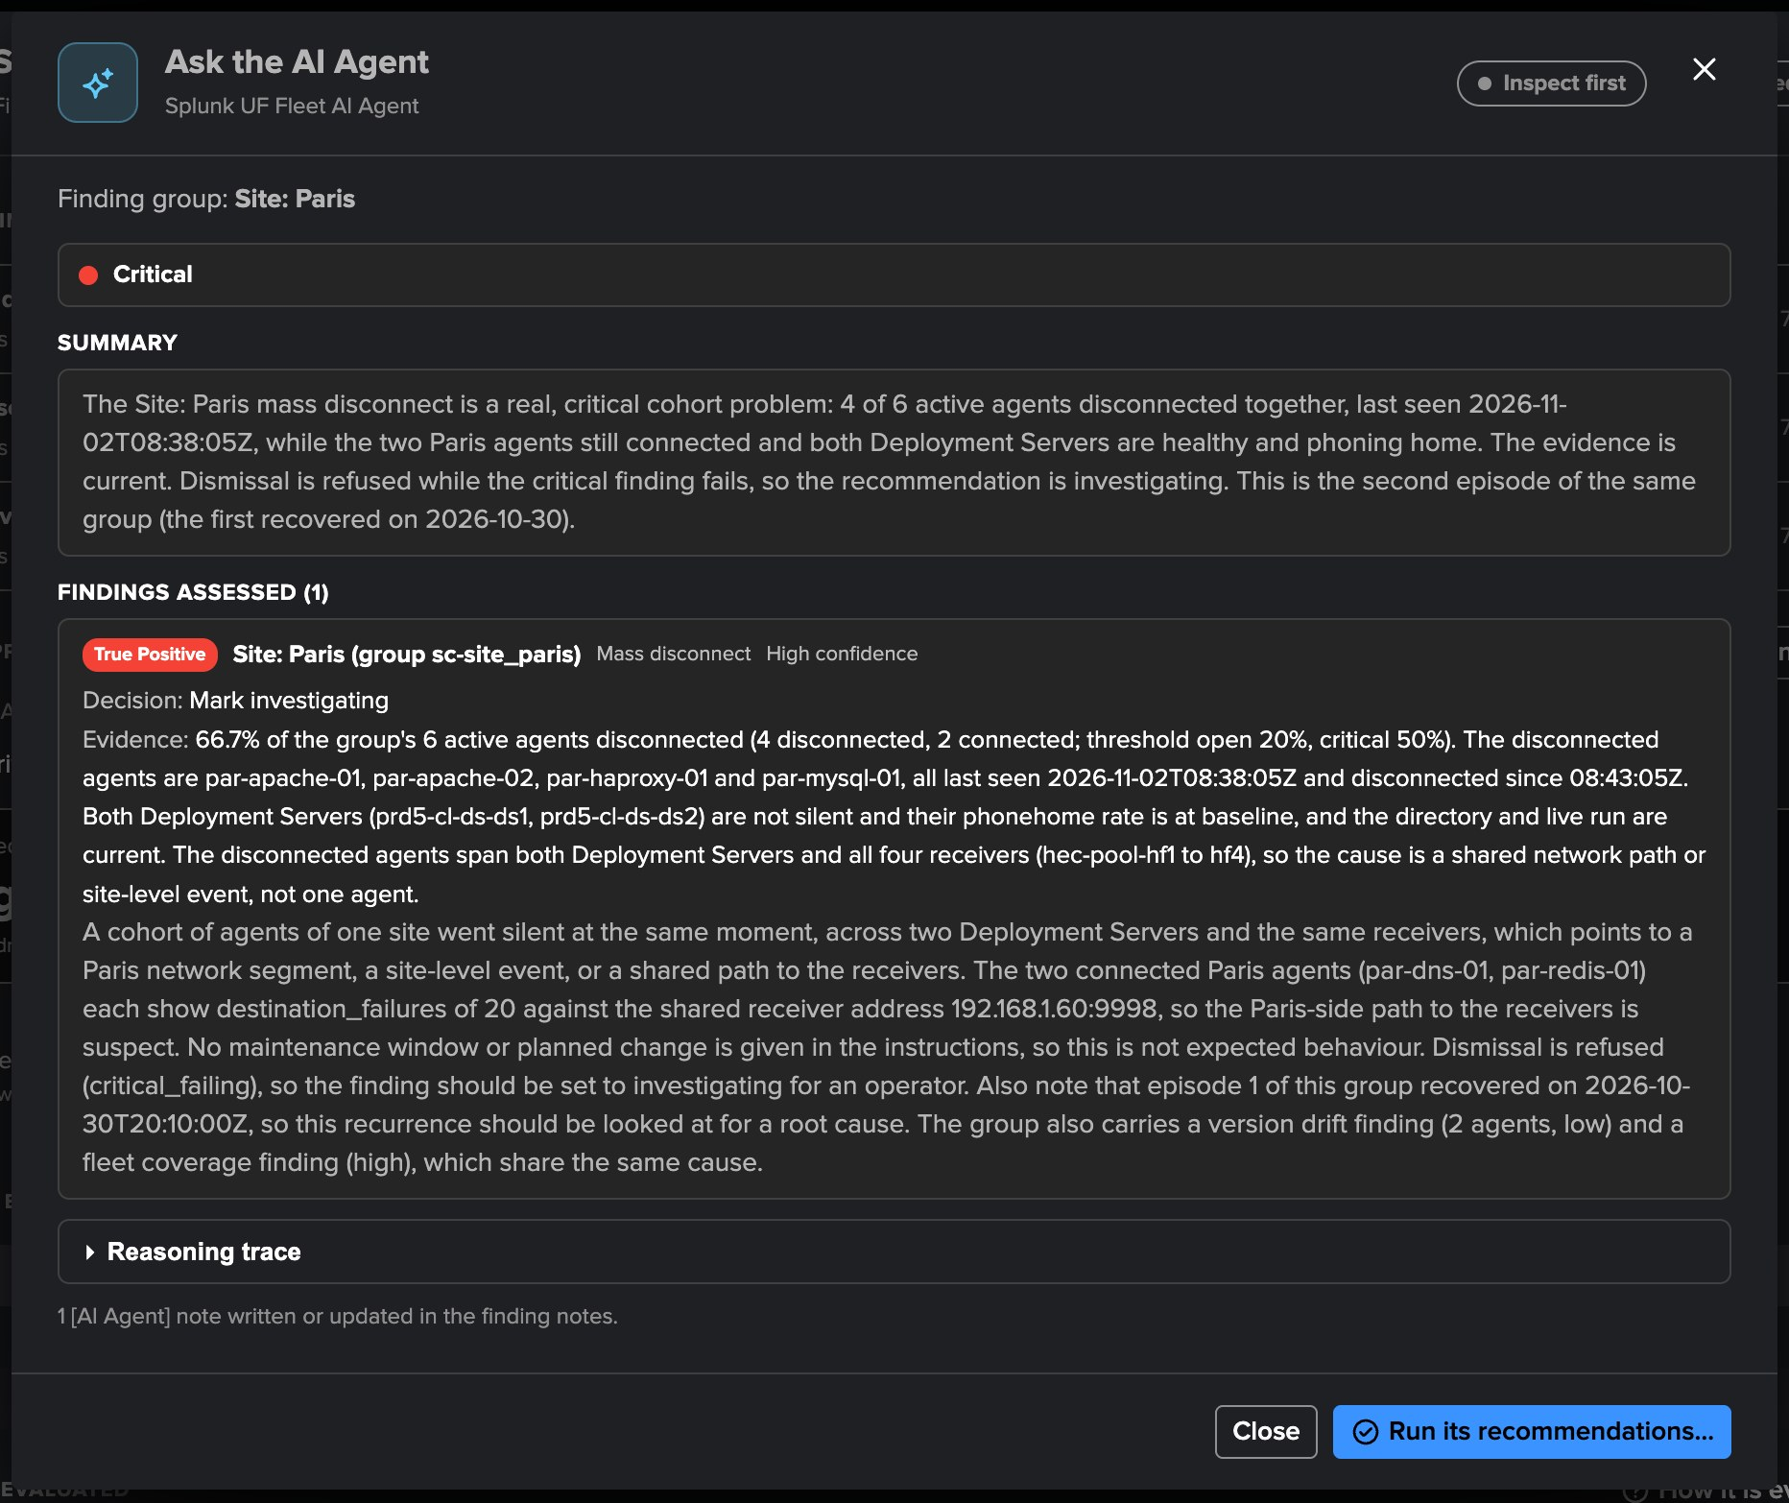
PART 4 · AI AGENT
The Splunk UF Fleet AI Agent — a review on demand or on a schedule
1
What it reads
The agent's directory row, its Deployment Server, the fleet, collection health.
2
Its tools
Fleet overview, agents, Deployment Servers, log evidence, trends.
3
One note per review
An [AI Agent] note on the finding.
4
It recommends
Never Forgets an agent, never adds an expected one: an operator decides.
TrackMe for Splunk · Hands-on: Splunk UF Fleet
docs.trackme-solutions.com
Notes:
Ask the AI Agent from a finding or a Finding group. Scheduled triage is off by default: hourly, up to ten findings per run. In act mode it applies only what the tenant allows, and never changes anything on an agent or a Deployment Server.

Slide 26
WHERE WE ARE
One tenant, every agent and Deployment Server
Set up
Configured
Followed
Judged
a tenant on the local search tier, two Deployment Server API accounts, the corporate scope
a CMDB on every agent, groups by site, role and environment, expected agents
the fleet, an agent up close, the Deployment Servers and their pace
a site gone dark as one finding, an expected agent missing
What made it work
The data path itself
Cohorts, not storms
Bounded at any size
Connected means a receiver saw it: no heartbeat to deploy, no agent polled.
A group or a fleet disconnecting together is one finding holding its members.
Aggregations over indexed terms, never a search per agent.
TrackMe for Splunk · Hands-on: Splunk UF Fleet
docs.trackme-solutions.com
Notes:
Where we are. A Splunk UF Fleet tenant set up on twenty universal forwarders and a Deployment Server cluster, enriched from a CMDB, grouped by site, role and environment, its critical agents expected; the fleet, the agents and the Deployment Servers followed; a site gone dark read as a mass disconnect per cohort, an expected agent missing, and the AI Agent.

