Slide 1

HANDS-ON WALKTHROUGH · SPLUNK HEC
Is every HEC endpoint up and receiving?
One tenant follows the HTTP Event Collector of a Splunk deployment — its endpoints, the pools they form behind a load balancer and the tokens senders use — from the telemetry Splunk already writes: nothing to install, nothing new to ingest.
Captured live on TrackMe 2.4.21 · two data centres, two heavy forwarders each, fed by Cribl Stream
Notes:
Hands-on walkthrough of the Splunk HEC tenant, generally available in TrackMe 2.4.21. Everything was captured live on a deployment with two data centres: two pools of two heavy forwarders, each pool receiving its own HEC token from Cribl Stream senders. In four parts: create the tenant, follow the endpoints, pools and tokens, read the findings of an endpoint stopped on purpose, and operate the tenant.

Slide 2
THE PROBLEM
HEC fails quietly: senders retry, data piles up elsewhere
A heavy forwarder that stops, a pipeline that backs up, a token sending to an index it may not use: the sender sees an error, Splunk logs it, nobody looks.
Endpoints that stop
"Server is busy"
Tokens and the load balancer
A heavy forwarder down, a pool left with one member, telemetry stalled behind a blocked output.
Refused requests, back pressure along the ingestion pipeline, the stage that cannot keep up, indexer acknowledgment under pressure.
Data rejected per token, a token that went silent, a pool member up but starved of traffic.
What a Splunk HEC tenant does
A dedicated tenant type for the HEC endpoints of one Splunk deployment. TrackMe reads the HEC telemetry Splunk already writes — its metrics in _introspection, its HTTP input, queue and output messages in _internal — with a few bounded searches every five minutes, and raises findings from eighteen built-in policies on endpoints, pools and tokens. It only reads: nothing is installed or changed on Splunk, and a token is only ever known by its name.
TrackMe for Splunk · Hands-on: Splunk HEC
docs.trackme-solutions.com
Notes:
A Splunk administrator asks the same HEC questions every day: are all my HEC endpoints up and receiving, are senders being refused and why, where is the bottleneck when HEC answers Server is busy, which tokens send data Splunk rejects, did a business-critical token stop sending, and does the load balancer spread the traffic over every member of the pool. The Splunk HEC tenant answers them with findings raised by built-in policies.

Slide 3
THE MODEL
Splunk's own telemetry, read every five minutes, judged per pool
1
Source
2
Discover
3
Measure
4
Decide
5
Act
HEC metrics in _introspection and the HTTP input messages in _internal — on this search tier or through a remote account.
Heartbeats find the endpoints; pools by host pattern or by hand; token names seen in 24 hours.
Every 5 minutes: throughput, refusals by reply code, queues and the bottleneck, output, CPU and memory.
18 built-in policies on endpoints, pools and tokens, plus custom SPL policies.
Finding groups, notifications, findings actions, the AI Agent, Topology Studio.
›
›
›
›
Pools judged as a whole
Endpoints behind one load balancer form a pool: TrackMe compares its members — members up against the expected size, the share of the traffic each one receives, their versions and settings — and judges its capacity and its traffic as a whole.
Traffic models learn what each pool and each token usually receives per hour of the week, from the history _introspection already keeps.
TrackMe for Splunk · Hands-on: Splunk HEC
docs.trackme-solutions.com
Notes:
The model. Every HEC instance writes its HEC metrics every minute, traffic or not: that heartbeat finds the endpoints and says whether they are up. Every five minutes TrackMe reads the last settled window of what Splunk indexed: traffic, refusals, queues, output and load per endpoint and token. An endpoint directory is rebuilt about once an hour, traffic models learn twice an hour, and the policies decide on each window. The cost does not grow with one search per endpoint.

Slide 4
THE PLAN
What we are going to do — one tenant, four parts
PART 1
PART 2
PART 3
PART 4
Setup
Endpoints, pools & tokens
Findings
Operate
The Splunk HEC card
The overview
A heavy forwarder stops
Policies and token silence
Source, endpoints and pools
Endpoints and one endpoint up close
How it is evaluated
Traffic models and tuning
The workspace and its strip
A pool, the tokens
Topology Studio, the AI Agent
Collection health, splunkd API
Every screen is the product as shipped, on two data centres of heavy forwarders.
TrackMe for Splunk · Hands-on: Splunk HEC
docs.trackme-solutions.com
Notes:
Four parts. Setup: the wizard, the pools and the workspace. Endpoints, pools and tokens: the overview, the endpoints, a pool and its traffic distribution, the tokens. Findings: a heavy forwarder stopped on purpose, what opens, how it is evaluated, the topology and the AI Agent. Operate: the policies, the tokens that must keep sending, the traffic models, collection health and the splunkd API.

Slide 5
01
PART 1 · SETUP
One source, two pools, one tenant
The Splunk HEC card, the source and its endpoints discovered from their heartbeats, the pools of each data centre, and the workspace.
TrackMe for Splunk · Hands-on: Splunk HEC
Notes:
Part one: setup. A Splunk HEC tenant reads one deployment: its local search tier, or another deployment through a TrackMe remote account, a Splunk Cloud stack included.

Slide 6
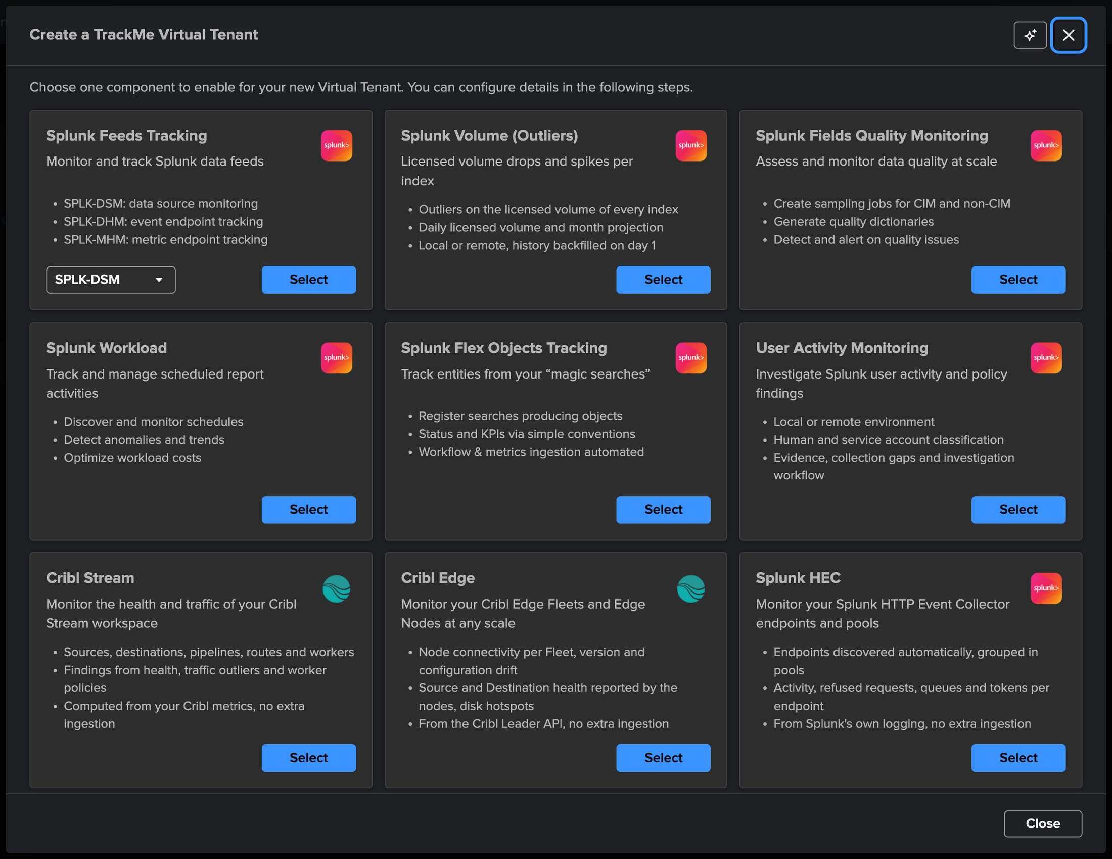
PART 1 · SETUP
A dedicated tenant — pick Splunk HEC
1
The Splunk HEC card
Endpoints discovered automatically, grouped in pools; activity, refused requests, queues and tokens per endpoint.
2
From Splunk's own logging
No extra ingestion and nothing installed on the endpoints.
3
Four steps
Basics, Source & endpoints, Indexes & RBAC, Review.
Licence
A valid Enterprise, Unlimited, Unlimited trial or Developer licence. Not available on the Foundation edition or the Foundation trial.
Virtual Tenants → Actions → Create a tracking tenant.
TrackMe for Splunk · Hands-on: Splunk HEC
docs.trackme-solutions.com
Notes:
Virtual Tenants, Actions, Create a tracking tenant, Splunk HEC card. A Splunk HEC tenant has no entities and no state colour: it is a findings tenant, like Cribl Stream, Cribl Edge and User Activity Monitoring.

Slide 7
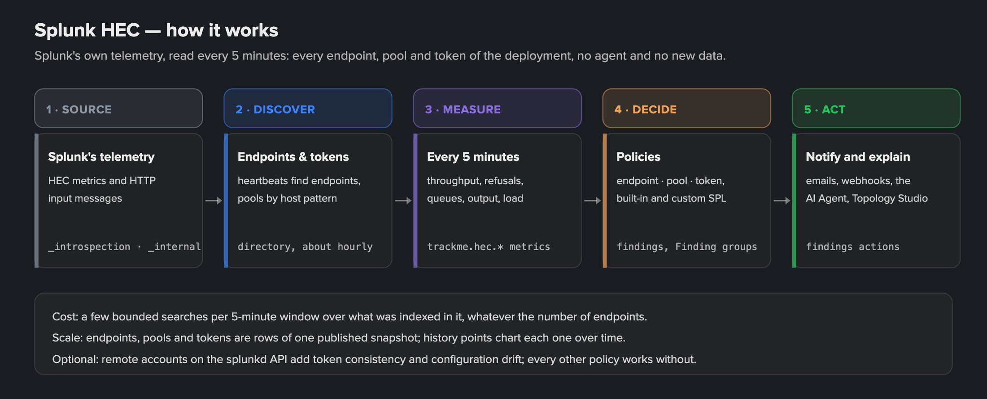
PART 1 · SETUP
The first screen explains the tenant — with a diagram on demand
1
Source
3
Measure
5
Cost
The HEC metrics and the HTTP input messages Splunk already writes.
Every 5 minutes: throughput, refusals, queues, output, load.
A few bounded searches per window, whatever the number of endpoints.
2
Discover
4
Decide and act
Heartbeats find the endpoints; pools by host pattern; a directory about hourly.
Policies on endpoints, pools and tokens; findings, emails, webhooks, the AI Agent.
TrackMe for Splunk · Hands-on: Splunk HEC
docs.trackme-solutions.com
Notes:
Basics is the tenant identifier, an alias and a description. The intro card says what the tenant does; How it works draws the five stages. The optional splunkd API enrichment adds two configuration policies; every other policy works without it.

Slide 8
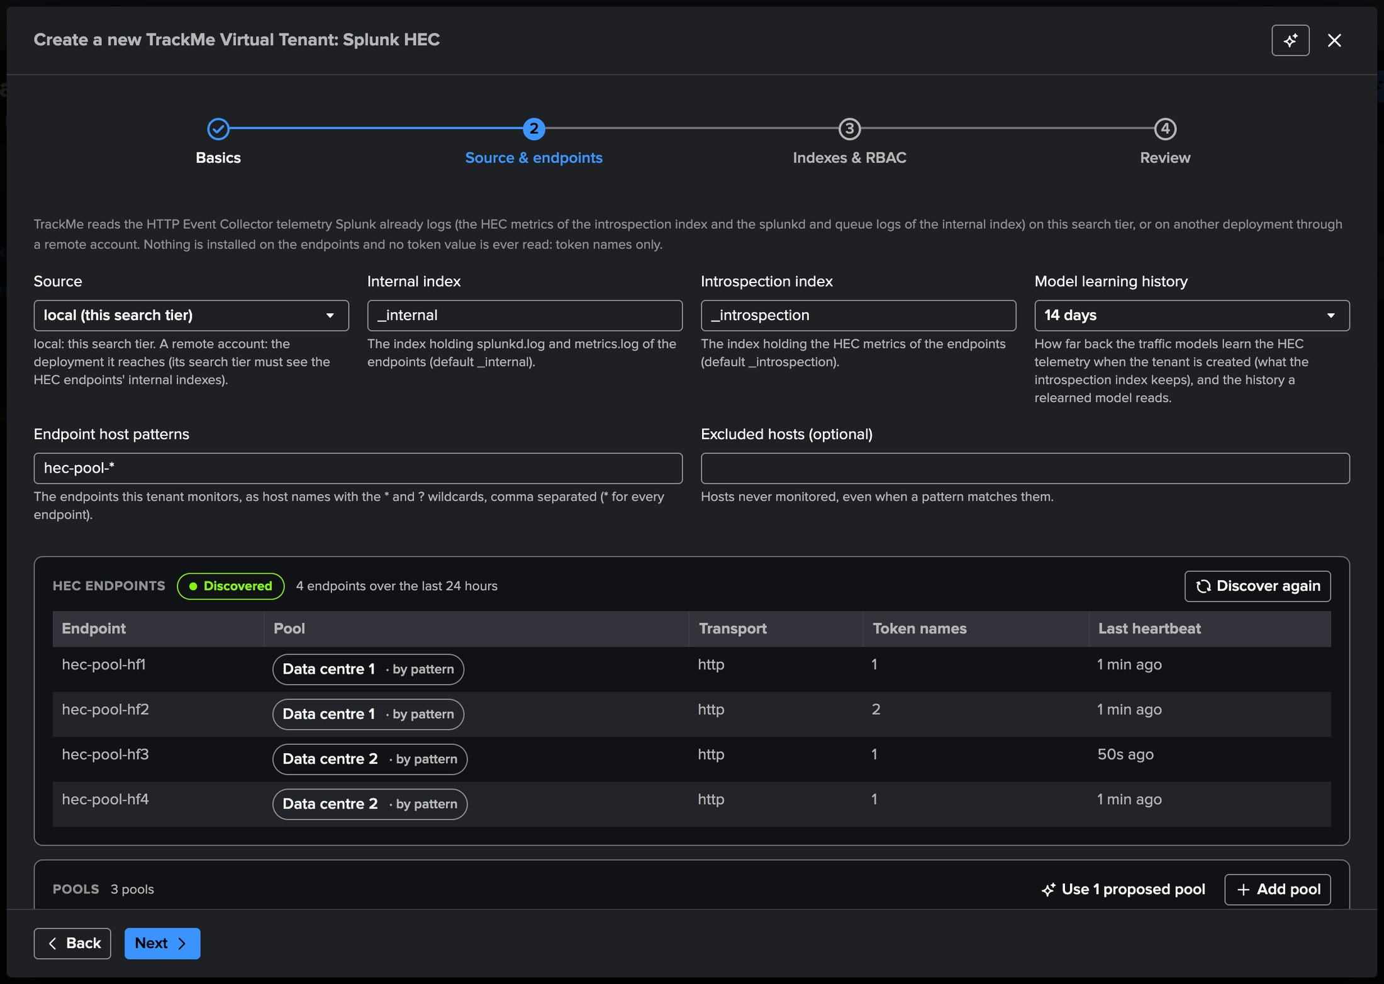
PART 1 · SETUP
Source & endpoints — found from their HEC heartbeats
1
Source
local, this search tier, or a TrackMe remote account to another deployment.
2
Indexes
_internal and _introspection by default; locked once the tenant exists.
3
Model learning history
14 days by default: the traffic models learn the telemetry _introspection already keeps.
4
Host patterns
hec-pool-* here: the old forwarders of the deployment stay out.
5
HEC endpoints
Every endpoint that reported in 24 hours, its transport, token names and last heartbeat.
TrackMe for Splunk · Hands-on: Splunk HEC
docs.trackme-solutions.com
Notes:
TrackMe searches the HEC telemetry of the source and lists every endpoint that reported in the last 24 hours. The host patterns narrow the tenant to the endpoints it should follow; excluded hosts are never monitored. When nothing reported, the tenant can still be created: endpoints join as soon as they report.

Slide 9
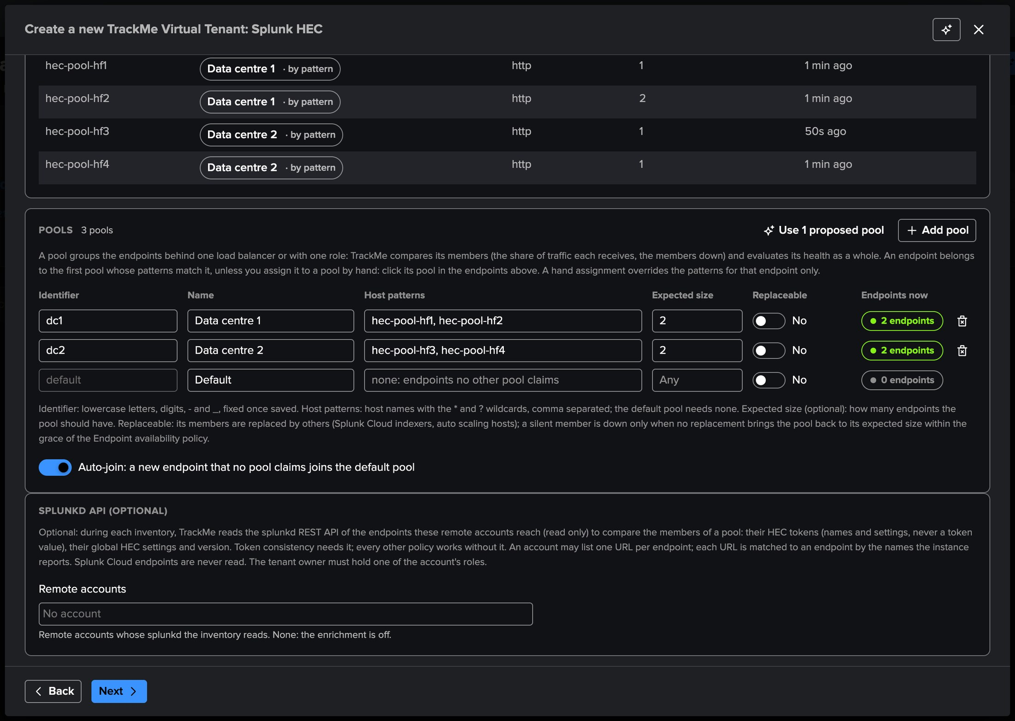
PART 1 · SETUP
Pools — one per data centre, each of two heavy forwarders
1
Endpoints and their pool
Each endpoint joins the first pool whose patterns match it; click its pool to assign it by hand.
2
Data centre 1 and 2
hec-pool-hf1/hf2 and hec-pool-hf3/hf4, expected size 2 each.
3
Proposed pools
One per host-name family, and one per Splunk Cloud stack.
4
Replaceable
For members replaced under new names: Splunk Cloud indexers, auto scaling.
5
Auto-join
A new endpoint no pool claims joins the default pool.
TrackMe for Splunk · Hands-on: Splunk HEC
docs.trackme-solutions.com
Notes:
A pool groups the endpoints behind one load balancer or with one role. Here each data centre has its own pool and its own token: the senders route one token to each data centre. The expected size is optional: without it Pool capacity learns the size from the pool's history. The splunkd API accounts, below, are optional too.

Slide 10
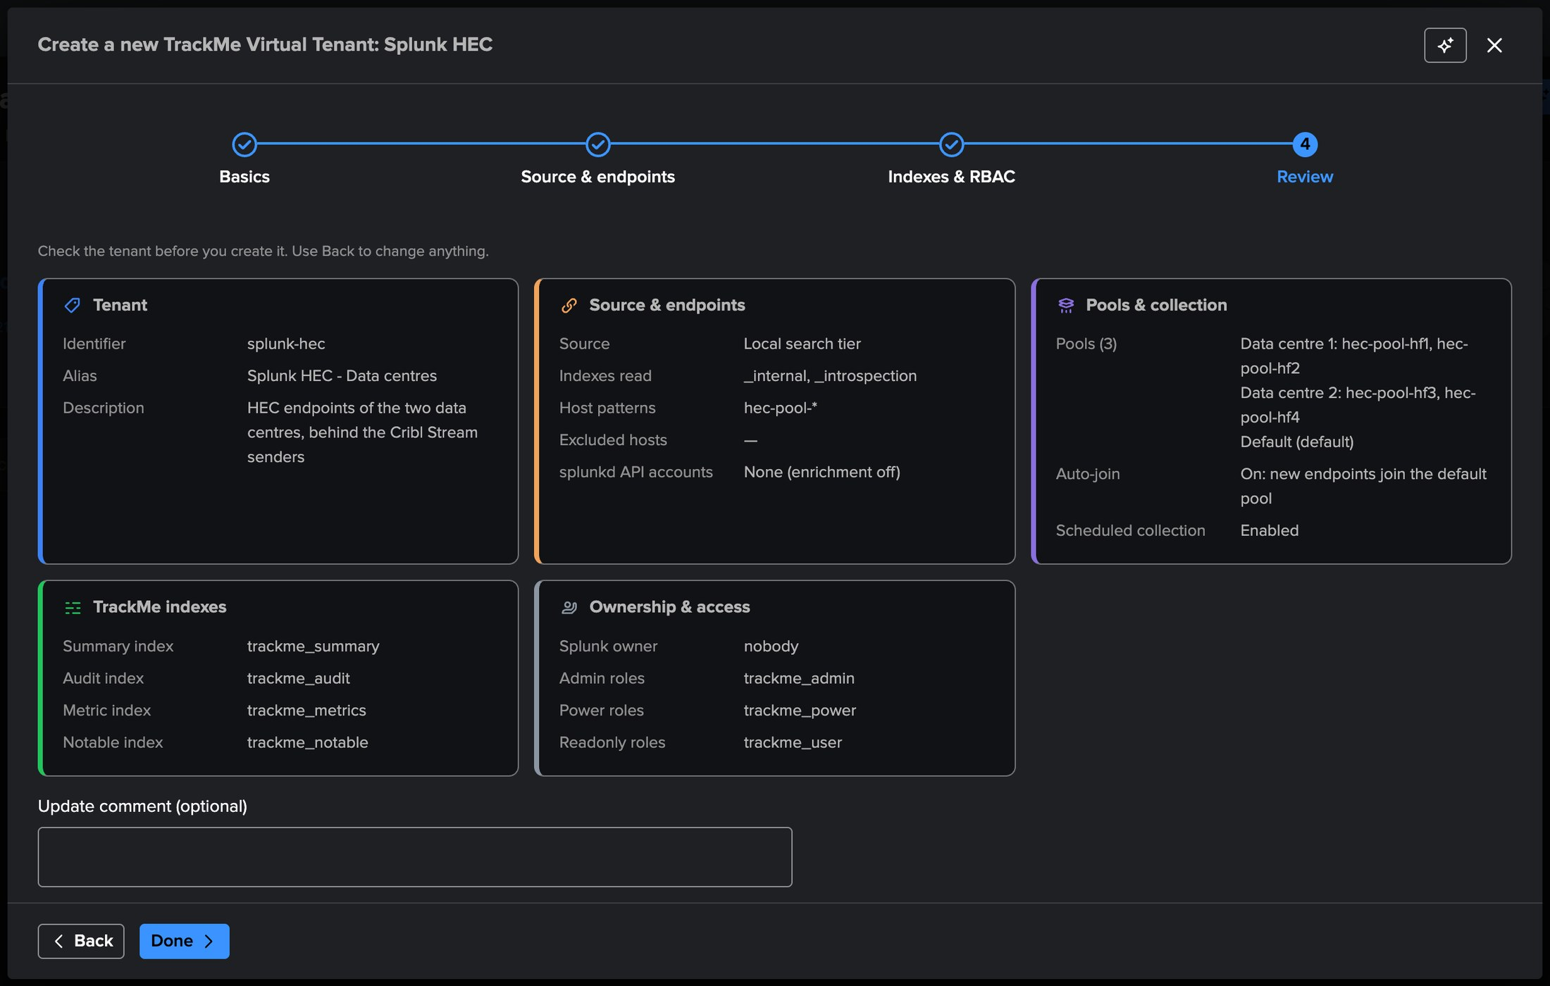
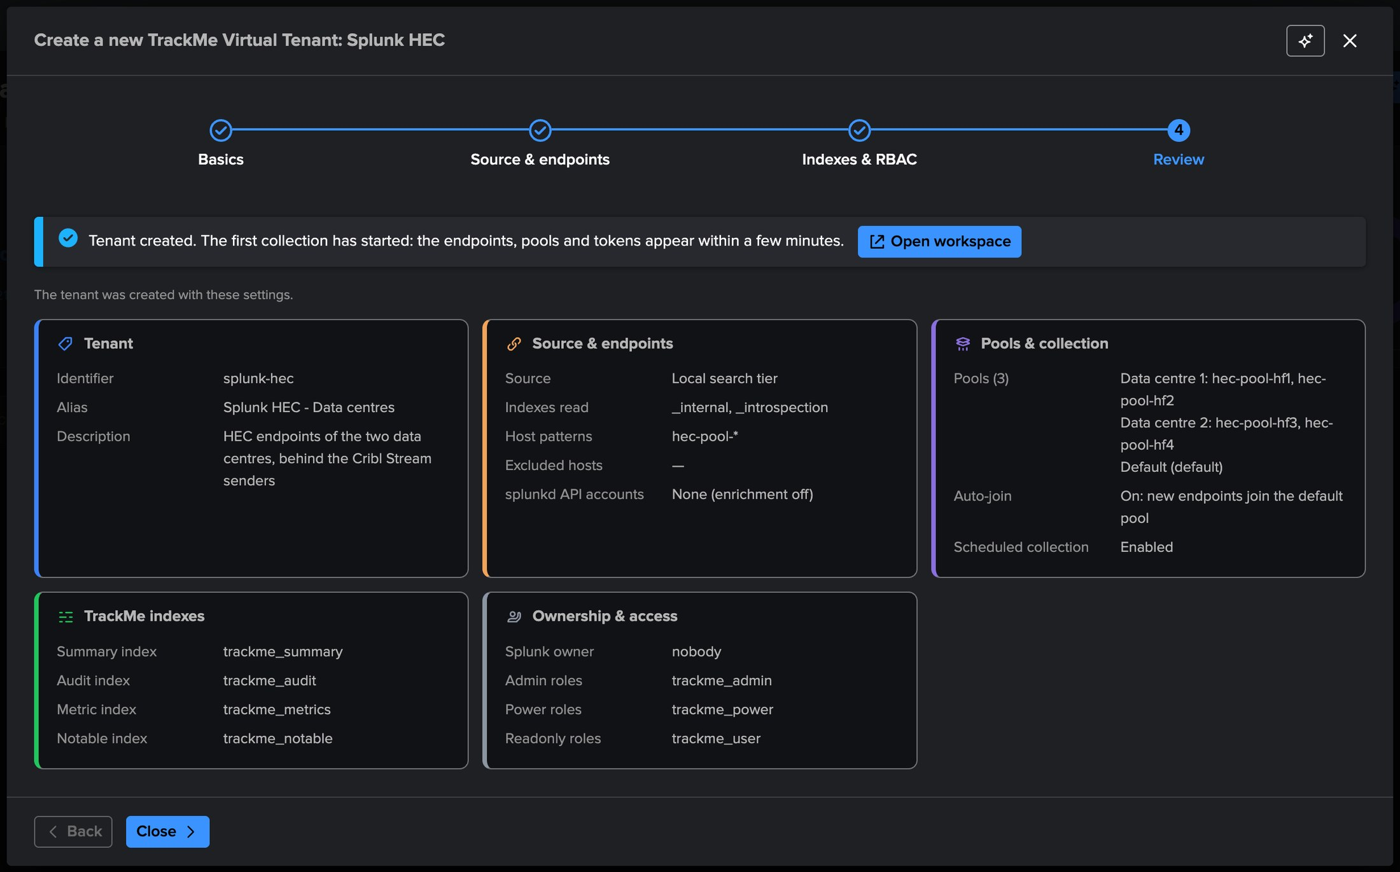
PART 1 · SETUP
Review, then create — the first collection starts at once
1
The summary
3
Created
Source, indexes read, host patterns, pools, auto-join, splunkd API accounts.
Collections and reports are created and the first collection starts.
4
Within minutes
2
Indexes and roles
Endpoints, pools and tokens appear in the workspace: Open workspace.
The tenant's TrackMe indexes, its owner and its roles.
TrackMe for Splunk · Hands-on: Splunk HEC
docs.trackme-solutions.com
Notes:
Collection is scheduled from the start: the HEC activity is read and the policies evaluated every five minutes, the endpoint directory rebuilt about once an hour, the traffic models trained twice an hour. A new tenant learns its traffic models from the history the source keeps, on its first runs.

Slide 11
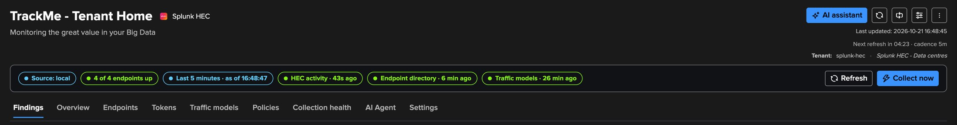
PART 1 · SETUP
The workspace — nine tabs and a strip that sums it up
1
Source and endpoints up
3
The three jobs
5
Nine tabs
local here; 4 of 4 endpoints up.
HEC activity, Endpoint directory and Traffic models with their last run.
Findings, Overview, Endpoints, Tokens, Traffic models, Policies, Collection health, AI Agent, Settings.
2
Last 5 minutes
The statistics of the last five minutes up to now, read on every refresh.
4
Collect now
For the TrackMe administrators of the tenant.
TrackMe for Splunk · Hands-on: Splunk HEC
docs.trackme-solutions.com
Notes:
The Splunk HEC workspace is built with the same components as the Cribl workspaces. States, findings and history come from settled windows; the figures shown are more recent: on every refresh TrackMe reads the last five minutes up to now and lays them over the collected rows.

Slide 12
02
PART 2 · ENDPOINTS, POOLS & TOKENS
The deployment at a glance, any endpoint up close
The overview, the endpoints and one endpoint with its ingestion pipeline, a pool and how it spreads its traffic, the tokens, and the maps each tab draws.
TrackMe for Splunk · Hands-on: Splunk HEC
Notes:
Part two: the endpoints, the pools and the tokens.

Slide 13
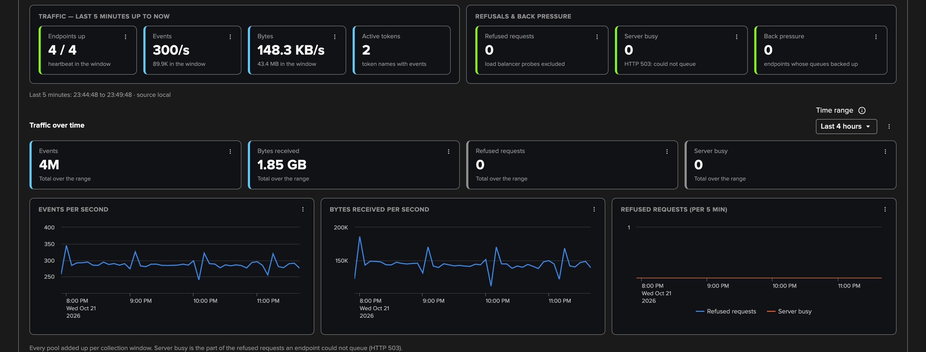
PART 2 · OVERVIEW
The overview — the HEC questions, answered at a glance
1
Endpoints up
3
Refused requests, server busy
5
Traffic over time
A heartbeat in the window.
Load balancer probes excluded; HTTP 503 when HEC could not queue.
Events, bytes, refusals and server busy over a range you choose.
2
Events, bytes, active tokens
The traffic of the last five minutes.
4
Back pressure
Endpoints whose queues backed up.
TrackMe for Splunk · Hands-on: Splunk HEC
docs.trackme-solutions.com
Notes:
The tiles answer the HEC questions at a glance; refused requests, server busy, back pressure and stalled open the Endpoints tab sorted or filtered on them. Below: the traffic over time, the pools, the endpoints needing attention, the discovered endpoints and the busiest tokens.

Slide 14
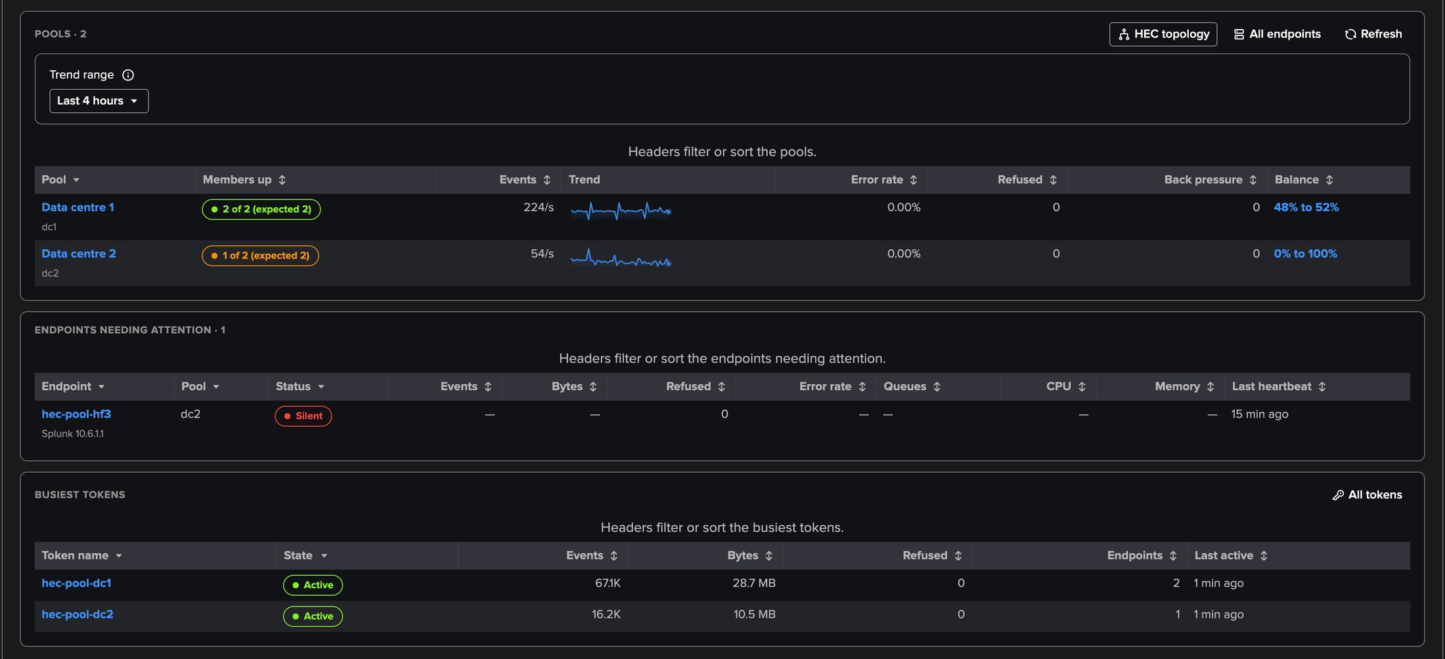
PART 2 · OVERVIEW
Pools, endpoints needing attention, busiest tokens
1
Pools
3
Needing attention
Members up against the expected size, traffic, refusals, back pressure, trend.
Not up, refusing, backed up, dropping oversized events, failing destinations.
2
Balance
4
Busiest tokens
The smallest and largest member shares: 48 % to 52 % is an even split.
By name, with the endpoints that received them.
TrackMe for Splunk · Hands-on: Splunk HEC
docs.trackme-solutions.com
Notes:
Data centre 2 has one of its two members up: hec-pool-hf3 was stopped on purpose, and it is listed as silent among the endpoints needing attention. Data centre 1 splits its traffic evenly, 48 to 52 per cent. A pool name or its Balance opens the pool drilldown, and HEC topology draws every pool and its endpoints on a live map.

Slide 15
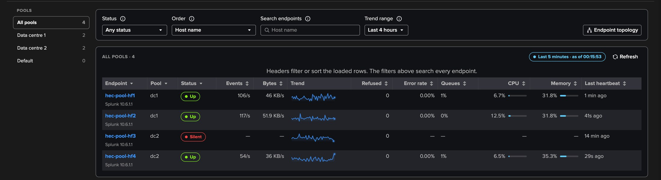
PART 2 · ENDPOINTS
Endpoints — by pool, filtered and paged by the server
1
Pools sidebar
3
Order
5
CPU and memory
All pools, one pool, or the discovered endpoints.
Most events, most refusals, highest error rate, back pressure first.
Host-wide, with a bar that turns amber from 75 % and red from 90 %; a dash without telemetry.
2
Status
4
Per endpoint
Up, late, stalled or silent: hec-pool-hf3 is silent.
Pool, traffic and its trend, refusals, error rate, fullest queue, last heartbeat.
TrackMe for Splunk · Hands-on: Splunk HEC
docs.trackme-solutions.com
Notes:
Every endpoint, by pool, filtered and paged by the server. An endpoint is up with a heartbeat in the window, late without one this window but one in the last five minutes, stalled when its output was in trouble and its own telemetry waits behind it, silent otherwise. CPU and memory are the host's own, every process on it included: here hec-pool-hf3 has none, since it is stopped. Endpoint topology draws the endpoints the tab selects.

Slide 16
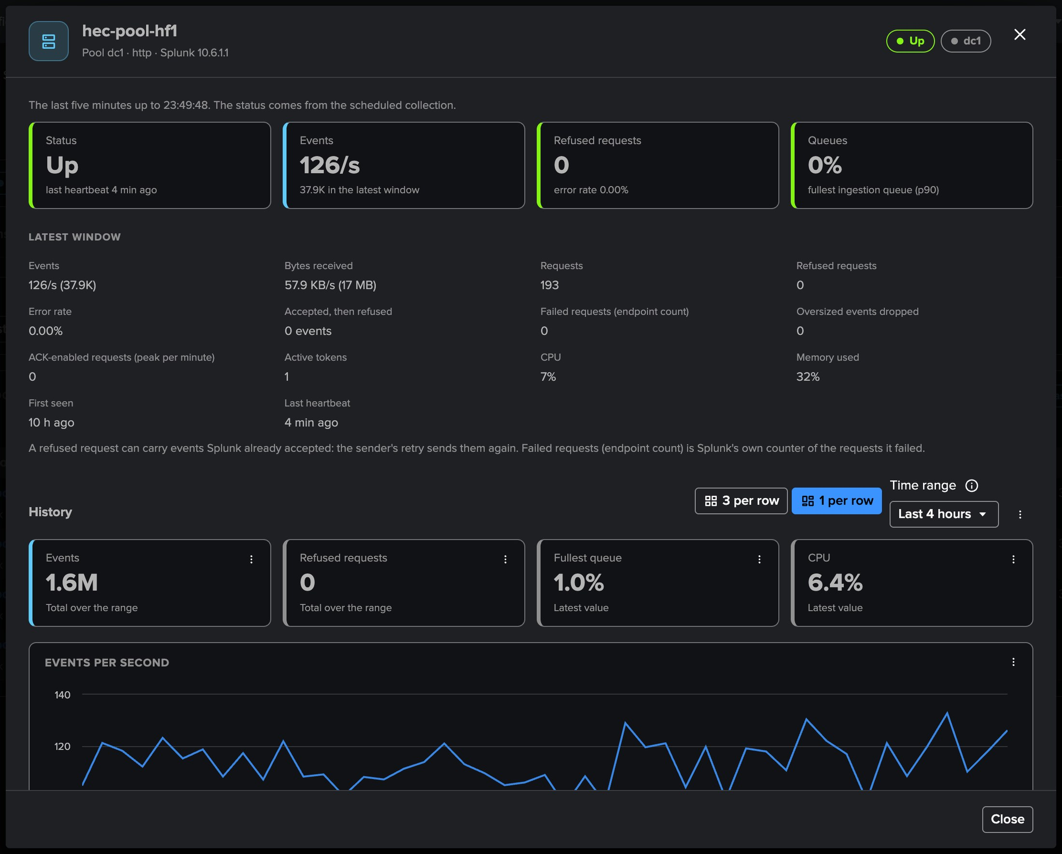
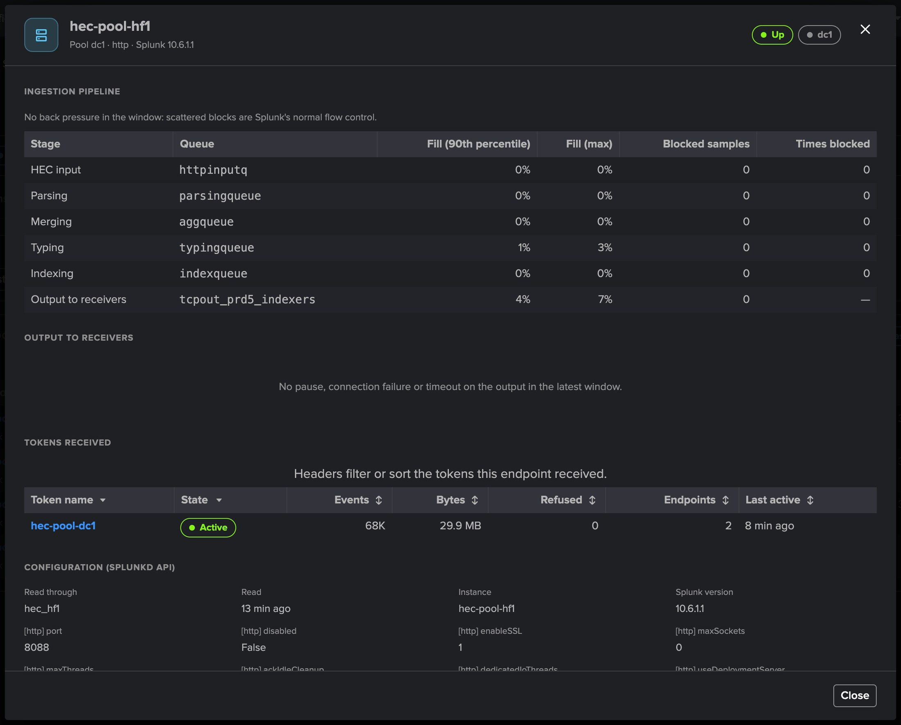
PART 2 · ONE ENDPOINT
One endpoint — its window, its pipeline, its output
1
Latest window
3
Ingestion pipeline
Events, bytes, requests, refused, error rate, CPU, memory, last heartbeat.
Each queue of the HEC path, its fill, the bottleneck and how busy its thread was.
2
Refused requests
By HEC reply code, in plain words.
4
Output and history
Destinations and receivers; events, refusals, fullest queue and CPU over time.
TrackMe for Splunk · Hands-on: Splunk HEC
docs.trackme-solutions.com
Notes:
The endpoint drilldown answers why HEC says Server is busy: HEC writes every request into one input queue, then into the ingestion pipeline and the output. When a stage cannot keep up, its queue fills, then the queues before it. TrackMe names the stage after the furthest-downstream saturated queue, and whether its thread was busy or waiting.

Slide 17
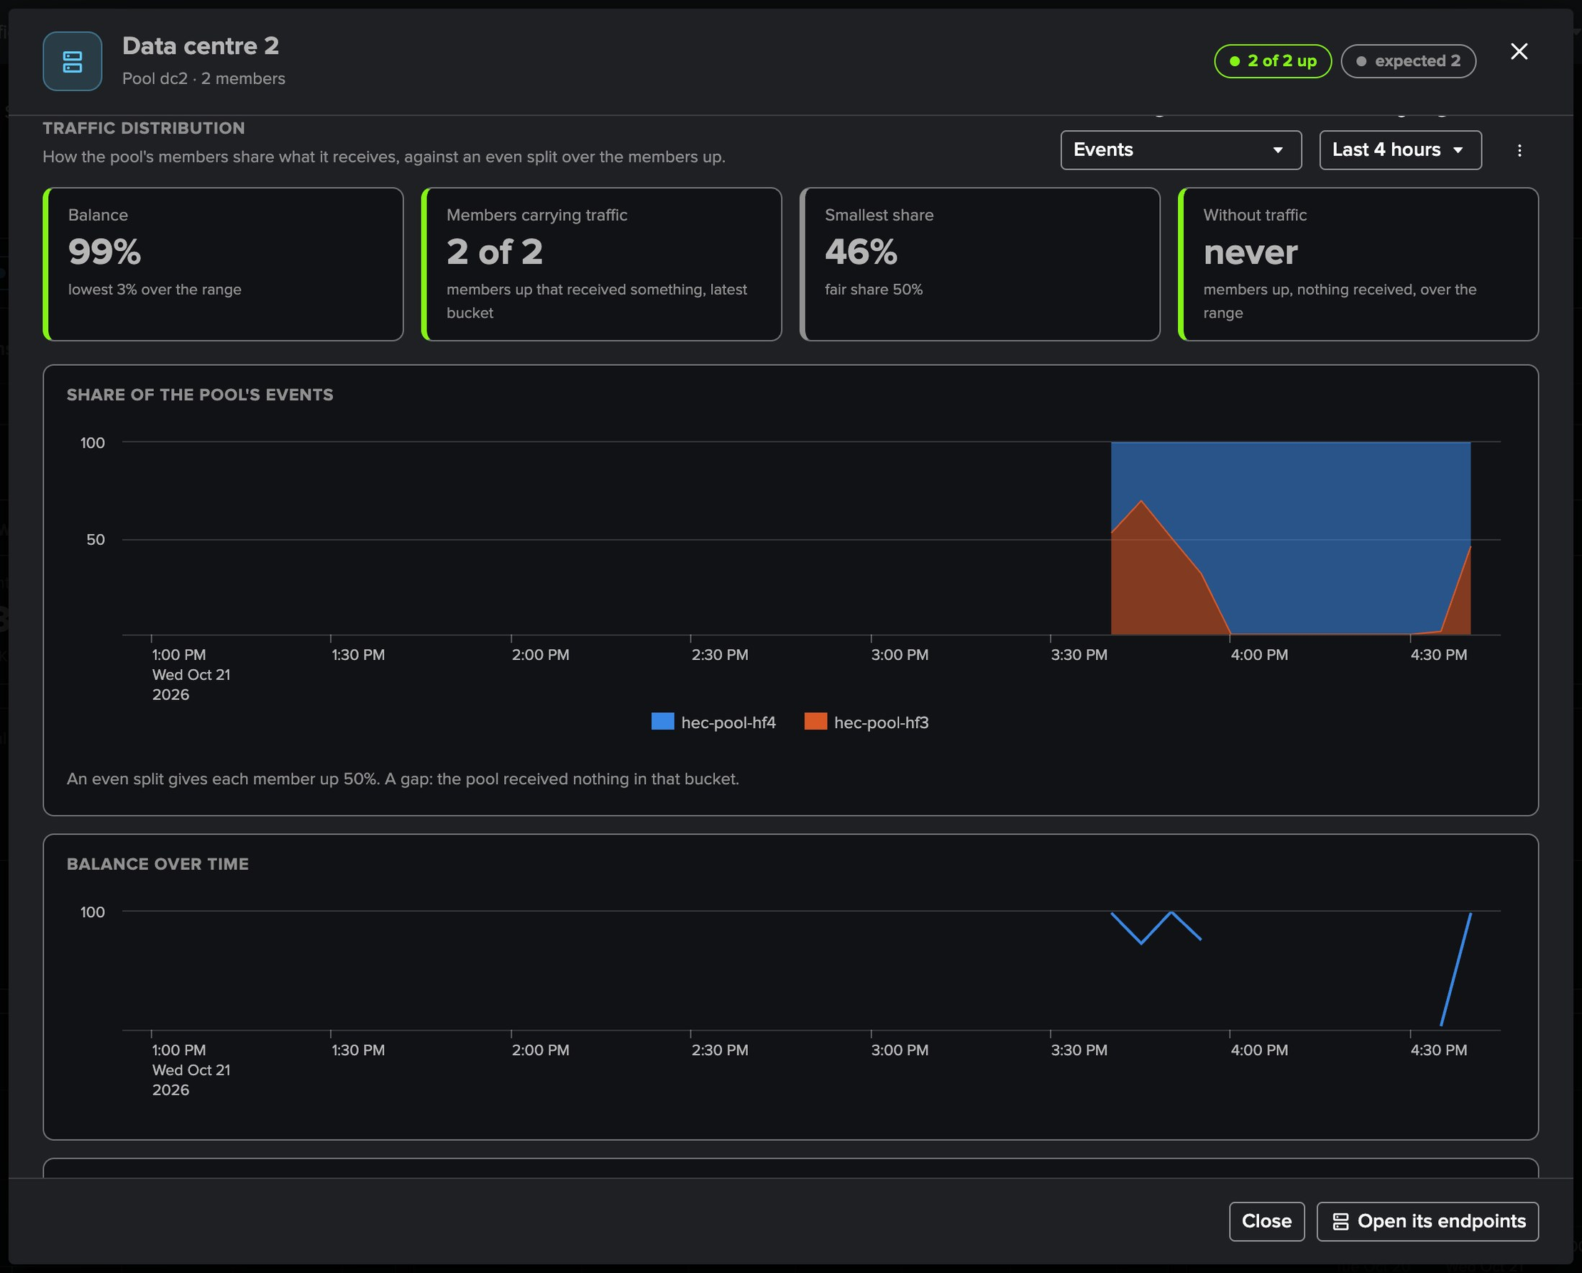
PART 2 · ONE POOL
A pool — is the load balancer spreading the traffic?
1
Balance
3
Members up that received nothing
100 for an even split over the members up, 0 when one member takes everything.
What Pool imbalance watches.
4
Share of each member over time
2
Members carrying traffic
With the balance over time and the members table.
And the smallest share against the fair share.
TrackMe for Splunk · Hands-on: Splunk HEC
docs.trackme-solutions.com
Notes:
The pool drilldown shows the latest window, then the traffic distribution over a range: the balance, the members carrying traffic, the smallest share against the fair share, the members up that received nothing, the share of each member over time and the balance over time.

Slide 18
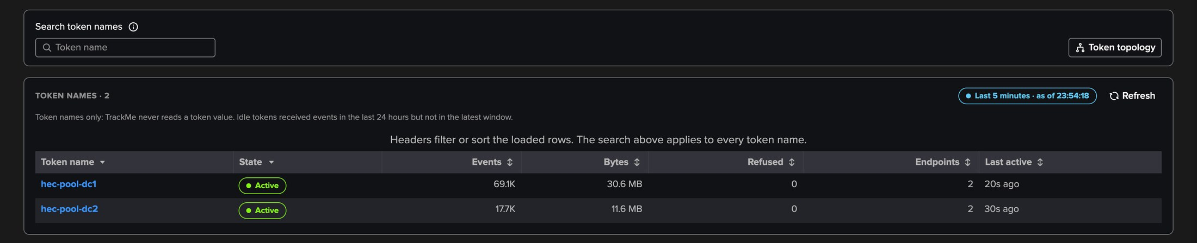
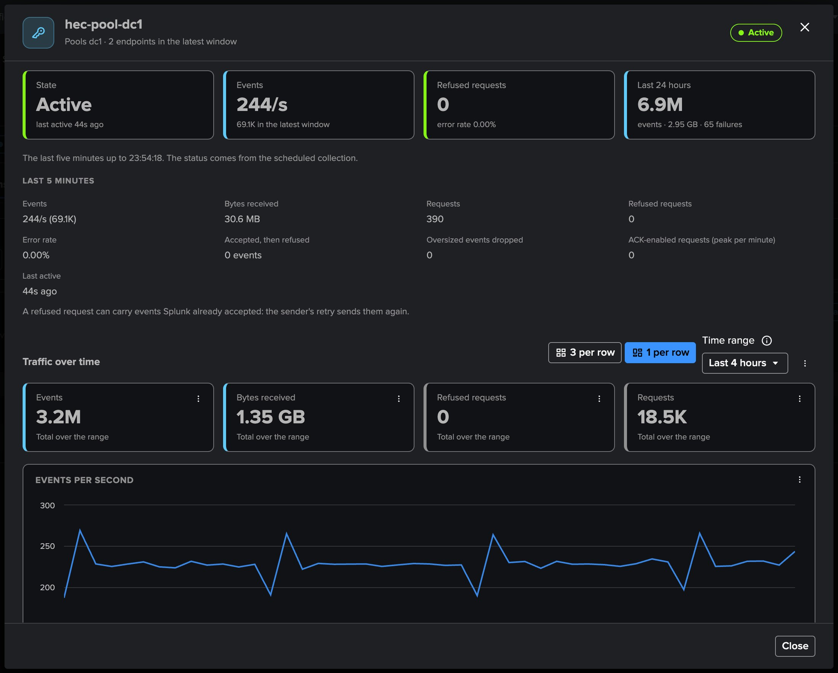
PART 2 · TOKENS
Tokens — known by name, never by value
1
Every token seen in 24 hours
3
Endpoints involved
The pools and endpoints that received it, events, bytes, refusals.
Each endpoint's share of the token's events against an even split.
2
The token drilldown
4
Errors
Its state, its last 24 hours, its traffic over time.
Reply codes in plain words, the index refused, the client addresses.
TrackMe for Splunk · Hands-on: Splunk HEC
docs.trackme-solutions.com
Notes:
TrackMe never reads, stores, logs or shows a token value: a token is the HEC input's name. Here each data centre has its own token, hec-pool-dc1 and hec-pool-dc2, received only by the two heavy forwarders of its pool.

Slide 19
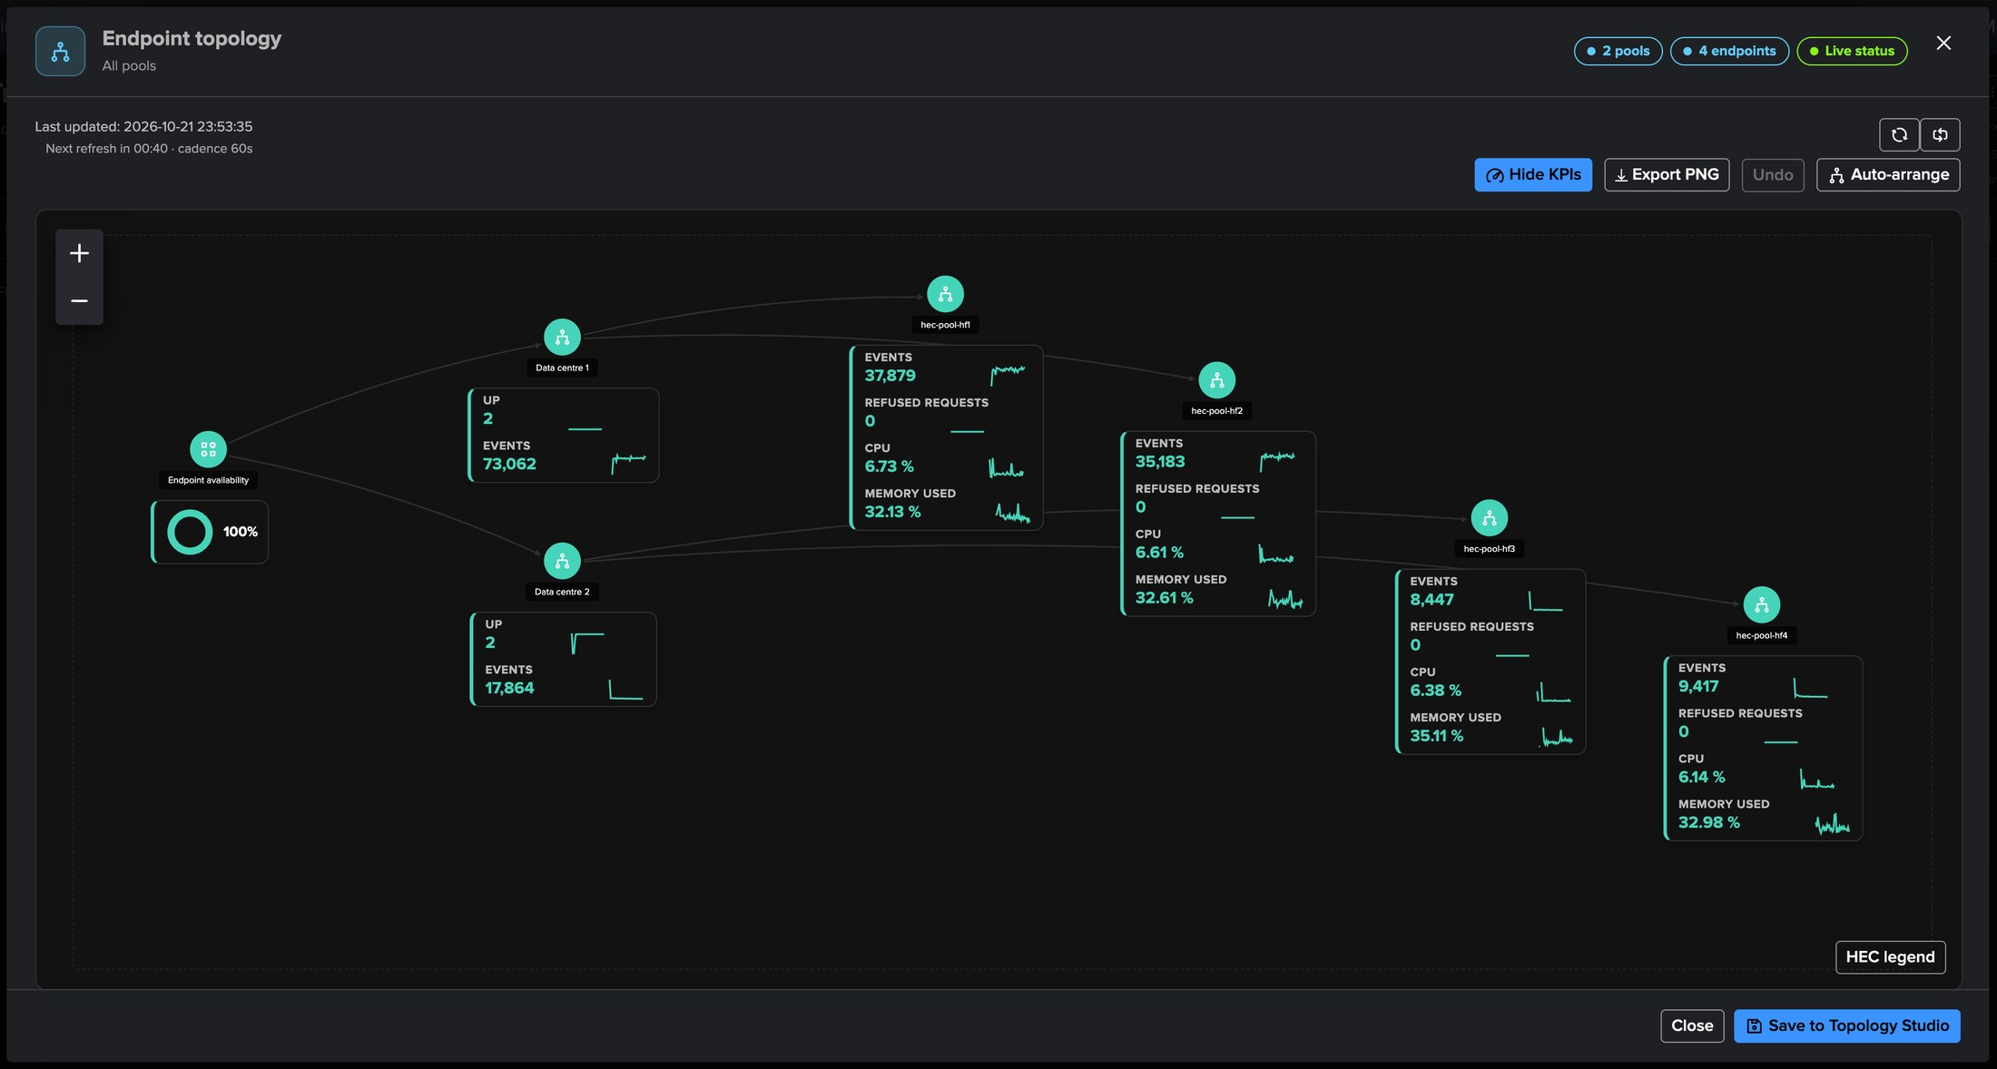
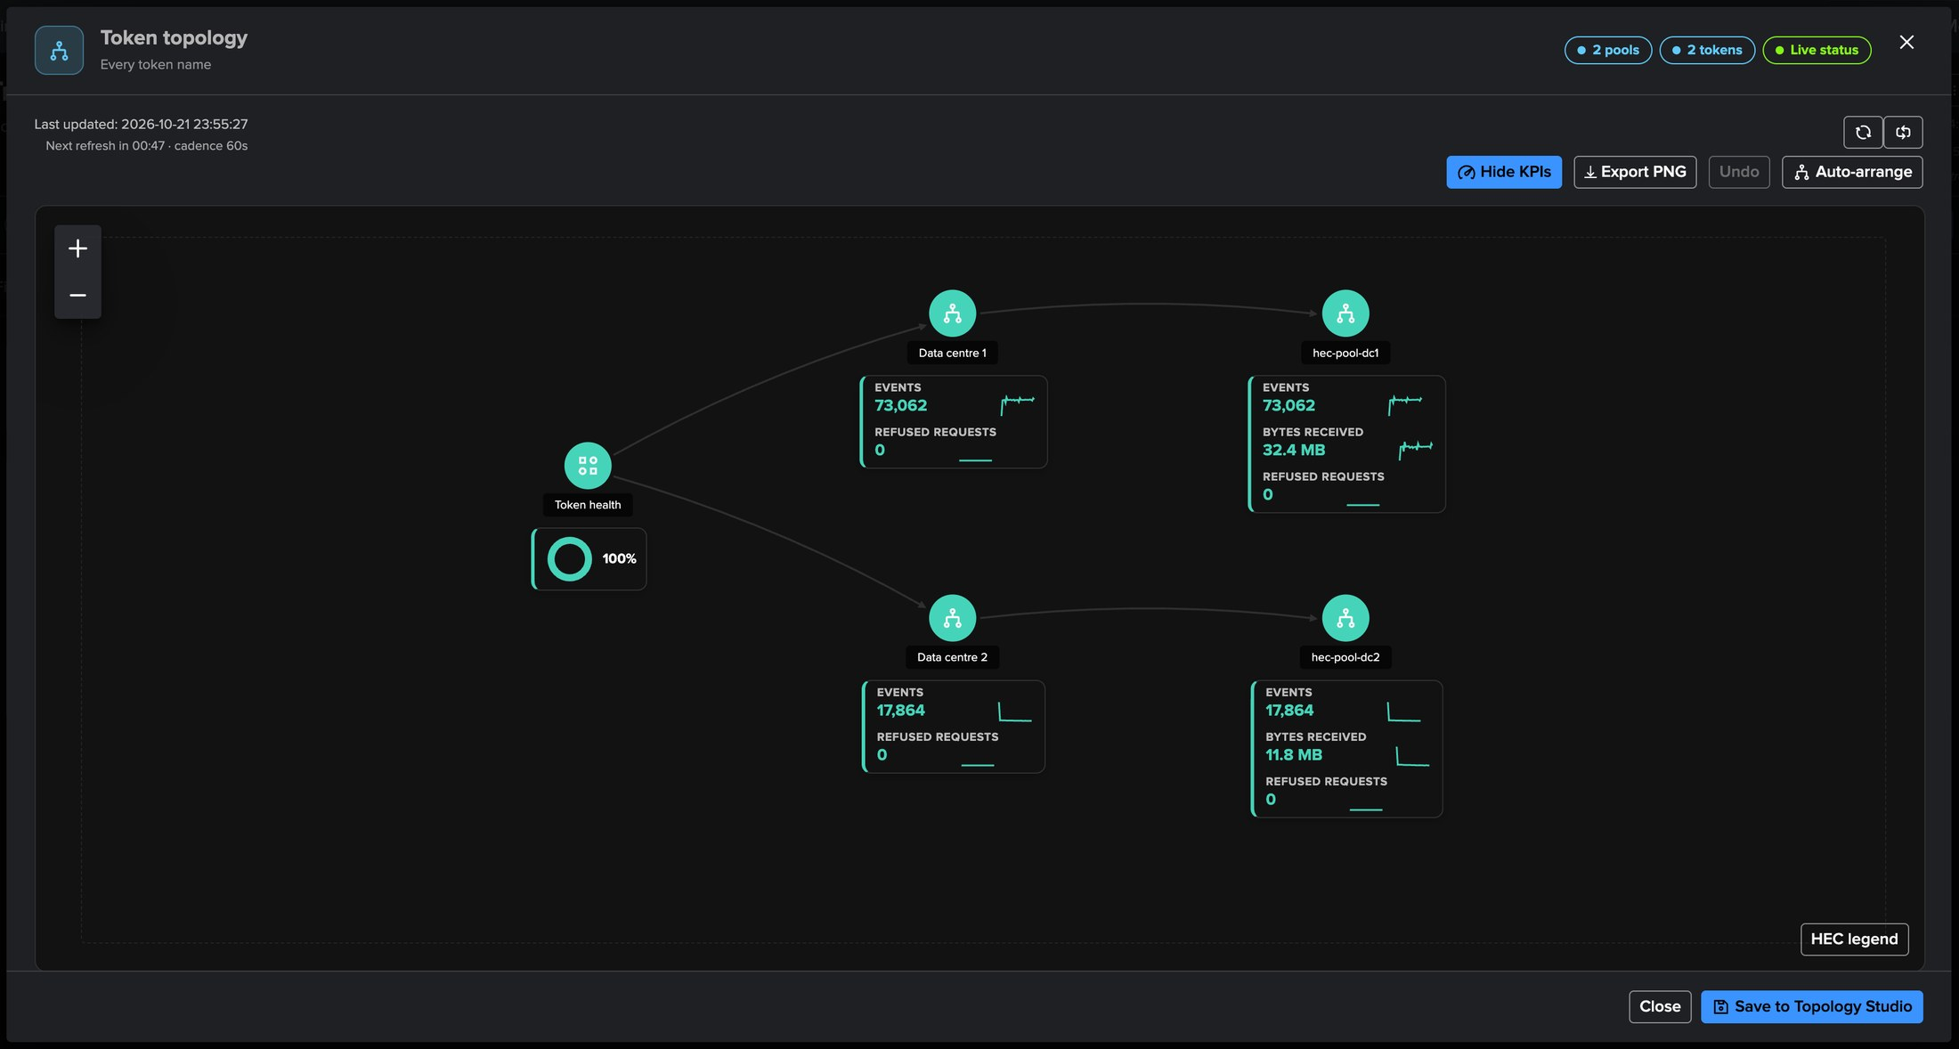
PART 2 · GENERATED TOPOLOGIES
Each tab draws its own map — one click, live
1
HEC topology
3
Token topology
From the Overview: every pool and its endpoints, with the availability donut.
Each token under the pools that received it, with its traffic.
4
Save to Topology Studio
2
Endpoint topology
A view like any other: share it, edit it, add Topology Alerts.
The endpoints the tab selects, with events, refusals, CPU and memory.
TrackMe for Splunk · Hands-on: Splunk HEC
docs.trackme-solutions.com
Notes:
Each workspace tab draws a live map of what it shows on the Topology Studio canvas: the HEC topology from the Overview, the Endpoint topology from the Endpoints tab with its filters, the Token topology from the Tokens tab. Every node shows its live status and twenty-four-hour sparklines, refreshed every minute. Save to Topology Studio keeps it as a view.

Slide 20
03
PART 3 · FINDINGS
A heavy forwarder stops — what opens, and why
hec-pool-hf3 stopped on purpose: Endpoint availability on the endpoint, Pool capacity on its pool, how each is evaluated, the topology and the AI Agent.
TrackMe for Splunk · Hands-on: Splunk HEC
Notes:
Part three: the findings. Findings work exactly as on the Cribl tenants: Finding groups, triage, notifications, assignment and findings actions.

Slide 21
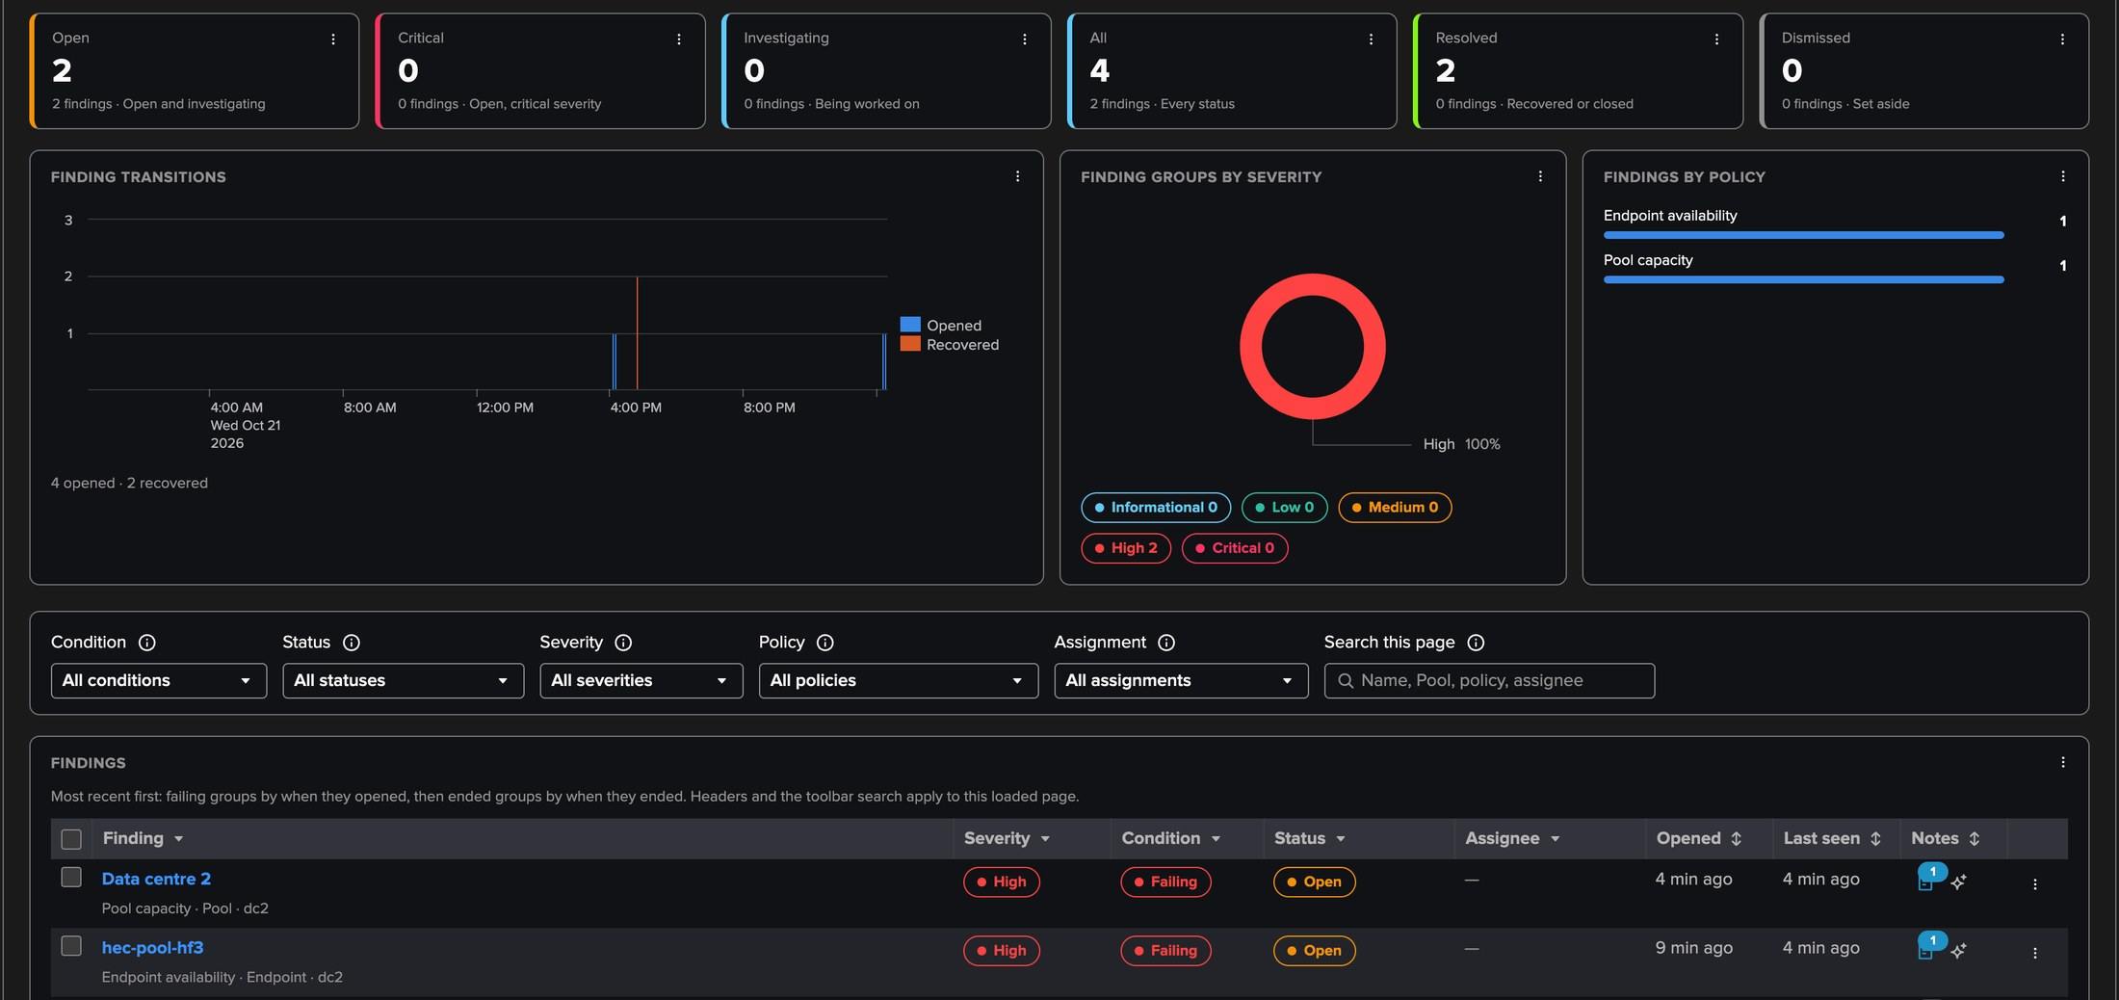
PART 3 · FINDINGS
The Findings tab — two findings, one cause
1
Open, critical, investigating
3
Endpoint availability
The counters of the tenant's findings.
hec-pool-hf3, High: silent for longer than 5 minutes.
2
Transitions and severities
4
Pool capacity
Opened and recovered over time, Finding groups by severity, findings by policy.
Data centre 2, High: 1 of 2 members up.
TrackMe for Splunk · Hands-on: Splunk HEC
docs.trackme-solutions.com
Notes:
One heavy forwarder of Data centre 2 was stopped. Endpoint availability opened on it at the first silent check, High; Pool capacity opened on its pool after two checks, High, critical only below half the expected size. Each object gathers its findings in one Finding group, the unit you triage and get notified about.

Slide 22
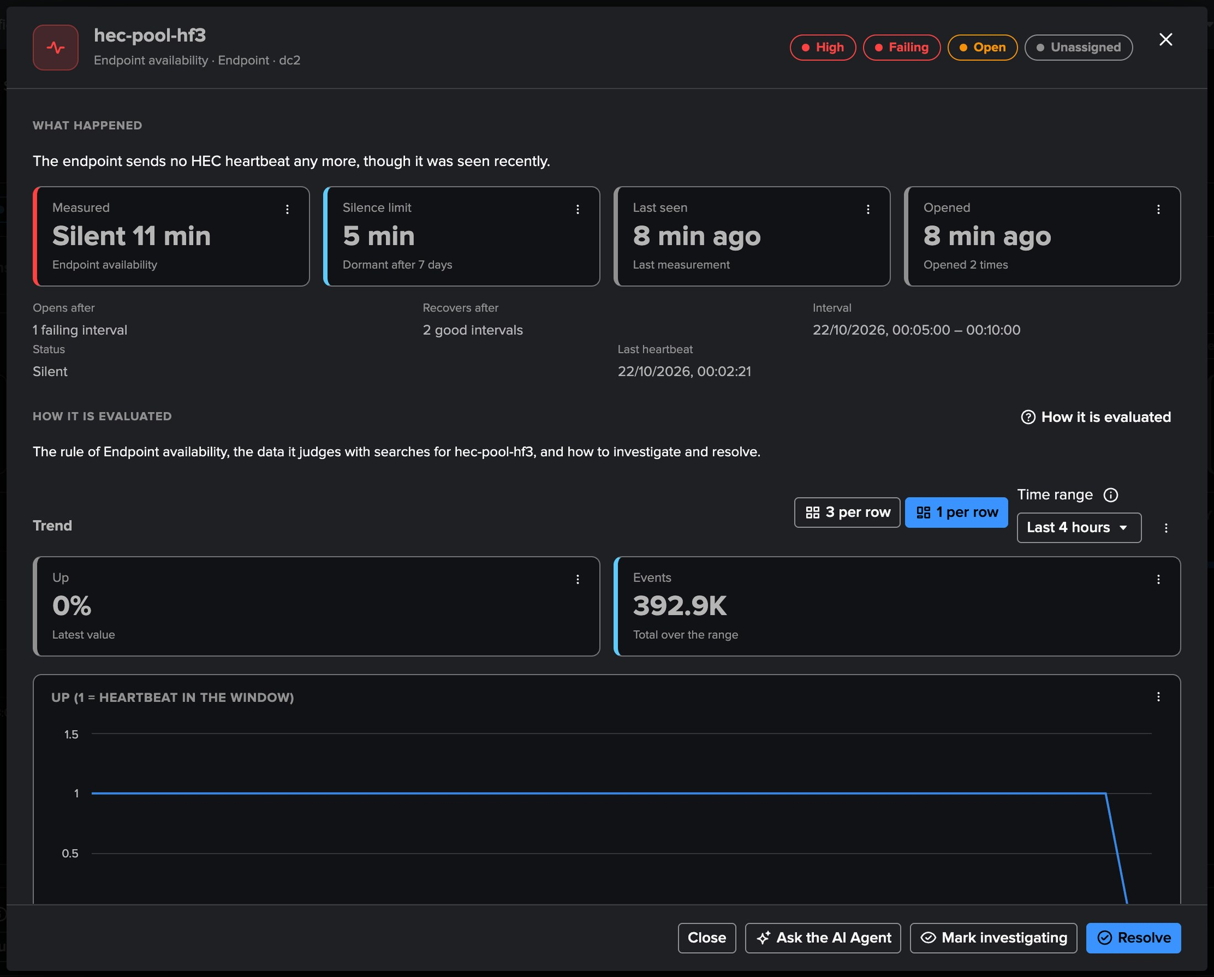
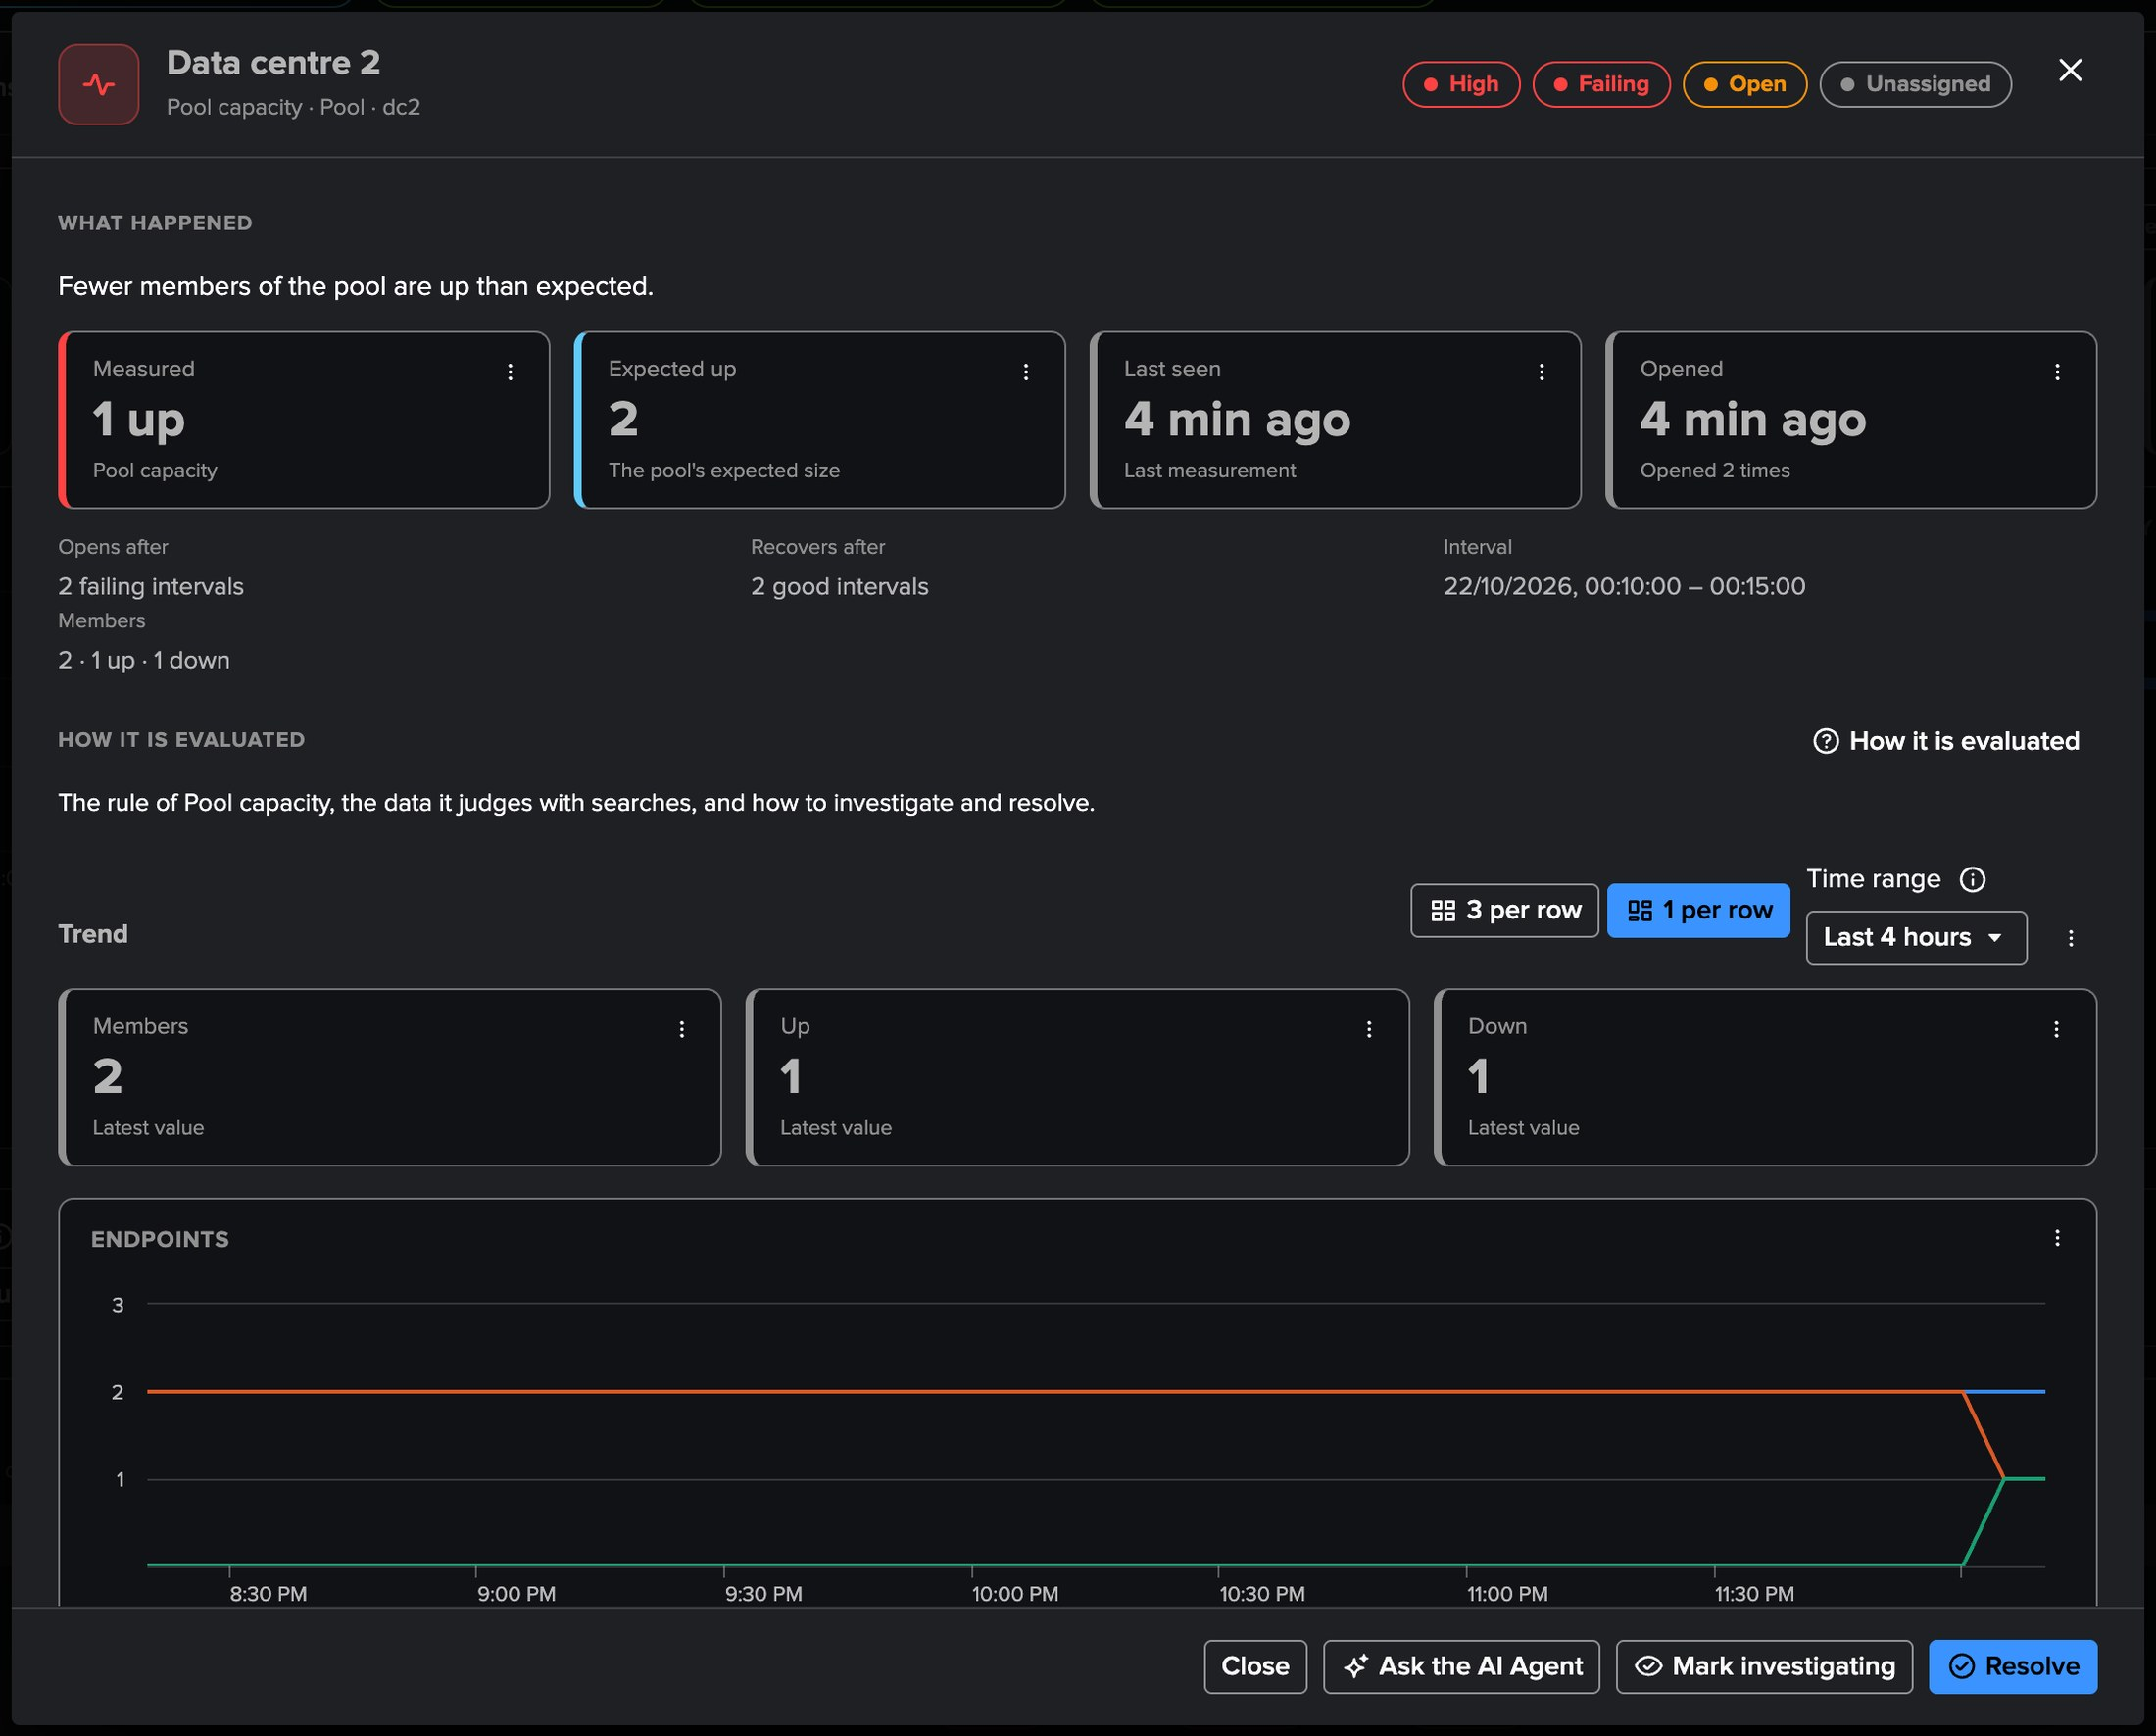
PART 3 · FINDINGS
The investigation — the decision in plain words
1
What happened
3
Opens and recovers
The endpoint sends no HEC heartbeat any more, though it was seen recently.
The checks to open and to recover, the interval judged.
2
Measured against what
4
Trend and actions
Silent 11 minutes against a 5-minute limit; 1 up against an expected 2.
The KPIs the policy judges; Ask the AI Agent, Mark investigating, Resolve.
TrackMe for Splunk · Hands-on: Splunk HEC
docs.trackme-solutions.com
Notes:
The investigation of a HEC finding gives the decision in plain words, the measurement and what it was compared with, the recorded facts, the trend of the KPIs its policy judges, and How it is evaluated. Open resource opens the endpoint, pool or token drilldown in place.

Slide 23
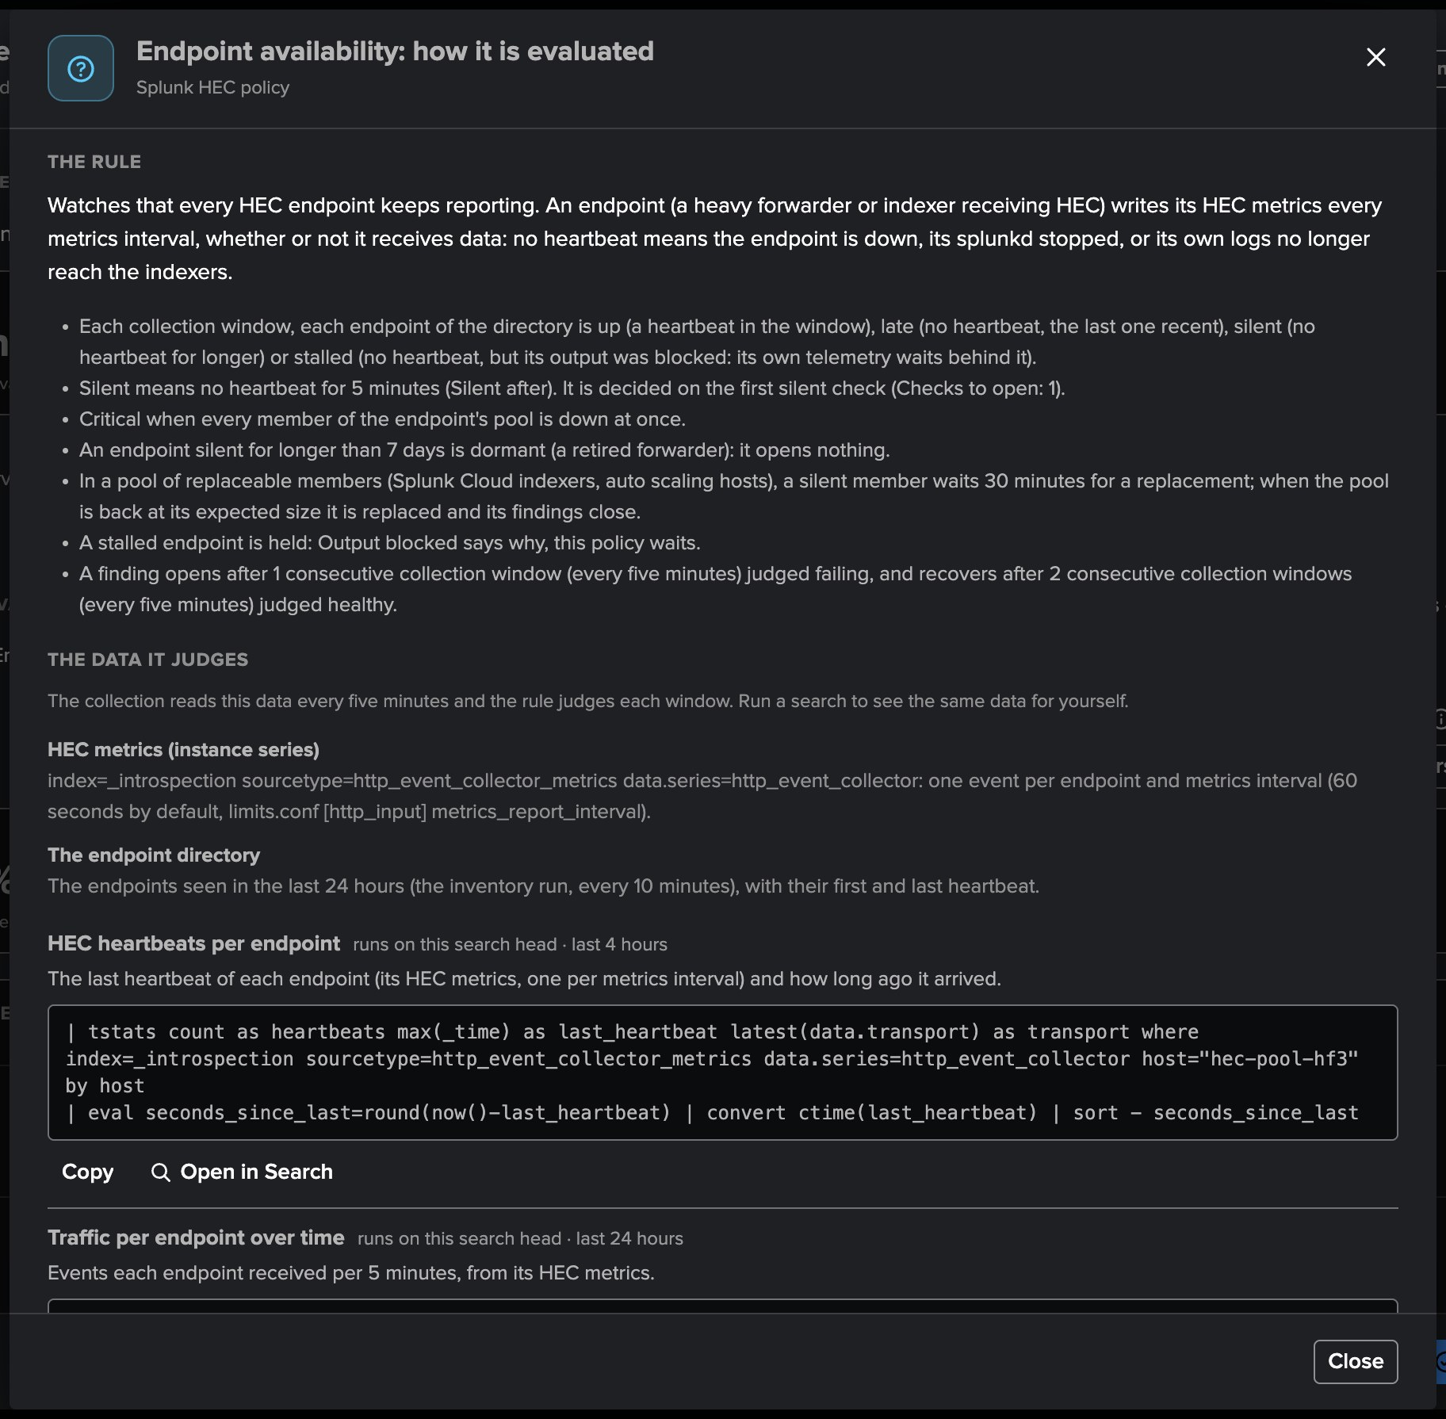
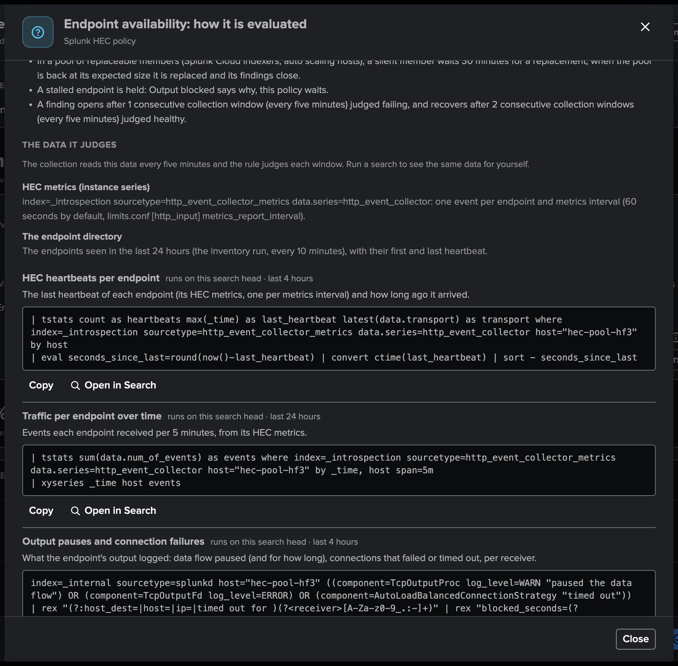
PART 3 · FINDINGS
How it is evaluated — the rule, and the searches to check it
1
The rule
3
Ready-to-run searches
What the policy decides with its current settings.
Narrowed to hec-pool-hf3, with Open in Search and Copy.
2
The data it judges
4
Investigate and resolve
The telemetry each decision reads.
Causes, resolutions and related policies.
TrackMe for Splunk · Hands-on: Splunk HEC
docs.trackme-solutions.com
Notes:
The same help opens from a policy's editor, with the searches built from the tenant's own source, and from a finding, with the searches narrowed to its endpoint or token: an administrator checks the decision against Splunk's own data in one click.

Slide 24
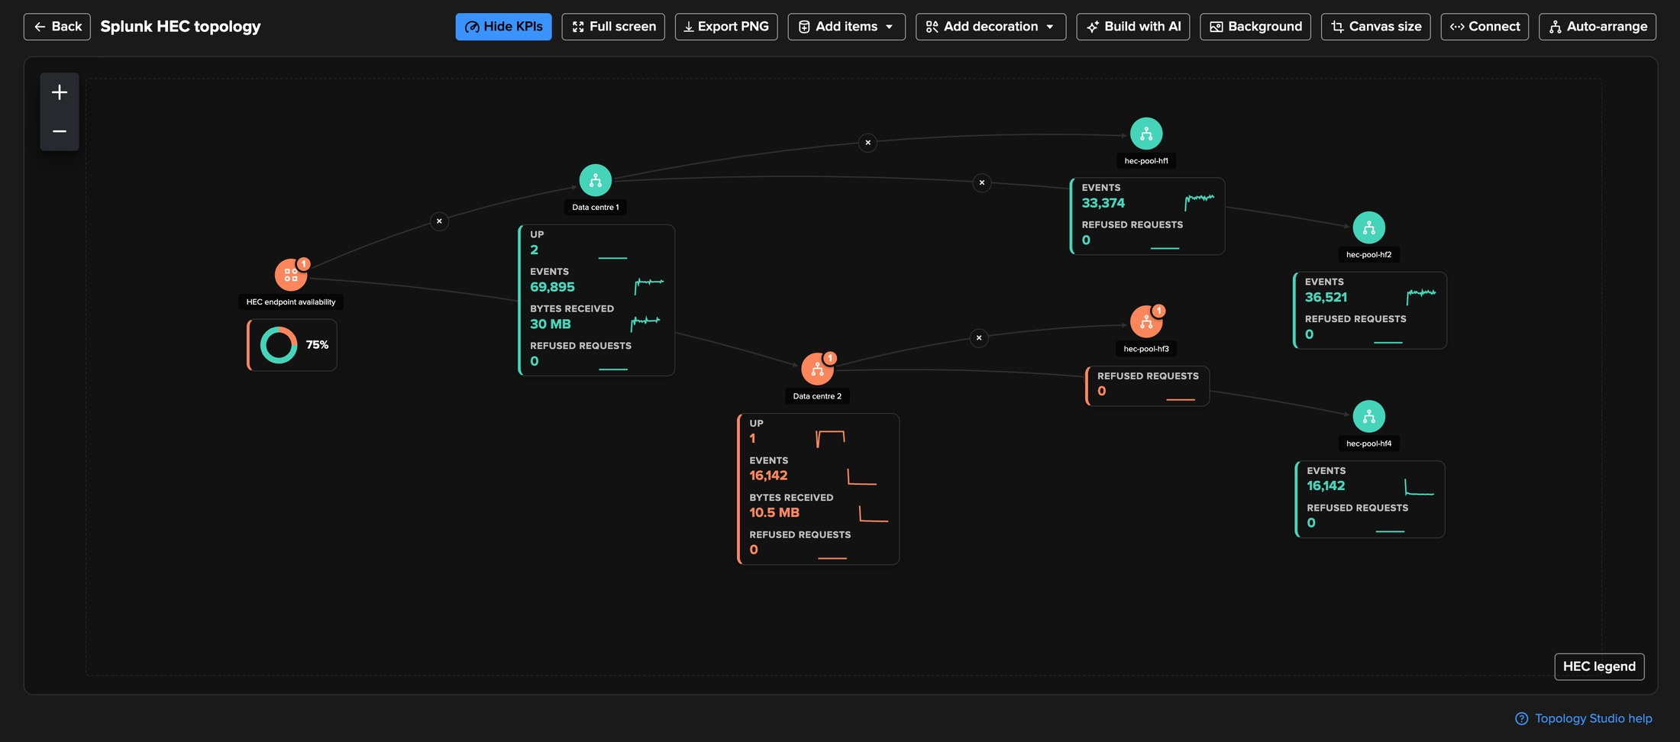
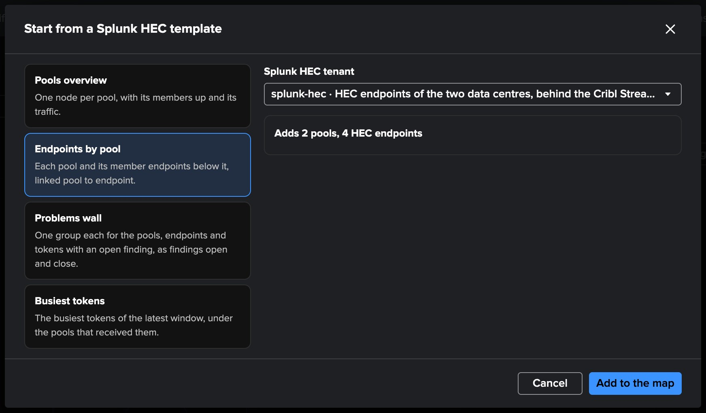
PART 3 · TOPOLOGY STUDIO
The data centres on a map — generated, saved, live
1
HEC topology, saved
3
Sparklines on the nodes
Generated from the Overview, saved to Topology Studio.
Members up, events, bytes and refusals per pool and endpoint.
2
Live status
4
Four templates
Data centre 2 and hec-pool-hf3 orange with their finding badges; availability at 75 %.
Pools overview, Endpoints by pool, Problems wall, Busiest tokens.
TrackMe for Splunk · Hands-on: Splunk HEC
docs.trackme-solutions.com
Notes:
Splunk HEC pools, endpoints and tokens are Topology Studio objects. The HEC topology generated from the Overview, saved as a view, shows the stopped heavy forwarder at once: its pool and the endpoint turn orange with their findings, and the endpoint availability falls to seventy-five per cent. Templates draw the pools with their endpoints, the busiest tokens or a wall of the objects with an open finding; Topology Alerts work on them, and Build with AI knows the HEC tenants.

Slide 25
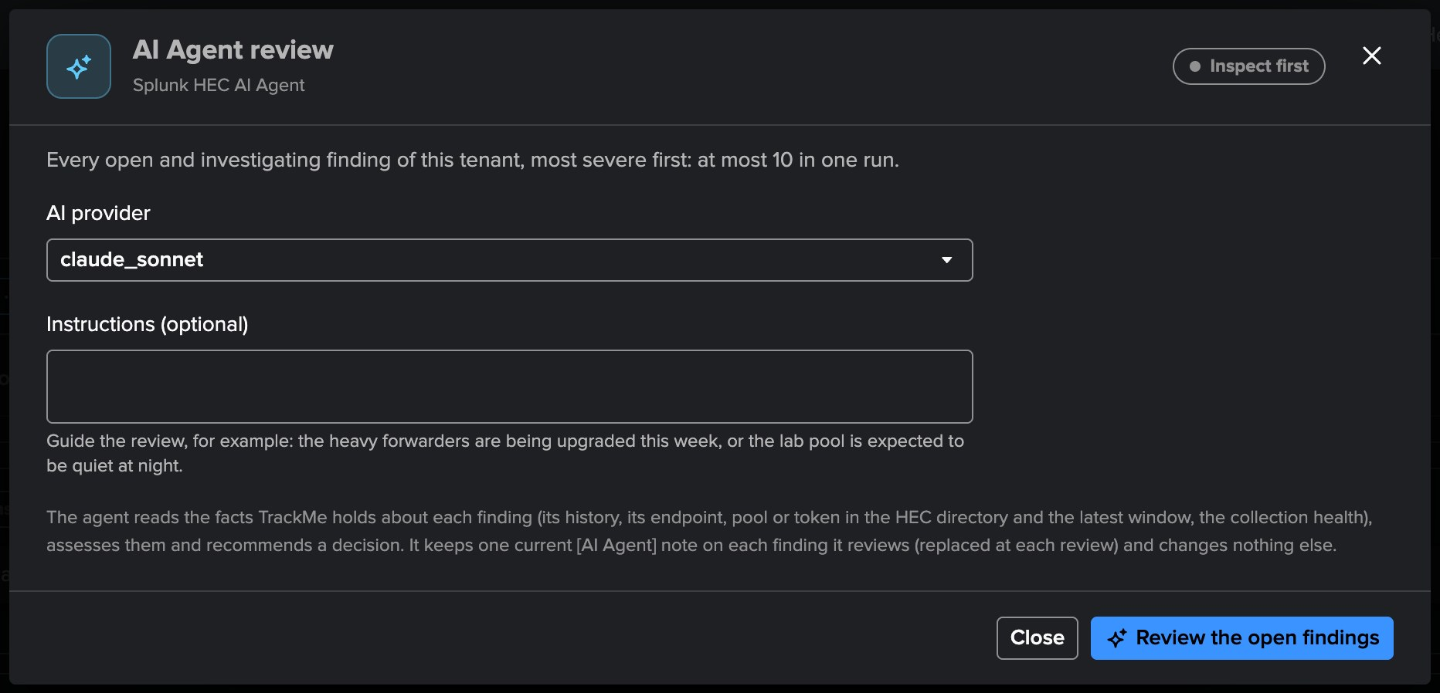
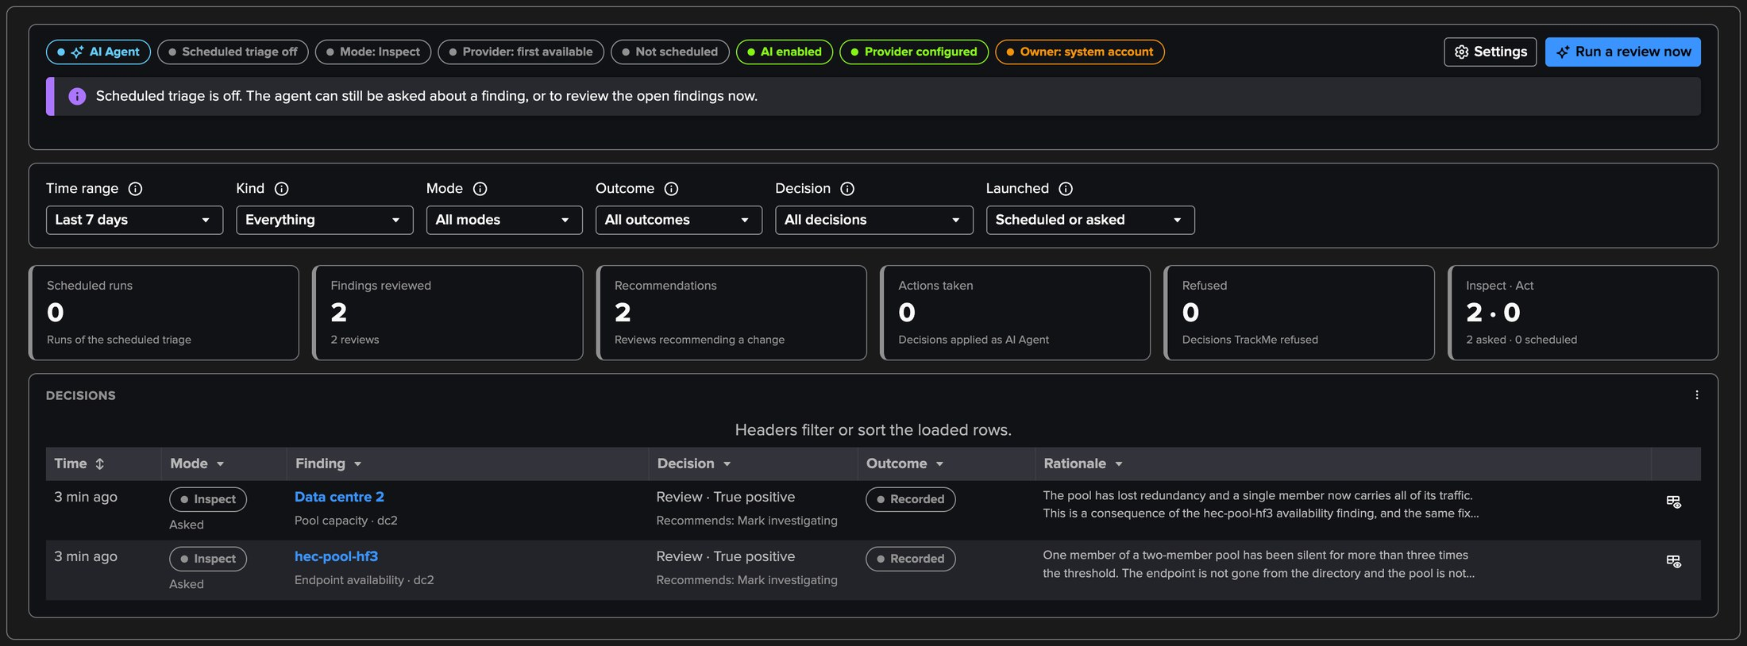
PART 3 · AI AGENT
The Splunk HEC AI Agent — reviews the findings like an operator
1
Run a review now
3
Its decisions
Every open finding, most severe first; optional instructions.
True positive for both findings, recommending Mark investigating.
2
Inspect first
4
One [AI Agent] note
It assesses and recommends; only Act applies what the tenant allows.
Kept current on each finding it reviews.
TrackMe for Splunk · Hands-on: Splunk HEC
docs.trackme-solutions.com
Notes:
The agent reads the facts TrackMe holds: the finding, its history, the endpoint or pool in the directory and the latest window, collection health and its own past decisions. It runs no search. Here it judged both findings true positives and recommended marking them investigating; in inspect mode it applied nothing. Scheduled triage is off by default.

Slide 26
04
PART 4 · OPERATE
Policies, models and the collection
Eighteen built-in policies, the tokens that must keep sending, the traffic models and their tuning, collection health and the splunkd API.
TrackMe for Splunk · Hands-on: Splunk HEC
Notes:
Part four: operating the tenant.

Slide 27
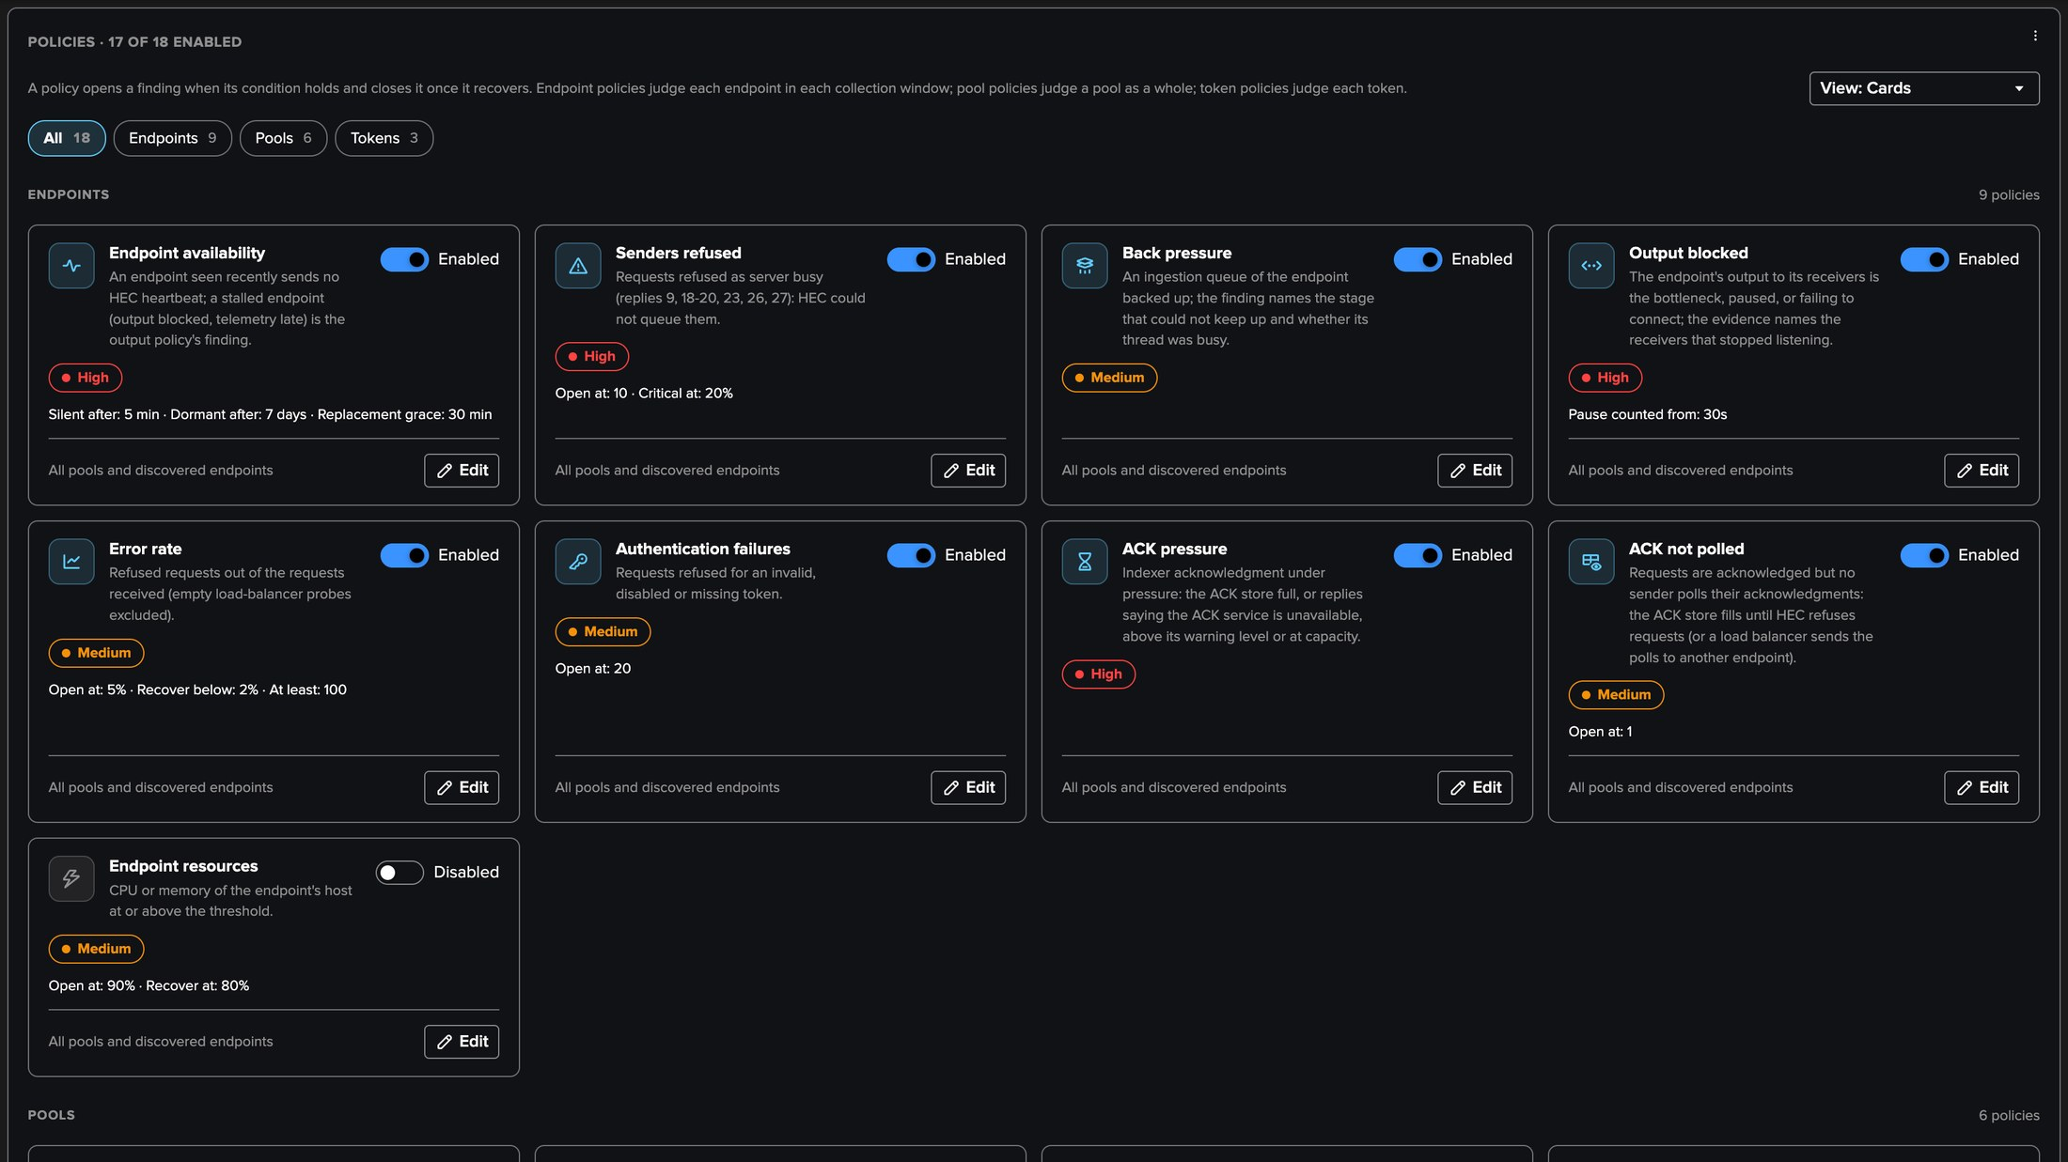
PART 4 · POLICIES
Eighteen built-in policies — endpoints, pools, tokens
1
Endpoints (9)
3
Tokens (3)
5
Editor
Availability, senders refused, back pressure, output blocked, error rate, authentication, ACK.
Rejected data, token silence, token traffic outlier.
Severity, checks to open and recover, conditions, pools, bank holidays.
4
17 on out of the box
2
Pools (6)
Endpoint resources is off: it watches the host, not HEC.
Capacity, imbalance, traffic drop, traffic outlier, token consistency, configuration drift.
TrackMe for Splunk · Hands-on: Splunk HEC
docs.trackme-solutions.com
Notes:
A TrackMe administrator of the tenant turns a policy on or off and opens its editor: General, How it is evaluated, Actions and Automations. When no built-in policy covers a rule of your own, write it as an SPL custom policy: each row names an endpoint, a pool or a token.

Slide 28
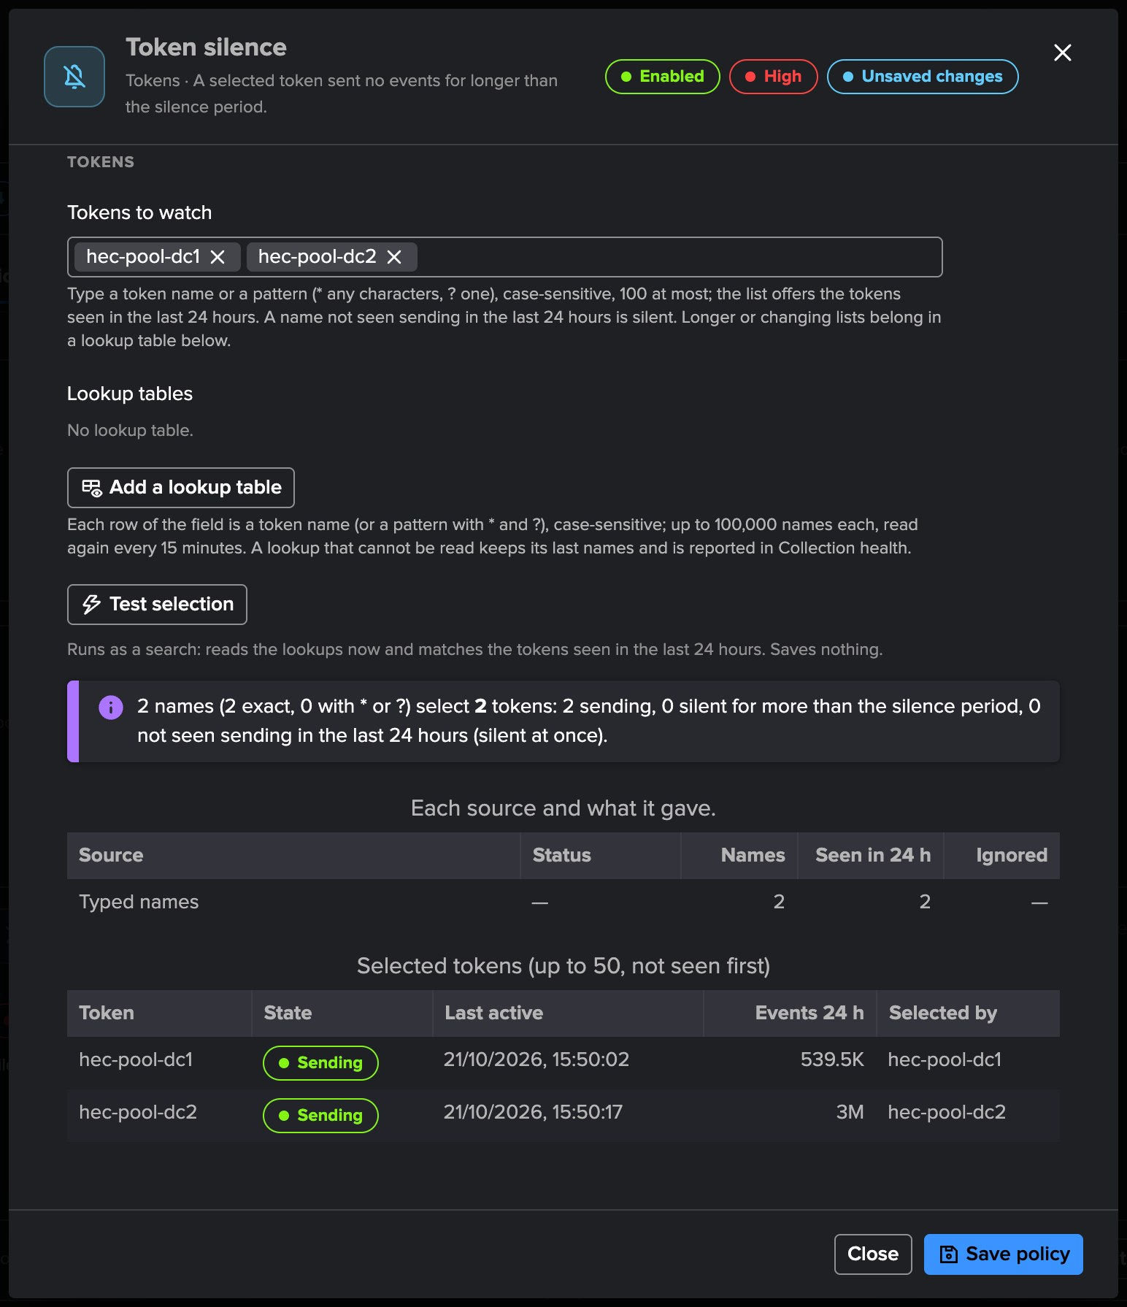
PART 4 · POLICIES
Token silence — the tokens that must keep sending
1
Tokens to watch
Names or patterns typed in the policy: hec-pool-dc1 and hec-pool-dc2.
2
Lookup tables
Up to 20, local or remote, Exact or Wildcard, re-read every 15 minutes.
3
Silent at once
A name selected exactly but not seen sending in 24 hours.
4
Test selection
Runs as a search, reads every lookup now; saves nothing.
TrackMe for Splunk · Hands-on: Splunk HEC
docs.trackme-solutions.com
Notes:
Token silence opens a finding when a token you select sends no event for longer than the silence period, 15 minutes by default. A lookup of the tokens a deployment relies on finds the dead ones: a name selected exactly and not seen sending in the last 24 hours is silent at once.

Slide 29
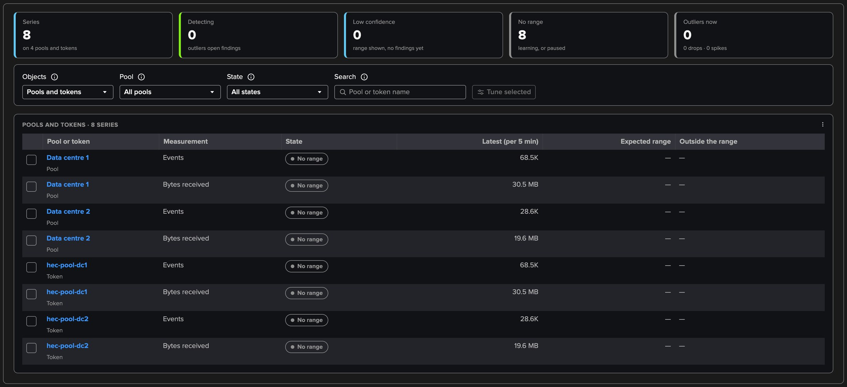
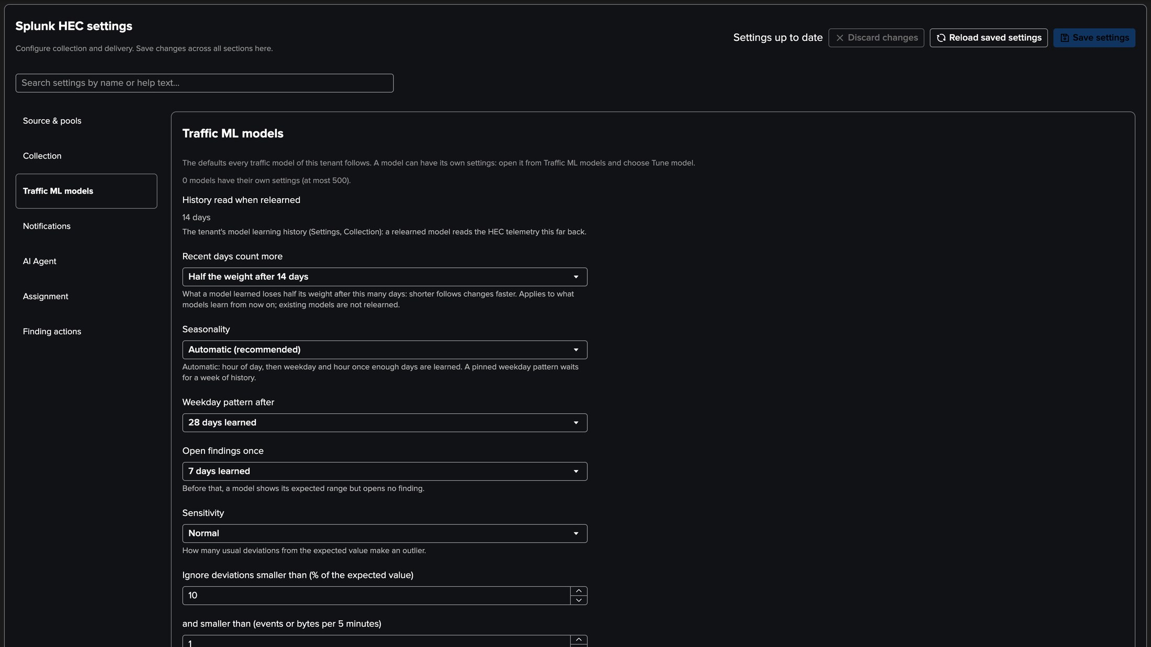
PART 4 · TRAFFIC MODELS
Traffic models — what each pool and token usually receives
1
One model per pool and token
3
Expected range on the charts
Events and bytes received, per hour of the week; 500 tokens, busiest first.
Pool and token histories and the traffic outlier findings.
4
Tuning and Not an anomaly
2
Learned from _introspection
Defaults in Settings; Tune model per model; excluded periods.
The Model learning history on the first runs, then every six hours.
TrackMe for Splunk · Hands-on: Splunk HEC
docs.trackme-solutions.com
Notes:
The Splunk HEC tenant learns each pool and token with the arithmetic of the Cribl Stream traffic models: hour of day first, weekday and hour after four weeks, an expected range never tighter than ten per cent. Pool traffic outlier and Token traffic outlier open findings once a model detects, at normal confidence. A new tenant learns as far back as its Model learning history.

Slide 30
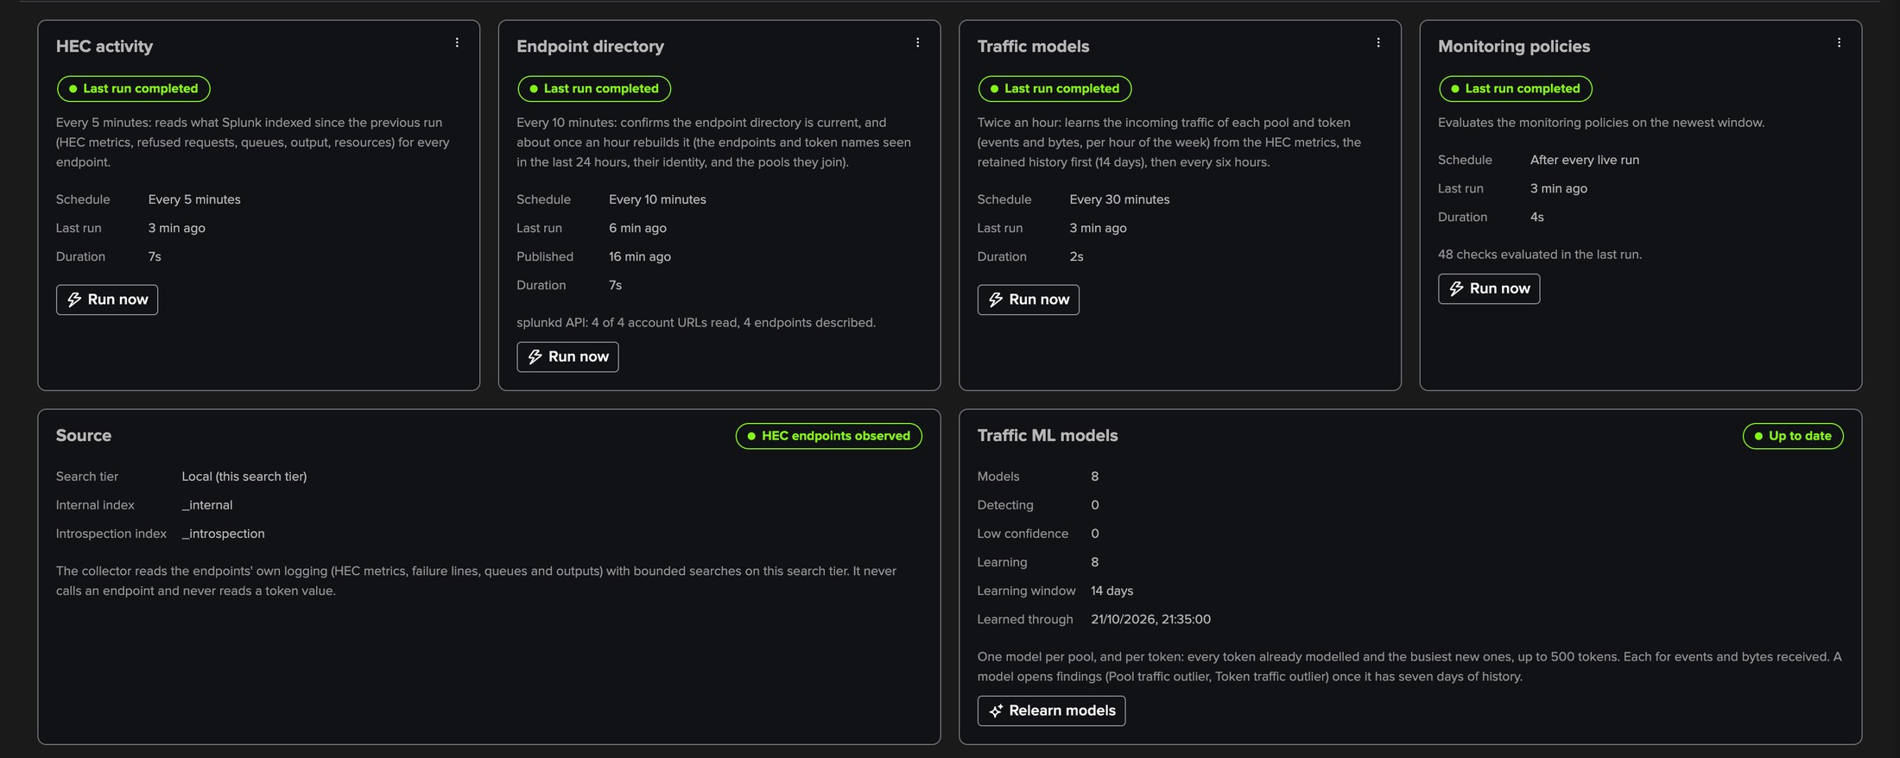
PART 4 · COLLECTION
Collection health — every job, the source and the models
1
One card per job
3
Run budgets
HEC activity, Endpoint directory, Traffic models, Monitoring policies.
Each run keeps to its interval less 30 seconds and ends before the next.
2
Schedule and last run
4
Source and models
With its outcome, the next run and Run now.
The indexes read, HEC endpoints observed, models and their confidence.
TrackMe for Splunk · Hands-on: Splunk HEC
docs.trackme-solutions.com
Notes:
When collection does not run as configured, the tab lists the problems in plain words and the Configuration Guardian raises Splunk HEC collection needs attention. A run that Splunk completed short, or whose searches carried Splunk messages, says so: those messages are recorded, never a failure.

Slide 31
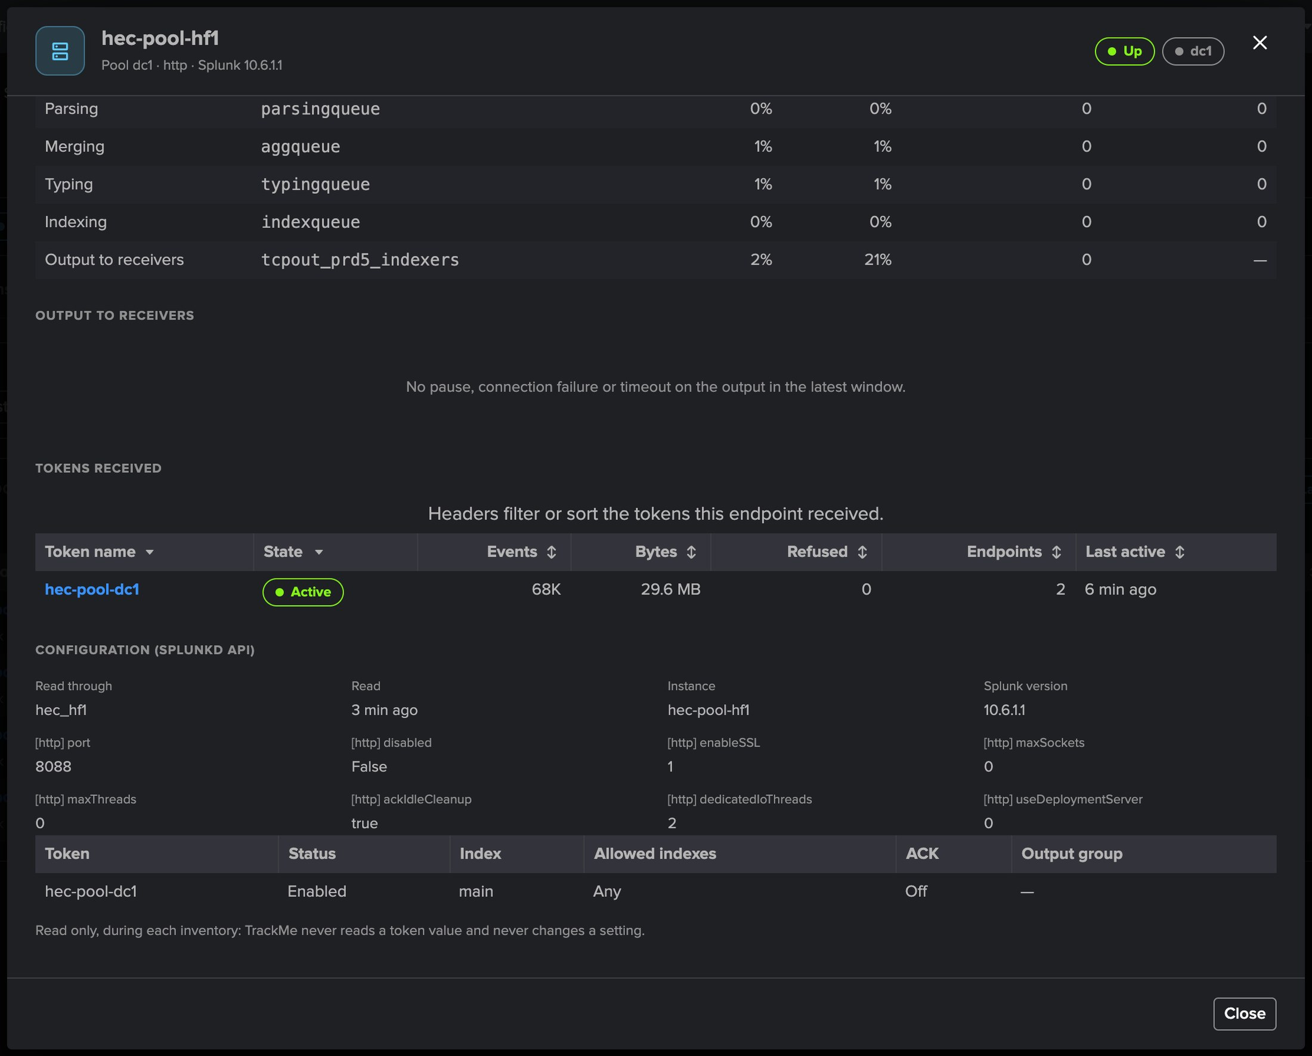
PART 4 · SPLUNKD API
The splunkd API — optional, read only, configuration compared
1
Remote accounts on the management port
Up to 20, one URL per endpoint.
2
What is read
server/info, the global HEC settings, the HEC tokens by name.
3
Token value dropped
While the answer is parsed: never stored, logged or returned.
4
Two policies
Token consistency and the HEC settings of Configuration drift.
5
Never Splunk Cloud
Its indexers have no customer-reachable management port.
TrackMe for Splunk · Hands-on: Splunk HEC
docs.trackme-solutions.com
Notes:
The telemetry tells what HEC does, not how it is configured. With remote accounts bound, the endpoint directory reads the splunkd REST API of the endpoints at each rebuild to compare the members of a pool: a token missing on some members, or with a different index or ACK, and differing global HEC settings. Every other policy works without it.

Slide 32
WHERE WE ARE
One tenant, every HEC endpoint, pool and token
Set up
Followed
Judged
Operated
a tenant on the local search tier, two pools, the endpoints found from their heartbeats
endpoints, pools and tokens, one endpoint's pipeline, a pool's balance
an endpoint silent and its pool short of a member, explained and reviewed
eighteen policies, token silence, traffic models, collection health, the splunkd API
What made it work
Splunk's own telemetry
Pools judged as a whole
Bounded at any size
No agent, no new data, no credential to the endpoints: the HEC metrics and logs Splunk already writes.
Members up against the expected size, shares of the traffic, versions and settings compared.
A few searches per five-minute window, whatever the number of endpoints and tokens.
TrackMe for Splunk · Hands-on: Splunk HEC
docs.trackme-solutions.com
Notes:
Where we are. A Splunk HEC tenant set up on a deployment with two data centres, its endpoints followed from their heartbeats, its pools compared member by member, its tokens by name; a heavy forwarder stopped and the two findings it opened, explained and reviewed by the AI Agent; and the policies, models and collection that run it.

