Slide 1

HANDS-ON WALKTHROUGH · SPLUNK S2S
Is every receiver accepting, and is my forwarding tier keeping up?
One tenant watches the Splunk-to-Splunk receiving side of a deployment — the indexers, the intermediate forwarders and the pools they form — from the telemetry Splunk already writes: nothing to install, nothing new to ingest.
Captured live on TrackMe 2.4.22 · a four-peer indexer cluster on two sites, a heavy forwarder tier, twenty universal forwarders
Notes:
Hands-on walkthrough of the Splunk S2S tenant, generally available in TrackMe 2.4.22. Everything was captured live on a deployment with a four-peer indexer cluster on two sites, a tier of four heavy forwarders and twenty universal forwarders sending to it. In four parts: create the tenant, follow the pools, the hosts and the data path, read the findings of a heavy forwarder stopped on purpose, and operate the tenant.

Slide 2
THE PROBLEM
Forwarding fails in the middle — and the senders only see a stall
A receiver that stops listening, an intermediate that pauses its output, a queue that backs up: the forwarders retry, data waits on disk, nobody sees which tier is the cause.
Receivers that refuse
Back pressure
An intermediate tier in trouble
Listening ports stopped on blocked queues, a member silent while its pool reports, a pool short of members.
A queue of the pipeline saturated: which stage cannot keep up, and whether the cause is downstream, local or a surge.
Output paused, every sender behind it held; a single destination where it usually load balances.
What a Splunk S2S tenant does
A dedicated tenant type for the S2S receiving side of one Splunk deployment. TrackMe reads what Splunk already writes — the receivers' and intermediates' connection lines, queues and output, their splunkd.log and health report — with bounded searches every five minutes, and raises findings from twenty-two built-in policies on receivers, intermediates, pools and destinations. It only reads: nothing is installed or changed, no forwarder is ever called.
TrackMe for Splunk · Hands-on: Splunk S2S
docs.trackme-solutions.com
Notes:
A Splunk administrator asks the same forwarding questions every day: is every receiver accepting and keeping up, is the intermediate tier blocked, backed up or silent, when senders are held back which tier is the bottleneck and is the cause downstream, local or an upstream surge, and how much flows into each pool, from how many senders, with which TLS and acknowledgement posture. The Splunk S2S tenant answers them with findings raised by built-in policies.

Slide 3
THE MODEL
Roles from signatures, pools from your clusters, judged every five minutes
1
Source
2
Discover
3
Measure
4
Decide
5
Act
metrics.log, splunkd.log, health report and _introspection — on this search tier or through a remote account.
Roles from signatures; indexer clusters (one pool per site) and intermediate families become pools; yours by pattern, output group or hand.
Every 5 minutes: inbound, senders, posture, queues and the bottleneck, output, churn, CPU and memory.
22 built-in policies on receivers, intermediates, pools and destinations, plus custom SPL policies.
Finding groups, notifications, findings actions, the AI Agent, Topology Studio.
›
›
›
›
Back pressure traced to its origin
A queue that fills, then the queues before it, until the receiver pauses its senders or stops listening: TrackMe reads every queue of the path and names the bottleneck — the stage after the furthest-downstream saturated queue — and, on an intermediate, the origin: downstream, local or an upstream surge.
Planned work is not an incident: while an indexer cluster is in maintenance mode or a rolling restart, its pool's findings wait.
TrackMe for Splunk · Hands-on: Splunk S2S
docs.trackme-solutions.com
Notes:
The model. Roles are read from signatures over a day: a host that receives and indexes is a receiver, a host that receives and forwards is an intermediate forwarder. Each indexer cluster the search head is attached to becomes a pool by itself, one per site of a multisite cluster; the intermediate forwarders no pool claims form one automatic pool per host-name family, and other hosts are grouped by host patterns, output groups or hand assignment. Every five minutes the live job reads the last index-time window and the policies decide.

Slide 4
THE PLAN
What we are going to do — one tenant, four parts
PART 1
PART 2
PART 3
PART 4
Setup
Pools, hosts & data path
Findings
Operate
The Splunk S2S card
The Pools tab and Blocked now
A heavy forwarder stops
The policy catalogue
Discovery and the manager account
Distribution and pipeline
How it is evaluated
Traffic ML models
Pools: automatic, then yours
The data path
The AI Agent
Collection health
Every screen is the product as shipped, on a lab of twenty universal forwarders, four heavy forwarders and four indexers.
TrackMe for Splunk · Hands-on: Splunk S2S
docs.trackme-solutions.com
Notes:
Four parts. Setup: the wizard, the indexer cluster's site pools and its manager account, the heavy forwarder tier made a configured pool. Pools, hosts and the data path: the pools, a pool's distribution, a receiver's pipeline, the data path. Findings: a heavy forwarder stopped on purpose, what opens and how it is evaluated, the AI Agent. Operate: the policies, the traffic models and collection health.

Slide 5
01
PART 1 · SETUP
One source, pools found for you, one to make your own
The Splunk S2S card, the discovery of the receivers and the indexer cluster, the manager account, the automatic pools and the heavy forwarder tier configured.
TrackMe for Splunk · Hands-on: Splunk S2S
Notes:
Part one: setup. A Splunk S2S tenant reads one deployment: its local search tier, or another deployment through a TrackMe remote account.

Slide 6
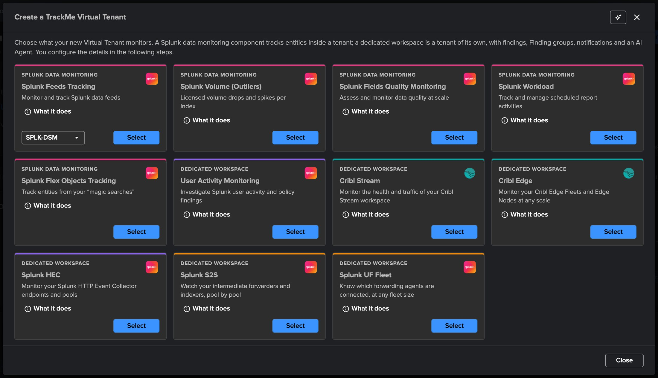
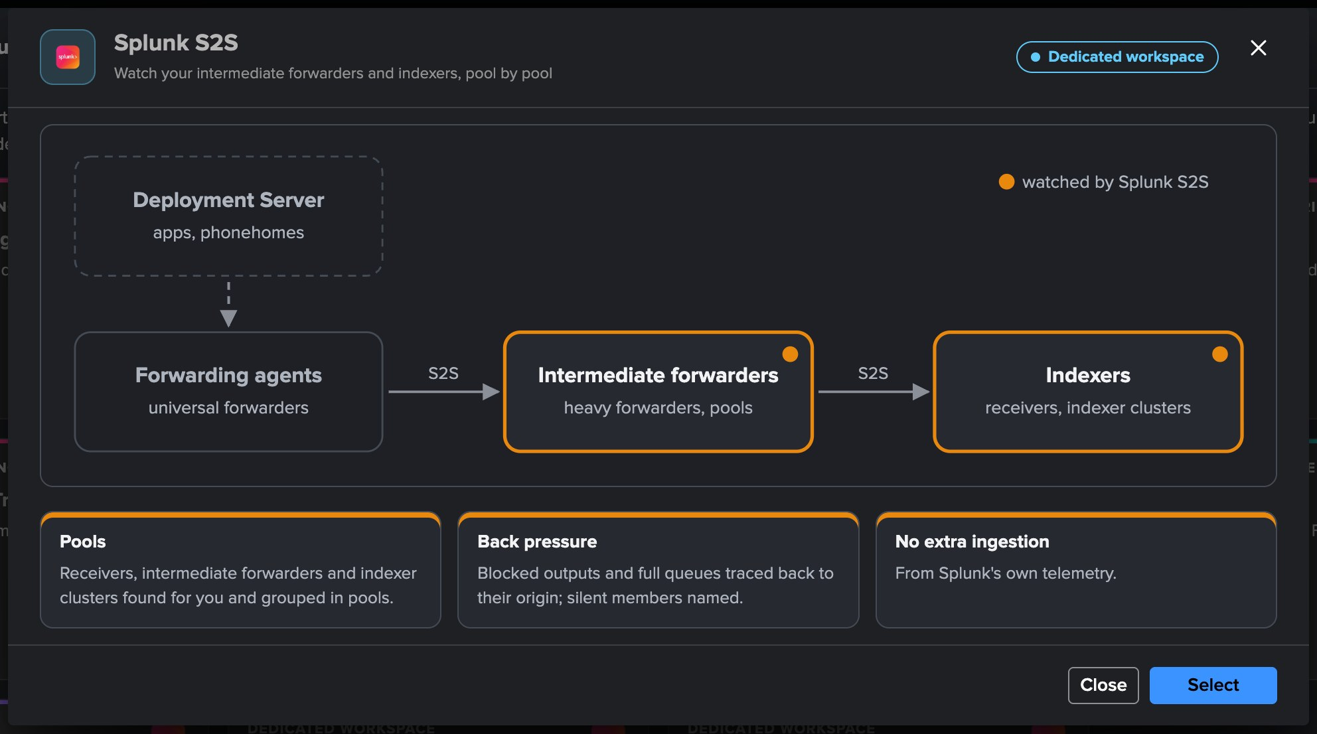
PART 1 · SETUP
A dedicated tenant — pick Splunk S2S
1
The Splunk S2S card
3
Four steps
Watch your intermediate forwarders and indexers, pool by pool.
Basics, Source & scope, Indexes & RBAC, Review.
2
What it does
4
Licence
The forwarding path, with the intermediate forwarders and the indexers watched.
Enterprise, Unlimited, the Unlimited trial or Developer; not Foundation.
TrackMe for Splunk · Hands-on: Splunk S2S
docs.trackme-solutions.com
Notes:
Virtual Tenants, Actions, Create a tracking tenant, Splunk S2S card. What it does draws the forwarding path: the forwarding agents send over S2S to the intermediate forwarders, which forward to the indexers; Splunk S2S watches the intermediates and the indexers. A Splunk S2S tenant has no entities and no state colour: it is a findings tenant.

Slide 7
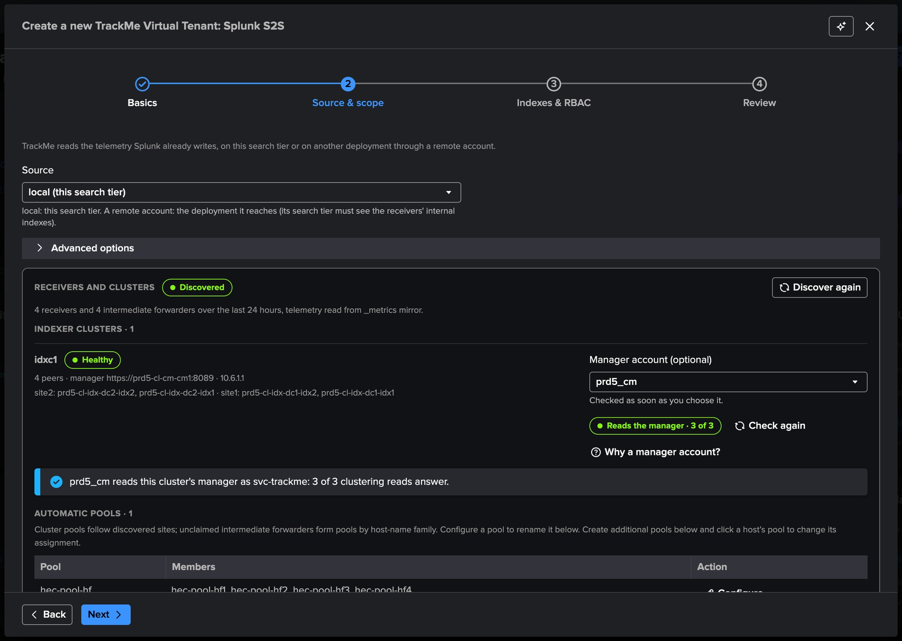
PART 1 · SETUP
The discovery finds the indexer cluster — a pool per site, without configuration
1
Source
This search tier, or another deployment through a remote account.
2
Receivers and clusters
4 receivers and 4 intermediate forwarders over the last 24 hours.
3
Indexer cluster idxc1
Healthy, four peers on two sites: one receiver pool per site, its size from the cluster.
4
Manager account (optional)
Checked as soon as it is chosen: reads the manager, 3 of 3.
5
Least privilege
A read-only role is enough; an account that could change the cluster gets an advisory.
TrackMe for Splunk · Hands-on: Splunk S2S
docs.trackme-solutions.com
Notes:
Source and scope. The discovery reads the receivers and intermediates of the last day and each indexer cluster the search head is attached to. The optional manager account lets the tenant read the manager's maintenance mode and rolling restarts. It is checked as soon as it is chosen; here it reads the manager as a least-privilege service account, 3 of 3 clustering reads. An account that could change the cluster gets an advisory with the read-only role to create: search, rest_properties_get and list_indexer_cluster.

Slide 8
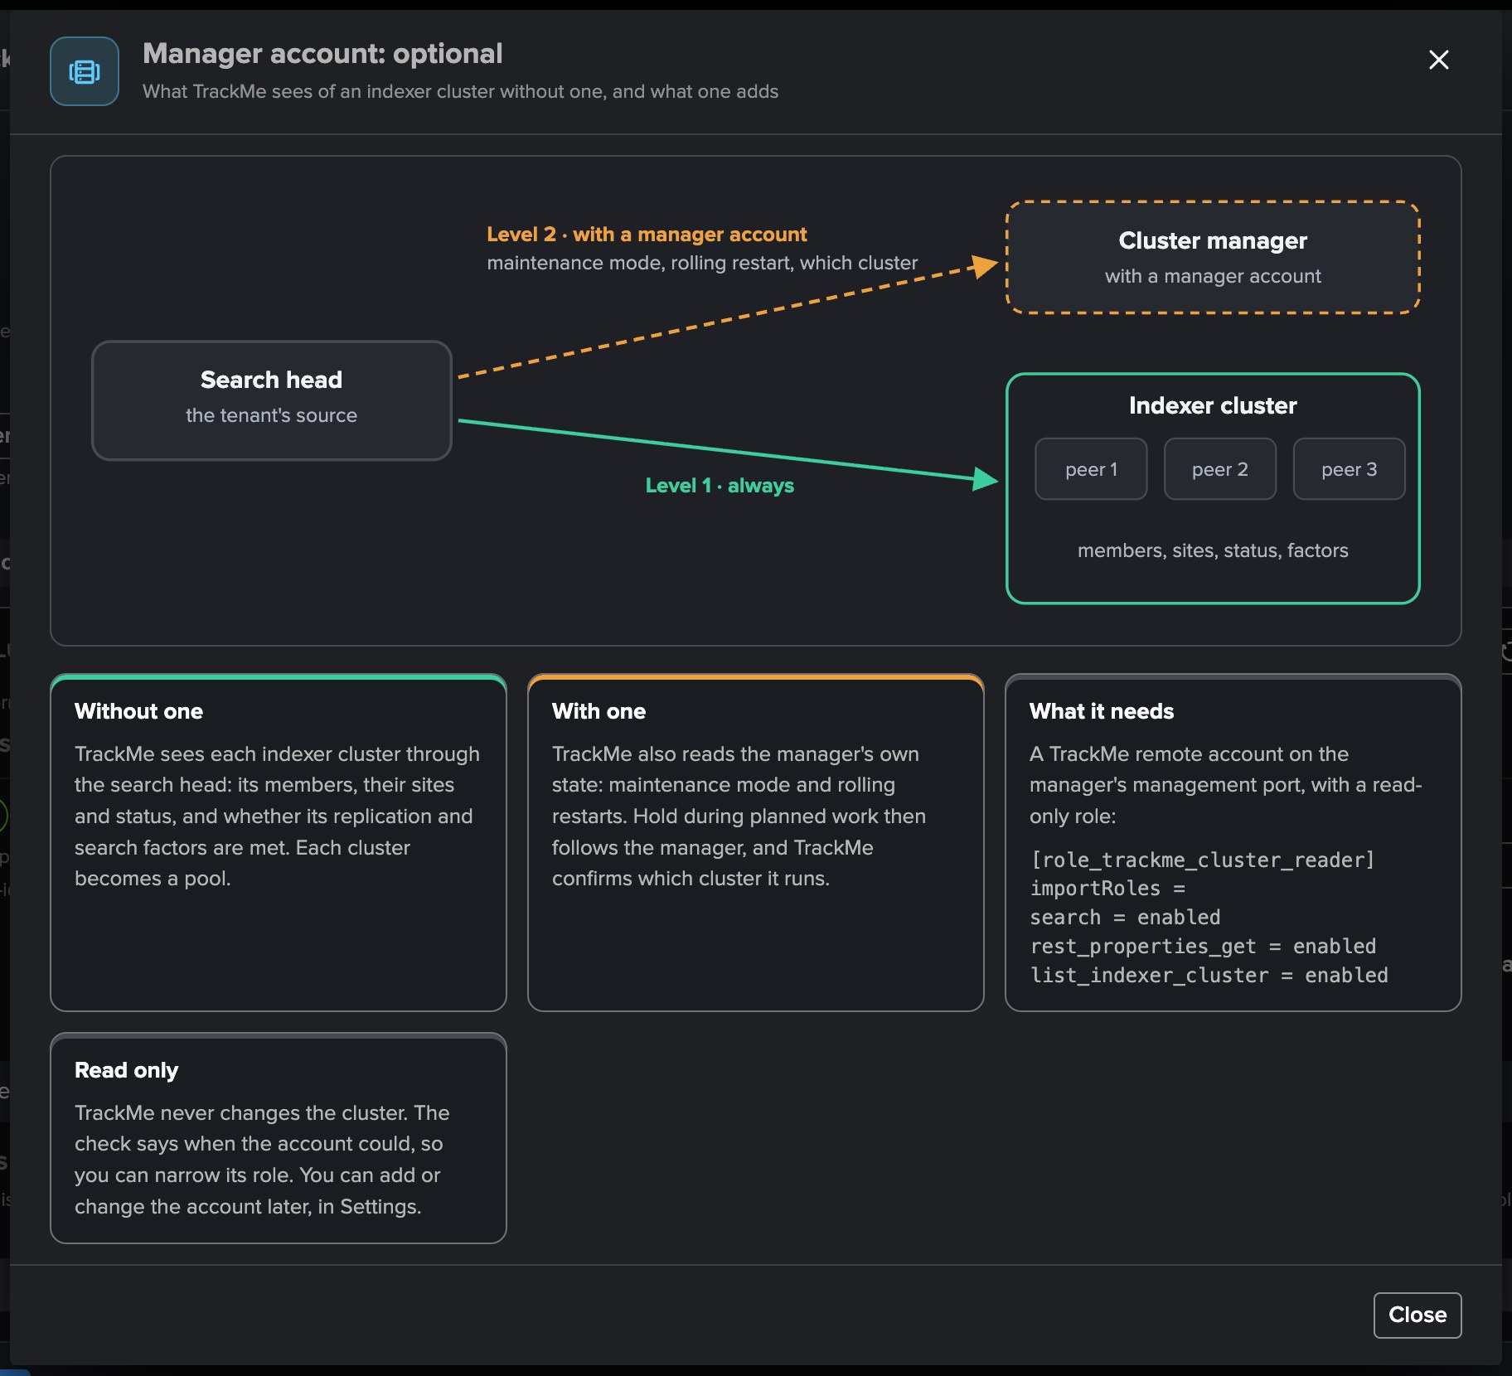
PART 1 · SETUP
Why a manager account? Planned work is not an incident
1
Level 1 · always
The search head's view: members, sites, status, factors. Each cluster becomes a pool.
2
Level 2 · with a manager account
Maintenance mode, rolling restart, which cluster.
3
Hold during planned work
Availability, capacity, balance, churn and traffic findings wait during planned work.
4
Read only
TrackMe never changes the cluster; the account can be added later in Settings.
TrackMe for Splunk · Hands-on: Splunk S2S
docs.trackme-solutions.com
Notes:
The search head always sees its indexer clusters. A manager account adds the manager's own state, so a rolling restart or a maintenance window holds the pool's findings instead of opening them: an open finding stays open, a new one waits until the planned work ends.

Slide 9
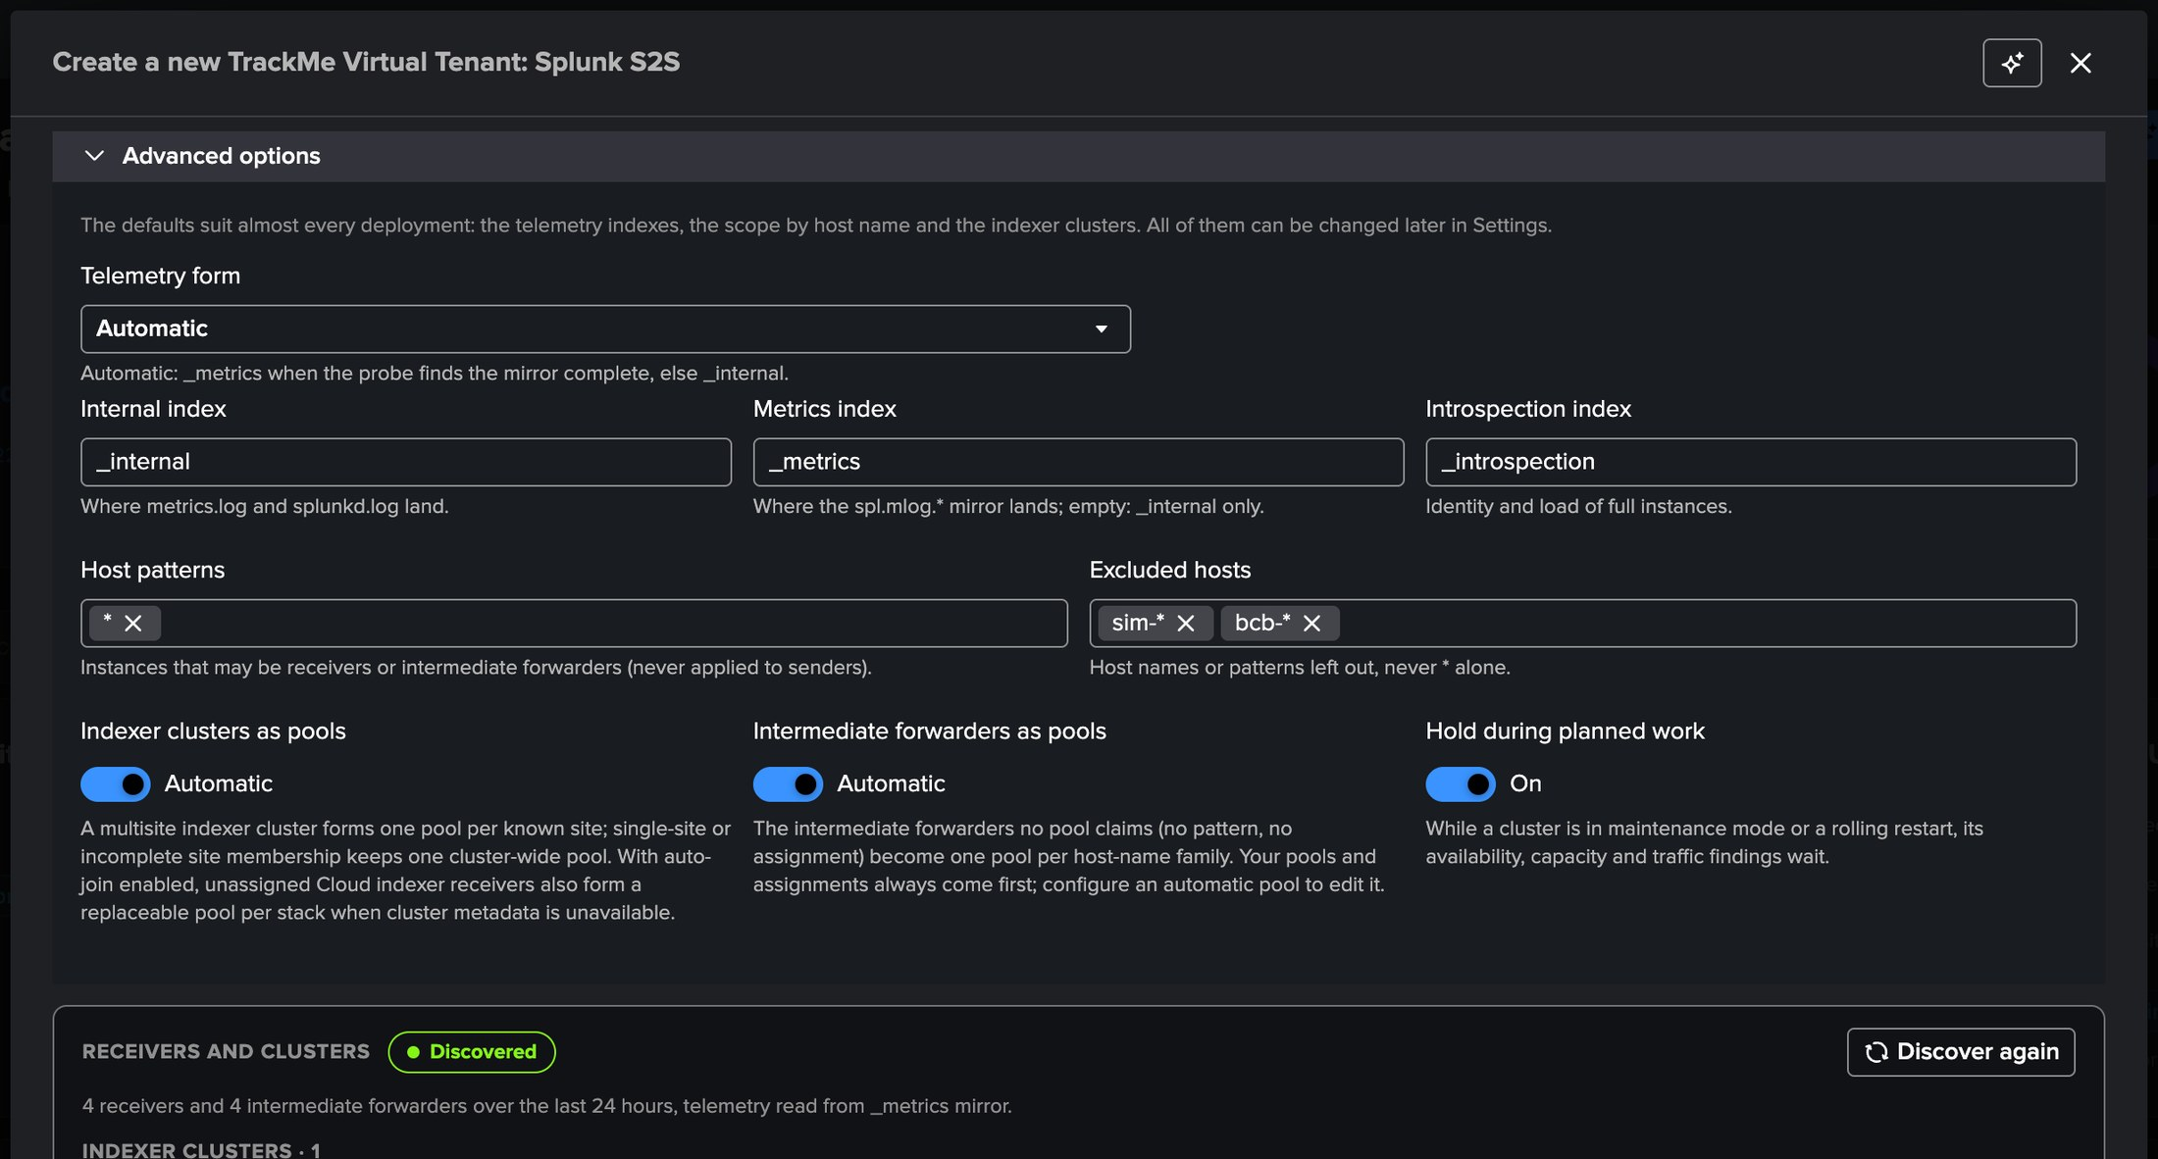
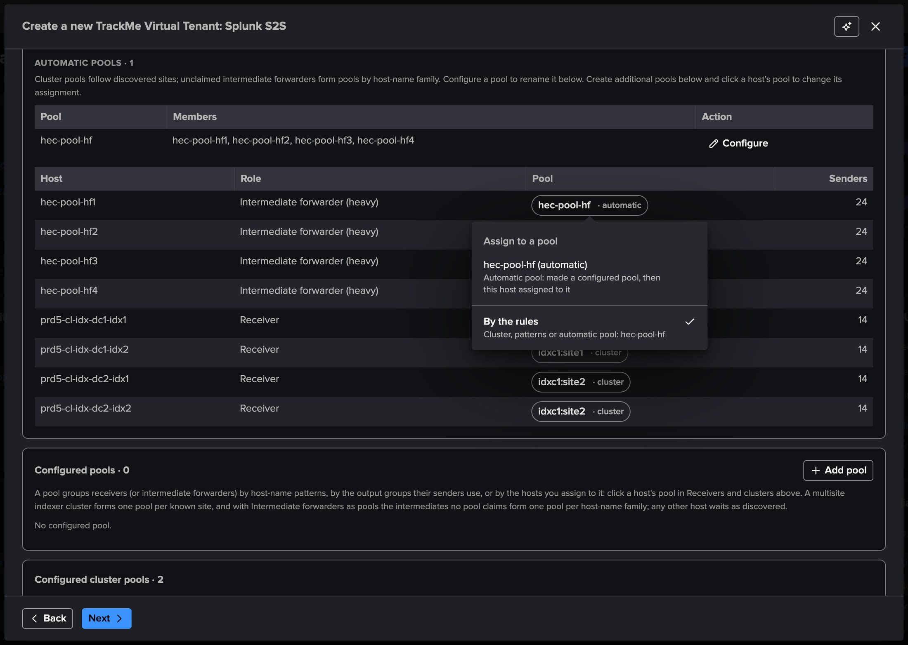
PART 1 · SETUP
Advanced options and the pools — the defaults suit most deployments
1
Telemetry form
3
Automatic pools
5
Same editor as Settings
Automatic: the _metrics mirror when complete, else _internal.
Indexer clusters and intermediate forwarders as pools, both Automatic.
Automatic pools with Configure, then your configured pools.
2
Host patterns, excluded hosts
4
Pool pills
Tokens: type a pattern, press Enter. Here sim-* and bcb-* are left out.
Every host with its pool: click it to assign the host, or By the rules.
TrackMe for Splunk · Hands-on: Splunk S2S
docs.trackme-solutions.com
Notes:
Advanced options stay folded unless a setting needs a fix; here the excluded hosts leave out two families of test receivers sharing the same indexes, set at creation so the first backfill never reads them. Below the clusters, the pools the tenant starts with: the indexer cluster's two site pools and the automatic pool hec-pool-hf of the four heavy forwarders. Each host carries its pool pill; clicking it assigns the host to another pool, By the rules gives it back. Nothing needs configuring at creation.

Slide 10
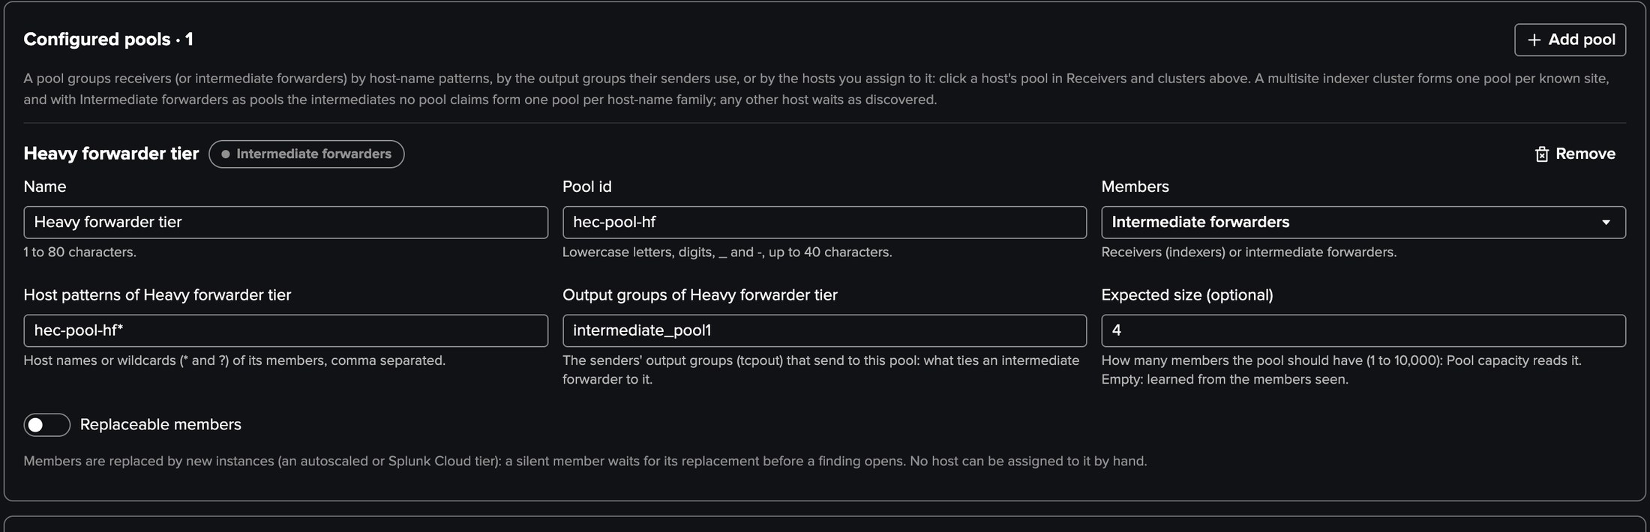
PART 1 · SETUP
Configure the automatic pool — the heavy forwarder tier, tied by its output group
1
Configure
The automatic pool hec-pool-hf becomes yours, same id, same history.
2
Output groups
intermediate_pool1: the forwarders' tcpout group that sends to this pool.
3
Expected size
4: Pool capacity compares the members up with it.
4
Replaceable members
For an autoscaled tier: a silent member waits for its replacement.
TrackMe for Splunk · Hands-on: Splunk S2S
docs.trackme-solutions.com
Notes:
Settings, Pools. The indexer cluster and the heavy forwarder tier are pools from the first run. Configure on the automatic pool hec-pool-hf makes it a configured pool with the same id: here it is named Heavy forwarder tier, given the output group its senders use, which ties the tier to the data path, and its expected size. A pool change applies from the next inventory; Run now the inventory, then Collect now, to see it at once.

Slide 11
02
PART 2 · POOLS, HOSTS & DATA PATH
Every pool, every host, every hop
The Pools tab, how a pool spreads its load, a receiver's pipeline queue by queue, and the data path from sender types to receivers.
TrackMe for Splunk · Hands-on: Splunk S2S
Notes:
Part two: the workspace. Pools, receivers and intermediates, and the data path between them.

Slide 12
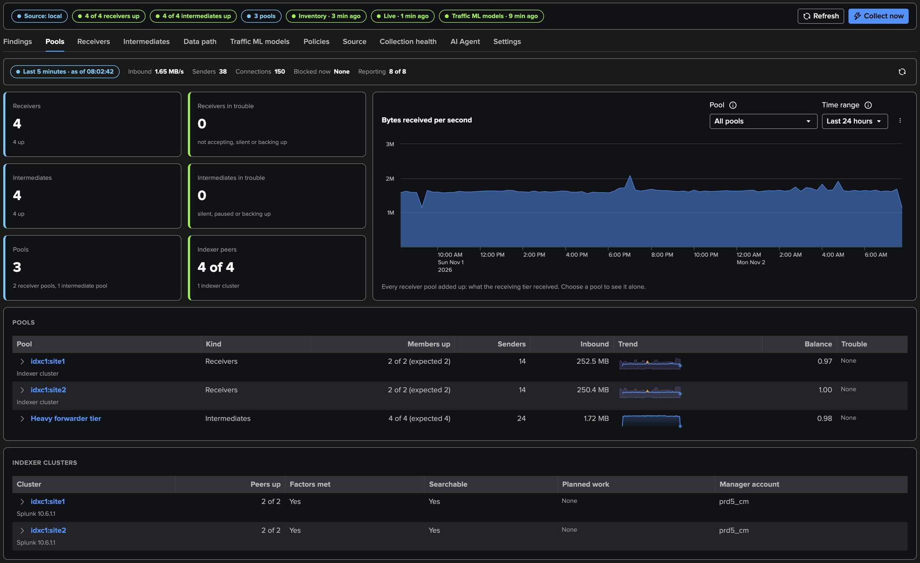
PART 2 · POOLS
The Pools tab — the last five minutes, then every pool
1
Status strip
3
Pools
5
Breakdowns
Receivers and intermediates up, the pools, the Inventory, Live and Models jobs.
idxc1:site1, idxc1:site2 and the Heavy forwarder tier: members against expected, senders, inbound, balance.
The Splunk versions of the hosts, the intermediate types.
2
Last 5 minutes
Inbound per second, senders, connections, blocked now, hosts reporting.
4
Indexer clusters
One row per site: peers up, factors met, searchable, planned work, manager account.
TrackMe for Splunk · Hands-on: Splunk S2S
docs.trackme-solutions.com
Notes:
The Pools tab opens on the last five minutes, then the host tiles, the pools with their members up against the expected size, their senders, inbound volume, trend and balance, and the indexer clusters with their peers, factors and planned work. A pool row expands to its members.

Slide 13
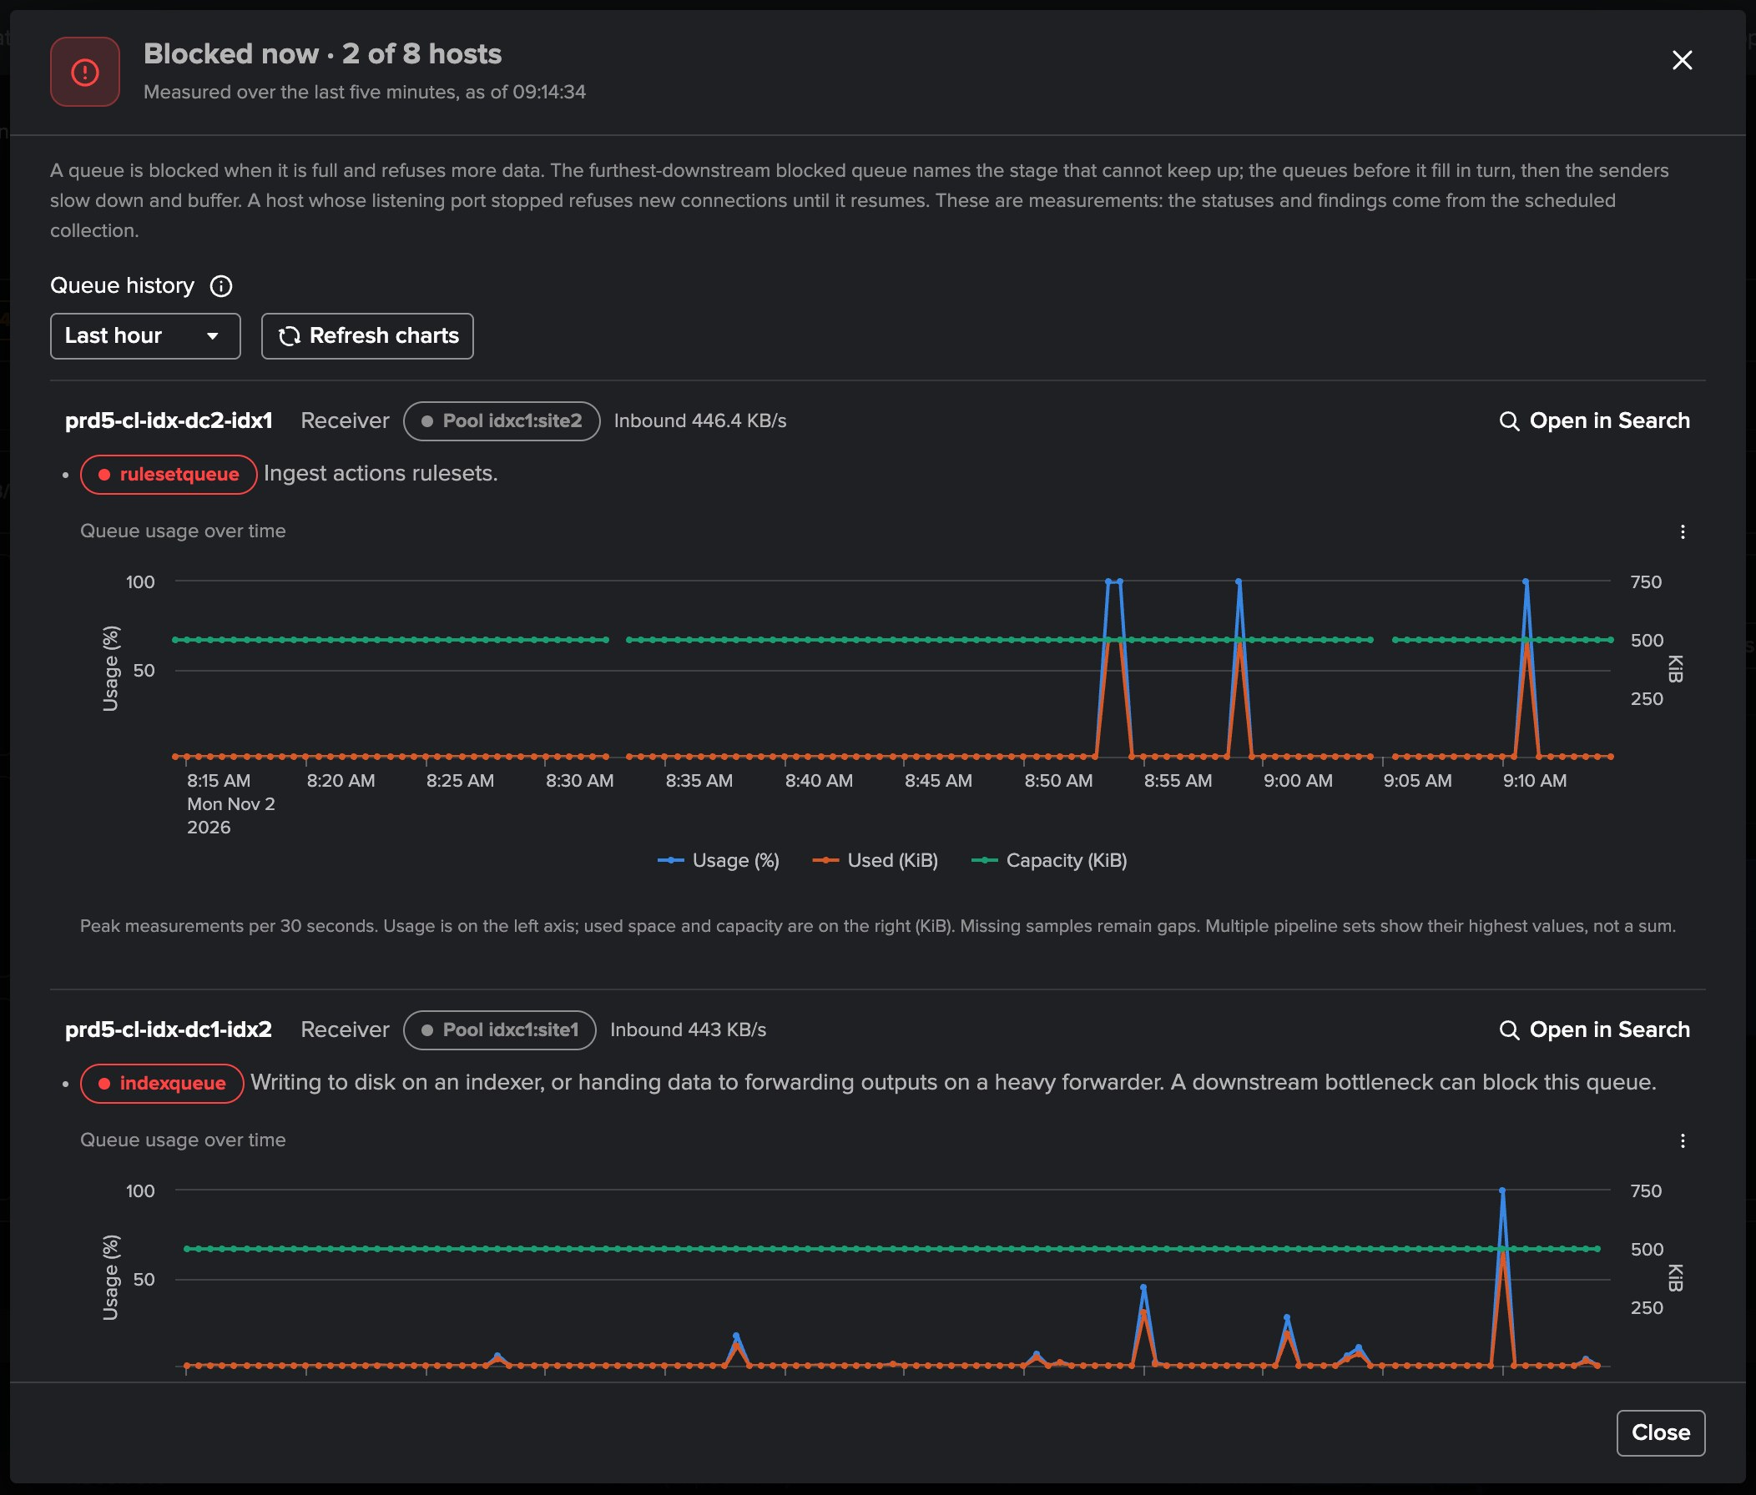
PART 2 · POOLS
Blocked now — which host, which queue, and its history
1
Blocked now · 2 of 8 hosts
The last five minutes strip: the pill opens what is blocked.
2
Each host
Its role, its pool, its inbound, and Open in Search on its queues.
3
Each blocked queue
What that stage does: indexqueue writes to disk, rulesetqueue applies ingest actions.
4
Queue history
Usage, used and capacity, from 15 minutes to 24 hours.
5
A measurement
Short peaks show here; statuses and findings come from the collection.
TrackMe for Splunk · Hands-on: Splunk S2S
docs.trackme-solutions.com
Notes:
The Blocked now pill of the last five minutes opens what is blocked: each host with its role, pool and inbound, every blocked queue with what that stage of the pipeline does, a stopped listening port, Open in Search, and the queue history of each blocked queue. Here an indexer of each site shows short peaks of a queue, the index queue on one and the ruleset queue on the other: measurements, not findings, which come from the scheduled collection.

Slide 14
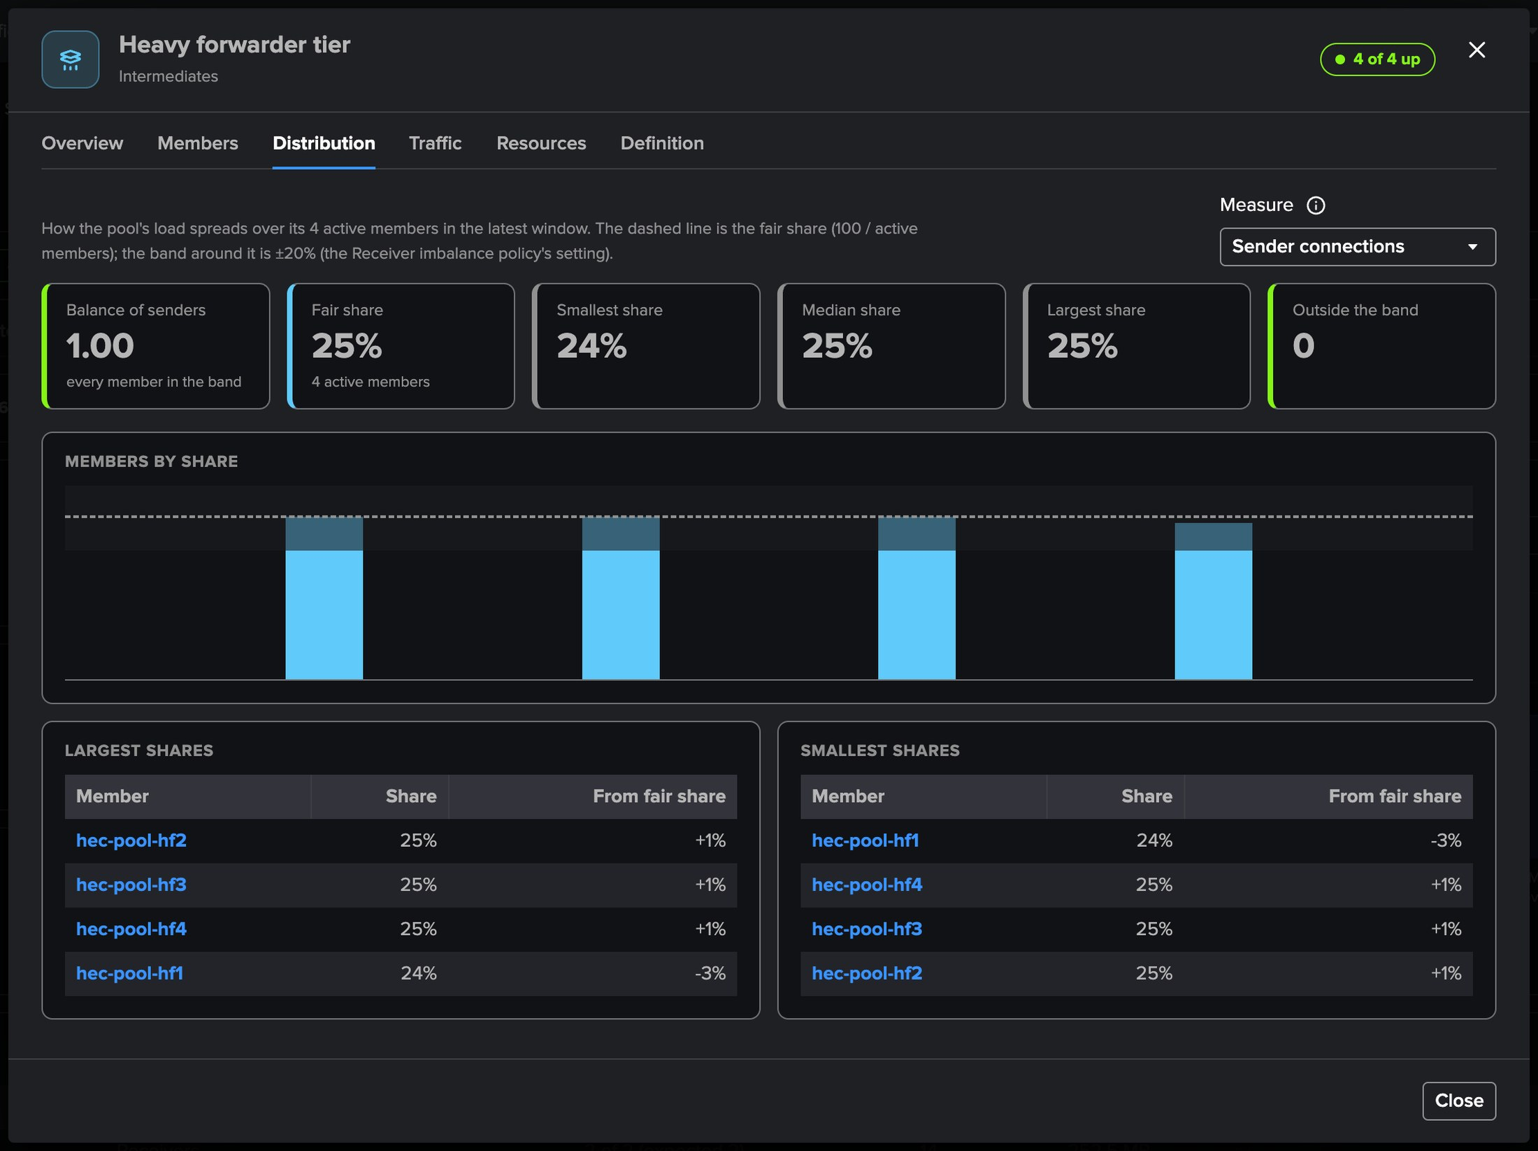
PART 2 · POOLS
How the pool spreads its load — the fair share and the band
1
Fair share
25 % for the four heavy forwarders: the dashed line.
2
The band
±20 %, the Receiver imbalance policy's setting.
3
Balance of senders
Jain's fairness index: 1.00, every member in the band.
4
Measure
Sender connections (the policy's own measure) or volume.
5
Largest and smallest
Each member's share and its distance from the fair share.
TrackMe for Splunk · Hands-on: Splunk S2S
docs.trackme-solutions.com
Notes:
The pool modal of the Heavy forwarder tier, Distribution tab. One bar per active member's share of the pool, the fair share and the band of the Receiver imbalance setting. A load balancer that starves one member shows here first, and the policy opens when a member stays below the band.

Slide 15
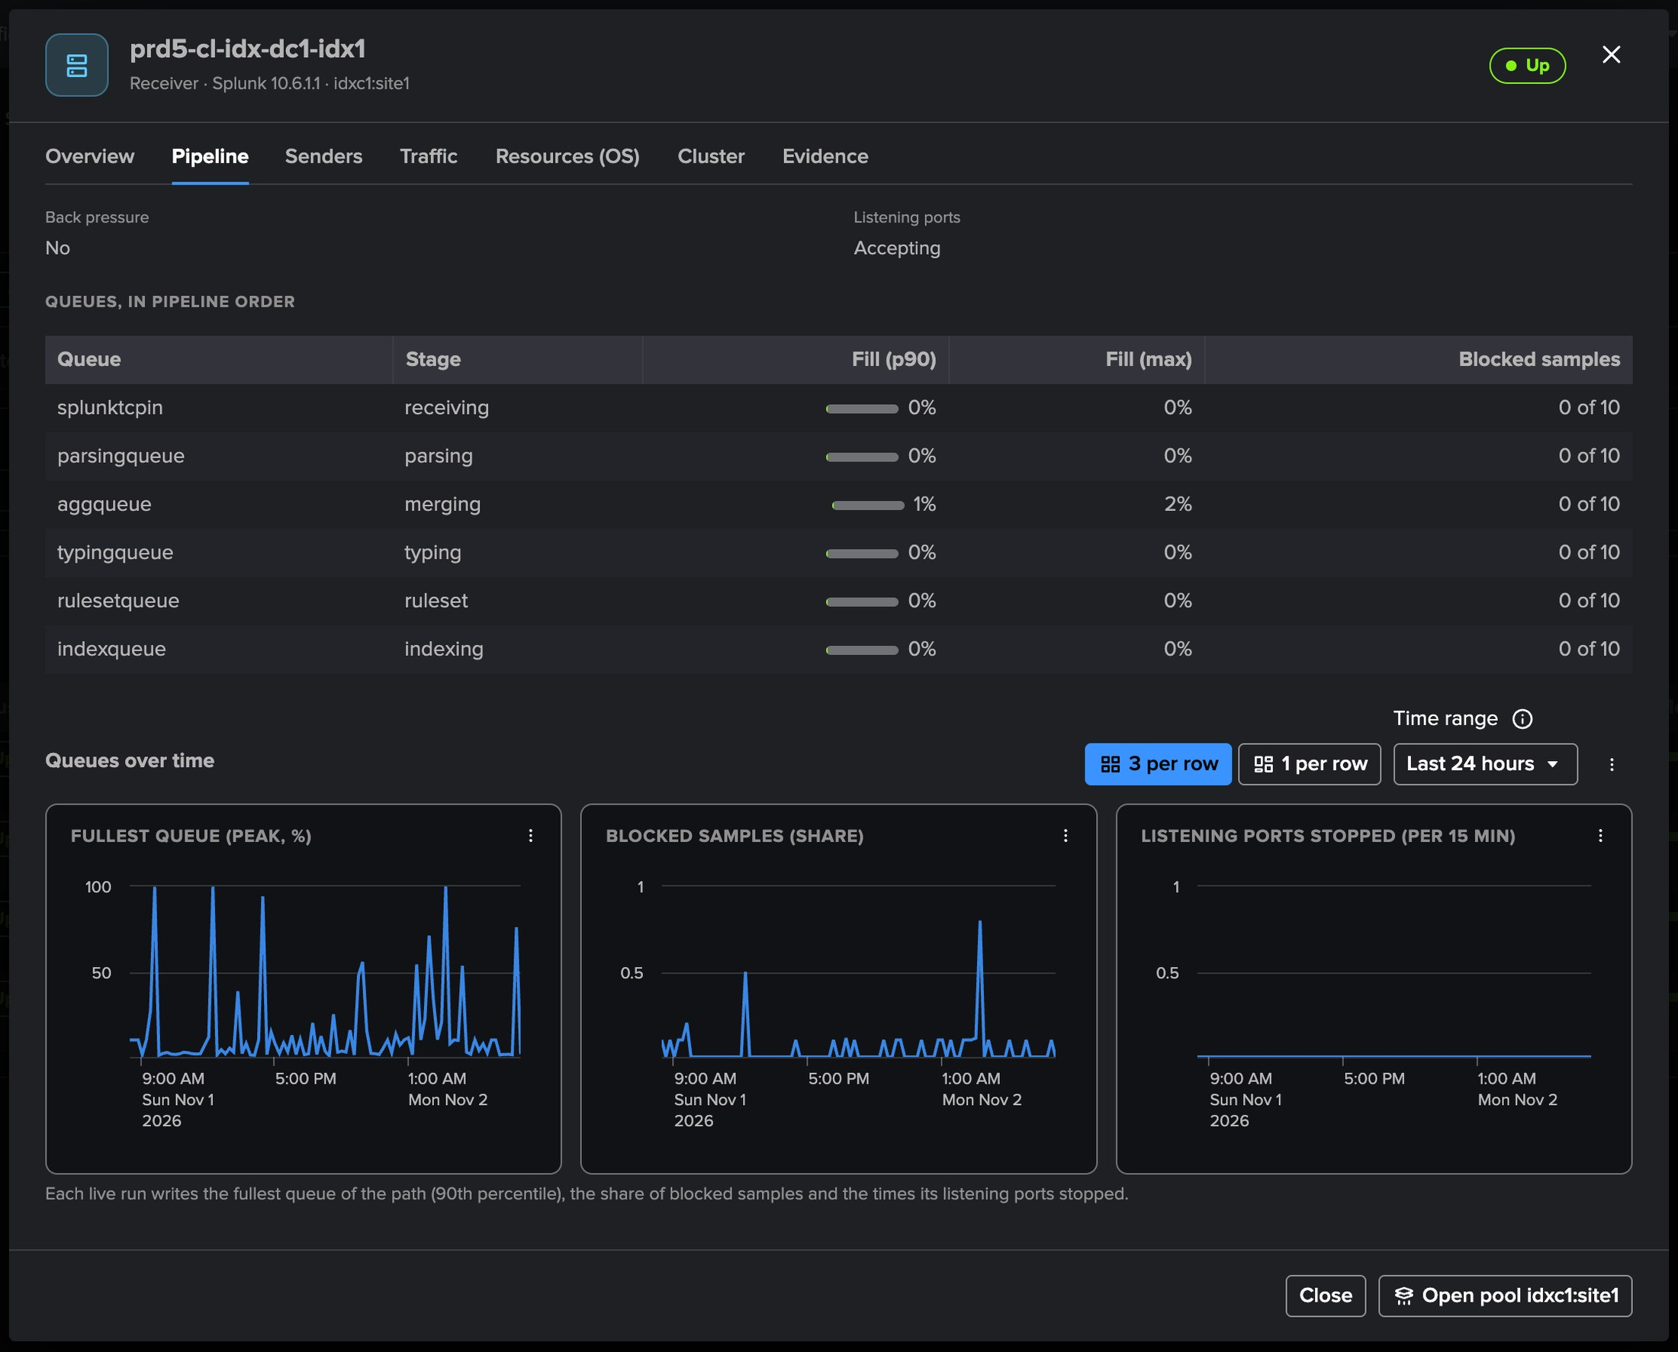
PART 2 · HOSTS
A receiver's pipeline — queue by queue, in order
1
Back pressure, listening ports
No back pressure; accepting its senders.
2
Queues in pipeline order
splunktcpin, parsing, aggregation, typing, ruleset, indexing.
3
Fill and blocked samples
90th-percentile and peak fill, blocked share of the samples.
4
Over time
The fullest queue over the last 24 hours.
TrackMe for Splunk · Hands-on: Splunk S2S
docs.trackme-solutions.com
Notes:
The host modal, Pipeline tab. Each queue of the receiver path with its fill and blocked samples. A queue saturated at 80 % or blocked in 30 % of its samples is back pressure: the finding names the stage that cannot keep up and whether its thread was busy or waiting on the next stage.

Slide 16
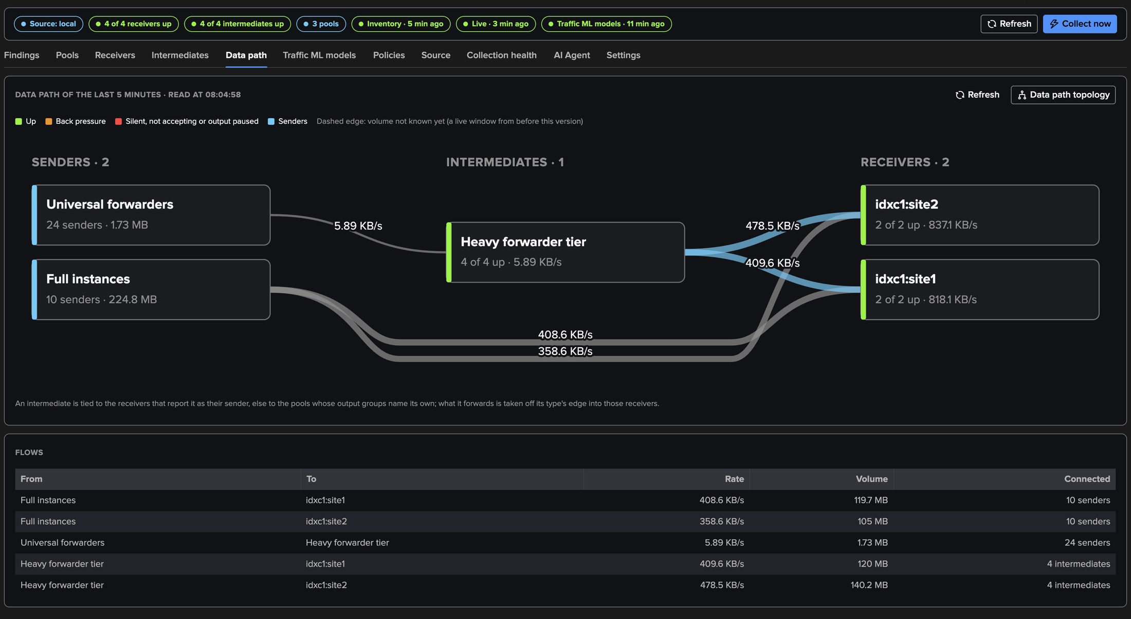
PART 2 · DATA PATH
The data path — sender types, intermediates, receivers
1
Three columns
3
Tied by output group
5
Data path topology
Sender types, intermediates, receivers; a pool as one node.
An intermediate is tied to the receivers that report it, else by its pool's output groups.
Saves it to Topology Studio on request.
2
Edges by volume
4
Read now
Width and KB/s labels: 24 universal forwarders into the Heavy forwarder tier.
The newest window, read with your rights; nothing saved.
TrackMe for Splunk · Hands-on: Splunk S2S
docs.trackme-solutions.com
Notes:
The Data path tab draws the forwarding path from what the receivers report: the universal forwarders into the Heavy forwarder tier, the tier into the two site pools of the indexer cluster, and the full instances sending straight to the indexers. A Flows table states every edge in words. An intermediate is never tied by guessing from a destination address.

Slide 17
03
PART 3 · FINDINGS
A heavy forwarder stops
One member of the heavy forwarder tier stopped on purpose: what opens, how each finding is evaluated, and the Splunk S2S AI Agent.
TrackMe for Splunk · Hands-on: Splunk S2S
Notes:
Part three: findings. One heavy forwarder of the tier was stopped on purpose.

Slide 18
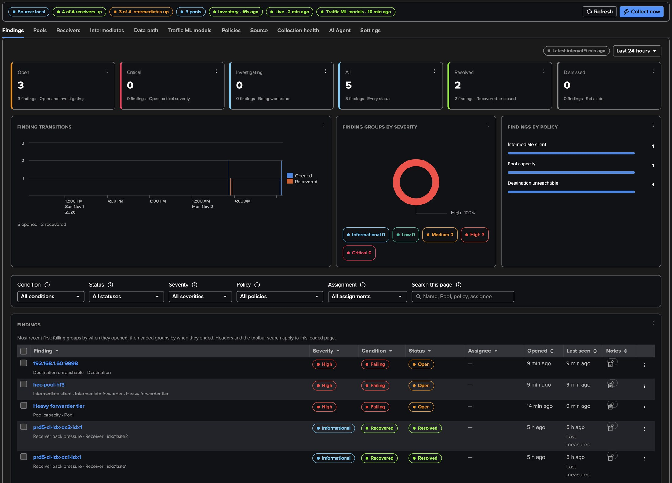
PART 3 · FINDINGS
What opens when a heavy forwarder stops
1
Intermediate silent
3
Destination unreachable
No connection line while the other members of its pool report.
Twenty senders fail to reach its port: one finding, never twenty.
2
Pool capacity
4
Triage
Three members up against four expected.
Investigate, snooze, dismiss, resolve; assign; merge into one group.
TrackMe for Splunk · Hands-on: Splunk S2S
docs.trackme-solutions.com
Notes:
The Findings tab. The stopped heavy forwarder opens Intermediate silent, its pool Pool capacity, and its receiving port Destination unreachable, measured on the twenty universal forwarders that failed to reach it. Each object has its Finding group. The forwarders load balance to the three other members, so no sender is held: there is no back pressure cascade.

Slide 19
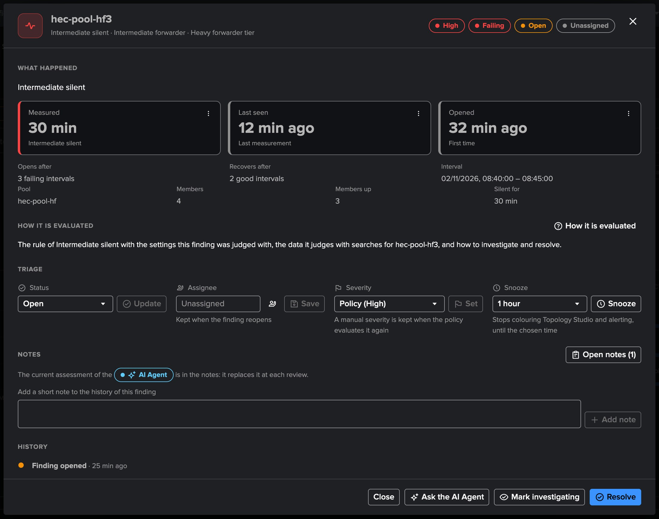
PART 3 · FINDINGS
A finding up close — what happened, triage, history
1
What happened
The measurement (silent for 15 minutes), when it opened, its live window.
2
Triage
Status, assignee, severity, snooze and notes, kept when it reopens.
3
Open resource
From the row menu: the host or the pool modal, in place.
4
How it is evaluated
Every policy's rule, data and searches, in the Policies tab.
TrackMe for Splunk · Hands-on: Splunk S2S
docs.trackme-solutions.com
Notes:
A finding opens with what happened, its triage and its history. When the heavy forwarder restarts, the findings recover after two healthy live windows.

Slide 20
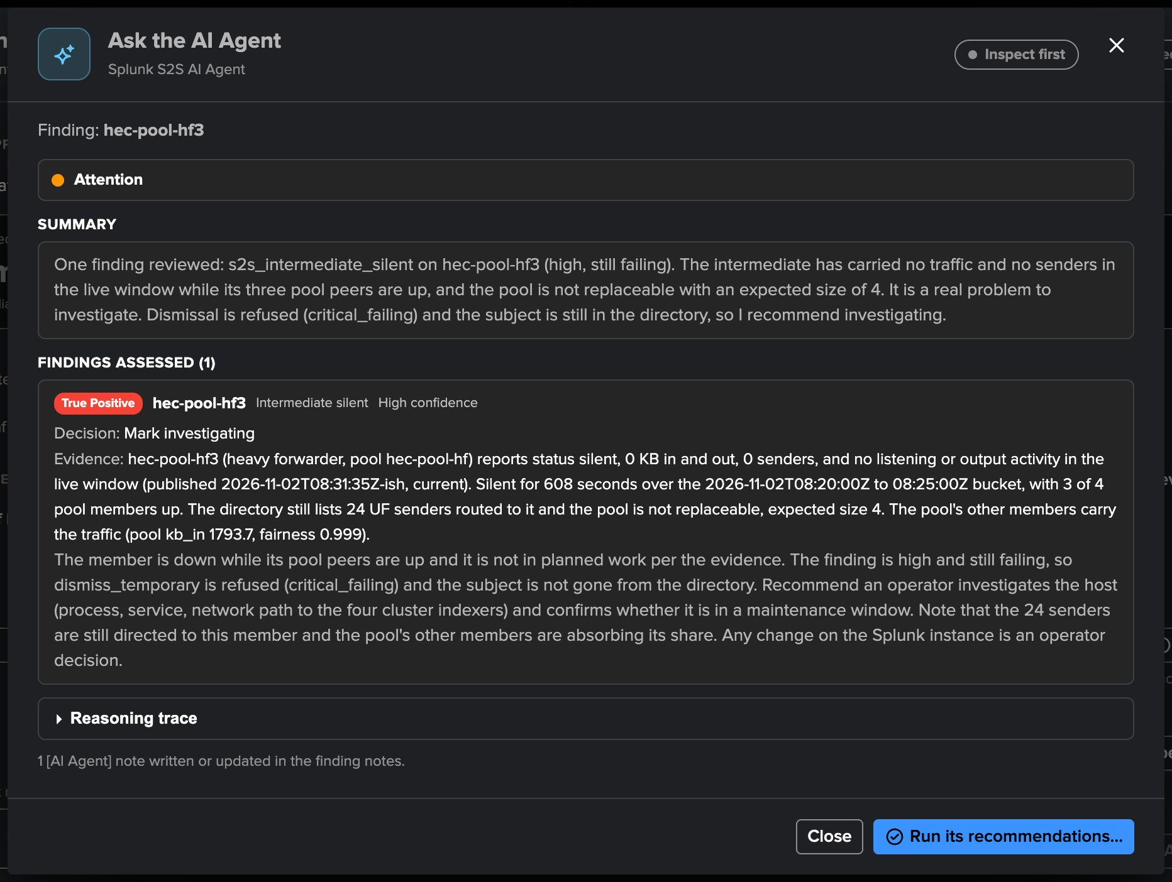
PART 3 · AI AGENT
The Splunk S2S AI Agent — a review on demand or on a schedule
1
What it reads
The host's live row, its pool, the cluster, collection health, past decisions.
2
Its tools
Hosts, pools, senders, data path, traffic models, evidence, trends.
3
One note per review
An [AI Agent] note on the finding.
4
Act mode
Only what the tenant allows; never a change on a Splunk instance.
TrackMe for Splunk · Hands-on: Splunk S2S
docs.trackme-solutions.com
Notes:
Ask the AI Agent from a finding or a Finding group. The Splunk S2S AI Agent knows the pipeline model, the bottleneck and cascade reading, planned cluster work and posture. Scheduled triage is off by default: hourly, up to ten findings per run.

Slide 21
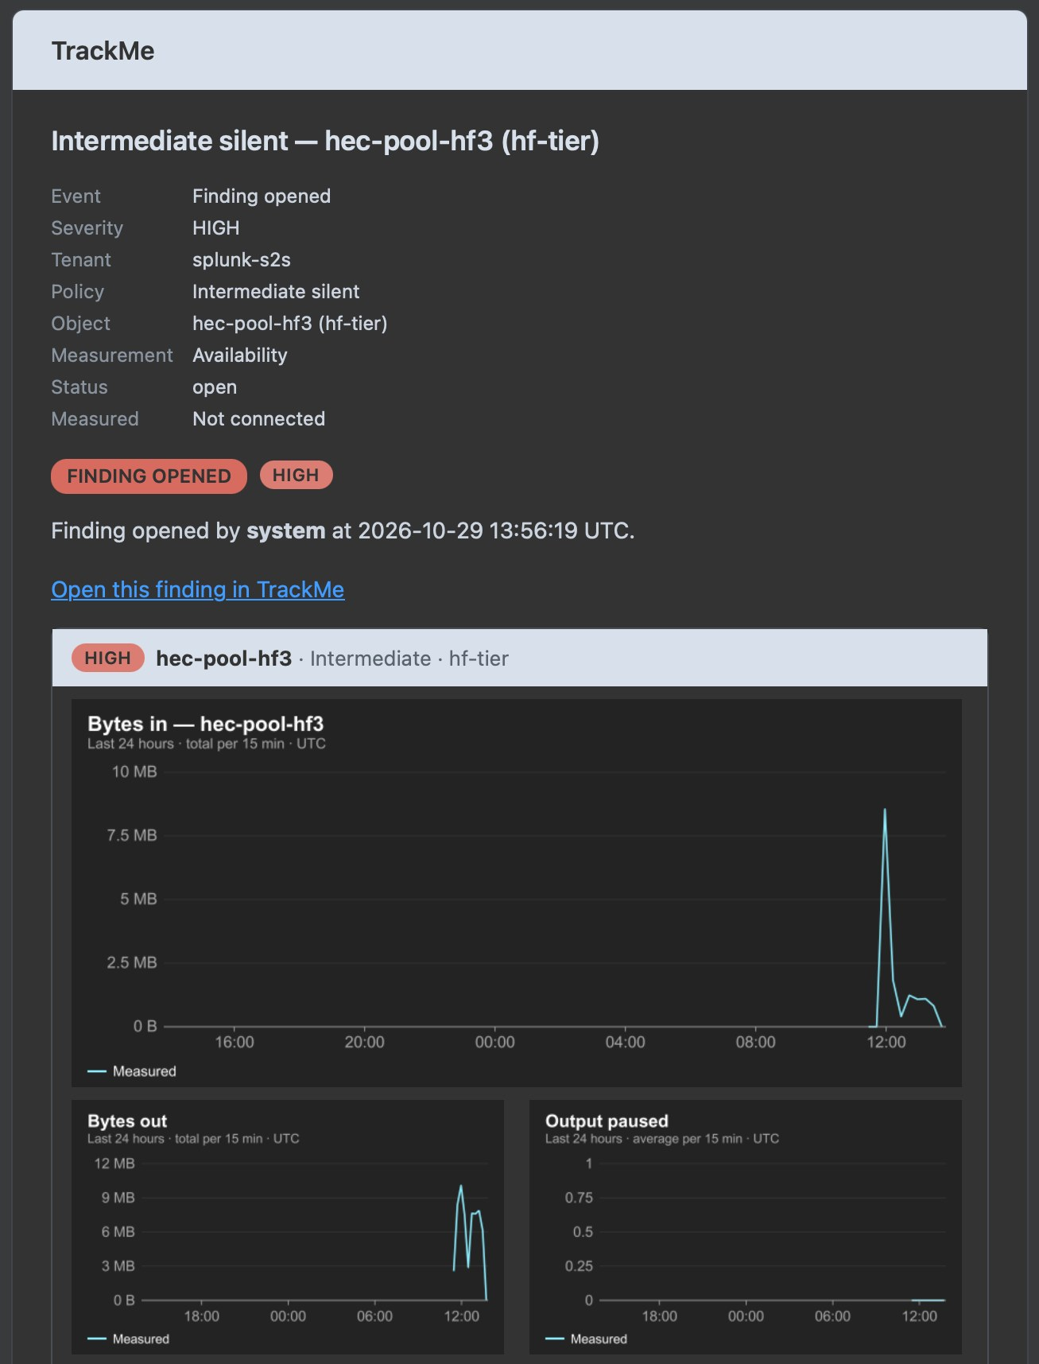
PART 3 · NOTIFICATIONS
The email — the finding, its measurement and its charts
1
Per Finding group or digest
One threaded email per transition, or one digest per live run.
2
What it says
Policy, object, measurement, status, and a link to the finding.
3
Charts embedded
The object's last 24 hours: bytes in, bytes out, output paused.
4
Always recorded
Every transition is an event in the notable index.
One stop, one email per object
The same stop emailed the Destination unreachable finding of its receiving port: twenty senders, one email.
TrackMe for Splunk · Hands-on: Splunk S2S
docs.trackme-solutions.com
Notes:
Settings, Notifications sends the transitions of the findings from a minimum severity, for every policy or chosen ones, through an email delivery account. Here, the email of the silent heavy forwarder, with its last 24 hours embedded.

Slide 22
04
PART 4 · OPERATE
Policies, models, collection
Twenty-two policies and how each is evaluated, the traffic ML models of every receiver pool, and collection health.
TrackMe for Splunk · Hands-on: Splunk S2S
Notes:
Part four: operate the tenant.

Slide 23
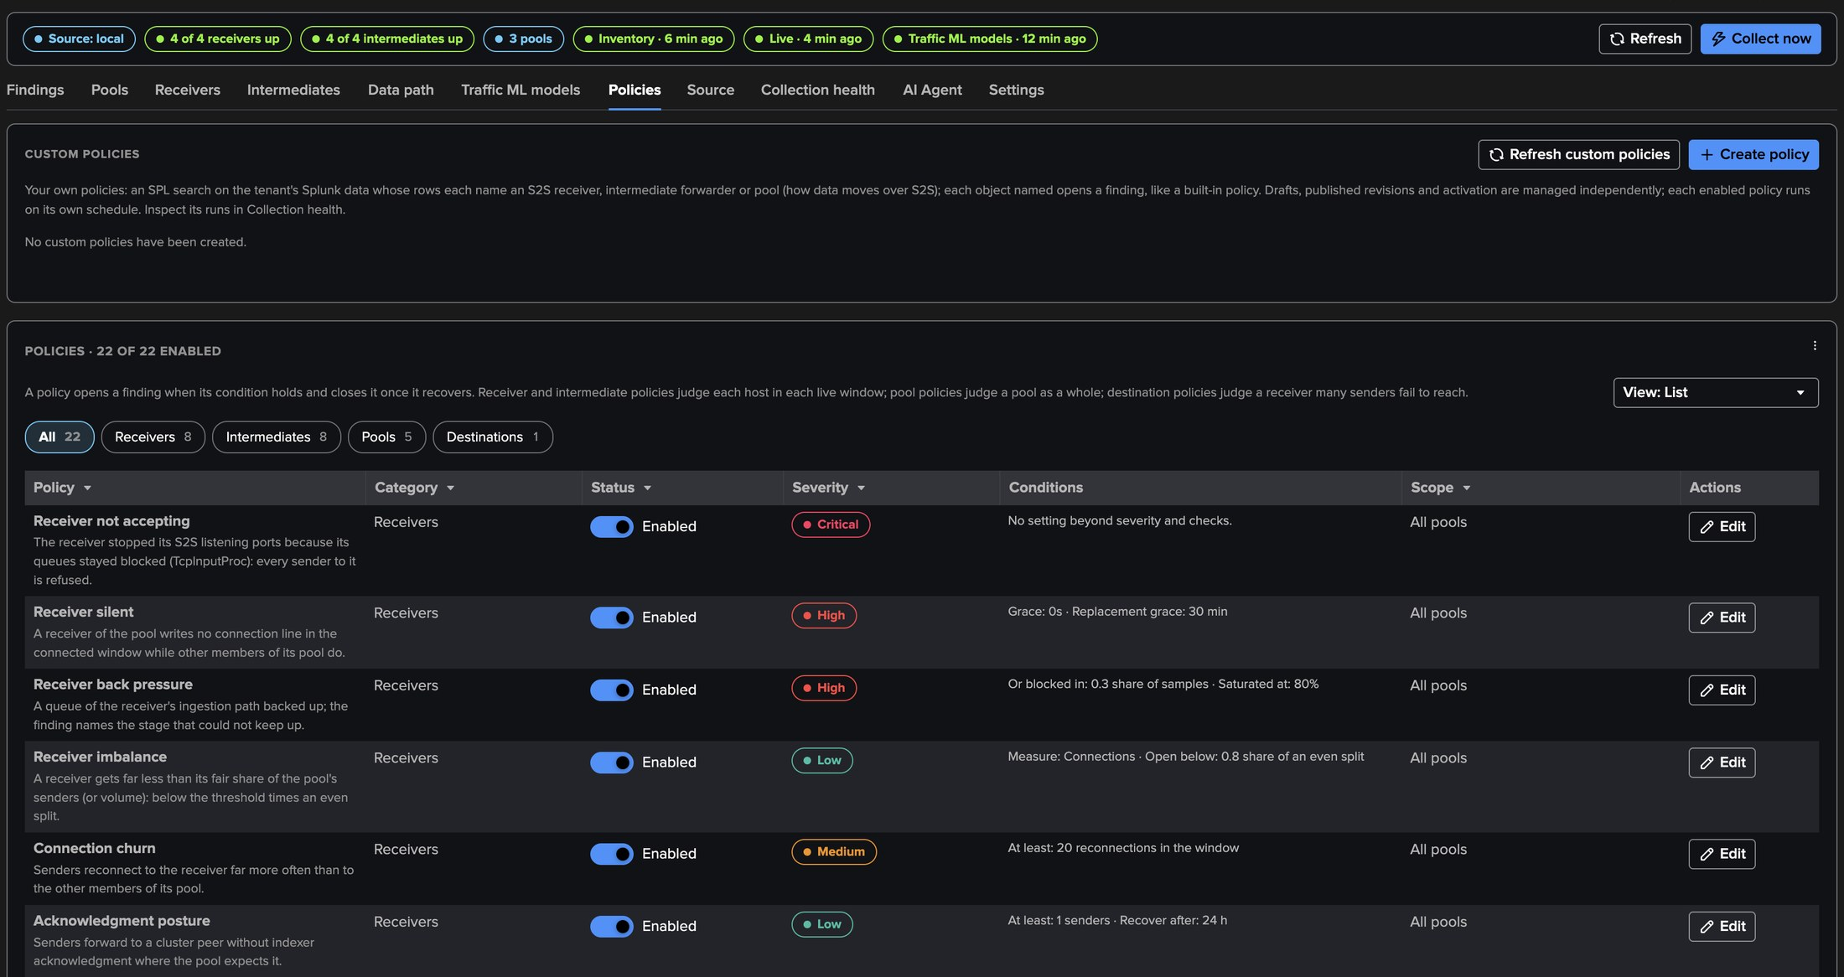
PART 4 · POLICIES
Twenty-two policies — receivers, intermediates, pools, destinations
1
Receivers
3
Pools
5
Custom policies
Not accepting, silent, back pressure, imbalance, churn, TLS, acknowledgement, versions.
Not receiving, capacity, traffic drop, traffic outlier, back pressure cascade.
Your own SPL: each row names a receiver, an intermediate or a pool.
2
Intermediates
4
Destinations
Output blocked, back pressure, silent, destinations, single destination, in / out.
A receiver many senders fail to reach: one finding, never one per sender.
TrackMe for Splunk · Hands-on: Splunk S2S
docs.trackme-solutions.com
Notes:
The policy catalogue in list view. Every policy has its severity, its checks to open and to recover, a scope by pool, a bank holiday hold and How it is evaluated. Above the catalogue, TrackMe administrators of the tenant write custom SPL policies.

Slide 24
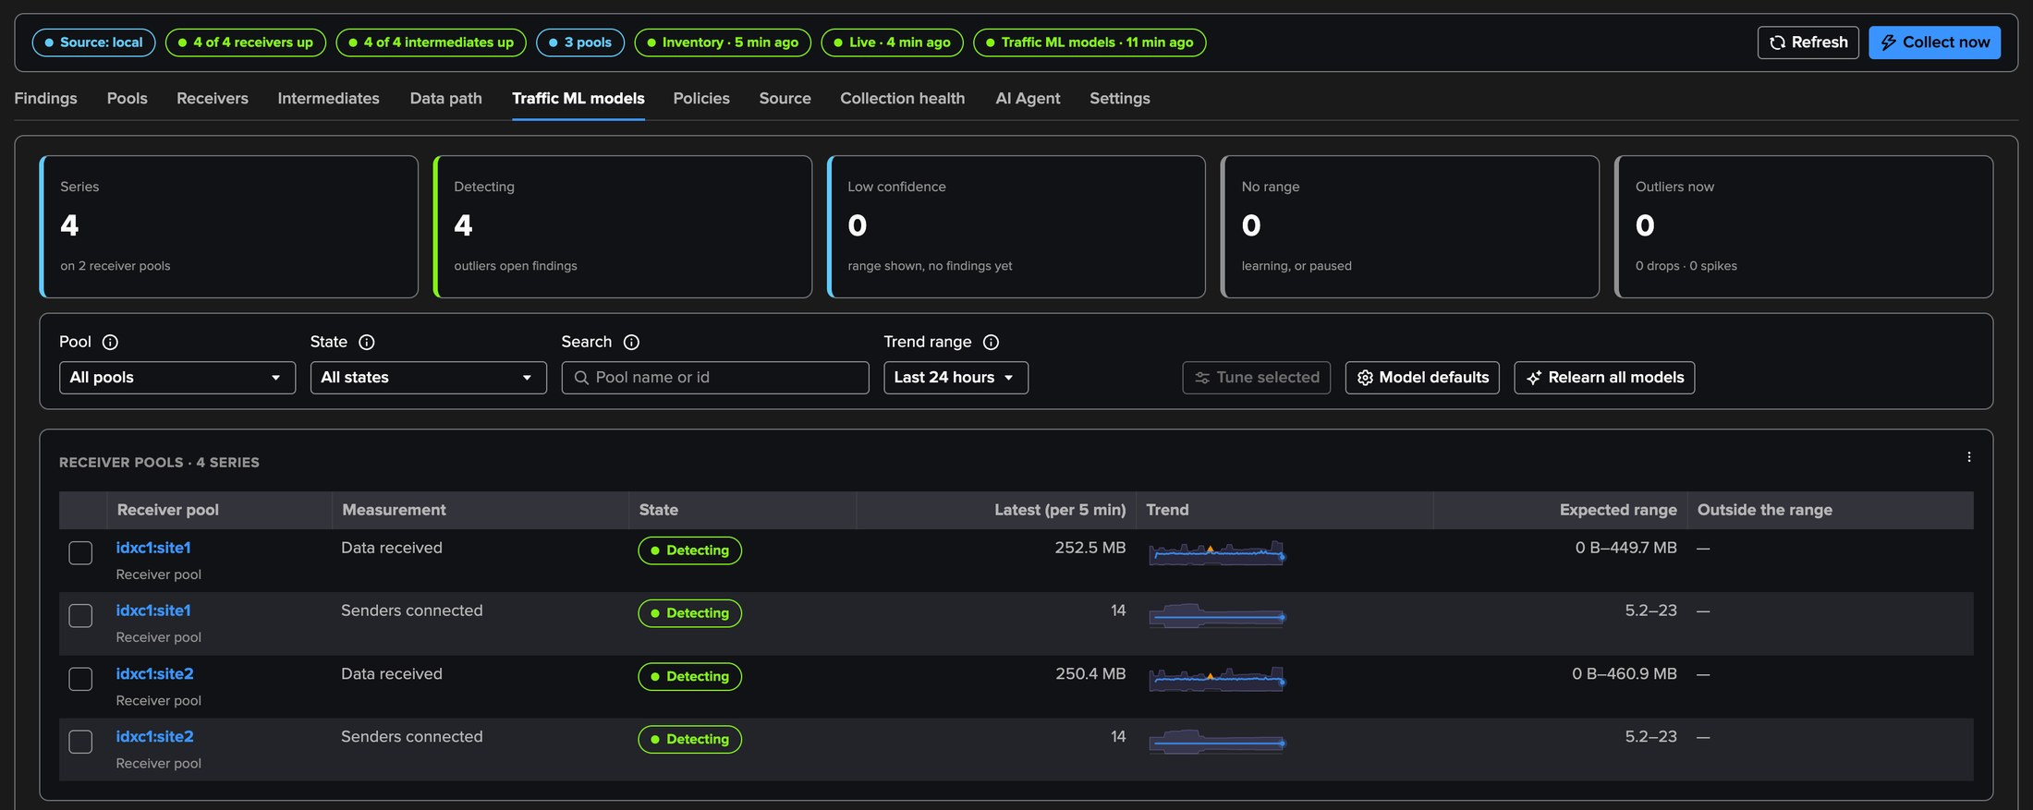
PART 4 · TRAFFIC MODELS
Traffic ML models — what each pool usually receives
1
Two models per pool
KB received and connected senders, per weekday and hour: four series on the two site pools.
2
Learned
From the members' lines over the learning history, 14 days by default.
3
Pool traffic outlier
Outside the model's range for this hour, from normal confidence.
4
Tuning
Tune model with a simulation, Not an anomaly, Relearn all models.
TrackMe for Splunk · Hands-on: Splunk S2S
docs.trackme-solutions.com
Notes:
Every receiver pool has two traffic models, learned per weekday and hour and refreshed twice an hour. They are the traffic models of the Splunk HEC and Cribl Stream tenants. Pool traffic drop, the same hour's median over seven days, needs no model.

Slide 25
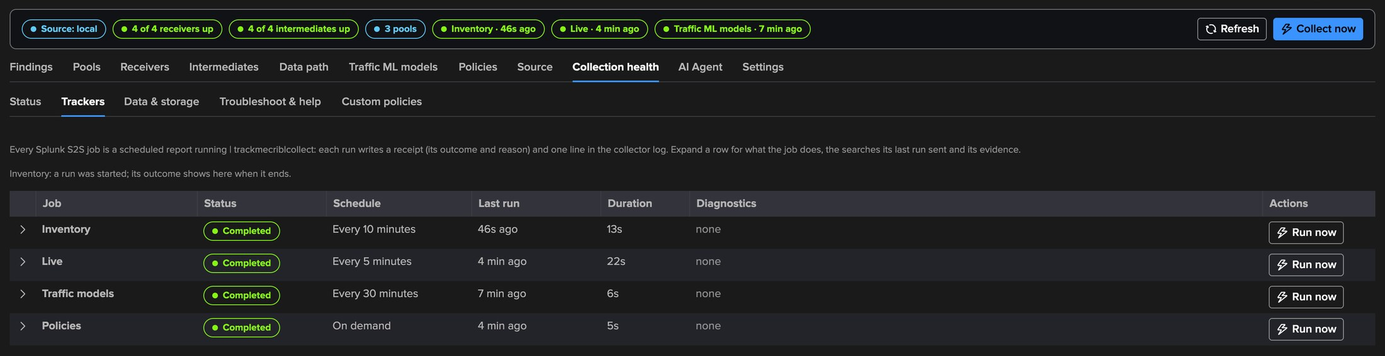
PART 4 · COLLECTION
Collection health — every job, and why when it does not run
1
Status
3
Cluster reads
Every problem with its meaning, source, causes and steps.
cluster_read_refused names the missing list_indexer_cluster.
2
Trackers
4
Configuration Guardian
Inventory, Live, Traffic models, Policies: last run, searches, Run now; Custom policies apart.
The same assessment raises cribl_collection_health.
TrackMe for Splunk · Hands-on: Splunk S2S
docs.trackme-solutions.com
Notes:
Collection health shows whether the tenant collects as configured. The cluster reads need the read-only list_indexer_cluster capability: without it Splunk answers nothing, and Collection health says so.

Slide 26
WHERE WE ARE
One tenant, every receiver, intermediate and pool
Set up
Followed
Judged
Operated
a tenant on the local search tier, an indexer cluster as one pool per site, the heavy forwarder tier
pools, a pool's distribution, a receiver's pipeline, the data path
a heavy forwarder silent and its pool short of a member, explained
twenty-two policies, traffic ML models, collection health
What made it work
Splunk's own telemetry
Pools judged as a whole
Back pressure explained
No agent, no new data, no call to a forwarder: the lines Splunk already writes.
Members up against the expected size, the share each one receives, planned work held.
The bottleneck and its origin, one cascade finding instead of a storm.
TrackMe for Splunk · Hands-on: Splunk S2S
docs.trackme-solutions.com
Notes:
Where we are. A Splunk S2S tenant set up on a deployment with a four-peer indexer cluster and a heavy forwarder tier, its cluster found without configuration as one pool per site, its heavy forwarder tier an automatic pool made its own; the pools, a receiver's pipeline and the data path followed; a heavy forwarder stopped and the findings it opened; and the policies, traffic models and collection that run it.

