Slide 1

HANDS-ON WALKTHROUGH · PART 2
Classify with policies
A tenant where every entity is “medium” is not a monitoring posture. Two lookup-based policies — priority and tags — and the same tenant now knows what matters and who owns it.
TrackMe 2.4.18 · tenant secops from Part 1
Notes:
Part 2 picks up exactly where Part 1 stopped: the secops tenant has its DSM entities, every one of them medium priority, none tagged. This deck shows the classification step of the cycle — step 4, CLASSIFY — done the way it scales: with policies driven by a CMDB-style lookup, not by hand.

Slide 2
CLASSIFICATION
Why policies — discovery finds everything, not what matters
Priority, tags, labels and SLA are how you tell TrackMe which feeds deserve a page at 2 AM, and which team to call. Setting them one entity at a time does not survive contact with a real estate.
Source of truth
Policy
Policy tracker
Entities
a Splunk lookup (CSV or KV Store), a regex, or an SPL search
maps lookup fields to entity fields, picks the value field, simulates before saving
a scheduled report per family — trackme_dsm_priority_tracker_tenant_secops — re-evaluates every cycle
priority / tags updated on every match; a manual override always wins; removing the policy cleans up
Three policy types, three families
Regex
Lookup
Search
Families
match the entity object name with a regular expression and assign a fixed value — quick, no external data
match entity fields against a lookup with wildcard or exact mode; the value comes from the lookup row — the CMDB pattern we use today
any SPL that returns entity keys and values — for the cases a lookup cannot express
Priority policies
Tags policies
SLA policies
Labels have their own rule engine.
TrackMe for Splunk · Hands-on: classify with policies
docs.trackme-solutions.com
Notes:
The vocabulary from the introduction: a policy assigns metadata automatically by rule. Three types (regex, lookup, search) and three families (priority, tags, SLA). Policies suggest; a manual override always wins; removing a policy auto-cleans what it assigned. If several policies match the same entity, the higher priority wins. The lookup type is the one customers end up with, because the source of truth already exists somewhere — a CMDB export, an index inventory.

Slide 3
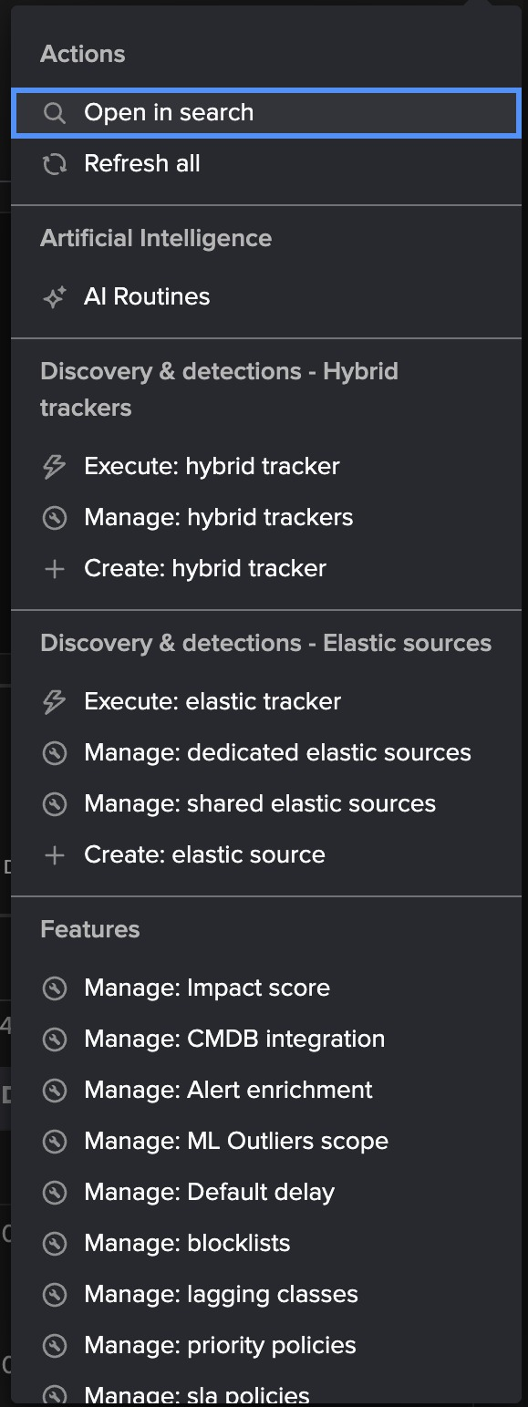
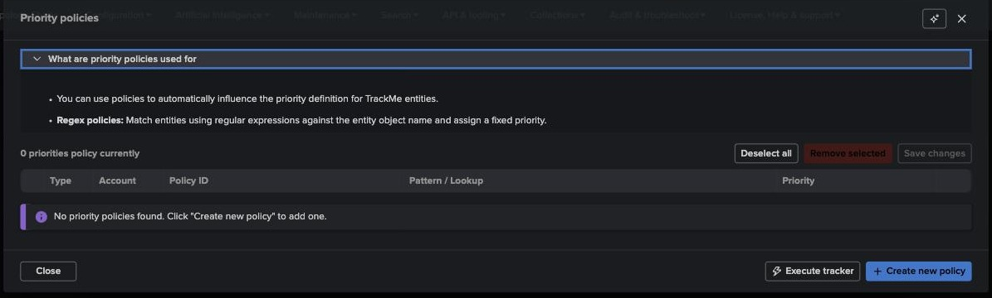
PRIORITY POLICY · STEP 0
Where — Tenant Home → Actions → Manage: priority policies
1
Features section
2
Every classification feature is tenant-scoped and lives in the same ⋮ menu: impact score, default delay, blocklists, lagging classes, priority / SLA / tags policies, logical groups, labels.
3
2
What are … used for
Each policies modal opens with a short explanation of the policy types — useful during a session.
The lookup we use — example_cmdb_indexes_simple
index
priority
tags
3
Create new policy
siem-cloud-*
medium
cloud
Also here: “Execute tracker” to apply policies right now instead of waiting for the schedule.
siem-firewall-*
critical
net,firewall
siem-identity-*
critical
identity
siem-infra-*
high
infra
siem-osnix-*
low
os
siem-web-*
critical
web
1
…10 rows. One row per index family, wildcards in the key — this is what a CMDB export usually looks like.
TrackMe for Splunk · Hands-on: classify with policies
docs.trackme-solutions.com
Notes:
Everything tenant-scoped is behind the ⋮ Actions menu on Tenant Home. Priority, SLA and tags policies are the three families you configure the same way. The lookup shipped with TrackMe as an example is deliberately shaped like a CMDB export: index pattern, priority, comma-separated tags. Customers replace it with their own CSV or KV Store — the policy definition does not change.

Slide 4
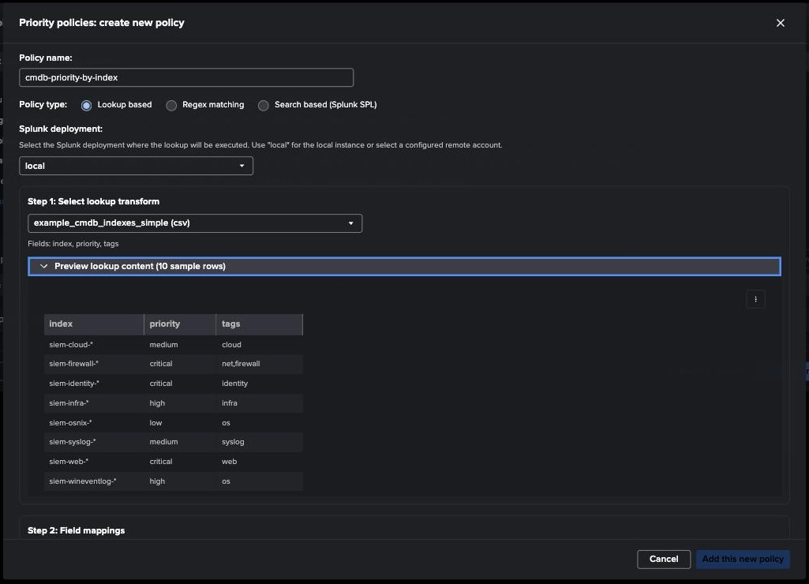
PRIORITY POLICY · CREATE
Step 1 — Lookup based: pick the transform, preview the content
1
Policy name + type
cmdb-priority-by-index · Lookup based. The other radios switch the form to regex or SPL.
1
2
Splunk deployment
Where the lookup is executed — local, or a remote account when the tenant monitors a remote Splunk.
2
3
Lookup transform
3
Any lookup definition visible to TrackMe; fields are read from it (index, priority, tags).
4
4
Preview lookup content
Ten sample rows, straight from the lookup — check the shape of the keys before mapping.
The preview is where the wildcards become visible: siem-cloud-*, siem-firewall-* … one row covers every region of that family.
TrackMe for Splunk · Hands-on: classify with policies
docs.trackme-solutions.com
Notes:
Name the policy after what it does — it appears in the policies table and in the audit trail. The lookup transform list is long on a real search head; the filter box narrows it. Preview the content before mapping: it tells you which field is the key and whether it contains wildcards, which decides the match mode on the next step.

Slide 5
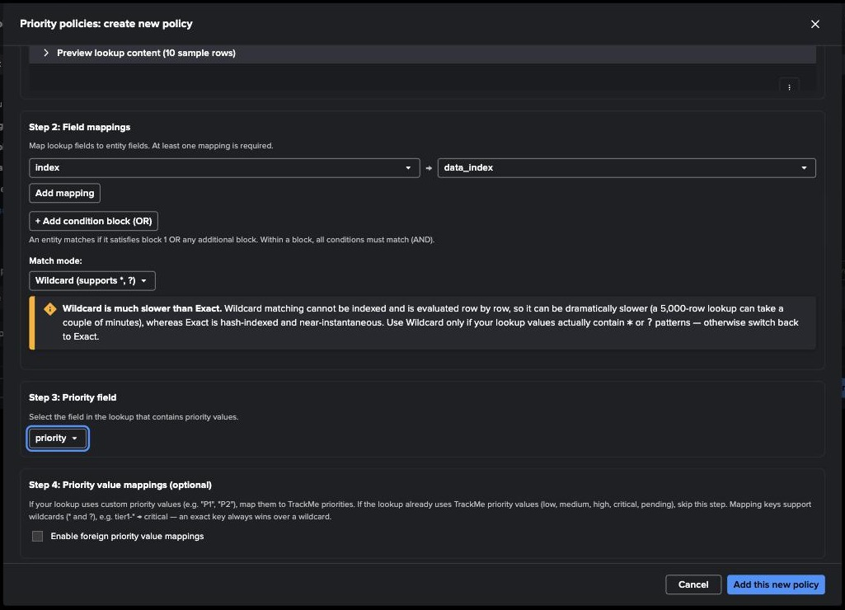
PRIORITY POLICY · CREATE
Step 2 — Field mapping and match mode
1
index → data_index
Lookup field on the left, entity field on the right. Entity fields include data_index, data_sourcetype, object, alias, tags… Add mappings for AND conditions.
1
2
Condition blocks (OR)
A second block matches alternative rows — an entity matches if any block matches, all conditions inside a block must match.
2
3
3
Match mode: Wildcard
Required here because the keys contain *. Wildcard is evaluated row by row; Exact is hash-indexed. Use Exact whenever the lookup has literal values.
4
4
Step 3 — priority field
The lookup column that carries the value: priority.
TrackMe for Splunk · Hands-on: classify with policies
docs.trackme-solutions.com
Notes:
The mapping is the heart of a lookup policy: which lookup column is compared with which entity attribute. Here one mapping is enough, index against data_index. The warning about wildcard performance is real — a 5,000-row lookup evaluated row by row against tens of thousands of entities takes minutes — so use Exact unless the keys actually contain wildcards. Step 3 selects the value column; step 4 optionally maps foreign values (P1, P2…) onto TrackMe priorities.

Slide 6
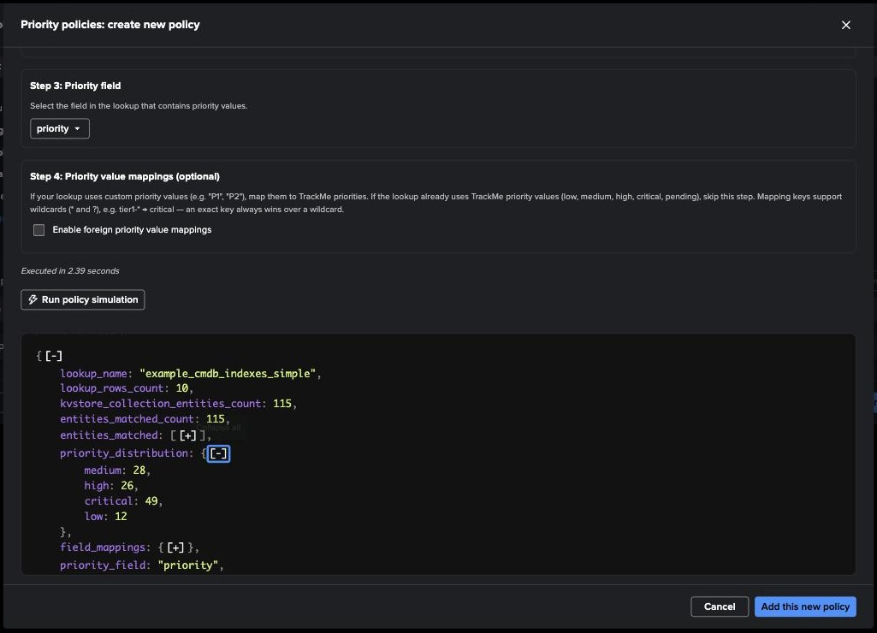
PRIORITY POLICY · CREATE
Simulate before you save — the whole tenant, classified
1
Step 4 — value mappings
Optional: if the lookup says P1 / tier1-*, map those to critical / high… Exact key wins over wildcard. Not needed with TrackMe values.
2
Run policy simulation
1
Executes the lookup against the tenant’s KV Store in 2.4 s — no entity is touched.
2
3
priority_distribution
Every entity matched; the distribution shows the split by priority. entities_matched lists every one of them.
4
Add this new policy
3
A confirmation asks for an update comment — it goes in the audit trail with the policy.
The simulation is the sales moment: the audience sees the whole tenant re-classified from one CMDB export before anything is written.
4
TrackMe for Splunk · Hands-on: classify with policies
docs.trackme-solutions.com
Notes:
Always simulate. The JSON is the same structure the policy tracker will apply; the distribution tells you immediately whether the mapping is right — every entity matched, none unmatched, and a plausible split. If the split looked wrong (everything medium, say), the value field or the match mode is wrong. Then Add, comment, confirm.

Slide 7
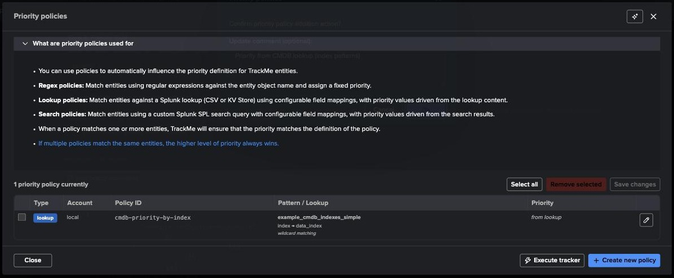
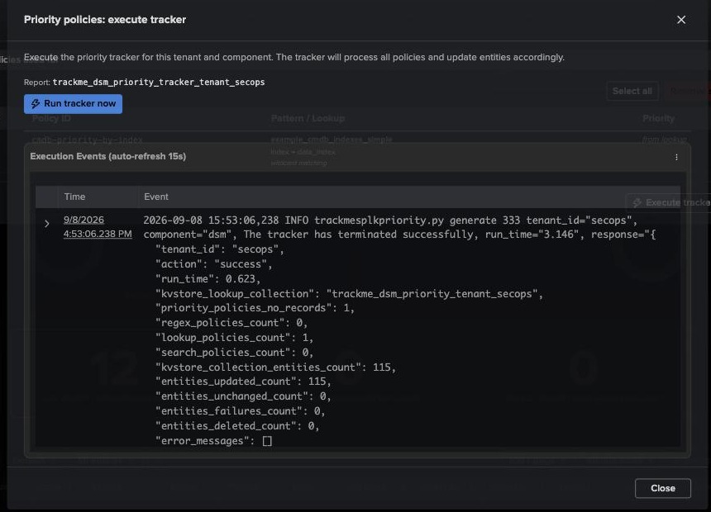
PRIORITY POLICY · APPLY
Apply — the policy tracker, on schedule or right now
1
One policy in the table
type lookup · account local · cmdb-priority-by-index · example_cmdb_indexes_simple, index → data_index, wildcard matching · priority from lookup. Edit in place with the pencil.
2
Execute tracker
Opens “Priority policies: execute tracker” for the report trackme_dsm_priority_tracker_tenant_secops → Run tracker now. Otherwise the scheduler applies it on its next cycle.
1
2
3
Execution events
trackmesplkpriority.py logs lookup_policies_count, kvstore_collection_entities_count, entities_updated_count (every entity) and entities_failures_count (no failure), with the run time.
3
Every family has its own tracker: trackme_dsm_priority_tracker_…, trackme_dsm_tags_tracker_…, trackme_dsm_sla_tracker_…. They are ordinary scheduled reports — visible in the Splunk scheduler and, if you monitor TrackMe with TrackMe, in WLK.
TrackMe for Splunk · Hands-on: classify with policies
docs.trackme-solutions.com
Notes:
Creating the policy does not change entities by itself: the policy tracker does, on its schedule. Execute it now to see the effect immediately. The execution log is explicit — updated / unchanged / failures — which is also what you check when a policy seems not to apply.

Slide 8
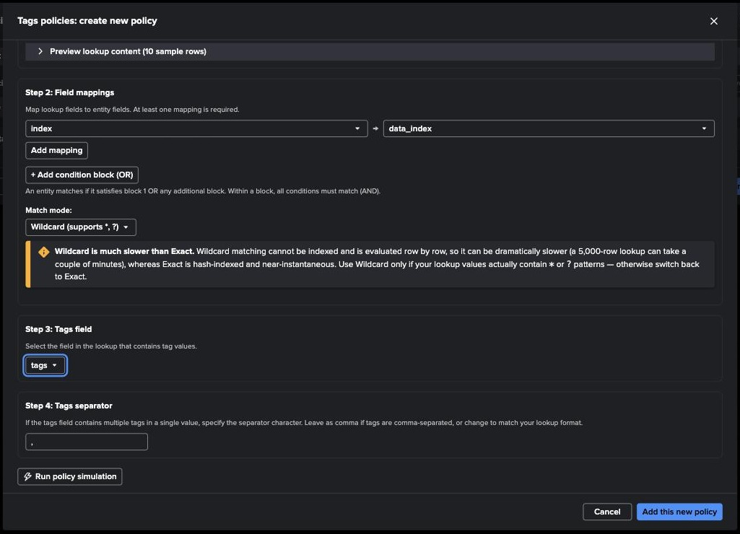
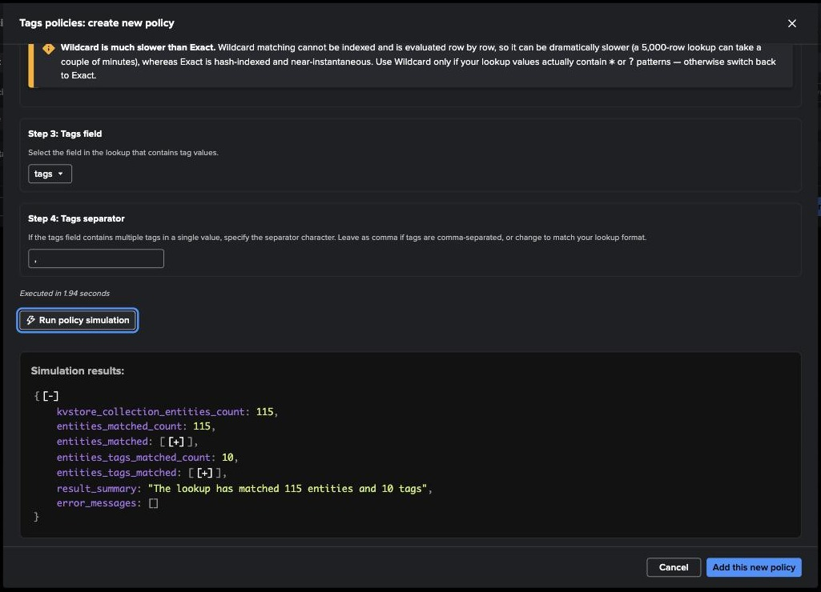
TAGS POLICY
Tags policy — same lookup, same mapping, one more field
1
3
2
1
Step 3 — tags field
2
Step 4 — separator
3
Simulation
The lookup column with the tag values: tags.
net,firewall is two tags — the separator (comma by default) splits multi-valued cells.
The simulation reports the entities matched and the tags found — then Add, then Execute tracker → Run tracker now, exactly as for priority.
TrackMe for Splunk · Hands-on: classify with policies
docs.trackme-solutions.com
Notes:
The tags policy is a copy of the priority one with the tags column selected and a separator. Tags are free-form strings — they become a filter and a grouping axis in the table, in Virtual Groups, in ML scope filters and in Topology Studio aggregates. Labels are different: a managed, coloured catalogue with its own rule engine.

Slide 9
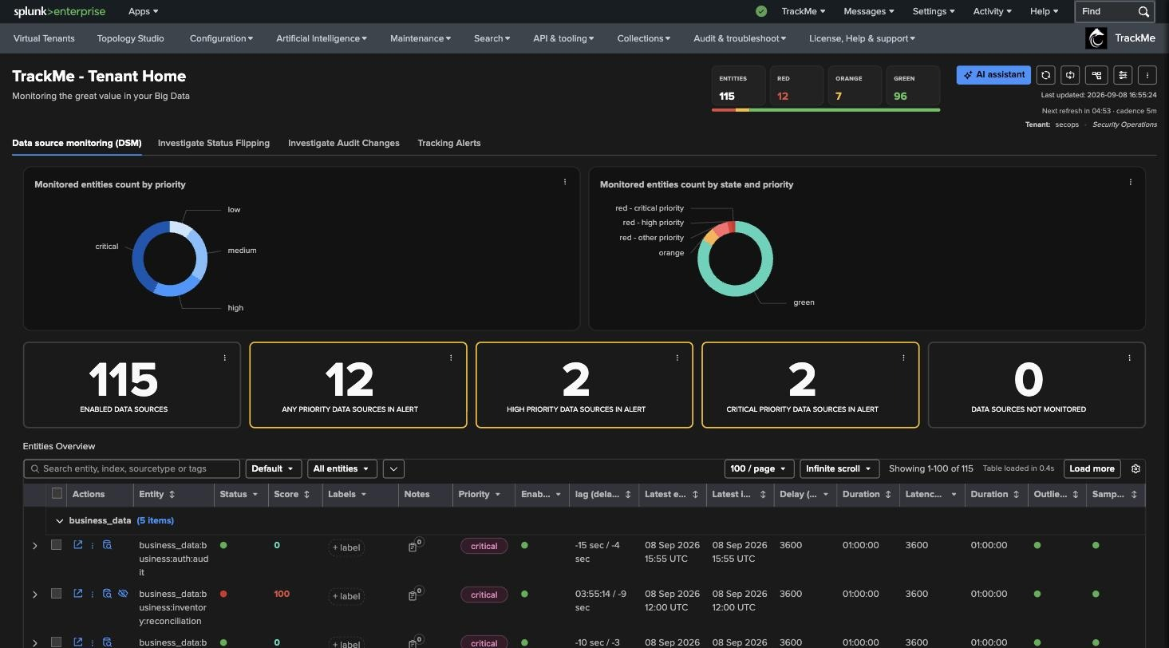
RESULT
Result — the same tenant, now with a point of view
1
Count by priority
One blue disc became four — critical, high, medium, low: the CMDB’s view of the estate.
2
State × priority
Red now splits into red-critical, red-high, red-other. The same red entities — but now you know which ones matter.
1
2
3
High and critical in alert
3
The single-stats that were 0 in Part 1 are populated. This is what an on-call filter looks like.
4
Priority chips
4
Every row carries critical / high / medium / low — assigned by the policy, overridable per entity.
TrackMe for Splunk · Hands-on: classify with policies
docs.trackme-solutions.com
Notes:
Same entities, same red ones. What changed is that TrackMe can now rank them. On the Virtual Tenants page the secops card now shows a high-priority count instead of 0 — that number is what a manager looks at. Tie it back to the introduction: priority feeds the alerting model — alert on critical and high, watch the rest.

Slide 10
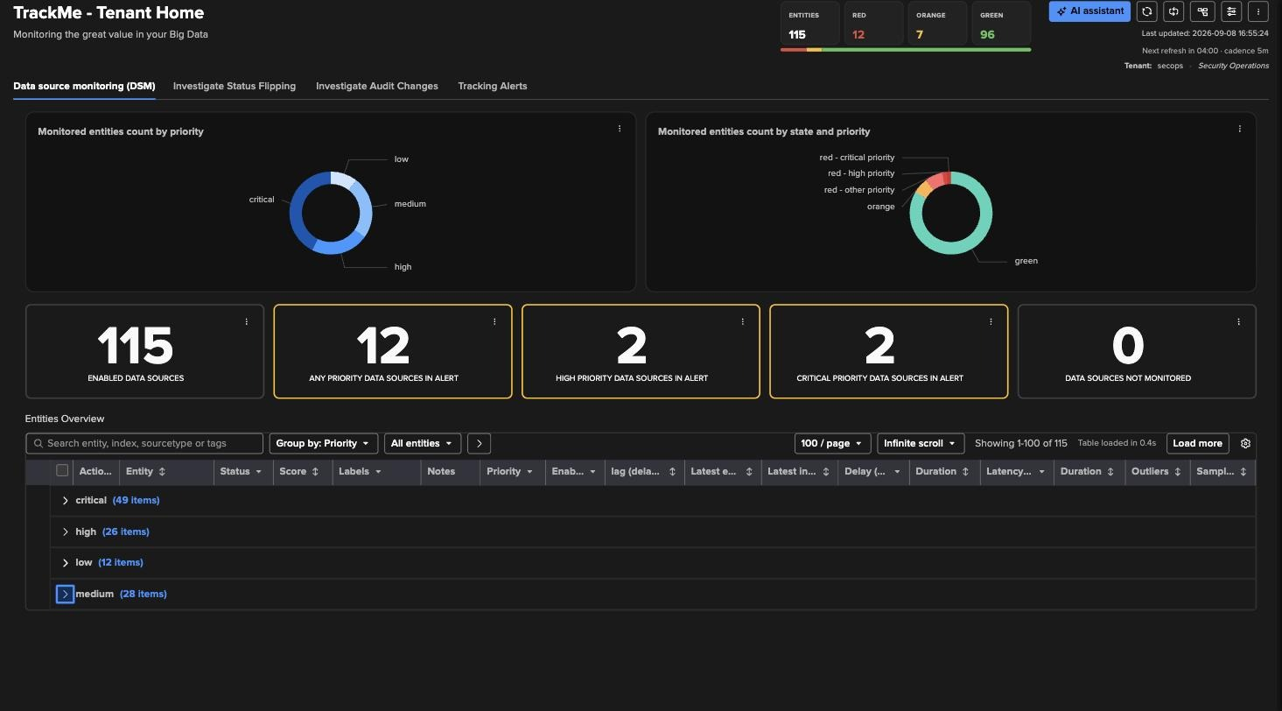
RESULT
Group by: Priority — the on-call view
1
Grouping selector
Default · No grouping · Index · State · Priority · Sourcetype · Tags · Labels · Anomaly reason. Remembered per user.
2
Four folds
critical · high · low · medium, each with its count. Expand a group to work through it; combine with the state filter to see “critical and red” only.
1
Also on the Virtual Tenants page
2
The secops card now shows its high-priority count, and the deployment-level single-stat “high priority entities in alert” is populated — the number that goes on a NOC screen or in a Virtual Group.
TrackMe for Splunk · Hands-on: classify with policies
docs.trackme-solutions.com
Notes:
Group by is a display setting on the entities table. Priority grouping is the on-call view: open critical, sort by score. Click into the critical group: the red one is the business_data inventory feed we opened in Part 1 — now critical because business_data is critical in the CMDB.

Slide 11
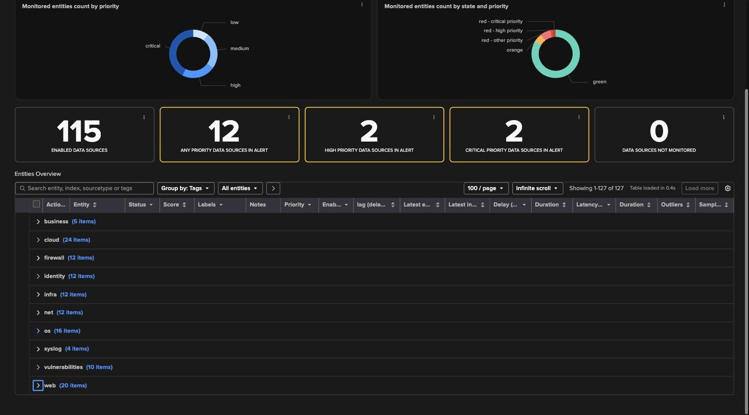
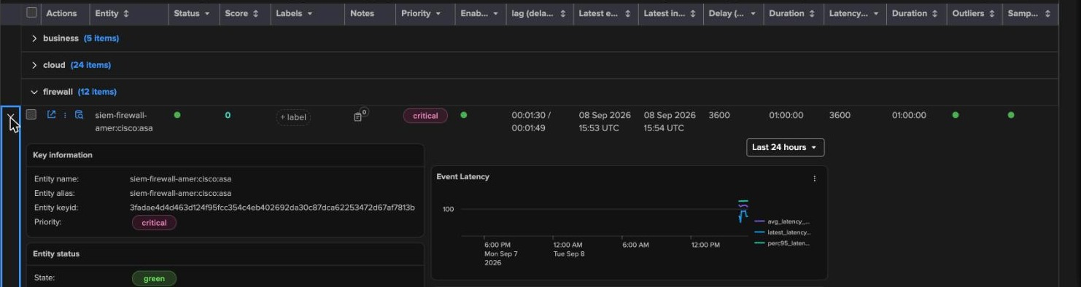
RESULT
Group by: Tags — the ownership view
1
One fold per tag
business · cloud · firewall · identity · infra · net · os · syslog · vulnerabilities · web. Tags come from the CMDB; nobody typed them.
2
More rows than entities
2
Not a bug: siem-firewall-* carries net,firewall, so those entities appear under both tags. Tags are multi-valued.
1
3
Inside a group
Expand firewall: siem-firewall-amer:cisco:asa is critical (from the priority policy), green, delay 1m30. The inline detail shows key information, status, thresholds and the 24 h charts.
Tags also drive: the search box (type a tag), Virtual Group filters (tags=firewall), ML outliers scope, Topology Studio aggregates, and alert routing.
3
TrackMe for Splunk · Hands-on: classify with policies
docs.trackme-solutions.com
Notes:
Tags are the ownership axis: the firewall team sees firewall, the identity team sees identity. Note that the table has more rows than entities — a multi-valued tag shows the entity in every group it belongs to. The same axis is what lets a team receive only the alerts for its own feeds.

Slide 12
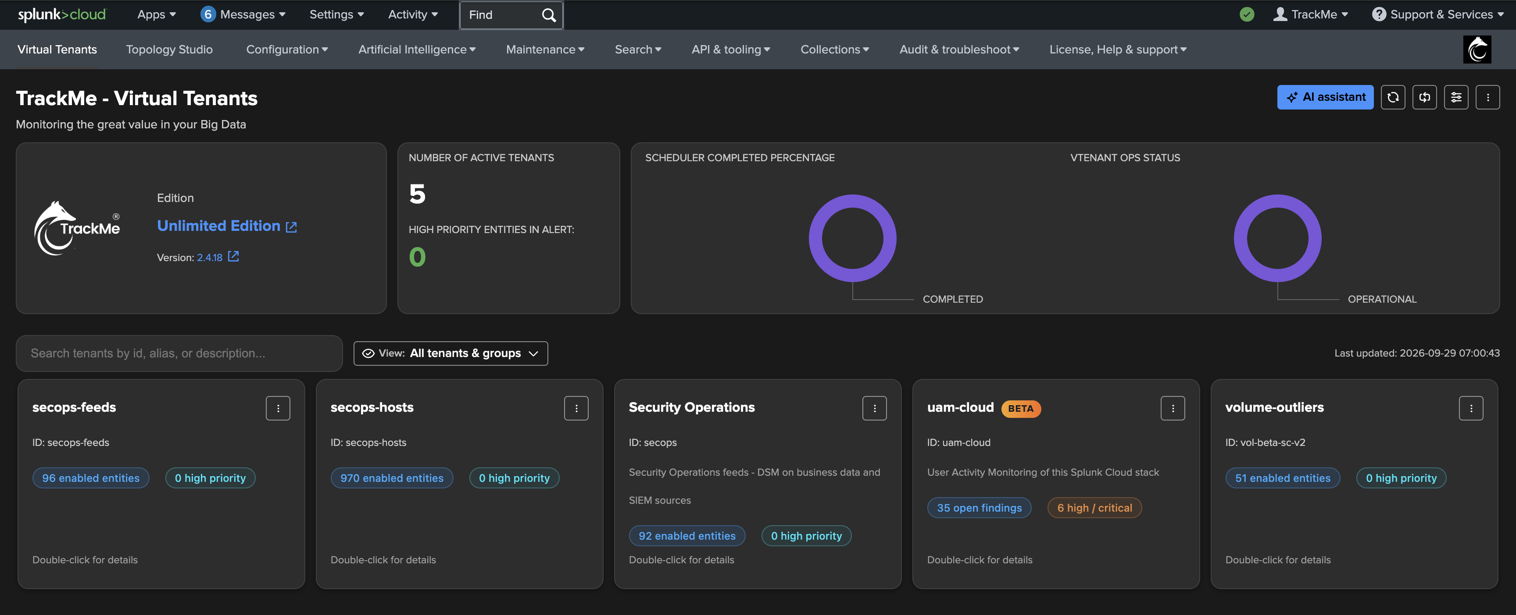
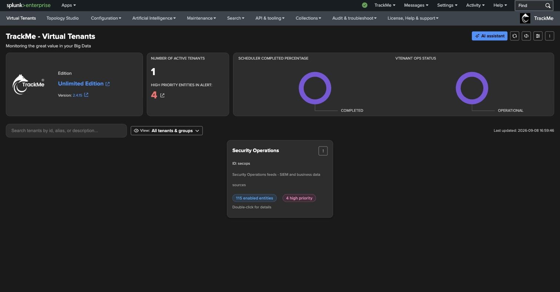
RECAP
Where we are
In this part
Two policies
priority and tags, both lookup-based on one CMDB export with wildcard keys
Simulated
every entity matched, distribution checked before saving
Applied
policy trackers run on demand: every entity updated, no failure
Read
the tenant by priority and by tag — on-call view, ownership view
What made it work
One source of truth
Simulate first
Trackers apply, overrides win
a CMDB-style lookup drives both priority and tags — wildcard keys, one row per index family
the priority distribution is checked before anything is written to an entity
policy trackers re-evaluate every cycle; a manual override always wins; removing a policy cleans up
TrackMe for Splunk · Hands-on: classify with policies
docs.trackme-solutions.com
Notes:
Recap: classification is step 4 of the cycle, and it is a policy problem, not a data-entry problem. The tenant now carries priority and tags on every entity, from one lookup — simulated before saving, applied by the policy trackers. Priority is what alert scoping relies on: an alert restricted to critical and high pages for the firewall and identity feeds, not for the low-priority ones.

