Slide 1

HANDS-ON WALKTHROUGH · VOLUME OUTLIERS
Volume outliers on the license usage
One tenant, a few clicks, and every index of the deployment is watched for abnormal drops, spikes and silence — with a month of history backfilled, a cost trend and a projection, and the whole environment’s license usage on one screen. From an empty tenant to 43 monitored indexes.
Captured live on TrackMe 2.4.18 · tenant volume-detection
Notes:
Hands-on walkthrough of Volume Outliers (VOL), the seventh TrackMe component, new in 2.4.18. Everything in this deck was captured live on TrackMe 2.4.18, starting from a brand new tenant on a Splunk Enterprise deployment with 43 indexes in one license pool. We create the tenant, let it backfill a month of history, read the results, tune the detection, use the global license usage view, wire alerting, and let the AI Advisors review a model.

Slide 2
THE PROBLEM
The feed is green — and half of its volume is gone
Data source monitoring sees freshness and latency. The volume of what arrives is a different signal — and the one the license bill, the detections and the capacity plan all depend on.
A drop — the pipeline is broken
A spike — cost and noise
A silent index — nobody correlates
A forwarder stops, a relay loses a route, a modular input silently dies, a parsing change discards events. The feed is still alive; half of it is missing.
A debug level left on, a runaway application, a duplicate forwarder, a new source pointed at the wrong index. Found at month end, it is an overage; found within the hour, a ticket.
The index still exists, dashboards still run over it. Its last event is a week old and no one noticed.
What Volume Outliers does
VOL reads the license usage log — the volume Splunk counts against your license, one source for every index of the deployment — incrementally, in 5-minute buckets. Every index becomes a TrackMe entity: an ML outliers model on its rolling volume (drops and / or spikes), an inactivity policy, the daily licensed volume, a 30-day trend and a month projection. State, score, history and alerting work exactly like a data source in DSM.
Splunk Enterprise or Splunk Cloud, local or remote deployment — and part of the Foundation edition.
TrackMe for Splunk · Hands-on: volume outliers
docs.trackme-solutions.com
Notes:
Availability monitoring answers "is the data arriving on time?". It does not answer "is the amount of data normal?". A broken forwarder, a lost syslog route, a parser change that drops half of the events: the feed still arrives, the freshness checks stay green, and the missing half only shows up in a detection that missed, a report that is off, or a license bill that surprises. VOL watches the volume itself, from the source Splunk uses to bill it.

Slide 3
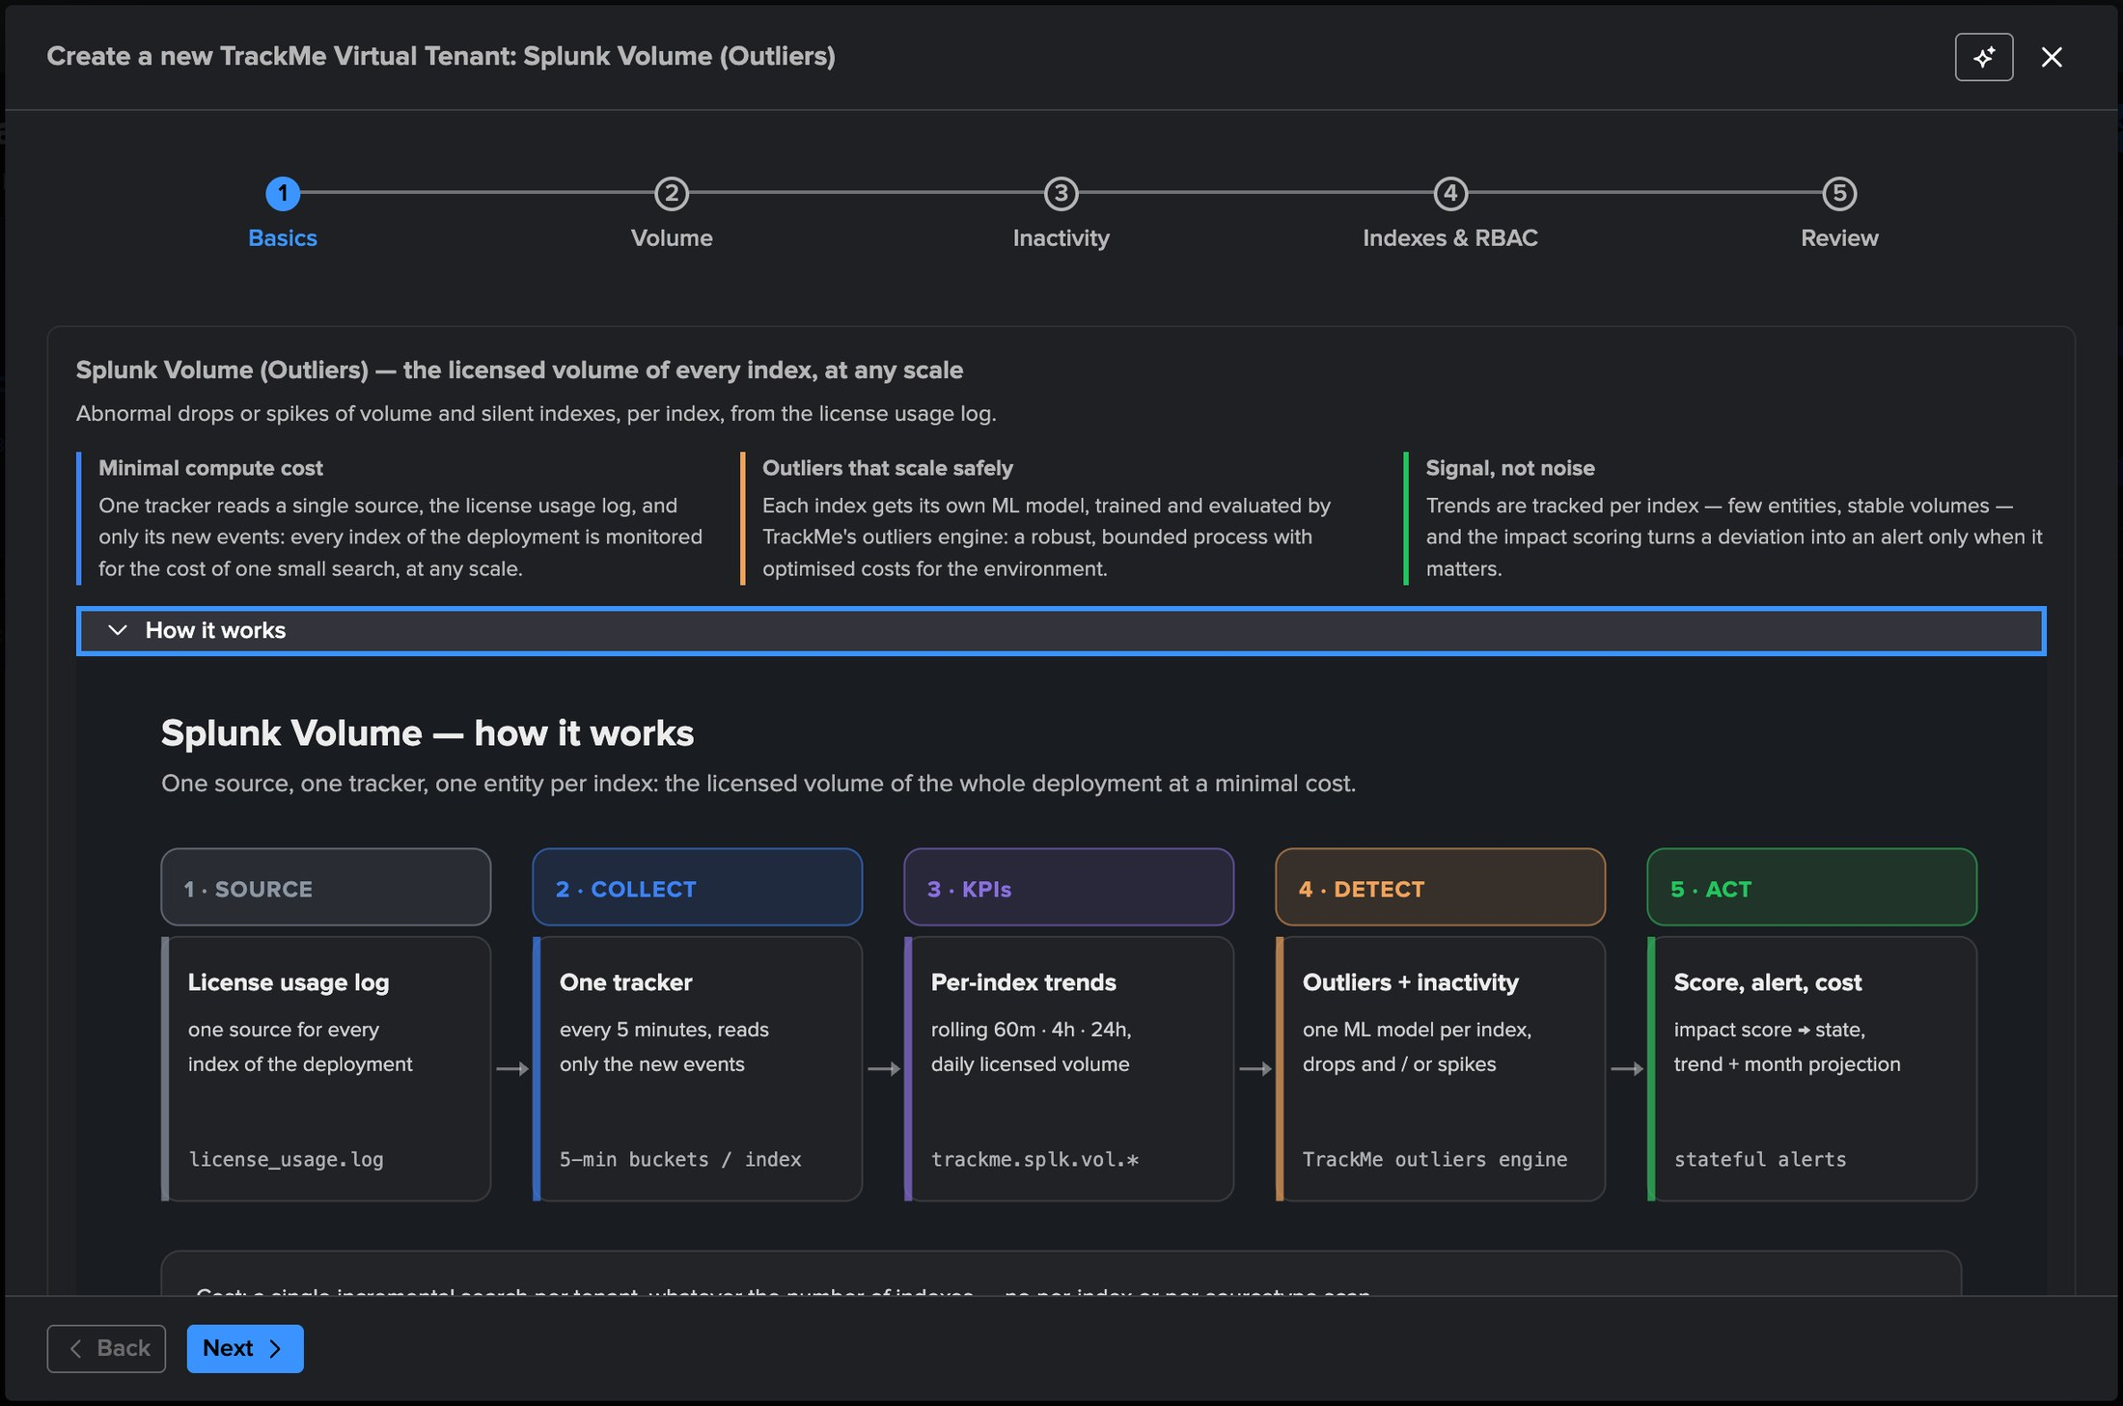
THE MODEL
One source, one tracker, one entity per index
1
Source — the license usage log
What Splunk bills: one log for every index of the deployment, on Enterprise and on Cloud.
2
Collect — one incremental tracker
Every 5 minutes, only the new events, into 5-minute buckets per index. Never a rescan.
3
KPIs — per-index trends
Rolling 60 min / 4 h / 12 h / 24 h volume and the daily licensed volume per license day, as trackme.splk.vol.* metrics.
1
2
3
4
5
4
Detect — outliers and inactivity
One ML model per index on the rolling volume, drops and / or spikes; a silent index turns red.
5
Act — score, alert, cost
Impact score to state, stateful alerts, the 30-day trend and the month projection.
The diagram is built into the wizard — expand "How it works" on the first step.
TrackMe for Splunk · Hands-on: volume outliers
docs.trackme-solutions.com
Notes:
This is the whole model, and the wizard shows it on its first step. The license usage log is the contract: it is what Splunk meters, it exists on every deployment, and it is cheap to read incrementally. TrackMe keeps a 24-hour ring of 5-minute buckets per index, derives the rolling KPIs and the daily volume from it, writes them as metrics, and the standard outliers engine and decision maker do the rest.

Slide 4
THE PLAN
What we are going to do — one tenant, four parts
PART 1 · SETUP
PART 2 · READ
PART 3 · TUNE
PART 4 · OPERATE
Create the tenant, let it backfill
What the tenant tells you
Make the detection yours
Analytics, alerting, AI
The wizard: basics, volume, inactivity, RBAC
The VOL table: volume, yesterday, trend, projection
Drops, spikes or both — per index, in bulk
Global license usage: figures, insights, pools
30 days of history replayed at creation
An index: Volume & cost, rolling volume, hourly profile
Inactivity: business hours vs nights, per index
SPLK-VOL alerts and stateful emails
Day one: pending → complete, models trained
The outliers model and its bounds
Default KPIs and the outliers scope
The AI ML Advisor reviews a volume model
Everything runs in one tenant created for the occasion: 43 indexes, one license pool, Splunk Enterprise. The same walkthrough applies to Splunk Cloud and to remote deployments.
TrackMe for Splunk · Hands-on: volume outliers
docs.trackme-solutions.com
Notes:
One Virtual Tenant covers the whole deployment. Part 1 creates it and lets the backfill fill a month of history. Part 2 reads what the tenant shows: the table, an index, its charts and its model. Part 3 tunes the detection: direction per index, inactivity policy, default KPIs. Part 4 covers the global license usage view, alerting, and the AI Advisor review of a model.

Slide 5
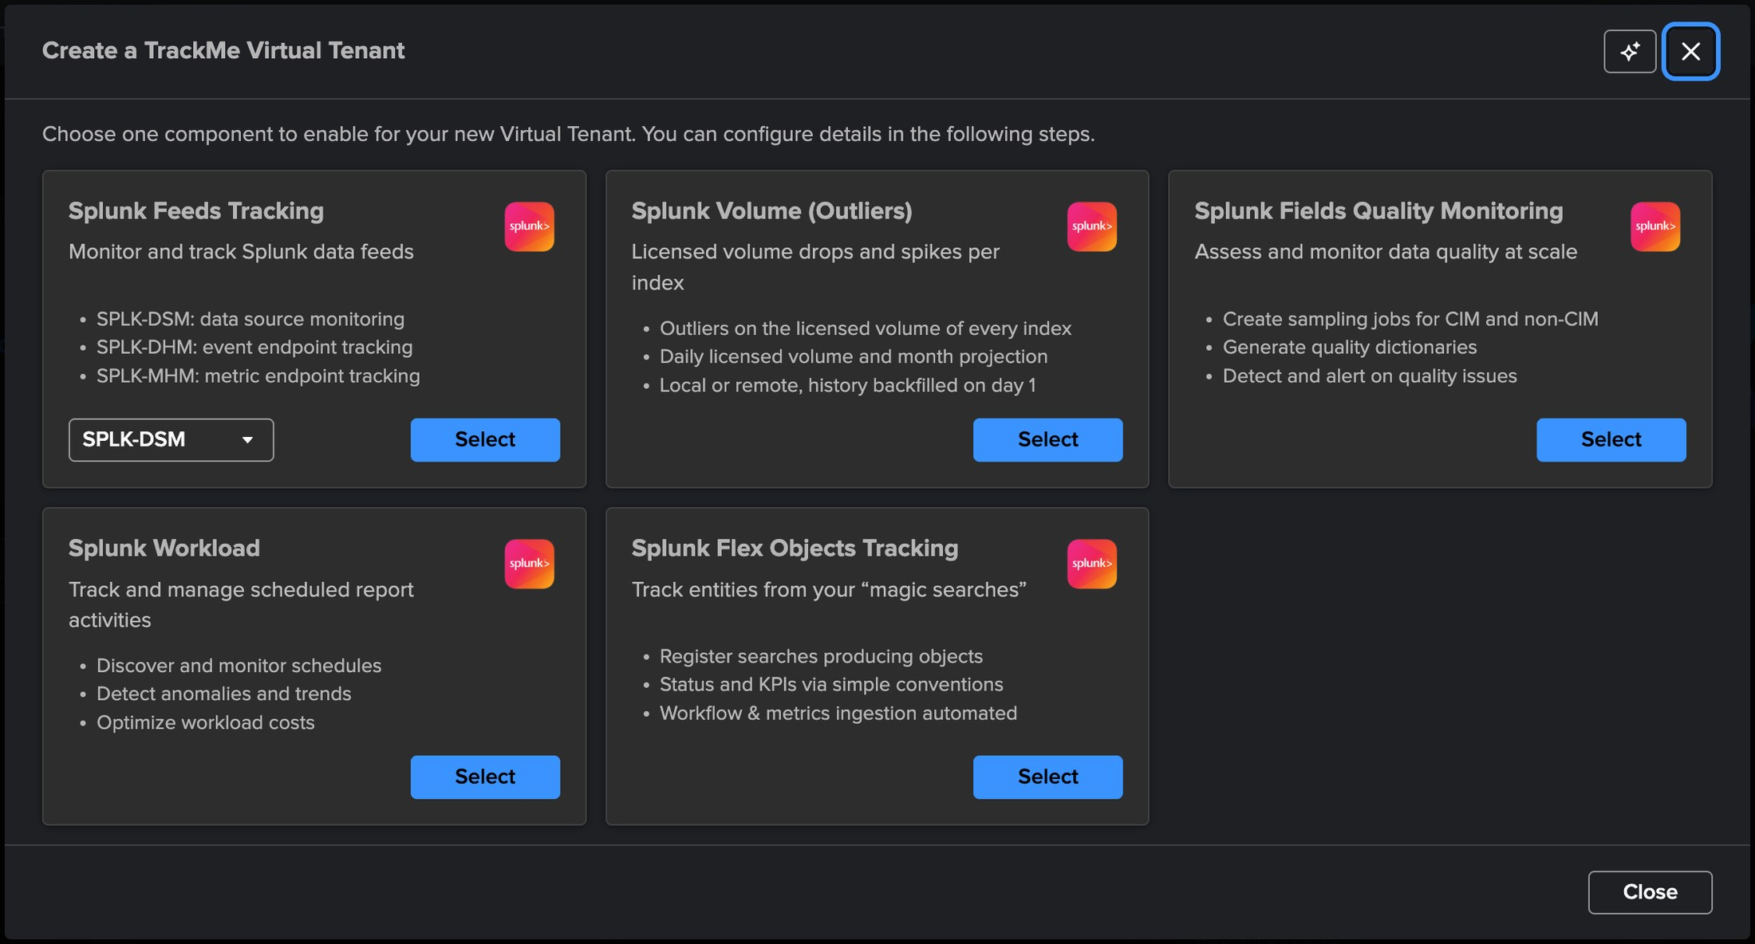
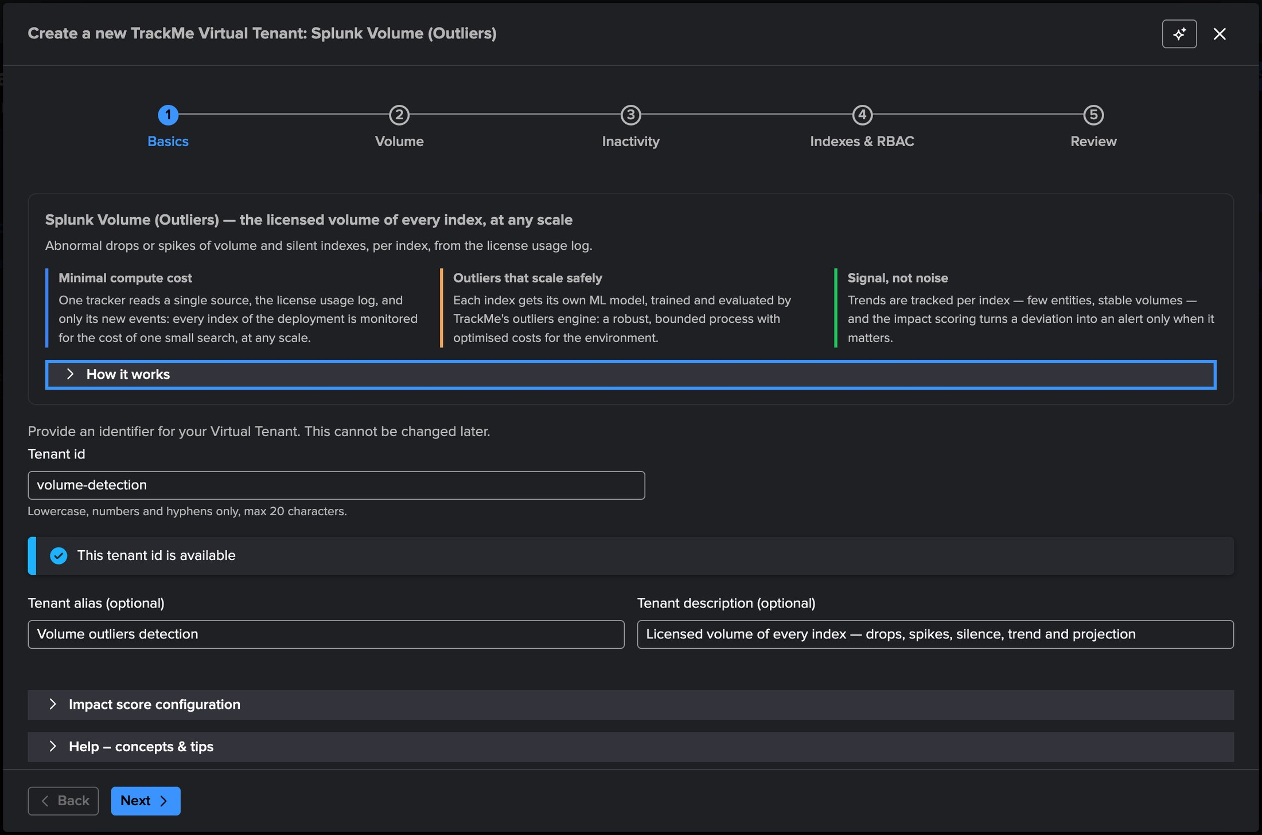
PART 1 · SETUP
A dedicated tenant — pick Splunk Volume (Outliers)
1
2
3
4
1
Splunk Volume (Outliers)
2
Why VOL, in three lines
4
Alias and description
Outliers on the licensed volume of every index, daily volume and month projection, local or remote, history backfilled on day one.
Minimal compute cost · outliers that scale safely · signal, not noise.
What people see on the Virtual Tenants card.
3
Tenant id — volume-detection
Immutable, checked for availability as you type.
TrackMe for Splunk · Hands-on: volume outliers
docs.trackme-solutions.com
Notes:
Virtual Tenants → Actions → Create a tracking tenant. The Volume card sits second in the chooser. The wizard has five steps: basics, volume, inactivity, indexes & RBAC, review. The first step recalls the three arguments of the component — minimal compute cost, outliers that scale safely, signal not noise — and asks for the tenant identity. Twenty characters max for the id: volume-detection here.

Slide 6
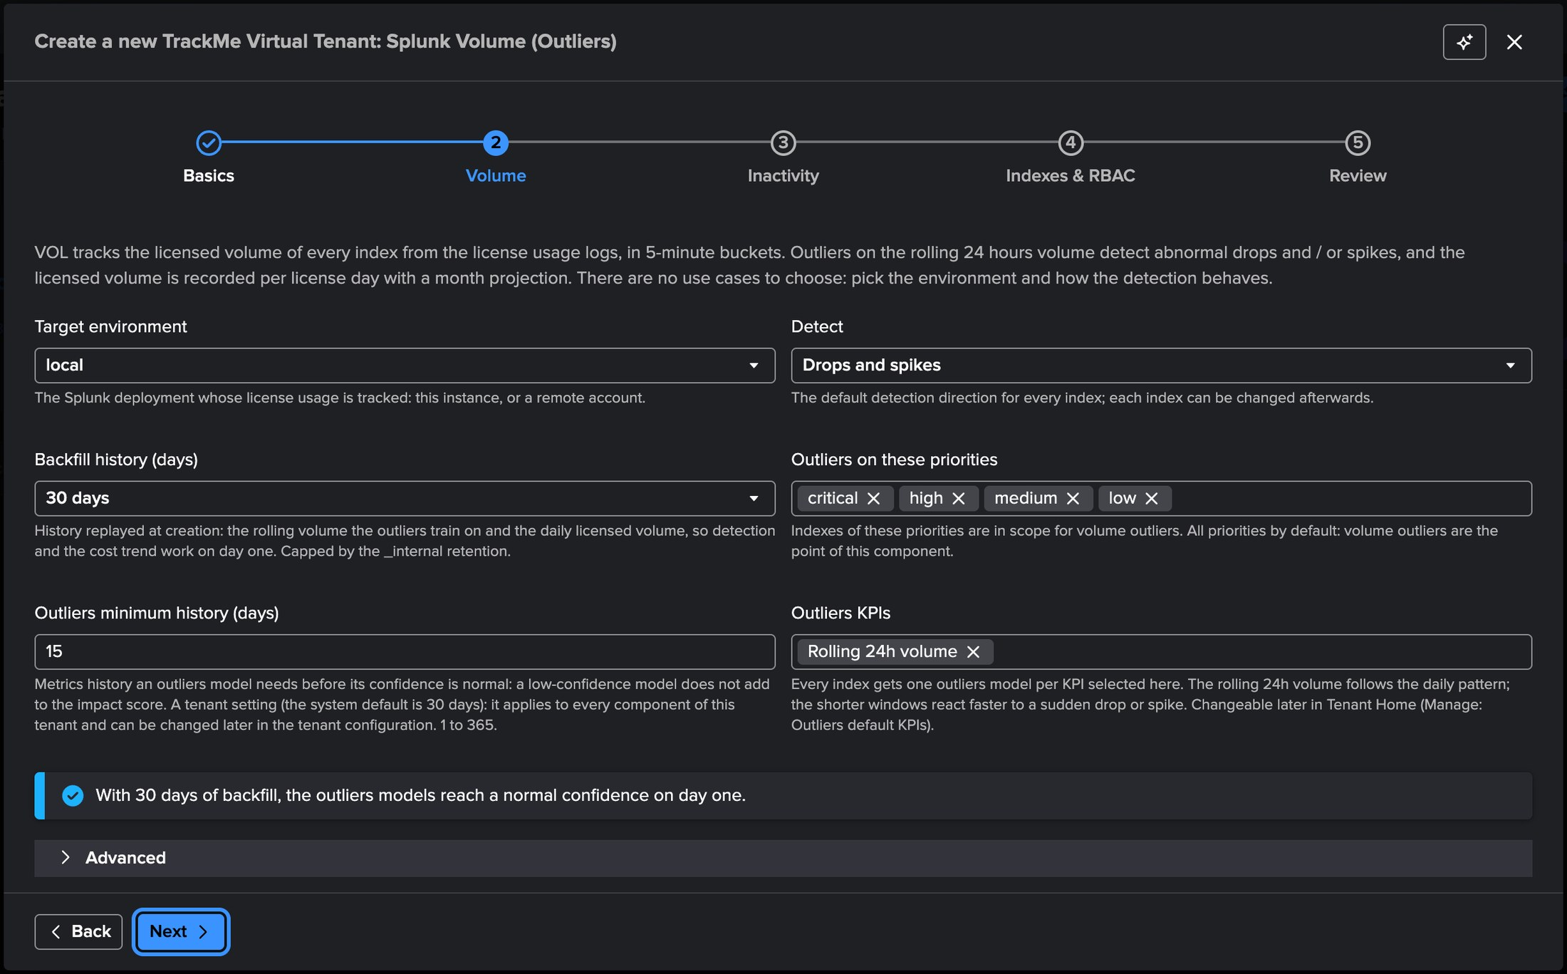
PART 1 · SETUP
Step 2 — Volume: where to collect, what to detect, how far back
1
Target environment — local
This Splunk, or any remote account.
2
Detect — drops and spikes
The default direction of every new index.
1
2
3
Backfill history — 30 days
Replayed at creation, capped by retention.
3
4
4
Outliers on every priority
The VOL scope: all priorities by default.
5
Minimum history — 15 days
5
6
Before a model reaches normal confidence.
6
Outliers KPIs — rolling 24h
7
One model per index, on the daily pattern.
7
Covered on day one
The backfill exceeds the minimum history.
TrackMe for Splunk · Hands-on: volume outliers
docs.trackme-solutions.com
Notes:
The Volume step is the whole configuration and its defaults are the recommended values. Target environment: this Splunk, or any remote account configured in TrackMe. Detect: the default direction of every new index — drops and spikes — changed per index later. Backfill history: 30 days replayed at creation, capped by the retention of the license usage log. Outliers scope: every priority by default, because volume outliers are the point of this component. Minimum history: 15 days before a model is trusted, and the notice confirms the backfill covers it. Default KPIs: one model per index on the rolling 24 hours.

Slide 7
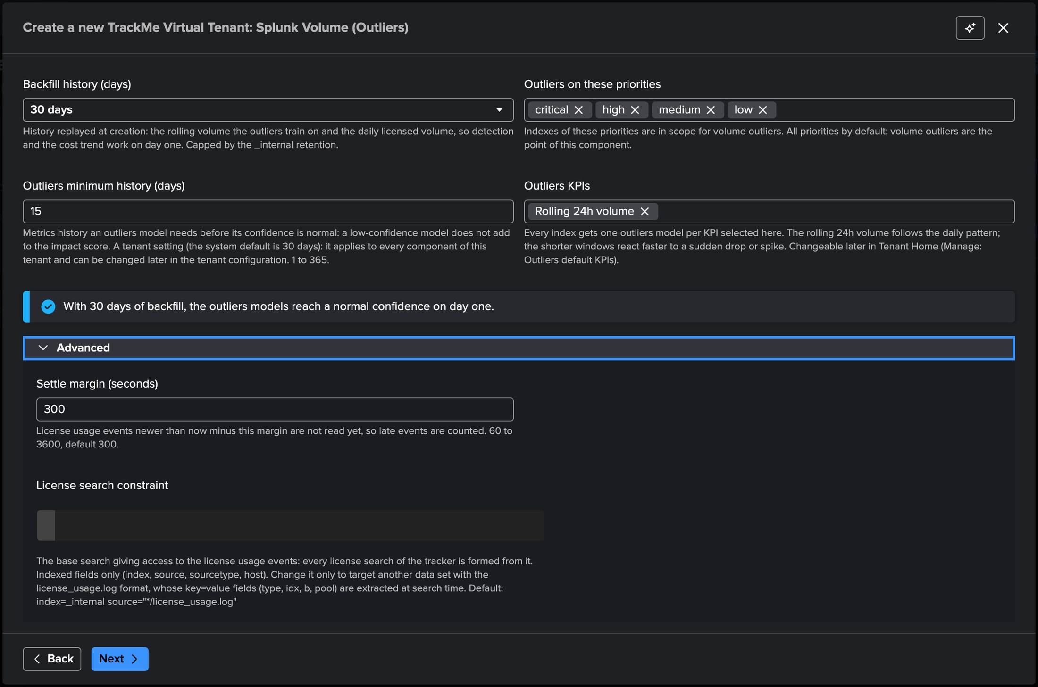
PART 1 · SETUP
Advanced — two settings you normally never change
1
Settle margin — 300 s
Events newer than now minus the margin wait for the next run, so late license events are counted. 60 to 3600.
2
License search constraint
The base search every license search of the tracker is built from — indexed fields only.
3
The default
index=_internal source="*/license_usage.log". Change it only to read a copy of the license usage events.
1
2
Leave the defaults
Both settings exist for the rare deployment that forwards its license usage events elsewhere, or delivers them late. Everything else in VOL is tuned per index after creation.
3
TrackMe for Splunk · Hands-on: volume outliers
docs.trackme-solutions.com
Notes:
Expand Advanced to see the two technical settings. The settle margin keeps the tracker behind the newest license events so that late ones are still counted in their bucket. The license search constraint is the base search the tracker builds on; the default reads the internal license usage log. Both can be changed later in the tenant configuration.

Slide 8
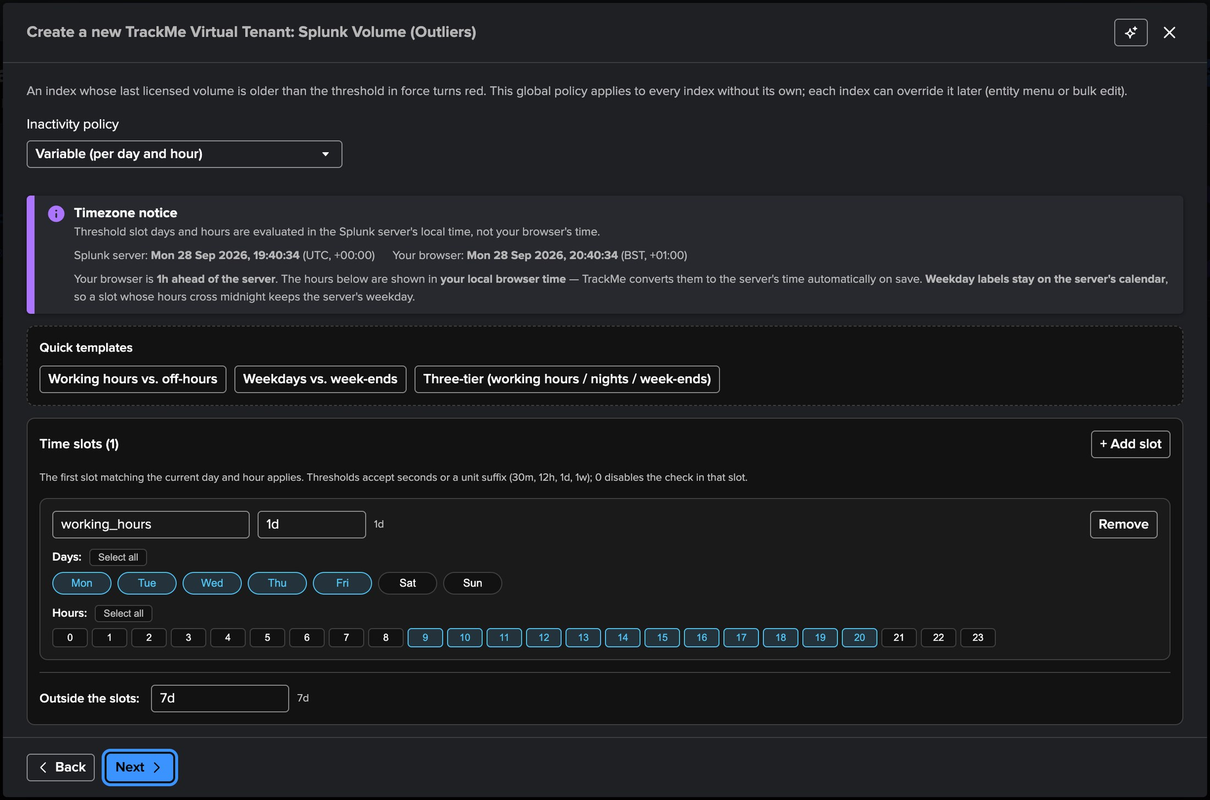
PART 1 · SETUP
Step 3 — Inactivity: when a silent index turns red
1
Variable (per day and hour)
Or static: one threshold at all times.
2
Timezone notice
1
Slots run in the server’s time; the editor converts your browser hours on save.
2
3
Quick templates
Working vs off-hours, weekdays vs week-ends, three tiers.
3
4
working_hours — 1d
Mon–Fri 08:00–19:59 server time: a silent index is red the next day.
4
5
Outside the slots — 7d
Nights and week-ends wait longer.
Tenant-wide, overridable
5
The policy applies live to every index without its own threshold. Any index can override it later — from its menu, the bulk edit, or a click in the table.
TrackMe for Splunk · Hands-on: volume outliers
docs.trackme-solutions.com
Notes:
Inactivity is the second detection: after how long without licensed volume does an index turn red. The default policy is variable by day and hour: one day during working hours, Monday to Friday 08:00 to 19:59 in the server’s time zone, and seven days for nights and week-ends. The timezone notice shows the server and browser clocks side by side, because the slots are evaluated on the server. Quick templates cover the usual shapes; the editor lets you draw your own slots.

Slide 9
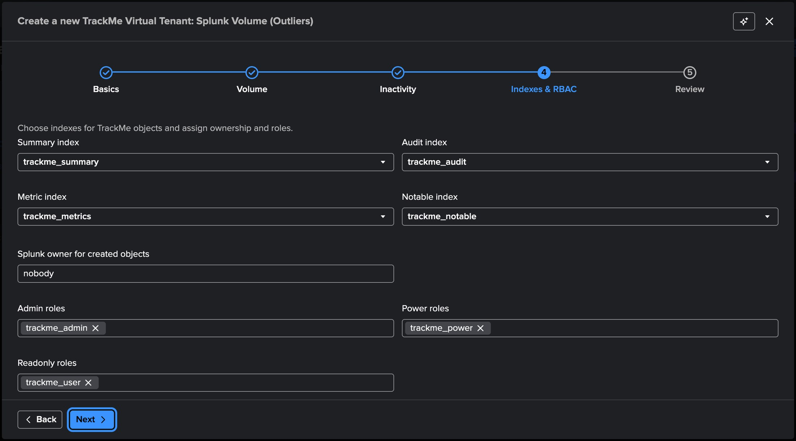
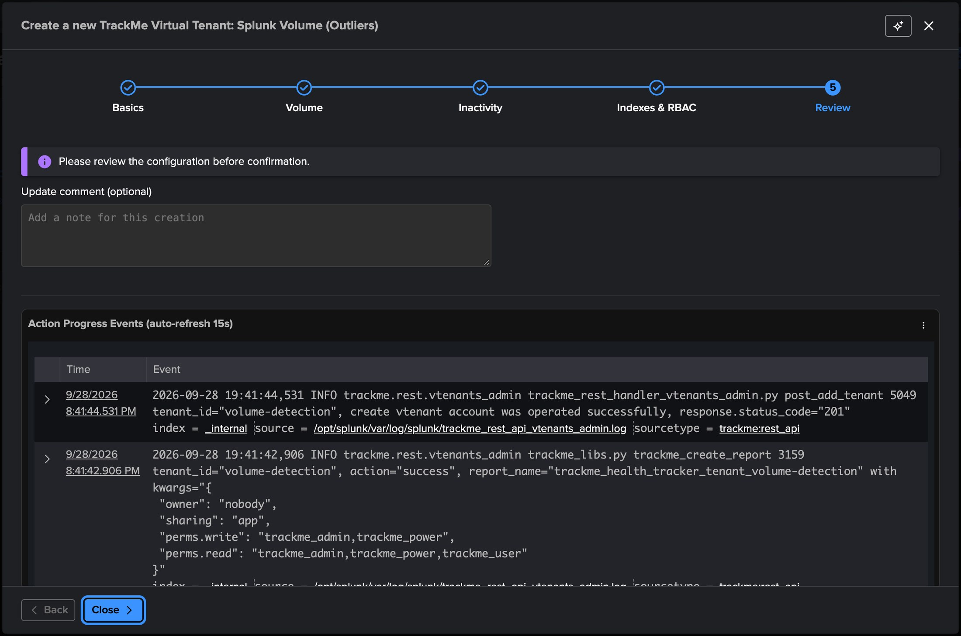
PART 1 · SETUP
Steps 4–5 — Indexes and RBAC, review, created in seconds
1
2
4
3
5
1
TrackMe indexes
4
Action progress events
Summary, audit, metric and notable — the defaults are fine.
The creation, live, as it happens.
2
Splunk owner — nobody
5
Tenant created
A service account instead if the tenant will run AI automation.
The account, its reports and trackers — in seconds.
3
Roles
trackme_admin, trackme_power, trackme_user — or your own roles.
TrackMe for Splunk · Hands-on: volume outliers
docs.trackme-solutions.com
Notes:
The last two steps are the ones every tenant shares. Indexes & RBAC: the TrackMe summary, audit, metric and notable indexes, the Splunk owner of the created objects, and the admin, power and read-only roles. Review, then Done: the progress events show the tenant account, its reports and trackers being created, and the first collection runs straight away. If the tenant will run AI automation, own it with a service account rather than nobody.

Slide 10
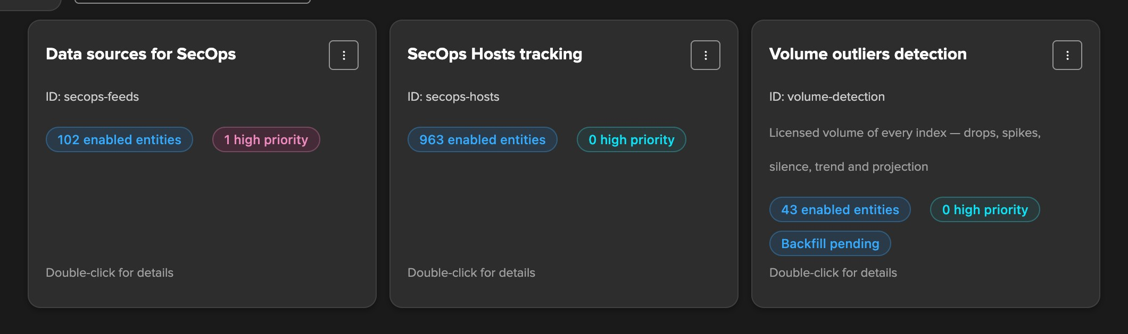
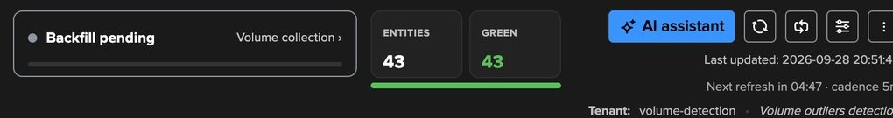
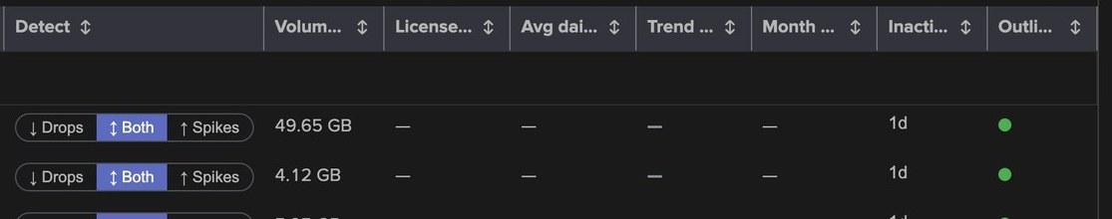
PART 1 · DAY ONE
Created — 43 indexes collected at once, the backfill pending
1
43 enabled entities
One per index, from the first collection at creation.
2
Backfill pending
1
The card follows the backfill until it completes.
2
3
The Tenant Home vignette
Pending, then the percentage — a click opens the volume collection screen.
3
4
All green from the start
4
Every index had licensed volume in the last 24 hours.
5
Volume 24h — already live
The seed reads the last 24 hours of the license usage log.
5
6
6
The cost columns wait
Licensed yesterday, average, trend and projection need the replayed history.
TrackMe for Splunk · Hands-on: volume outliers
docs.trackme-solutions.com
Notes:
The creation runs the first collection: the tracker seeds the last 24 hours of the license usage log and one entity per index appears — 43 here — each with its rolling volume. The backfill job plans itself at its first hourly run; until then the Virtual Tenants card reads Backfill pending, so does the vignette in the Tenant Home header, and the table shows the 24-hour volume while the cost columns wait for the replayed history.

Slide 11
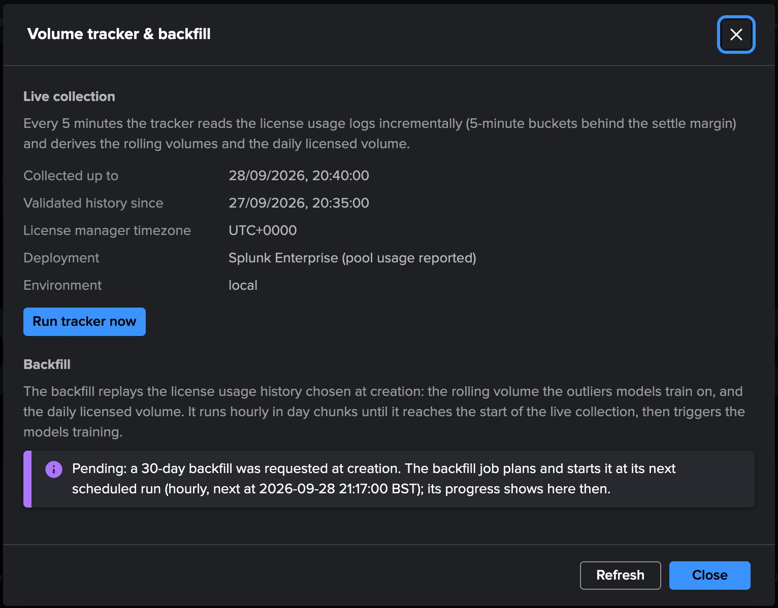
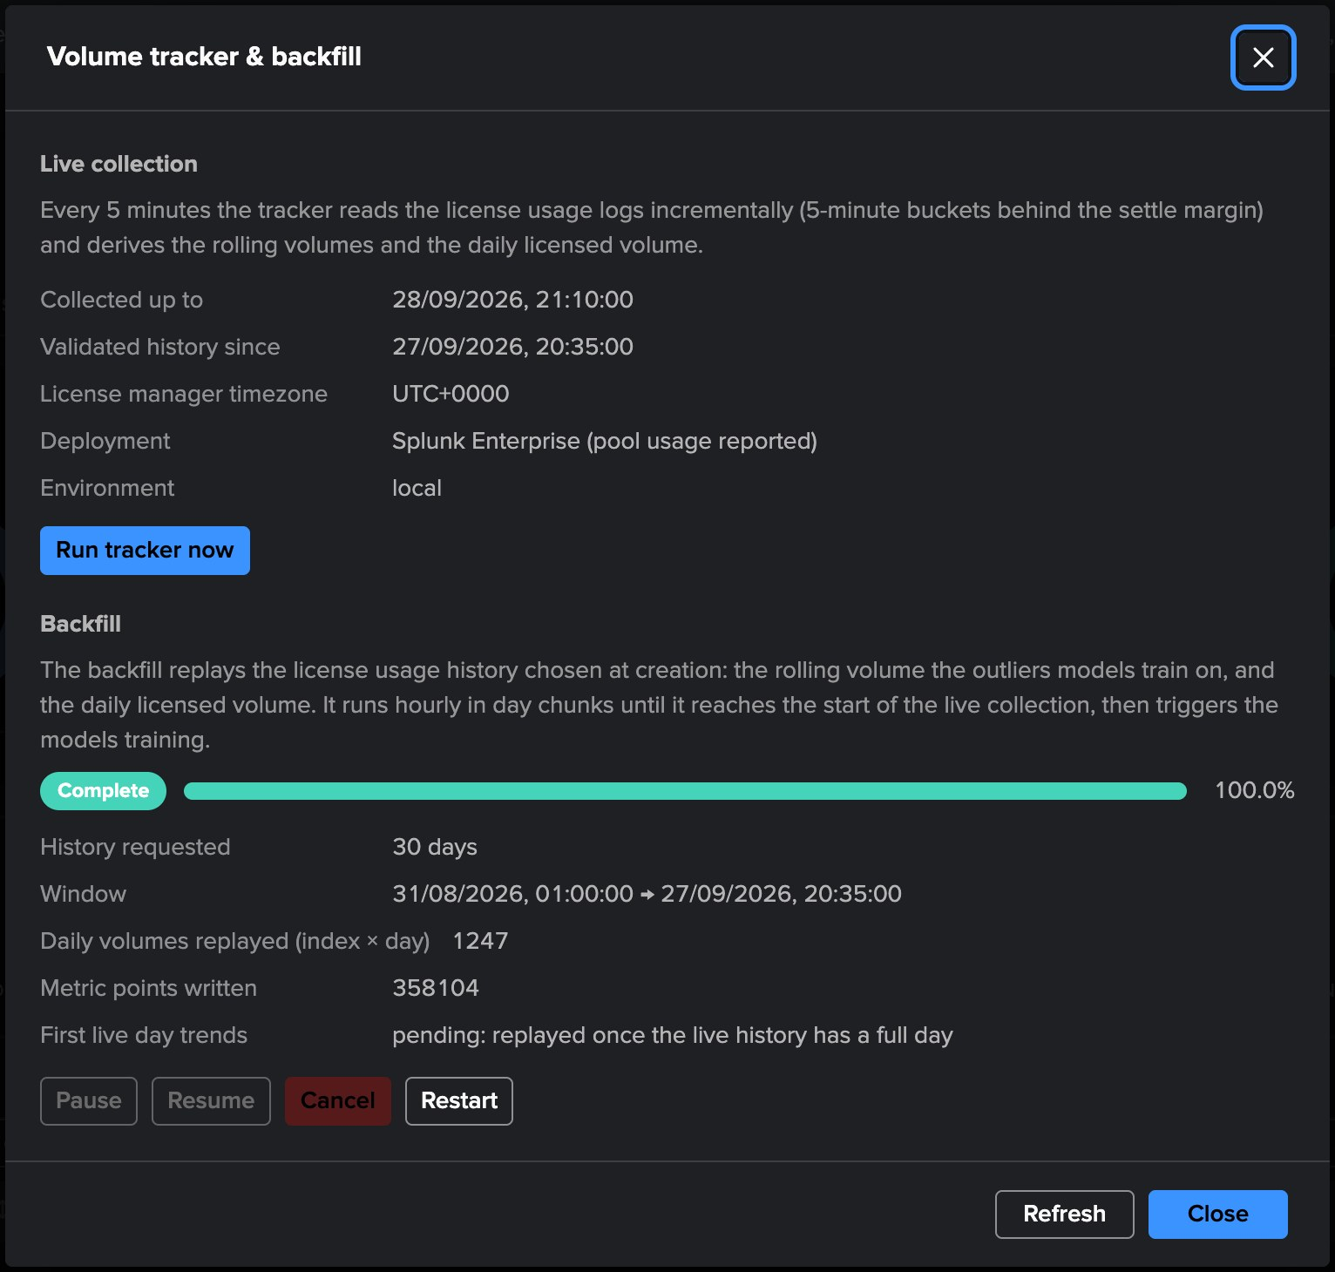
PART 1 · DAY ONE
A month of history, replayed at the first hourly run
1
Live collection
1
Every 5 minutes, incremental, behind the settle margin.
2
Run tracker now
Collect on demand.
3
Pending
2
Planned at the next hourly run of the backfill job.
4
4
Complete — 100%
5
Replayed, then every model trained.
3
6
5
What was replayed
30 days: 1,247 index-days, 358,104 metric points.
Left: right after creation. Right: the same screen once the backfill has run.
6
Controls
Pause, resume, cancel; restart extends history backward.
TrackMe for Splunk · Hands-on: volume outliers
docs.trackme-solutions.com
Notes:
The volume collection screen explains both jobs. Live collection: every five minutes, incrementally, behind the settle margin. Backfill: pending until the backfill job plans it at its next hourly run, then replayed day by day through the same code as the live collection, with historical timestamps — the rolling volumes the models train on, and the daily licensed volume of every license day. On this deployment the whole month completed at the first run; on a large one it spans a few hourly slots and the card shows the percentage. On completion every model is trained on the replayed history.

Slide 12
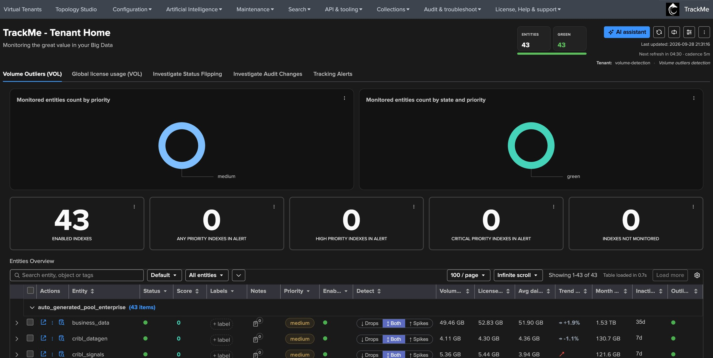
PART 1 · DAY ONE
The Tenant Home, complete on day one
1
Two tabs
2
The indexes, and the global license usage.
1
2
Header counters
3
Entities and green; the vignette is gone.
3
By priority and by state
4
Every index medium and green.
4
Key counts
43 enabled, none in alert.
5
5
Entities overview
6
Grouped by license pool.
6
Cost columns filled in
Yesterday, average, trend, projection.
TrackMe for Splunk · Hands-on: volume outliers
docs.trackme-solutions.com
Notes:
Once the backfill has completed the Tenant Home is the finished product: two tabs — the Volume Outliers indexes and the global license usage — the usual counters and charts by priority and state, and the entities table grouped by license pool with every cost column filled from the replayed month.

Slide 13
01
PART 2 · READ
What the tenant tells you
One row per index with its volume, its trend and its projection; one screen per index with the charts behind the figures; and the outliers model that turns a deviation into a state.
TrackMe for Splunk · Hands-on: volume outliers
Notes:
Part 2 reads the tenant: the VOL table, the entity screen of an index, and its outliers model.

Slide 14
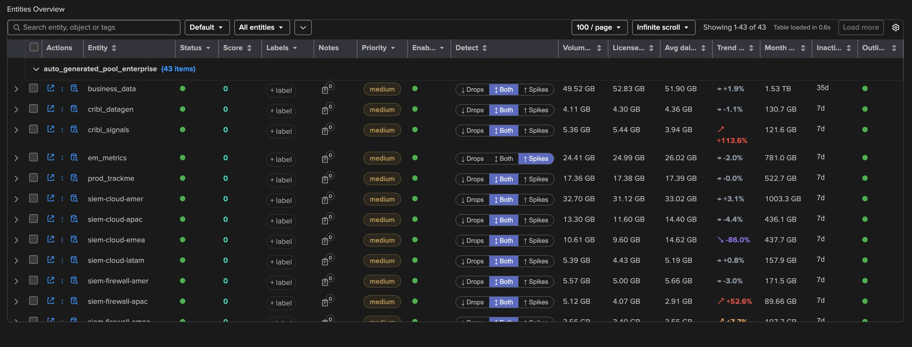
PART 2 · THE VOL TABLE
One row per index — the volume, the cost and the detection
1
Grouped by license pool
2
3
4
5
6
7
The pool is the entity group.
1
2
Detect — one click
Drops, both or spikes, in place.
3
Volume 24h · licensed
Rolling volume, last license day.
4
Avg daily · trend 30d
Baseline and direction, coloured.
5
Month projection
At the weekday pattern.
6
Inactivity
The threshold in force: 7d, 35d.
7
Outliers
The model state of the index.
em_metrics detects spikes only; business_data has its own 35-day inactivity threshold.
TrackMe for Splunk · Hands-on: volume outliers
docs.trackme-solutions.com
Notes:
The VOL table is the component’s home: an operator reads the volume, the cost and the detection settings of every index in one place. Splunk Cloud has no license pool, so the rows are not grouped there. The Detect toggle and the Inactivity column are editable in place; everything else is computed by the collector every five minutes. The trend turns red when an index grows fast — cribl_signals and siem-firewall-apac here.

Slide 15
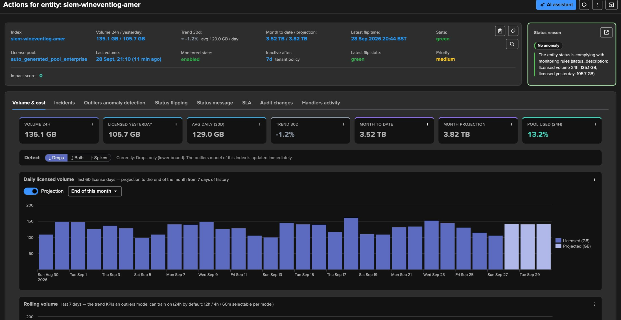
PART 2 · AN INDEX
Volume & cost — the figures and the daily licensed volume
1
The header
1
Volume, trend, month, inactivity.
2
Key figures
24h, yesterday, average, trend, month to date, projection, pool used.
2
3
Detect
3
Drops only here, applied at once.
4
4
Daily licensed volume
5
One bar per license day, 60 days.
6
5
Projection
End of this month or of next.
6
Projected days
Lighter bars, weekday pattern.
TrackMe for Splunk · Hands-on: volume outliers
docs.trackme-solutions.com
Notes:
The entity opens on Volume & cost. Every tile has an Open in search. The daily chart shows the license days — a day rolls at the license manager’s midnight — and the projection follows the same rule as the table, so the chart and the tile always agree. The status reason on the right says it in words: licensed volume 24 hours and yesterday, complying with the monitoring rules.

Slide 16
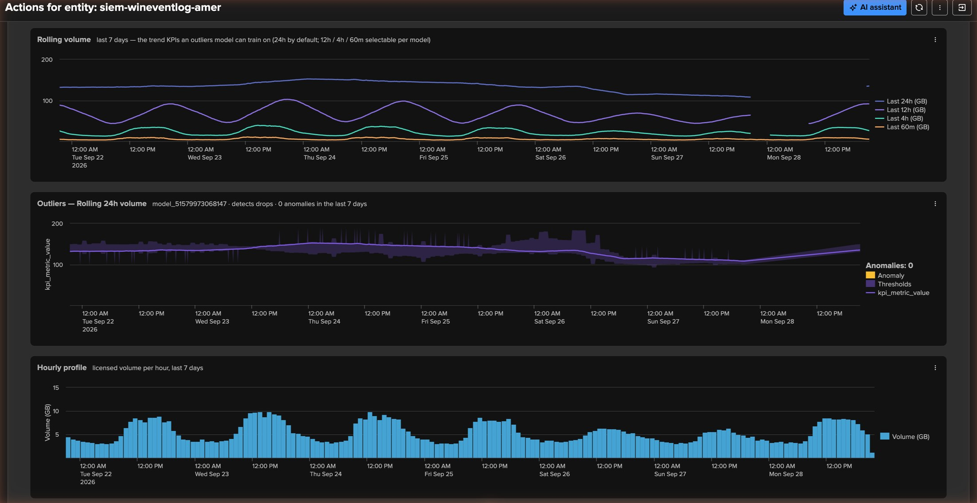
PART 2 · AN INDEX
Rolling volume, the outliers model and the hourly profile
1
Rolling volume — 7 days
1
The KPIs a model can train on.
2
2
24h, 12h, 4h, 60m
One unit per chart, here GB.
3
Outliers — rolling 24h
3
The model, its direction, anomalies.
4
4
The learned band
Outside it: a candidate outlier.
5
Hourly profile
5
Business hours peak, nights low.
TrackMe for Splunk · Hands-on: volume outliers
docs.trackme-solutions.com
Notes:
The rolling 24-hour volume follows the daily pattern and is the proven default KPI; the shorter windows react faster and are noisier. The outliers chart shows the model of the index — here drops only, zero anomalies in the last 7 days — with its band. The hourly profile explains the band: business hours peak, nights and week-ends low.

Slide 17
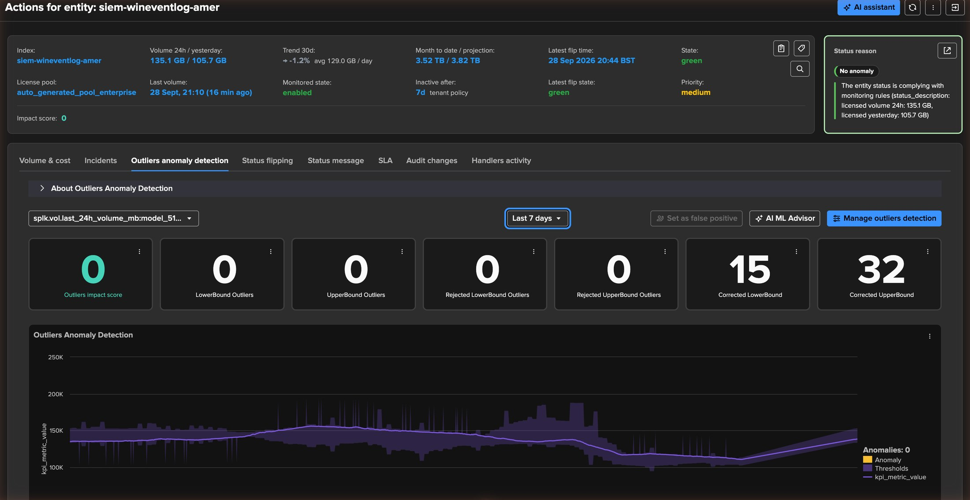
PART 2 · THE MODEL
The outliers model — trained on day one, normal confidence
1
The model
Rolling 24h volume, one per KPI.
2
Time range
The last 7 days of history.
3
AI ML Advisor · Manage
3
Review it, or tune it by hand.
1
2
4
Impact score
What an outlier adds to the score.
4
5
5
Outliers by bound
Accepted, rejected, corrected.
6
Value against the band
6
The KPI and its thresholds.
TrackMe for Splunk · Hands-on: volume outliers
docs.trackme-solutions.com
Notes:
VOL rides TrackMe’s native outliers engine: the same models, simulation, false-positive handling and AI ML Advisor as every other component. Because the history was backfilled, the model reached normal confidence on day one — no four-week wait. The corrected counters show the engine’s guards at work: candidate outliers that were corrected rather than raised.

Slide 18
02
PART 3 · TUNE
Make the detection yours
Which direction matters for each index, when silence becomes an incident, which KPIs carry a model, which indexes are in scope — all live, per index or in bulk.
TrackMe for Splunk · Hands-on: volume outliers
Notes:
Part 3 tunes the detection. The defaults are sensible; these are the settings operators actually use.

Slide 19
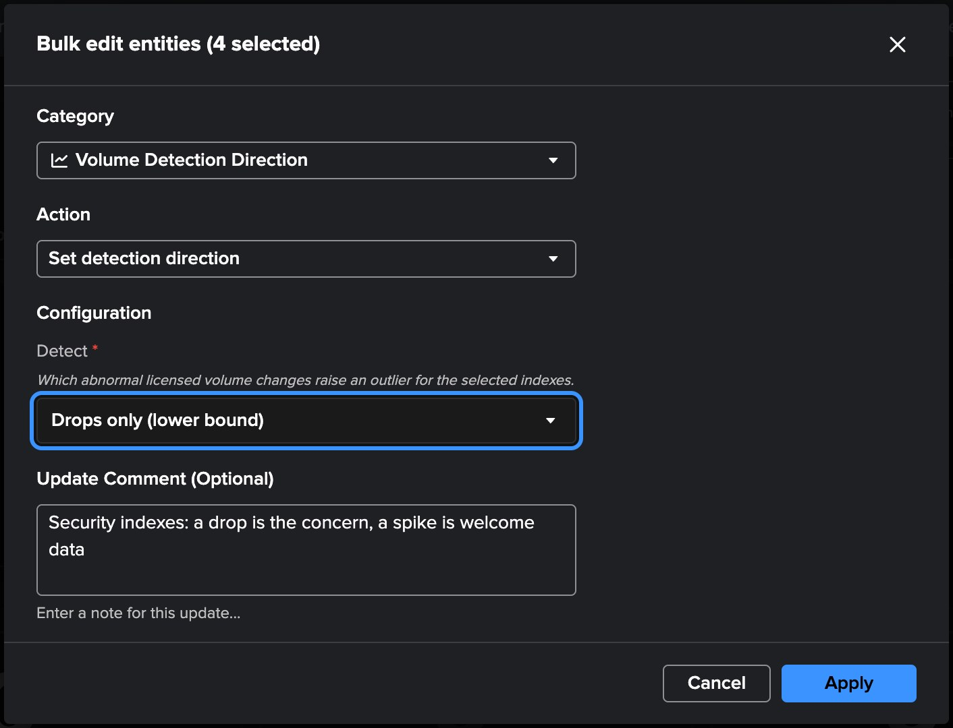
PART 3 · DIRECTION
Drops, spikes or both — per index, in one click or in bulk
1
3
2
4
5
1
Both — the default
business_data: a drop and a spike both matter.
2
Spikes only
3
Volume Detection Direction
em_metrics: a drop costs nothing, a spike costs license.
Category, then Set detection direction.
4
Drops only (lower bound)
Drops only
Applied to the 4 selected indexes.
Drops only fits security indexes: a drop is the incident. Four siem-wineventlog indexes are switched at once on the right.
5
Update comment
Why — kept in the audit trail.
TrackMe for Splunk · Hands-on: volume outliers
docs.trackme-solutions.com
Notes:
Not every index deserves both directions. A security index is a drop concern: a spike is welcome data. A metrics or development index is a spike concern: a drop costs nothing. The Detect toggle switches one index in the table; the bulk edit category Volume Detection Direction applies a choice to a selection. The direction is stored on the index’s outliers model — lower bound for drops, upper bound for spikes — and takes effect immediately.

Slide 20
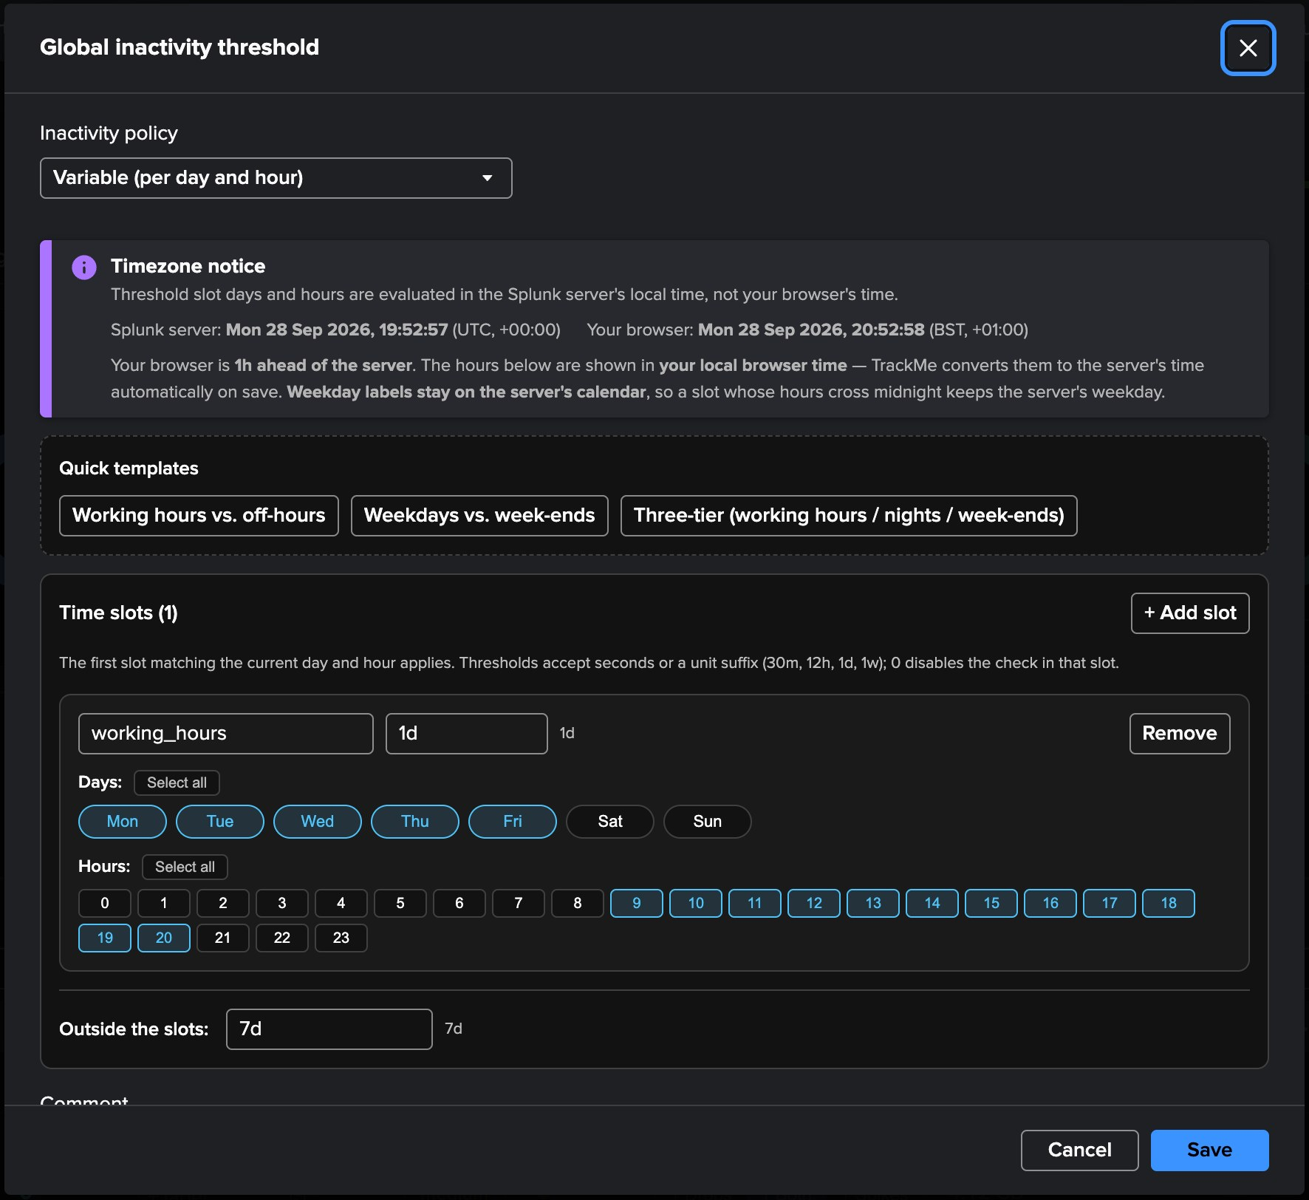
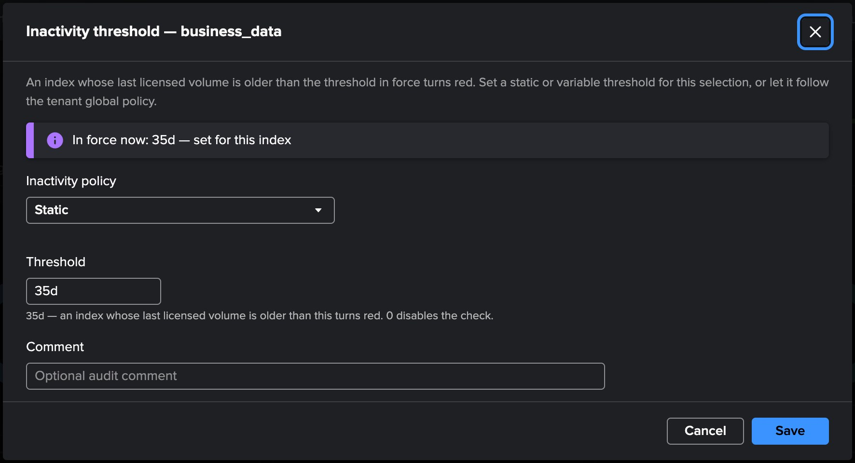
PART 3 · INACTIVITY
When silence becomes an incident — tenant policy, index override
1
Variable (per day and hour)
Or static: one threshold.
1
6
7
2
Server time zone
2
Your browser’s hours are converted on save.
8
3
Quick templates
3
Three common shapes.
4
working_hours — 1d
6
In force now: 35d, set for this index
Mon–Fri, business hours.
4
The table and the status message name the slot and its source.
5
Outside the slots — 7d
7
Static override
Nights and week-ends.
Or variable, or back to the tenant policy.
5
8
35d
s, m, h, d, w units or [D+]HH:MM:SS.
TrackMe for Splunk · Hands-on: volume outliers
docs.trackme-solutions.com
Notes:
The tenant policy applies live to every index without its own: variable by day and hour, 1 day in working hours, 7 days otherwise. Manage: Global inactivity threshold edits it on a day and hour grid; the slots are evaluated in the server’s time zone and the editor shows them in your browser’s. An index gets its own override from its menu, the bulk edit, or a click on the Inactivity column: business_data, fed by a monthly batch, gets a static 35-day threshold. 0 disables the check.

Slide 21
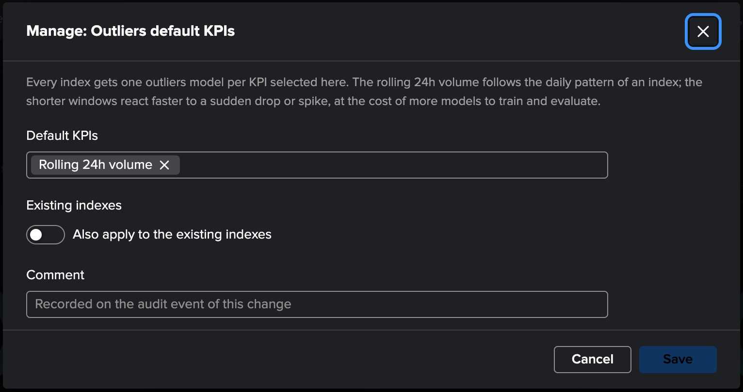
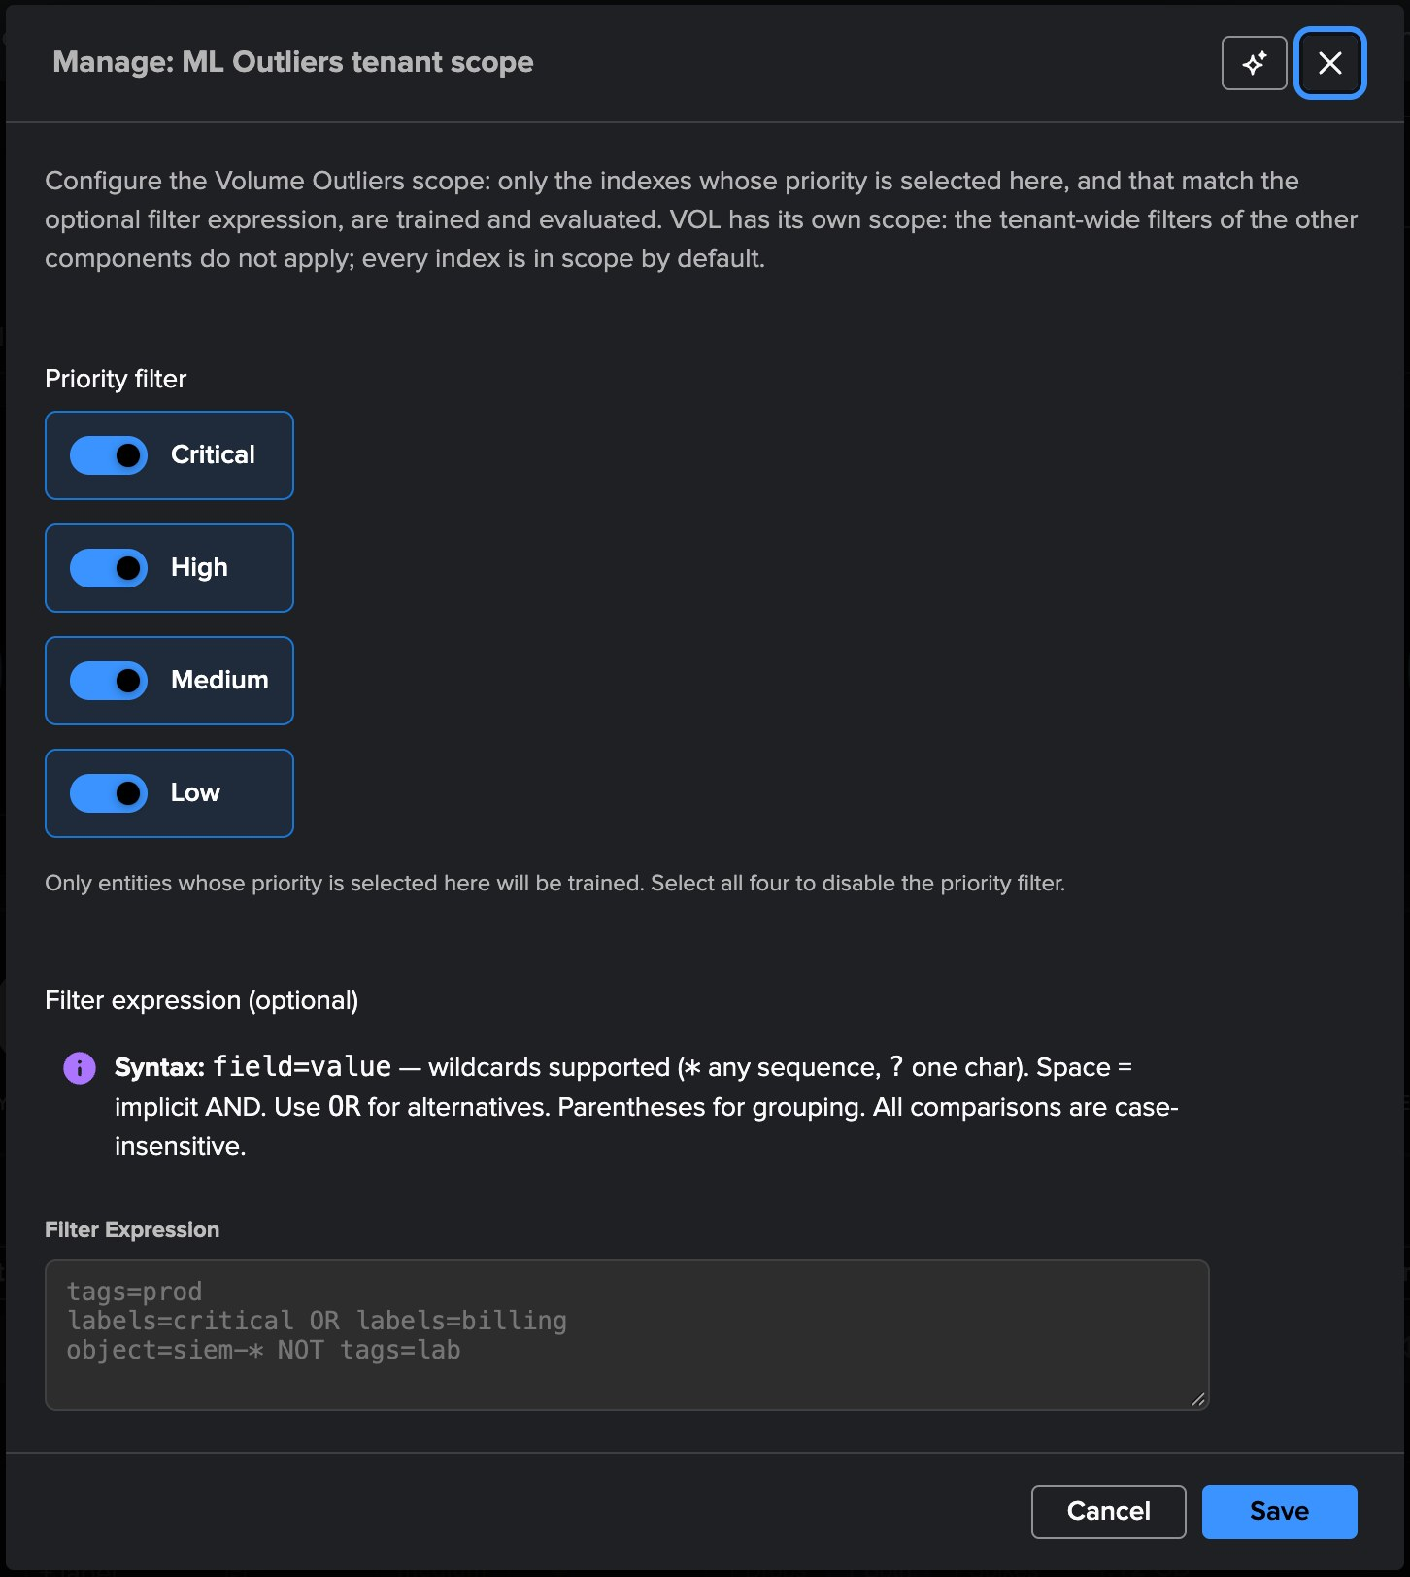
PART 3 · MODELS
Which KPIs carry a model, which indexes are in scope
3
Every priority
Volume outliers are the point.
4
Filter expression
1
object=siem-* NOT tags=lab …
3
2
Independent
The tenant-wide ML filters of the other components do not apply to VOL: its scope is its own.
4
1
Default KPIs
Rolling 24h, 12h, 4h, 60m — one model per KPI per index.
2
Also apply to the existing indexes
Adds the new models and removes the deselected ones; never touches the others.
TrackMe for Splunk · Hands-on: volume outliers
docs.trackme-solutions.com
Notes:
Manage: Outliers default KPIs sets the rolling KPIs every new index gets a model on — the 24-hour volume by default; the shorter windows react faster to a sudden drop or spike, at the cost of more models. An opt-in switch reconciles the existing indexes. Manage: ML Outliers tenant scope sets which indexes are trained and evaluated: VOL has its own scope — every priority by default — and an optional filter expression on object, priority, tags, labels and pool.

Slide 22
03
PART 4 · OPERATE
The whole environment’s license, on one screen
Global license usage (VOL) reads what the tenant already collected — no monitoring, no alerting, no extra search on the license usage log — and answers the questions every Splunk administrator gets asked.
TrackMe for Splunk · Hands-on: volume outliers
Notes:
Part 4: the global license usage view, alerting, and the AI Advisors.

Slide 23
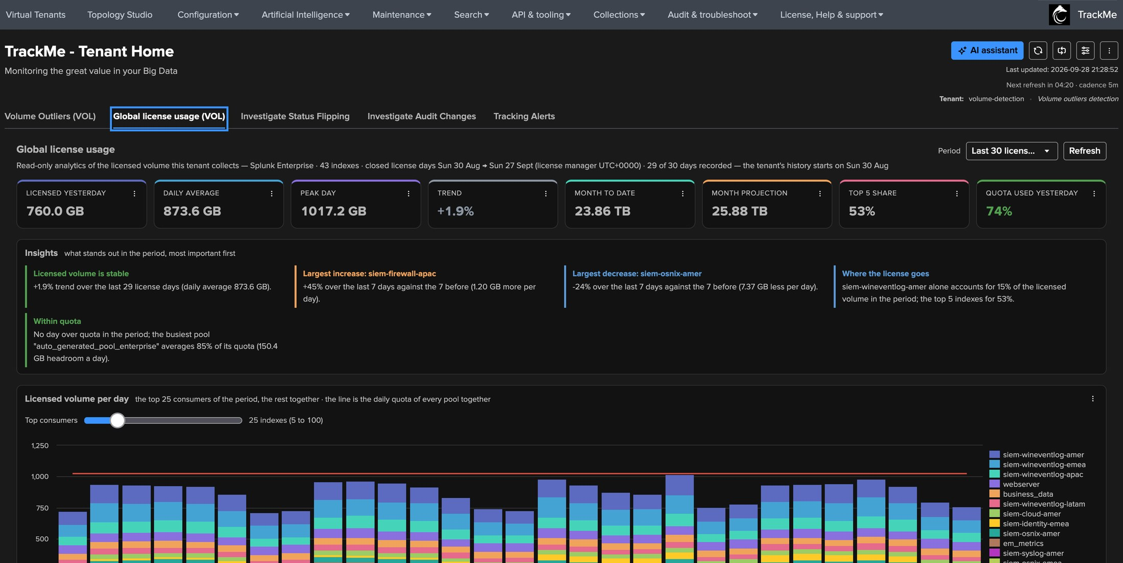
PART 4 · GLOBAL LICENSE USAGE
Key figures and insights, in plain words
1
Period
30, 60 or 90 closed license days.
2
Yesterday · average · peak
1
What the license is measured on.
3
Trend
2
6
3
4
7
5
The slope of the environment.
4
Month to date · projection
The sum of the per-index figures.
5
Quota used yesterday
Against the pool quota.
6
Insights
Stable or growing, movers, quota.
7
Where the license goes
One index is 15%, the top 5 53%.
TrackMe for Splunk · Hands-on: volume outliers
docs.trackme-solutions.com
Notes:
This tab is the dashboard people otherwise build by hand. It reads what the tenant already collected — its own metrics and entity figures — so it costs nothing and works the same for a remote deployment. The insights say in words what stands out: the environment is stable at +1.9%, the largest increase and decrease of the week, and how concentrated the license is. On Splunk Cloud, where a pool has no quota, the quota figures are not shown and the view says so.

Slide 24
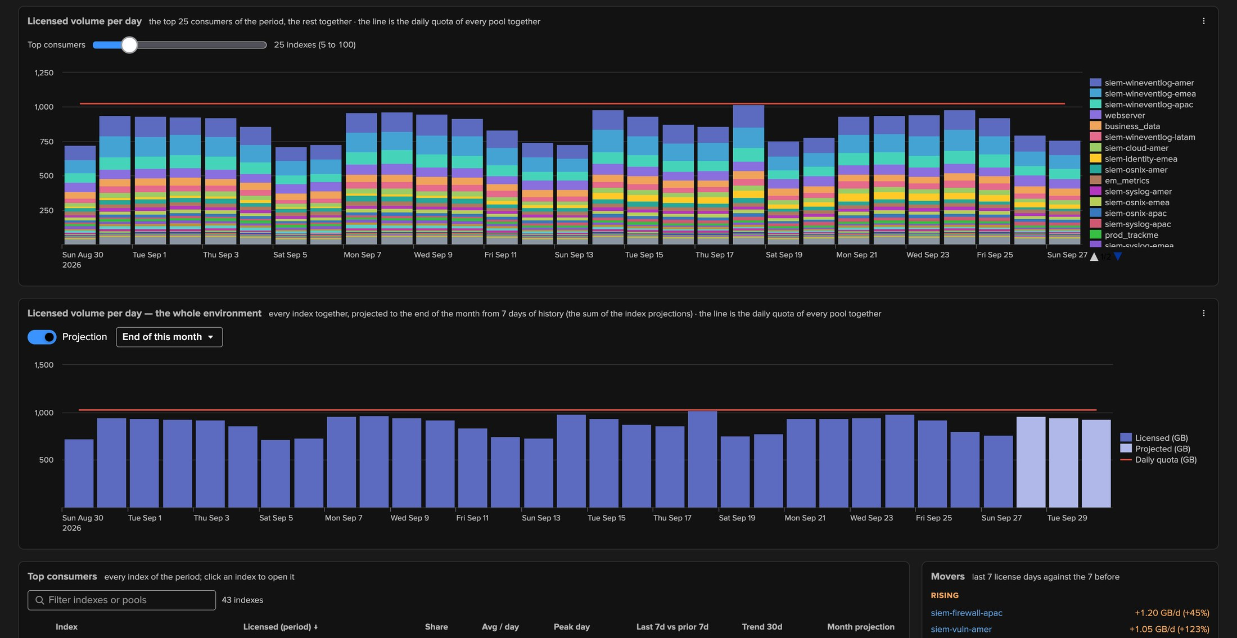
PART 4 · GLOBAL LICENSE USAGE
Who consumes the license, day by day — and where the month ends
1
Top consumers slider
1
2
3
5 to 100 series, the rest together.
2
The daily quota line
Every pool’s quota together.
3
Stacked per index
Each license day, by consumer.
4
4
The whole environment
Projected to the end of the month.
5
5
Projected days
Lighter bars, weekday pattern.
TrackMe for Splunk · Hands-on: volume outliers
docs.trackme-solutions.com
Notes:
The first chart stacks the top consumers of the period; the slider brings more of them out of the rest. The second chart is the environment total with the same projection controls as the entity chart, and the quota line when the license is metered.

Slide 25
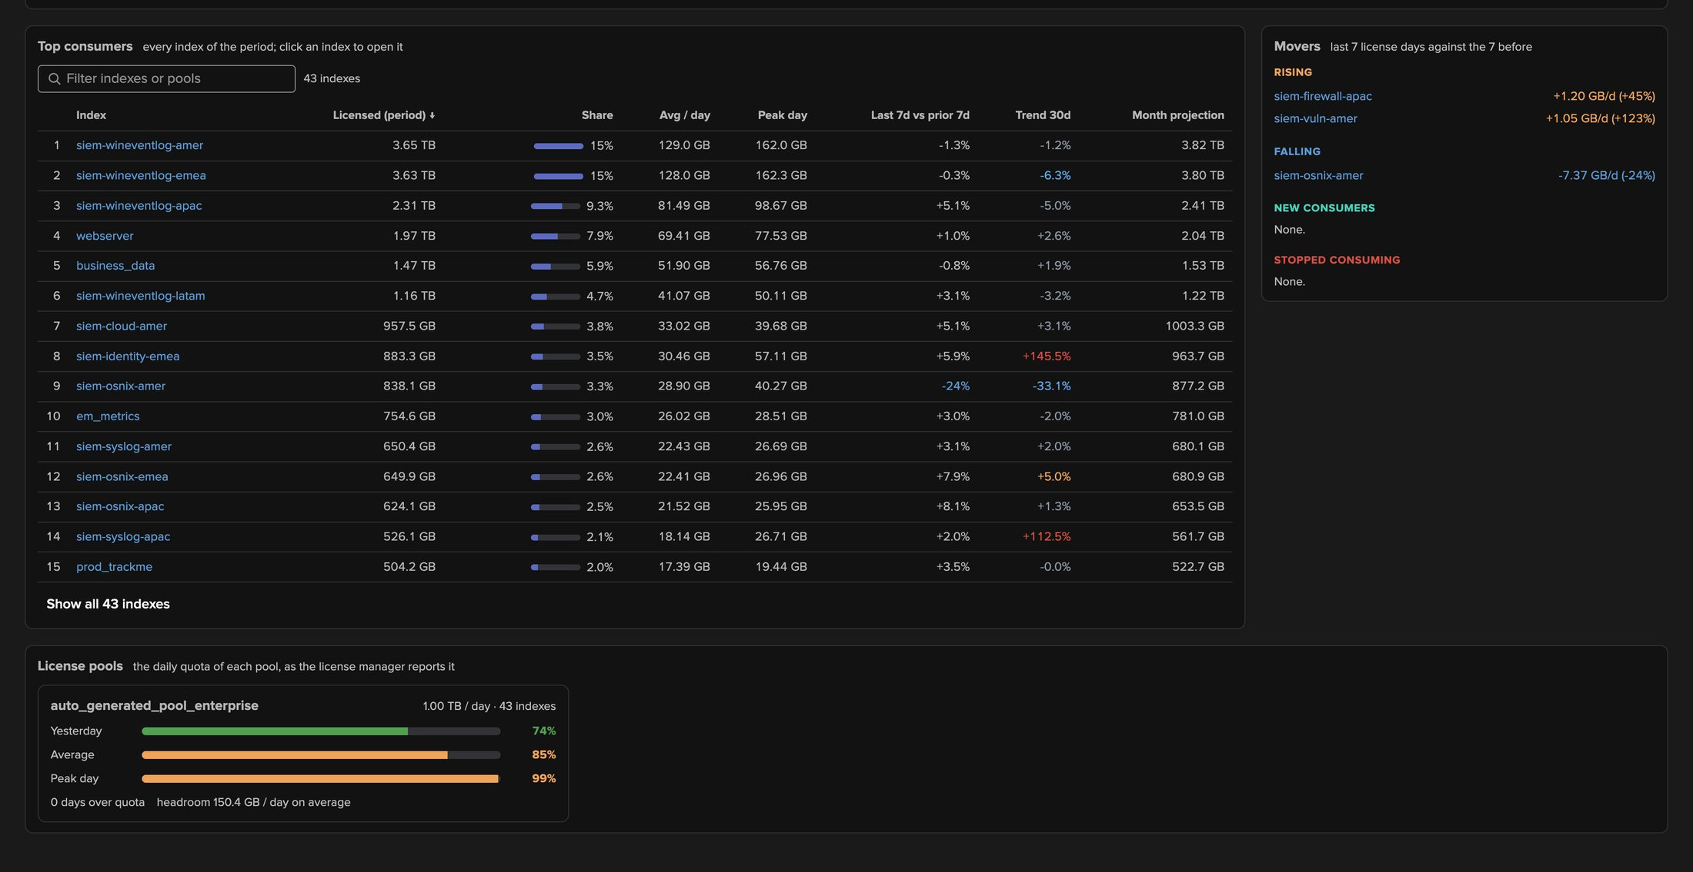
PART 4 · GLOBAL LICENSE USAGE
Consumers, movers and pools
4
1
Top consumers
1
2
3
Sort, filter, click to open.
2
Share · average · peak
The weight of each index.
3
Week over week · trend 30d
The direction of each index.
4
Movers
Rising, falling, new, stopped.
5
License pools
Usage meters, days over quota.
5
TrackMe for Splunk · Hands-on: volume outliers
docs.trackme-solutions.com
Notes:
The consumers table is where a license review starts. The movers card turns the week-over-week comparison into a short list — the first place to look after a jump in the environment total: here siem-firewall-apac rose by 45% and siem-osnix-amer fell by 24%. The pool cards give the capacity view: yesterday, average, peak, days over quota and headroom.

Slide 26
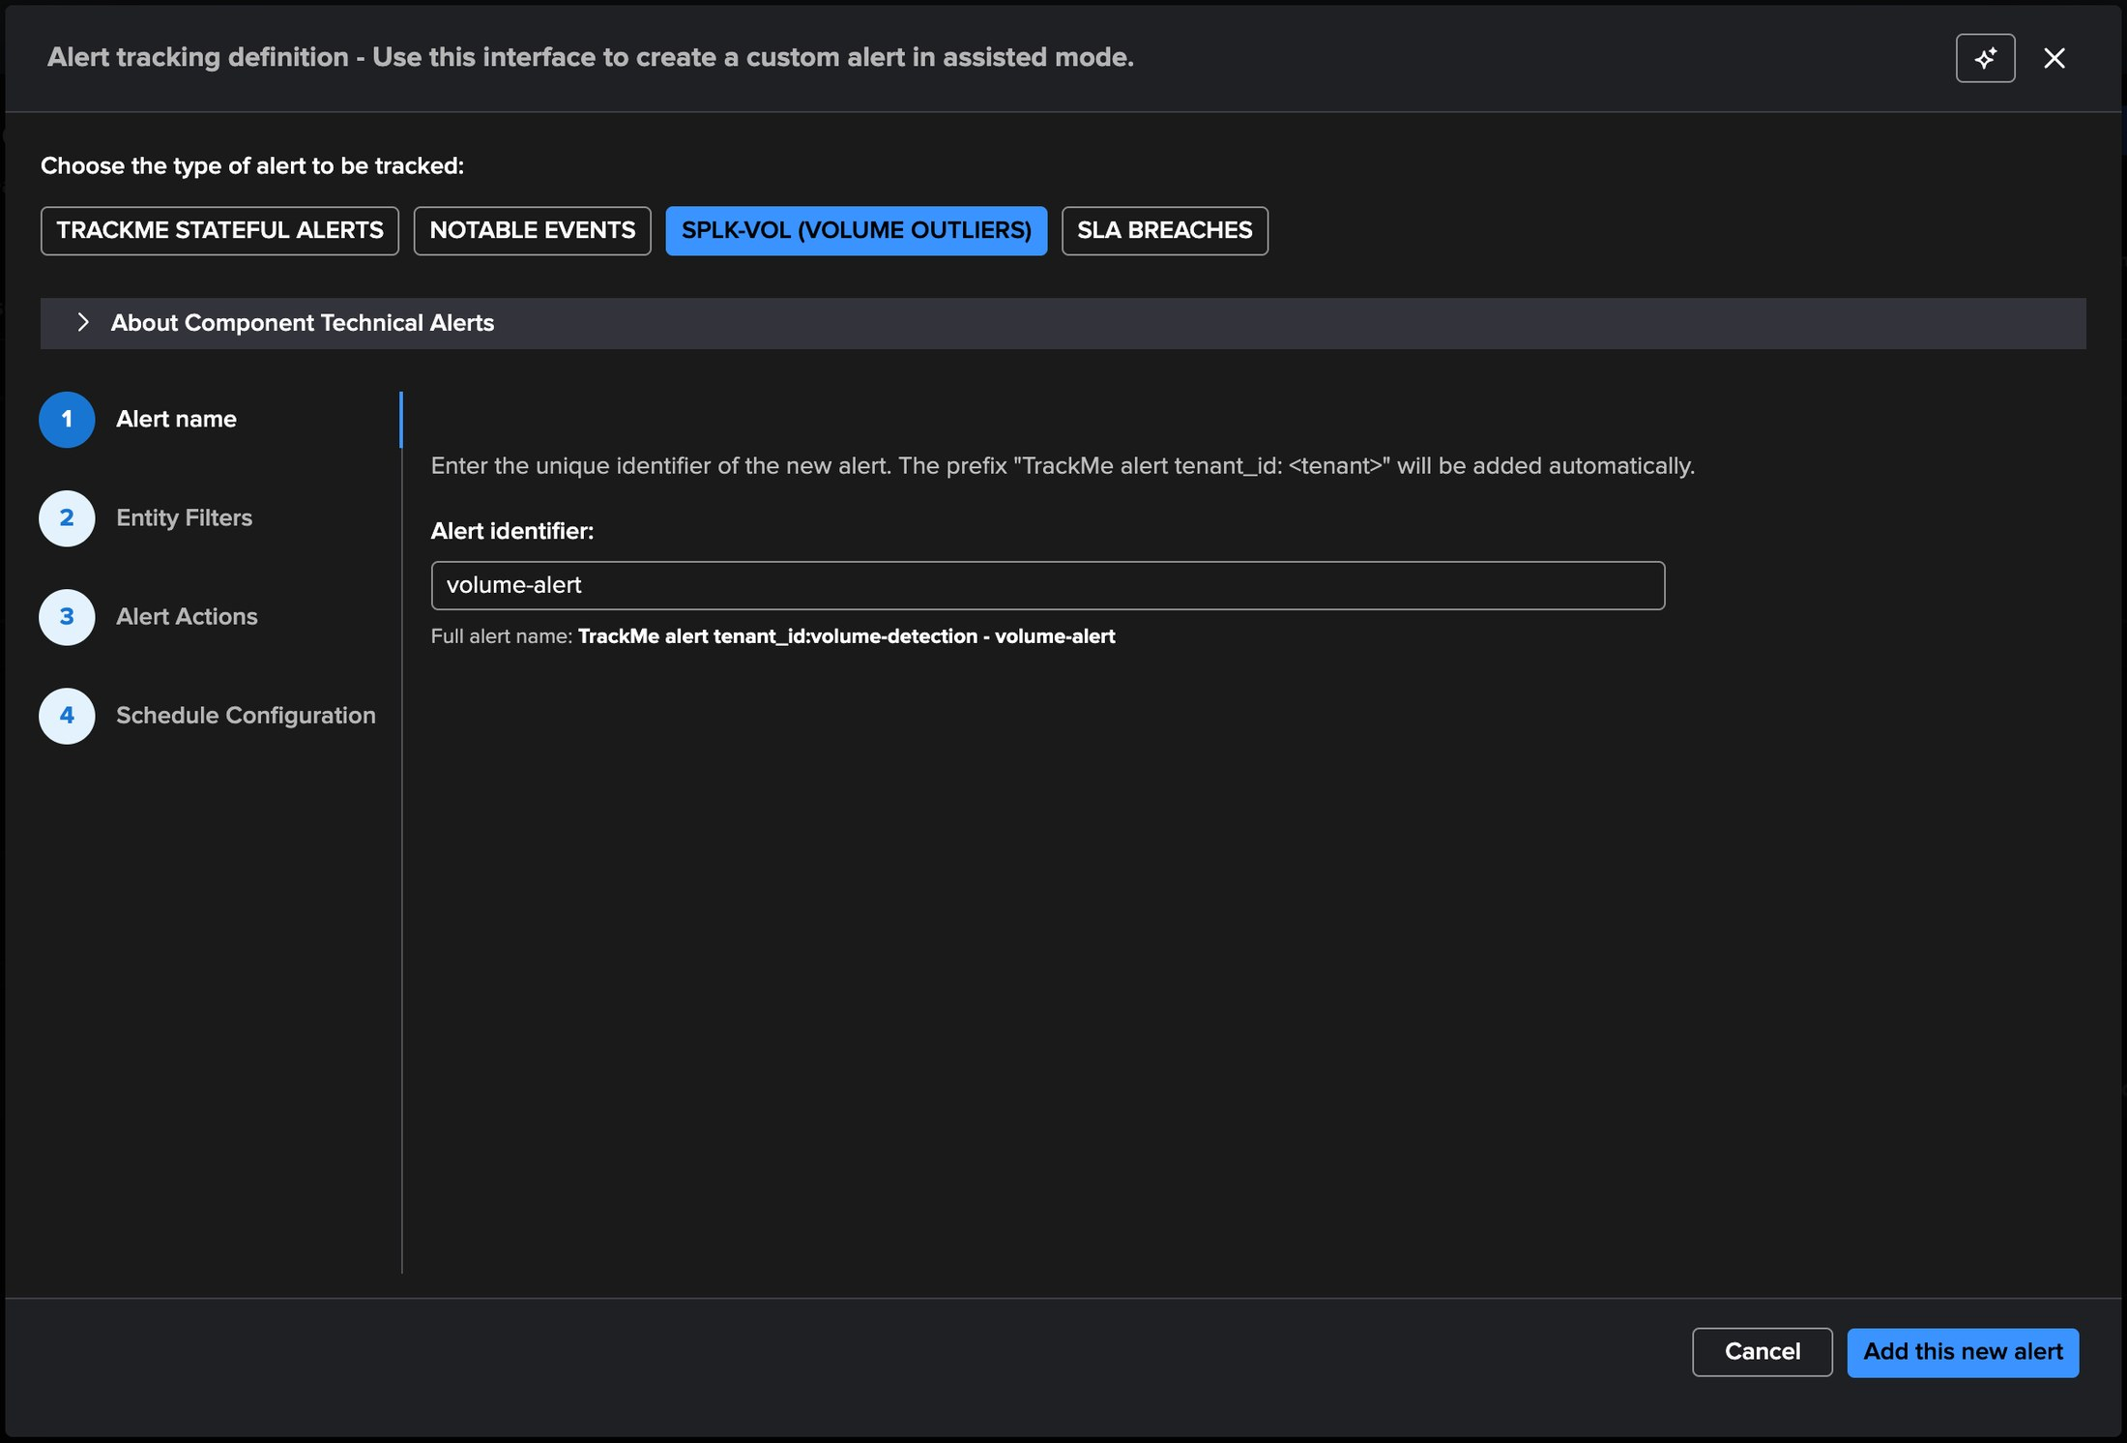
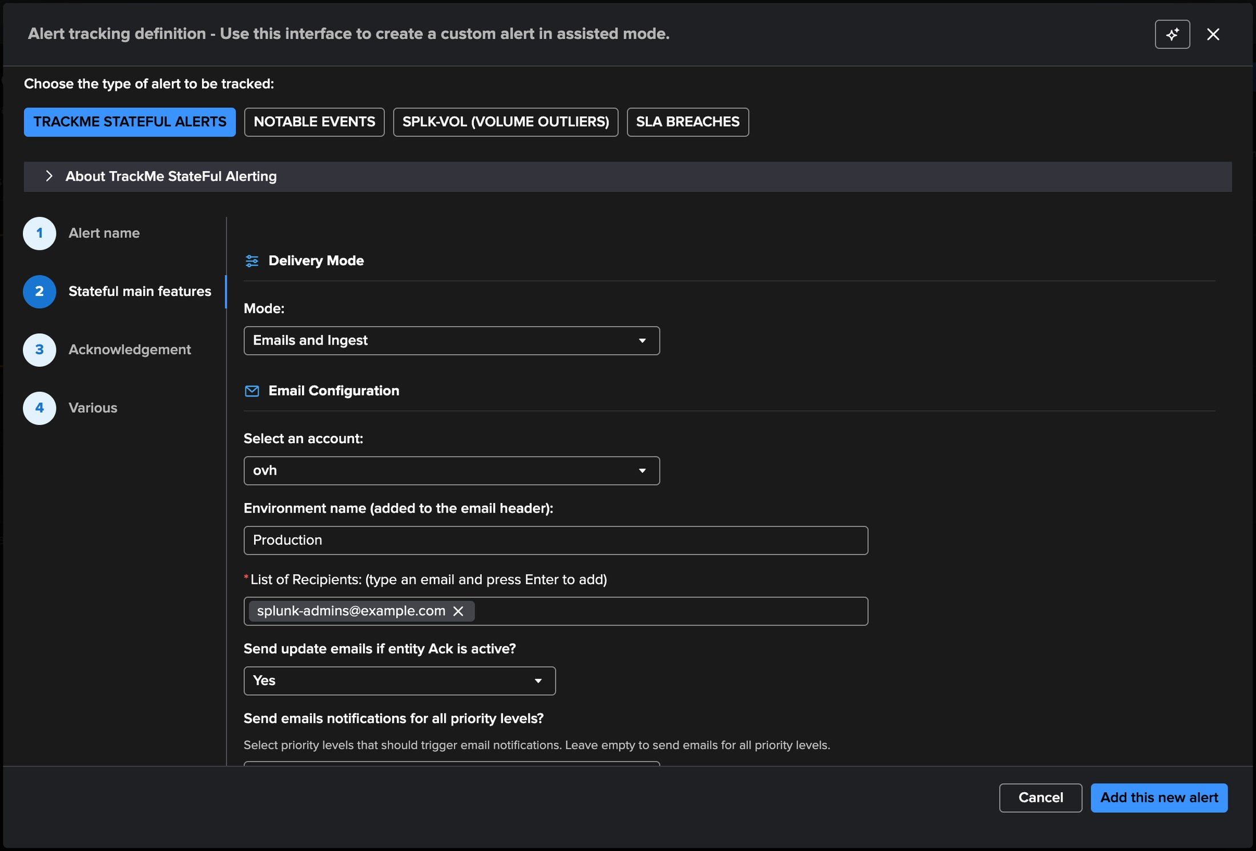
PART 4 · ALERTING
Alerting — the SPLK-VOL alert and stateful emails
1
2
3
4
5
6
1
SPLK-VOL (Volume Outliers)
3
Emails and Ingest
5
Environment name
The component alert: notables and acknowledgments.
Emails plus stateful events.
Stamped in the email header.
2
volume-alert
4
Delivery account
6
Recipients
Defaults: any priority, red, all indexes, outliers on.
Any email account in TrackMe.
Charts and AI report further down.
TrackMe for Splunk · Hands-on: volume outliers
docs.trackme-solutions.com
Notes:
Volume Outliers alerts like any TrackMe component. The SPLK-VOL alert type generates the notable events and acknowledgments for red indexes — the outliers trigger stays on, the outliers being the state of this component, and the same alert covers an index turning red for inactivity. A TrackMe stateful alert sends the emails: opened, updated, closed, with the rolling volume charts, the outliers chart, the daily licensed volume and, optionally, an AI status report embedded.

Slide 27
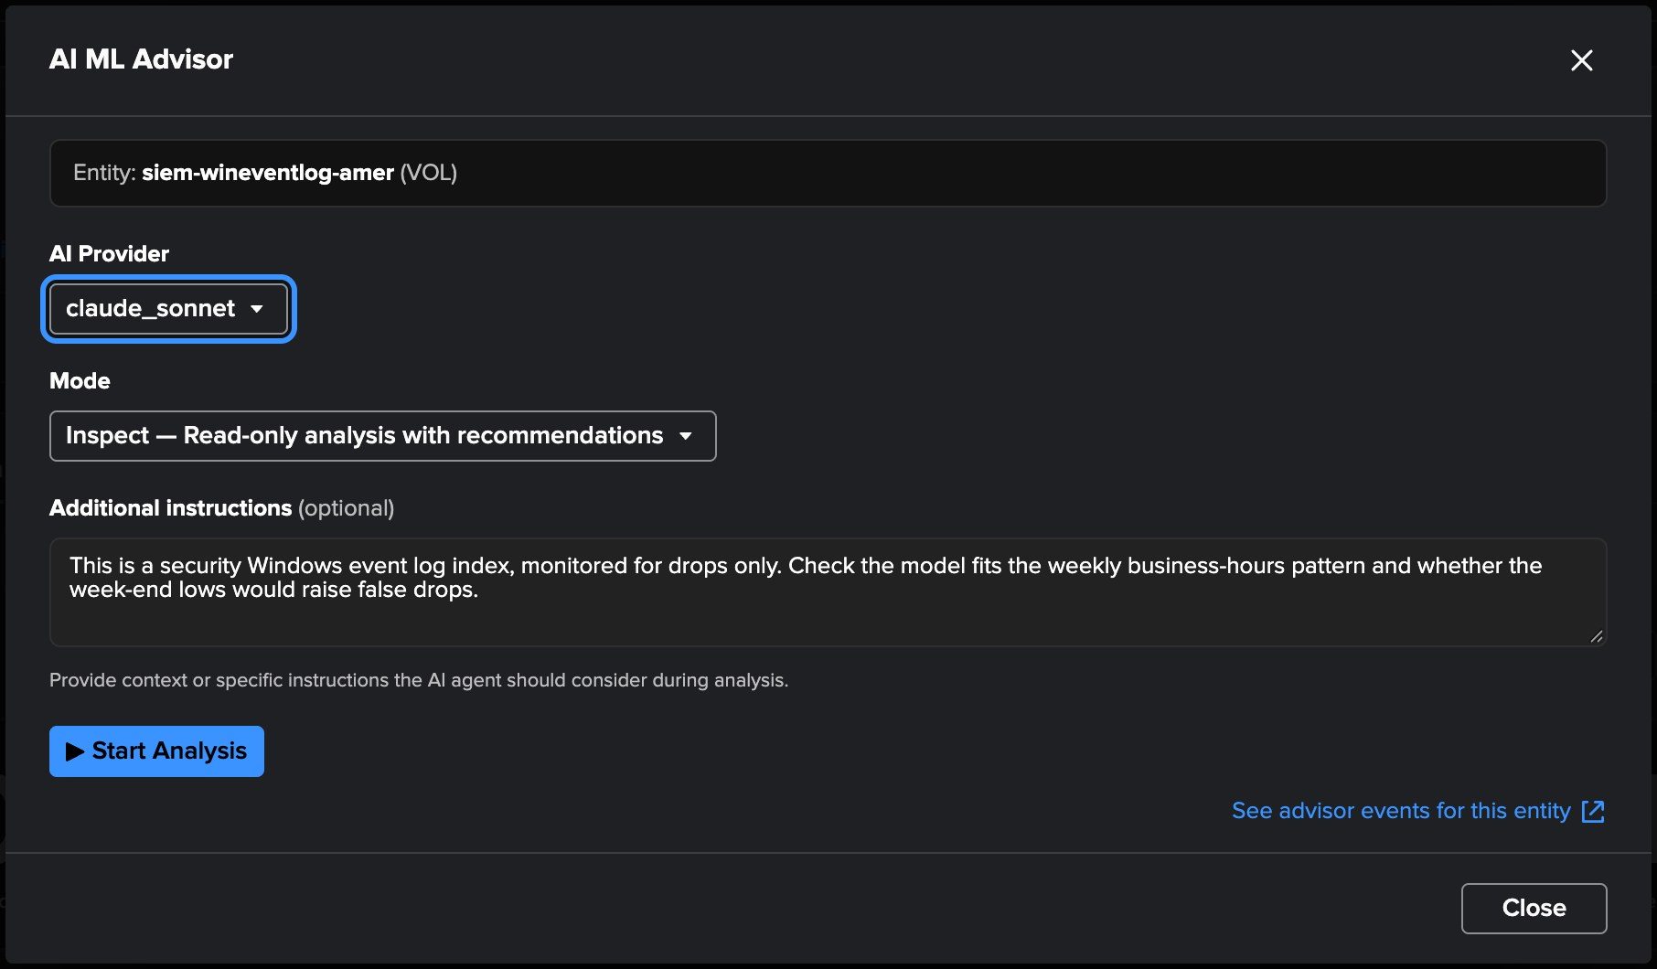
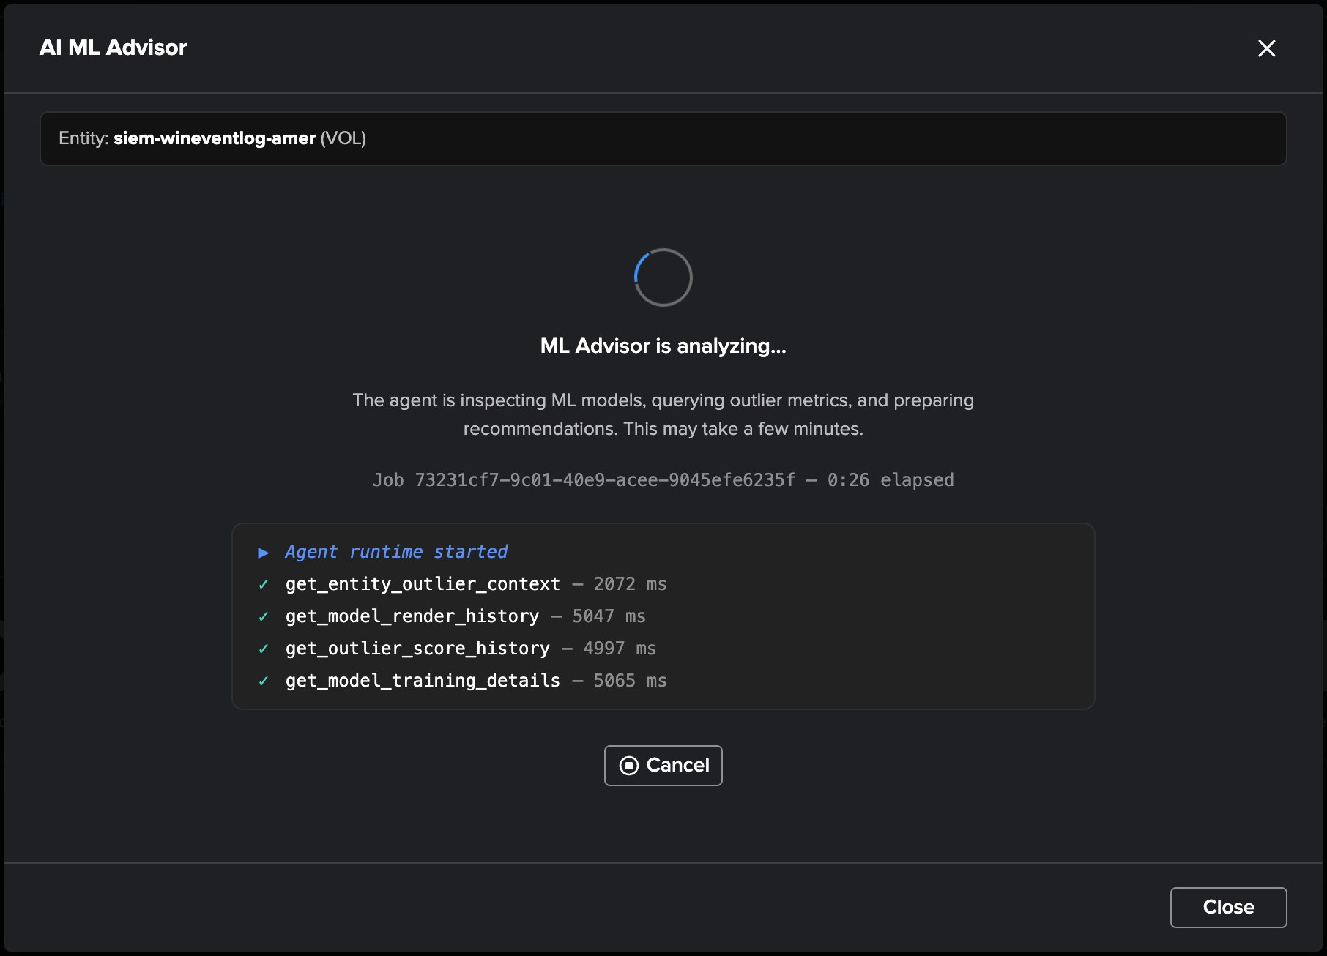
PART 4 · AI
The AI ML Advisor reviews an index’s model
1
2
3
5
4
1
AI provider
3
Additional instructions
5
Live progress
Any provider configured in TrackMe.
The operator’s intent, in words.
Each tool call streamed as it runs: outlier context, render history, score history, training details.
4
Start Analysis
2
Inspect or act
A background agent job.
Review, or remediate after consent.
TrackMe for Splunk · Hands-on: volume outliers
docs.trackme-solutions.com
Notes:
From the Outliers tab of an index, the AI ML Advisor runs as an agent with read tools — the entity, its model rules, the outlier and score history, the training details. The operator states the intent in plain words: this security index is monitored for drops only; does the model fit the weekly business-hours pattern, and would the week-end lows raise false drops? Inspect mode changes nothing; act mode applies its recommendations after consent.

Slide 28
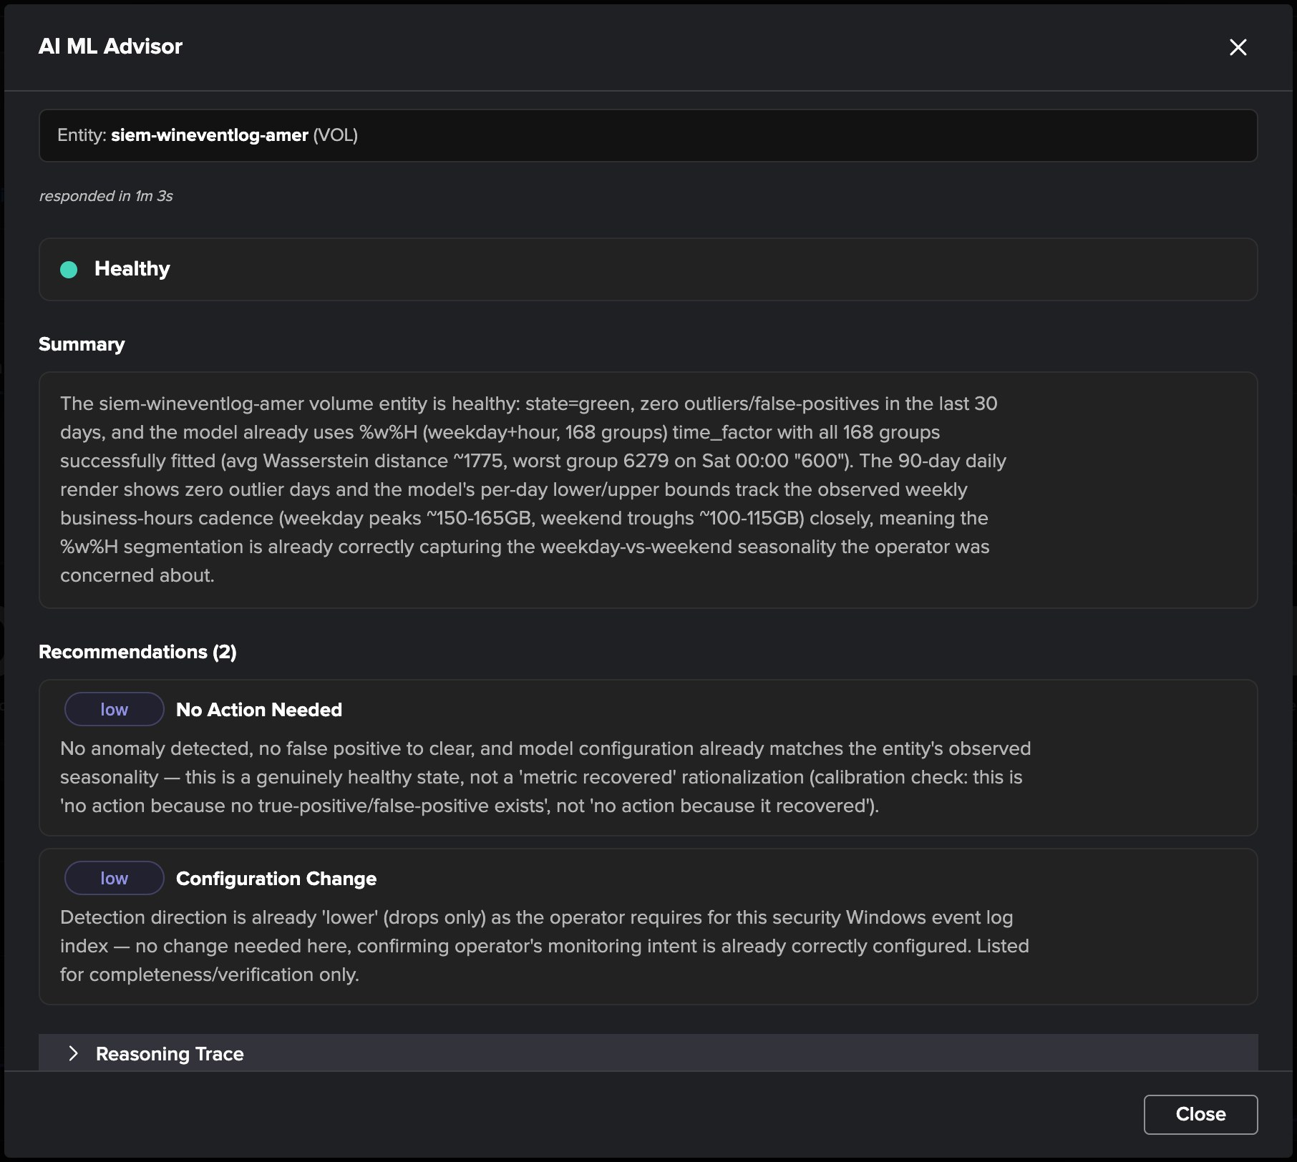
PART 4 · AI
The verdict — the model already fits the index
1
Healthy
Green, no outlier and no false positive in the last 30 days.
2
Summary
1
The model uses weekday × hour seasonality — 168 groups, all fitted — so the week-end lows are expected, not drops.
2
3
Recommendations — two, low
No action needed; the drops-only direction confirmed, as the operator asked.
3
Inspect first, act on consent
Act mode would apply period exclusions, retraining or bound changes after consent. The automated batch runs the same review nightly over the in-scope indexes.
TrackMe for Splunk · Hands-on: volume outliers
docs.trackme-solutions.com
Notes:
The advisor answered the operator’s question with evidence from the model itself: it already segments by weekday and hour, every group is fitted, and its bounds track the weekday peaks and the week-end troughs. Nothing to change — and it says why, rather than rationalising a recovered metric. The reasoning trace at the bottom shows every step.

Slide 29
AT SCALE
Cheap by design — what VOL costs to run
Collection
Metrics
One bounded search per tenant every 5 minutes, only the new license usage events — whatever the number of indexes. No per-index, no per-sourcetype scan.
About 216 KB per index per day of metric-index licensing; the backfill writes the same series over the chosen depth (the wizard shows the estimate).
Models
Integrity
One model per index on the rolling 24 hours, trained on the standard schedule; the VOL scope and the default KPIs control how many.
Live and backfill never overlap; no point is written twice; a failed search never advances the cursor, so missing volume is never recorded as a drop.
The same component serves Splunk Enterprise and Splunk Cloud, on this deployment or on a remote account.
TrackMe for Splunk · Hands-on: volume outliers
docs.trackme-solutions.com
Notes:
The collection reads only what is new: one bounded search per tenant every five minutes. The metrics footprint is compact and shown before you confirm the backfill. The rolling values come from the buckets TrackMe holds, not from its own metrics, so a blocked metrics pipeline never reads as a drop. One model per index by default; the scope limits them where needed.

Slide 30
RECAP
Where we are
In one walkthrough
Created
Read
Tuned
Operated
a Volume Outliers tenant covering 43 indexes, with a month of history backfilled at creation
the volume, the cost and the detection of every index, and the model behind each state
the direction per index, the inactivity policy with an override, the KPIs and the scope
the global license usage view, SPLK-VOL alerting with emails, and the AI Advisors
What made it work
The right source
Useful on day one
Signal, not noise
The license usage log: the volume Splunk bills, one log for every index, read incrementally.
The backfill replays the history, so the models are trusted and the trend is complete immediately.
One entity per index, a direction per index, an inactivity policy by business hours — and impact scoring.
TrackMe for Splunk · Hands-on: volume outliers
docs.trackme-solutions.com
Notes:
Recap: one tenant watches the licensed volume of every index. The backfill makes it useful on day one; the table, the entity screen and the model explain every figure; four settings make the detection yours; the global license usage view, alerting and the AI Advisors take it into operations.

