Slide 1

HANDS-ON WALKTHROUGH · USER ACTIVITY MONITORING (BETA)
Who is doing what on your Splunk?
One tenant watches every account of a deployment — people and service accounts — through the audit trail and the introspection, raises findings from a policy catalogue, and gives you the investigation workflow. From an empty tenant to classified accounts and findings.
Captured live on TrackMe 2.4.18 (Beta) · Splunk Cloud · tenant uam-cloud
Notes:
Hands-on walkthrough of User Activity Monitoring, the seventh tenant type of TrackMe, introduced in 2.4.18 as a Beta. Everything in this deck was captured live on a Splunk Cloud search head cluster, starting from a brand new tenant called uam-cloud. In four parts we create the tenant, watch the first day of collection, read and classify what it found, then tune the policies and operate the tenant. The accounts you will see — alice.moreau, ben.okafor, svc-siem-collector and friends — are the fictitious names of a small platform team.

Slide 2
THE PROBLEM
You know what the data does. Do you know what the people do?
Data monitoring sees the feeds. A Splunk platform is also a few hundred saved searches, twenty accounts and the automation behind them — and their behaviour has no owner.
Schedules nobody reviews
People and services look alike
Resource hogs are invisible
Reports scheduled under a personal account, searches dispatched all time, a real-time schedule left running. Nobody notices until the owner leaves — or the search head does.
A SOAR connector, a reporting script, an analyst: the same audit lines. Without a class, every policy is either noisy or blind.
One account re-running a two-week search every five minutes takes half of the search CPU. The symptom is a slow search head; the cause is a search ID in the introspection.
What User Activity Monitoring does
UAM is a dedicated tenant type. It reads the audit trail and the introspection of a deployment, keeps an inventory of the scheduled searches, the users and the roles, records one compact evidence record per search and window, classifies every account as system, human or service, and evaluates a catalogue of eleven policies that raise findings — each with evidence, a suggested remediation, an assignee, a status and a history. It never edits or dispatches the searches it observes.
Beta in 2.4.18: a complete tenant type, captured here on a Splunk Cloud search head cluster — the platform you are about to see.
TrackMe for Splunk · Hands-on: User Activity Monitoring
docs.trackme-solutions.com
Notes:
TrackMe has always monitored the data. The other half of a Splunk platform is the people and the automation that use it, and nobody looks at that half: personal schedules and all-time searches that nobody reviews, service accounts that nobody can tell apart from people, and resource hogs that stay invisible until the search head suffers. UAM turns the audit trail and the introspection into an inventory, findings and an investigation workflow.

Slide 3
THE MODEL
One tenant, one deployment: trackers, evidence, classes, findings
1
Sources
2
Trackers
3
Evidence
4
Classification
5
Findings
The audit trail (_audit), the introspection (resource usage, capacity), the saved searches, users and roles of every tier.
inventory · listing · activity · policies · backfill — bounded windows, durable checkpoints, one receipt per run.
trackme:uam:* in the summary index: one record per search and window, REST access summarised, inventory deltas, receipts.
system · human · service — seeded, detected from Splunk Web and from sustained automation, then rules and manual classes.
Eleven policies in three families raise one finding per policy and subject: evidence, remediation, assignee, status, history.
›
›
›
›
1
A dedicated tenant type
4
Compact evidence, indexed
Not an entity component: its own wizard card, its own tabs, its own trackers — one tenant per deployment.
trackme:uam:* — one record per search and window; the REST access of an account summarised per batch.
2
One indexing layer, one or more tiers
5
Classes, policies, findings
The local search head, plus any remote account as another tier of the same indexing layer.
Accounts are system, human or service; eleven policies raise one finding per policy and subject; you investigate.
3
Five trackers
Inventory · listing · activity · policies · backfill. Bounded, checkpointed, replayed when a run dies.
Investigation on top: assign, investigate, resolve, dismiss — with notifications on the transitions and an AI Findings Advisor.
TrackMe for Splunk · Hands-on: User Activity Monitoring
docs.trackme-solutions.com
Notes:
The model in one picture. UAM is not an entity component: it is its own tenant type, with its own tabs and its own trackers. A tenant covers one indexing layer and one or more search head tiers — the local one here; a remote account would add another tier. Five trackers collect: the inventory and the listing read the saved searches, users and roles; the activity tracker reads the audit trail five minutes at a time and the introspection window by window; the policies tracker evaluates the catalogue; the backfill walks the history backwards. Everything lands in the summary index as trackme:uam:* events, compact by design.

Slide 4
THE PLAN
What we are going to do — one tenant, four parts
PART 1
PART 1 · DAY ONE
PART 2
PART 3 · 4
Setup
Inventory, activity, first findings
Read & classify
Tune & operate
Pick the UAM card in the tenant chooser
Five trackers scheduled at creation
The Findings tab and the Investigate view
The policy catalogue and the insight
Basics, Configure UAM, Indexes & RBAC, Review
Collection health: receipts and backfill
The Users tab: human · service · system
Classification rules, collection limits
A dedicated service-account owner
The tenant overview: KPIs and transitions
One account deep-dive, the Activity tab
Notifications: digest or threads
The tenant card with its Beta badge
The first findings are inventory facts
How the classification is decided
Collection health, recovery, the Guardian
One Virtual Tenant, one local search head tier, a 30-day backfill. Every screen is the product as shipped; nothing was pre-configured.
TrackMe for Splunk · Hands-on: User Activity Monitoring
docs.trackme-solutions.com
Notes:
Four parts. Setup: create the tenant through the wizard — six screens, one specific to UAM. Day one: what the trackers deliver within the first quarter of an hour, and what the backfill adds over the day. Read and classify: the findings, the accounts and the evidence, and how the classes settle. Tune and operate: the policy catalogue, the notifications and the collection health. No entity, no threshold to write: the catalogue ships with defaults.

Slide 5
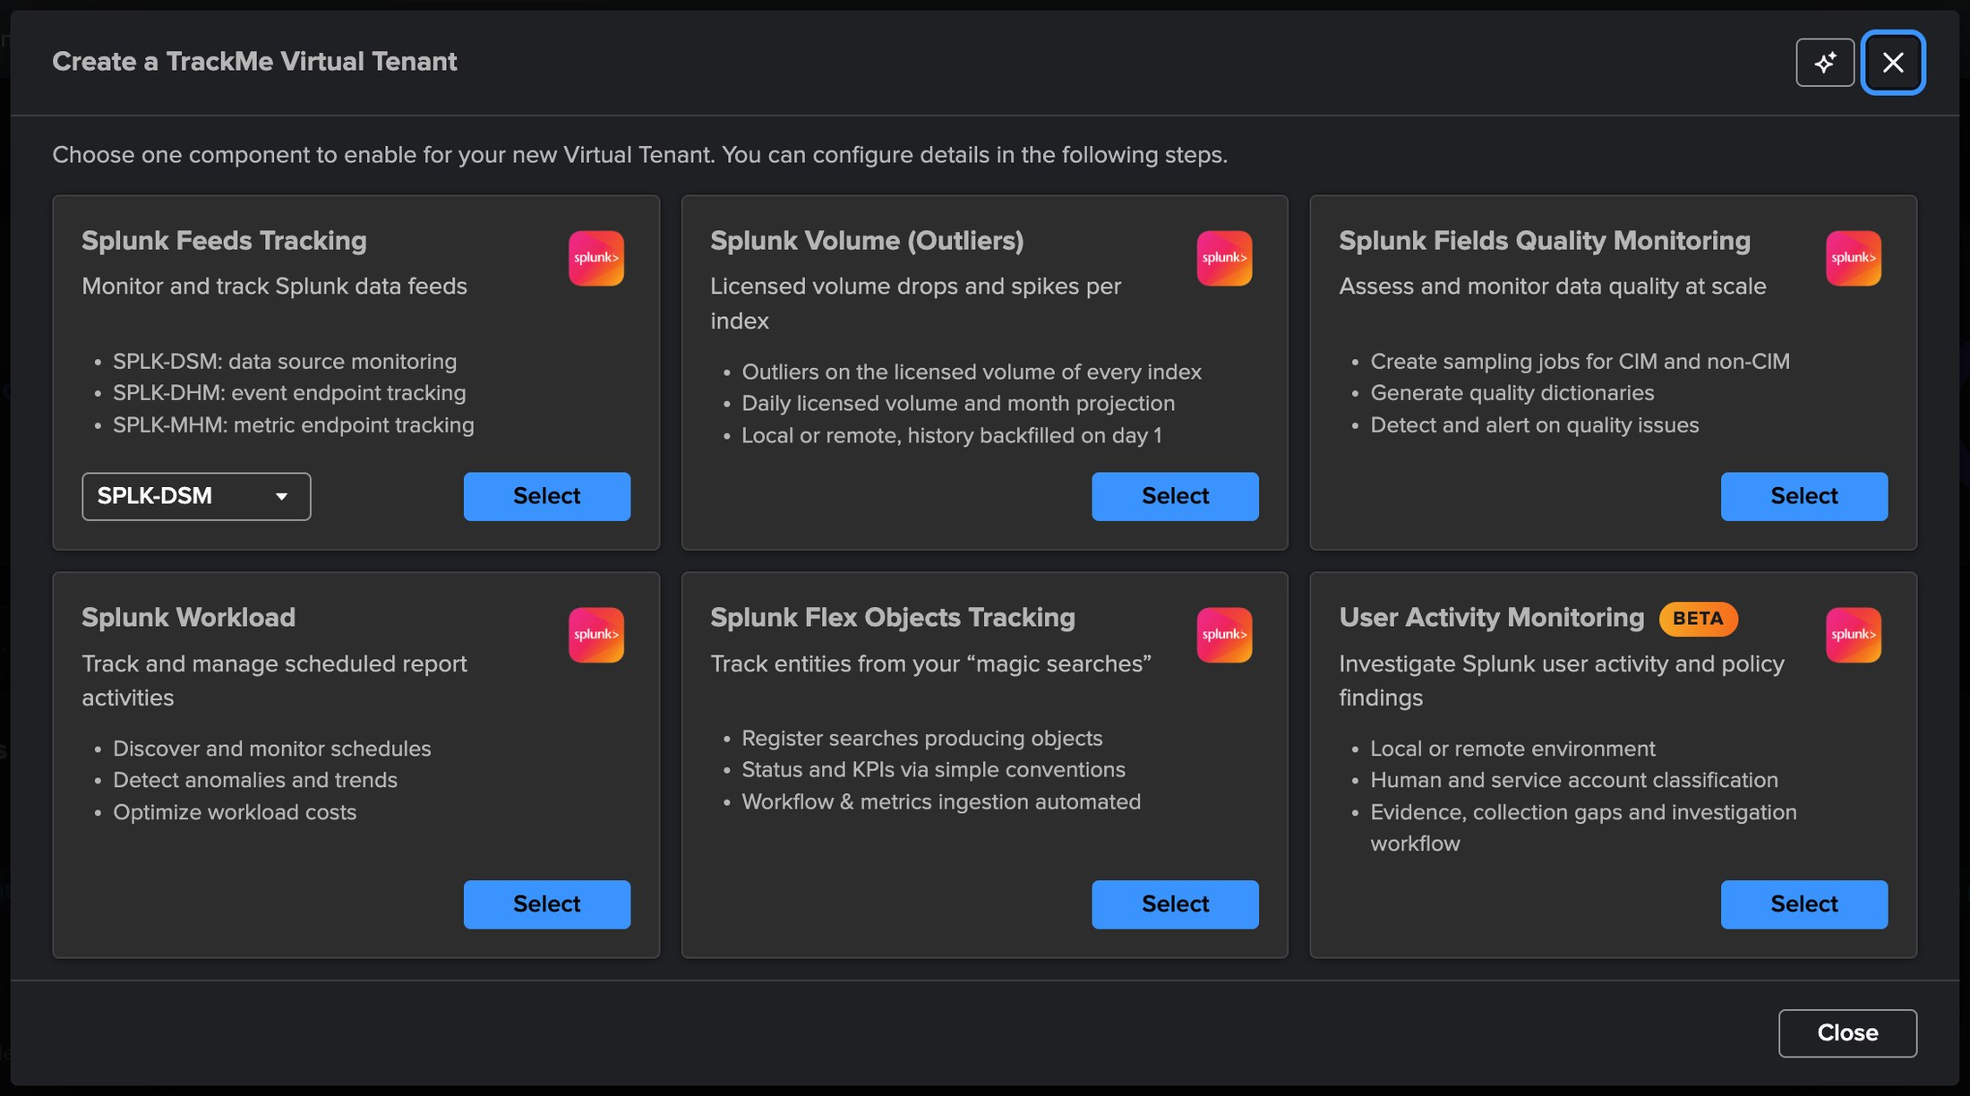
PART 1 · SETUP
A dedicated tenant — pick User Activity Monitoring in the chooser
1
The User Activity Monitoring card
The sixth card of the chooser, next to the five entity components. One tenant monitors one deployment.
2
Beta badge
Introduced in 2.4.18 as a Beta: a complete tenant type whose policies and evidence may still move between beta releases.
2
1
3
Select
Opens the UAM flavour of the tenant wizard: Basics, Configure UAM, Indexes & RBAC, Review.
3
Not an entity component
A UAM tenant carries no entities: no DSM, DHM or FLX component can be added to it, and it does not appear in the entity views. It has its own tabs — Findings, Users, Activity, Scheduled searches, Policies, Collection health, Settings.
Virtual Tenants → Actions → Create a tracking tenant.
TrackMe for Splunk · Hands-on: User Activity Monitoring
docs.trackme-solutions.com
Notes:
Virtual Tenants, Actions, Create a tracking tenant. The chooser lists the entity components and, since 2.4.18, the User Activity Monitoring card with its Beta badge. Selecting it starts the same wizard as any tenant, with one extra step specific to UAM. There are no entities in this tenant type, which is why it has its own card rather than a checkbox in the component list.

Slide 6
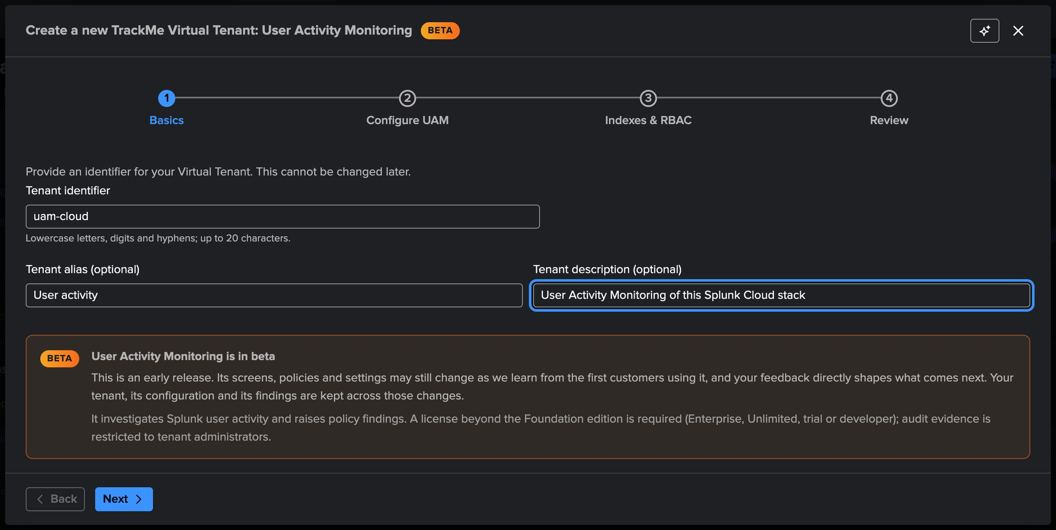
PART 1 · SETUP
Basics — an identifier, an alias, and the Beta notice
1
Tenant id — uam-cloud
Immutable identifier, checked for availability as you type; it names the KV collections and the trackers.
3
2
Alias and description
1
What people see on the Virtual Tenants card: "User activity monitoring" here.
2
3
The Beta notice
States what the beta does not do yet, and that the schema may move between beta releases.
How many tenants
One deployment, one UAM tenant. A second tenant would monitor a second indexing layer — another Splunk stack — not a second team of the same one; the RBAC of the findings lives inside the tenant.
TrackMe for Splunk · Hands-on: User Activity Monitoring
docs.trackme-solutions.com
Notes:
The Basics step is the one every tenant type shares: identifier, alias, description. Two details are specific: the Beta notice at the top, and the fact that the identifier will also name the three KV collections of the tenant — settings, inventory and findings.

Slide 7
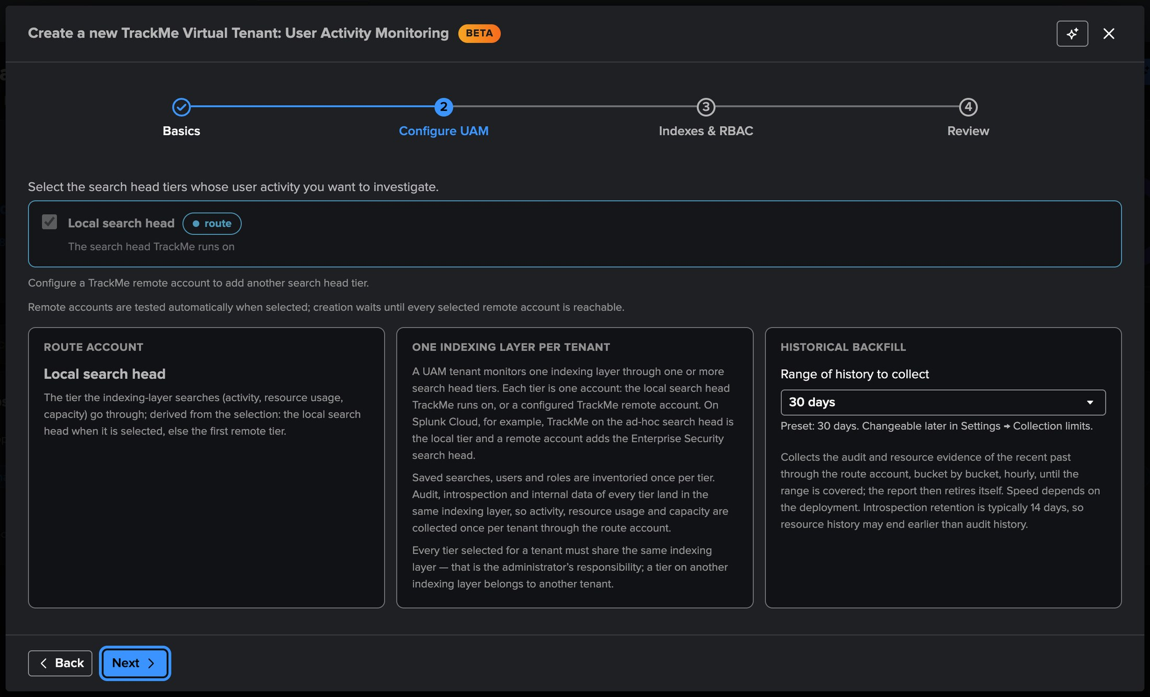
PART 1 · SETUP
Configure UAM — the tiers, the route account, the backfill
1
Search head tiers — local
The local search head is the first tier. Any remote account adds another tier of the same indexing layer (an ES cluster, for instance).
1
2
Connectivity test
Every remote tier passes its connectivity test before the creation is allowed.
2
3
Route account
The account used for the indexing-layer searches — audit, introspection, internal data. Derived: local here.
3
4
4
Historical backfill — 30 days
The audit and resource history collected before the live start. None, or up to 90 days.
Why backfill
The backfill is what makes the classification usable on day one: people are detected from the past weeks of Splunk Web activity, and service accounts earn their seven days of automation-only activity from history instead of waiting a week.
TrackMe for Splunk · Hands-on: User Activity Monitoring
docs.trackme-solutions.com
Notes:
This is the only step specific to UAM, and it decides the shape of the tenant. A tier is a search head — or a cluster — whose saved searches, users and roles are inventoried and whose audit trail is read. The route account is the one used to search the indexing layer. The backfill range matters more than it looks: without it, the classification takes a week to settle.

Slide 8
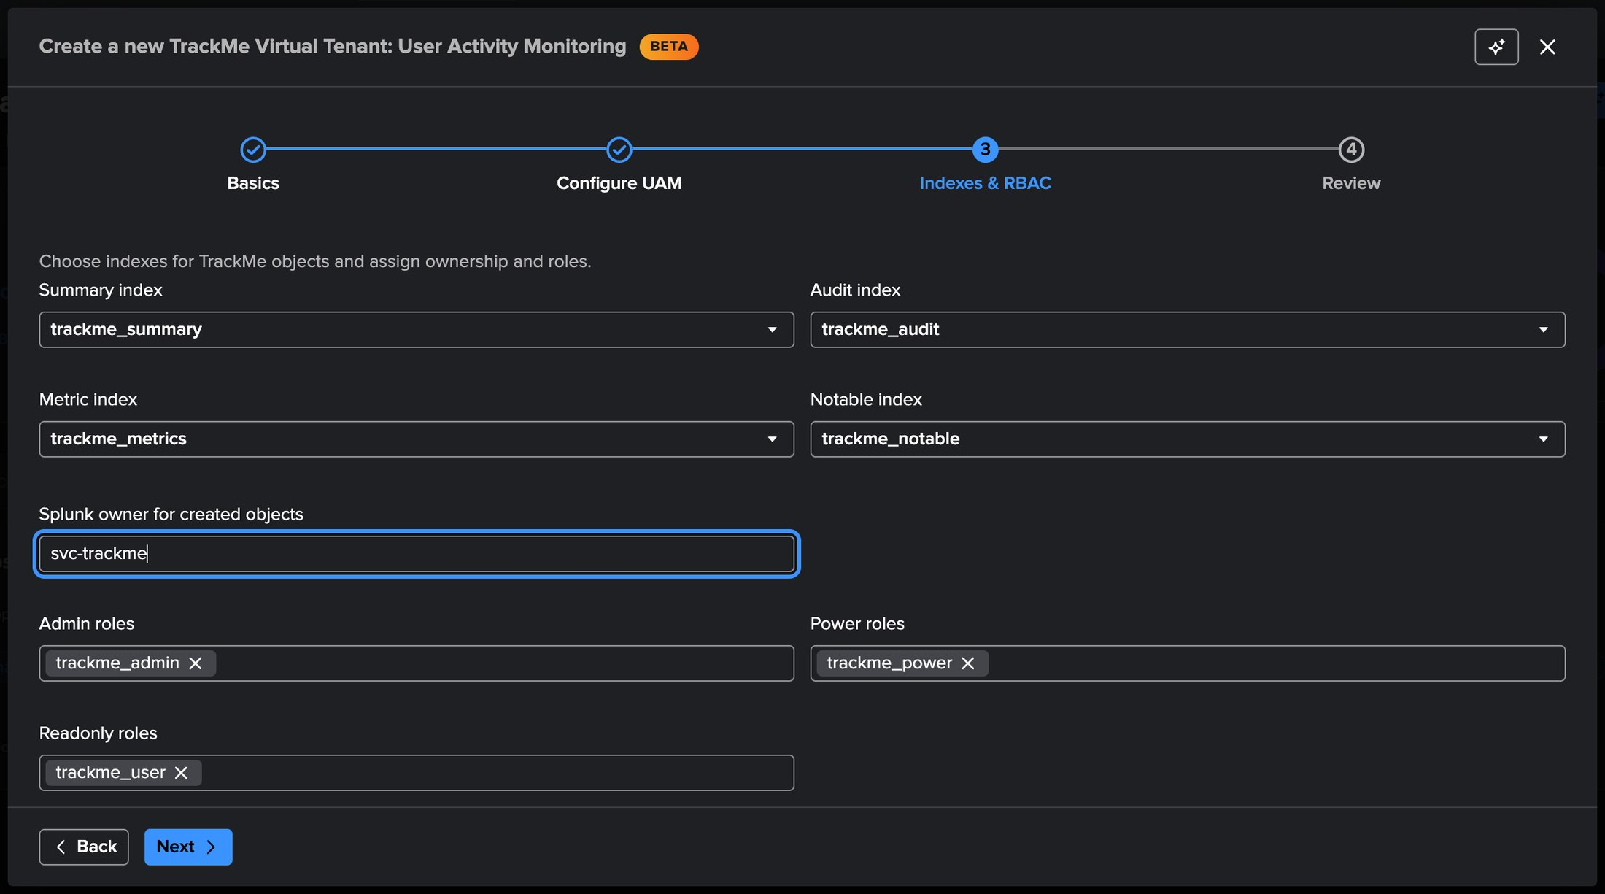
PART 1 · SETUP
Indexes & RBAC — give the tenant a service-account owner
1
Indexes
Summary, audit, metric and notable indexes — the defaults are fine. The trackme:uam:* evidence lands in the summary index.
1
2
Owner — a dedicated service account
The recommendation specific to UAM: an account with administrative rights (svc-trackme). The trackers and the scheduled AI review run as the owner.
2
3
Roles
Admin, power and user roles of the tenant: who administers, who investigates, who reads the findings.
3
What the owner needs
The owner must be able to read _audit and _introspection and to list the saved searches, users and roles of every tier. An owner without those rights leaves the inventory and the activity empty — and the Configuration Guardian tells you.
TrackMe for Splunk · Hands-on: User Activity Monitoring
docs.trackme-solutions.com
Notes:
Indexes and RBAC is the step every tenant ends with. The one recommendation specific to UAM is the owner: a dedicated service account with administrative rights, because the trackers run as the owner and need to read the audit trail, the introspection and the knowledge objects of every tier. We classify that account as system later, so the platform's own workload never appears in a finding.

Slide 9
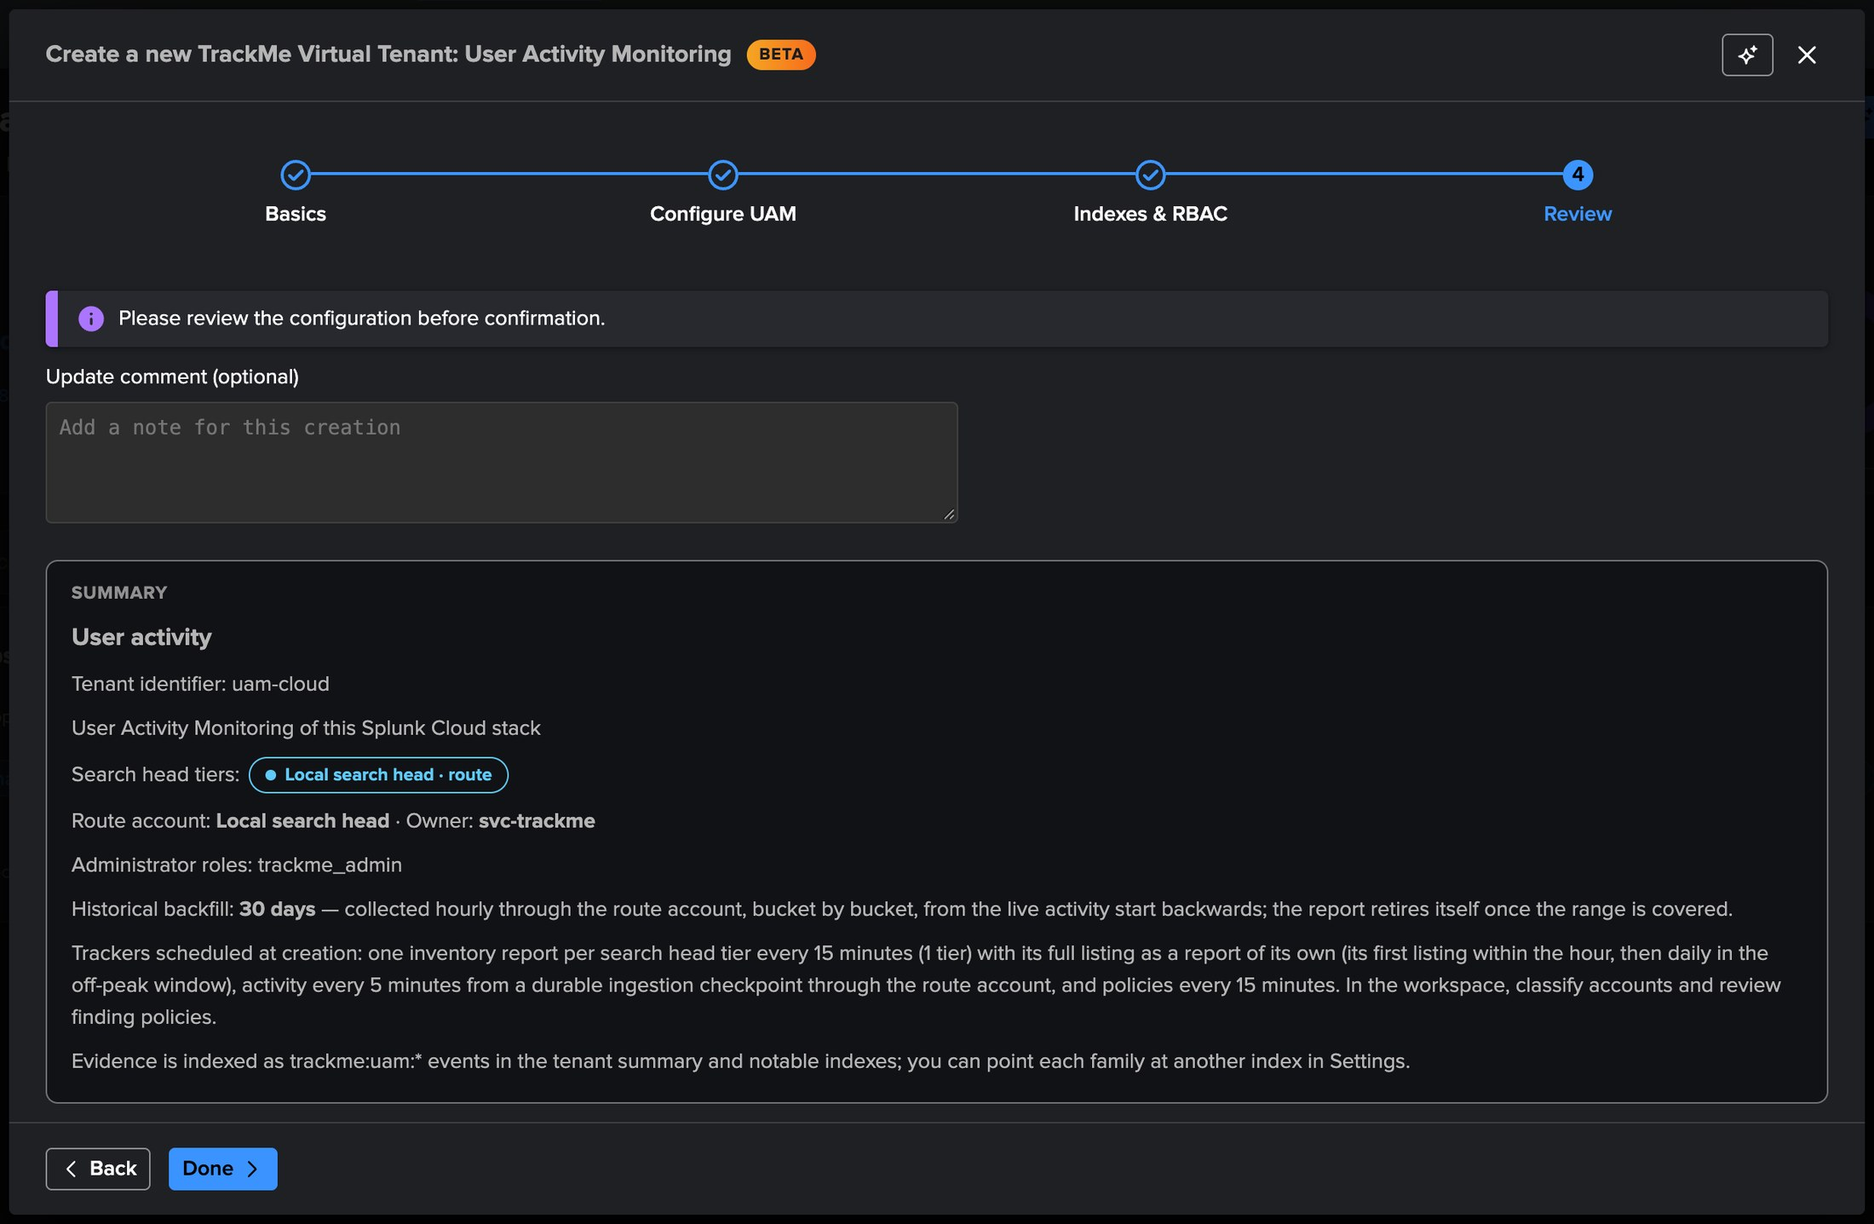
PART 1 · SETUP
Review — the summary, then everything is created in seconds
1
Identity and tiers
uam-cloud, one local tier, the route account, the 30-day backfill.
1
2
What gets created
Three KV collections (settings, inventory, findings), the lookups, five trackers and the health tracker.
2
3
Scheduled immediately
The inventory, listing, activity and policies trackers start at their next slot; the backfill plans itself at its first hourly slot.
3
4
Create
Or automate it: one REST call to vtenants/admin/add_tenant with tenant_uam_enabled and a uam_config object.
4
TrackMe for Splunk · Hands-on: User Activity Monitoring
docs.trackme-solutions.com
Notes:
The review shows the whole shape before anything is written. Creation takes seconds: the collections, the lookups and the trackers exist immediately, and the trackers are scheduled at once. The same creation is one REST call for those who automate their tenants.

Slide 10
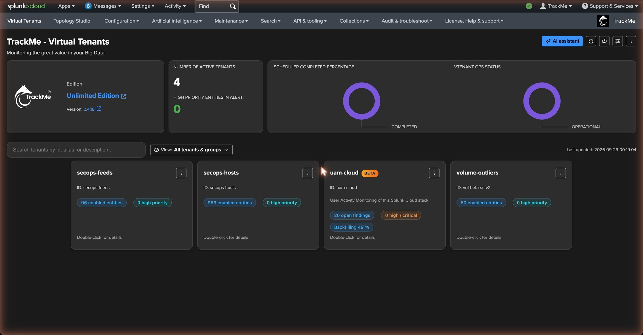
PART 1 · SETUP
The tenant card — a Beta badge, findings and the backfill at a glance
1
The UAM card
Alias, identifier, the Beta badge and the tier list — no entity KPIs, no donut.
1
2
Open findings pill
Open findings by severity — empty right after creation, the inventory facts appear within the quarter of an hour.
2
3
3
Backfill pill
Planned, running with its progress, or complete: the history being walked backwards, newest first.
4
Collection status
4
Green while the trackers run on time; the Guardian check uam_collection_health turns it amber when something stalls.
Virtual Tenants, a few seconds after creation.
TrackMe for Splunk · Hands-on: User Activity Monitoring
docs.trackme-solutions.com
Notes:
Back on the Virtual Tenants page the tenant has its card. It looks different from the entity tenants on purpose: instead of state donuts it shows the open findings by severity and the backfill status. Both pills are empty or planned right now; we come back after the first runs.

Slide 11
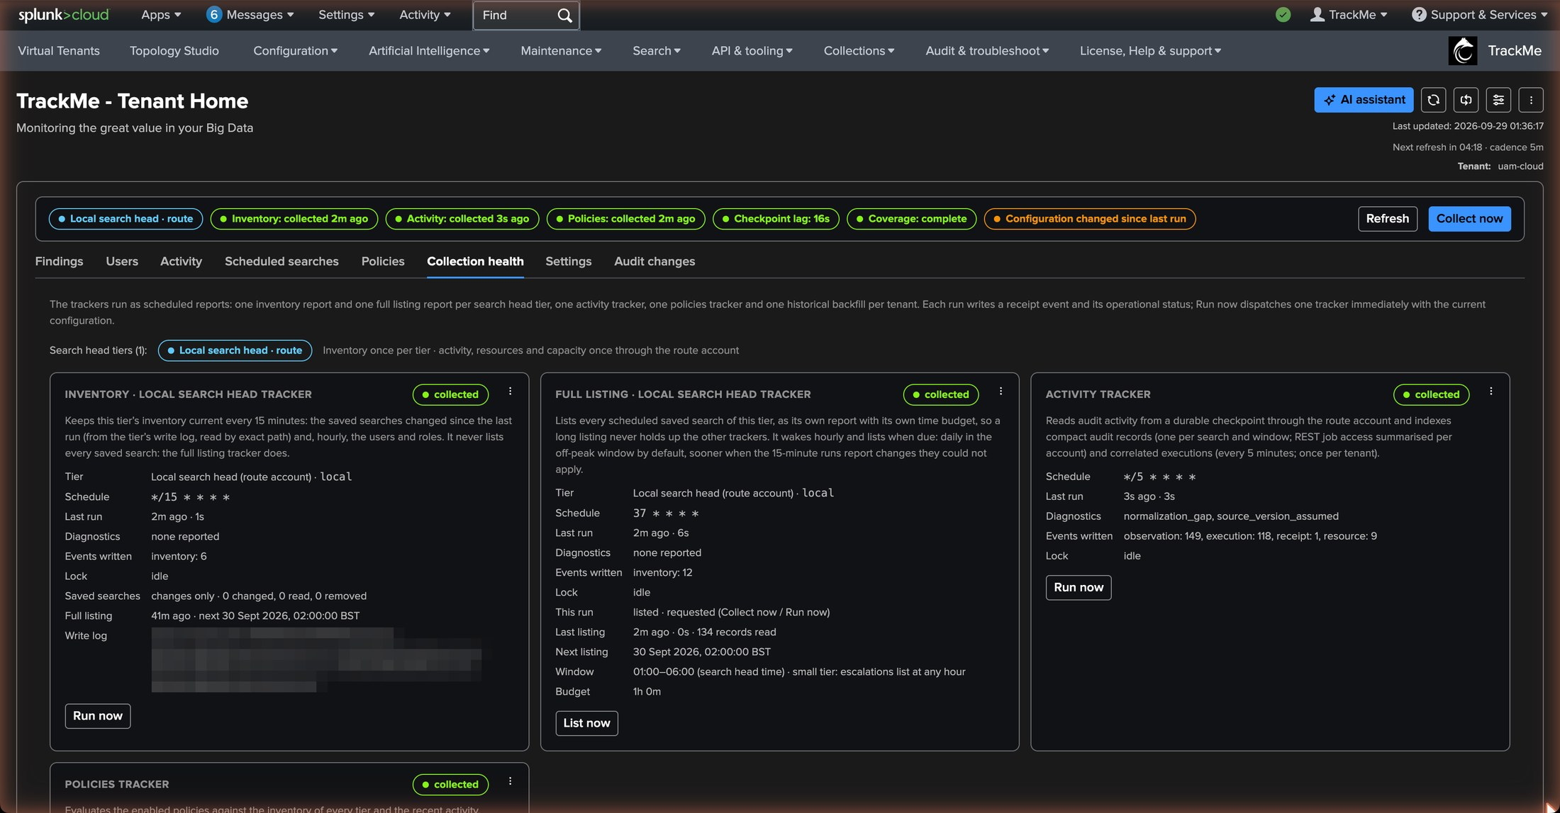
PART 1 · DAY ONE
Collection health — five trackers, their receipts, the backfill walking back
1
The trackers
5
Inventory · listing · activity · policies · backfill, each with its last run explained and its seven-day history.
1
2
2
Receipts
One trackme:uam:receipt per run: windows read, records written, gaps, duration.
3
3
Activity checkpoint and lag
The audit trail is read five minutes at a time from a durable checkpoint — never all time.
4
4
Backfill progress
Thirty days walked backwards in fifteen-minute buckets, a little under an hour per slot; its edges show where the history ends.
5
Collect now
Dispatches every tracker on demand. A scheduled run never disables the page.
TrackMe for Splunk · Hands-on: User Activity Monitoring
docs.trackme-solutions.com
Notes:
Within the quarter of an hour that follows the creation, the Collection health tab shows the trackers running. Each run leaves a receipt, so what was read and what was written is always explainable. The backfill runs on its own hourly slots; the range is bounded by the retention of the sources: on this fresh stack the audit and resource history reached retention within the day, so the backfill retired itself early.

Slide 12
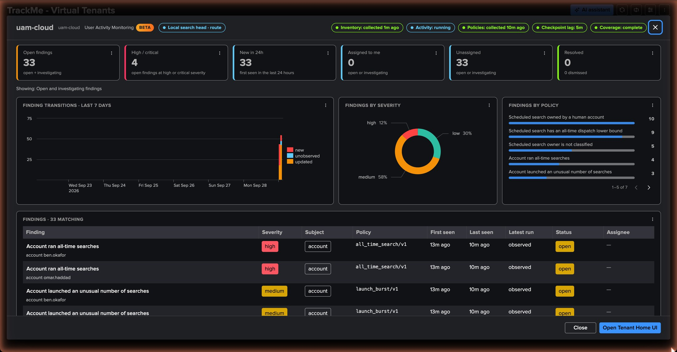
PART 1 · DAY ONE
The tenant overview — first KPIs, first transitions, first policies
1
KPI tiles
Accounts seen, scheduled searches inventoried, open findings by severity, evidence records of the day.
1
2
Transitions over time
New, reopened, escalated, resolved, dismissed — the life of the backlog as a timeline.
2
3
3
By policy
Which policies raised what: on day one, all_time_schedule and realtime_schedule — inventory facts.
4
4
No personal_schedule yet
That policy needs the owners classified as human first; the backfill and the next part bring it.
TrackMe for Splunk · Hands-on: User Activity Monitoring
docs.trackme-solutions.com
Notes:
The overview modal from the tenant card summarises the tenant. On day one the numbers are the inventory facts: schedules dispatched all time and a real-time schedule. Nothing about people yet, because nobody is classified yet — the personal_schedule policy waits for that. This is the honest starting point of every UAM tenant.

Slide 13
01
PART 2 · READ & CLASSIFY
Findings, accounts, evidence
The Findings tab and the Investigate view; the Users tab where the classes settle; one account deep-dive; the Activity tab with the raw evidence. Most of the classification happens without us.
TrackMe for Splunk · Hands-on: User Activity Monitoring
Notes:
Part two is about reading. A finding is one row per policy and subject; the Investigate view gives everything an administrator needs to decide. Then the accounts: who is a person, who is a service, who is the platform itself — and how UAM decided it.

Slide 14
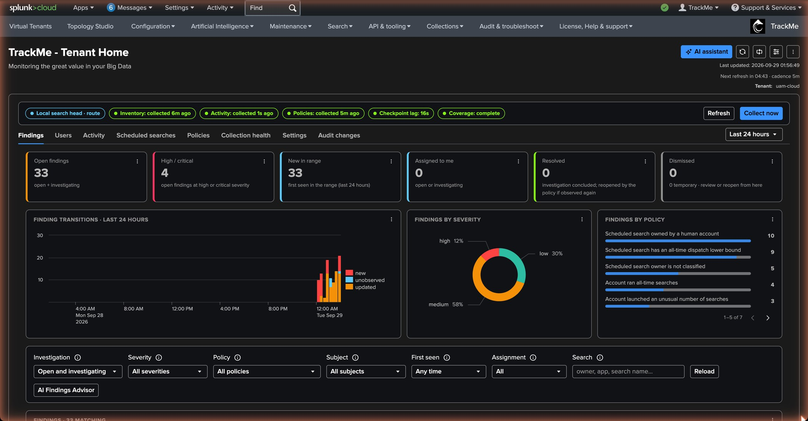
PART 2 · FINDINGS
The Findings tab — the backlog, one row per policy and subject
1
Tiles
1
Open, high / critical, new in the range, assigned to me, resolved, dismissed.
2
Transitions chart
2
3
The backlog over time by event; one bar per policies run that changed something.
3
By severity, by policy
4
Where the weight is: severity on the left, policy on the right.
4
Filters
5
Status, severity, policy, subject type, assignee, "still observed by the latest run".
5
The table
Severity, subject (a schedule or an account), policy, first and last seen, observed, status, assignee. Bulk edit on a selection.
TrackMe for Splunk · Hands-on: User Activity Monitoring
docs.trackme-solutions.com
Notes:
The Findings tab is the backlog. The tiles give the shape, the charts give the trend and the weight, the table gives the rows. Each finding is one policy applied to one subject — a scheduled search or an account — and keeps its identity across runs: a condition that persists updates the same finding rather than creating a new one every quarter of an hour.

Slide 15
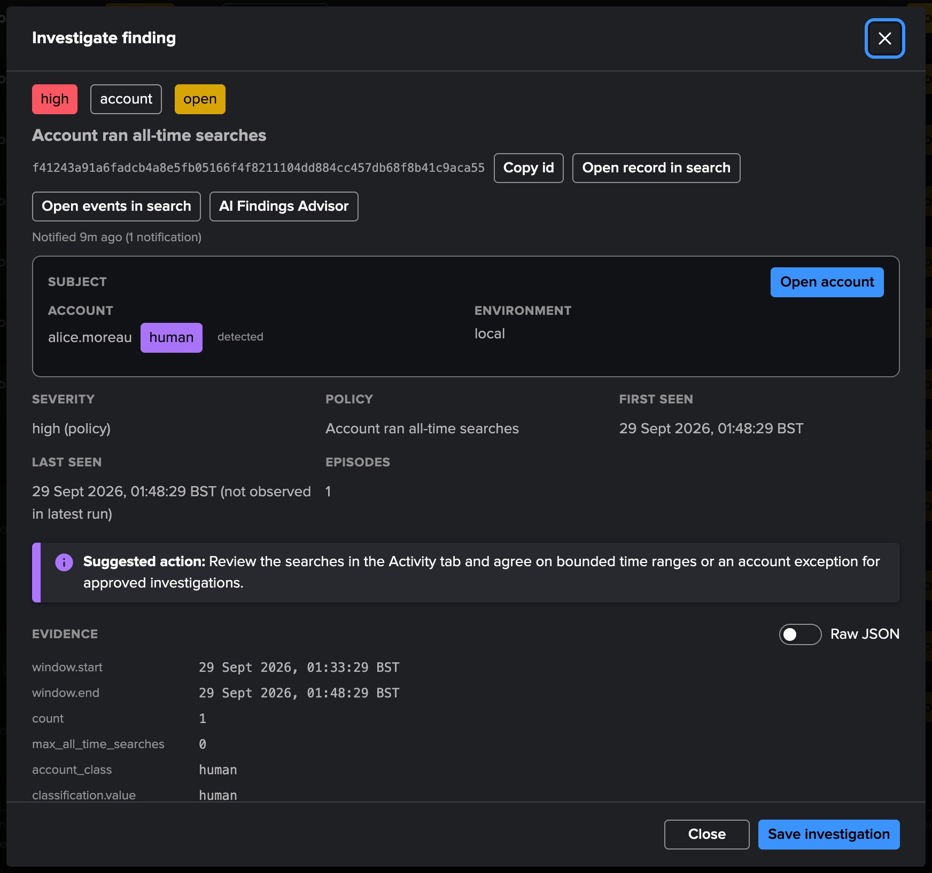
PART 2 · FINDINGS
Investigate a finding — subject, evidence, suggested action, decisions
1
Severity and status chips
1
5
high · open · account — alice.moreau ran an all-time search.
2
The subject
Here an account, its class and where it comes from (human · detected), its environment; for a schedule: the saved search, its app, its owner.
2
3
The evidence
3
The policy window, the all-time searches observed in it and the threshold in force (max_all_time_searches 0); for a schedule, the dispatch bounds read.
4
Suggested action
4
Advisory only: UAM never edits nor dispatches the observed searches.
5
Open events · record · owner account
6
Every indexed transition, the current KV record, and the deep-dive of the owner.
6
Assign, investigate, resolve, dismiss
Each decision with who, when and a note; a resolved finding reopens if the condition returns.
TrackMe for Splunk · Hands-on: User Activity Monitoring
docs.trackme-solutions.com
Notes:
We open the high finding on alice.moreau: an account that ran an all-time search. The Investigate view is the whole case: what the subject is, what was observed, what to do about it, and the links to the events and the owner. We assign it to tom.hendricks, who administers the platform, and mark it investigating with a note. Two decisions close a finding: Resolve says the investigation concluded — the policy reopens it if the condition is still there; Dismiss says it is accepted, permanently or for a duration.

Slide 16
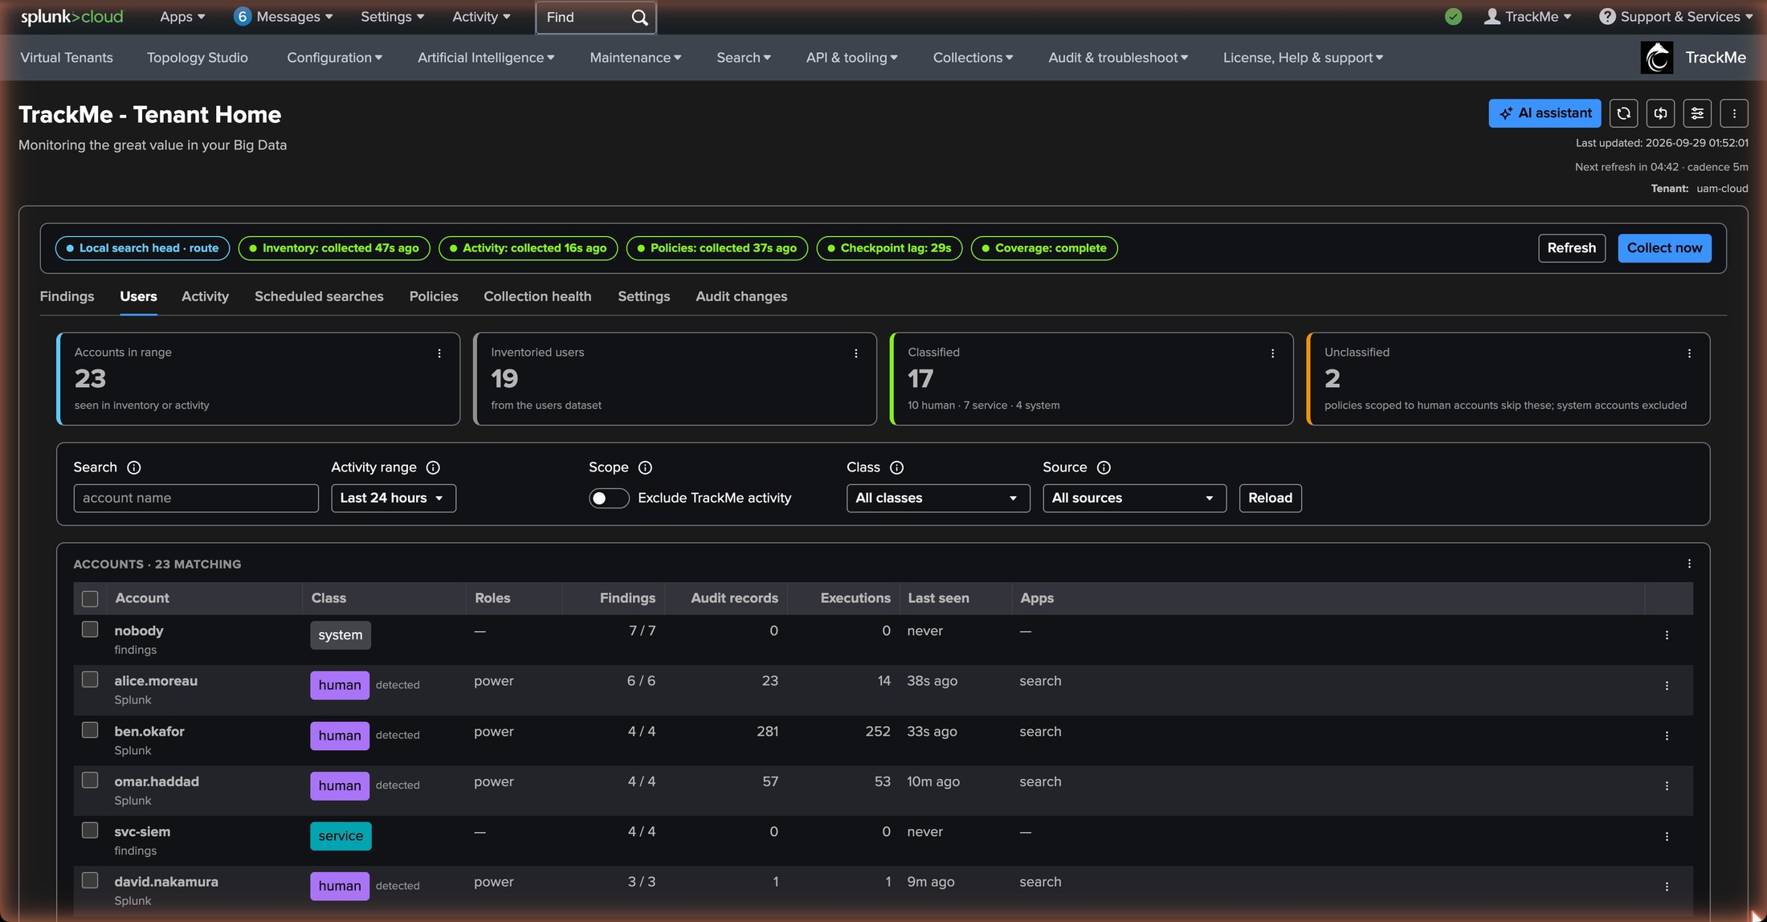
PART 2 · ACCOUNTS
The Users tab — every account seen, with its class and its weight
1
Tiles
1
Accounts, inventoried users, classified and unclassified.
2
human · detected
alice.moreau, ben.okafor, tom.hendricks: a Splunk Web search or a browser login. One interactive signal is enough.
2
service · detected
5
6
3
svc-siem-collector, svc-soar-actions: seven distinct days of automation only, or the svc-* rule on day one.
3
4
system
4
nobody, splunk-system-user, admin by default; svc-trackme and the administrators by our decision.
5
Findings and evidence counts
Findings, audit records and executions, last activity, apps — per account.
6
Class chip actions
The row menu classifies an account in place: svc-bi-exporter → service, before it earns its seven days.
TrackMe for Splunk · Hands-on: User Activity Monitoring
docs.trackme-solutions.com
Notes:
The Users tab is the account-centric view. Most of the classification happened without us: the people were detected from Splunk Web, and one wildcard rule, svc-* to service, classified the service accounts before they earn their seven days of automation-only activity. One decision was ours: svc-trackme, the owner of the tenant, classified system together with the administrators so that the platform's own workload never appears in a finding.

Slide 17
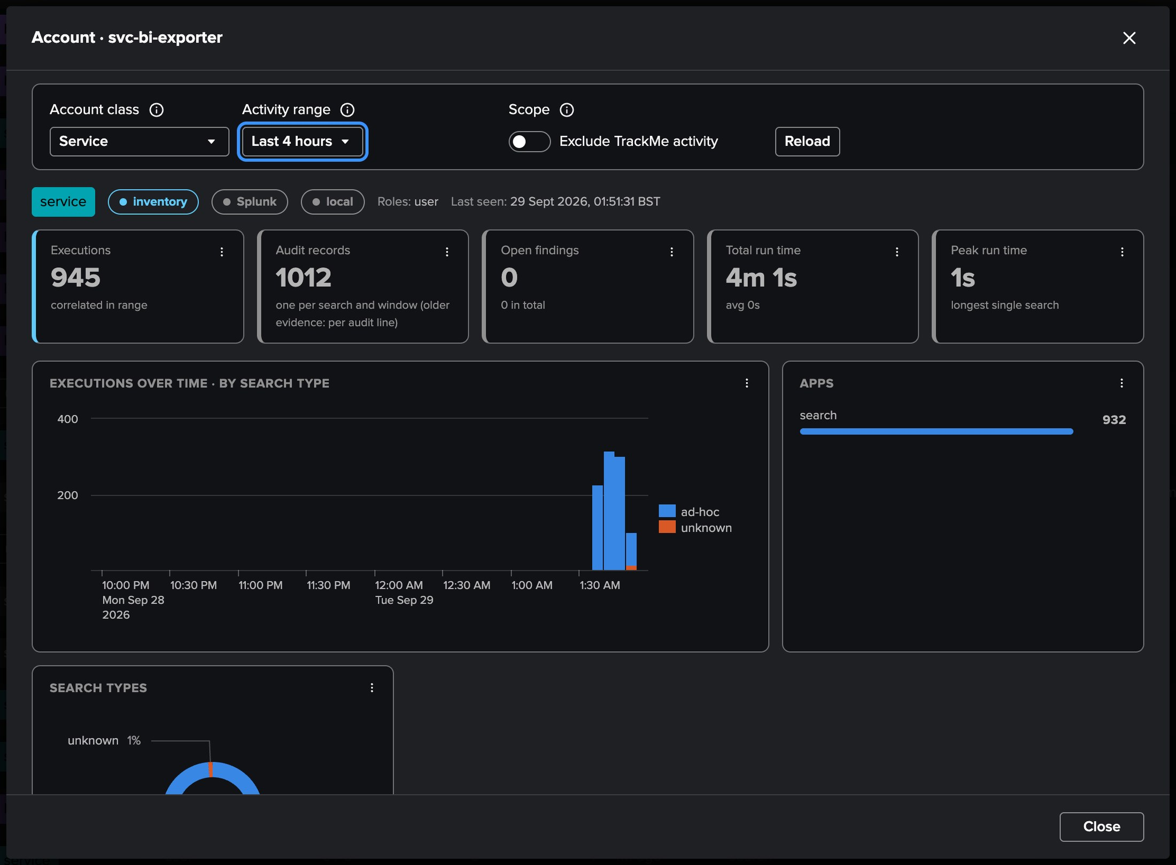
PART 2 · ACCOUNTS
One account — its activity, its resources, its findings
1
Identity
svc-bi-exporter — service by the svc-* rule; its roles, its apps, its tier.
1
5
2
Activity
Executions over time by search type: API dispatches only, no Splunk Web — the profile of an export job.
2
3
Resources
CPU timeline by search type, indexer share, peak memory, and the twenty most expensive searches.
3
4
Findings
Every finding where this account is the subject or the owner; the resource policies judge it against the capacity-derived allowance.
4
5
Open in Search
The rollup SPL of each panel, for the analyst who wants the raw view.
TrackMe for Splunk · Hands-on: User Activity Monitoring
docs.trackme-solutions.com
Notes:
The account deep-dive fans its searches out concurrently with a bound, so a heavy account answers with what finished. This one is the BI export job: API dispatches only, in batches, with the CPU profile of an export. Because the svc-* rule classified it as a service, the resource policies judge it against the capacity-derived allowance; the deep-dive lists its most expensive searches, which is what the owner of the job needs.

Slide 18
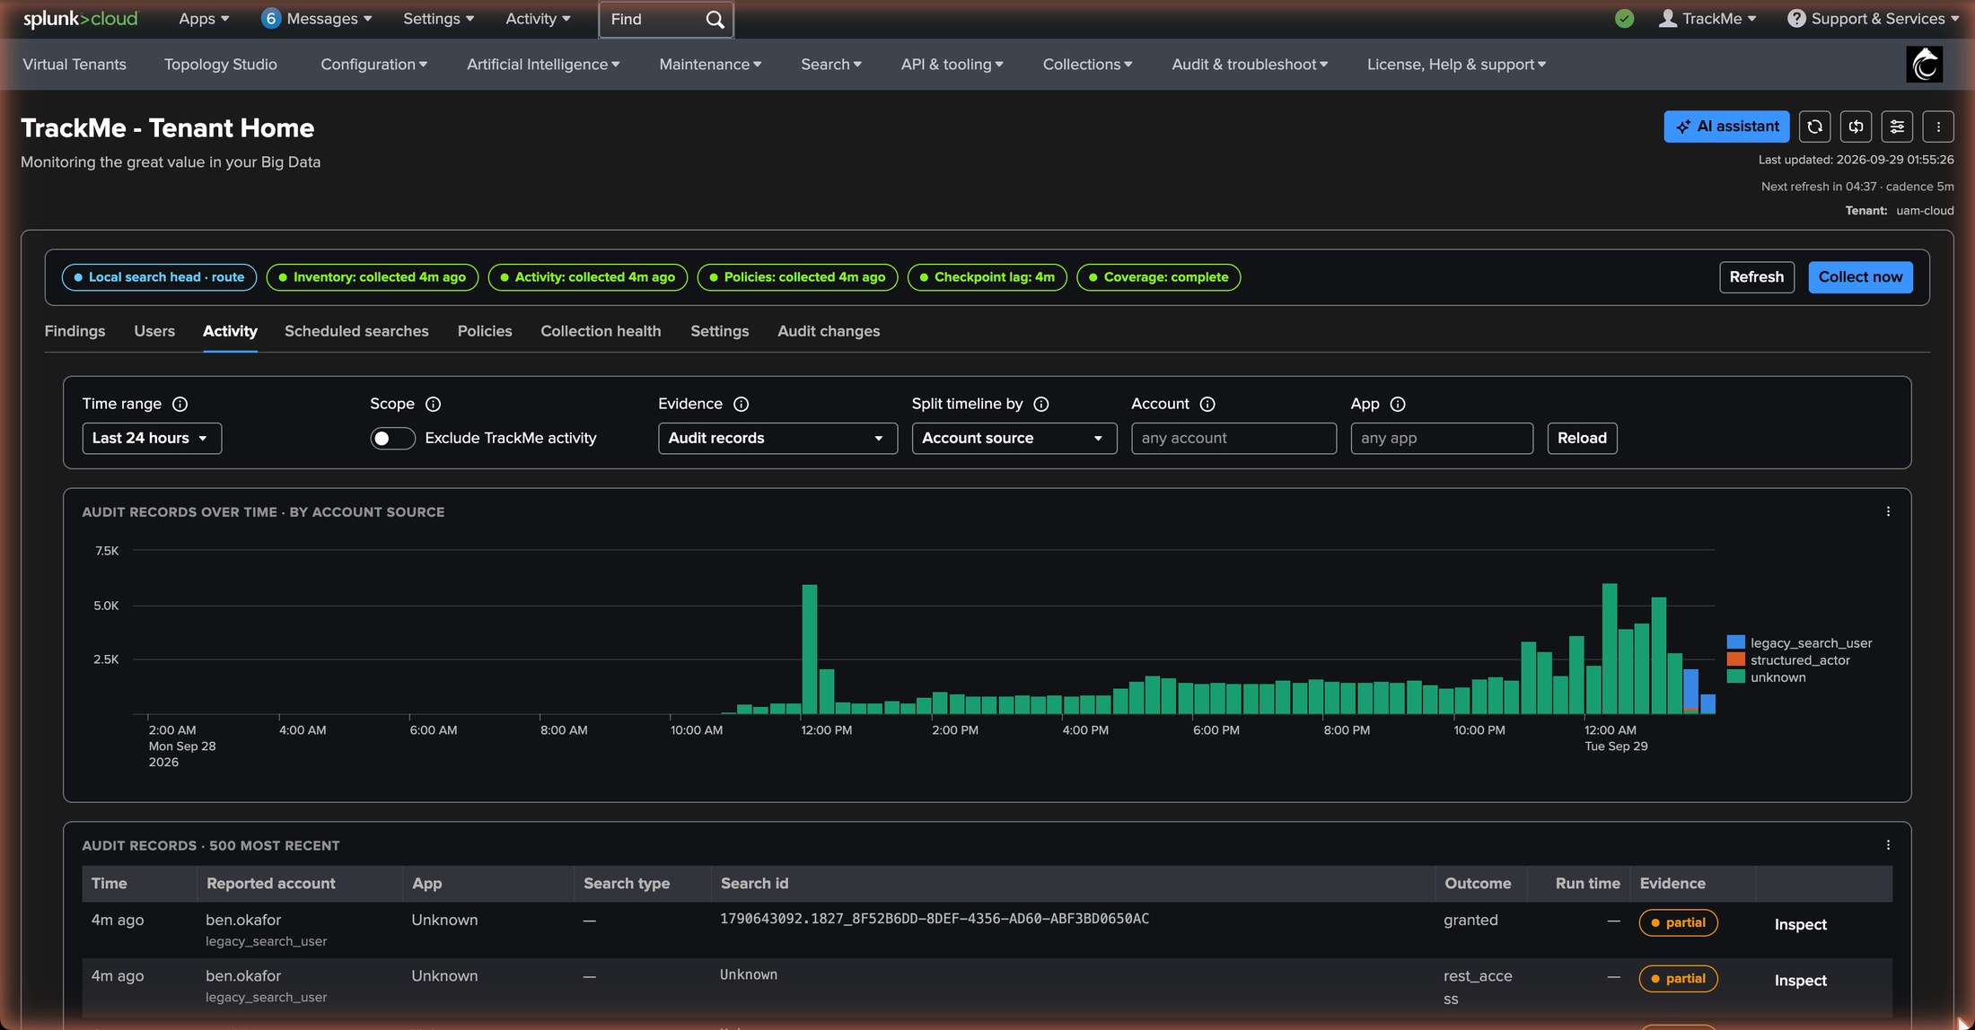
PART 2 · EVIDENCE
The Activity tab — the audit records, one per search and window
1
Records over time
The audit records by account source: the UI, the REST API, the scheduler.
1
2
2
By account
Who generates the records: the connectors dominate by count, the analysts by variety.
3
The records table
3
4
Account, app, search id, type, status, run time, events and results, the time range searched.
4
Evidence pills
One trackme:uam:observation per search and window; the REST access of an account summarised per batch.
5
5
Search lifecycle
Dispatch, run and completion correlated on the search id, with the resource record of the introspection.
TrackMe for Splunk · Hands-on: User Activity Monitoring
docs.trackme-solutions.com
Notes:
The Activity tab is the raw evidence: what the audit trail said, compacted. One record per search and window rather than one line per audit event; the REST access of an account summarised per batch rather than hundreds of lines. This is the material every policy is evaluated on, and what an analyst opens when a finding needs a second look.

Slide 19
PART 2 · CLASSIFICATION
How an account gets its class — and in which order
human · detected
service · detected
rules and manual classes
system
A search from Splunk Web (the UI:* provenance) or a browser login. One interactive signal is enough, and the class is sticky.
Seven distinct UTC days of automation-only activity — rest:jobs, the scheduler — and nothing a person does. One Splunk Web search withdraws it.
Ordered exact or wildcard rules (svc-* → service) previewed on the known accounts; a manual class from the row menu overrides everything.
nobody, splunk-system-user, admin by default. Add the tenant owner and the administrators: the platform's own workload never appears in a finding.
Precedence
manual class → system defaults → first matching rule → human detection → service detection
Two limits of the beta
What changes next
The automation scan reads the legacy key=value _audit format — a JSON-only _audit gives no automatic service detection — and the seven days must lie inside the audit retention. Both are stated in the Beta notice; a rule or a manual class covers the gap.
Once the owners are classified, the next policies run raises the personal_schedule findings — at severity low, by design: hygiene, not incidents.
TrackMe for Splunk · Hands-on: User Activity Monitoring
docs.trackme-solutions.com
Notes:
The classification is what makes the policies meaningful: the audit policies evaluate human accounts by default, and a service account is never blamed for a personal schedule. Precedence is always the same: a manual class first, then the system defaults, then the first matching rule, then the human detection, then the service detection. Two beta limits: the automation scan reads the legacy key=value audit format, and the seven days must lie inside the audit retention.

Slide 20
02
PART 3 · TUNE
The policy catalogue and the settings
Eleven policies in three families, six on by default. Severity, thresholds, exclusions and scope per policy; the insight that explains an evaluation; the classification rules and the collection limits.
TrackMe for Splunk · Hands-on: User Activity Monitoring
Notes:
Part three is tuning. The catalogue ships with defaults that fit a busy cluster, so tuning is a few decisions: which severity, which exclusions, which scope. The policy insight is how you check that a change did what you meant.

Slide 21
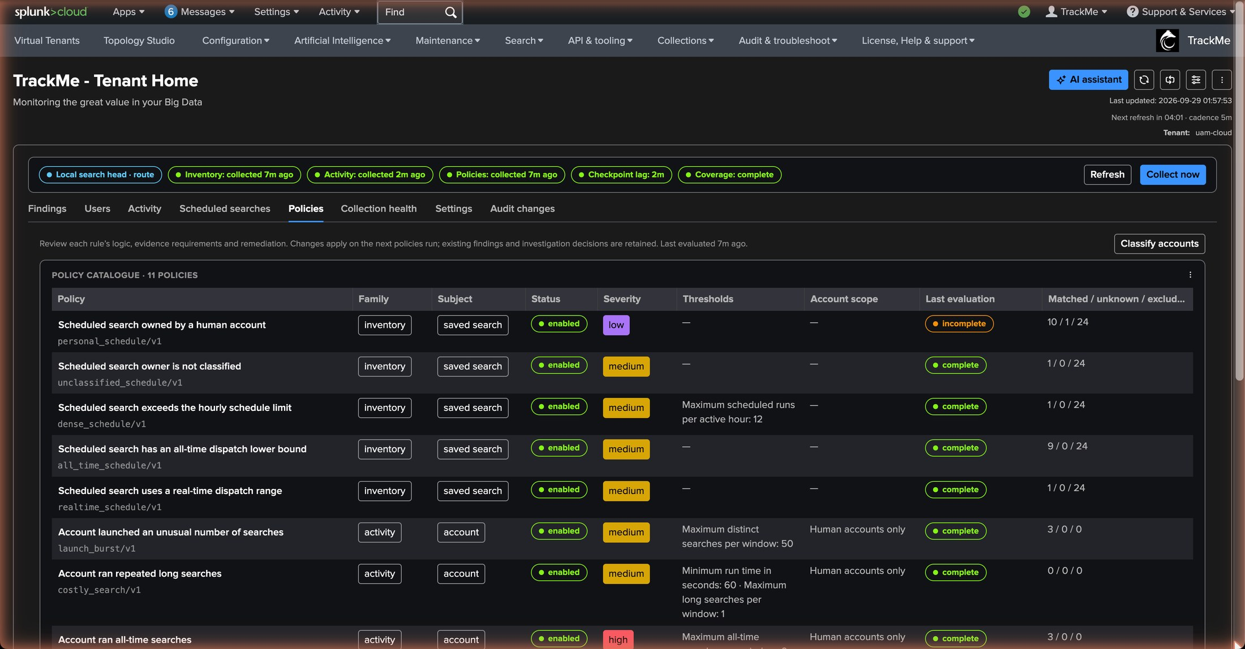
PART 3 · POLICIES
The Policies tab — the catalogue with its defaults and its counters
1
The catalogue
Eleven policies in three families — inventory, activity, resources — one row each.
2
Enabled, opt-in, preview
1
2
3
4
5
Six on by default; four opt-in; the daily baseline deviation in preview mode.
3
Severity
all_time_search is high by default: an all-time search is the one thing that should not happen. all_time_schedule stays medium.
4
Thresholds in force
Compared strictly; the resource policies derive theirs from the measured capacity (auto-thresholds).
6
5
Last evaluation
Matched, excluded, not applicable, unknown — the counters of the last run, and the entry to the insight.
6
Edit and preview
The modal edits one policy and previews the draft against the current inventory before saving.
TrackMe for Splunk · Hands-on: User Activity Monitoring
docs.trackme-solutions.com
Notes:
The Policies tab is the catalogue. Each row shows the enablement, the severity, the thresholds in force, the exclusions and the counters of the last evaluation. What we changed here: we switched on the four opt-in policies with thresholds that fit a small platform — launch_burst at 50 distinct searches, costly_search at 60 seconds — and left the defaults otherwise. The trackme and Splunk_SA_CIM apps are excluded from every policy by default.

Slide 22
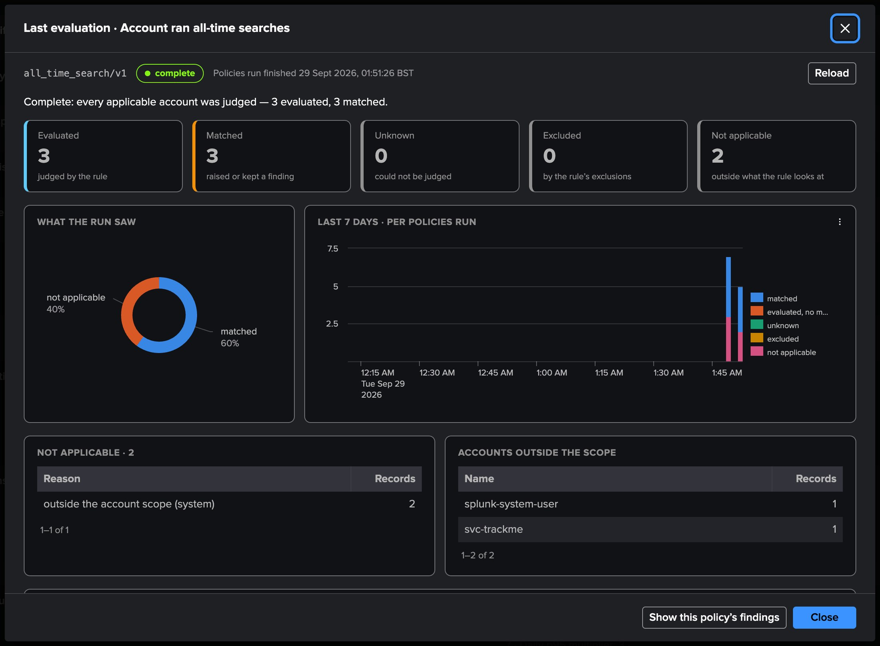
PART 3 · POLICIES
The policy insight — why an evaluation matched what it matched
1
The verdict
all_time_search, complete: every applicable account was judged — 3 evaluated, 3 matched, 2 outside the scope.
1
2
Matched subjects
The accounts behind the findings, with the evidence that matched.
2
3
Not applicable and excluded
The system accounts — the Splunk context identity, the tenant owner — the policy never judges, listed with the reason.
3
4
4
The unknowns
Accounts without a class, classified in place from the insight.
5
Seven-day history
5
The counters run after run: proof that every classified person is judged, every run.
TrackMe for Splunk · Hands-on: User Activity Monitoring
docs.trackme-solutions.com
Notes:
The policy insight opens from the Last evaluation cell. It explains one evaluation: who was in the population, why records were unknown, excluded or not applicable, which accounts sit behind the unknowns, and the seven-day history of the counters. It is how we checked that the system accounts — the tenant owner, the Splunk context identities — sit outside the scope and can never raise a finding.

Slide 23
PART 3 · THE CATALOGUE
Eleven policies, three families — six on by default
INVENTORY · the schedules
ACTIVITY · the audit records
RESOURCES · the introspection
personal_schedule
on · low
all_time_search
on · high
resource_consumption
on · medium
A scheduled search owned by a human account.
An account ran an all-time search. High by default: more than zero is a finding.
An account's CPU seconds over the window against its allowance — 10 % of the search CPU capacity per fifteen minutes.
all_time_schedule
on · medium
A schedule dispatched with no lower time bound.
launch_burst
opt-in
More than N searches launched by an account in a window.
resource_intensity
on · medium
realtime_schedule
on · medium
The count of individually heavy searches — 2 % of the capacity, or 10 % of the smallest host's memory.
A real-time schedule left running.
costly_search
opt-in
unclassified_schedule
opt-in
An individual search above a cost threshold.
resource_deviation
preview
A schedule whose owner has no class yet.
Daily baseline deviation: records what it would raise after seven fully covered days.
dense_schedule
opt-in
A schedule denser than the threshold.
Every threshold is compared strictly; every policy has its own exact exclusions; the trackme and Splunk_SA_CIM apps are excluded everywhere by default. A stored configuration keeps its values across upgrades.
TrackMe for Splunk · Hands-on: User Activity Monitoring
docs.trackme-solutions.com
Notes:
The catalogue in one view. Inventory policies read the schedules; activity policies read the audit records of the trailing window; resource policies read the introspection against budgets derived from the measured capacity. Six are on by default, four are opt-in because their thresholds depend on the platform, and the daily baseline deviation stays in preview mode until seven fully covered days exist.

Slide 24
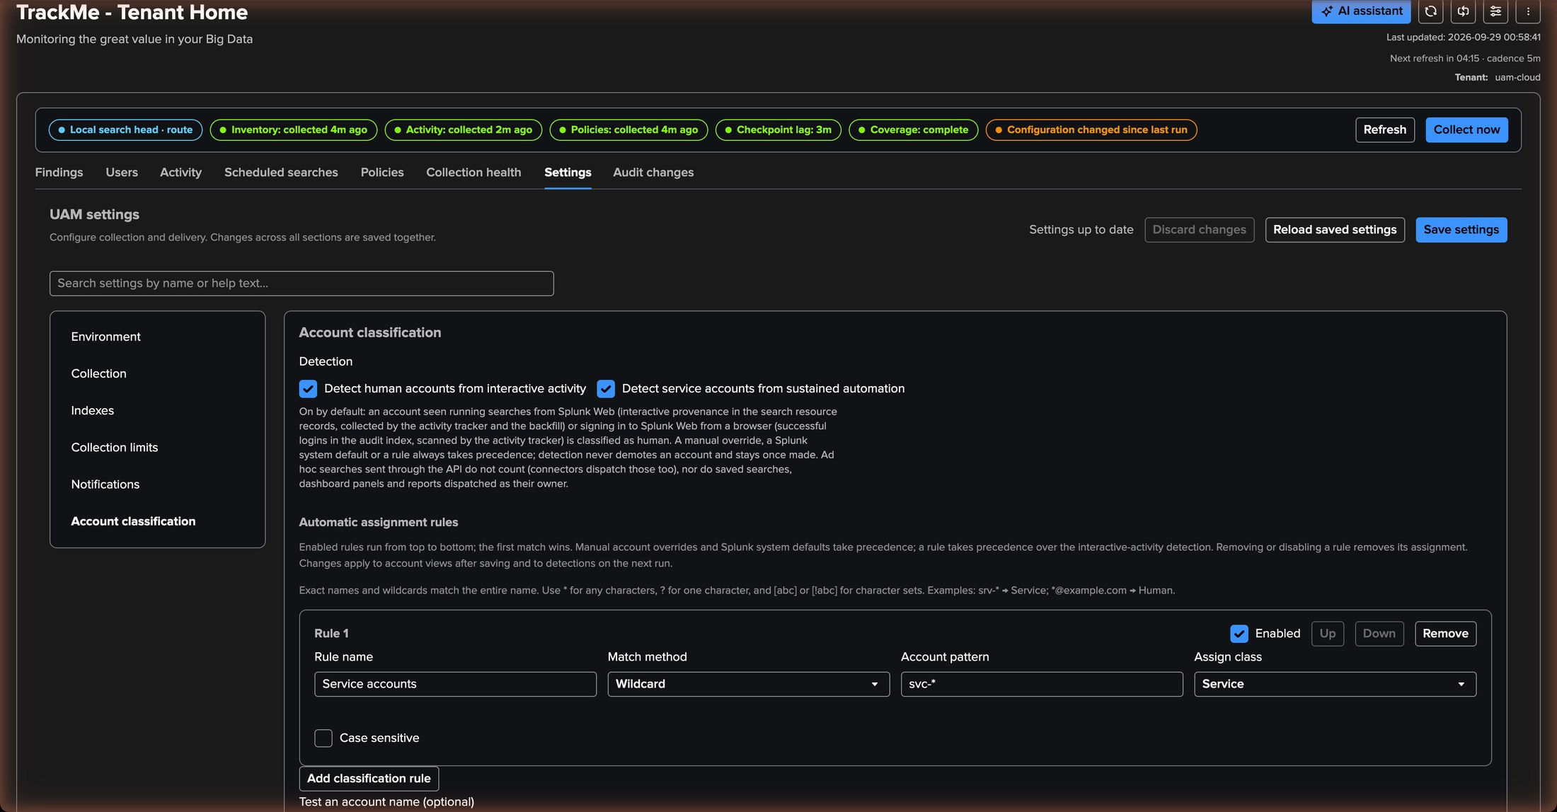
PART 3 · SETTINGS
Account classification — manual classes, rules, detection switches
1
Manual classes
Every class set from a row menu, with who and when — svc-trackme and the administrators as system.
1
2
Rules
Ordered exact or wildcard rules: svc-* → service. Previewed on the known accounts before saving.
2
3
3
Detections
The human and service detections as they stand, with the signal that decided each one.
4
4
Detection switches
Turn a detection off if a platform convention makes it wrong — a shared browser account, for instance.
TrackMe for Splunk · Hands-on: User Activity Monitoring
docs.trackme-solutions.com
Notes:
Settings, Account classification. Three layers you control and two you observe: the manual classes and the rules are yours; the human and service detections are UAM's, and you can switch either off. The preview shows the effect of a rule on the known accounts before it is saved — the way to check that svc-* does not catch something it should not.

Slide 25
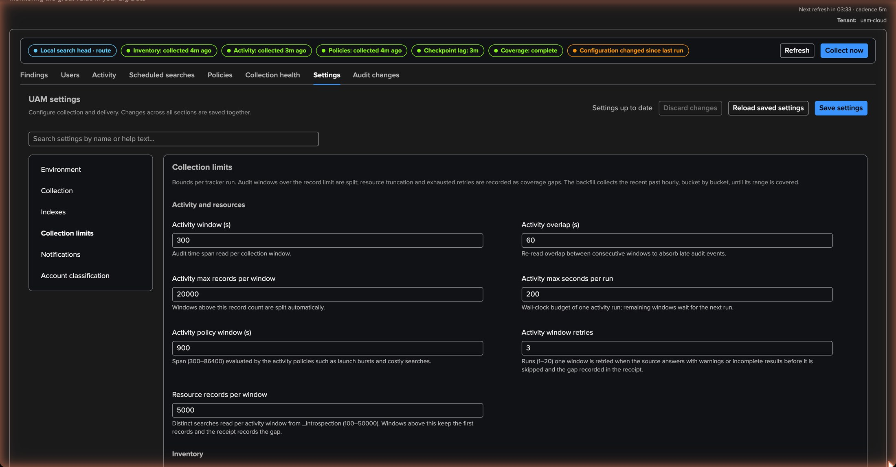
PART 3 · SETTINGS
Collection limits — every budget is a tunable, not a cap
1
Activity budgets
Windows and records per run: the audit trail five minutes at a time, a window split when it overflows.
1
2
Resources and inventory
2
The introspection window, the inventory cadences and the listing window — one full listing a day, off-peak.
3
Findings and backfill
3
The findings collection cap (50,000 by default), the backfill slot duration and bucket size.
4
Store SPL search — off
4
5
The SPL adds about a third to a record and can carry literals and secrets. Off by default; on when the analysts need the text in the evidence.
5
Validated ranges
Every budget has a range; the defaults fit a busy cluster.
TrackMe for Splunk · Hands-on: User Activity Monitoring
docs.trackme-solutions.com
Notes:
Collection limits is where the cost of the tenant is decided. Every budget — activity windows and records, resources, inventory cadences, findings, backfill — is a tunable with a validated range, not a product cap. The one switch worth a conscious decision is Store SPL search: off by default because the search text adds about a third to each record and can carry literals and secrets; turn it on if your analysts want the SPL inside the evidence.

Slide 26
03
PART 4 · OPERATE
Notifications, collection health, the inventory
State-aware emails on the transitions of the findings; the Collection health tab, the recovery of a killed run and the Guardian check; the Scheduled searches tab as the living inventory of the tier.
TrackMe for Splunk · Hands-on: User Activity Monitoring
Notes:
Part four is operating the tenant day to day. Notifications are one tenant-level setting, not one alert per policy. Collection health tells you the trackers are on time, and the Guardian tells you on the Virtual Tenants page when they are not.

Slide 27
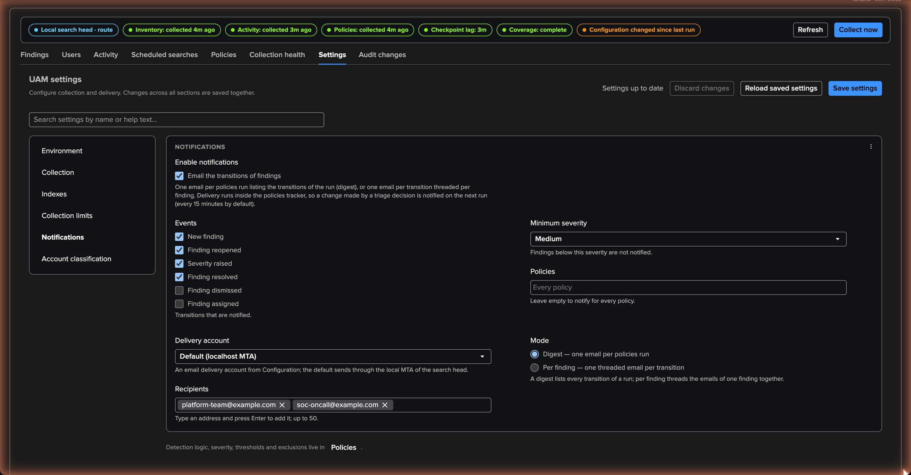
PART 4 · NOTIFICATIONS
Notifications — the transitions of the findings, as a digest or as threads
1
Events
new, reopened, escalated and resolved — the defaults; dismissed and assigned stay off.
1
2
Minimum severity — medium
2
The low personal-schedule findings stay out of the mailbox.
3
3
Policies and recipients
Every policy, two recipients — the platform owners.
4
Delivery account
4
An email delivery account of TrackMe; delivery is fail-open and retried until the transitions expire.
5
5
Digest or per-finding
Digest: one email per policies run that produced a transition. Per-finding: one email per transition, threaded per finding.
TrackMe for Splunk · Hands-on: User Activity Monitoring
docs.trackme-solutions.com
Notes:
UAM notifies on the transitions of the findings: one tenant-level setting, no per-policy alert. In digest mode every policies run that produced a transition sends one email listing them, grouped by event then severity, each with a deep link into the Investigate view. The per-finding mode threads the emails per finding — opened, escalated, assigned, resolved read as one conversation — the right choice for a small backlog with named owners.

Slide 28
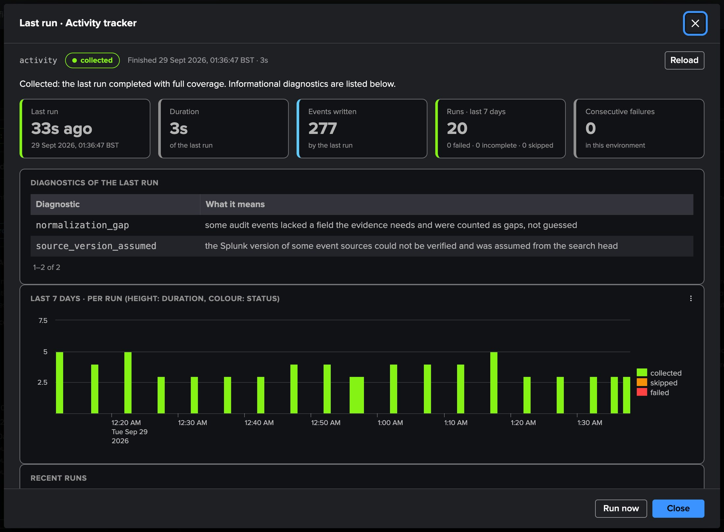
PART 4 · COLLECTION HEALTH
Collection health and recovery — always explainable, self-healing
1
Tracker run view
Every tracker with its last run explained and its seven-day history; the measured capacity; the backfill with its edges and controls.
1
2
4
2
Receipts
What each run read and wrote. A run that dies is replayed, never skipped; a degraded source is retried a bounded number of times, then recorded as a gap.
3
Diagnostics
3
The reasons of a slow or partial run, in the page rather than in a log file.
4
Recover stopped run
A run killed mid-way leaves a lock; a lock older than five minutes whose job has stopped is recovered at the next run, or on demand.
5
5
Guardian — uam_collection_health
A stale or failing tracker, a stalled checkpoint, an overdue listing, a stopped backfill or a failed delivery, surfaced on the Virtual Tenants page. Clears itself.
TrackMe for Splunk · Hands-on: User Activity Monitoring
docs.trackme-solutions.com
Notes:
Operating the tenant is mostly reading this tab. Every run leaves a receipt, every problem has a diagnostic, and the two failure modes that matter — a killed run and a stalled checkpoint — recover on their own. The Configuration Guardian check uam_collection_health, tenant scope, warning, surfaces anything that stays wrong on the Virtual Tenants page and in the Guardian, with the problems in its metadata, and clears itself once they are gone.

Slide 29
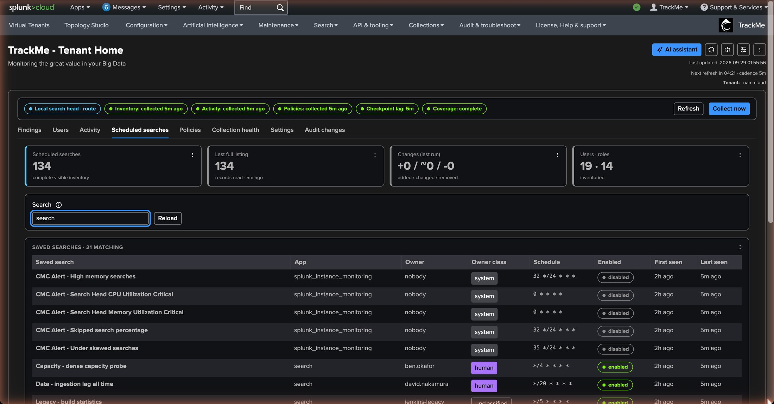
PART 4 · INVENTORY
The Scheduled searches tab — the inventory of the tier, with its owners
1
134 schedules
Every scheduled search of the tier, read by delta with one full listing a day.
1
2
Owner and owner class
Who owns it and whether that is a person, a service or the platform — the inventory policies read this column.
2
3
4
3
Schedule and dispatch
The cron expression, the enablement, the earliest and latest time of the dispatch.
4
App and tier
5
Where it lives; the excluded apps are still listed, they are just not evaluated.
5
Every change recorded
Who created a schedule, when it changed, when it disappeared — trackme:uam:inventory events.
TrackMe for Splunk · Hands-on: User Activity Monitoring
docs.trackme-solutions.com
Notes:
The Scheduled searches tab is the living inventory of the tier. It is also the answer to the questions that come before any policy: how many schedules do we have, who owns them, which ones are dense, which ones are all time. Every change is recorded, so a schedule that appears on a Friday evening under a personal account is a finding by Monday.

Slide 30
AT SCALE
Cost and scale — compact evidence, bounded budgets, a stated Beta
1 record
Compact
Bounded
Licence
per search and window — not one line per audit event; the REST access of an account summarised per batch.
audit records folded per search, REST access summarised per account and batch, one receipt per run — evidence you can afford to keep.
five-minute audit windows from a durable checkpoint, introspection window by window, one full listing a day, backfill under an hour per slot.
the trackme:uam:* evidence counts against the Splunk licence like every TrackMe summary event; Store SPL search off by default.
Beta statement
Not in the beta
A complete, supported tenant type. The service detection needs the legacy key=value _audit format and at least seven days of audit retention. The schema of the evidence may move between beta releases; feedback is welcome.
Concurrent-use and off-hours policies — "N searches running at once", "a human searching at 3 a.m." — need qualified start / end semantics of the search lifecycle. Notifications v2 — delivery to the assignee's own address, a webhook channel. Cross-environment identity linking. Automatic remediation: UAM never edits, disables or dispatches an observed search.
Reads: tstats on indexed dimensions — O(accounts) rather than O(events). State: three KV collections per tenant; the findings collection is capped and accelerated on its time fields.
TrackMe for Splunk · Hands-on: User Activity Monitoring
docs.trackme-solutions.com
Notes:
The cost of a UAM tenant is the evidence it indexes, and it is designed to be small: one record per search and window, the REST access of an account summarised per batch, one receipt per run. The evidence counts against the Splunk licence like every TrackMe summary event, and the SPL of the searches is only indexed when you switch it on. Collection is bounded by validated budgets, reads run through tstats on indexed dimensions, and the state is three KV collections per tenant.

Slide 31
RECAP
Where we are
In four parts
Created
Classified
Tuned
Operated
a UAM tenant in six screens — one local tier, a 30-day backfill, a dedicated service-account owner — with five trackers scheduled at once
twenty accounts: people detected from Splunk Web, service accounts by one wildcard rule, the platform's own accounts as system
the catalogue: the four opt-in policies switched on with thresholds fitting a small platform, a svc-* rule for the service accounts, the rest left at its defaults
with digest notifications above medium, the Collection health tab, self-recovering runs and the uam_collection_health Guardian check
What made it work
Backfill first
A catalogue, not a wizard
Evidence you can afford to keep
Thirty days of history make the people and the services known on day one — instead of a week later.
Eleven policies with defaults that fit a busy cluster; tuning is severity, scope and exclusions, checked in the insight.
One record per search and window, budgets you can read, and a Guardian that says when collection stalls.
TrackMe for Splunk · Hands-on: User Activity Monitoring
docs.trackme-solutions.com
Notes:
Recap. One tenant, four parts. We created it in six screens, watched the trackers fill it on day one, read the findings and the accounts and let the classification settle, then tuned a few policies and set up the notifications. What made it work: the backfill that made the classification usable on day one, a catalogue with defaults that fit a busy cluster, and evidence compact enough to keep.

