Slide 1

PRODUCT INTRODUCTION
TrackMe for Splunk
The key concepts behind the product — what TrackMe is, what it tracks, how it decides, and how it tells you.
Knowledge transfer session · TrackMe 2.4.18
Notes:
Welcome. This deck is a 20–25 minute introduction that sets the vocabulary and the mental model of TrackMe 2.4.18. Everything here maps 1:1 to the Product Guide on docs.trackme-solutions.com, so you can go back to it after the session.

Slide 2
THE PROBLEM
In a large Splunk environment, data silently breaks.
A forwarder stops
A sourcetype arrives late
A field stops parsing
A scheduled search skips
The index keeps ingesting from other hosts. The dead machine is invisible.
Detections run on a window that no longer contains the events they need.
Correlation searches quietly return less — or nothing. Nobody notices.
Summary indexes and reports drift. Scheduler debt accumulates over years.
Splunk itself will not tell you.
The searches simply return less, or nothing, and nobody notices until a detection misses or a dashboard goes blank. Modern Splunk estates are not tidy lists of feeds: thousands of indexes, tens of thousands of sourcetypes, hundreds of thousands of hosts. You cannot watch — or even classify — all of that by hand.
TrackMe for Splunk · Product introduction
docs.trackme-solutions.com
Notes:
Most teams come to TrackMe because of one specific pain: a critical feed died hours ago and nobody noticed; a host went silent while the index still looked busy; a field extraction drifted and a detection stopped firing; scheduled searches started skipping. Four different pains, one root cause: Splunk does not monitor its own data. The question TrackMe answers is: how do you stay confident your data is healthy across an estate this big, without manually defining 'healthy' for every single thing in it?

Slide 3
DEFINITION
What is TrackMe?
TrackMe is a Splunk app that discovers, maintains, and monitors the availability and quality of your data — across one Splunk deployment or many, at any scale.
Think of it as a control plane on top of Splunk: it continuously watches raw index activity and turns it into something you can operate on — per-entity health states, SLOs, stateful alerts and, optionally, LLM-generated investigations.
The questions classic Splunk monitoring leaves open
Is my data still flowing?
Is my data still good?
Are my searches still healthy?
Who do I tell, and how urgently?
Every data source, host and metric feed is tracked for delay, latency and volume — and licensed volume per index.
Field parsing quality and CIM compliance are monitored, not assumed.
Scheduled-search execution, skipping and errors are first-class entities.
Priority, SLA and impact scoring decide what is worth an alert and what is noise.
TrackMe for Splunk · Product introduction
docs.trackme-solutions.com
Notes:
One sentence: TrackMe discovers, maintains and monitors the availability and quality of your data. It is a control plane on top of Splunk — it runs entirely inside Splunk (on-prem, Splunk Cloud or hybrid), no outbound SaaS. It answers four questions classic Splunk monitoring leaves open: is the data flowing (including the licensed volume of every index), is it good, are the searches healthy, and who do I tell. Who it is for: Splunk administrators proving the platform is healthy, SOC and detection engineers who depend on complete well-parsed data, service owners reporting SLA attainment, and MSPs operating many isolated customer environments from one place.

Slide 4
CORE CONCEPTS
The mental model in one sentence
TrackMe tracks entities (grouped into components, isolated inside virtual tenants); on every cycle a decision maker gives each entity a state and a score, policies classify it, and alerting turns critical states into notifications.
1
Entity
2
Component
3
Virtual Tenant
The unit TrackMe monitors: one data source, host, metric feed, scheduled search or custom object. Has an identity, a state, a score and metadata.
The kind of entity — DSM, DHM, MHM, VOL, FLX, FQM or WLK. Decides what is measured and what “healthy” means.
An isolated monitoring domain: one customer, environment or team. Own entities, config, roles — the unit of isolation and scale.
4
Decision maker
5
Policy
6
Alerting
The shared engine that, each cycle, reads an entity’s metrics and computes its state and score — one consistent answer everywhere.
Assigns priority, tags and SLA automatically by rule (regex, lookup or SPL). Policies suggest; a manual override always wins.
Stateful: one incident record per problem — opened, updated, closed — delivered by email, notable event, ingest or command.
TrackMe for Splunk · Product introduction
docs.trackme-solutions.com
Notes:
TrackMe has a small, consistent vocabulary — a dozen terms that appear on every page of the guide and in the UI. Everything else in this deck expands one word of this sentence. Key points: there is no global list of entities, every entity lives inside exactly one tenant. The decision maker is the single place where 'is this entity healthy?' is answered, so the answer is consistent across UI, alerts and API.

Slide 5
MONITORING COMPONENTS
Seven components — grouped by the question they answer
Is the data
arriving?
Is the volume
normal?
Is it
well-formed?
Are searches
healthy?
Anything
else?
DSM
VOL
FQM
WLK
FLX
Data Source Monitoring
Volume Outliers
Field Quality Monitoring
Workload Knowledge
Flex Objects
index × sourcetype feeds
licensed volume per index
parsing quality & CIM
scheduled-search health
any SPL → tracked entity
DHM
Is the licensed volume of each index normal? ML outliers on drops and spikes.
Is every field parsed and CIM-compliant? Coverage and success measured per field.
Are searches skipping, erroring or running late? Execution health as first-class entities.
Everything else — you write the SPL; it becomes an entity with custom KPIs and dynamic thresholds.
Data Host Monitoring
host × sourcetype activity
MHM
Metric Host Monitoring
hosts sending metric data
delay · latency · volume
Plus UAM — User Activity Monitoring (Beta): a dedicated tenant type that watches Splunk accounts and their activity; findings from a policy catalogue, no entities.
TrackMe for Splunk · Product introduction
docs.trackme-solutions.com
Notes:
Everything tracked in TrackMe is an entity, and every entity belongs to one of seven components. The three-letter codes appear everywhere — URLs, REST paths, the UI. The short version: DSM, DHM and MHM answer 'is the data arriving?' (they form the Splunk Feeds family and share a delay/latency model); VOL, the seventh component, answers 'is the volume normal?' — one entity per index, the licensed volume read from the license usage log, ML outliers on drops and spikes — and is available in Foundation; FQM answers 'is it well-formed?'; WLK answers 'are my searches healthy?'; and FLX lets you monitor anything else by writing the SPL yourself. FLX, FQM and WLK share a dynamic-thresholds + metrics model. Almost every deployment starts with DSM. UAM — User Activity Monitoring, in Beta — is not an entity component but a dedicated tenant type: no entities, no decision maker; it watches Splunk accounts and their activity and raises findings from a policy catalogue.

Slide 6
MONITORING COMPONENTS
Seven components, one entity model
However different the seven components look, every entity has the same shape and the same lifecycle. Learn one component — you have half-learned them all.
Every entity always has
…and goes through the same lifecycle each cycle
object
its canonical, unique key — what it identifies differs per component
DISCOVER
TRACK
EVALUATE
ALERT / LIFECYCLE
alias
an editable display name
state
green · orange · red · blue
a tracker enumerates units and creates entities
each run refreshes metrics and times
decision maker sets state + score from thresholds
stateful alerting, acknowledgment, purge of inactive entities
score
the impact score the state derives from
thresholds & metrics
anomaly fields and a cache of the latest measurements
Trackers are scheduled searches, usually running every five minutes — the freshness of a delay measurement is only as precise as the tracker cadence. Entities can also be declared before they exist (expected sources / hosts): a declared entity starts red until real data arrives.
metadata
priority, tags, labels, SLA class
TrackMe for Splunk · Product introduction
docs.trackme-solutions.com
Notes:
The shared entity model is what makes TrackMe consistent: same object/alias/state/score shape, same lifecycle. Classification, protection, stateful alerting, scoring and ML outliers are documented once and apply to all seven components. Where they differ: variable delay and lagging classes are DSM/DHM; data sampling, elastic sources and lookup monitoring are DSM only; dynamic time-sliceable thresholds are FLX/FQM; versioning, orphan detection and SVC cost are WLK; the template catalogue and converging trackers are FLX; VOL has one entity per index, fed incrementally from the license usage log, with a state that comes from ML outliers and inactivity.

Slide 7
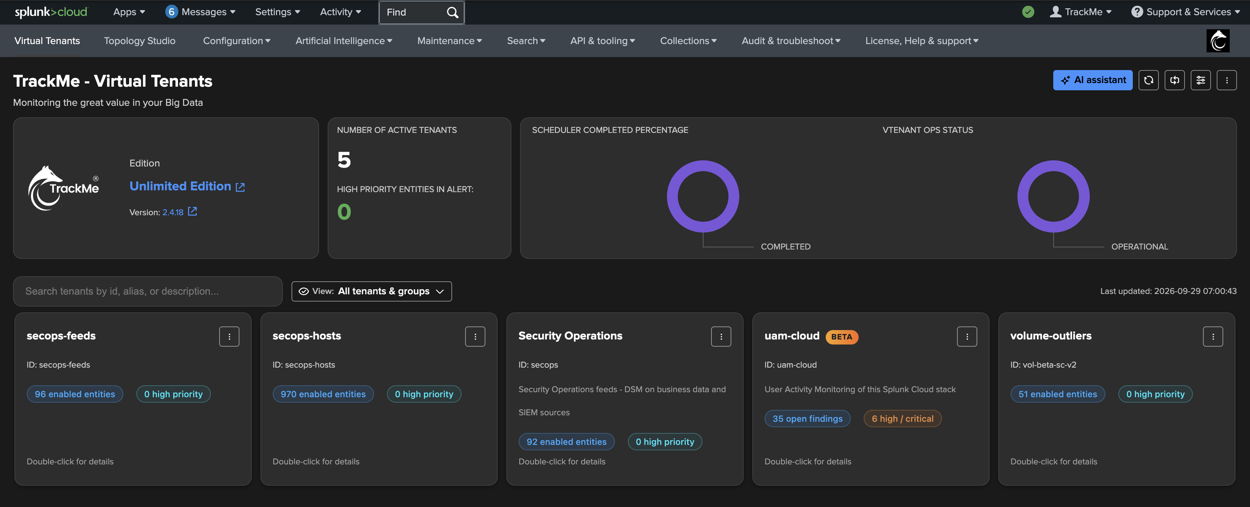
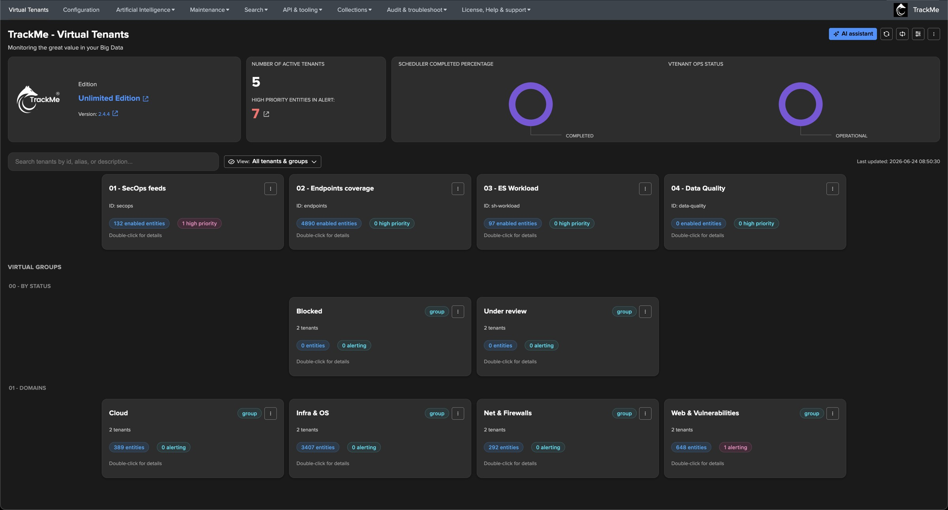
MULTI-TENANCY
Virtual Tenants — the unit of isolation and the unit of scale
A virtual tenant is a self-contained, isolated instance of TrackMe inside your Splunk app. It owns its data, configuration, trackers, access control and — optionally — its own remote Splunk deployment to monitor.
Why tenants exist
Segmentation
by company, country, business unit or team
By technology
firewall, performance and application logs with their own thresholds
The Virtual Tenants page — the entry point of the product
By scope
one tenant per Splunk cluster, index family or search-head tier
Access control
teams own their data spaces without seeing each other’s entities
Virtual Groups aggregate entities from several tenants into one read-only cross-tenant card (NOC view). Remote deployments: a tenant can monitor the local search head or a remote Splunk Enterprise / Cloud over a token-rotated connection with failover — the experience is identical.
TrackMe for Splunk · Product introduction
docs.trackme-solutions.com
Notes:
Manually, a single flat monitoring space does not survive contact with a real Splunk estate. Tenants carve the estate into domains that match how the organisation works. Everything else — entities, policies, thresholds, alerts — is scoped to a tenant; there is no global entity list. A tenant enables one or more components (splk-feeds = DSM/DHM/MHM, splk-vol, splk-wlk, splk-flx, splk-fqm, splk-cim). A UAM tenant (splk-uam, Beta) is a dedicated tenant type: a tenant is either an entity tenant or a UAM tenant. RBAC is per tenant via Splunk roles. Saved Views let a team land on just the tenants relevant to them. Common Phase-2 mistake: mixing hosts (DHM) into the feeds tenant — hosts usually deserve a dedicated tenant.

Slide 8
HOW IT WORKS
How TrackMe works — the monitoring cycle
TrackMe is not a live dashboard that queries Splunk when you open it. Trackers run on a cycle and persist their results; the UI reads the last computed state. This is what lets it scale to thousands of entities and alert without anyone watching a screen.
1
2
3
4
5
6
DISCOVER
MEASURE
DECIDE
CLASSIFY
PROTECT
ALERT
trackers scan the tenant’s indexes and find entities — new (index, sourcetype) pairs, hosts, searches…
each entity’s metrics are refreshed: delay, latency, volume, parsing quality, execution health
the decision maker computes the impact score = Σ (delay, latency, outliers, thresholds…) and the state green / orange / red
policies assign priority, tags and SLA; labels are evaluated
logical groups, disruption grace, maintenance and ack may demote an entity to blue (suppress alerting)
stateful alerting opens / updates / closes alert records and delivers email, notable events, ingest, commands
Steps 3–6 are the heart of the product — the rest of this session is a tour of each step.
TrackMe for Splunk · Product introduction
docs.trackme-solutions.com
Notes:
Each cycle, for every tenant: discover, measure, decide, classify, protect, alert. The deliberate separation between WHAT state (decision maker, step 3) and WHETHER to tell you (protection and alerting, steps 5–6) is why TrackMe is quiet in practice despite tracking so much. Trackers are scheduled searches, typically every 5 minutes.

Slide 9
STEP 3 — HOW STATE IS DECIDED
Entity state and impact score
Healthy
green
Hybrid impact scoring — additive, predictable, explainable
No active anomaly. The vast majority of entities should be green most of the time.
total_score
=
base_score
from the metrics index
Warning
orange
+ impact_score_delay
if the delay threshold is breached
A non-critical anomaly is active — score above zero, below critical. An early signal, not yet paging.
+ impact_score_latency
if the latency threshold is breached
+ impact_score_outliers
from ML outlier detection
+ threshold_scores
sum of breached dynamic thresholds
Critical
red
+ …
every contribution is a configurable weight
The entity has crossed the critical threshold. The alert fires — by design.
The score maps to a colour
Suppressed
blue
= 0
< 100
≥ 100
Protected from alerting — group protection, disruption grace or maintenance — even though an anomaly may be present.
Weights are configurable per tenant and can be overridden per entity — you decide whether a latency breach matters more than a volume drop. Nothing happens without a traceable reason.
TrackMe for Splunk · Product introduction
docs.trackme-solutions.com
Notes:
Every cycle each entity gets one of four colours. The state is derived from a numeric impact score: TrackMe adds up everything currently wrong with an entity into a single total_score. 0 is green, below 100 orange, 100 and above red. Because every contribution is just a number with a configurable weight, you control exactly what makes an entity 'critical'. One major breach trips red immediately; several small breaches accumulate. Blue is not a fifth severity — it is 'I see this, but I am not waking you up'.

Slide 10
STEPS 4 & 5
Classify what matters. Protect against noise.
Classification metadata
Why a red score might not page you
Priority
critical / high / medium / low / pending — how much an entity matters
Logical group protection
N entities judged collectively. If enough members are green, struggling members are demoted to blue — one flaky member of a healthy cluster does not page you.
Tags
free-form string metadata for filtering and grouping
Disruption grace
Labels
a curated, colour-coded catalogue of chips, assignable by rules
A new anomaly is held in blue until it has persisted for a minimum time — transient blips are absorbed, only sustained problems escalate.
SLA class
platinum / gold / silver with associated thresholds
Maintenance mode
The entity, tenant or whole instance is inside a maintenance window.
Policies do it automatically
Acknowledgment
Setting priority or SLA on thousands of entities by hand does not scale. A policy assigns metadata by rule — a regex, a Splunk lookup or an SPL search. Policies suggest; a manual override always wins; removing a policy auto-cleans what it assigned.
Someone already accepted this problem. Sticky until cleared, or unsticky with automatic expiry; revoked if the anomaly reason changes.
TrackMe for Splunk · Product introduction
docs.trackme-solutions.com
Notes:
Step 4 — classification: priority, tags, labels and SLA are the four kinds of metadata attached to entities. Tags and labels are not the same feature: tags are free-form strings, labels come from a managed coloured catalogue. Three policy families exist: priority, tags and SLA. Step 5 — protection: four mechanisms can hold an entity in blue instead of red. This separation between what state and whether to tell you is deliberate.

Slide 11
STEP 6 — HOW YOU GET TOLD
Stateful alerting — one incident per problem
Instead of re-firing every cycle an entity is in trouble, TrackMe keeps one incident record per problem: it opens when the entity first goes into alert, updates while the problem persists, and closes when the entity recovers. Rich, context-aware notifications without the spam.
INCIDENT OPENED
INCIDENT UPDATED
INCIDENT CLOSED
entity turns into an alerting state
new events while still alerting
entity returns to non-alerting
Stateful event → trackme:stateful_alerts
Stateful event → trackme:stateful_alerts
Stateful event → trackme:stateful_alerts
Email · new thread (Message-ID set) + AI report
Email · threaded reply (In-Reply-To) + AI report
Email · closure (In-Reply-To) + AI report
Active command · commands_opened
Active command · commands_updated
Active command · commands_closed
Delivery channels
Email
Notable events
Ingest
Commands
embedded 24-hour charts, threaded, optional AI-written status report
for Enterprise Security or a custom correlation workflow
an event written to a Splunk index
run a saved-search / active command (SOAR, XSOAR, ServiceNow…)
TrackMe for Splunk · Product introduction
docs.trackme-solutions.com
Notes:
Stateful alerting is TrackMe's modern alert path. One incident record per entity, keyed by incident_id, persisted in the KV Store with the embedded chart store. It is driven by TrackMe's state events (trackme:state, trackme:flip, trackme:notable, trackme:sla_breaches). It opens when an entity first turns red (or orange if you opt in), updates each cycle the problem persists, closes on recovery. On those transitions it can deliver an email with embedded charts and optionally an AI-written incident summary, write a notable event, ingest an event and/or run a command.

Slide 12
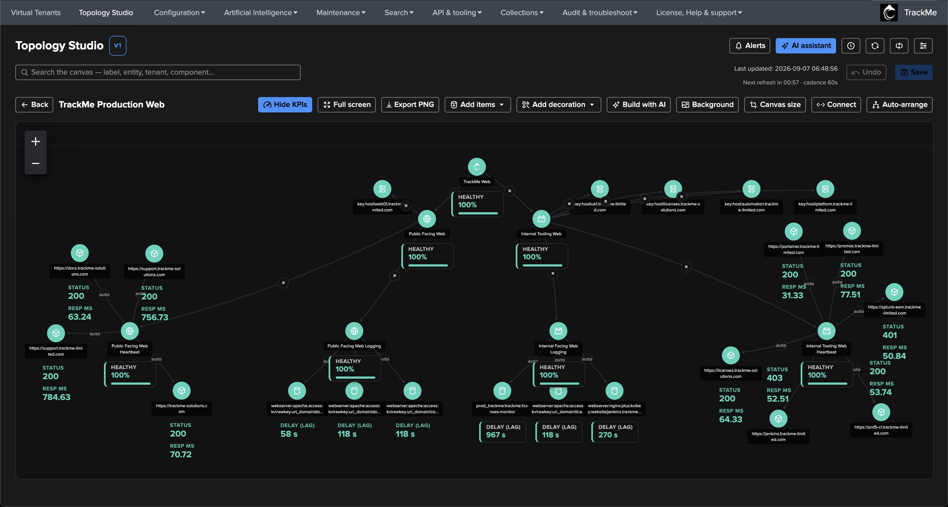
TOPOLOGY STUDIO
Topology Studio — your view of the environment, kept alive
Build live dependency maps from real TrackMe entities — place them, connect them, share them, watch their status update in real time. And because a map you cannot act on is just a picture, any topology can also alert.
Four node types
Entity
one monitored entity, live state colour, optional on-canvas KPI
Aggregate
live roll-up of many entities (scope + filter) — worst state, per-state counts
View
another saved view folded into one health node — a map of maps
Label
free-text annotation for zones, tiers or flows
Built from real entities
Authored by you
Shared under RBAC
Alerting-capable
AI-integrated
Available in every edition — Foundation, Enterprise, Unlimited and trials — including full authoring and Topology Alerts. Complementary to the built-in per-component topology graphs (auto-derived, read-only) and Virtual Groups (cross-tenant counters, no canvas).
TrackMe for Splunk · Product introduction
docs.trackme-solutions.com
Notes:
Topology Studio is the canvas for YOUR view of the environment: a payment flow, a datacenter, an ingestion pipeline, a business service. Every node is a monitored entity (any tenant, any component), a live aggregate, or another saved view rolled up as one node. Views are global objects shared under RBAC with separate read/write permissions, and can be shown full-screen on a wall of screens. Topology Alerts correlate the health of the whole map and notify on transitions, with the rendered topology image embedded in the email. The AI Assistant understands your views and can build them for you. Live status polls on a fixed cadence with a countdown, manual refresh and pause.

Slide 13
ARTIFICIAL INTELLIGENCE
TrackMe Agentic — AI alongside the monitoring cycle
The AI layer helps operators understand and resolve what TrackMe detects, grounding every answer in the live state of the environment and keeping the operator in the loop. Built in four levels — they read best in that order.
Level 1
Level 2
Level 3
Level 4
AI Assistant
AI Advisors & Concierge
AI Agents automation
AI Routines
The conversational front door — a context-aware chat drawer on every entity, page and feature. Understands your environment; can write AI status reports into alert emails.
Six specialists that inspect and, with consent, act: ML models, feed lifecycle, FLX thresholds, field quality, component health, UAM findings — plus the Concierge generalist.
The same advisors running unattended on a nightly schedule, scoped by per-tenant policy, within guardrails you define.
Your own standing instructions in natural language: describe what to watch for, TrackMe evaluates it on your schedule, then notifies or acts under the consent you granted.
Opt-in only
Trust
Auditability & traceability
Completely inert until an administrator configures a provider. No data leaves, no LLM call is made, until you opt in — from air-gapped Ollama to Splunk-hosted LLMs.
Agents never make up entity state: every claim traces to a tool call; outputs are typed; read-only inspect mode is the default.
Runtime guardrails and hard caps enforce the blast radius; every tool call and every write is indexed and prefixed [AI Agent] in the audit trail.
TrackMe for Splunk · Product introduction
docs.trackme-solutions.com
Notes:
TrackMe 2.4.0 made TrackMe Agentic generally available. Four surfaces, all built on the same Splunk Agent SDK runtime, the same provider abstraction (OpenAI, Azure, Anthropic, Gemini, Mistral, Ollama, Custom, Splunk Hosted) and the same audit trail. Compatibility: the Assistant and Concierge run on Python 3.9+, any supported Splunk; Advisors, Agents automation and Routines need Python 3.13 / Splunk 10.2+. The whole layer is opt-in and inert until a provider is configured — important for security and compliance discussions; there is a dedicated compliance, privacy and data-governance page.

Slide 14
ARCHITECTURE
How TrackMe is built — three layers, all inside Splunk
Presentation
A modern React interface — Virtual Tenants, Tenant Home, Topology Studio, dashboards — and the optional AI Assistant.
Deployment facts
Runs inside Splunk
Splunk Enterprise, Splunk Cloud or hybrid. No outbound SaaS — suitable for air-gapped environments.
Control plane
A REST API and a per-tenant KV Store hold all configuration and current state — the single source of truth for the UI, the alerts and the API.
Local or remote
A tenant monitors the local search head or a remote deployment over an authenticated, token-rotated connection with automatic failover.
Data plane
Scheduled searches (trackers) run on a cycle and a shared decision maker computes each entity’s state and score. This is where “is it healthy?” is decided.
Built for scale
Multi-tenant, in production above 100 TB/day. Scale and cadence are tuned per tenant.
Editions
You do not need to know the internals to use TrackMe — but the shape explains why it behaves the way it does: the UI reads state, it does not compute it.
Foundation, Enterprise, Unlimited. A new install starts a 90-day trial; an expired license first switches to read-only while monitoring keeps running.
TrackMe for Splunk · Product introduction
docs.trackme-solutions.com
Notes:
Three layers: data plane (trackers + decision maker), control plane (REST API + per-tenant KV Store), presentation (React UI + AI Assistant). Everything runs inside your Splunk environment. Remote deployments: from the user's point of view the experience is identical — only the data source differs. Editions: Foundation covers the feeds components and Volume Outliers (DSM/DHM/MHM/VOL); Enterprise adds FLX, FQM and WLK; Unlimited removes the edition limits — for large estates, multi-Splunk and MSSPs. UAM (Beta) needs any licence other than Foundation. Topology Studio is available in every edition. An expired licence first switches to read-only while monitoring keeps running; after 30 days the AI features stop, and after 60 days the tenants are disabled until a licence is registered.

Slide 15
WHERE CUSTOMERS GO FROM HERE
The adoption journey — a map, not a ladder
Most customers walk the same path — not because we prescribe it, but because the questions arrive in a particular order. Most are in several phases at once; the point is to know where you are and what is typically next.
1
2
3
4
5
6
Data sources
Hosts & endpoints
Volume outliers
Scheduler health
Expansion
Steady state
DSM
DHM · MHM
VOL · ML
WLK
FLX · FQM · UAM · Topology
All
“Is my data still arriving?” Where every deployment starts — get a clean alert with the right priority to the right team.
“How do I know when a single machine stops sending?” Usually a dedicated tenant, with logical groups for fleet-level protection.
“Which volumes are abnormal — without hand-written thresholds?” VOL tracks the licensed volume of every index; ML outliers with seasonality extend to the feeds.
“Can I extend this to Splunk’s own scheduler?” Surfaces the scheduler debt every large estate accumulates silently.
“How do we keep this alive, growing and shared?” Champions, periodic gap analysis, upgrade and backup hygiene — a continuous practice.
“What else can I monitor?” Splunk infra, field quality, SOAR, Cribl, host OS, who does what on the platform (UAM) — and topology maps of what matters.
TrackMe for Splunk · Product introduction
docs.trackme-solutions.com
Notes:
This journey is a map, not a ladder. Phase 1 is where every deployment starts and where most teams stay for weeks or months — get the basics solid before layering anything else. Phase 3 has its own component, VOL, which watches the licensed volume of every index; phase 5 includes UAM (Beta) for who does what on the platform. Common mistakes: mixing DHM into the feeds tenant (phase 2); enabling ML on every component (phase 3 — outliers are a focused per-component opt-in); ML outliers on WLK (scheduler metrics are discrete, use thresholds); enabling every FLX template at once (phase 5 — stagger them). Phase 6 is not a destination, it is a continuous practice.

Slide 16
RECAP
Where we are
1
What TrackMe is
2
Seven components + UAM
a Splunk app that discovers, maintains and monitors the availability and quality of your data
DSM, DHM, MHM, VOL, FLX, FQM, WLK share one entity model; UAM (Beta) is its own tenant type
3
Virtual Tenants
4
The cycle
the unit of isolation and scale: own entities, configuration and roles, local or remote Splunk
discover → measure → decide → classify → protect → alert, on every tracker run
5
State and impact score
6
Classify, protect, alert
green, orange, red, blue — derived from one configurable impact score per entity
policies, protection and stateful incidents — with Topology Studio and the AI layer alongside
Remember the sentence:
TrackMe tracks entities (grouped into components, isolated inside virtual tenants); on every cycle a decision maker gives each entity a state and a score, policies classify it, and alerting turns critical states into notifications.
TrackMe for Splunk · Product introduction
docs.trackme-solutions.com
Notes:
Recap. TrackMe is a Splunk app that discovers, maintains and monitors the availability and quality of your data. It tracks entities of seven components — DSM, DHM, MHM, VOL, FLX, FQM and WLK — plus UAM, a Beta tenant type for account activity. Everything is isolated in virtual tenants. Every cycle runs discover, measure, decide, classify, protect and alert; the state — green, orange, red or blue — derives from one impact score. Policies classify, protection mechanisms hold entities in blue, and stateful alerting turns critical states into one incident per problem, with Topology Studio and the AI layer alongside. Reference: docs.trackme-solutions.com → Product Guide.

