Slide 1

HANDS-ON WALKTHROUGH · FIELD QUALITY
Field quality monitoring
Two feeds, two paths. A CIM firewall feed checked against Network_Traffic, and a raw JSON business feed whose data dictionary the AI Advisors draft, tighten and review. From an empty tenant to 89 monitored fields.
Captured live on TrackMe 2.4.18 · tenant field-quality
Notes:
Hands-on walkthrough of Field Quality Monitoring (FQM). Everything in this deck was captured live on TrackMe 2.4.18, starting from a brand new tenant. Two examples: a CIM data source (Cisco ASA firewall logs checked against the Network_Traffic data model) and a non-CIM JSON business feed (e-commerce orders), where the AI Advisors generate and refine the data dictionary. We finish with what a mature FQM tenant looks like.

Slide 2
THE PROBLEM
The events keep arriving — the fields inside them quietly break
Data source monitoring sees volume and latency. Detections, dashboards and business reports depend on something else: the values inside each event.
A field stops parsing
A value drifts from the standard
A field goes missing on a subset
A TA or parser change leaves the field empty. Searches keep running — and silently match less.
teardown instead of allowed, EURO instead of EUR. The field exists, the value is wrong, CIM-based content misses it.
One region, one host, one message type stops carrying the field. Averages hide it; per-field quality shows it.
What Field Quality Monitoring does
FQM samples the events of a feed, checks every field against a data dictionary (presence, regular expression, optional type), and turns the result into TrackMe entities: one per field plus one @global per context. Each entity has a threshold, a state, a score, history and alerting — exactly like a data source in DSM.
Works for CIM data models and for any raw or custom format — only the data context and its dictionary change.
TrackMe for Splunk · Hands-on: field quality monitoring
docs.trackme-solutions.com
Notes:
Availability monitoring tells you the feed is alive. It does not tell you the fields your detections, dashboards and reports depend on are still correct. A parser change, a new log format, an application release: the event count stays green while the fields rot. FQM measures the fields themselves.

Slide 3
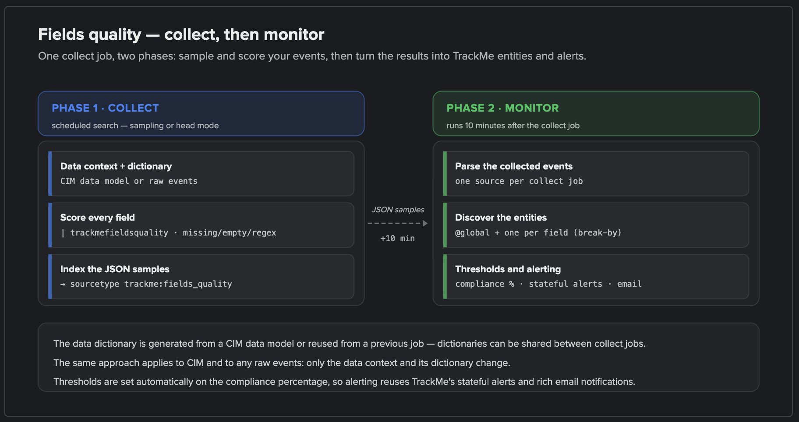
THE MODEL
One collect job, one monitor job, one data dictionary
1
Data dictionary
Per field: regular expression, optional type, allow unknown, allow missing / empty. Generated from CIM or drafted by AI, shared between jobs.
1
2
Collect job — score every field
A scheduled search samples the events and runs trackmefieldsquality: missing, empty, pattern and type checks, per event.
2
4
3
5
3
Samples indexed
Results land in the summary index as trackme:fields_quality JSON samples.
4
Monitor job — build the entities
Runs ~10 minutes after the collect job: one entity per field, plus @global per context.
5
Thresholds and alerting
Success % against the threshold drives the state; stateful alerts and emails come for free.
The workflow diagram is built into the wizard — expand "Fields Quality Monitoring Workflow Diagram" at the top of every job wizard.
TrackMe for Splunk · Hands-on: field quality monitoring
docs.trackme-solutions.com
Notes:
This is the whole model. The dictionary is the contract; the collect job measures the events against it; the monitor job turns measurements into entities TrackMe knows how to alert on. Both jobs are created and scheduled by the wizard. The dictionary is a first-class object: reuse it across trackers that share a format.

Slide 4
THE PLAN
What we are going to do — two feeds, two dictionary strategies
EXAMPLE 1 · CIM
EXAMPLE 2 · NON-CIM (JSON)
Cisco ASA firewall logs
E-commerce order transactions
index=siem* sourcetype="cisco:asa"
index="business_data" sourcetype="business:orders:transactions"
Checked against Network_Traffic / All_Traffic
Custom pseudo data model, raw JSON payload
Dictionary generated from the CIM data model
Dictionary drafted by the AI dictionary advisor
Simulate, inspect a regex failure, tune, re-simulate
Per-field AI advisor tightens currency
Sampling with Auto define, create, run
FQM Advisor reviews the failing field
76 entities over 4 regional indexes
13 entities, 28% of orders with a bad currency
Both run in one Virtual Tenant created for the occasion. The last slides show a mature tenant with several months of history.
TrackMe for Splunk · Hands-on: field quality monitoring
docs.trackme-solutions.com
Notes:
Example 1 shows the CIM path: TrackMe generates the dictionary from the CIM data model, we measure, understand and tune it. Example 2 shows a custom JSON feed: no CIM, so the AI Advisors draft the dictionary from the sampled fields, a per-field advisor tightens one rule, and the FQM Advisor reviews the verdict. Both examples use sampling with Auto define.

Slide 5
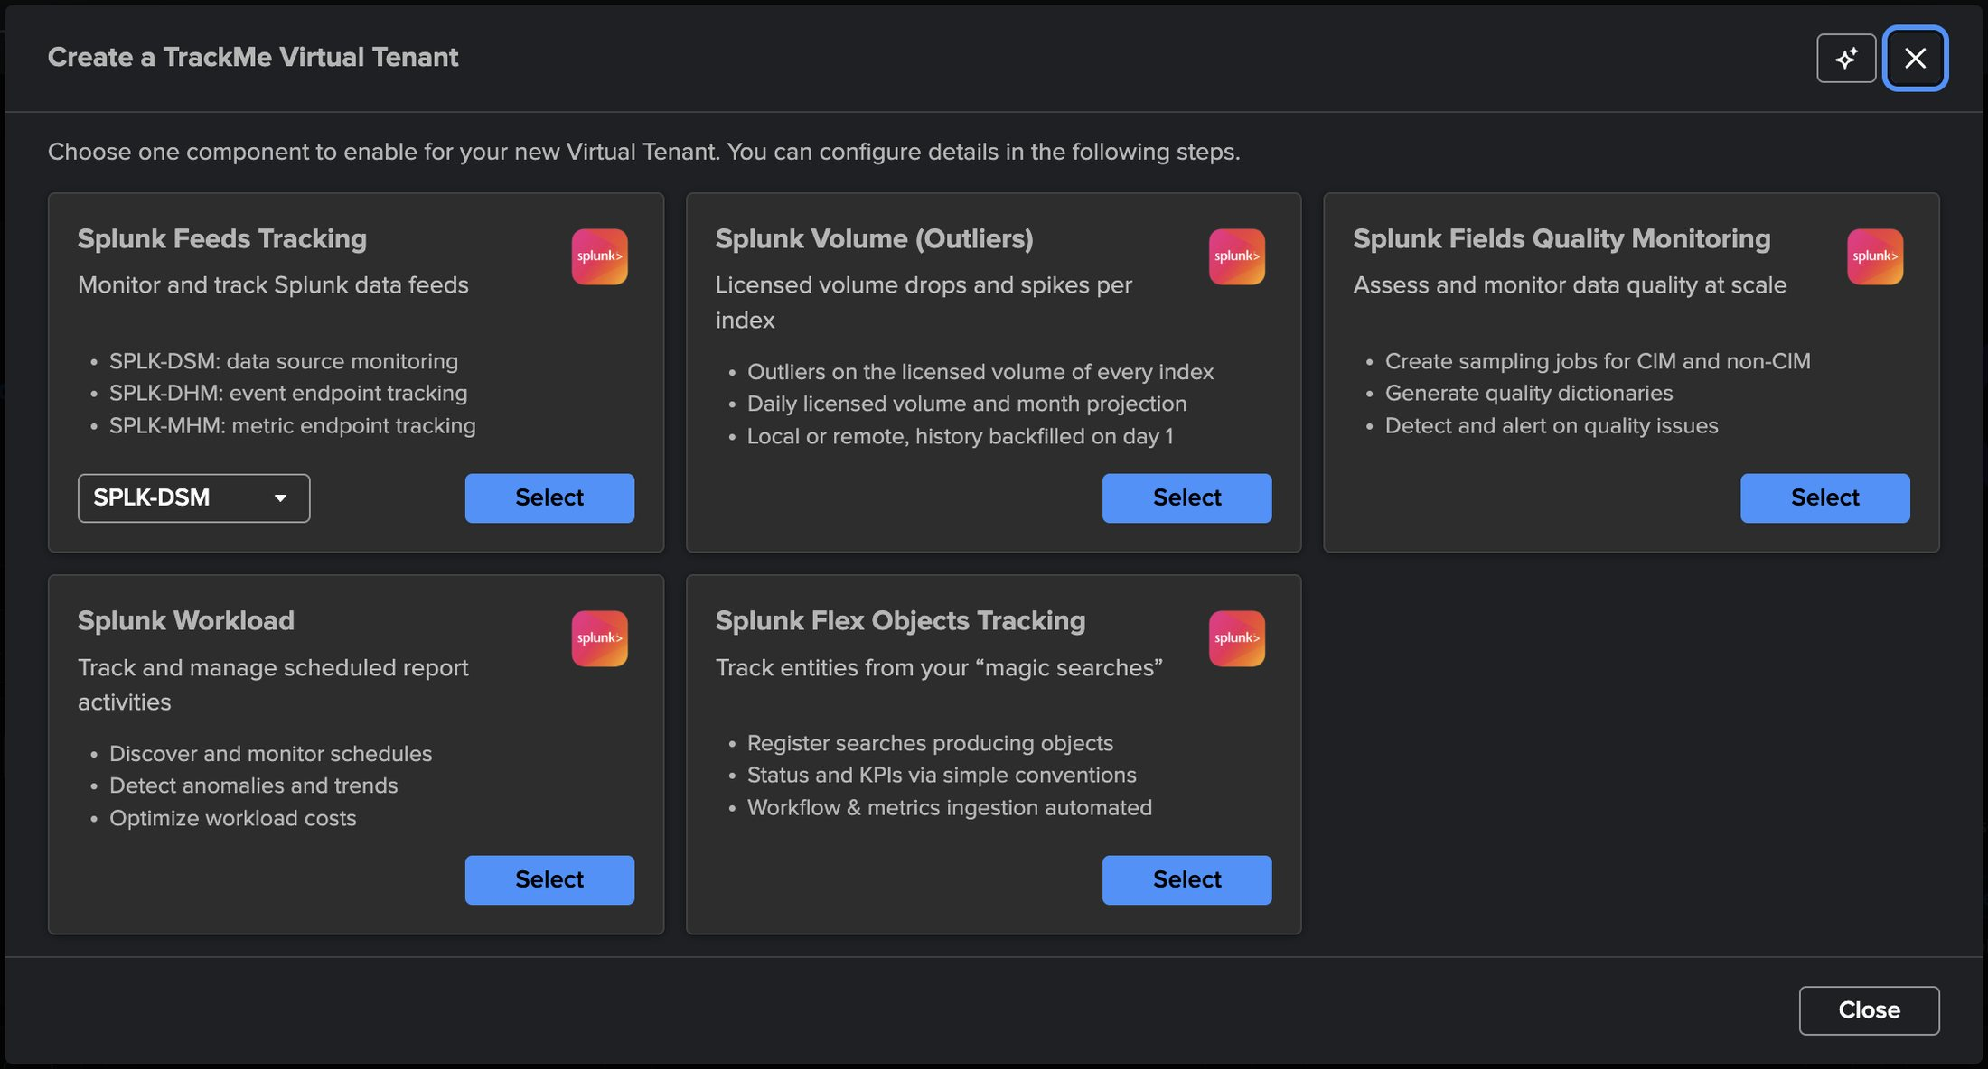
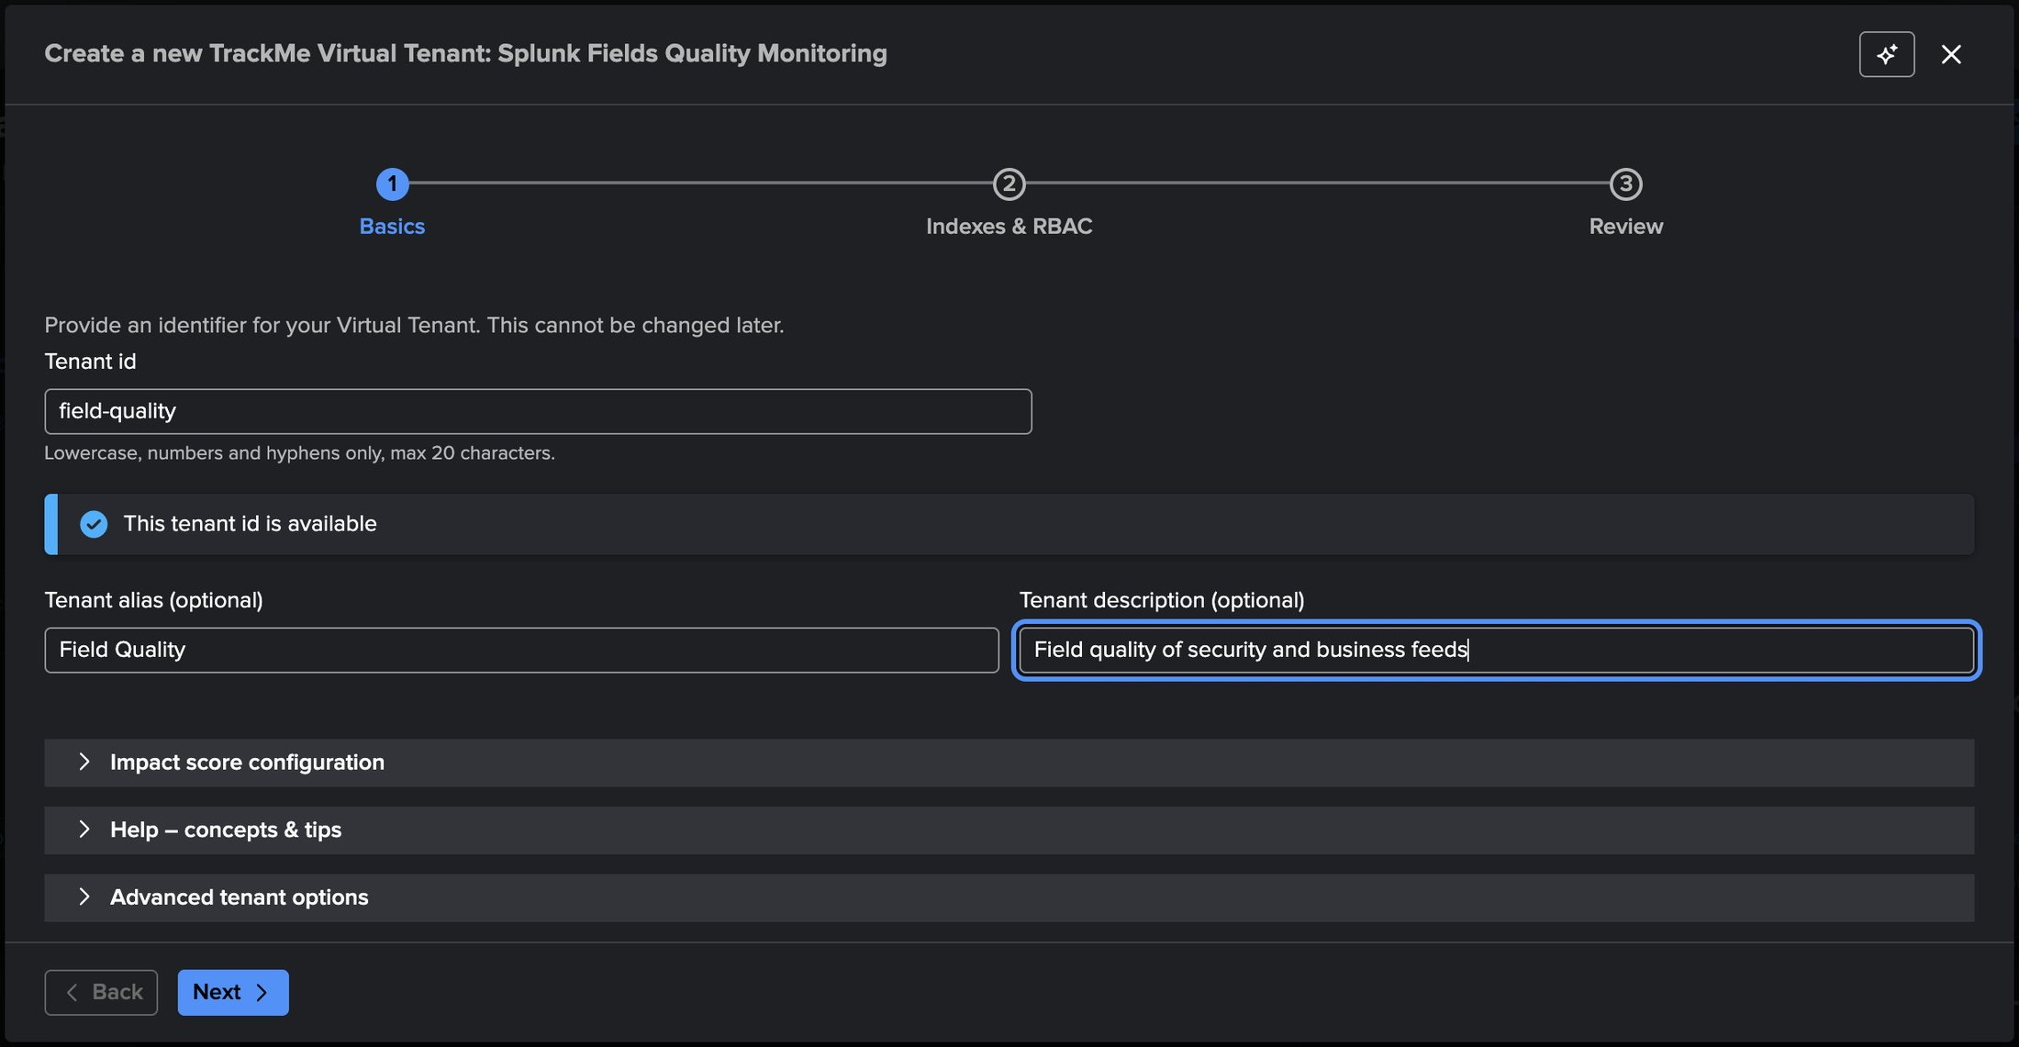
SETUP
A dedicated tenant — pick Splunk Fields Quality Monitoring
2
1
3
4
1
Splunk Fields Quality Monitoring
2
Tenant id — field-quality
4
Next: indexes & RBAC
Sampling jobs for CIM and non-CIM data, quality dictionaries, alerts on quality issues.
Immutable identifier, checked for availability as you type.
Summary, audit, metric and notable indexes, owner and roles — defaults are fine.
3
Alias and description
What people see on the Virtual Tenants card.
TrackMe for Splunk · Hands-on: field quality monitoring
docs.trackme-solutions.com
Notes:
Virtual Tenants → Actions → Create a tracking tenant. The component chooser lists every TrackMe component; FQM is its own card. The wizard asks three questions: basics (id, alias, description), indexes and RBAC, review. TrackMe creates the KV collections, lookups and the health tracker for the tenant in seconds.

Slide 6
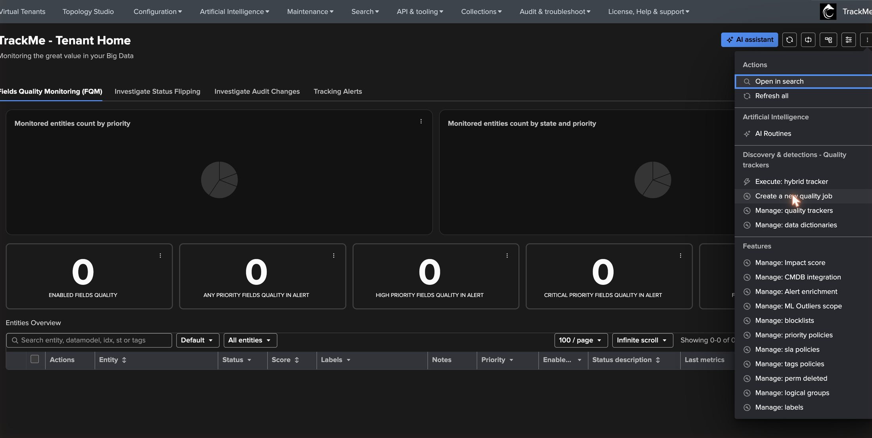
SETUP
The tenant is ready — every FQM action starts from here
1
Execute: hybrid tracker
Run any collect or monitor job on demand, with its execution events.
2
Create a new quality job
Opens the collect & monitor wizard — CIM, CIM/non-CIM, or monitor-only.
1
3
2
4
3
Manage: quality trackers
List trackers and their knowledge objects, delete in bulk.
5
4
Manage: data dictionaries
Create, import, export, edit dictionaries; see which trackers use them.
5
Empty KPIs
Enabled fields, fields in alert by priority, fields not monitored.
TrackMe for Splunk · Hands-on: field quality monitoring
docs.trackme-solutions.com
Notes:
Tenant Home is where FQM lives. The kebab menu at the top right carries every FQM action. We start with Create a new quality job.

Slide 7
01
EXAMPLE 1 · A CIM DATA SOURCE
Cisco ASA firewall logs against Network_Traffic
index=siem* sourcetype="cisco:asa" — four regional indexes, one sourcetype, one CIM data model. TrackMe generates the dictionary from CIM; we read the results, fix what is expected, and keep what is a real finding.
TrackMe for Splunk · Hands-on: field quality monitoring
Notes:
First example: a CIM source. The dictionary comes from the CIM data model, so the interesting part is interpreting the first results: which failures are real CIM compliance problems, and which are simply fields that only exist on some message types.

Slide 8
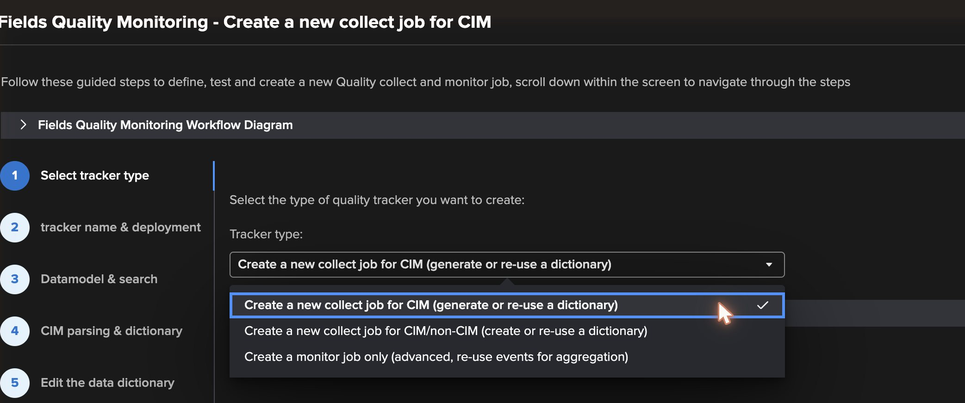
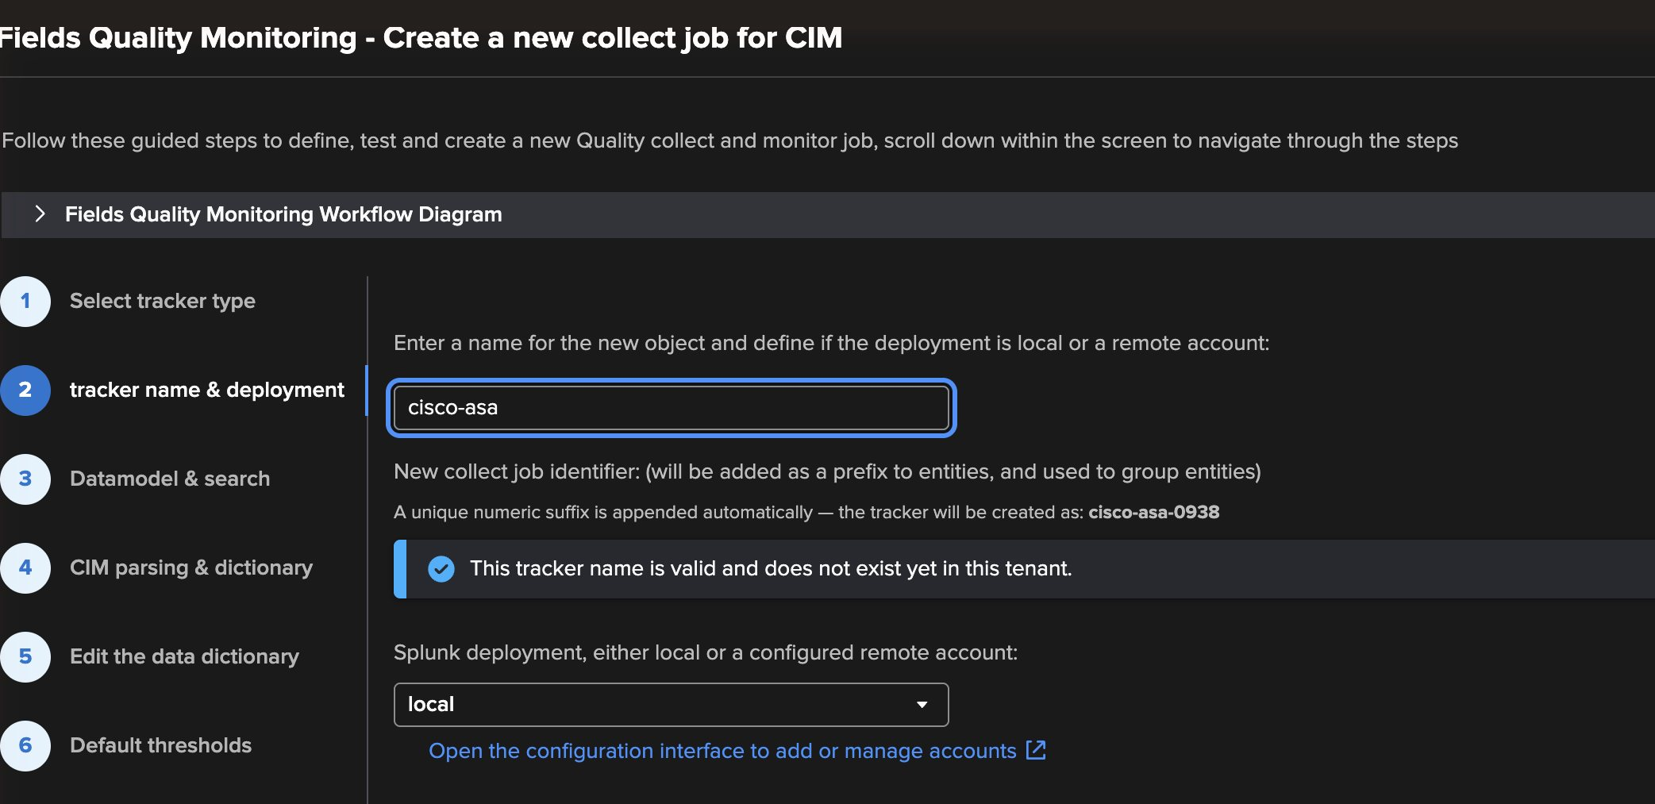
EXAMPLE 1 · WIZARD
Steps 1–2 — Tracker type, name and deployment
4
1
5
2
3
4
Tracker name — cisco-asa
1
CIM collect job
Prefix of every entity and job; a unique suffix is added (cisco-asa-0938).
Generate the dictionary from a CIM data model, or reuse one.
5
Local or remote deployment
2
CIM / non-CIM collect job
The same wizard targets any remote Splunk account configured in TrackMe.
Any search, any format — Example 2.
3
Monitor job only
Advanced: aggregate events collected elsewhere.
TrackMe for Splunk · Hands-on: field quality monitoring
docs.trackme-solutions.com
Notes:
Three tracker types. CIM collect job: the dictionary is generated from the selected data model (or reused). CIM/non-CIM: any search, create or reuse a dictionary — this is Example 2. Monitor only: advanced, reuses events already collected. The name becomes the prefix of every entity; TrackMe appends a short unique suffix. Deployment can be local or any configured remote Splunk account.

Slide 9
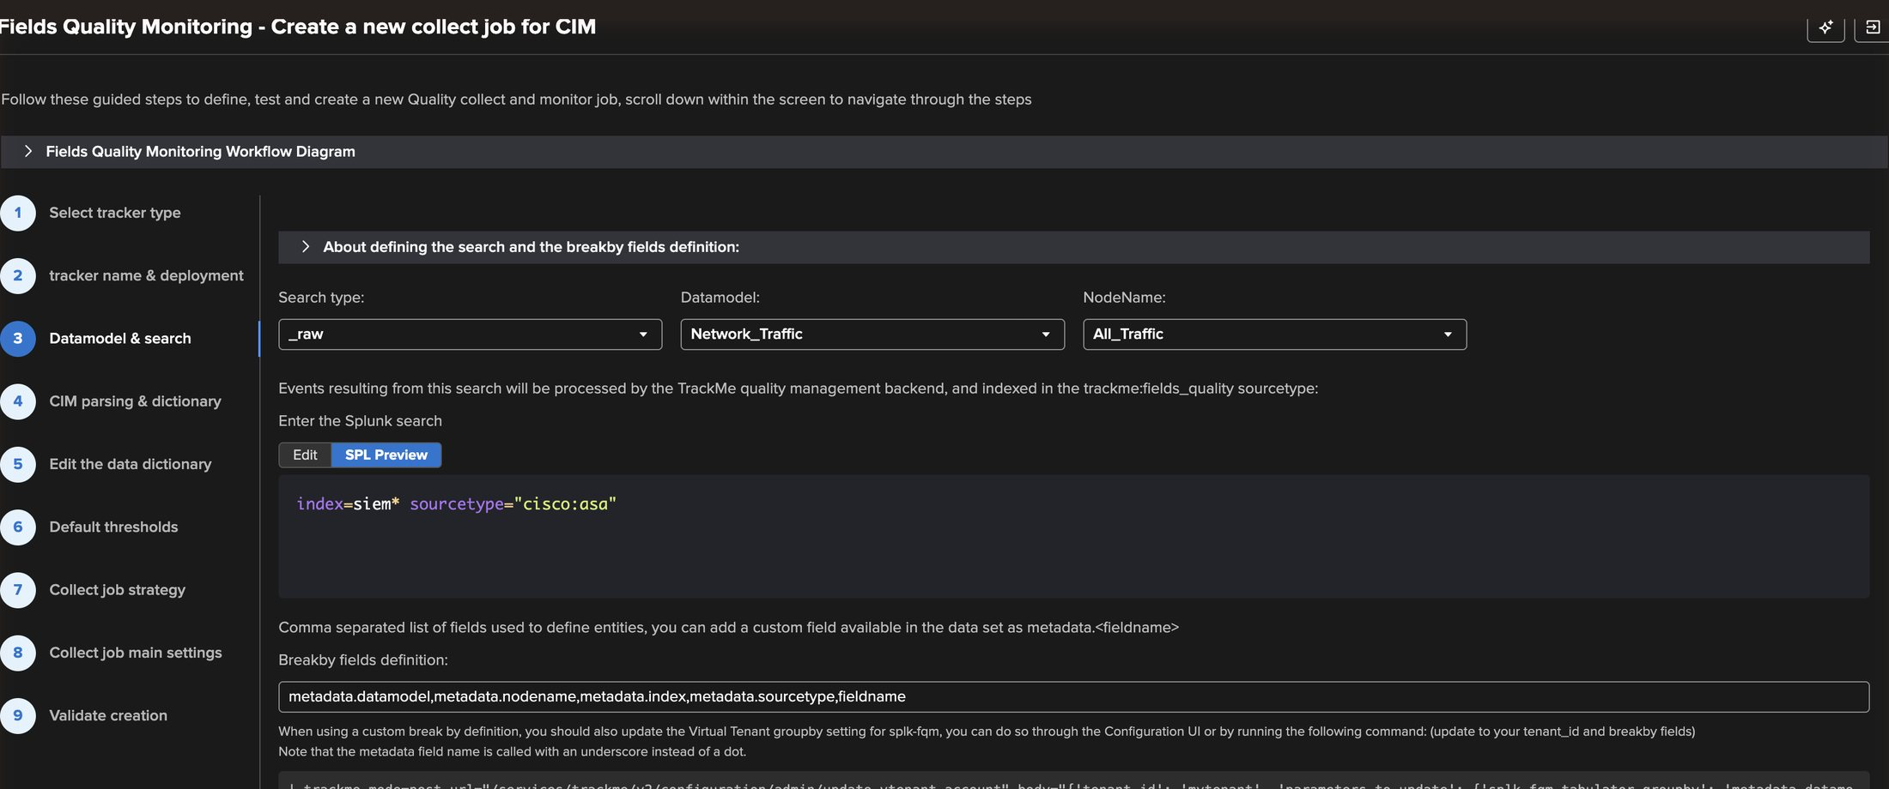
EXAMPLE 1 · WIZARD
Step 3 — Data model, node and the search that feeds it
1
Search type
_raw for an event search; generating for a tstats or custom generating search.
2
Data model — Network_Traffic
1
2
3
The CIM model the events should comply with.
3
Node — All_Traffic
4
Picked automatically from the model; drives the recommended fields.
5
4
The search
index=siem* sourcetype="cisco:asa" — four regional indexes at once.
5
Break-by fields
Data model, node, index, sourcetype, field: one entity per field per index.
Because index is part of the break-by, a parsing problem on one region shows up on that region only — it is not averaged away by the other three.
TrackMe for Splunk · Hands-on: field quality monitoring
docs.trackme-solutions.com
Notes:
The search can be anything returning the events you want to qualify. The break-by is the identity of the entities: here, one set of field entities per index. That is what lets FQM spot a problem on one region without the others hiding it.

Slide 10
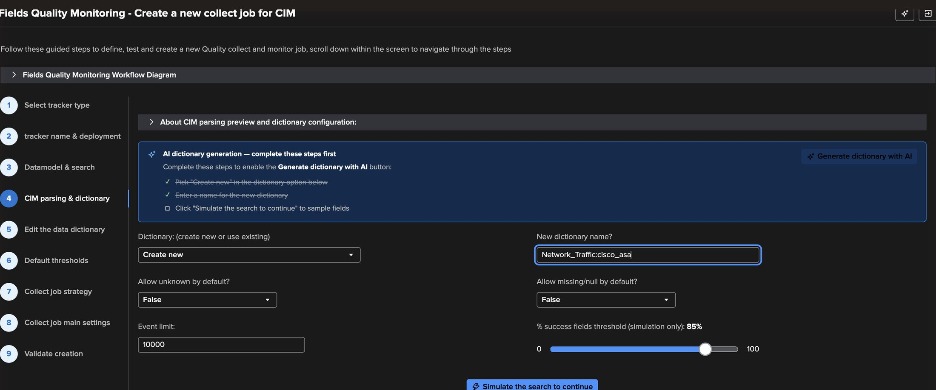
EXAMPLE 1 · WIZARD
Step 4 — Name the dictionary, simulate on 10,000 events
1
Create new, or reuse
A dictionary is shared: reuse it for every tracker on the same format.
2
Network_Traffic:cisco_asa
The new dictionary name.
3
Defaults for the generated rules
1
2
Allow unknown, allow missing/null — false by default.
3
4
Event limit — 10,000
4
5
6
How many events the simulation scores.
5
Simulation threshold
The success % a field needs to pass — 85 by default.
6
Simulate the search
One search job: the whole scoring in seconds, nothing written.
TrackMe for Splunk · Hands-on: field quality monitoring
docs.trackme-solutions.com
Notes:
The simulation runs the real collect logic on a sample and shows the verdict per field, without creating anything. It is the loop you iterate on: simulate, read, tune, simulate again. 10,000 events is the default; a larger simulation (100k) also works well.

Slide 11
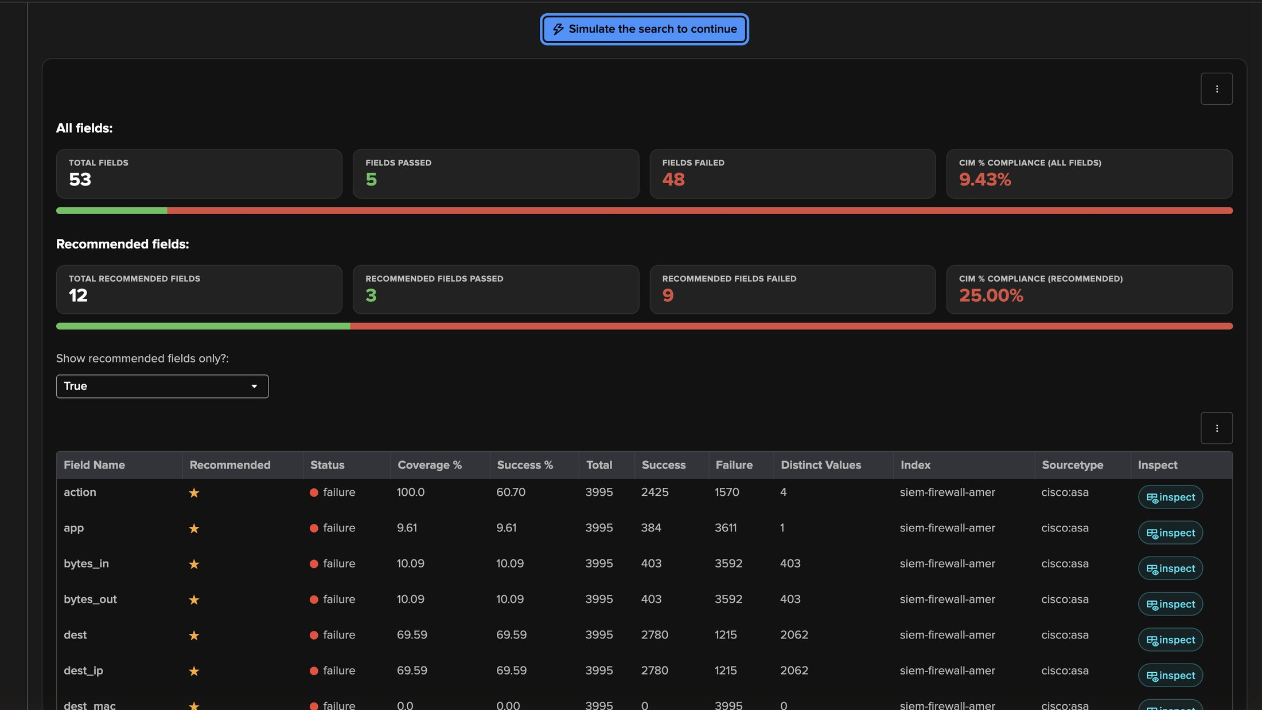
EXAMPLE 1 · FIRST RESULTS
First verdict — 25% CIM compliance on the recommended fields
1
All fields: 53 checked, 5 passed
Every field of the Network_Traffic model — 9.43%. Most are irrelevant for a firewall.
1
2
Recommended fields: 3 of 12
The fields CIM recommends for All_Traffic — the number that matters: 25%.
2
3
Recommended only
3
Filter the table to the 12 recommended fields (star column).
4
5
4
Per field and per index
Coverage %, success %, totals, failures, distinct values.
5
Inspect
Opens Field Details for one field — next two slides.
A low first score is normal on CIM. The job now is to separate real compliance defects from fields that simply do not exist on every message type.
TrackMe for Splunk · Hands-on: field quality monitoring
docs.trackme-solutions.com
Notes:
Do not panic at 9% or 25%. The CIM model lists every possible field; a Cisco ASA feed mixes connection builds, teardowns and translations that carry different fields. The simulation gives you the evidence to decide field by field.

Slide 12
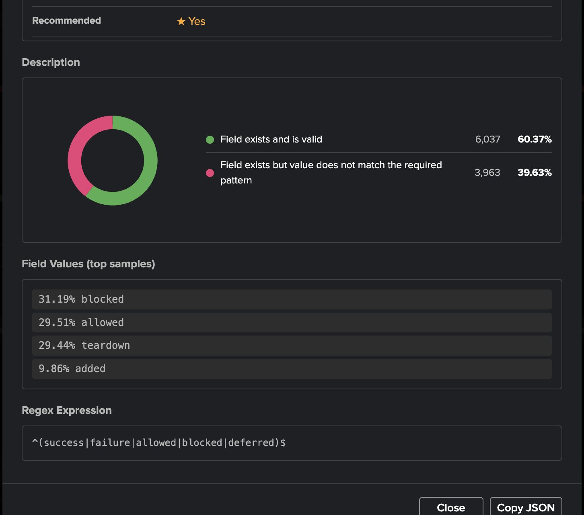
EXAMPLE 1 · FIELD DETAILS
A real CIM defect — action fails on the regular expression
1
Valid — 60.4%
Present on 100% of events, below the 85% threshold: status failure.
2
Does not match the pattern — 39.6%
The field exists, the value is wrong.
1
3
The evidence
2
blocked 31% · allowed 30% · teardown 29% · added 10%. teardown and added are not CIM actions.
4
The rule, from the CIM model
^(success|failure|allowed|blocked|deferred)$
3
Why it matters
CIM-based content (correlation searches, dashboards) that filters on action=allowed or action=blocked silently misses 40% of these events.
4
TrackMe for Splunk · Hands-on: field quality monitoring
docs.trackme-solutions.com
Notes:
Field Details for action (simulation → inspect): present on 100% of events, but only about 60% pass. The description donut splits valid values from values that exist but do not match the pattern. The top values tell the story: blocked and allowed are CIM values, teardown and added are not. This is a genuine CIM compliance issue in the field extraction — exactly what FQM is for. We keep this rule strict.

Slide 13
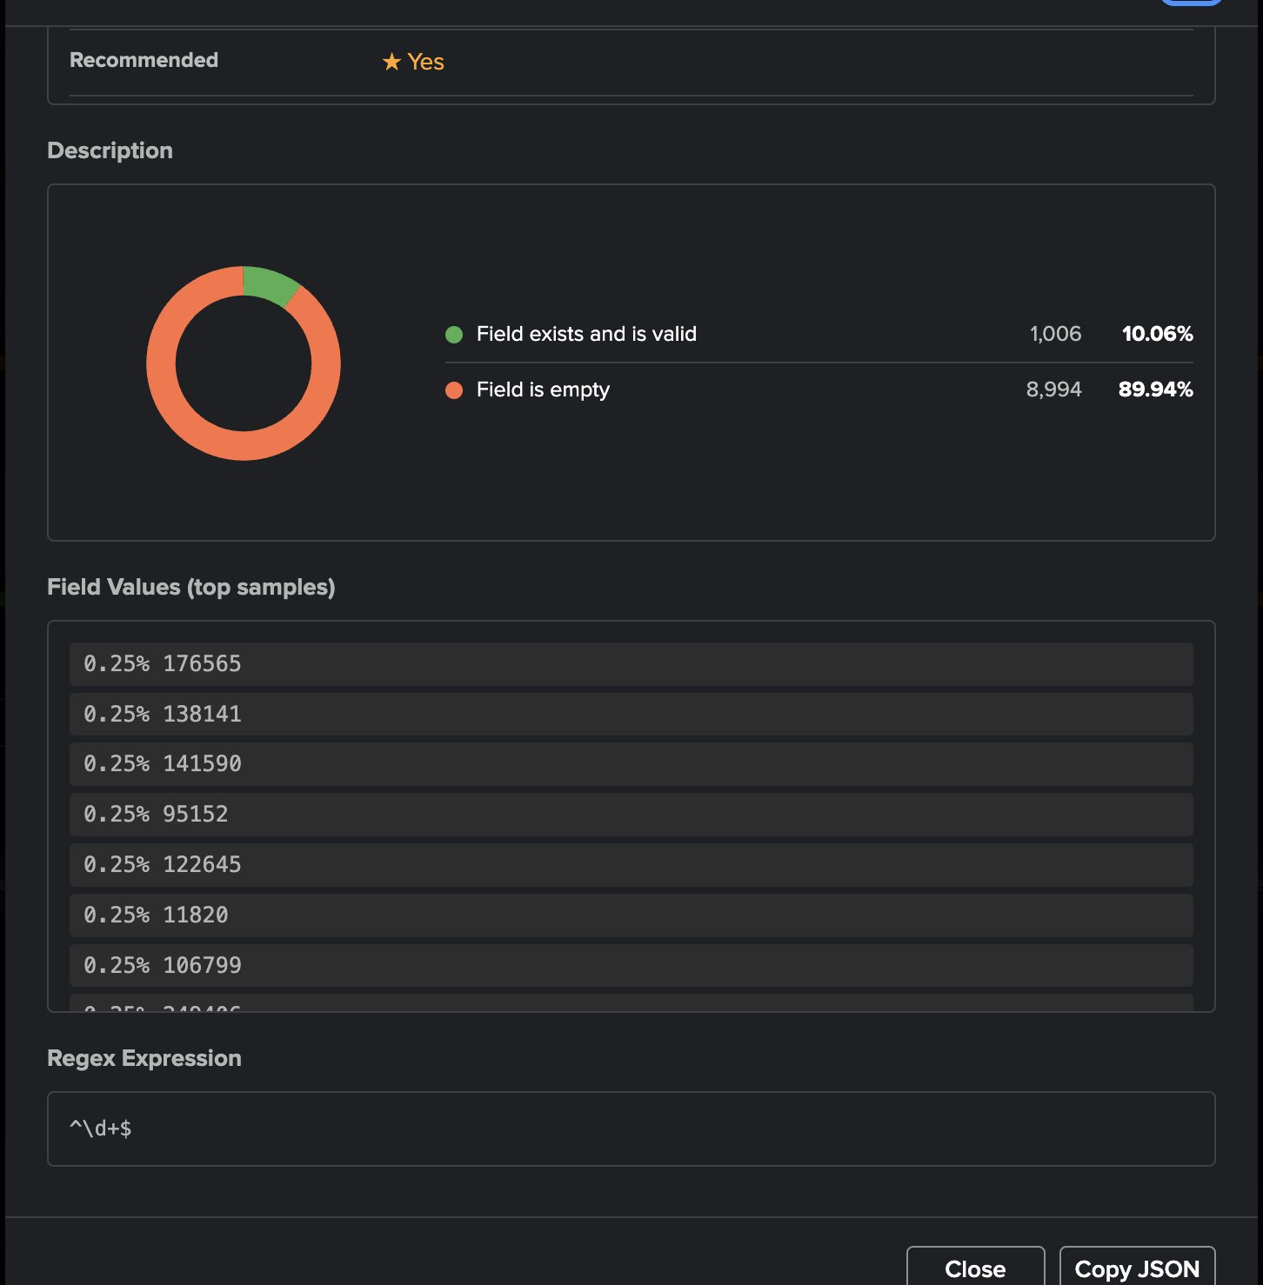
EXAMPLE 1 · FIELD DETAILS
An expected gap — bytes_in only exists on some messages
1
Field exists and is valid — 10%
Read the category, not only the score
Every value present passes ^\d+$.
Two failures, two different answers:
action → value does not match: a real CIM defect, keep the rule strict and alert on it.
bytes_in → value missing on most events by design: allow missing, keep validating the values that are there.
2
Field is empty — 90%
No value on most events — no parsing problem.
1
2
3
Values are healthy
Hundreds of distinct byte counts, all numeric.
4
Regex ^\d+$
3
Correct — keep it, and add a type check.
4
The same reading applies to app, user and dest_mac on this feed.
TrackMe for Splunk · Hands-on: field quality monitoring
docs.trackme-solutions.com
Notes:
Contrast with bytes_in: every value that exists is valid (a clean integer), but the field is empty on 90% of the events, because only connection teardown messages carry byte counts. This is not a defect of the feed — it is the nature of the log. The right fix is in the dictionary: allow missing for this field.

Slide 14
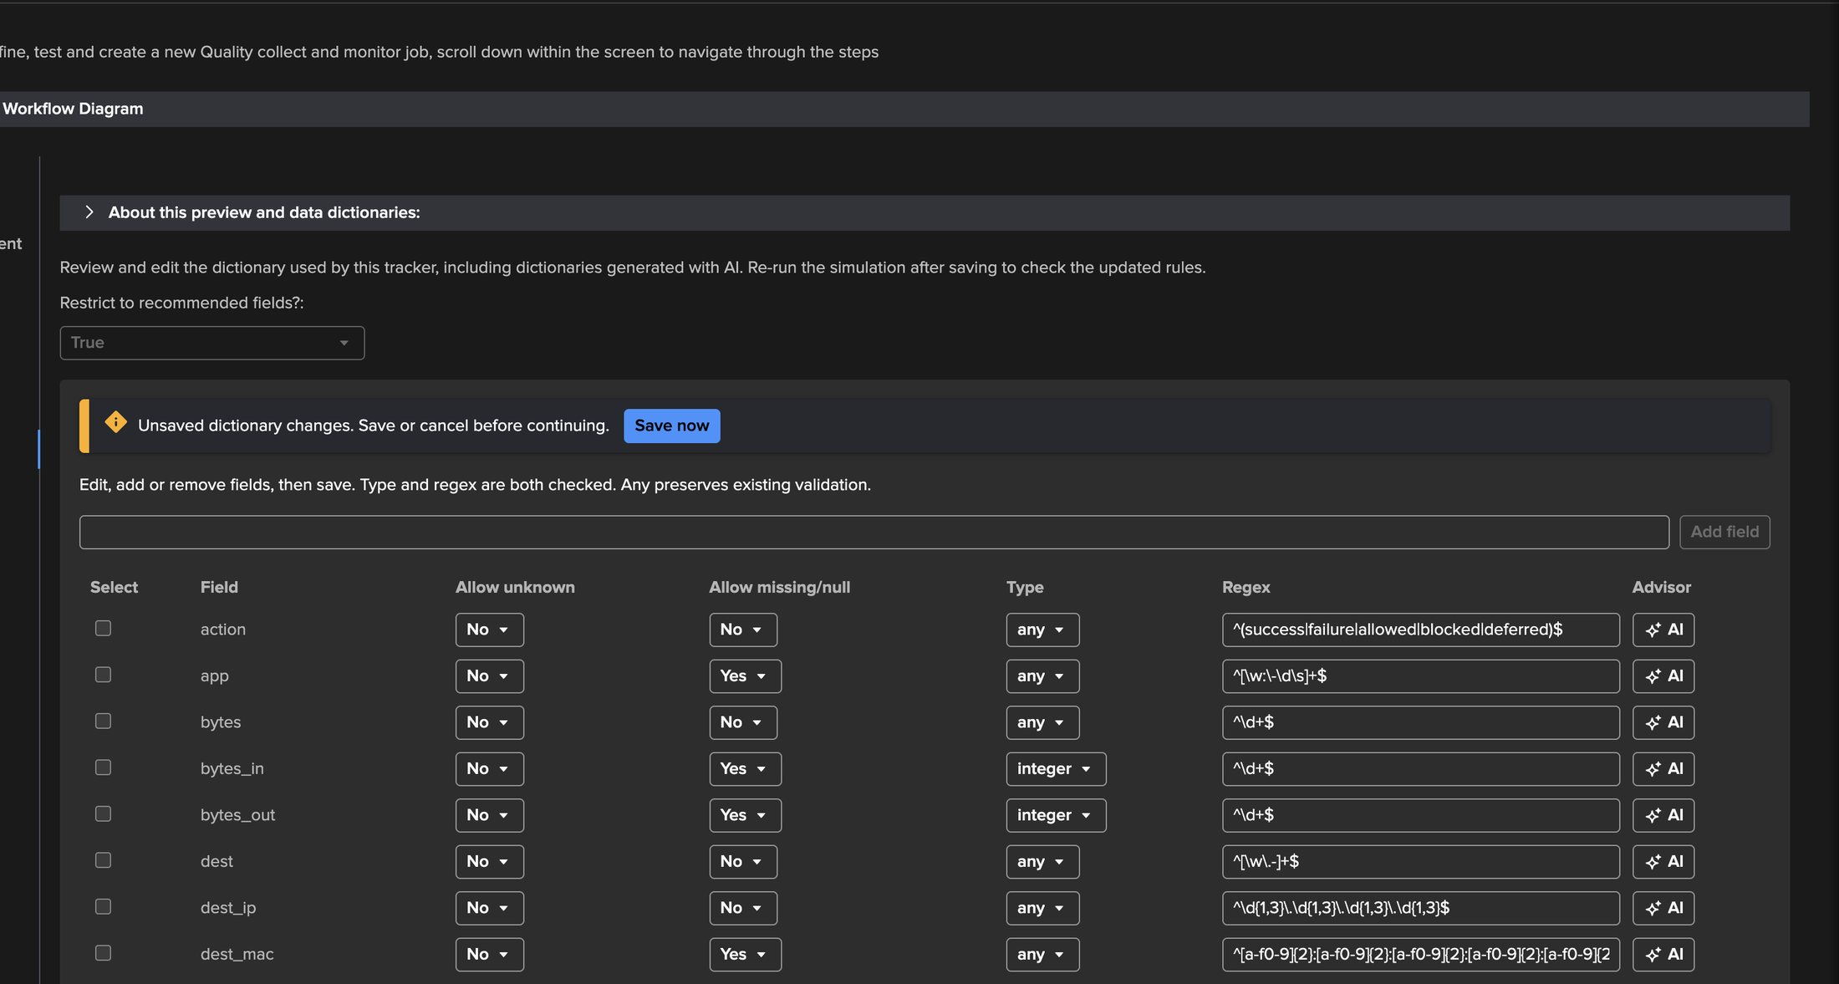
EXAMPLE 1 · TUNE
Step 5 — Edit the data dictionary in place
1
Unsaved changes banner
Edits stay local until Save now; steps and simulation are blocked meanwhile.
2
Allow missing/null: Yes
app, bytes_in, bytes_out, user, dest_mac — present only on some message types.
1
3
Type: integer
bytes_in and bytes_out: regex and type are both checked.
4
5
2
4
action stays strict
3
The CIM regex is kept — it is a real finding.
5
Per-field AI
Ask the AI field advisor about one rule — used in Example 2.
TrackMe for Splunk · Hands-on: field quality monitoring
docs.trackme-solutions.com
Notes:
Every rule is editable in the wizard: add or remove fields, allow unknown, allow missing or empty, an optional type (integer, numerical, alpha, alphanumeric, boolean), and the regex. Save writes the whole dictionary at once and checks nobody changed it in between.

Slide 15
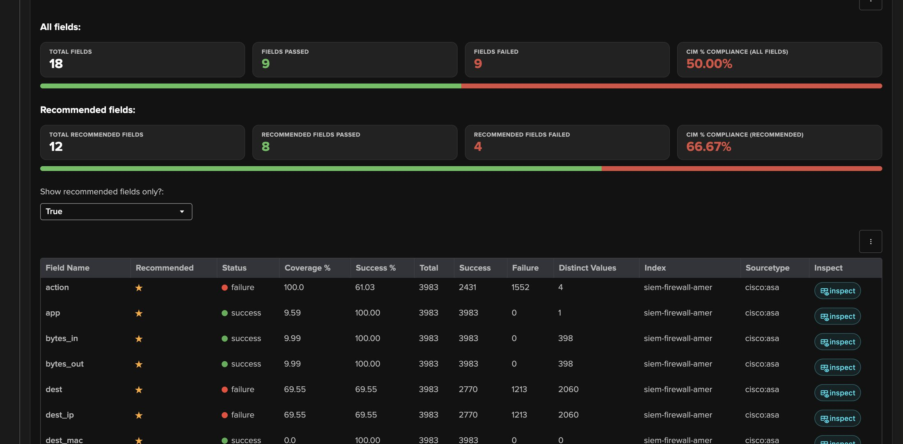
EXAMPLE 1 · RE-SIMULATE
Before and after — 25% to 66.7%, and the right fields still fail
2
1
3
4
BEFORE — dictionary as generated from CIM
AFTER — 5 fields allow missing, 2 typed
1
25.00% — 3 of 12 recommended fields pass
2
66.67% — 8 of 12 pass
Expected gaps and real defects mixed together.
Expected gaps are now accepted.
3
bytes_in / bytes_out / app pass
Values still checked when present.
4
action still fails
TrackMe for Splunk · Hands-on: field quality monitoring
The real CIM defect stays visible.
docs.trackme-solutions.com
Notes:
Same data, new dictionary. Recommended-field compliance goes from 25% to 66.7%. The fields we allowed to be missing now pass, their values still validated. What remains red is meaningful: action (CIM values), and dest, dest_ip, protocol, missing on about 30% of events — worth a look with the TA owner.

Slide 16
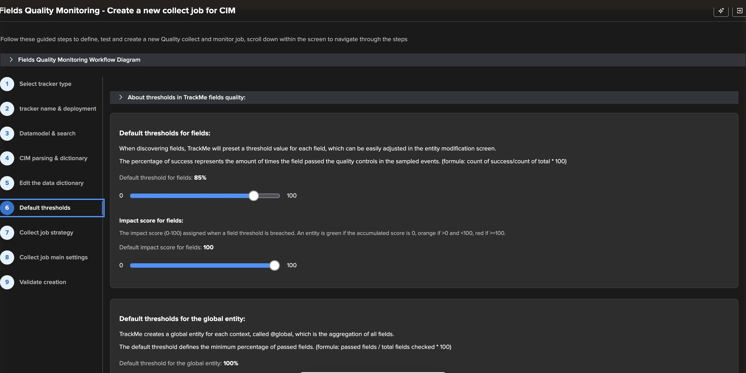
EXAMPLE 1 · WIZARD
Step 6 — Default thresholds and impact score
1
Field threshold — 85%
Minimum success % per field. Adjustable per entity later.
2
Impact score — 100
Score added when a field breaches: 100 = red, below 100 = orange.
1
3
Global threshold — 100%
The @global entity: share of fields that must pass in the context.
2
3
Thresholds reuse TrackMe's hybrid scoring: a field below threshold adds its impact score to the entity, and the usual states, stateful alerts and emails follow — no FQM-specific alerting to learn.
TrackMe for Splunk · Hands-on: field quality monitoring
docs.trackme-solutions.com
Notes:
Default values are sensible. Lower the impact score if you want quality issues to show orange rather than red. The @global entity summarises the context: 100% means any failing field turns it red.

Slide 17
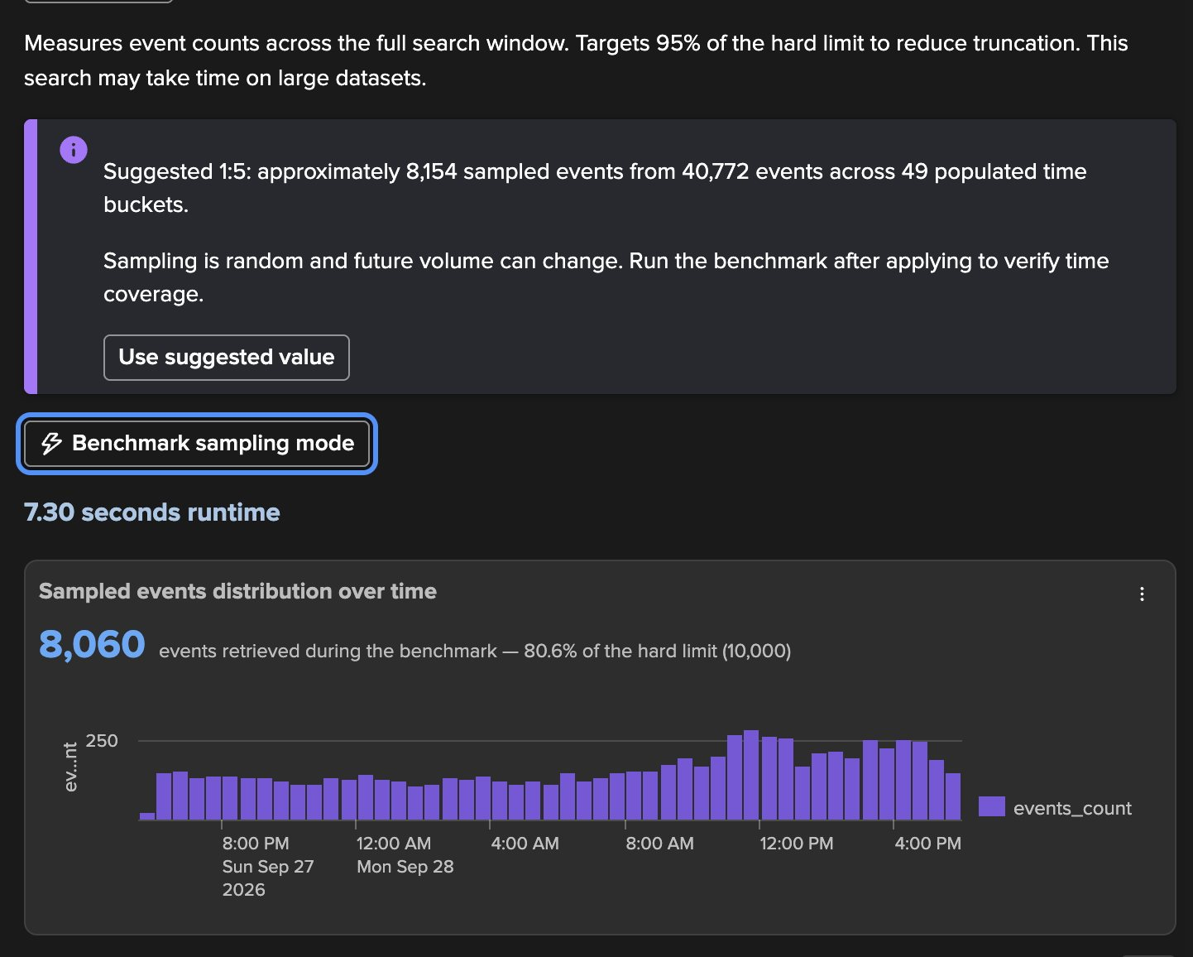
EXAMPLE 1 · COLLECT STRATEGY
Step 7 — Sampling, sized by Auto define
1
Auto define
Counts every event of the search window, per time bucket, and targets 95% of the hard limit.
1
2
Suggested 1:5
40,772 events in 49 buckets → ~8,154 sampled. One click applies it as a custom ratio.
2
3
Benchmark: 7.3 s
3
The real collect search with the new ratio.
4
8,060 events — 80.6% of the limit
4
Close to the target, with headroom for volume growth.
5
5
The whole 24 hours
Every bucket of the day is represented.
Deterministic
Auto define is deterministic — a count per bucket, no AI, no guess. Re-run it when the volume of the feed changes significantly.
TrackMe for Splunk · Hands-on: field quality monitoring
docs.trackme-solutions.com
Notes:
This is the step that makes FQM representative. Auto define measures the full window and computes the sampling ratio that fills the hard limit without truncation, so the sample covers the whole day. Then the benchmark runs the real search with that ratio so you can see the distribution before you commit.

Slide 18
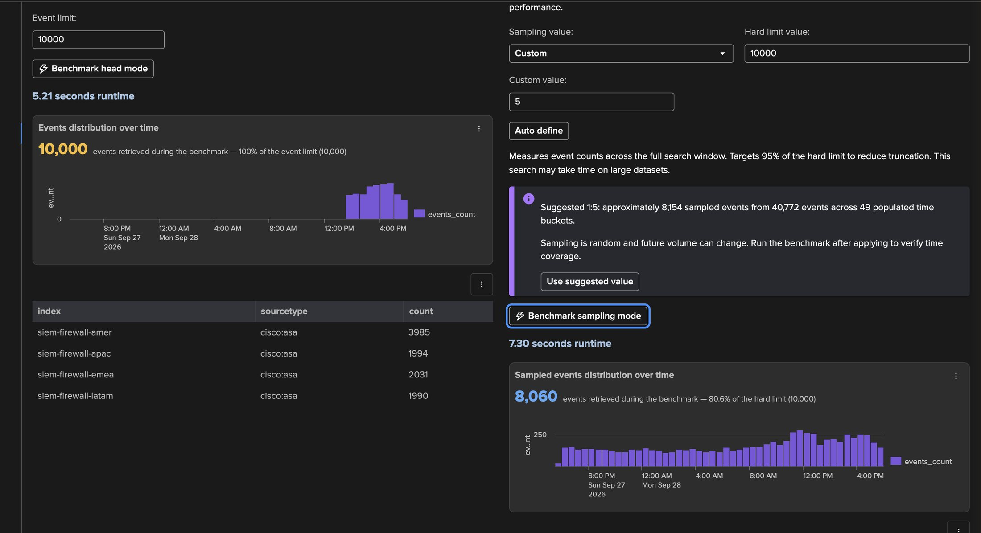
EXAMPLE 1 · COLLECT STRATEGY
Why sampling — head mode only sees the last few hours
1
Head mode: 10,000 events
100% of the limit, all in the last hours of the window.
2
2
Sampling 1:5 (Auto define)
1
Custom ratio applied from the suggestion.
3
Sampling: 8,060 events
Evenly spread across the 24 hours.
4
4
Per-index breakdown
Each benchmark lists events per index and sourcetype.
3
Same search, same window, same limit — only the collect strategy differs.
TrackMe for Splunk · Hands-on: field quality monitoring
docs.trackme-solutions.com
Notes:
Head mode is the simplest baseline: the first N events the search returns, which on Splunk means the most recent. The chart shows all 10,000 events inside the last few hours. Sampling with the Auto define ratio spreads 8,060 events across all 24 hours. For quality measurement, representative beats recent: a parsing problem at 3 AM is invisible to head mode.

Slide 19
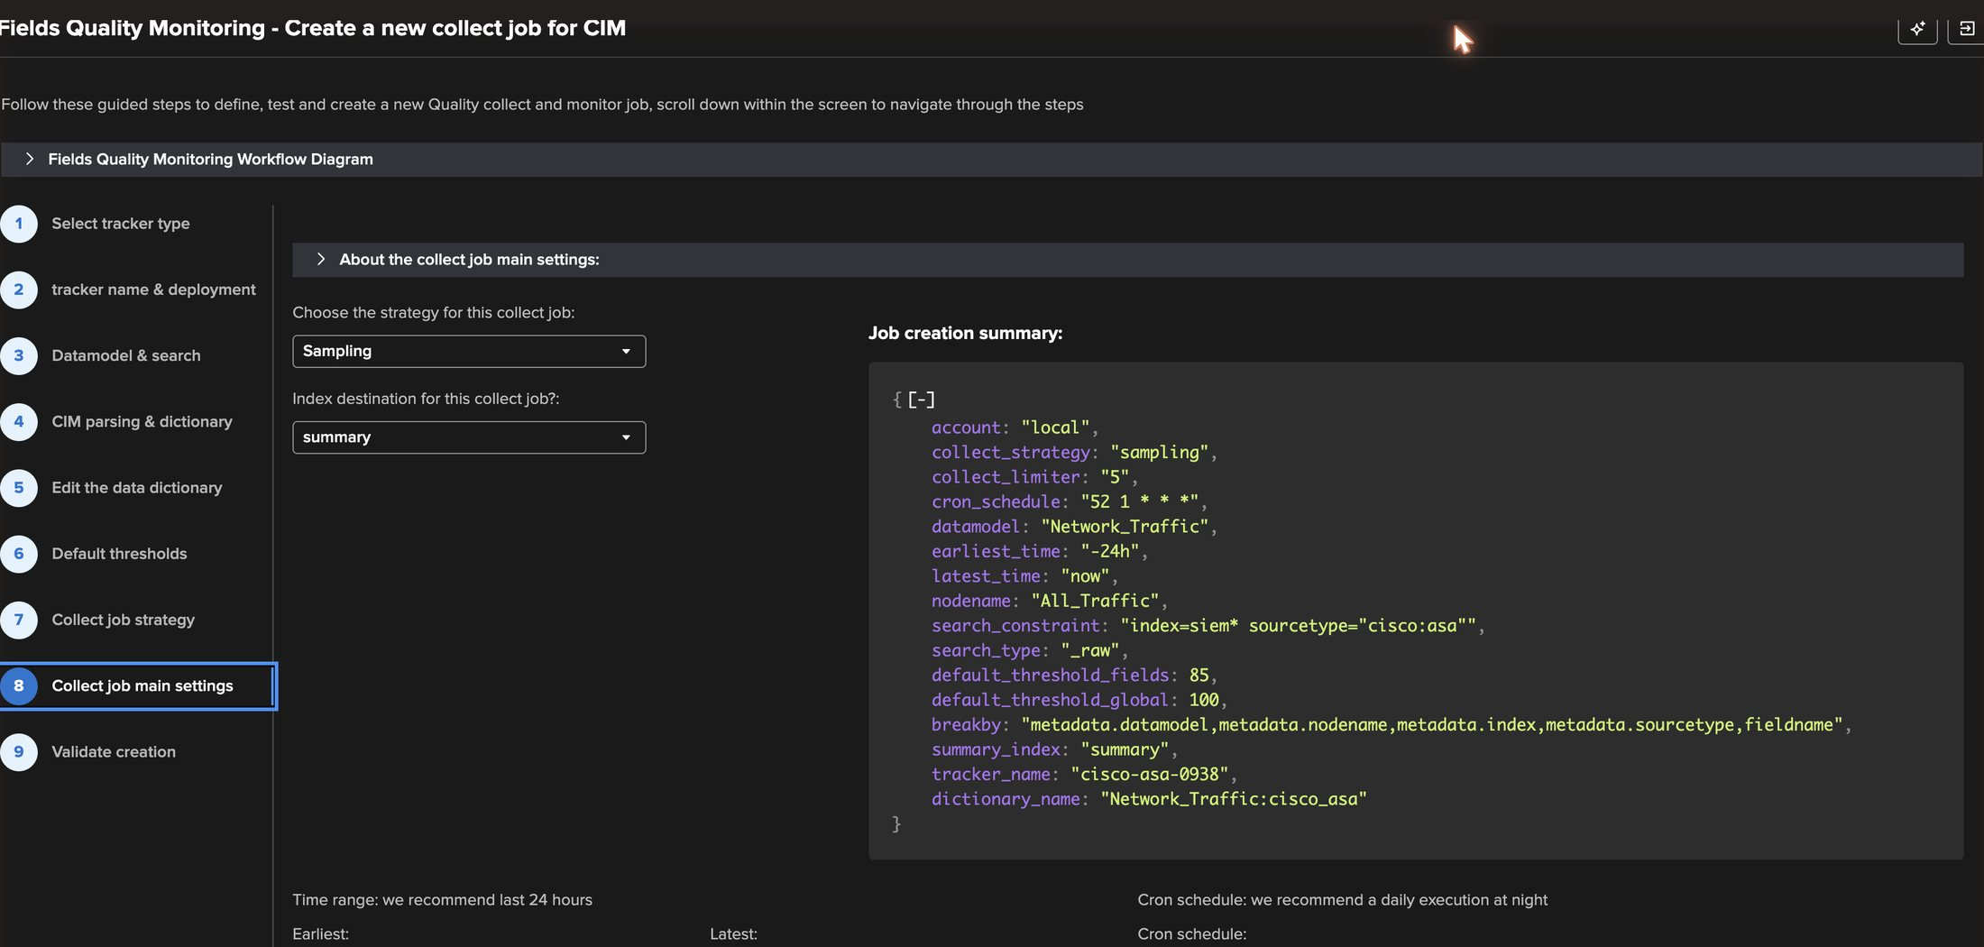
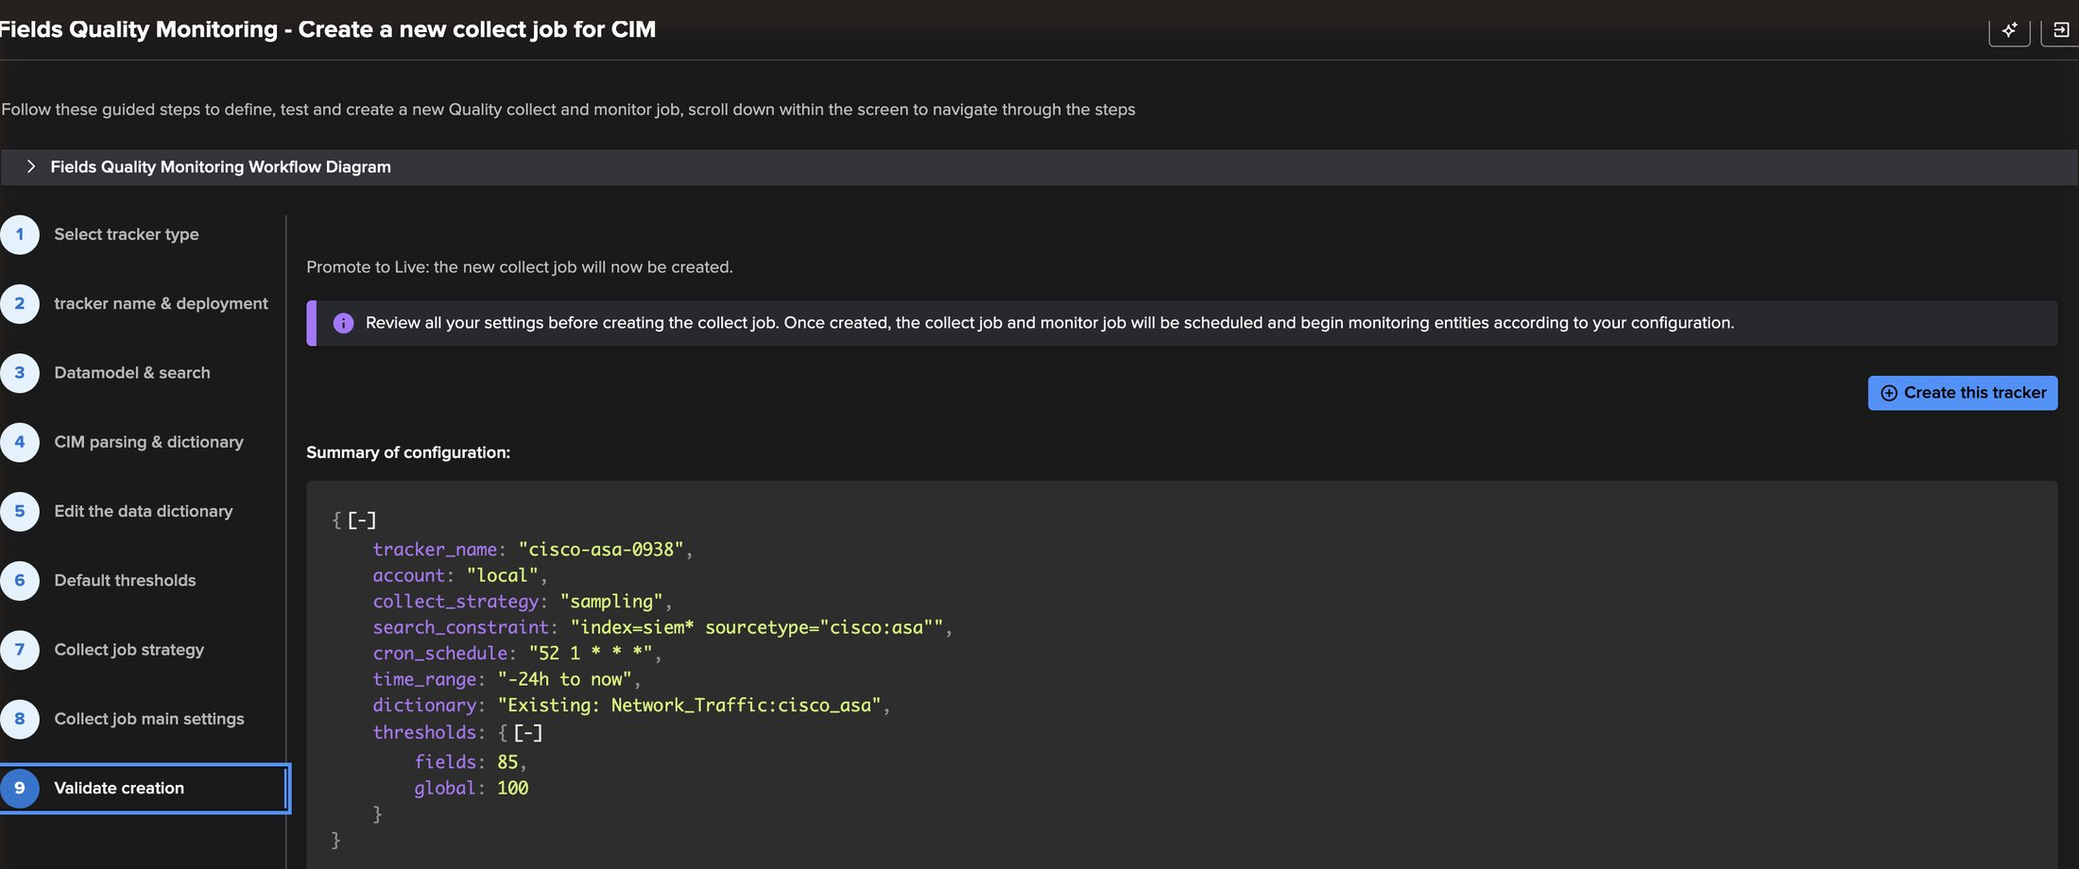
EXAMPLE 1 · WIZARD
Steps 8–9 — Main settings, review, create
1
2
5
3
4
6
5
Create this tracker
1
Strategy: Sampling
Creates and schedules the collect and monitor jobs.
Carried from step 7 — collect_limiter 5.
6
Final summary
2
Job creation summary
Tracker cisco-asa-0938, sampling, dictionary, thresholds 85 / 100.
The exact definition that will be created.
3
collect_strategy: sampling, limiter 5
The ratio chosen with Auto define; last 24 hours window.
4
Daily cron at night
52 1 * * * here; the monitor job follows ~10 minutes later.
TrackMe for Splunk · Hands-on: field quality monitoring
docs.trackme-solutions.com
Notes:
Step 8 confirms the strategy (sampling), the summary index, the time range and the cron. The recommendation is a daily run over the last 24 hours, at night. The job creation summary is the exact payload sent to TrackMe. Step 9 shows the final configuration and creates both scheduled jobs, the collect and the monitor.

Slide 20
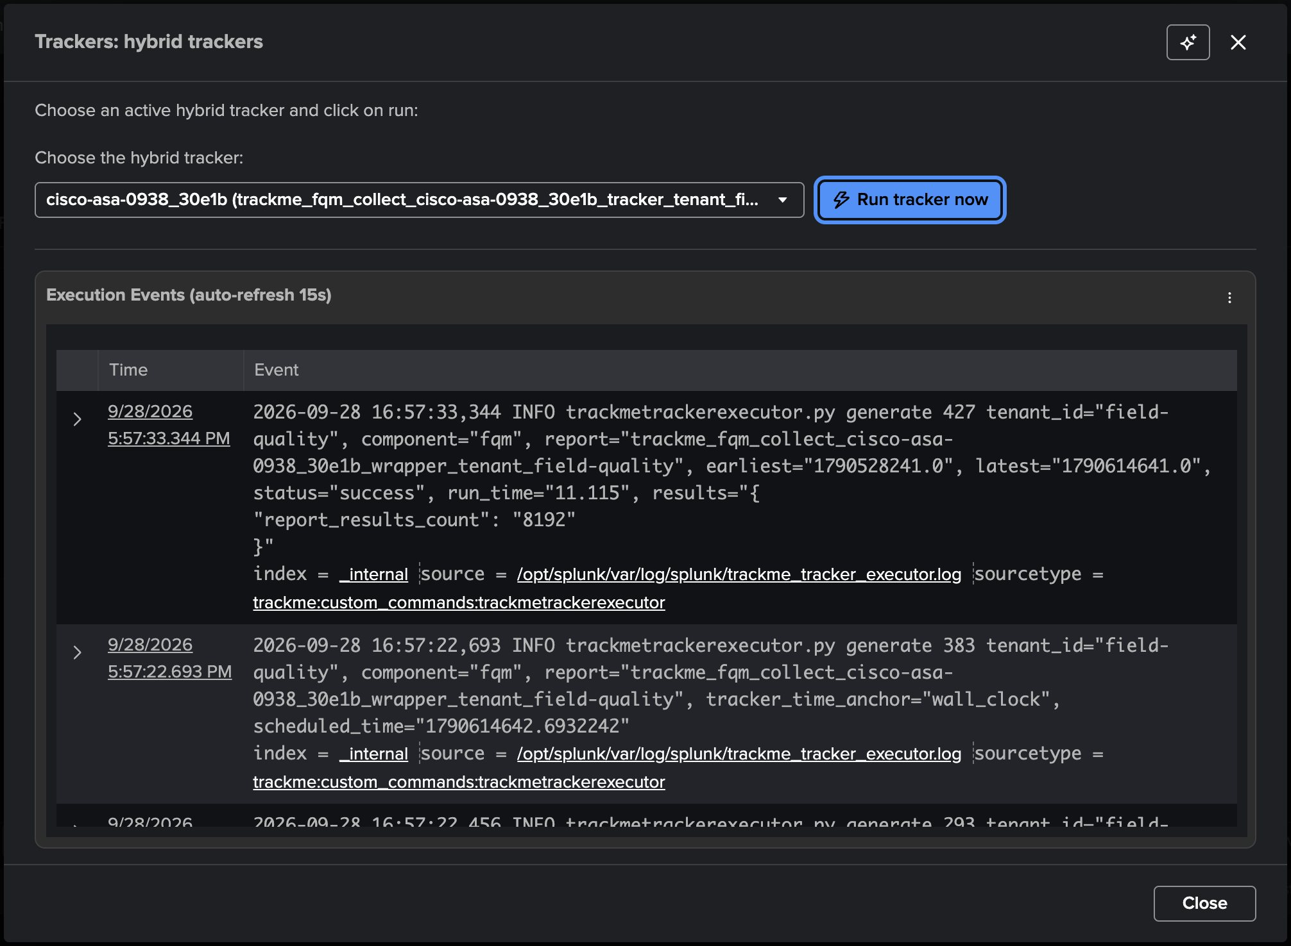
EXAMPLE 1 · RUN
No need to wait for the night — run the jobs now
1
Execute: hybrid tracker
1
2
Pick the collect job, then the monitor job.
2
Run tracker now
3
Runs the job as the scheduler would, with its time window.
3
Execution events
Collect: success in 11.1 s, 8,192 events scored. Monitor: success in 24 s, 76 entities.
76 entities = 4 indexes × (18 dictionary fields + one @global). From now on both jobs run daily on their own.
TrackMe for Splunk · Hands-on: field quality monitoring
docs.trackme-solutions.com
Notes:
In production the jobs run on their cron. For a first validation, run them on demand from the Tenant Home menu: the modal streams the executor events, including runtime and result counts.

Slide 21
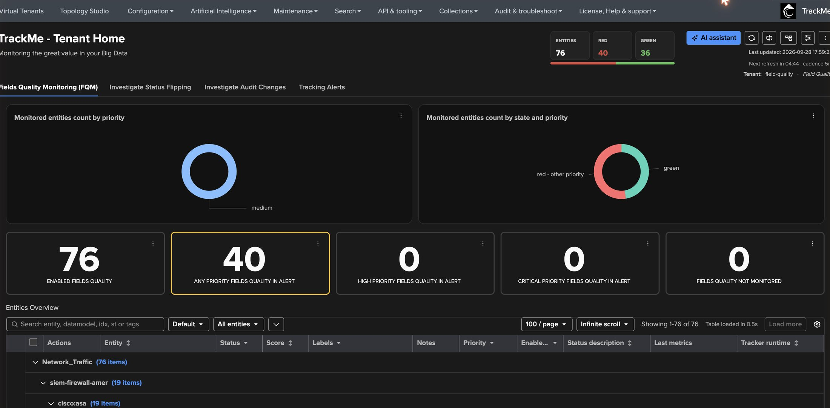
EXAMPLE 1 · RESULT
76 field entities — grouped by data model, index and sourcetype
1
76 enabled fields
5
Every field of the dictionary, per index.
2
40 in alert
Fields below threshold — and one @global per index.
3
3
State by priority
1
2
Classify with priority, tag and SLA policies like any entity.
4
Hierarchy
Network_Traffic → index → sourcetype → field.
4
5
Header KPIs
Entities · red · green, always visible.
TrackMe for Splunk · Hands-on: field quality monitoring
docs.trackme-solutions.com
Notes:
FQM entities are regular TrackMe entities: priority, tags, SLA, labels, logical groups, acknowledgments, maintenance, stateful alerting. The table groups them by the break-by: data model, index, sourcetype.

Slide 22
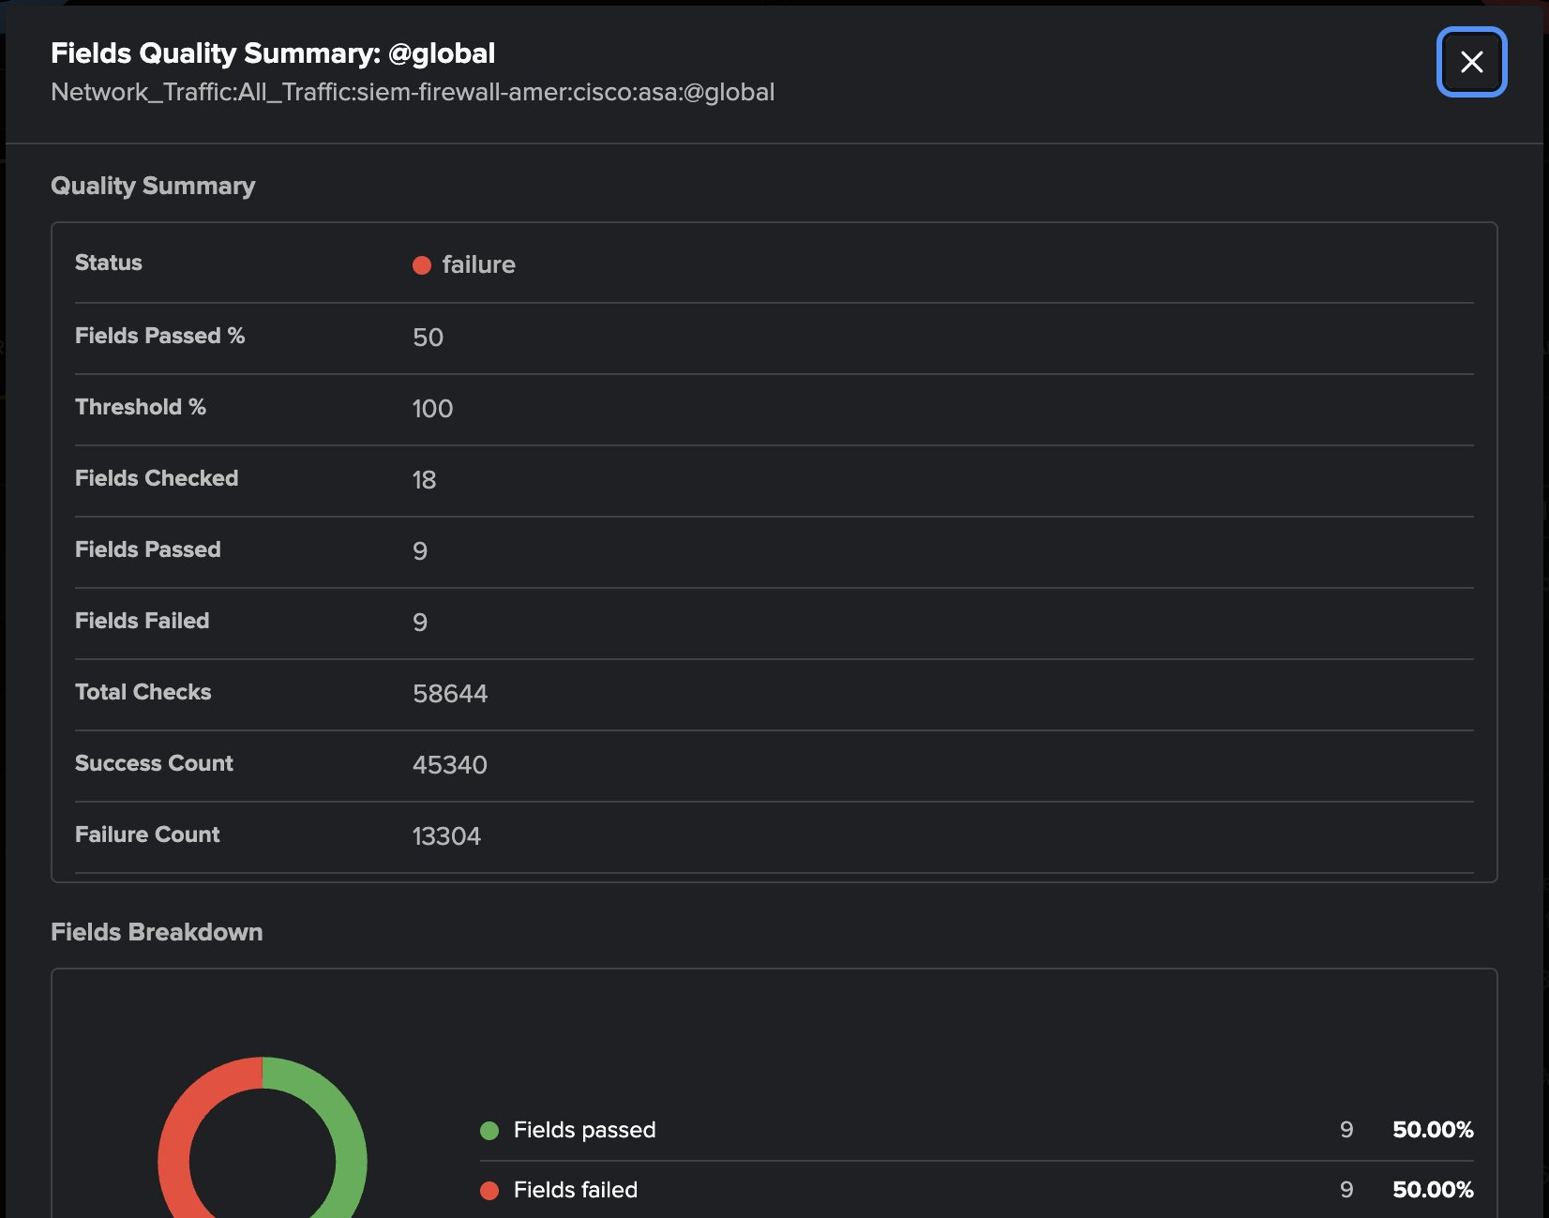
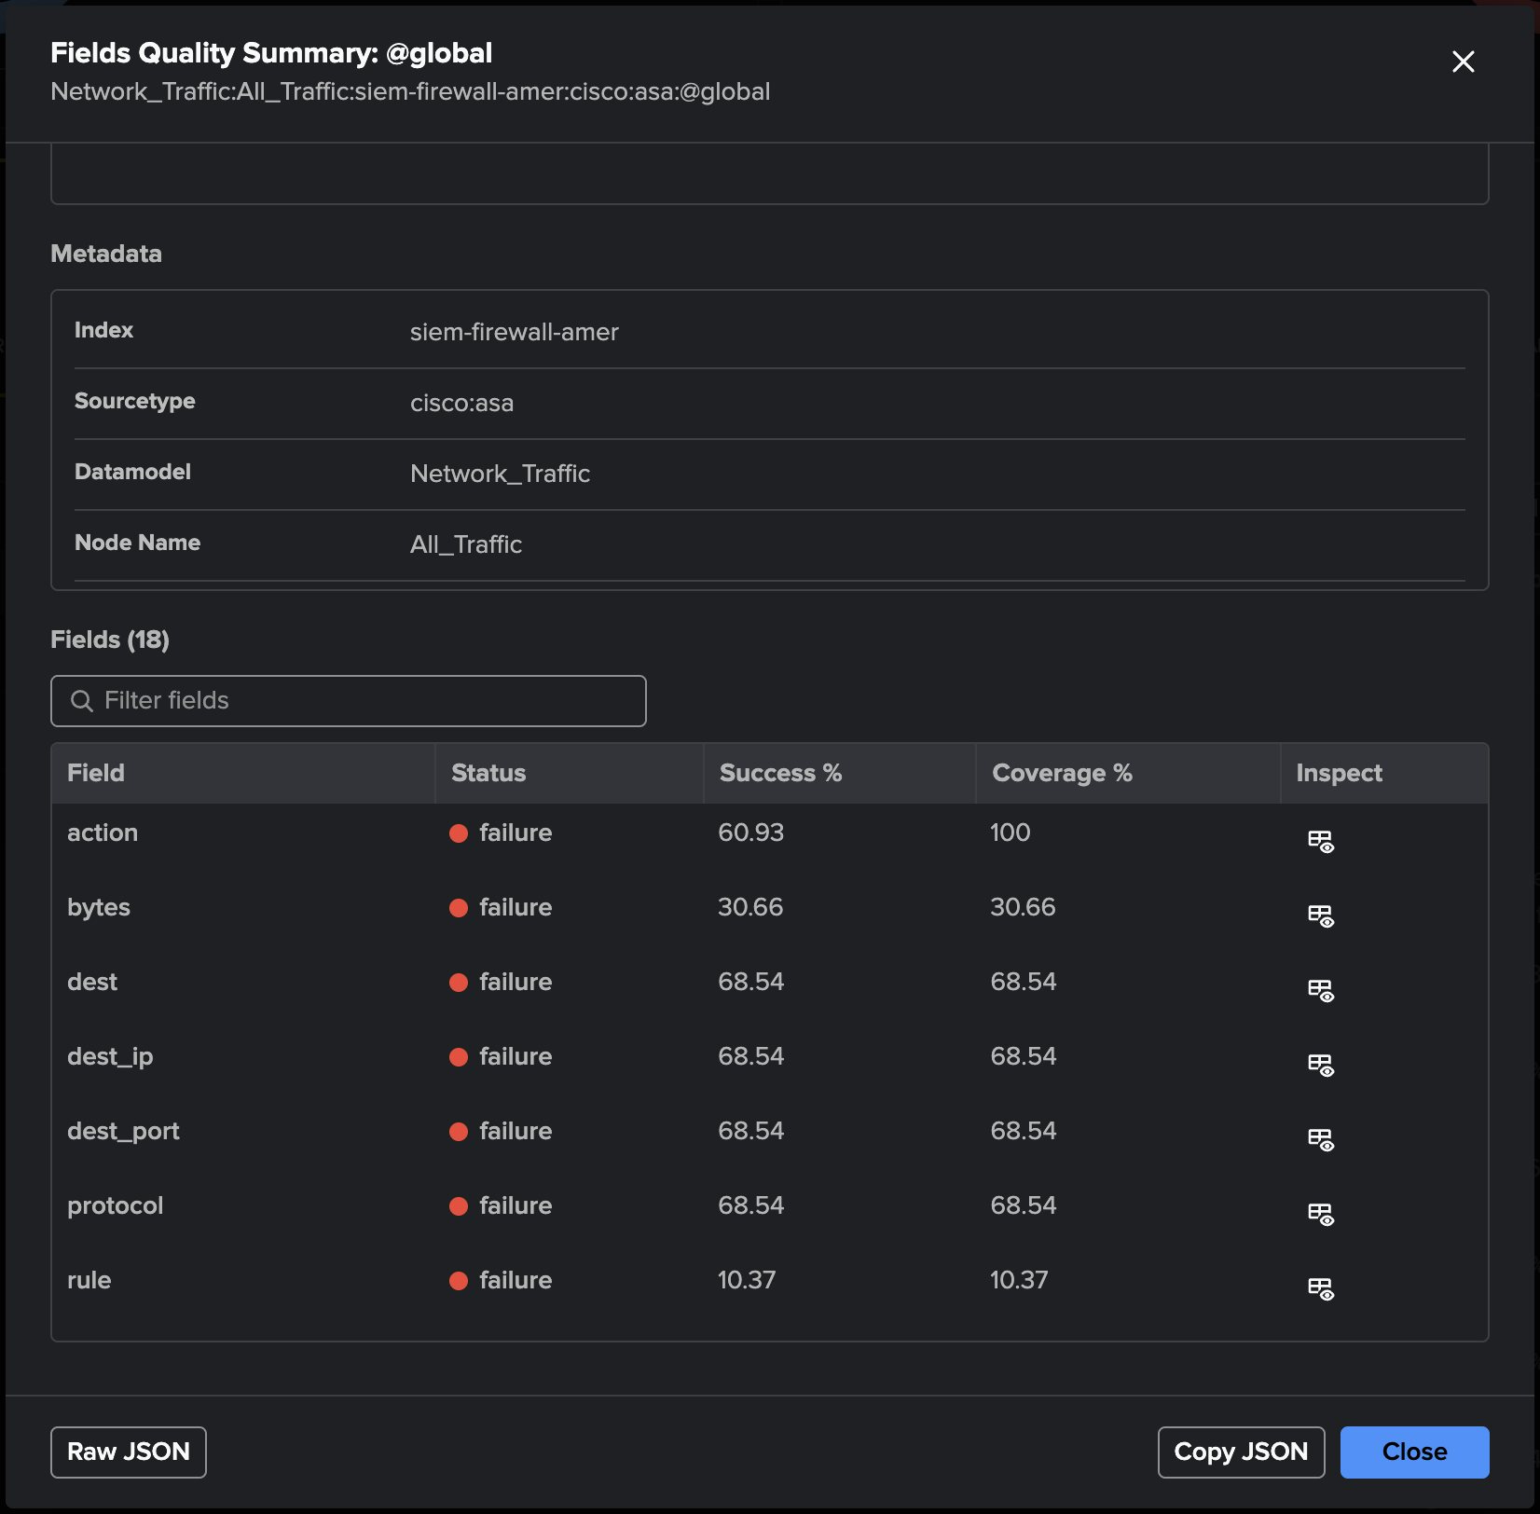
EXAMPLE 1 · RESULT
The @global entity — the context in one view
1
Status: failure
1
9 of 18 fields pass — 50% against a 100% threshold.
2
2
Fields passed %
The @global metric the threshold is evaluated on.
3
5
3
58,644 checks
6
7
Every field of every sampled event: 45,340 successes, 13,304 failures.
4
Fields breakdown
4
Passed vs failed at a glance.
5
Filter fields
Find one field in large dictionaries.
6
Failed first
action, bytes, dest, dest_ip, dest_port, protocol, rule…
7
Drill down
Opens Field Details of that field.
TrackMe for Splunk · Hands-on: field quality monitoring
docs.trackme-solutions.com
Notes:
@global aggregates every field of one context — here Network_Traffic / All_Traffic / siem-firewall-amer / cisco:asa. The inspect view shows fields passed against the threshold, total checks, a passed/failed donut, and the list of fields, failed first, each one drilling into its own Field Details with a Back to @global link.

Slide 23
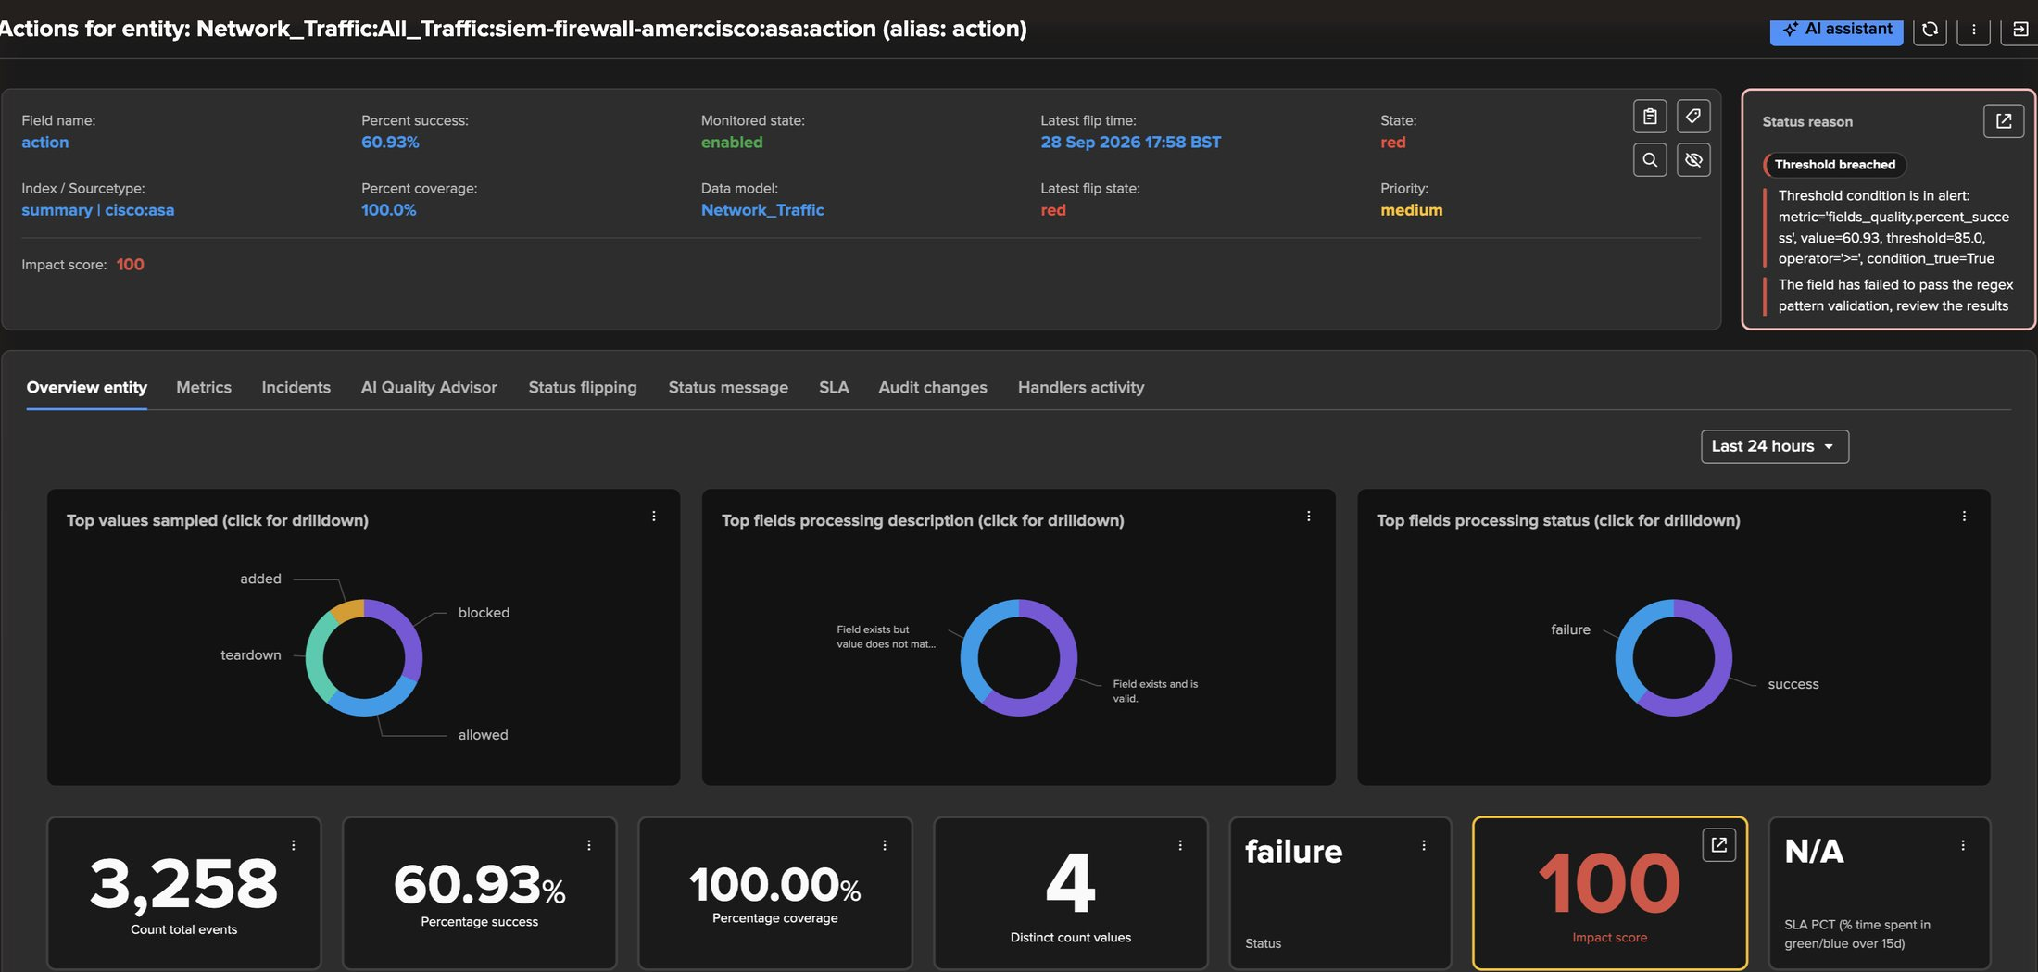
EXAMPLE 1 · INVESTIGATE
The entity — action, red, and why
1
Status reason
Threshold breached: percent_success 60.93 against 85 — the field failed the regex validation.
1
2
Top values sampled
5
blocked · allowed · teardown · added — click to drill down.
3
Processing description
2
3
4
Valid vs value does not match the pattern.
4
Processing status
Success vs failure over the period.
5
AI Quality Advisor tab
The FQM Advisor, per entity — Example 2.
The three charts read the collected samples for this field only, so they stay fast on large trackers.
TrackMe for Splunk · Hands-on: field quality monitoring
docs.trackme-solutions.com
Notes:
Opening the entity gives the same evidence as the wizard, now over time: top values, the category breakdown and the status. The status reason is written in plain language. The AI Quality Advisor tab hosts the FQM Advisor for this entity.

Slide 24
02
EXAMPLE 2 · A NON-CIM DATA SOURCE
E-commerce orders — a dictionary drafted by AI
index="business_data" sourcetype="business:orders:transactions" — JSON order events, no CIM model. The AI Advisors draft the dictionary from the sampled fields, tighten one rule on request, and review the verdict.
TrackMe for Splunk · Hands-on: field quality monitoring
Notes:
Second example: a business feed with no CIM model behind it. This is where the AI Advisors do the heavy lifting: they turn the sampled fields into a starter dictionary, then help tighten and review it. The analyst stays in control of every change.

Slide 25
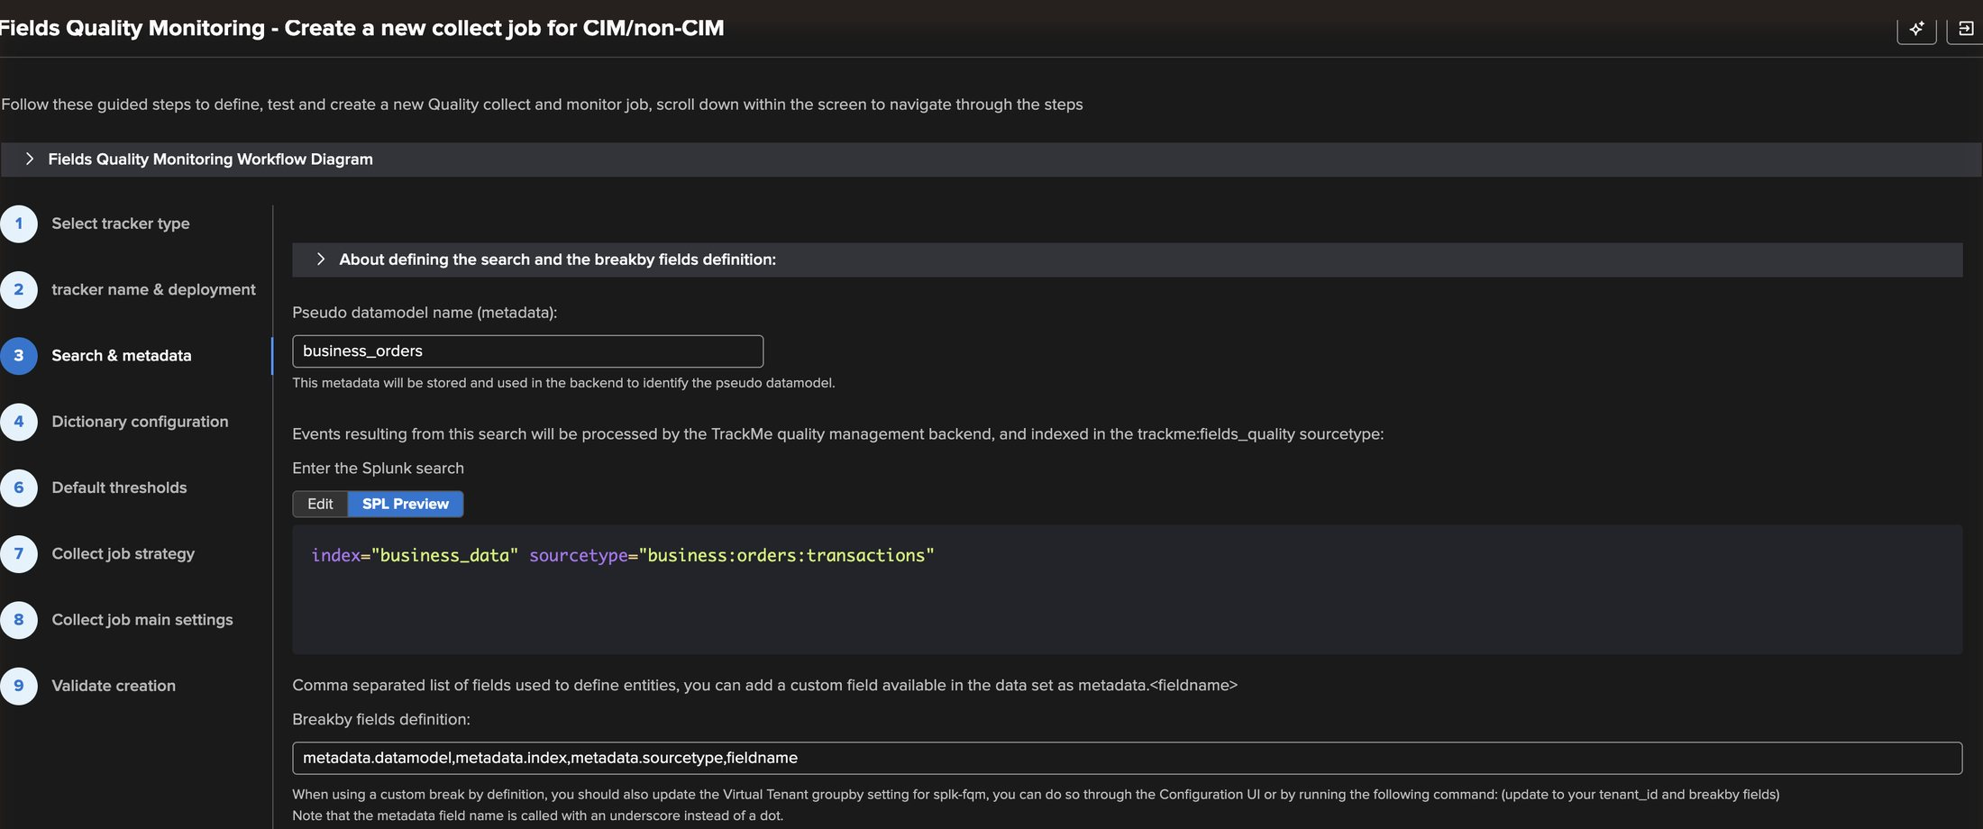
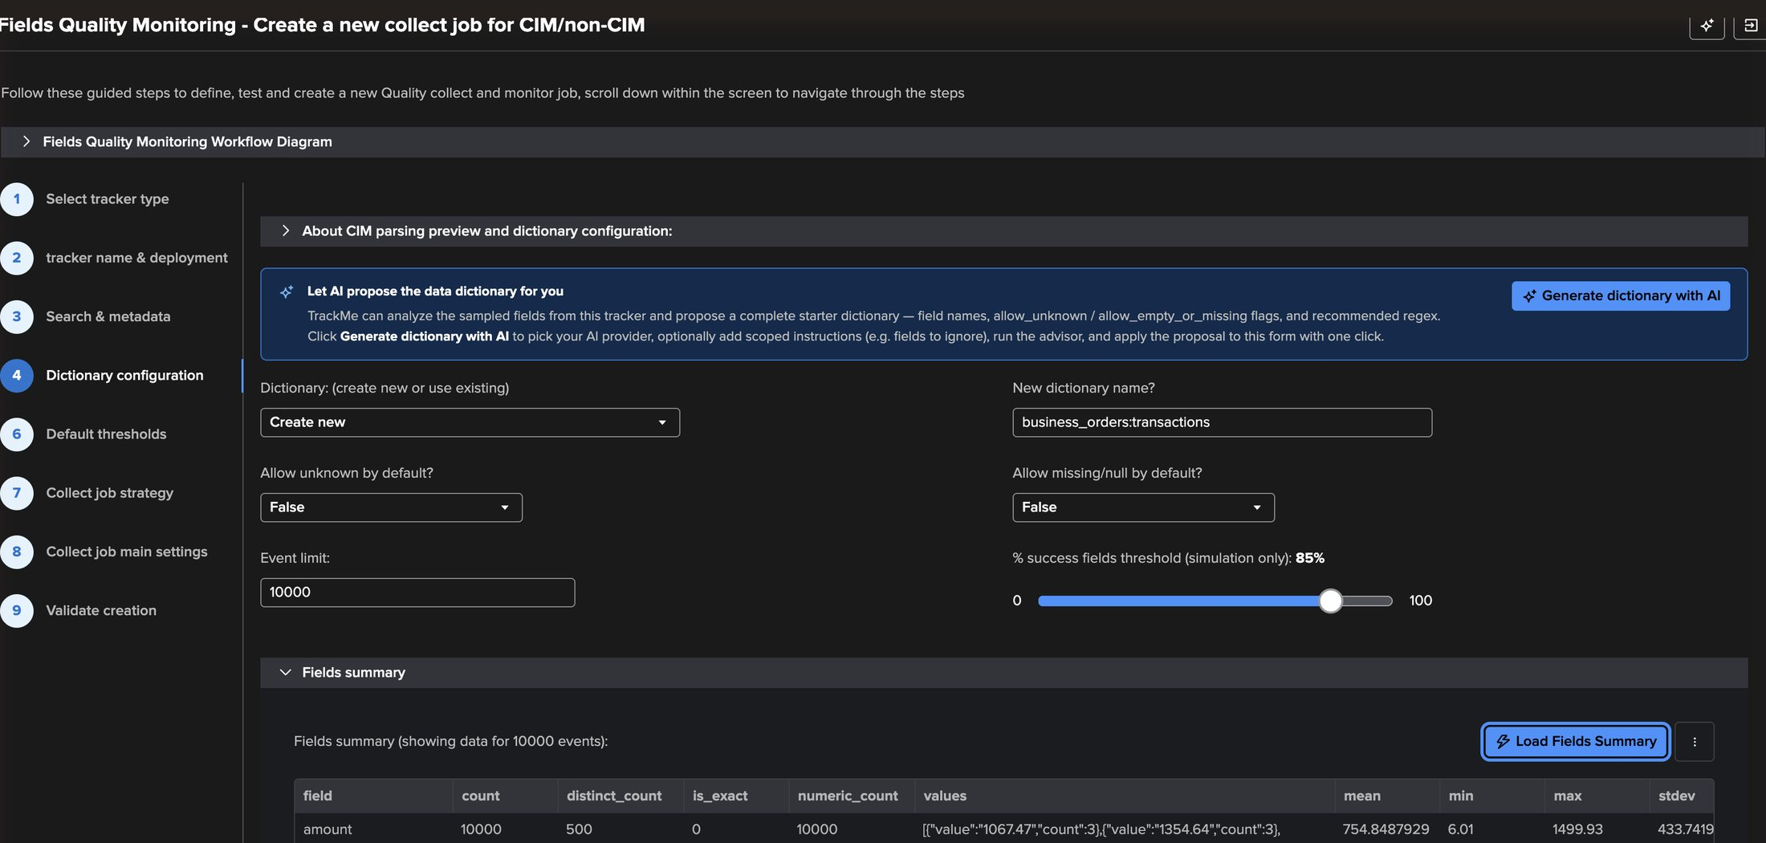
EXAMPLE 2 · WIZARD
Option 2 — any search, a pseudo data model, the sampled fields
1
6
4
2
3
5
1
Pseudo data model — business_orders
Top of the entity hierarchy, like a CIM model.
4
New dictionary — business_orders:transactions
2
The search
Created by this job, reusable by others.
index="business_data" sourcetype="business:orders:transactions"
5
Load fields summary
3
Break-by
fieldsummary over 10,000 events.
Same identity as CIM: model, index, sourcetype, field.
6
Generate dictionary with AI
Enabled once the fields summary is loaded.
TrackMe for Splunk · Hands-on: field quality monitoring
docs.trackme-solutions.com
Notes:
Tracker type: CIM/non-CIM. Step 3 takes a pseudo data model name — business_orders — used to group entities, and any search. Step 4 names the new dictionary and loads the fields summary: the fields found in 10,000 events with counts, distinct values and statistics. That summary is what the AI dictionary advisor analyses.

Slide 26
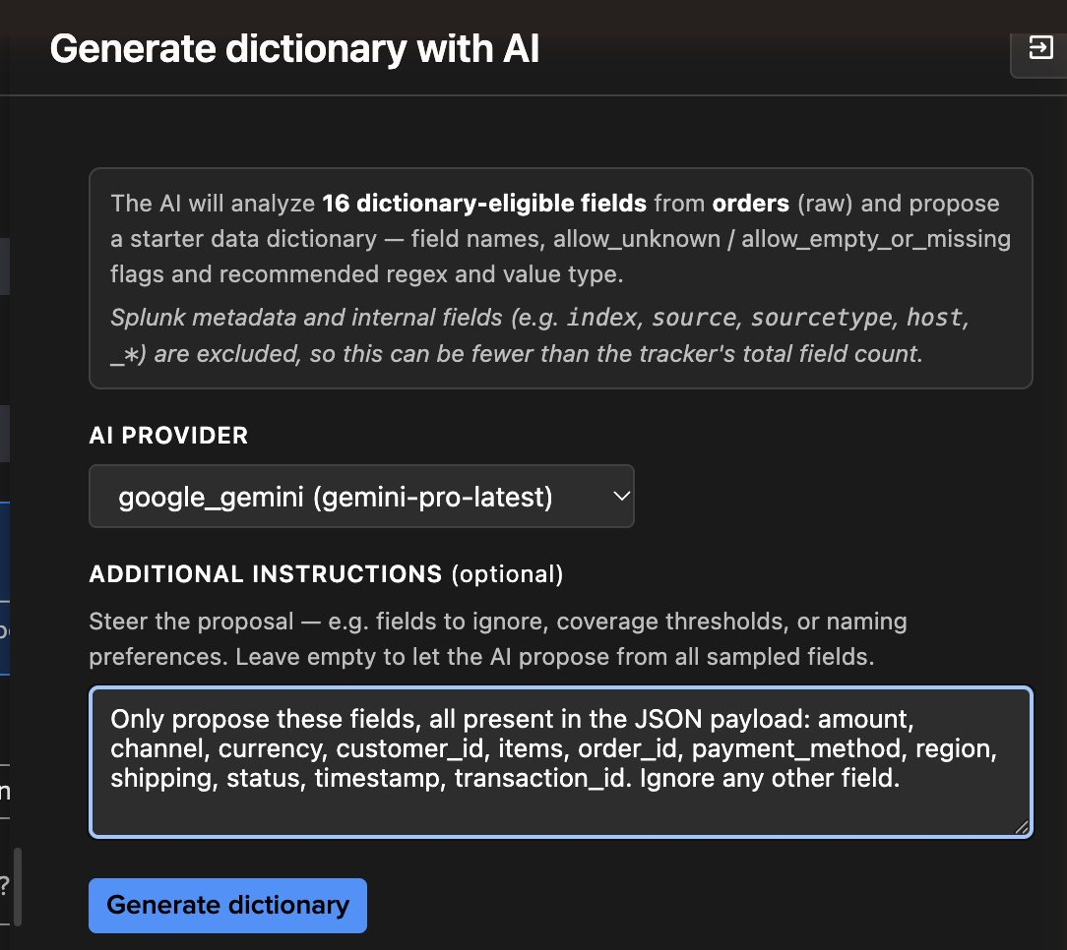
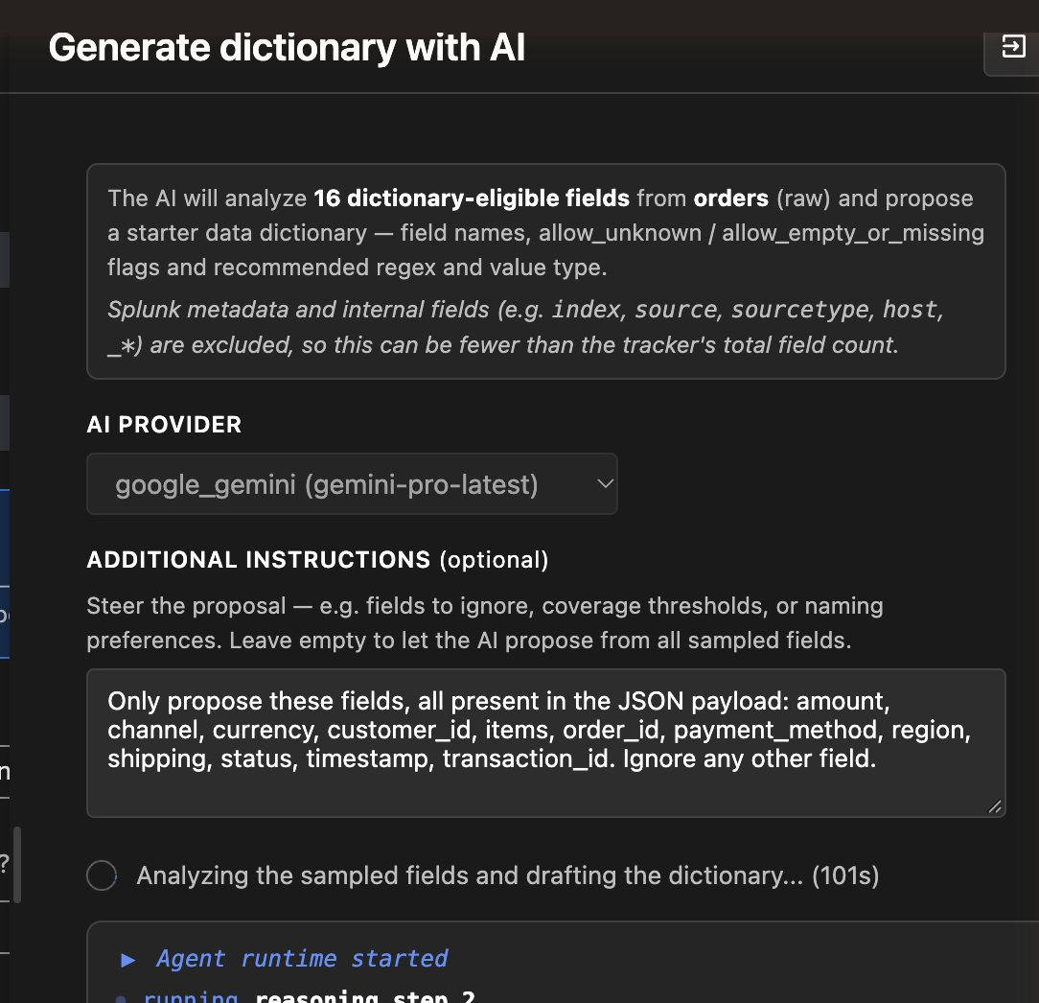
EXAMPLE 2 · AI DICTIONARY ADVISOR
Generate the dictionary with AI — scoped by your instructions
1
16 dictionary-eligible fields
From the sampled events; metadata excluded.
1
2
AI provider
Any provider configured in TrackMe.
3
Additional instructions
2
amount, channel, currency, customer_id, items, order_id, payment_method, region, shipping, status, timestamp, transaction_id.
3
4
Generate dictionary
Starts an AI Advisor run.
4
5
5
Live progress
Agent runtime and reasoning steps, streamed.
The advisor proposes — nothing is written until you apply.
TrackMe for Splunk · Hands-on: field quality monitoring
docs.trackme-solutions.com
Notes:
The AI dictionary advisor analyses the dictionary-eligible fields of the sample — Splunk metadata and internal fields are excluded — and proposes a complete starter dictionary: field names, allow flags, a recommended regex and a value type. Pick the AI provider configured in TrackMe and optionally steer it with instructions. Here we listed the business fields we care about. The run is an AI Advisor agent: its live progress is streamed in the panel.

Slide 27
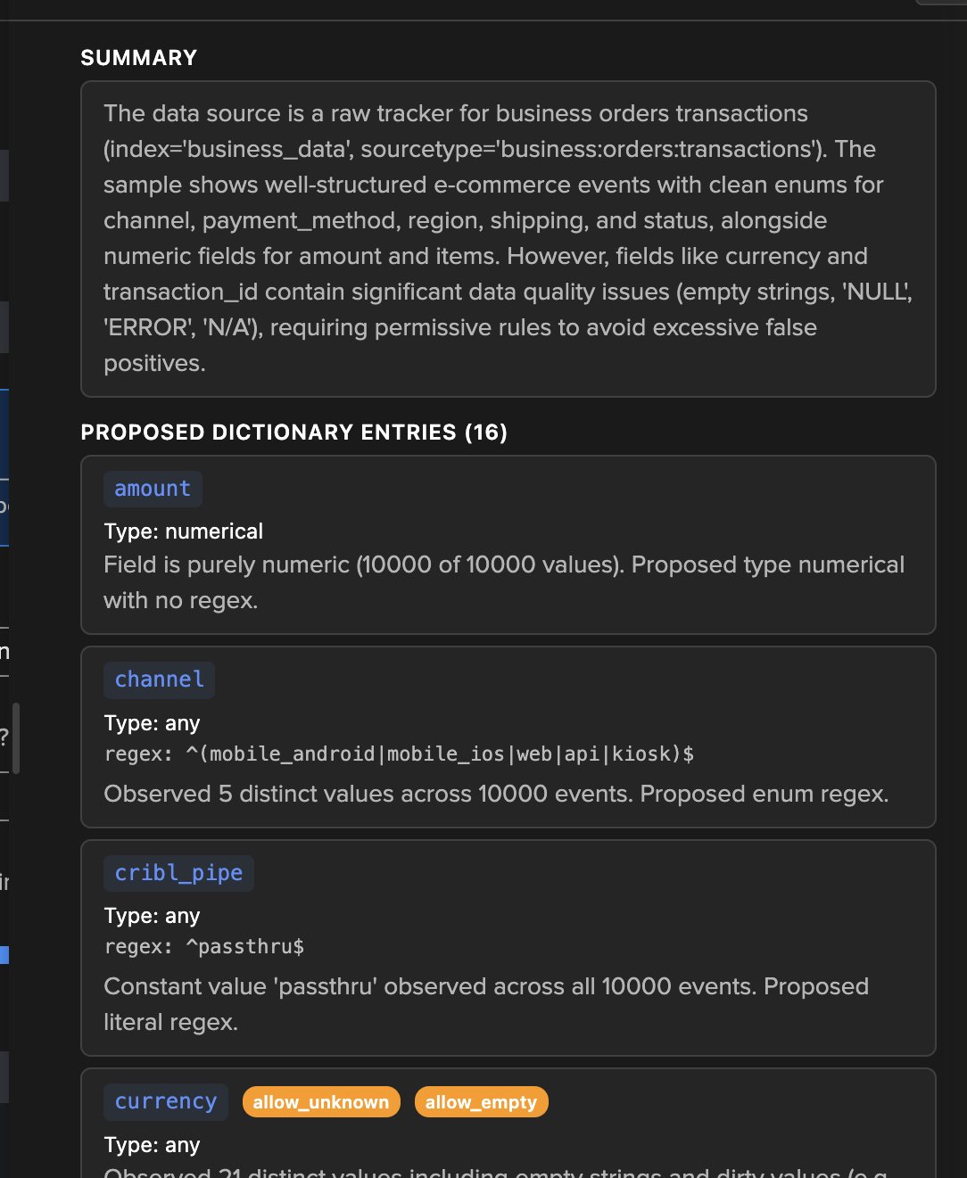
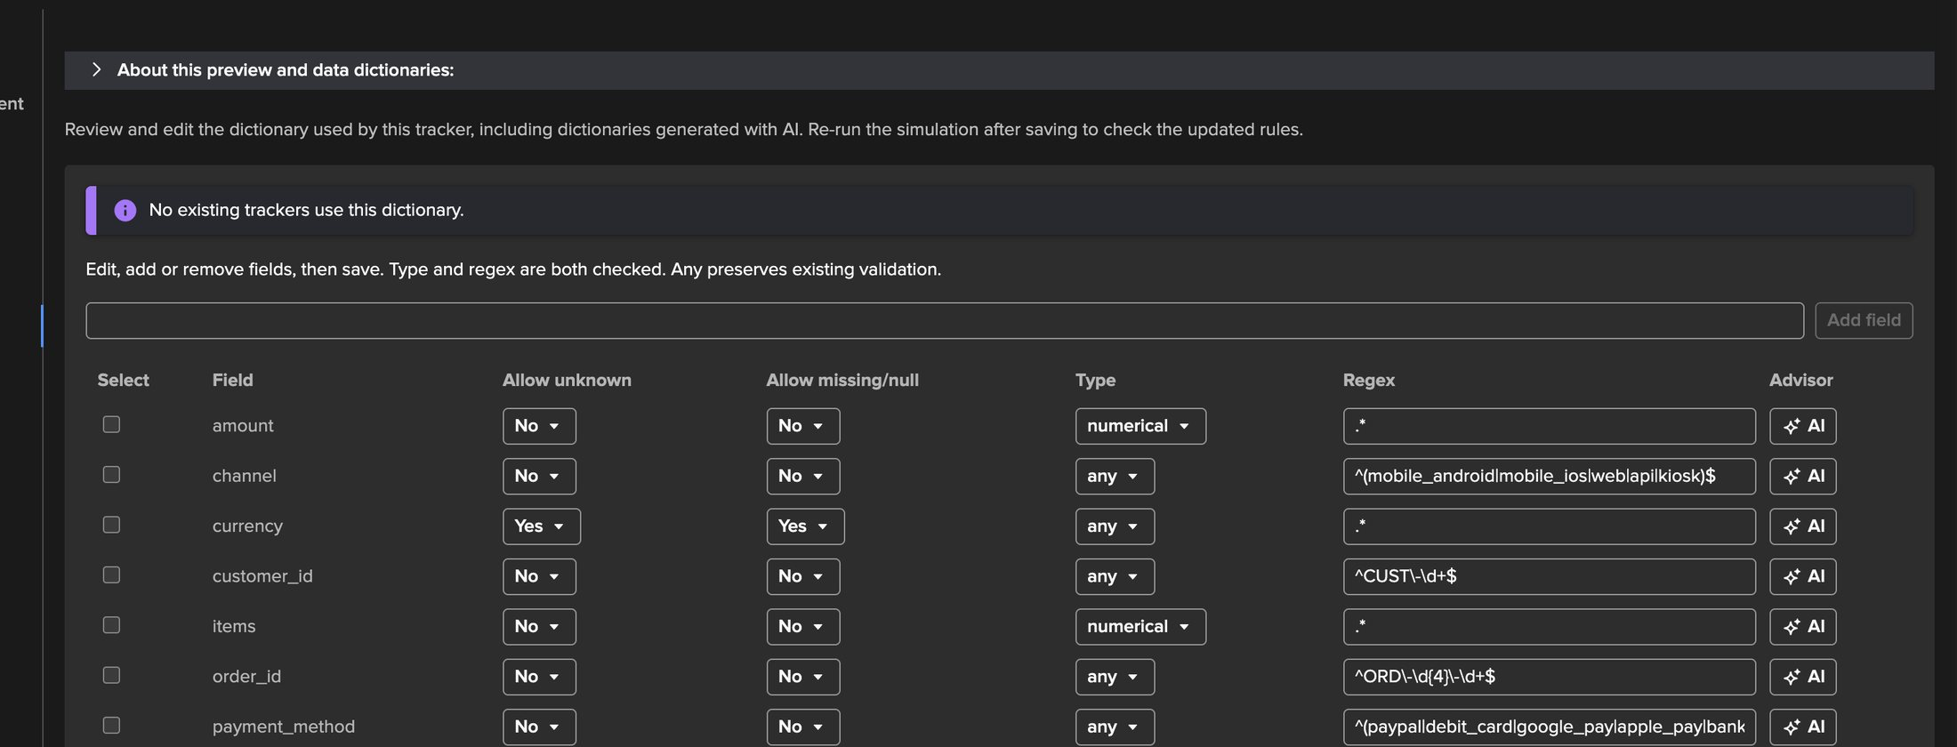
EXAMPLE 2 · AI DICTIONARY ADVISOR
The proposal — a reasoned rule per field, applied in one click
1
Summary of the data
1
Enumerations, numerics — and dirty currency and transaction_id values.
5
6
2
amount — numerical
Purely numeric in 10,000 of 10,000 values.
2
3
channel — enumeration
3
^(mobile_android|mobile_ios|web|api|kiosk)$
What the advisor got right
4
currency — permissive
Enumerations became strict regexes, numeric fields got a type, IDs got recogniser patterns (^ORD-\d{4}-\d+$, ^CUST-\d+$). Minutes of work instead of an afternoon of reading events.
Allow unknown and empty "to avoid false positives" — we will challenge that.
4
5
Applied to the wizard
Saved as a real dictionary, 12 fields kept.
6
AI per field
Every row can ask the AI field advisor.
TrackMe for Splunk · Hands-on: field quality monitoring
docs.trackme-solutions.com
Notes:
The proposal starts with a summary of the data: clean enumerations for channel, payment_method, region, shipping and status; numeric amount and items; and data quality issues on currency and transaction_id. Each entry explains its rule. The advisor proposed an entry for every sampled field, including four ingestion pipeline fields; after applying, we removed those in the editor to keep the 12 business fields.

Slide 28
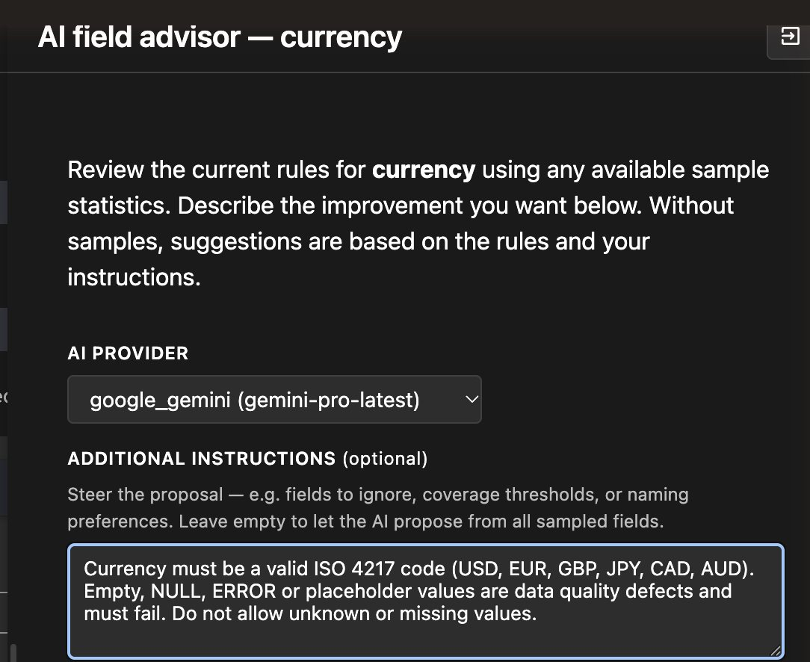
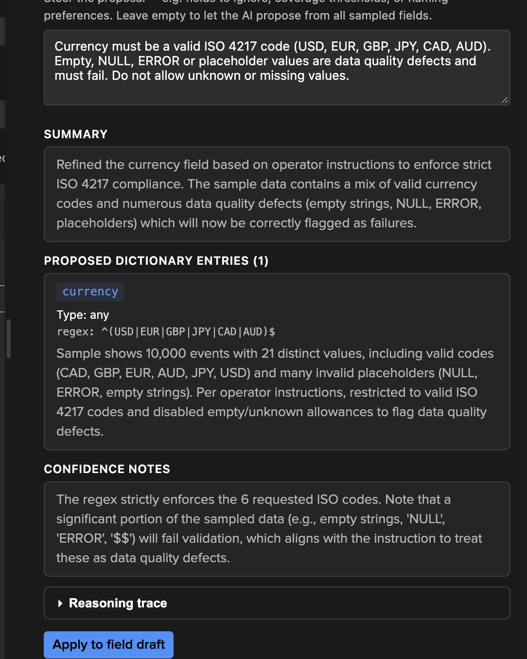
EXAMPLE 2 · AI FIELD ADVISOR
Tighten one rule — ask the AI field advisor about currency
1
One field, one question
AI field advisor — currency, with the sample statistics.
1
3
2
The instruction
Valid ISO 4217 codes only; empty, NULL, ERROR are defects and must fail.
3
Summary
4
Why the rule changes.
4
The rule
2
^(USD|EUR|GBP|JPY|CAD|AUD)$ — allow unknown and missing off.
5
5
Confidence notes
Same pattern as the dictionary advisor: propose, explain, apply only on consent.
The advisor states the impact on the sample up front.
6
6
Apply to field draft
Updates the row; saved with the dictionary.
TrackMe for Splunk · Hands-on: field quality monitoring
docs.trackme-solutions.com
Notes:
The dictionary advisor made currency permissive to avoid false positives. For a quality monitor that is the wrong call: the dirty values are precisely what we want to catch. The per-field AI advisor reviews one rule with the sample statistics and our instruction. Its proposal: a strict ISO 4217 regex, empty and unknown no longer allowed, and a confidence note that states the consequence — a significant share of the sample will fail, which is the point.

Slide 29
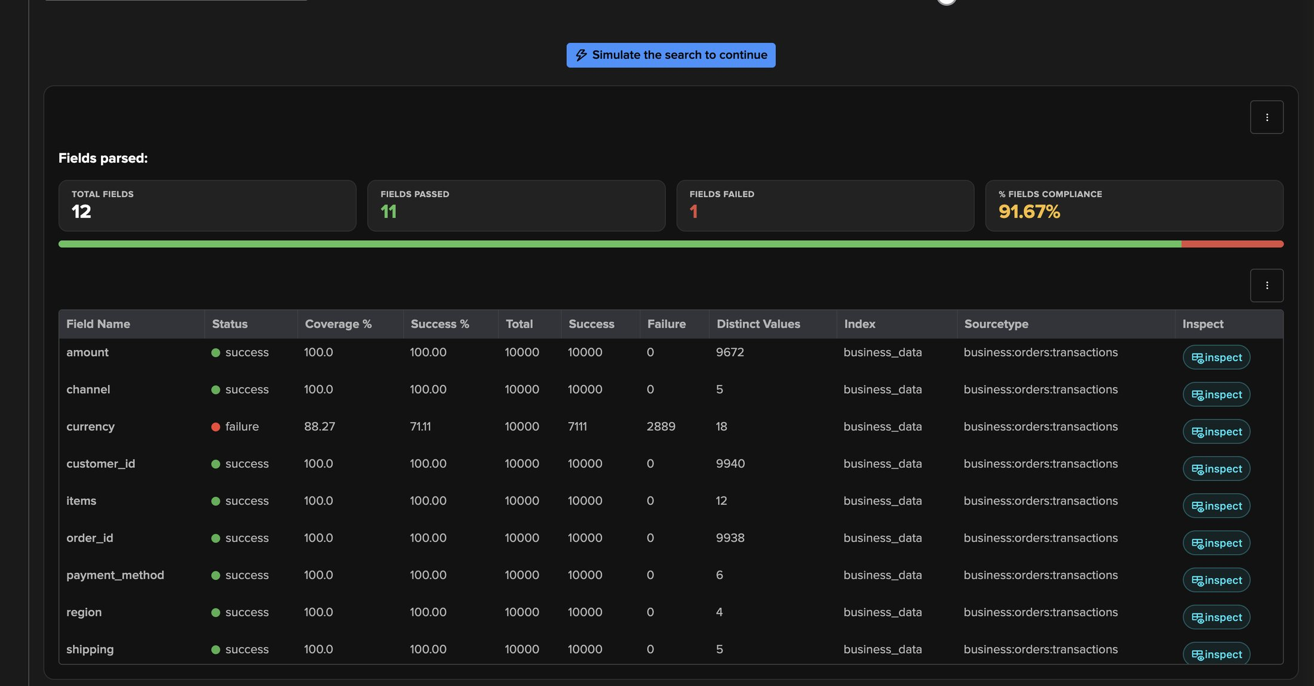
EXAMPLE 2 · SIMULATE
11 of 12 fields pass — currency is the business finding
1
91.67% field compliance
12 fields checked, 11 passed, 1 failed.
2
currency — failure
1
Coverage 88.3%, success 71.1%.
3
2,889 failures in 10,000 orders
4
Almost 29% of the orders carry an unusable currency.
2
3
4
Everything else is clean
IDs, enumerations, amounts and timestamps: 100%.
Why it matters
For finance and reporting teams this is not a parsing detail: revenue by currency is wrong for more than a quarter of the orders.
TrackMe for Splunk · Hands-on: field quality monitoring
docs.trackme-solutions.com
Notes:
With the tightened rule, the simulation isolates exactly one problem. Everything the AI qualified as clean is clean. The failure on currency is a genuine data quality issue in the source application.

Slide 30
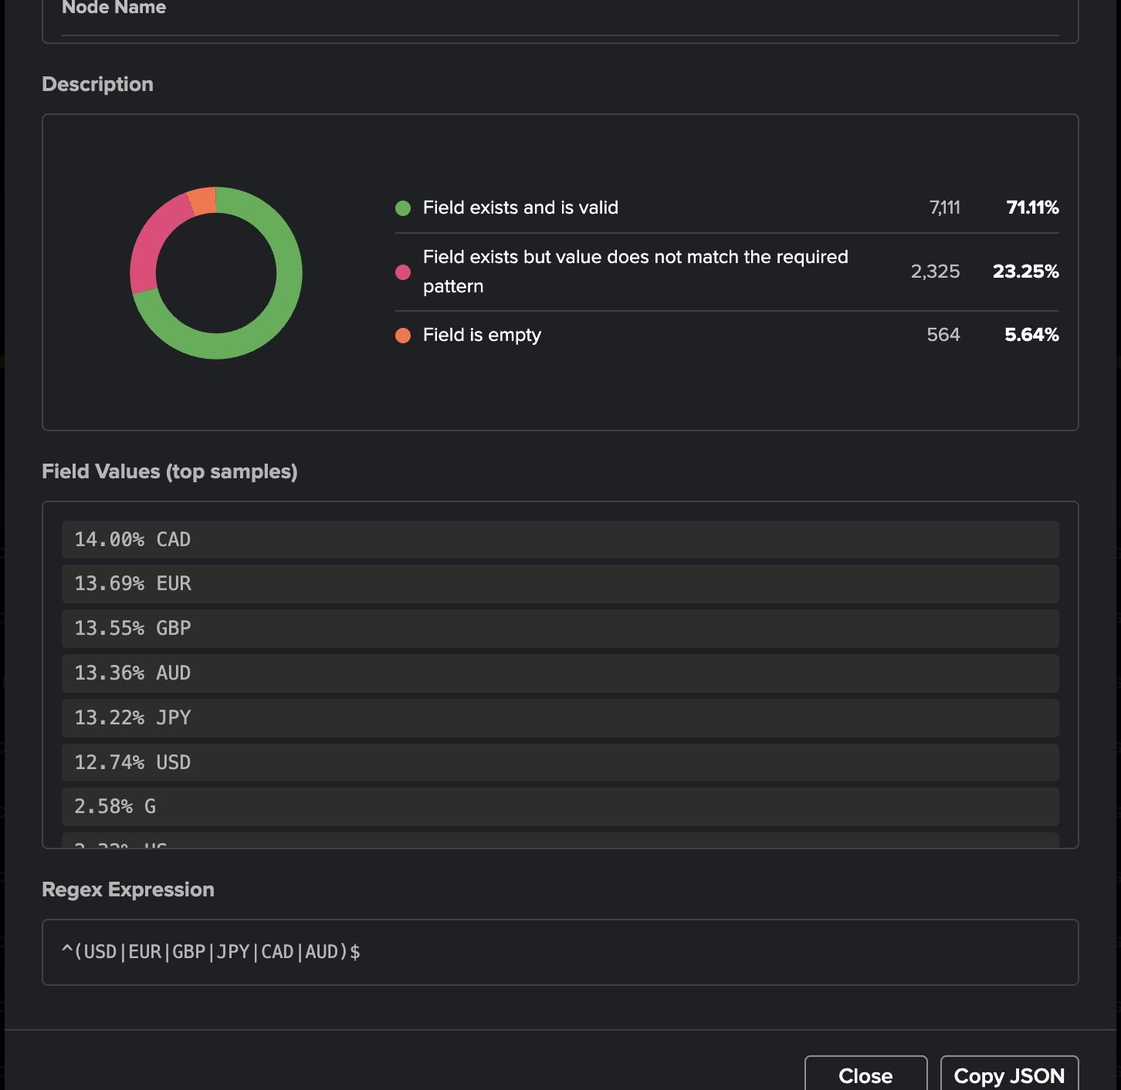
EXAMPLE 2 · FIELD DETAILS
currency — wrong codes, spelled-out words, placeholders, blanks
1
Field exists and is valid — 71.1%
Same view everywhere
CAD, EUR, GBP, AUD, JPY, USD: 12.7% to 14% each.
The same view exists in the wizard (simulation → inspect) and in Tenant Home (Last metrics → inspect) once the tracker runs.
2
Value does not match — 23.3%
1
2
Present, but not an ISO 4217 code.
4
The failing values
3
G · US · EU · XYZ · DOLLAR · $$ · EURO · NULL · - — each 1–3% of the orders.
4
Field is empty — 5.6%
No currency at all.
3
TrackMe for Splunk · Hands-on: field quality monitoring
docs.trackme-solutions.com
Notes:
Field Details for currency. 71% valid; 23% present but not matching the ISO pattern; 6% empty. The top values are the evidence you forward to the application team: truncated codes (G, US, EU), spelled-out words (DOLLAR, EURO), symbols ($$), placeholders (NULL, -, XYZ).

Slide 31
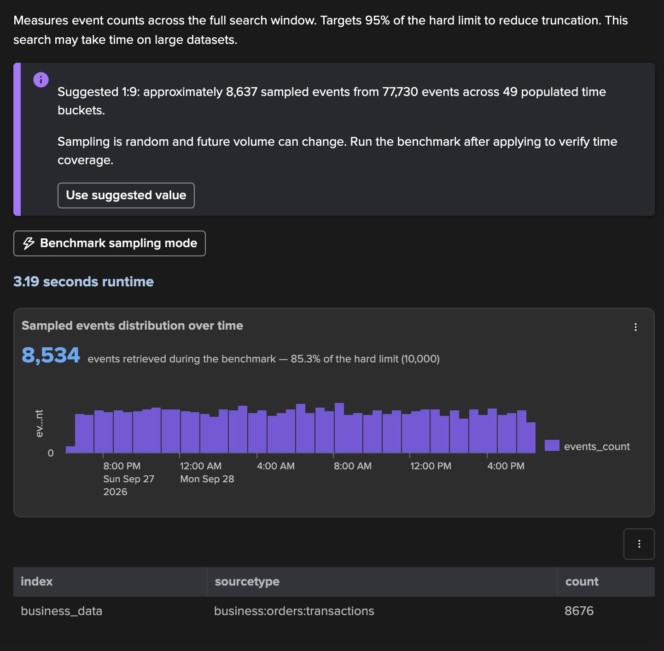
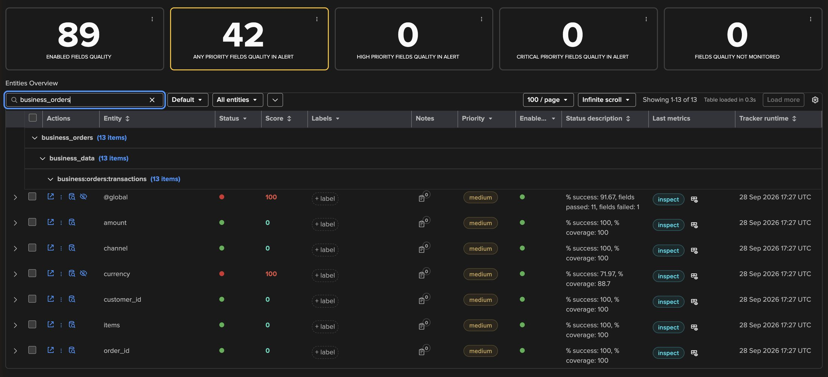
EXAMPLE 2 · CREATE AND RUN
Auto define again — then 13 entities in the tenant
1
3
4
2
5
3
business_orders → business_data → business:orders:transactions
1
Suggested 1:9
Same hierarchy as CIM.
77,730 events → ~8,637 sampled, 49 buckets.
4
@global — 91.67%
2
8,534 events, 3.2 s
11 of 12 fields pass.
5
currency — red
Spread over the full 24 hours.
success 71.97%, coverage 88.7%.
TrackMe for Splunk · Hands-on: field quality monitoring
docs.trackme-solutions.com
Notes:
Step 7 again: Auto define measures 77,730 order events in 49 buckets and suggests 1:9, about 8,600 sampled events; the benchmark retrieves 8,534 in 3.2 s. After creation and a first run, the tenant has 13 new entities: 12 fields and the @global. currency and @global are red, everything else green.

Slide 32


EXAMPLE 2 · AI ASSISTANT → FQM ADVISOR
Ask about the entity — the Assistant hands over to the FQM Advisor
1
The question
Which values fail, what share, what to fix?
2
Failing values, by kind
1
Truncated · non-standard · error values · empty.
4
3
28.03% of orders
22.35% invalid, 5.68% empty.
4
What to fix at the source
2
Standardise outputs, fix truncation, handle nulls.
5
6
5
FQM Advisor — proposed action
3
Inspect the failing values and the dictionary.
6
Run now (inspect)
Read-only run, launched from the chat.
TrackMe for Splunk · Hands-on: field quality monitoring
docs.trackme-solutions.com
Notes:
On the currency entity we asked the AI Assistant which values fail, how many orders are affected and what the application team should fix. It answers from the entity data: the failing values grouped by kind, 28% of orders, three concrete fixes. Then it proposes the right specialist: an FQM Advisor inspect run, as an action card the user launches in one click.

Slide 33
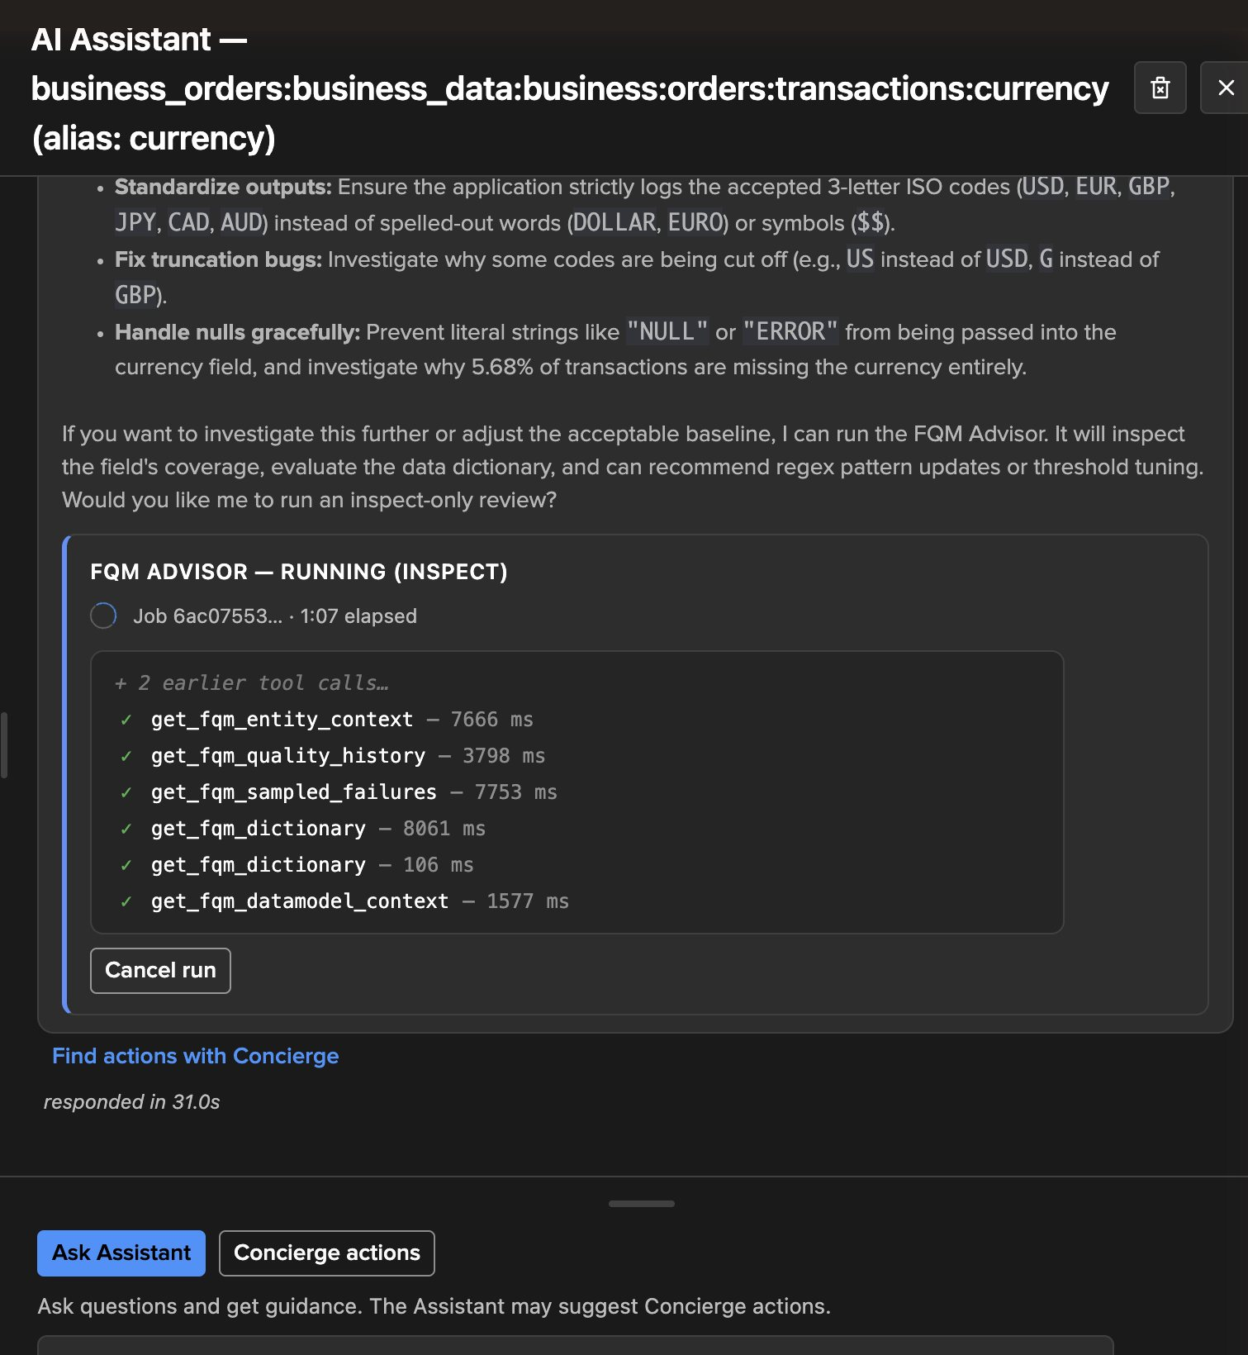

EXAMPLE 2 · FQM ADVISOR
The FQM Advisor verdict — keep the rule, fix the data
1
Running (inspect)
Read-only mode: no change is possible.
2
Evidence gathered
Entity context, history, sampled failures, dictionary, data model.
3
3
Collect Job Issue
1
4
The verdict category.
4
The rule is right
2
Failures come from garbage or unparsed data, not the dictionary.
5
5
Do not loosen the regex
"Loosening the regex would hide real data breakage."
6
6
Act mode
Applies recommended changes — only after consent.
Three AI Advisor steps: draft the dictionary · tighten one rule · review the verdict.
TrackMe for Splunk · Hands-on: field quality monitoring
docs.trackme-solutions.com
Notes:
The FQM Advisor runs as an agent with read tools: entity context, quality history, sampled failures, the dictionary and the data model context — the live feed shows each call. Its verdict: Collect Job Issue. The rule is correct; the failures come from upstream parsing or the data source; loosening the regex would hide real data breakage. Act mode can then apply recommended changes, with the same consent step.

Slide 34
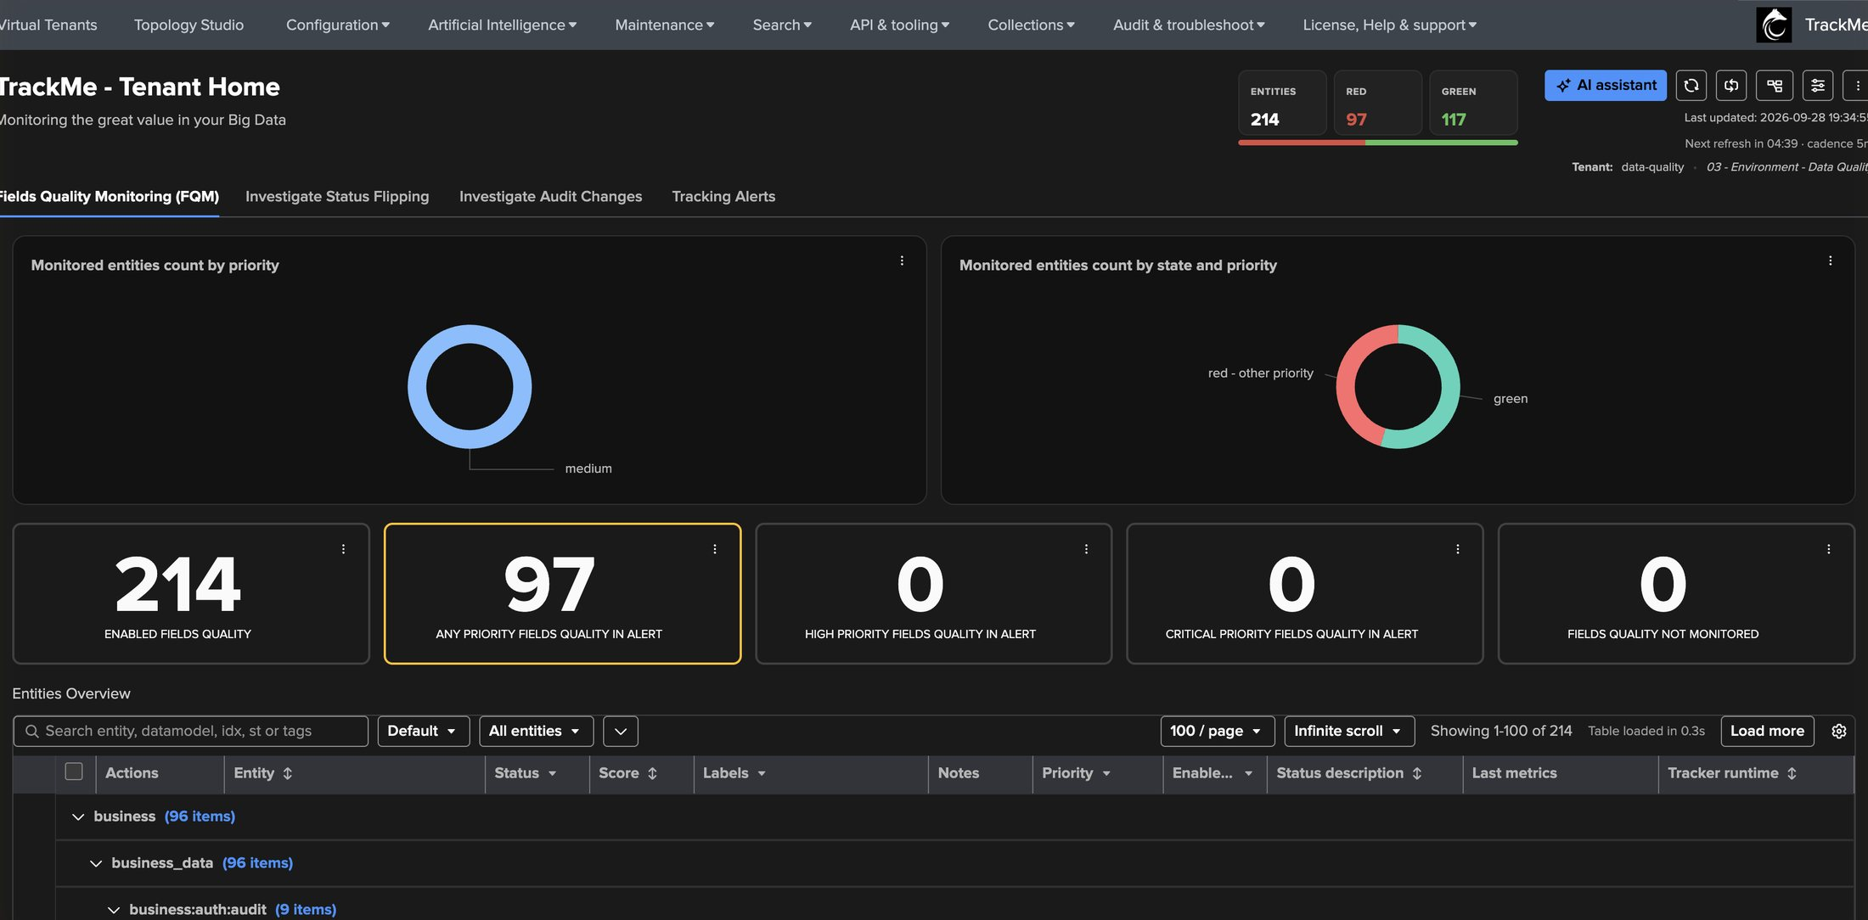
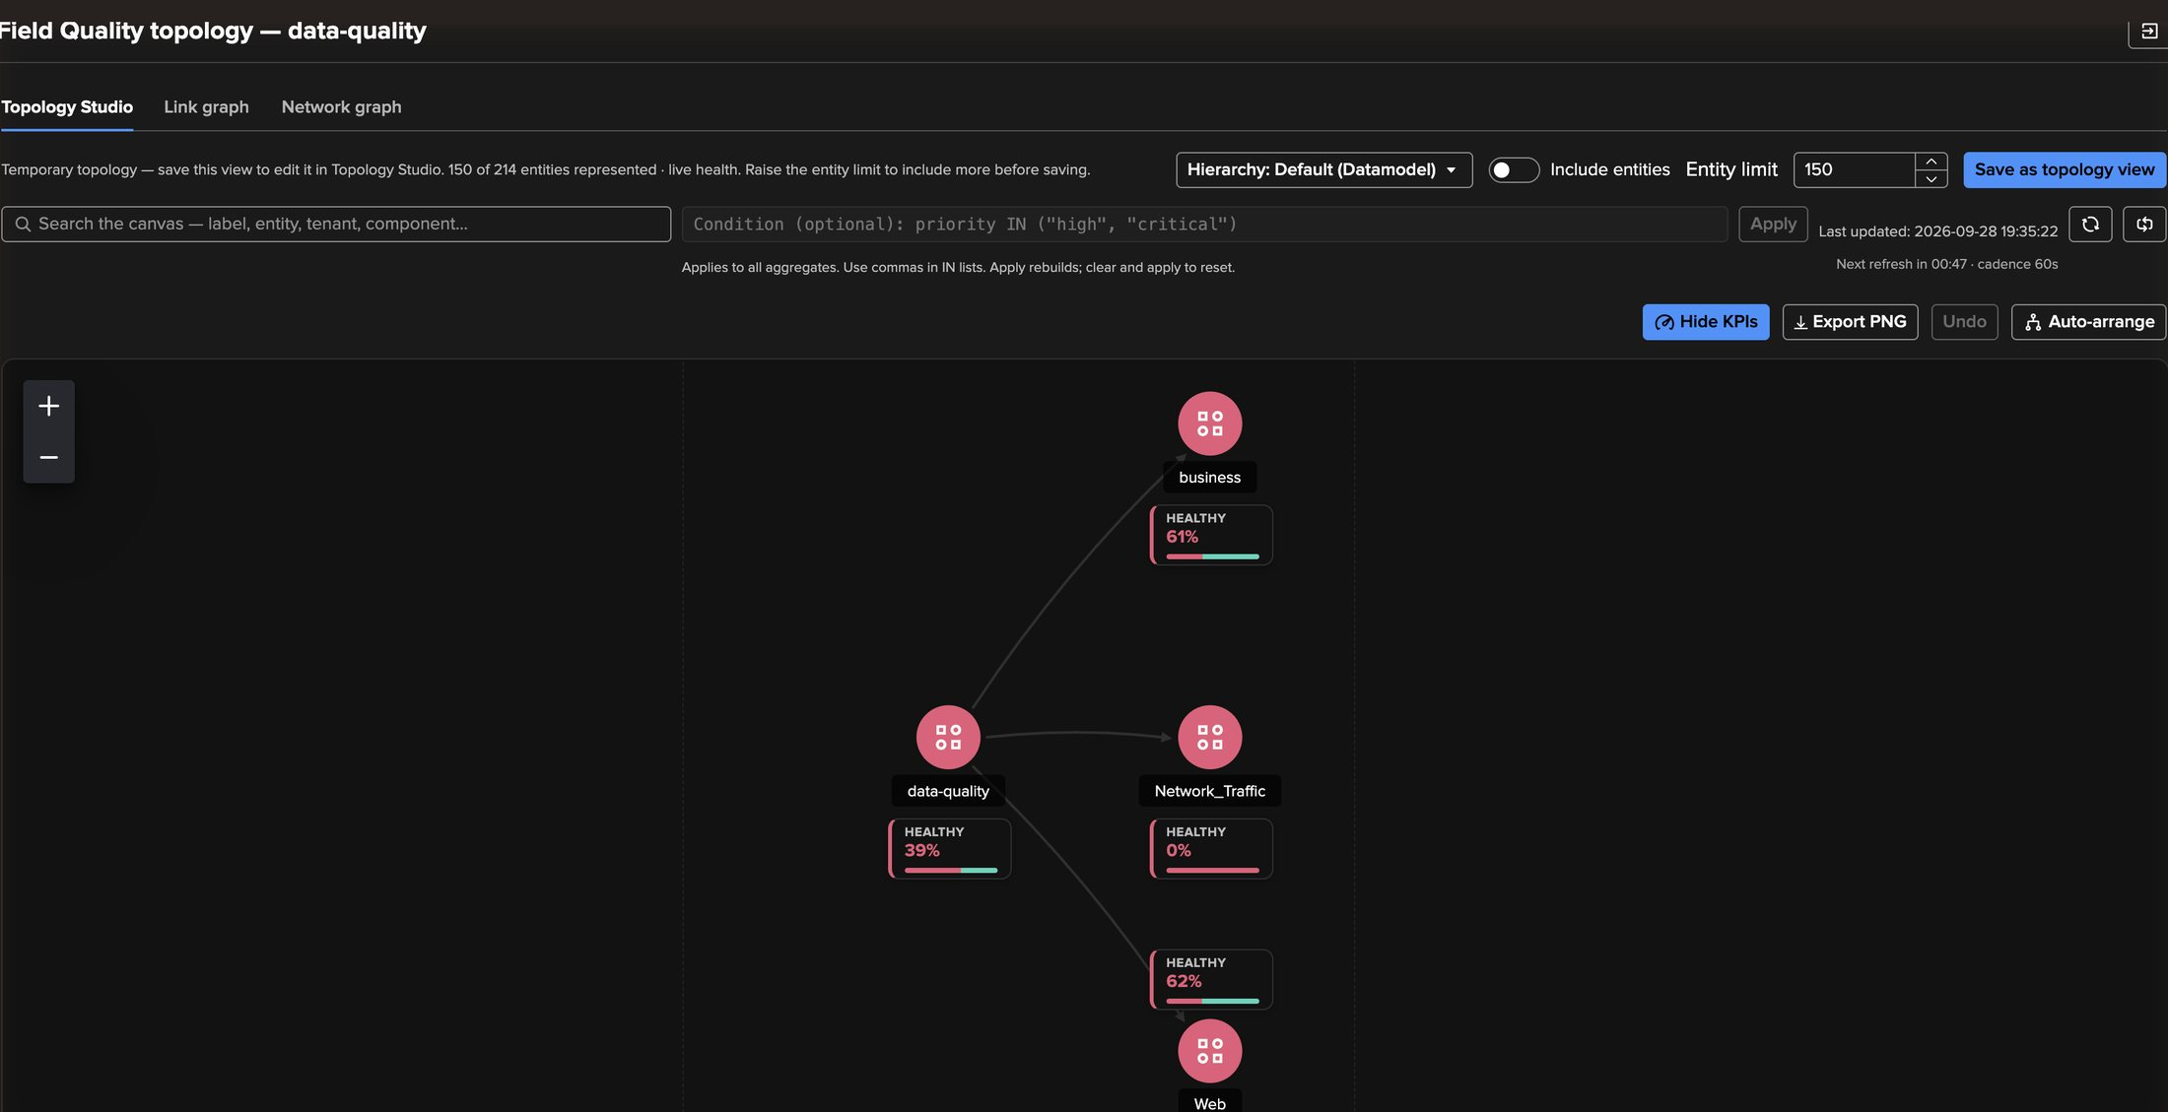
AT SCALE
A mature FQM tenant — 214 fields, months of history
5
1
2
4
6
3
1
214 enabled fields
4
Field Quality topology
Across business and CIM trackers.
Tenant → data model, with live health.
2
97 in alert
5
business — 61% healthy
Quality issues to route to owners.
Aggregated from every field below it.
3
Grouped by data model
6
Network_Traffic — 0%
business · Network_Traffic · Web.
Save it as a Topology Studio view.
TrackMe for Splunk · Hands-on: field quality monitoring
docs.trackme-solutions.com
Notes:
The same model on an established tenant: several business and CIM trackers, 214 field entities, months of history. The topology graph summarises health by data model — here business at 61%, Web at 62%, Network_Traffic at 0% healthy. Every entity keeps its history, flips, incidents and SLA like any TrackMe entity, and stateful alerts notify the owners.

Slide 35
RECAP
Where we are
In two walkthroughs
Created
Measured
Tuned
Found
a Field Quality tenant and two trackers — a CIM Cisco ASA job and a non-CIM JSON orders job
with simulations on 10,000 events, then sampling sized by Auto define across the full 24 hours
the CIM dictionary (25% → 66.7%) and an AI-drafted dictionary, tightened per field
a CIM defect on action, and a currency problem on 28% of orders confirmed by the FQM Advisor
What made it work
Dictionary first
Read the category
Representative samples
CIM generates it, the AI dictionary advisor drafts it — you decide, rule by rule, in the editor.
Value does not match is a defect. Field missing by design is a dictionary setting.
Sampling with Auto define covers the whole window; head mode only sees the latest events.
TrackMe for Splunk · Hands-on: field quality monitoring
docs.trackme-solutions.com
Notes:
Recap: two feeds, two dictionary strategies, one model. CIM gives you the rules; the AI Advisors draft them for everything else. Sampling sized by Auto define keeps the measurement representative. The Field Details and @global views explain every verdict, and the FQM Advisor tells rule problems apart from data problems.

