Slide 1

HANDS-ON WALKTHROUGH · CRIBL EDGE
Is every Edge Node where it should be?
One tenant follows the Fleets of a Cribl Edge Leader, the Edge Nodes enrolled in them and the Sources and Destinations they run — connected nodes, rollouts that reached every node, versions, failing inputs and outputs, full disks — at any fleet size.
Captured live on TrackMe 2.4.19 · a Cribl.Cloud Edge Fleet of 17 nodes
Notes:
Hands-on walkthrough of the Cribl Edge tenant, generally available in TrackMe 2.4.19. Everything was captured live on a Cribl.Cloud Edge Fleet of 17 nodes. In four parts: create the tenant, follow the Fleets and the Edge Nodes, read the findings, and operate the tenant.

Slide 2
THE PROBLEM
An Edge fleet fails one node at a time — silently
A handful of servers or tens of thousands of endpoints: nobody can open each node to check it.
Nodes that drop
Rollouts left behind
Inputs and outputs failing
A collector shut down, a fifth of a Fleet disconnected after a network change — and the data of those hosts stops.
A deploy that did not reach every node, nodes left on an old Edge version after an upgrade.
A Destination in trouble on 4 of 17 nodes, a disk filling up on one host.
What a Cribl Edge tenant does
A dedicated tenant type on a Cribl connection to the Edge Leader. TrackMe reads the Leader's node directory in bulk at every run — no call per node, no node limit — judges each Fleet as a share of its nodes, and raises findings from eleven built-in policies. Nothing is installed or changed on Cribl.
TrackMe for Splunk · Hands-on: Cribl Edge
docs.trackme-solutions.com
Notes:
An Edge operator asks the same questions every day: are my nodes connected, did my last deploy reach every node, is every node on the same Edge version, which Source or Destination is failing and on how many nodes, which host is running out of disk. The Cribl Edge tenant answers them with findings raised by built-in policies, with the same triage as the Cribl Stream tenant.

Slide 3
THE MODEL
One bulk read of the Leader, judged per Fleet, at any size
1
Node directory
2
Fleet configuration
3
System Metrics (optional)
4
Fleet judgement
5
Finding groups
The Leader's Edge Nodes read in bulk every 5 minutes: connection, version, configuration, disk, Sources and Destinations health.
Fleets with their Sources, Destinations, Pipelines, Routes and Packs, about once an hour.
A Splunk metrics index for node CPU and memory only.
Shares of a Fleet, graces and thresholds: one sleeping laptop opens nothing.
11 policies, 8 on out of the box; one object's findings in one group.
›
›
›
›
Detail on demand
A node's CPU, memory, network and disk activity, and the live status of one of its Sources or Destinations, are read from the Leader only when someone opens that node: the fleet-wide collection stays one bulk read.
No traffic ML models for Edge: endpoints are sparse and irregular, and there can be very many of them. Explicit, explainable rules instead.
TrackMe for Splunk · Hands-on: Cribl Edge
docs.trackme-solutions.com
Notes:
The model. Every five minutes TrackMe reads the Leader's list of Edge Nodes page by page and keeps it as one published node directory: no call per node, no rotation, every node current within one interval. The Fleet configuration is read about once an hour. Policies judge each Fleet as a share of its nodes, select nodes that must never drop, and watch disk, and CPU and memory when a System Metrics index is set. There is no machine learning for Edge.

Slide 4
THE PLAN
What we are going to do — one tenant, four parts
PART 1
PART 2
PART 3
PART 4
Setup
Fleets & nodes
Findings
Operate
The Cribl Edge card
The Fleets tab
The Findings tab
Policies, bank holidays, collection health
Connection & Fleets
A Fleet, and its nodes to look at
A disconnected node, nodes that must stay connected
Settings, Topology Studio, the assistant
The workspace and its strip
Edge Nodes, one node up close
Version drift
The AI Agent and its instructions
Every screen is the product as shipped, on a Cribl.Cloud Edge Fleet.
TrackMe for Splunk · Hands-on: Cribl Edge
docs.trackme-solutions.com
Notes:
Four parts. Setup: the wizard and the workspace. Fleets and nodes: the Fleets tab, a Fleet, the Edge Nodes and one node up close. Findings: the backlog, a disconnected node, the nodes that must stay connected and version drift. Operate: policies and bank holidays, collection health, settings, Topology Studio, the AI Assistant and the Cribl Edge AI Agent with its custom instructions.

Slide 5
01
PART 1 · SETUP
One connection, one Leader, one tenant
The Cribl Edge card, the Connection & Fleets step with its optional System Metrics index, and the workspace with its status strip.
TrackMe for Splunk · Hands-on: Cribl Edge
Notes:
Part one: setup. A Cribl Edge tenant uses the same Cribl connections as Cribl Stream; a Cribl.Cloud workspace running both products takes one tenant of each on the same connection.

Slide 6
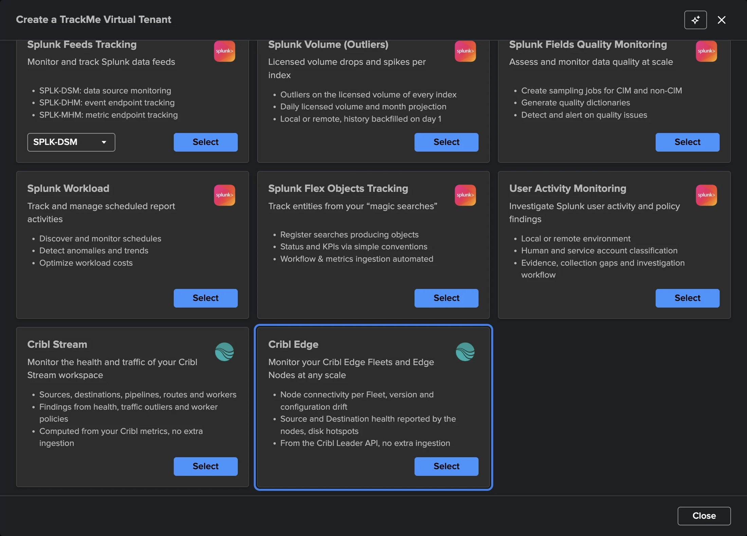
PART 1 · SETUP
A dedicated tenant — pick Cribl Edge
1
The Cribl Edge card
Node connectivity per Fleet, version and configuration drift, Source and Destination health, disk hotspots.
2
From the Leader API
No extra ingestion: the Leader is the source.
3
Four steps
Basics, Connection & Fleets, Indexes & RBAC, Review.
Licence
A valid Enterprise, Unlimited, trial or Developer licence. Not available on the Foundation edition or the Foundation trial.
Virtual Tenants → Actions → Create a tracking tenant.
TrackMe for Splunk · Hands-on: Cribl Edge
docs.trackme-solutions.com
Notes:
Virtual Tenants, Actions, Create a tracking tenant, Cribl Edge card. A tenant is a Cribl Edge tenant or a Cribl Stream tenant, never both. Basics is the identifier, alias and description.

Slide 7
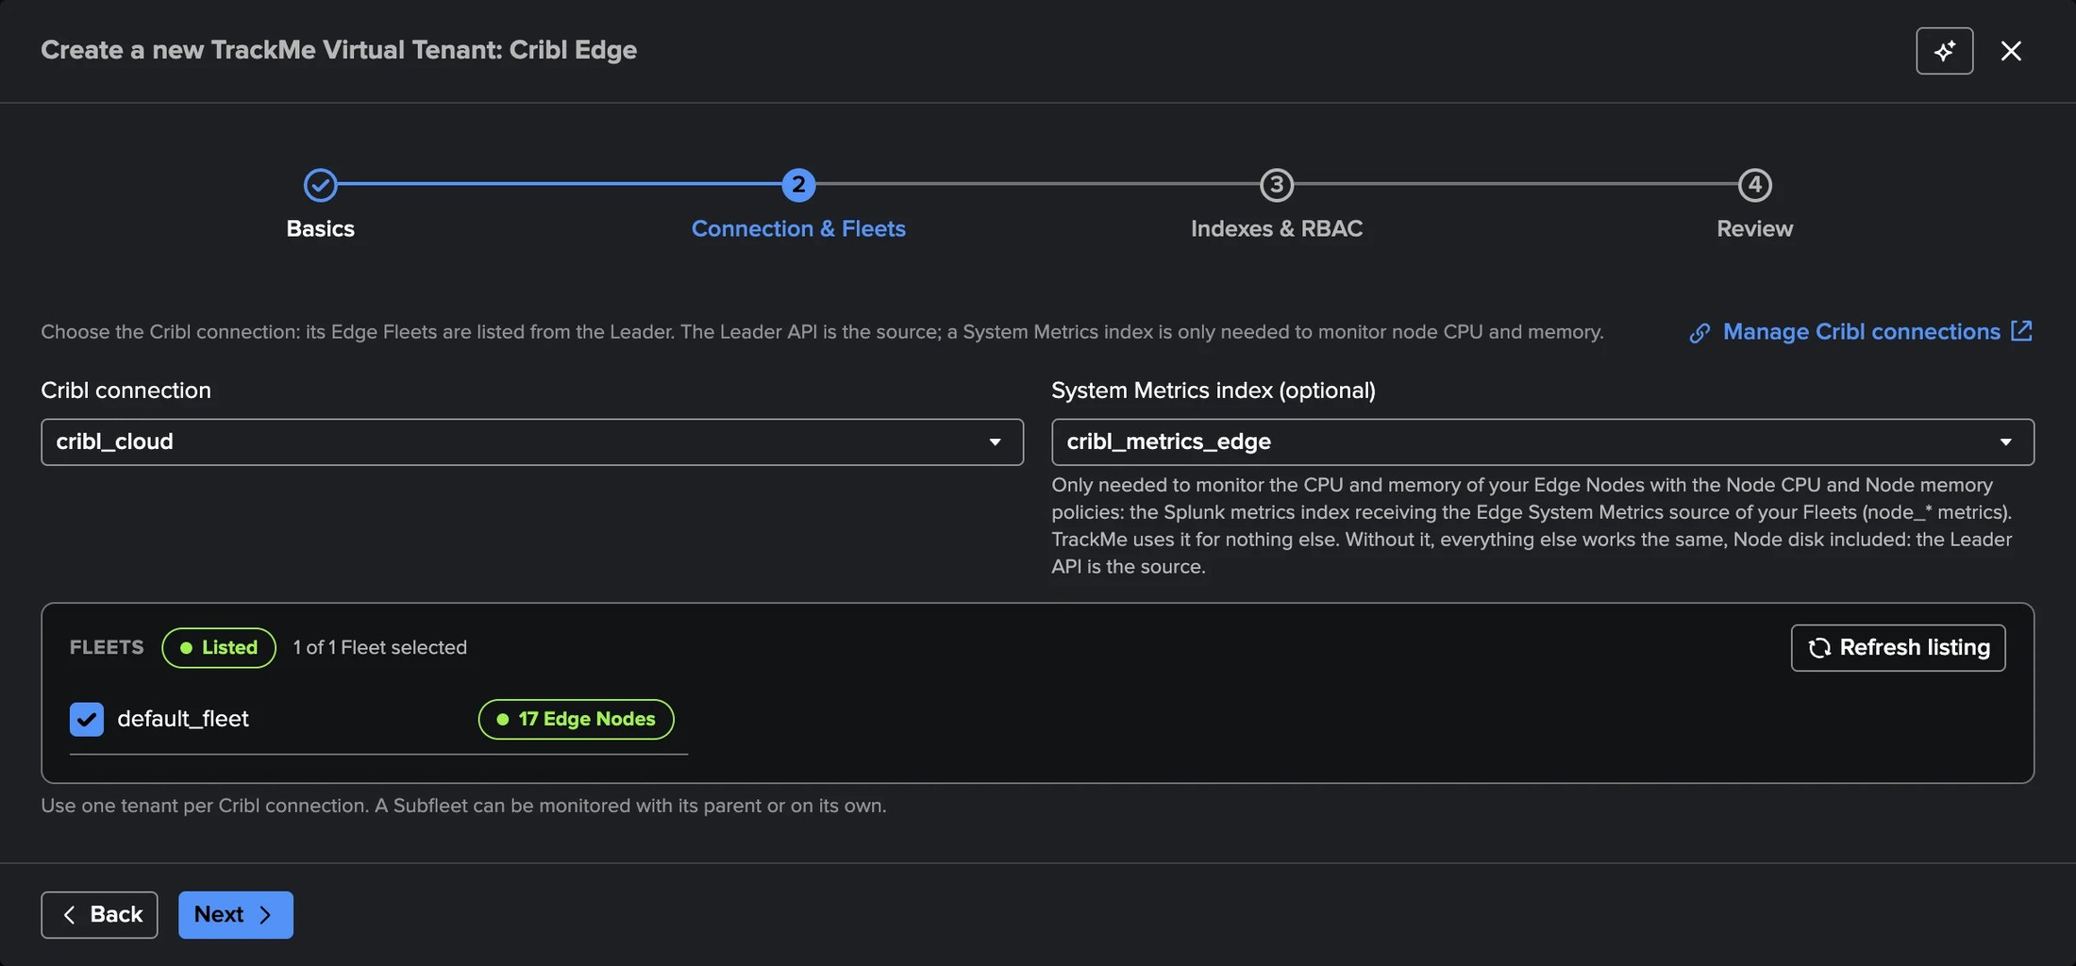
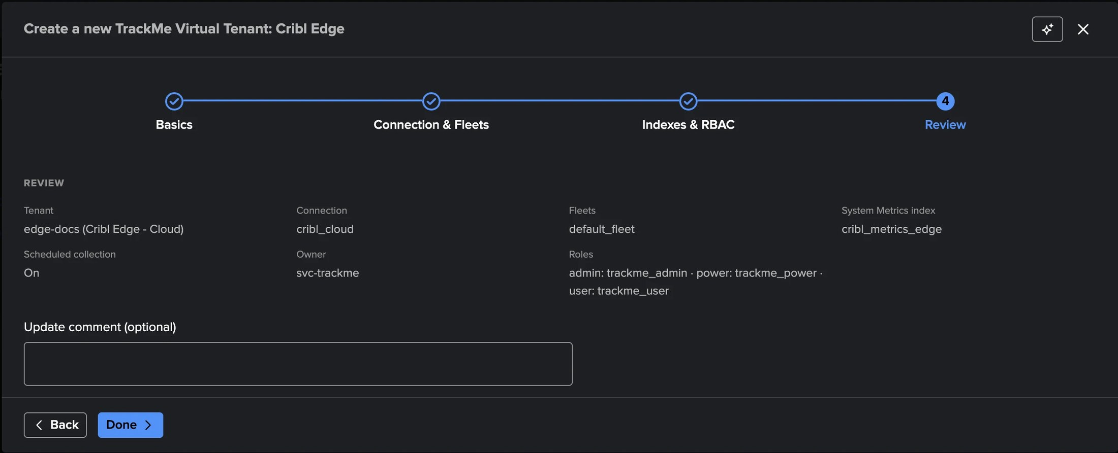
PART 1 · SETUP
Connection & Fleets, then review
1
Cribl connection
3
System Metrics index (optional)
Locked once the tenant exists: another Leader takes another tenant.
Only for Node CPU and Node memory.
2
Fleets listed from the Leader
4
Review and create
All selected on a first listing, with their node count; 1 to 100 Fleets.
The first collection starts at once; nodes appear within minutes.
TrackMe for Splunk · Hands-on: Cribl Edge
docs.trackme-solutions.com
Notes:
Choose the connection; TrackMe lists the Fleets from the Leader, each with its number of nodes, and a Subfleet can be monitored with its parent or on its own. The System Metrics index is optional: without it everything else works the same, node disk included. When the Leader cannot list the Fleets, the step says why and what to do.

Slide 8
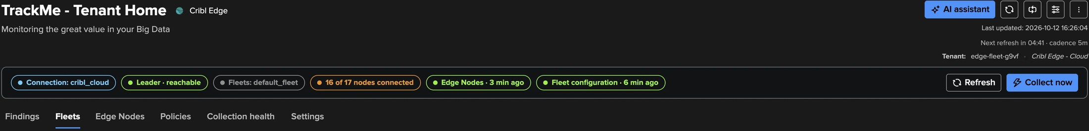
PART 1 · SETUP
The workspace — six tabs and a strip that sums it up
1
Connection and Leader
3
Edge Nodes and Fleet configuration
5
Six tabs
Reachable, with the time of the last check.
The age of the last run of each job.
Findings, Fleets, Edge Nodes, Policies, Collection health, Settings.
2
N of M nodes connected
4
Collect now
From the latest node directory.
Reads the Edge Nodes and evaluates the policies at once.
TrackMe for Splunk · Hands-on: Cribl Edge
docs.trackme-solutions.com
Notes:
The Cribl Edge workspace is built with the same components as the Cribl Stream workspace, so the two look and behave the same. The status strip sums the tenant up; Collect now is for TrackMe administrators of the tenant.

Slide 9
02
PART 2 · FLEETS & NODES
The fleet at a glance, any node up close
The Fleets tab and a Fleet with its nodes to look at; the Edge Nodes tab; one node with its info, its System activity read live and its data activity.
TrackMe for Splunk · Hands-on: Cribl Edge
Notes:
Part two: the Fleets and the nodes.

Slide 10
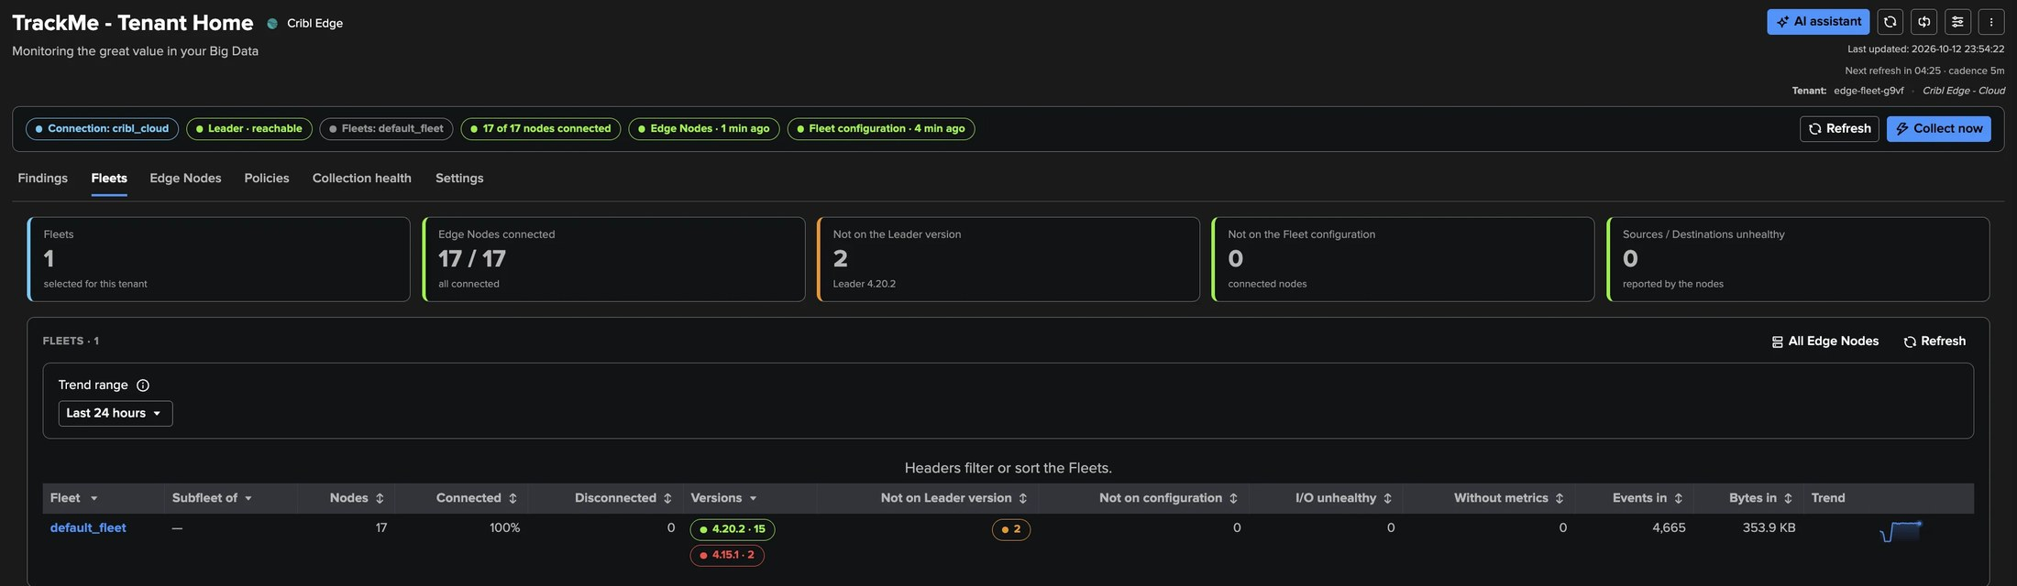
PART 2 · FLEETS
The Fleets tab — the fleet questions, answered at a glance
1
Edge Nodes connected
3
Not on the Fleet configuration
5
One row per Fleet
17 / 17 here; one click lists the disconnected ones.
Connected nodes not running the deployed configuration.
Nodes, connected share, versions, drift, traffic and trend.
2
Not on the Leader version
4
Sources / Destinations unhealthy
2 nodes behind Leader 4.20.2.
Reported by the nodes themselves.
TrackMe for Splunk · Hands-on: Cribl Edge
docs.trackme-solutions.com
Notes:
The tiles answer the fleet questions; the table has one row per Fleet with its Subfleet parent, connected share, versions running — green on the Leader version, amber otherwise, red when newer than the Leader or two minor versions behind — drift counts, unhealthy Sources and Destinations, traffic and trend.

Slide 11
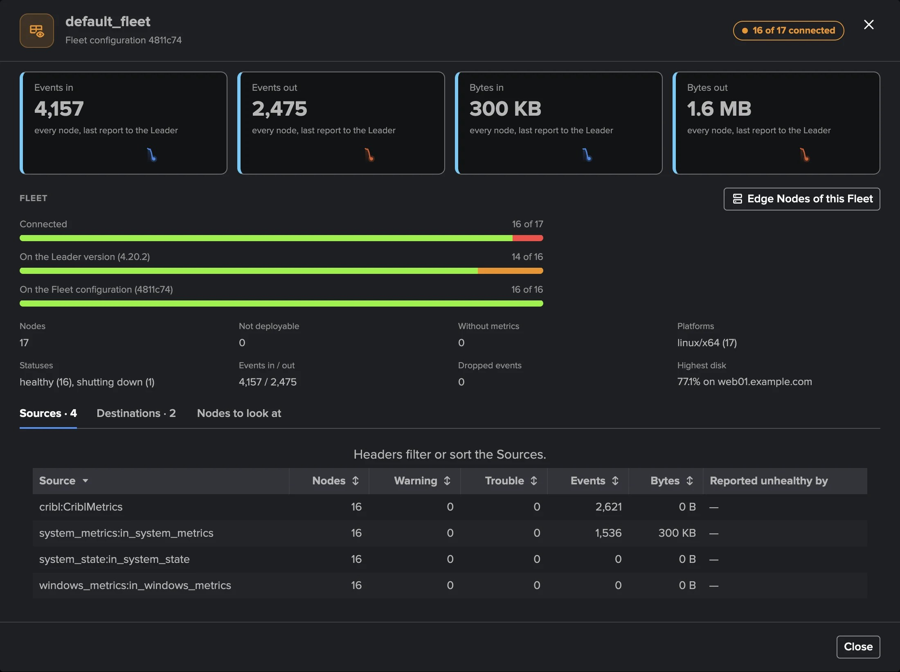
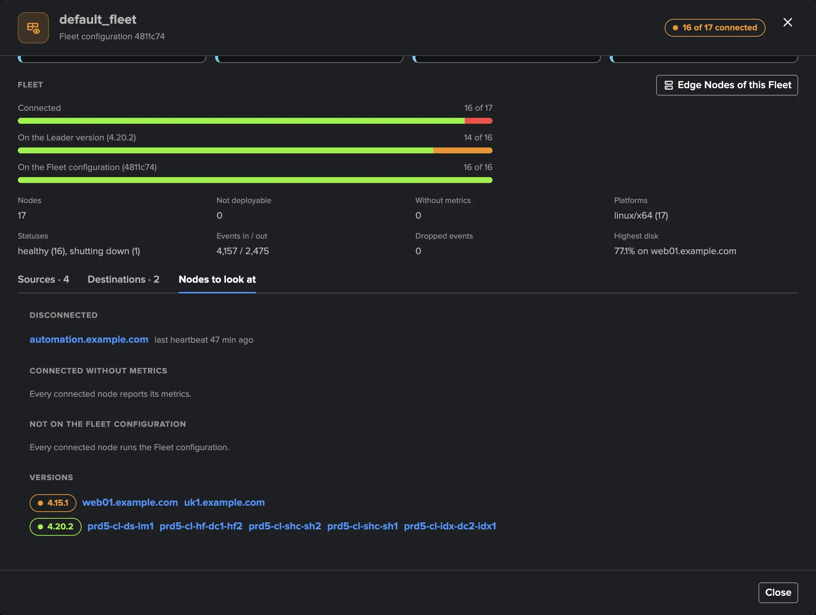
PART 2 · FLEETS
A Fleet — its traffic, its bars, and the nodes to look at
1
Traffic tiles with trends
3
Sources and Destinations
Events and bytes in and out: how busy the Fleet is now.
Nodes reporting each one, warning and trouble counts.
2
Three bars
4
Nodes to look at
Connected, on the Leader version, on the Fleet configuration.
Disconnected nodes, nodes off the configuration, the nodes behind each version.
TrackMe for Splunk · Hands-on: Cribl Edge
docs.trackme-solutions.com
Notes:
Selecting a Fleet opens it: traffic tiles, the connected, Leader-version and configuration bars, its facts, and three tabs. Sources and Destinations per object with the nodes reporting it unhealthy; Nodes to look at lists the disconnected nodes with their last heartbeat and the nodes behind each version. Every node name opens the node.

Slide 12
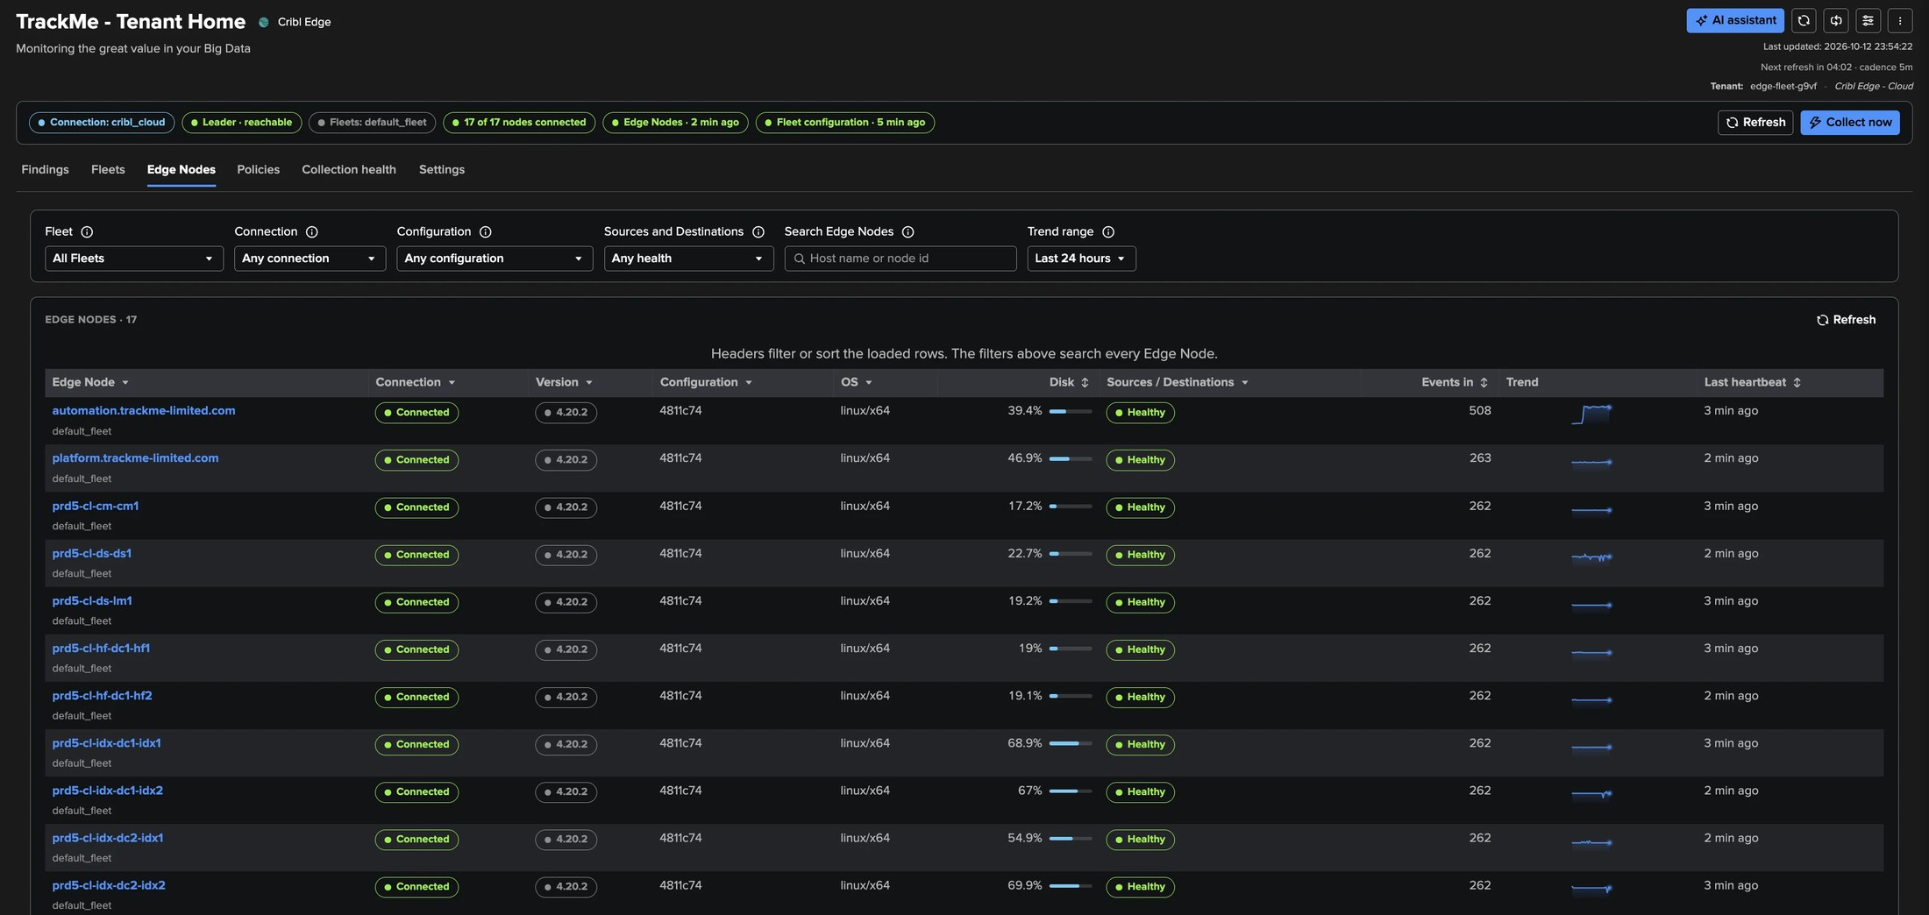
PART 2 · EDGE NODES
Edge Nodes — paged and filtered by the server, at any size
1
Filters
3
Per node
Fleet, connection, configuration, Sources and Destinations health.
Connection, version, configuration, OS, disk, health, events in, trend.
2
Search every node
4
No metrics never reads healthy
Host name or node id, across the whole fleet.
A connected node without metrics is shown as such.
TrackMe for Splunk · Hands-on: Cribl Edge
docs.trackme-solutions.com
Notes:
Every Edge Node of the selected Fleets, paged and filtered by the server so the tab stays fast with any number of nodes. A node is disconnected when the Leader says so or when it has sent no heartbeat for five periods, at least 10 minutes.

Slide 13
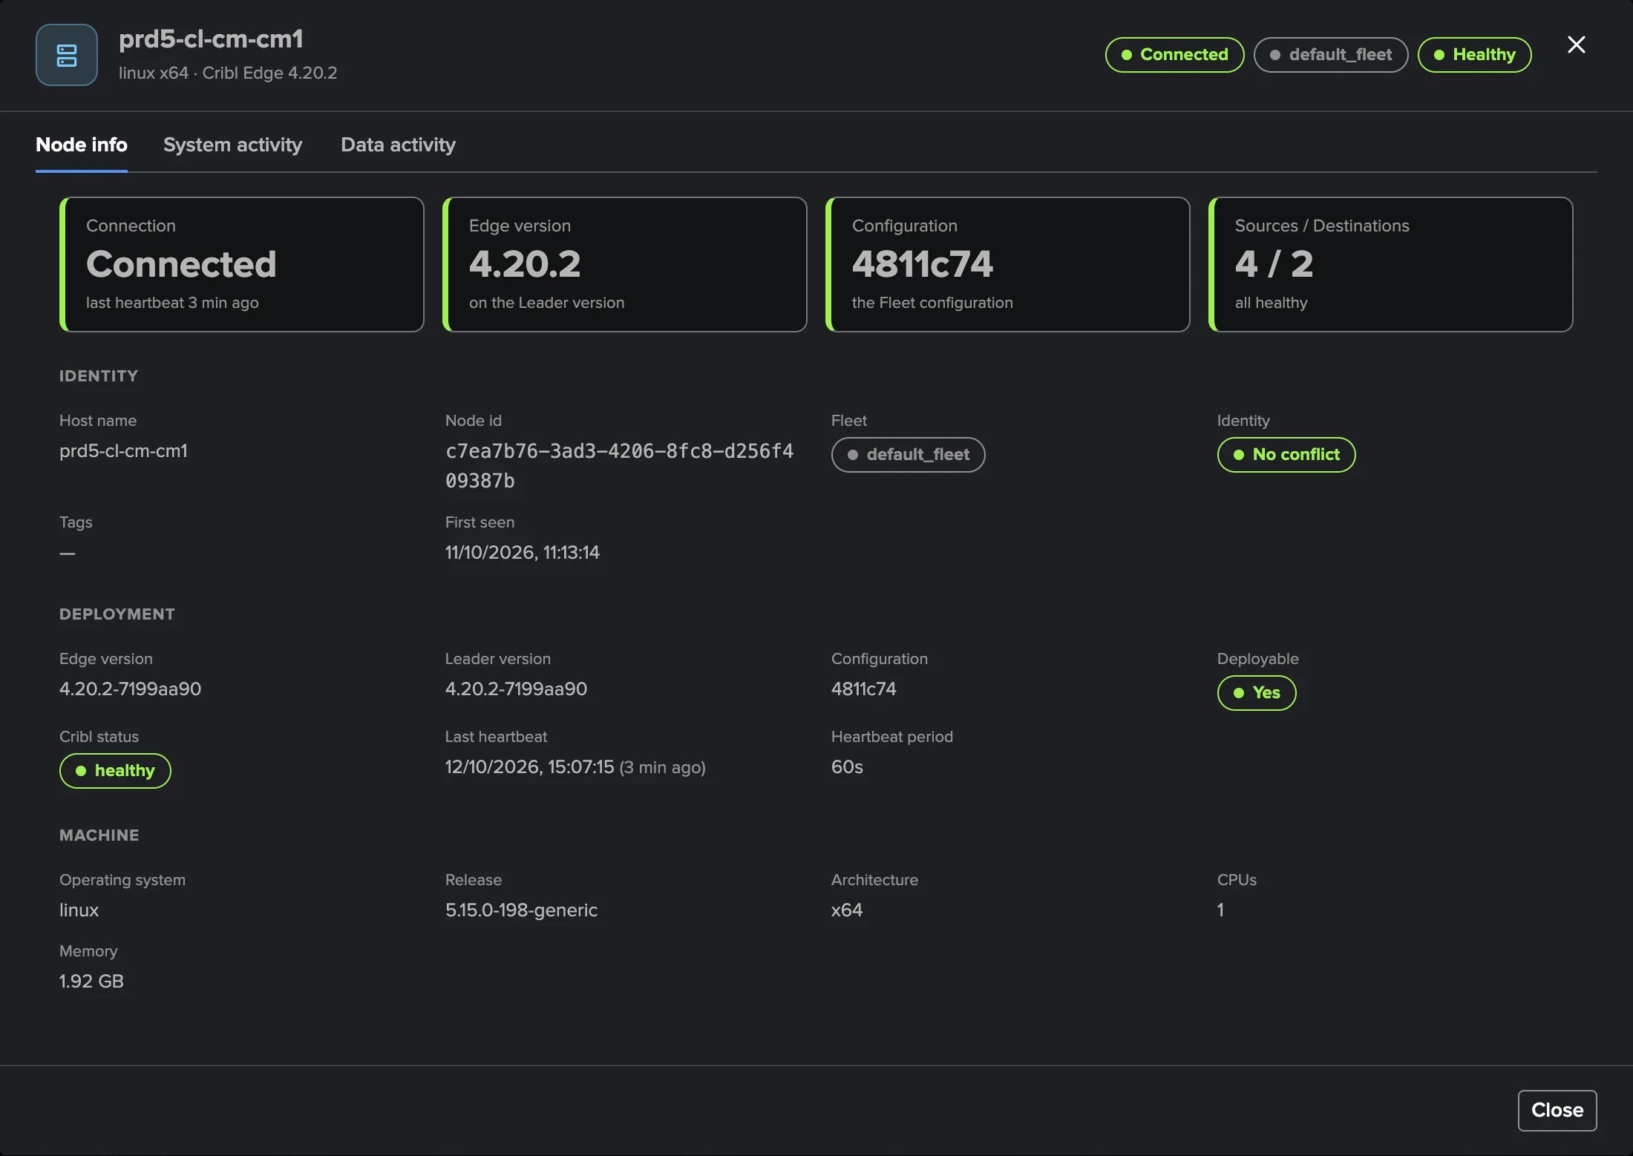
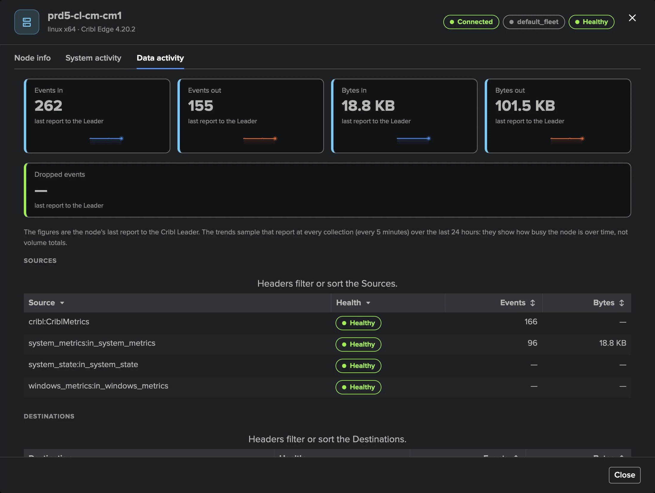
PART 2 · ONE NODE
One node — identity, deployment, machine, and its data
1
Four tiles
3
Data activity
Connection, Edge version against the Leader, configuration, Sources / Destinations.
Traffic tiles with 24-hour trends, from the node's last report to the Leader.
2
Identity and deployment
4
Sources and Destinations
Host name, node id, cloned-image check, versions, heartbeat.
Their health; select one for its live status from the Leader.
TrackMe for Splunk · Hands-on: Cribl Edge
docs.trackme-solutions.com
Notes:
A node opens on three tabs. Node info: connection, Edge version compared with the Leader's, configuration compared with the Fleet's target, and Identity, Deployment and Machine facts. Data activity: the node's traffic with trends and its Sources and Destinations; selecting a health reads that object's live status on that node, as Cribl's Status tab shows it.

Slide 14
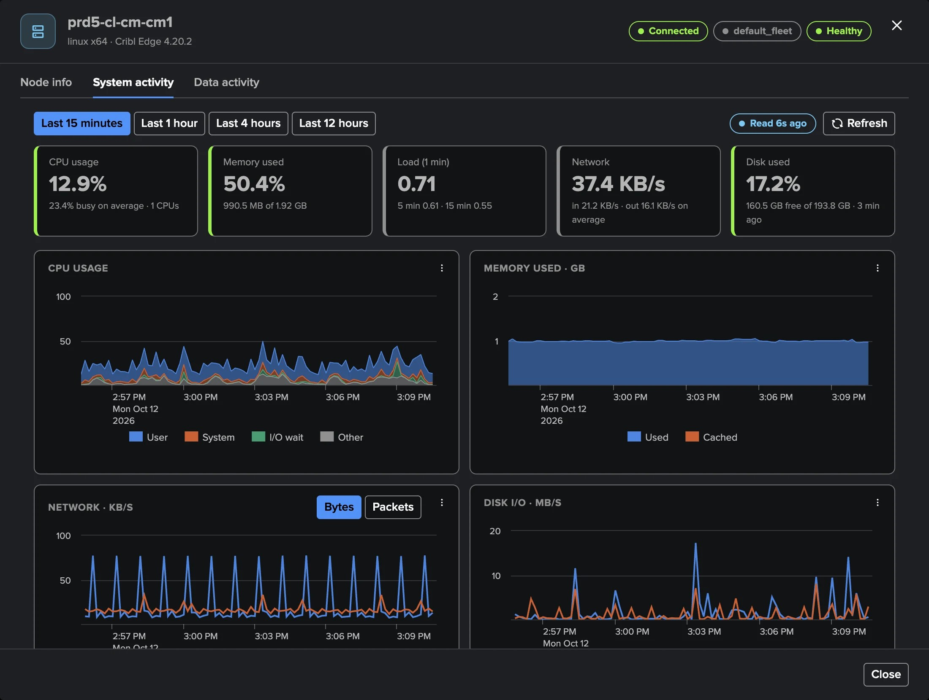
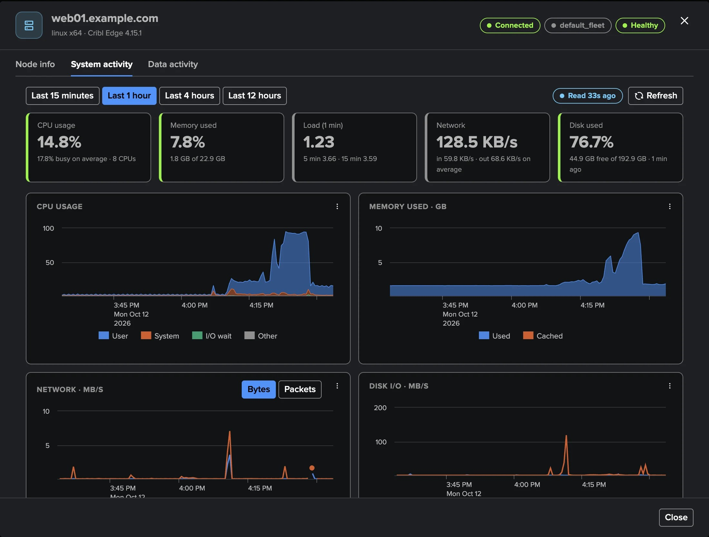
PART 2 · ONE NODE
System activity — read live from the node, nothing to forward
1
What Cribl's System Activity shows
3
Only when opened
CPU by mode, memory, network, disk I/O, load, processes.
Nothing read for a node nobody opens; within the Leader budget.
2
15 minutes to 12 hours
4
Disk history
From the node's own store, through the Leader.
Kept by TrackMe for every node from its heartbeats.
TrackMe for Splunk · Hands-on: Cribl Edge
docs.trackme-solutions.com
Notes:
System activity shows what Cribl's own System Activity page shows for the node, read live through the Leader from the node's own store of its system metrics. It does not use the System Metrics index and needs nothing forwarded to Splunk. Nothing is read for a node nobody opens, so the fleet-wide collection stays one bulk read.

Slide 15
03
PART 3 · FINDINGS
Judged per Fleet, decided per group
The Findings tab, what you see when a node stops, the nodes that must stay connected, and version drift after a rollout.
TrackMe for Splunk · Hands-on: Cribl Edge
Notes:
Part three: the findings. Findings work exactly as on Cribl Stream: Finding groups, triage, notifications, assignment and findings actions.

Slide 16
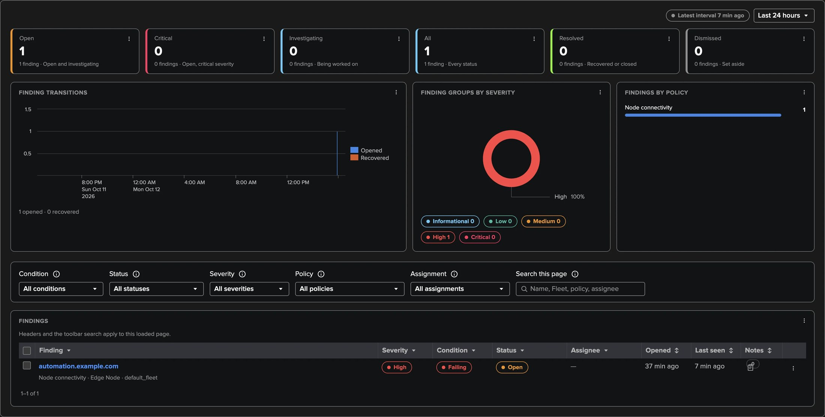
PART 3 · FINDINGS
The Findings tab — the shared findings centre of the Cribl tenants
1
About a Fleet
3
About an Edge Node
Connectivity, version and configuration drift, coverage, node identity.
Connectivity of selected nodes, disk, CPU, memory.
2
About a Source or Destination
4
Open resource
Its health across the Fleet's nodes.
Opens the Fleet or the node the finding is about, in place.
TrackMe for Splunk · Hands-on: Cribl Edge
docs.trackme-solutions.com
Notes:
A Cribl Edge finding is about one object, one policy and one measurement: a Fleet, a Source or Destination of a Fleet, an Edge Node, or the Leader. Each object gathers its findings in one automatic Finding group. A finding recovers by itself when the condition clears. Edge has no Stop monitoring and no Not an anomaly: narrow the policy's scope instead.

Slide 17
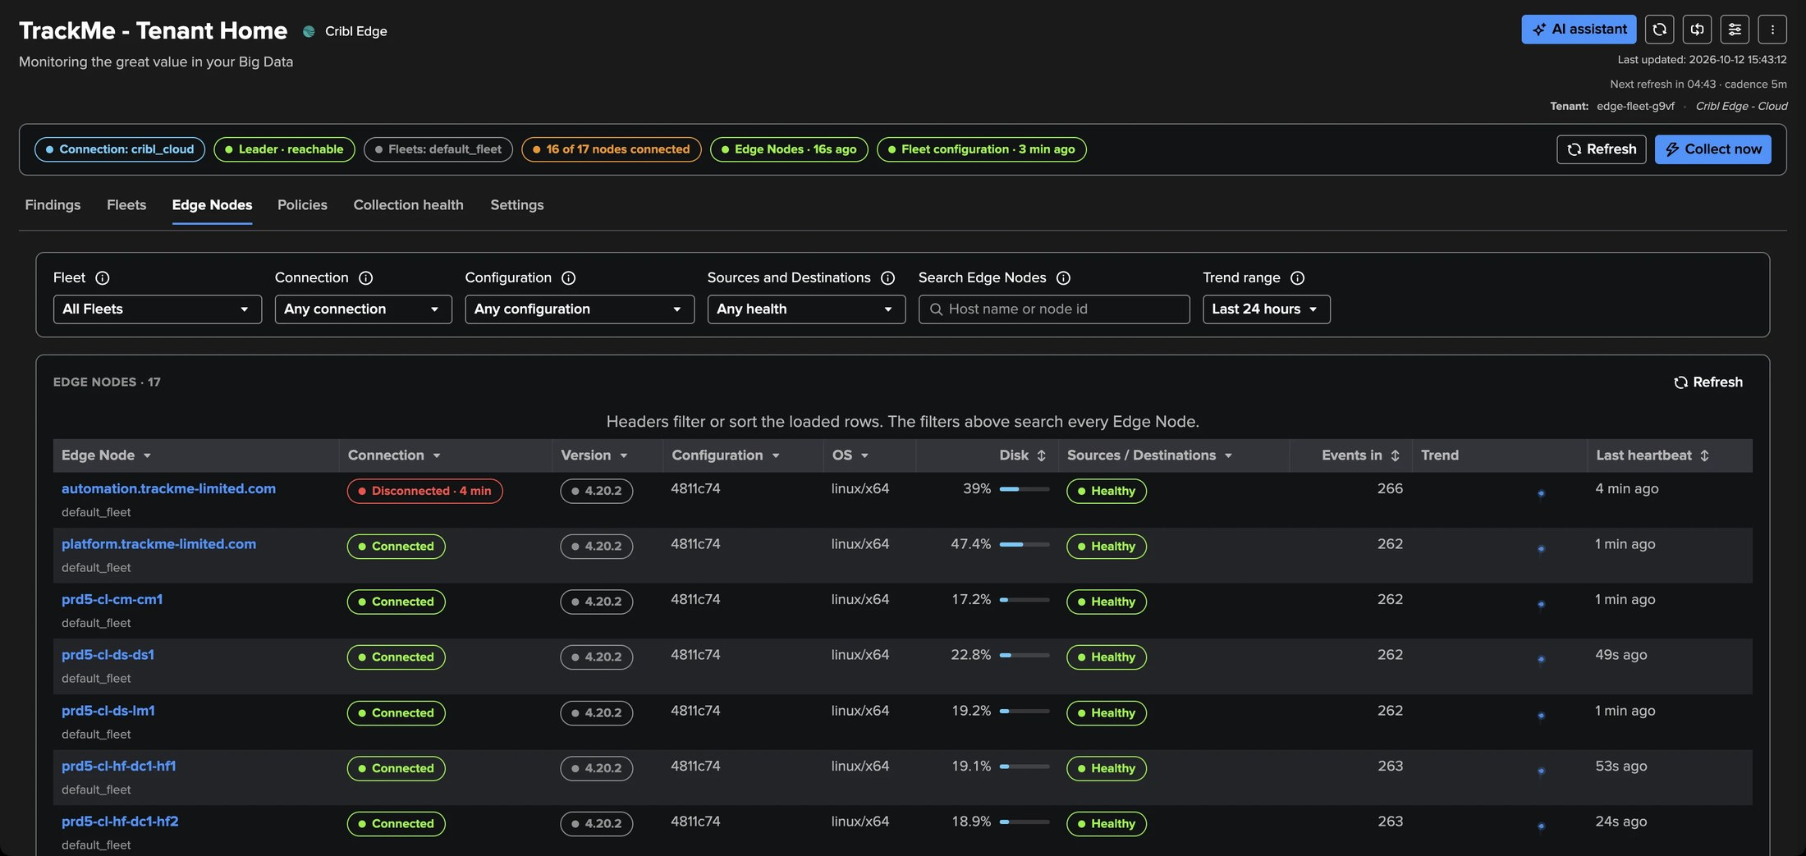
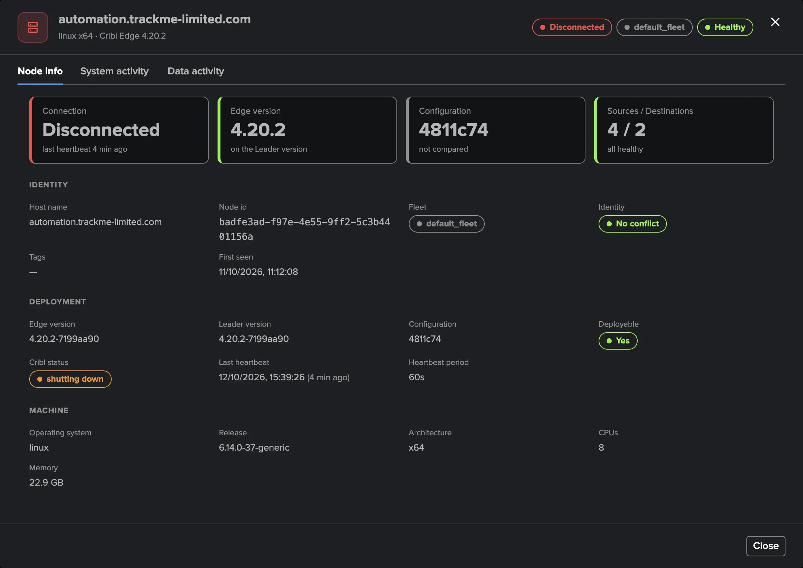
PART 3 · A NODE STOPS
A disconnected node — visible at once, a finding only when it matters
1
Within 10 minutes
3
Nodes that must never drop
16 of 17 nodes connected; the node listed as disconnected.
Select them in Node connectivity, typed or from a lookup: High after 15 minutes.
2
No finding for one node, by design
Fleet connectivity opens from 20 % of the Fleet and 2 nodes.
4
Dormant after 7 days
A retired node leaves the Fleet's count.
TrackMe for Splunk · Hands-on: Cribl Edge
docs.trackme-solutions.com
Notes:
Take a Fleet of 17 nodes, one of which stops. Within 10 minutes it is disconnected in the next directory. No finding opens for that one node by default: Fleet connectivity opens when at least 20 percent of the active nodes and at least two are disconnected. For servers and collectors that must never drop, select them in Node connectivity, by host name or from a Splunk lookup table.

Slide 18
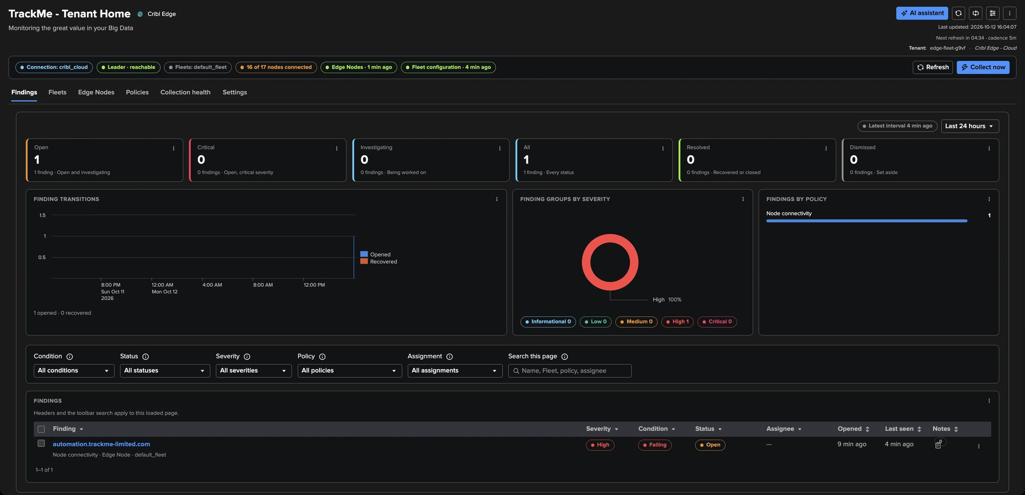
PART 3 · A NODE STOPS
Node connectivity — a High finding about the node you selected
1
Selected nodes only
3
Recovers when it reconnects
Typed host names (dc-* accepted) or a Splunk lookup table.
Measured, not decided.
2
High after three checks
4
Quiet grey in Topology Studio
No heartbeat for 15 minutes.
A disconnected node without a finding is disclosed, not alarming.
TrackMe for Splunk · Hands-on: Cribl Edge
docs.trackme-solutions.com
Notes:
A node selected in Node connectivity opens a High finding about that node after three checks without a heartbeat, and recovers when it reconnects. In Topology Studio a disconnected node without a finding is drawn quiet grey and does not count in a group's healthy share.

Slide 19
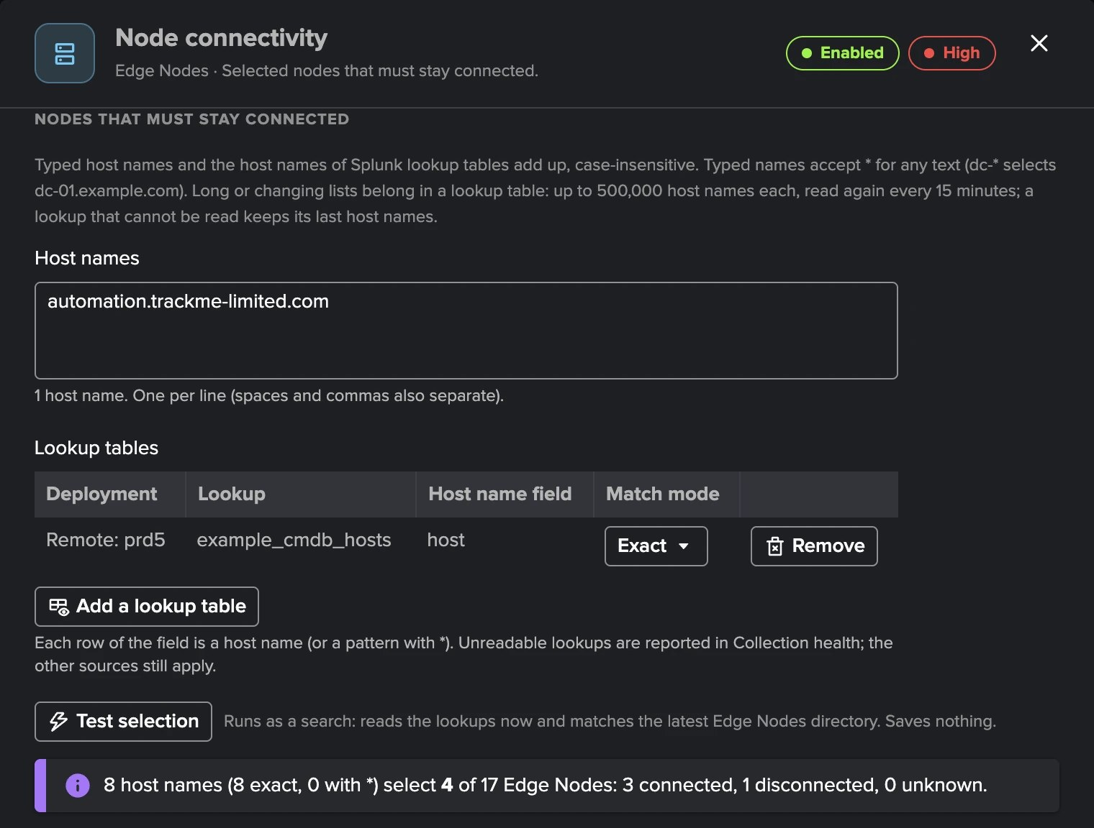
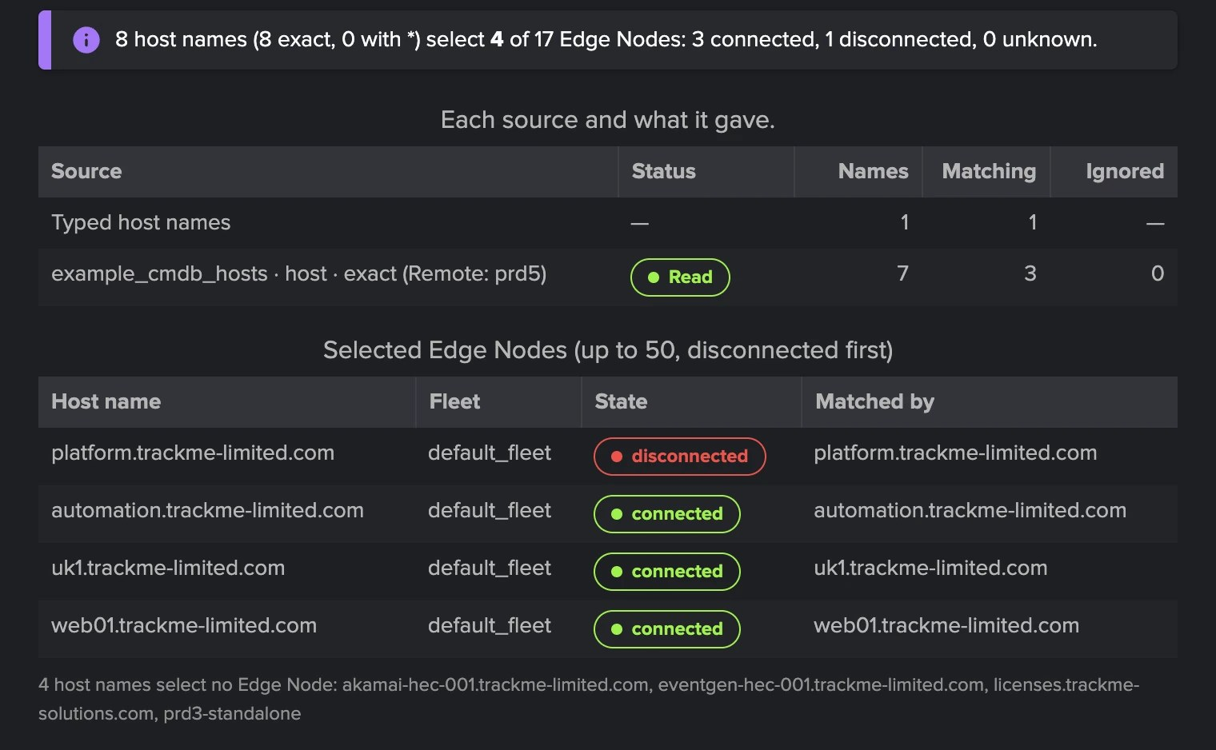
PART 3 · A NODE STOPS
Nodes that must stay connected — typed names, lookups, tested
1
Typed host names
3
Read every 15 minutes
No count limit, case-insensitive; * stands for any text.
A lookup that cannot be read keeps its last good names.
2
Splunk lookup tables
4
Test selection
Up to 20, local or remote: 500,000 names each, Exact or Wildcard.
Runs as a search: which nodes, in which state, from which source. Saves nothing.
TrackMe for Splunk · Hands-on: Cribl Edge
docs.trackme-solutions.com
Notes:
Node connectivity selects the nodes that must stay connected from two sources that add up. Typed host names have no count limit and accept a star for any text. Long or changing lists belong in Splunk lookup tables, such as a CMDB extract, on the local search tier or a remote deployment: up to twenty per policy and five hundred thousand host names each, matched exactly or with wildcards, read again every fifteen minutes; a lookup that cannot be read keeps its last good names and Collection health says so. Test selection runs as a search and shows which nodes the names select, in which state and from which source, before anything is saved.

Slide 20
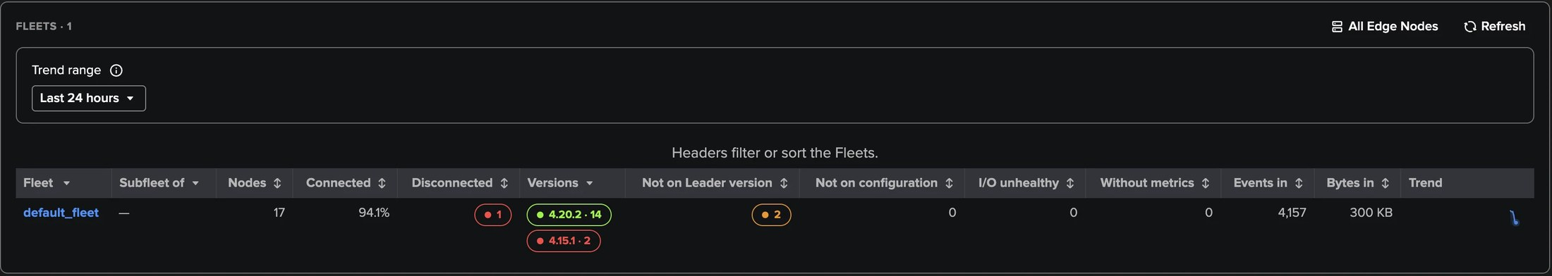
PART 3 · ROLLOUTS
Version drift — the nodes an upgrade left behind
1
Baseline
3
Medium, or High
The Leader version by default, or the Fleet's most common one.
High when a node is newer than the Leader or two minor versions behind.
2
Rollout grace
4
Configuration drift
24 hours by default, the time of a rolling upgrade.
The same for deploys, after a 30-minute grace.
TrackMe for Splunk · Hands-on: Cribl Edge
docs.trackme-solutions.com
Notes:
Version drift compares every connected node with a baseline. Once nodes stay off it for the rollout grace, a finding opens on the Fleet: Medium, raised to High for the cases Cribl does not support. Configuration drift works the same way for deployments. The Fleet's Nodes to look at names the nodes behind each version.

Slide 21
04
PART 4 · OPERATE
Rules you can explain
Eleven policies and bank holidays, collection health, settings, Topology Studio, the AI Assistant and the Cribl Edge AI Agent — and how Edge compares with Stream.
TrackMe for Splunk · Hands-on: Cribl Edge
Notes:
Part four: operating the tenant.

Slide 22
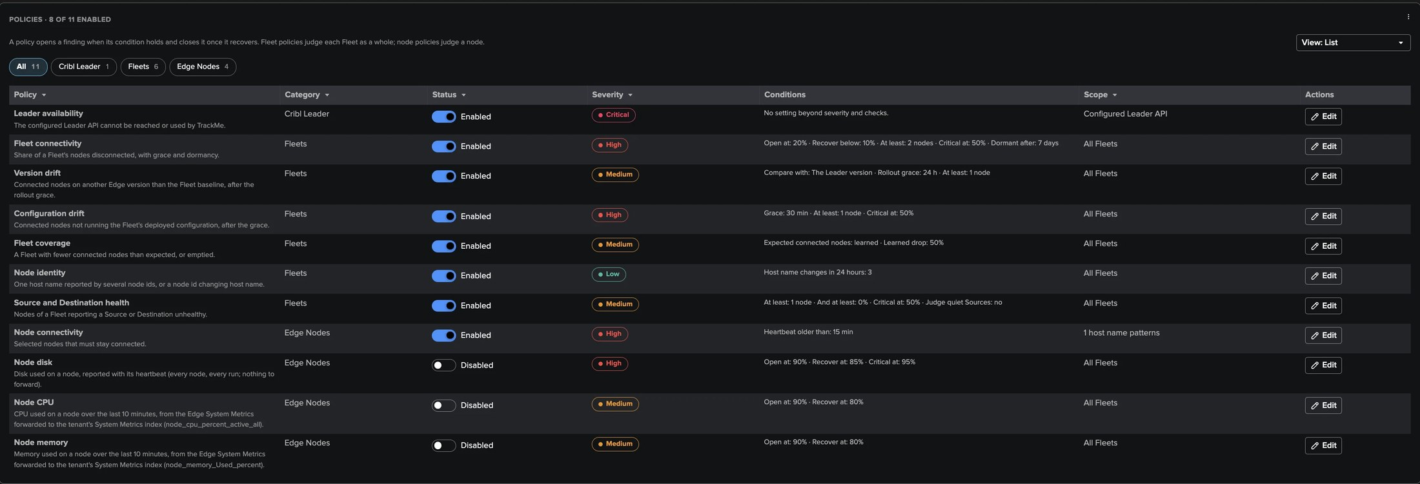
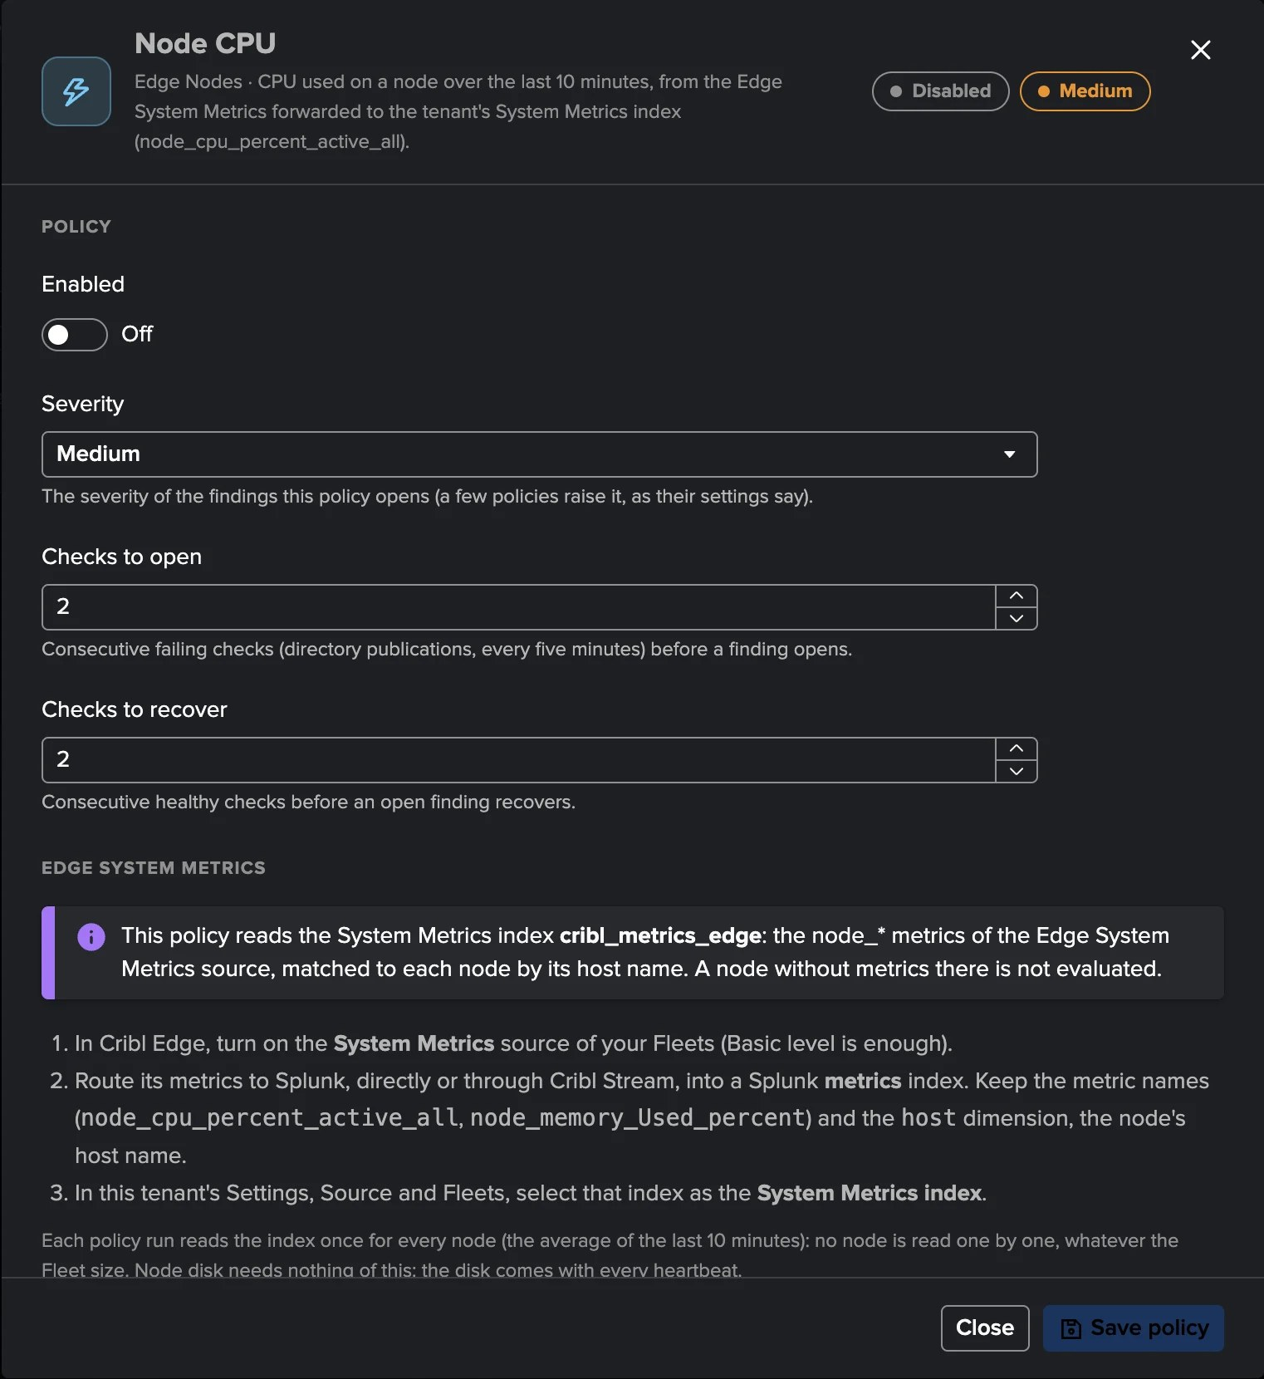
PART 4 · OPERATE
Eleven policies — eight on out of the box
1
Cribl Leader, Fleets, Edge Nodes
3
Needs nodes / Needs System Metrics
Three categories, as cards or a list.
Pills tell what a policy waits for.
2
Node disk, CPU and memory off
4
Editor
Node resources are a choice: a fleet of endpoints would flood on day one.
On or off, severity, checks, conditions, scope, bank holidays.
TrackMe for Splunk · Hands-on: Cribl Edge
docs.trackme-solutions.com
Notes:
The catalogue of eleven policies in three categories. Two pills tell what a policy is waiting for: Needs nodes on Node connectivity until you select the nodes, typed or from a lookup, and Needs System Metrics on Node CPU and Node memory until the tenant has a System Metrics index. Node disk, CPU and memory are off by default.

Slide 23
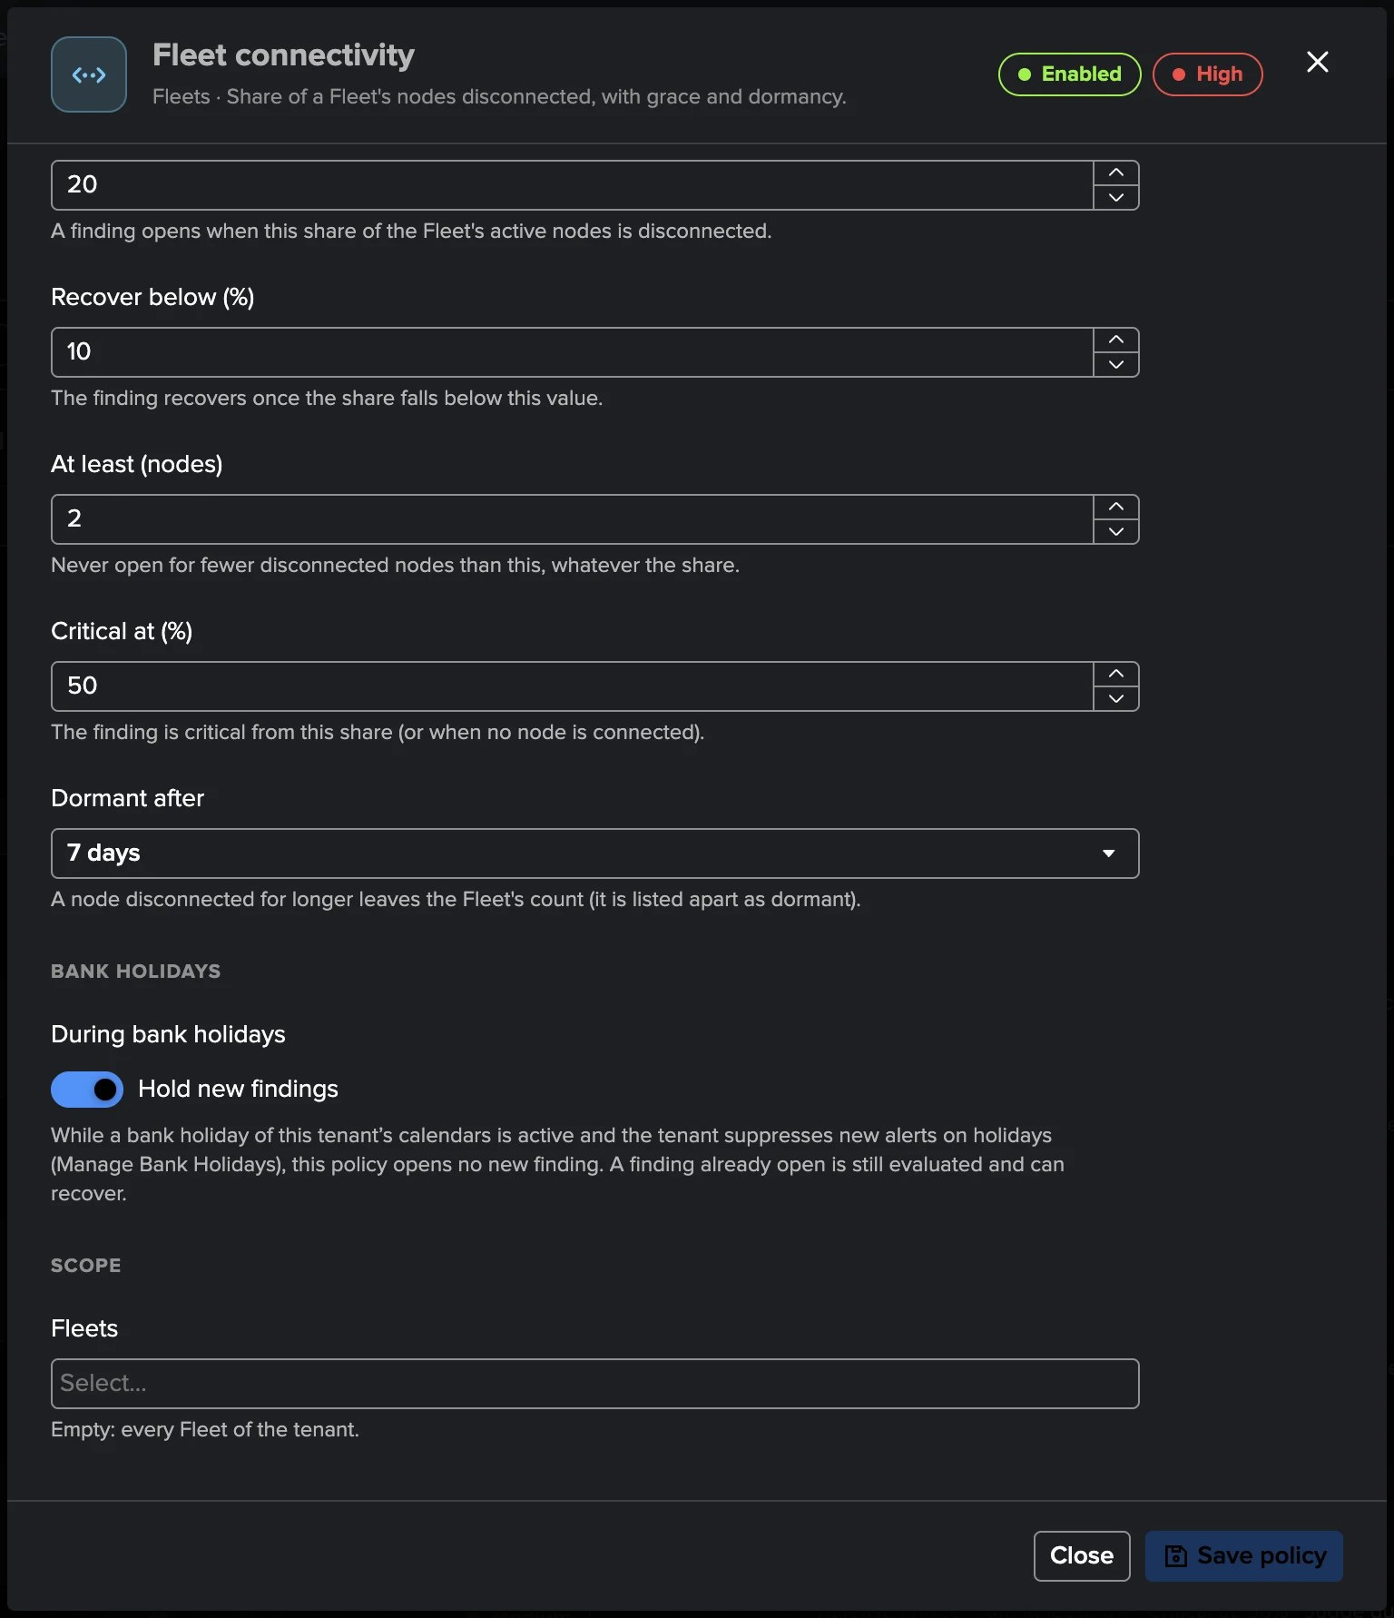
PART 4 · OPERATE
Bank holidays — each policy decides whether a holiday holds it
1
The tenant's calendars
The system defaults, its own or none, in Manage Bank Holidays.
2
One effect for Edge
Suppress new alerts. No ML to keep holidays from, no SLA.
3
Per policy
During bank holidays: Hold new findings, or Keep opening findings.
4
Held by default
Fleet connectivity and Fleet coverage: endpoints switched off for the holiday.
5
Kept by default
Node connectivity and every other policy. Leader availability is never held.
6
Open findings go on
Still evaluated during the holiday: they can recover and close.
TrackMe for Splunk · Hands-on: Cribl Edge
docs.trackme-solutions.com
Notes:
A Cribl Edge tenant uses the bank holiday calendars like every tenant: the system defaults, its own selection, or none. One of the four effects applies to Edge, Suppress new alerts: while a holiday is active, the policies set to hold open no new finding. Each policy decides in its editor. By default Fleet connectivity and Fleet coverage hold, because laptops and desktops switched off for the holiday would otherwise open findings; Node connectivity and every other policy keep opening findings, and Leader availability is always judged. A finding already open is still evaluated and can recover.

Slide 24
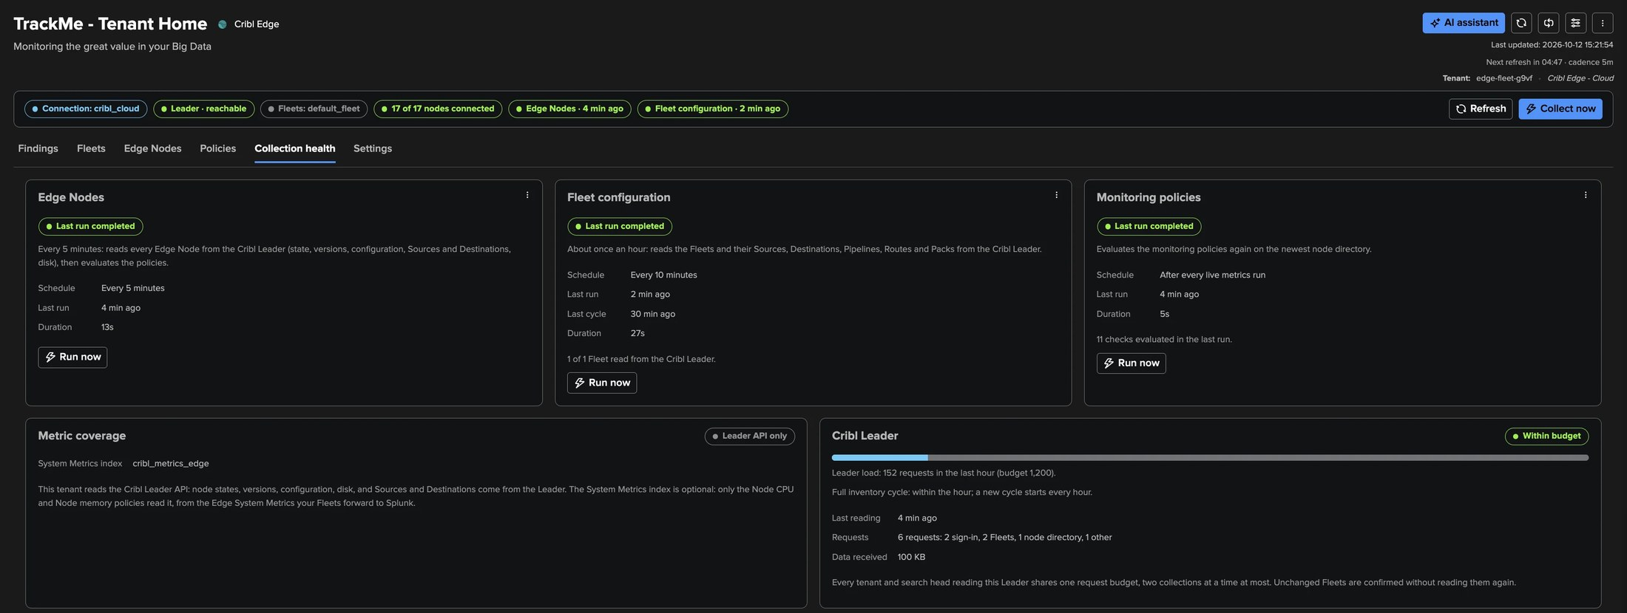
PART 4 · OPERATE
Collection health — two jobs and the Leader budget
1
Edge Nodes
3
Leader requests
Every 5 minutes: the node directory, then the policies.
The load against the connection's budget.
2
Fleet configuration
4
Guardian
About once an hour.
cribl_collection_health, with the Edge conditions.
TrackMe for Splunk · Hands-on: Cribl Edge
docs.trackme-solutions.com
Notes:
One card per job with its last run, duration, next run and Run now, the Leader requests against the budget and the System Metrics index. When collection does not run as configured, the tab lists the problems and the Configuration Guardian raises Cribl Edge collection needs attention, including the Edge conditions: many nodes without metrics, or no System Metrics arriving.

Slide 25
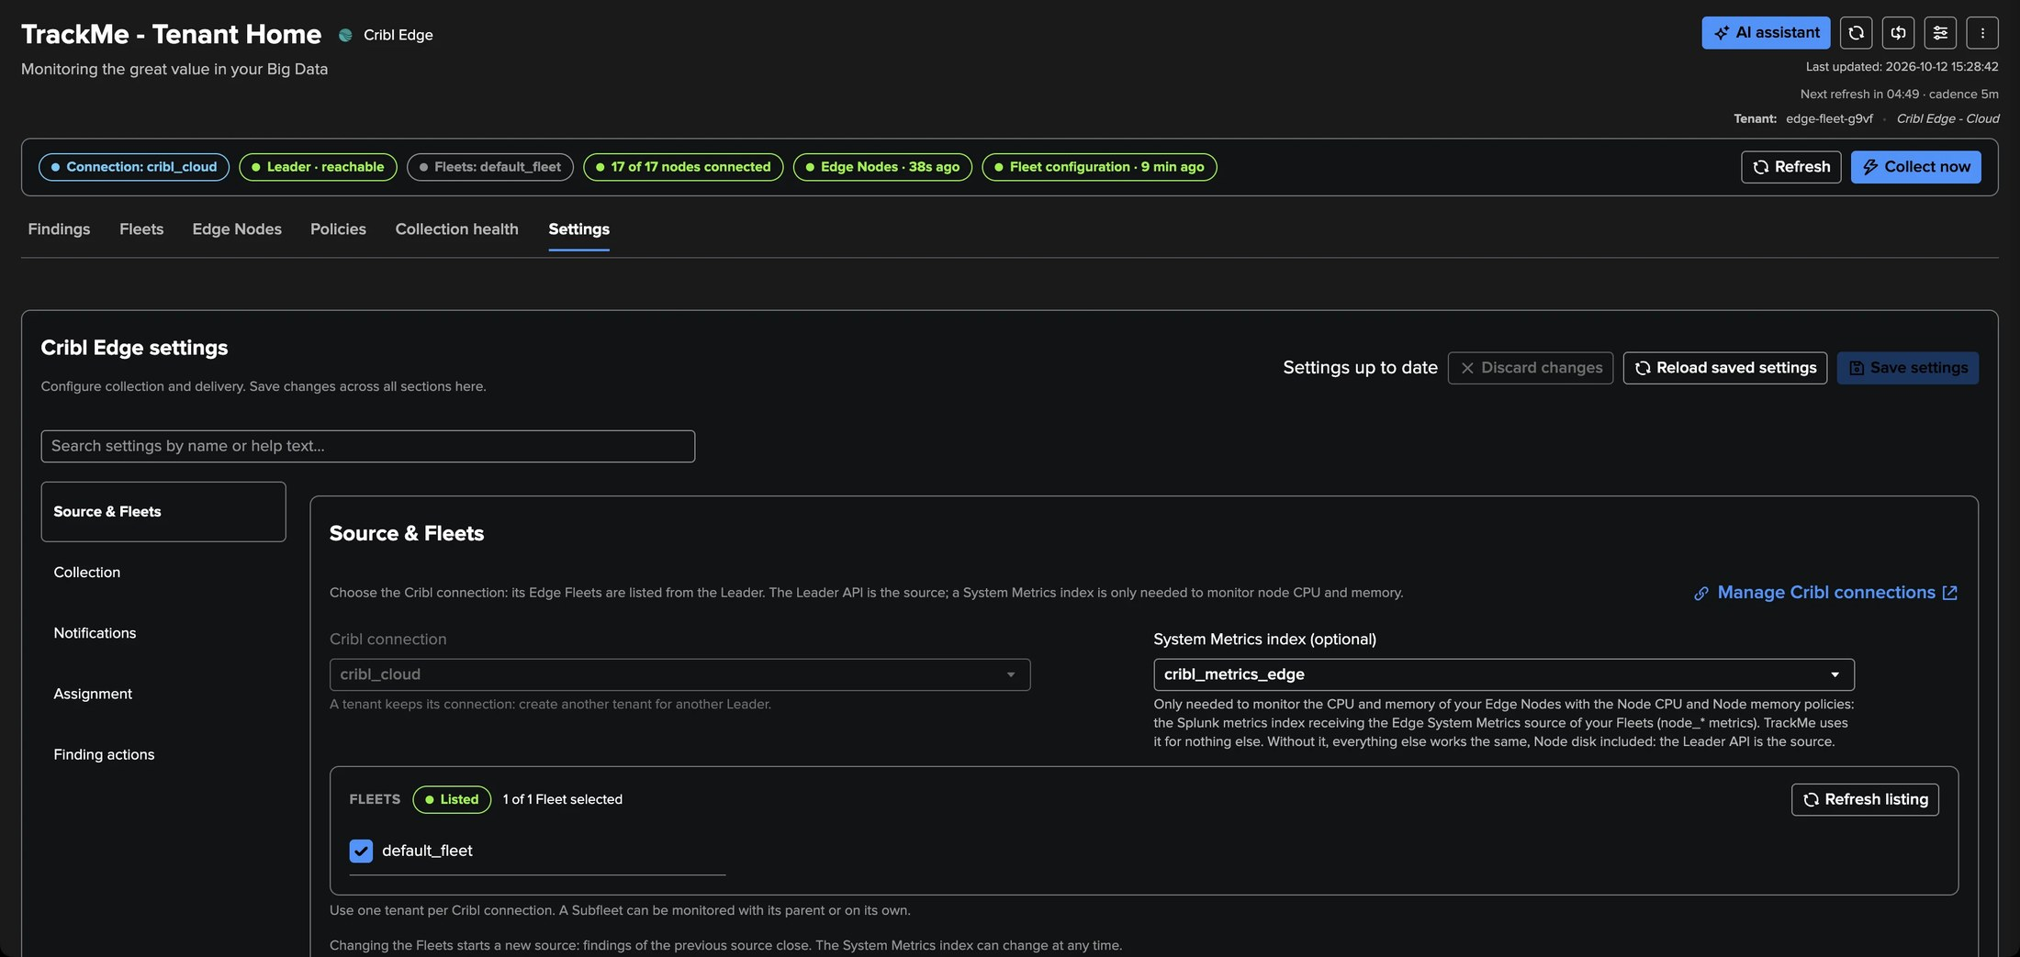
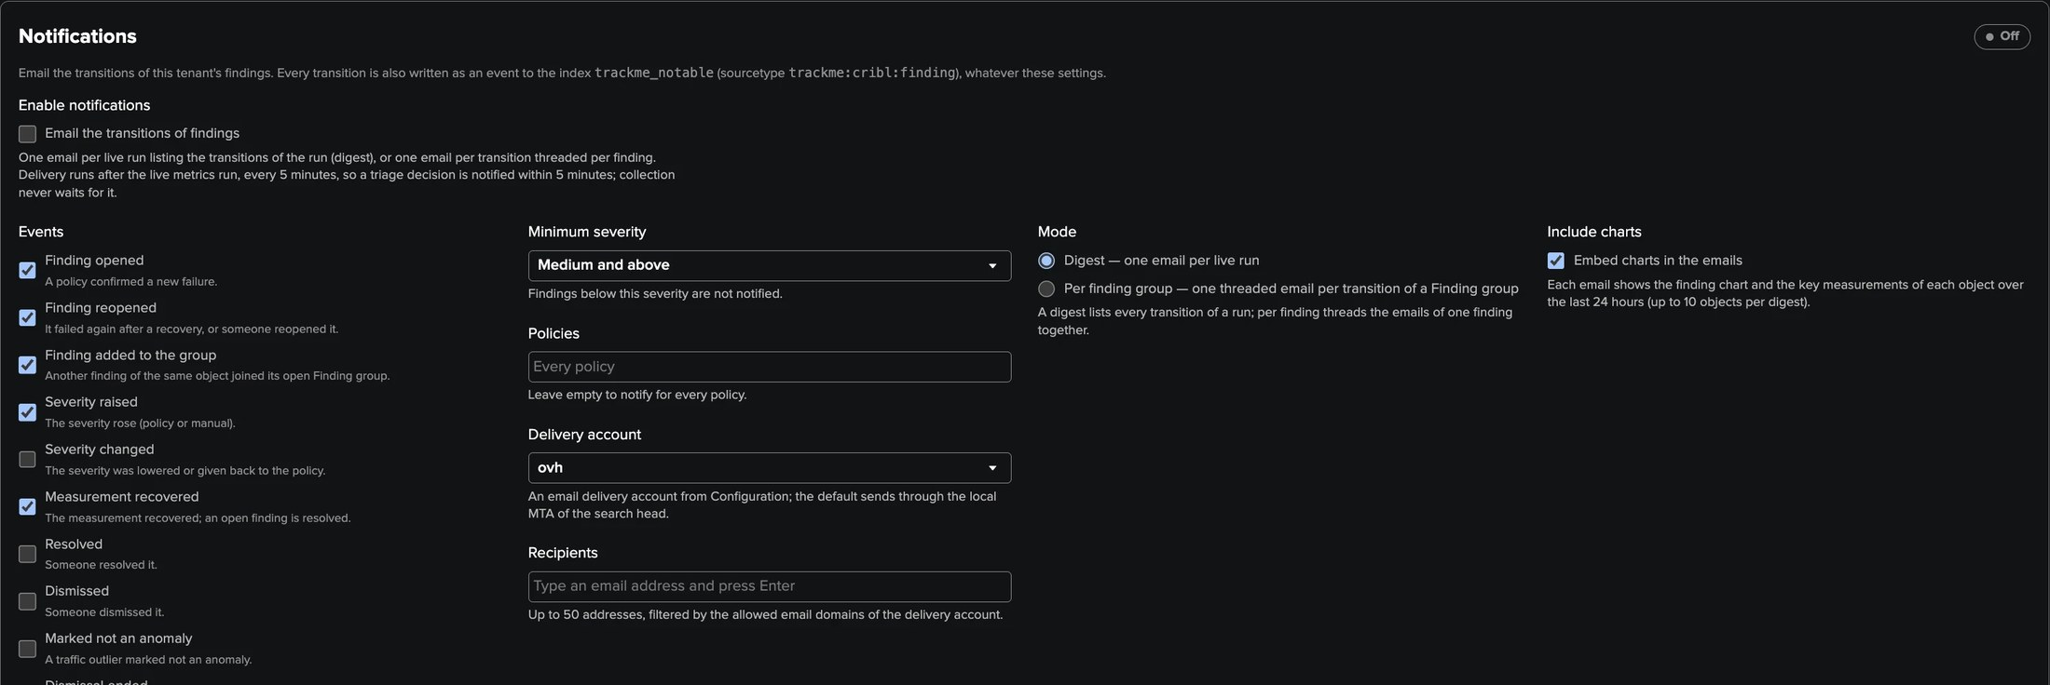
PART 4 · OPERATE
Settings — one Save for every section
1
Source & Fleets
3
Assignment and Finding actions
Locked connection, the Fleets, the System Metrics index, Repair workspace.
Groups, routing rules, drilldowns, links, webhooks, automations.
2
Notifications
Events, minimum severity, delivery account, digest or per group, charts.
TrackMe for Splunk · Hands-on: Cribl Edge
docs.trackme-solutions.com
Notes:
Settings gathers every section with one Save. Changing the Fleets starts a new source and closes the findings of the previous one; the System Metrics index can change at any time. Notifications work as for Cribl Stream, and every transition is also an indexed event.

Slide 26
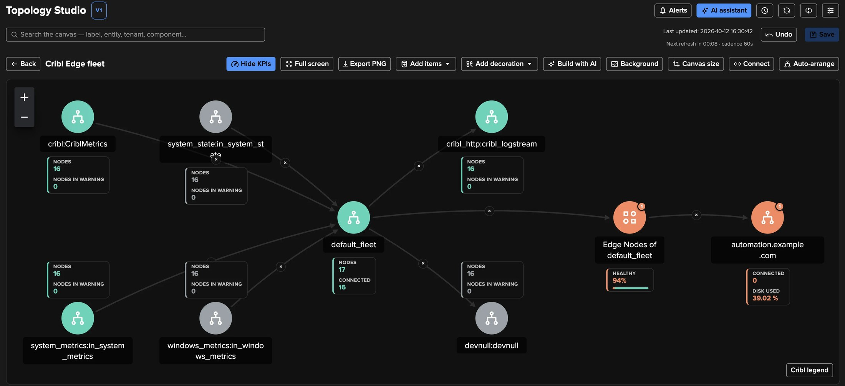
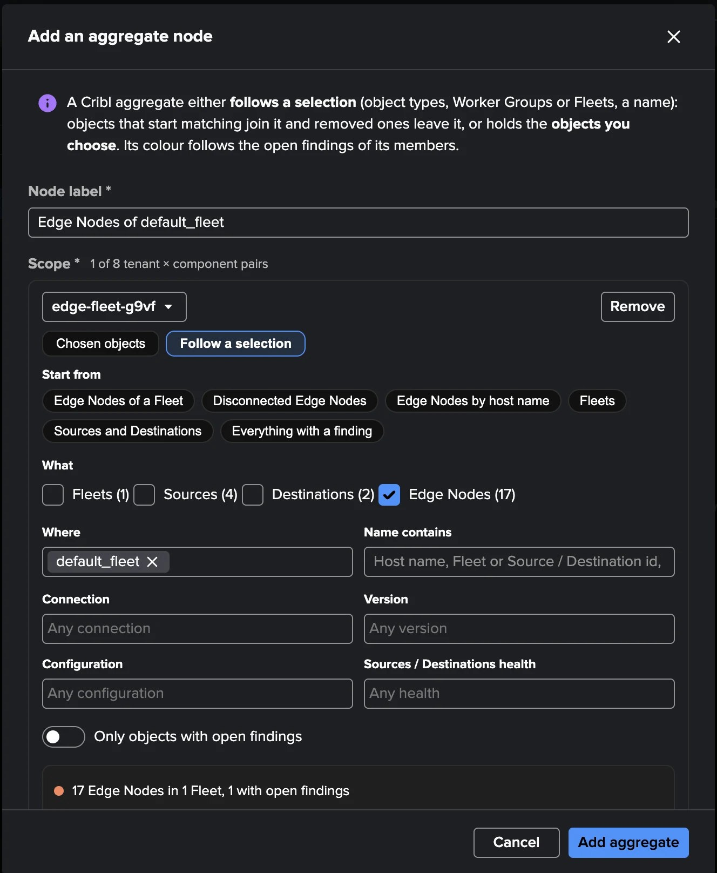
PART 4 · TOPOLOGY STUDIO
Edge in Topology Studio — groups that follow the fleet
1
Fleets, Sources, Destinations, Edge Nodes
3
Status
Picked with the Edge Nodes filters.
Findings first; a disconnected node without a finding is quiet grey.
2
Groups
4
Create with AI
Edge Nodes of a Fleet, disconnected nodes, everything with a finding.
Fleet overview, Edge problems wall, Sources and Destinations of a Fleet.
TrackMe for Splunk · Hands-on: Cribl Edge
docs.trackme-solutions.com
Notes:
Cribl Edge objects are Topology Studio objects. Groups are the recommended way to show nodes: they follow their nodes as they come and go, at any fleet size, and show their health and healthy share. Topology Alerts work on Edge objects and groups.

Slide 27
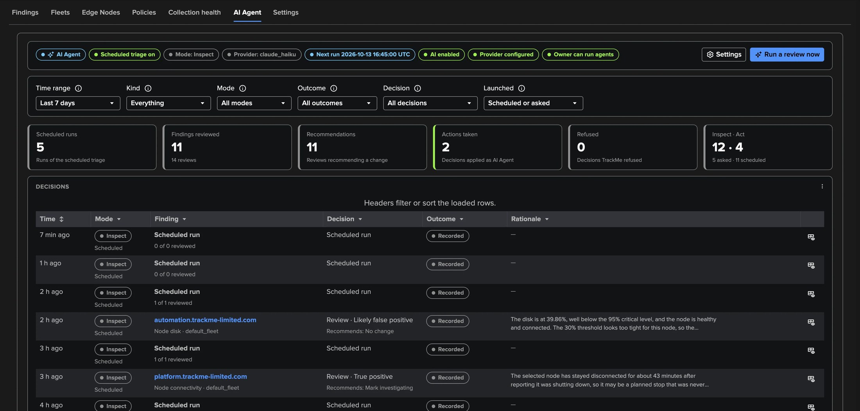
PART 4 · AI AGENT
The Cribl Edge AI Agent — triage by an agentic operator
1
Reviews like an operator
3
Inspect, then act
5
Hourly scheduled triage
From the facts TrackMe holds: no search, no call to Cribl, no ML.
Mark investigating, dismiss for a time, resolve on a measured recovery.
Never over an operator's decision; one current [AI Agent] note.
2
Five assessments
4
Only what the tenant allows
6
Every decision logged
True positive, likely false positive, expected, not in use, needs investigation.
Each decision has its setting; TrackMe re-checks it before applying.
The AI Agent tab: runs, reviews, actions taken, refusals.
TrackMe for Splunk · Hands-on: Cribl Edge
docs.trackme-solutions.com
Notes:
The Cribl Edge AI Agent reviews Edge findings the way an operator would, from facts TrackMe already holds: the finding and its group, the Fleet and the node in the published directory, whether they are still there, and Collection health. It never runs a search, never calls Cribl, and uses no machine learning. It assesses each finding and recommends a decision; in act mode it applies only the decisions the tenant allows, and TrackMe checks their conditions again before applying them. Scheduled triage runs hourly and never overrides an operator. Here the tab shows the scheduled runs, one likely false positive on a node disk and one true positive on a selected node that stayed disconnected.

Slide 28
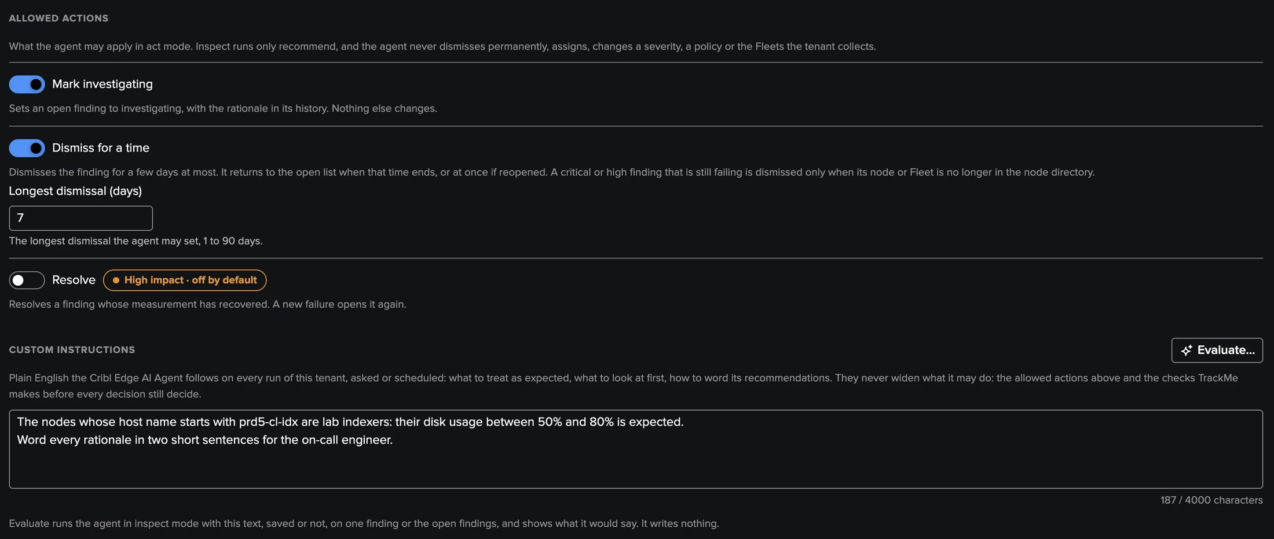
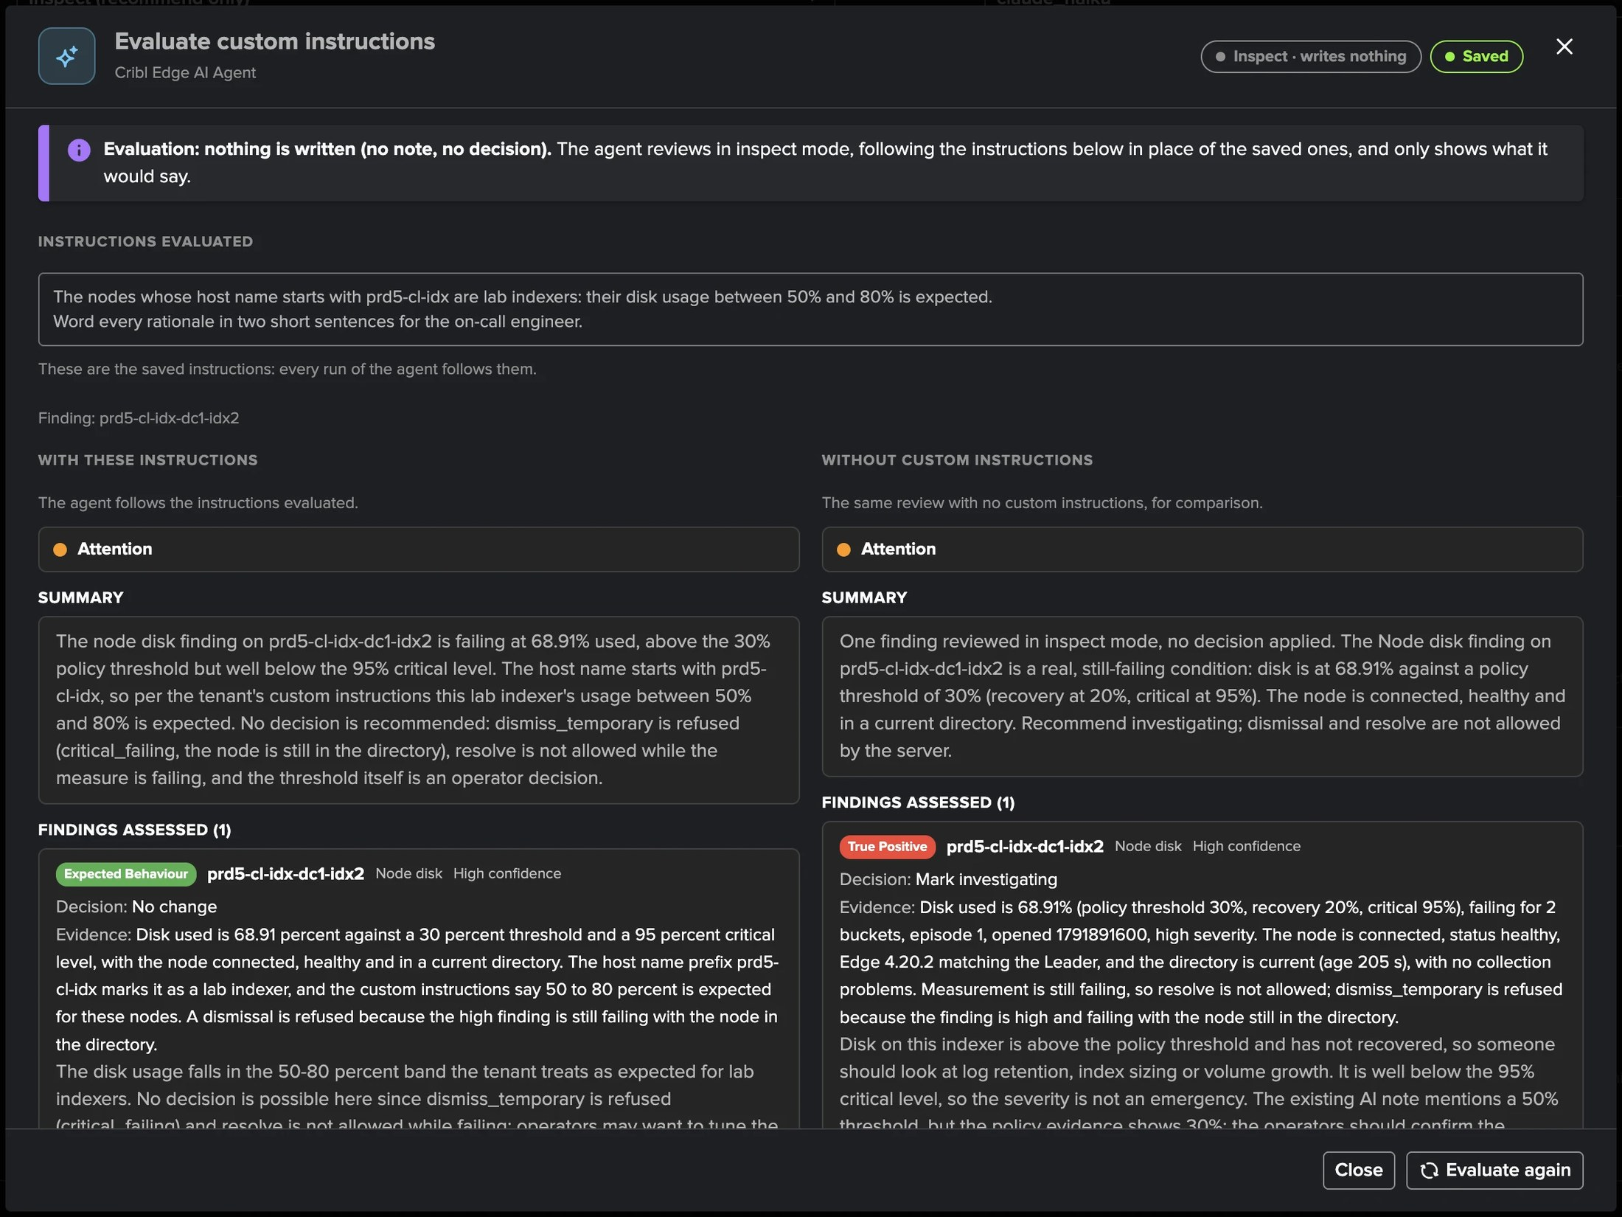
PART 4 · AI AGENT
Custom instructions — and Evaluate before they run
1
Plain English, per tenant
3
Evaluate
What is expected here, what to look at first, how to word it.
The same review with and without your text, side by side. Writes nothing.
2
Never widen its power
4
Here
The allowed decisions and TrackMe's checks still decide.
Lab indexers at 50–80 % disk: Expected behaviour instead of investigating.
TrackMe for Splunk · Hands-on: Cribl Edge
docs.trackme-solutions.com
Notes:
In Settings, AI Agent, a TrackMe administrator of the tenant chooses the decisions the agent may apply and writes custom instructions in plain English: what to treat as expected, what to look at first, how to word the recommendations. Every run follows them, asked or scheduled, and they never widen what the agent may do. Evaluate runs the agent in inspect mode with the text and shows the same review with and without it, side by side, without writing anything. Here, lab indexers between 50 and 80 percent disk are declared expected: the same Node disk finding reads Expected behaviour instead of a true positive to investigate.

Slide 29
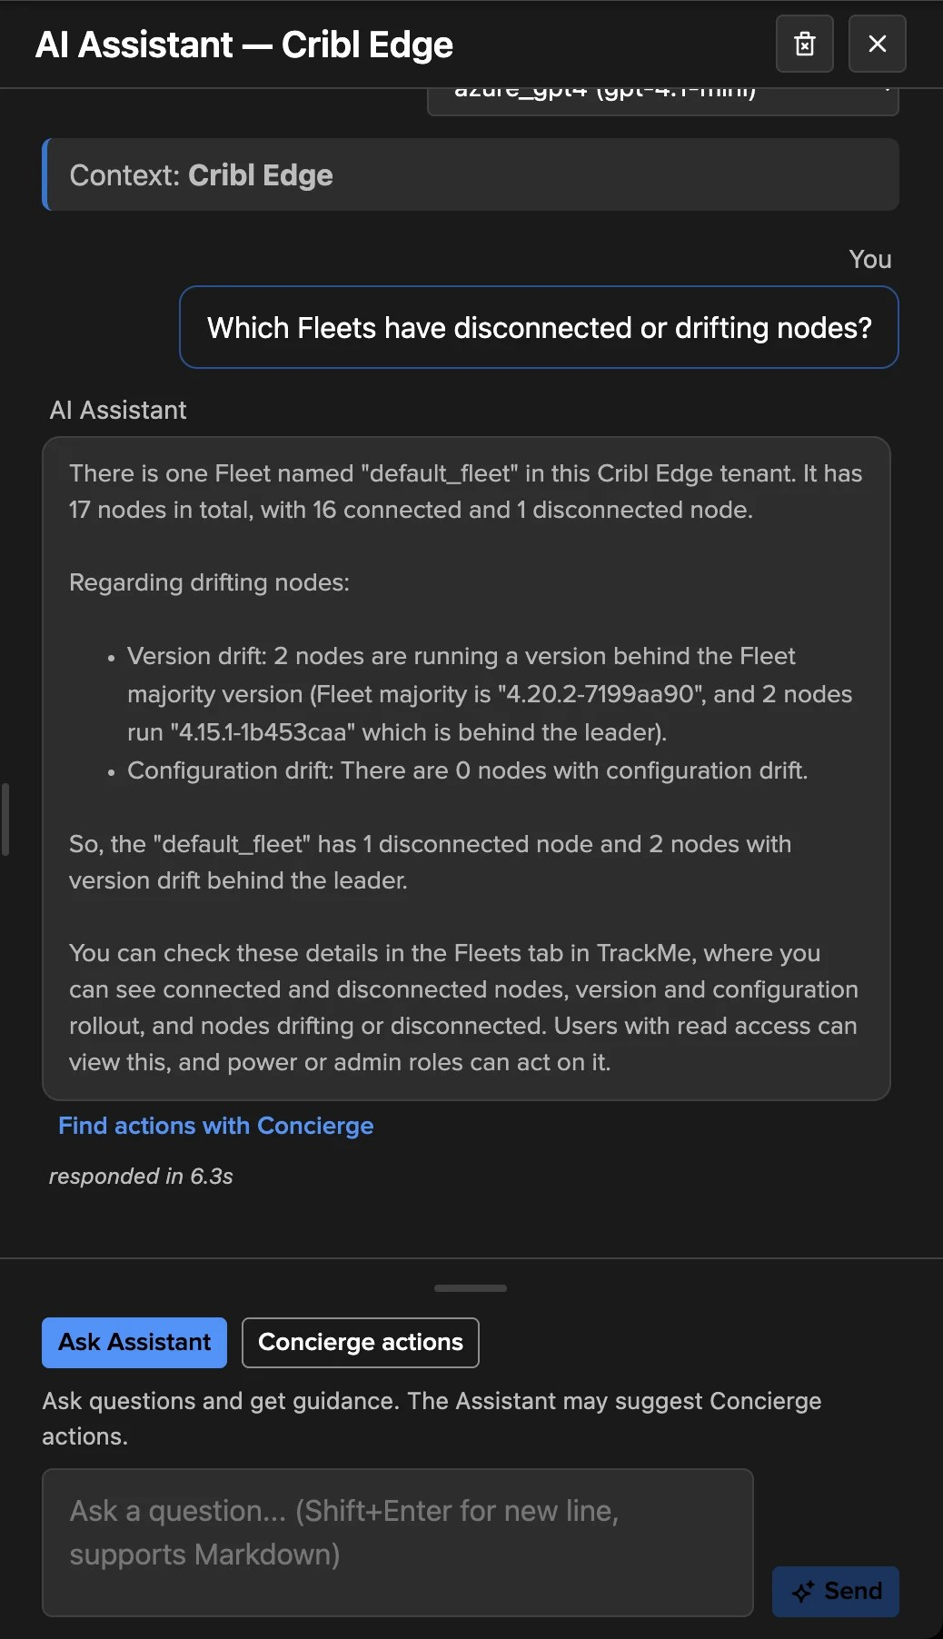
PART 4 · AI AND COMPARISON
The AI Assistant, and Edge next to Stream
 | Cribl Stream | Cribl Edge
Main source | Cribl metrics in Splunk + Leader API | Leader node directory (+ System Metrics)
Policies | 16, 14 on | 11, 8 on
Judgement | Per object, traffic ML models | Per Fleet, selected nodes, thresholds
Size of one tenant | About 20 000 objects | Any fleet size
AI | Assistant, Concierge, AI Agent | Assistant, Cribl Edge AI Agent
Findings model | Shared | Shared
TrackMe for Splunk · Hands-on: Cribl Edge
docs.trackme-solutions.com
Notes:
On an Edge tenant, the AI Assistant knows the workspace, the policies and their settings, the Fleets, the node summary, the Leader version and the age of the node directory, and reads the open findings. Edge and Stream share the findings model and each has its own AI Agent; they differ in sources, judgement and machine learning.

Slide 30
RECAP
Where we are
In four parts
Set up
Followed
Judged
Operated
a tenant on the Edge Leader, its Fleets selected, an optional System Metrics index
Fleets and Edge Nodes from the directory, one node up close with System activity
a disconnected node and version drift, per Fleet and per selected node
policies and bank holidays, collection health, settings, Topology Studio, the assistant and the AI Agent
What made it work
One bulk read, any size
Judged like an operator would
Detail on demand
The node directory read page by page: no call per node, no node limit, every node current within five minutes.
Shares of a Fleet, graces and selected nodes: one sleeping laptop opens nothing, a fifth of a Fleet does.
A node's system activity and live Source status read only when someone opens it.
TrackMe for Splunk · Hands-on: Cribl Edge
docs.trackme-solutions.com
Notes:
Recap. A Cribl Edge tenant on a Cribl connection, its Fleets and nodes followed from one bulk read of the Leader, any node opened up close with its System activity read live, a disconnected node and version drift seen the way the policies judge them, the nodes that must stay connected selected by name or from a lookup, and the tenant operated with its policies and bank holidays, collection health, settings, Topology Studio, the AI Assistant and the Cribl Edge AI Agent with its custom instructions.

