Slide 1

HANDS-ON WALKTHROUGH · PART 1
Your first DSM tenant
From an empty TrackMe to monitored data sources — create a Virtual Tenant, let the hybrid tracker discover the feeds, and read the first entity in alert and why.
Captured live on TrackMe 2.4.18 · Splunk Cloud
Notes:
Part 1 of the hands-on series. Everything in this deck was captured live on TrackMe 2.4.18 on Splunk Cloud, starting from a tenant that did not exist. The goal is to show the product doing what the introduction described: discover, measure, decide.

Slide 2
THE PLAN
What we are going to do
One tenant, one component, one tracker. The wizard asks six questions; the tracker does the rest.
1
2
3
4
5
6
Choose
Wizard
Create
Run
Tenant Home
Entity
the component: Splunk Feeds → DSM
6 steps: basics · DSM & indexes · default delay · ML scope · indexes & RBAC · review
TrackMe builds the KV collections, transforms and the hybrid tracker
execute the hybrid tracker once — or wait 5 minutes for the scheduler
every data source appears, already green, orange or red
open one entity in alert and read why
Our example tenant
Tenant id
Alias
Component
Index scope
Everything else
secops
Security Operations
DSM — Data Source Monitoring
siem-*
wizard defaults
TrackMe for Splunk · Hands-on: your first DSM tenant
docs.trackme-solutions.com
Notes:
The pattern is the same for every customer: one tenant per domain, DSM first. We use secops as the tenant id — lowercase, immutable — and scope discovery to the SIEM index families. Everything else stays on defaults on purpose: the defaults are good, and each one can be revisited from the Tenant Home later.

Slide 3
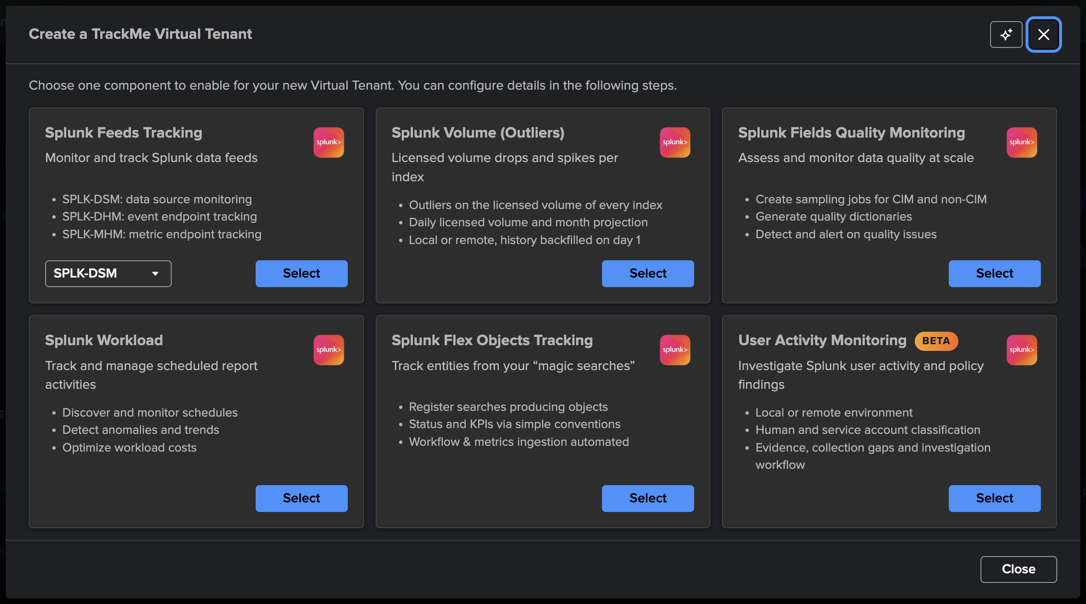
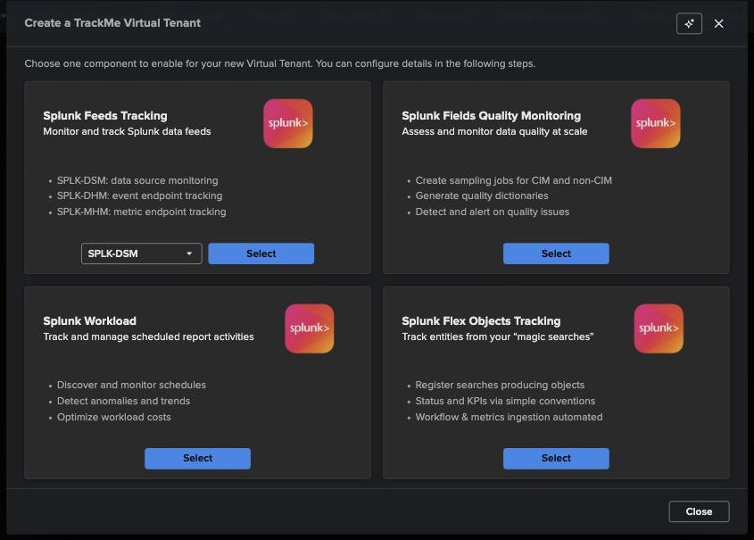
CREATE A VIRTUAL TENANT
Step 0 — choose the component
1
Splunk Feeds Tracking
Bundles the three feeds components. The selector picks which one this tenant starts with — SPLK-DSM here. DHM and MHM can be enabled later from “Manage components”.
2
2
One tenant, one starting component
1
The wizard configures a single component; a tenant can run several. The other tiles start Volume (Outliers), Fields Quality, Workload, Flex Objects or User Activity Monitoring (Beta) tenants.
Why DSM first
It answers the question every Splunk team has — is my data still arriving? — and it is auto-discovered: nothing to declare, nothing to maintain.
TrackMe for Splunk · Hands-on: your first DSM tenant
docs.trackme-solutions.com
Notes:
The chooser opens from Virtual Tenants → Actions → Create a tracking tenant. Six tiles: Splunk Feeds Tracking — the data-flow family: DSM (index × sourcetype), DHM (host × sourcetype), MHM (metric hosts) — then Volume (Outliers) (VOL, licensed volume per index), Fields Quality (FQM), Workload (WLK), Flex Objects (FLX) and User Activity Monitoring, a Beta tenant type of its own. We start with DSM. The AI icon top-right of the wizard opens the AI Assistant in context.

Slide 4
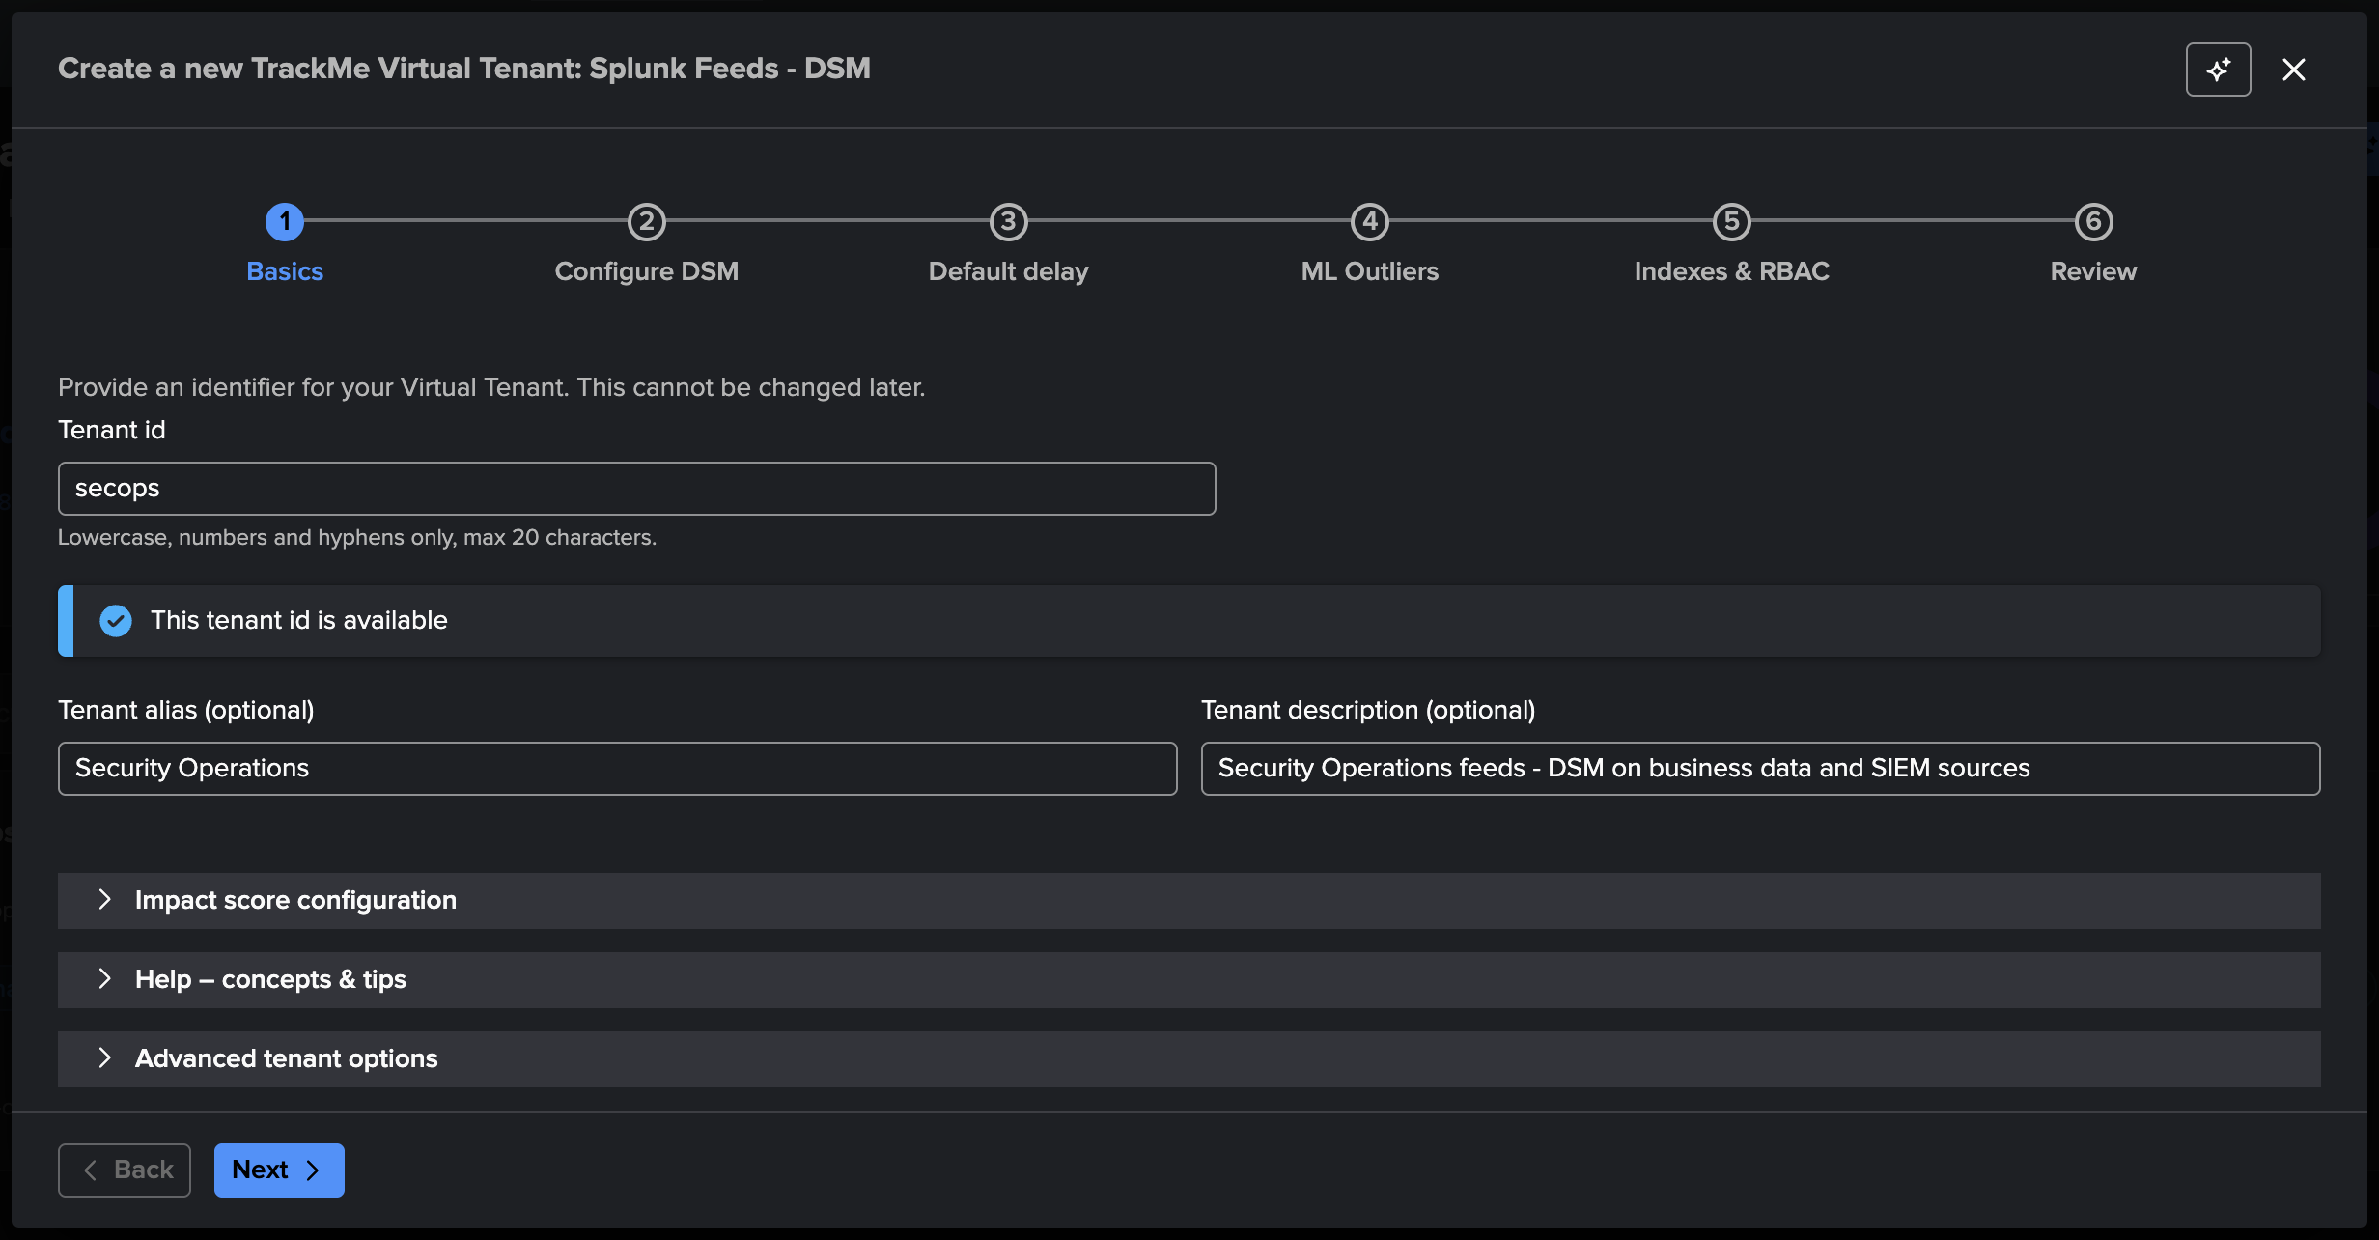
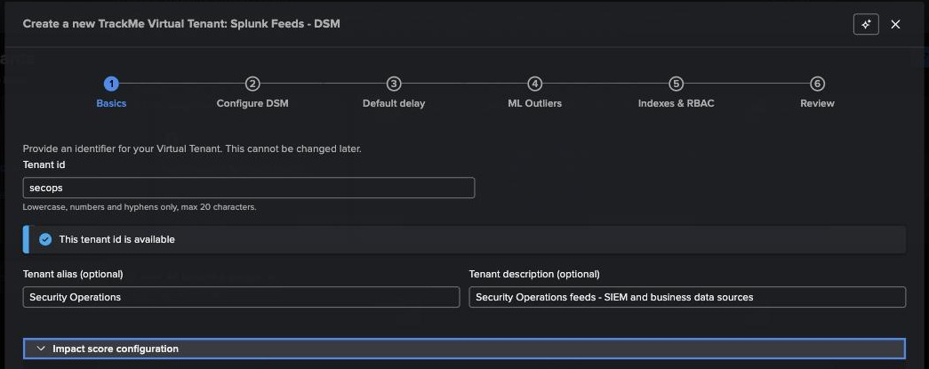
WIZARD 1 / 6
Step 1 — Basics: identity that cannot change
1
Tenant id — immutable
Lowercase, digits, hyphens, max 20 chars. It is stamped as an indexed field on every event and metric the tenant produces. Choose it like a hostname.
1
2
Alias
2
3
Human-readable display name — editable any time. Cards are ordered by alias, so “01 - SecOps” style prefixes work well.
4
3
Description
Free text shown on the tenant card.
The banner confirms the id is available. Try a taken id and the wizard refuses before you spend time on the next steps.
4
Expanders
Impact score configuration, concepts & tips, advanced options — defaults are fine for a first tenant.
TrackMe for Splunk · Hands-on: your first DSM tenant
docs.trackme-solutions.com
Notes:
The tenant_id cannot be changed later — it becomes part of every KV collection name, every report name and every summary event. Aliases and descriptions are cosmetic and editable. We use secops / Security Operations.

Slide 5
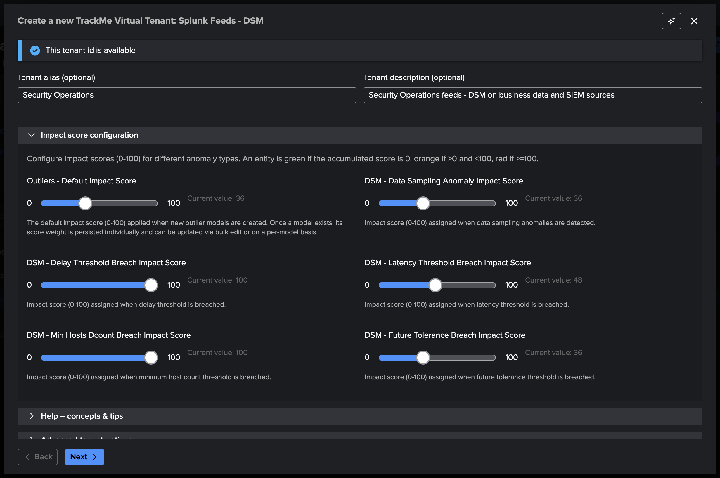
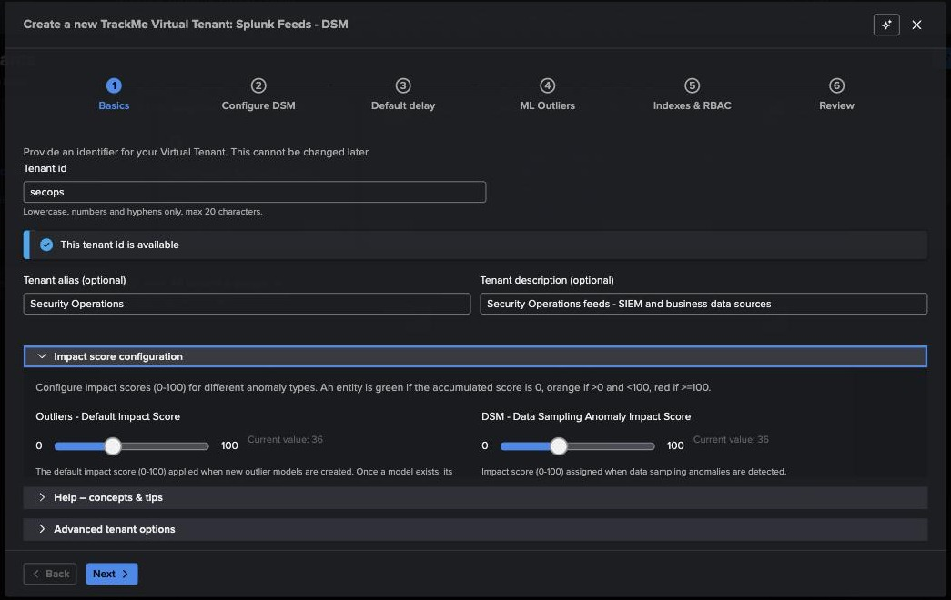
WIZARD 1 / 6 · EXPANDER
Step 1 — the impact-score weights live at tenant level
1
Impact score configuration
The weights from the introduction — outliers, data sampling, delay breach, latency breach, min hosts, future tolerance — are set here per tenant, 0–100 each.
1
2
Delay breach = 100
A delay-threshold breach alone reaches the red threshold (≥ 100). Latency is 48, outliers 36: on their own they only make an entity orange.
2
Remember
total_score = Σ weights of active anomalies
0 → green · < 100 → orange · ≥ 100 → red
The tenant default cascades to every entity and can be overridden per entity or in bulk. We keep the defaults.
TrackMe for Splunk · Hands-on: your first DSM tenant
docs.trackme-solutions.com
Notes:
This is where the hybrid scoring model from the introduction becomes concrete. Delay breach carries 100 because a feed that stopped is, by definition, critical. Latency and outliers carry less so that a single soft signal warns rather than pages. These are tenant defaults; per-entity overrides exist.

Slide 6
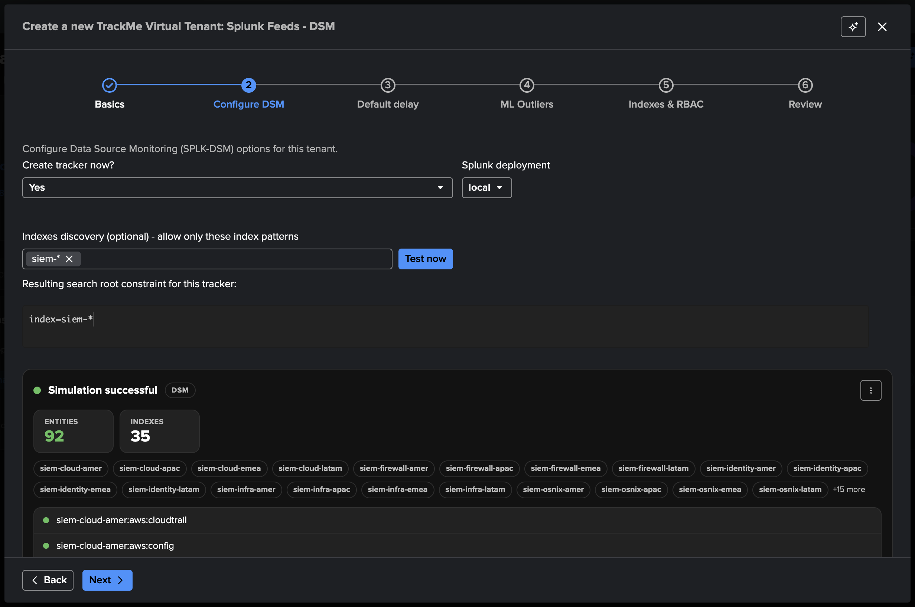
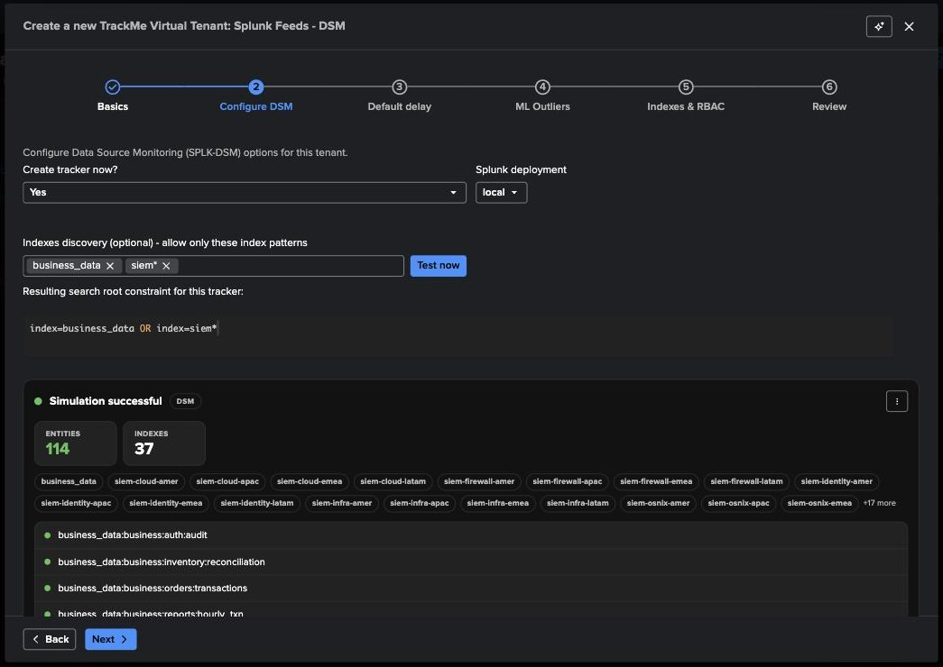
WIZARD 2 / 6
Step 2 — Configure DSM: the hybrid tracker is born here
1
Create tracker now = Yes
The wizard creates the DSM hybrid tracker for you — a scheduled search that runs every 5 minutes against the local deployment (or a remote one).
1
2
Index patterns
Chips, wildcards allowed: siem-* covers every SIEM index family. Leave empty to discover every index the tracker’s owner can read.
2
3
3
Resulting root constraint
4
index=siem-* — this is the SPL the tracker will start from.
4
Test now = simulation
Before creating anything: the entities and indexes the tracker will discover, listed. No surprises after creation.
TrackMe for Splunk · Hands-on: your first DSM tenant
docs.trackme-solutions.com
Notes:
Two things happen on this step: we scope discovery, and we ask TrackMe to create the hybrid tracker during tenant creation — this is the flow we use in every demo. 'Test now' runs the discovery search as a simulation and shows exactly which entities would be created; it is the fastest way to validate index patterns and permissions before committing.

Slide 7
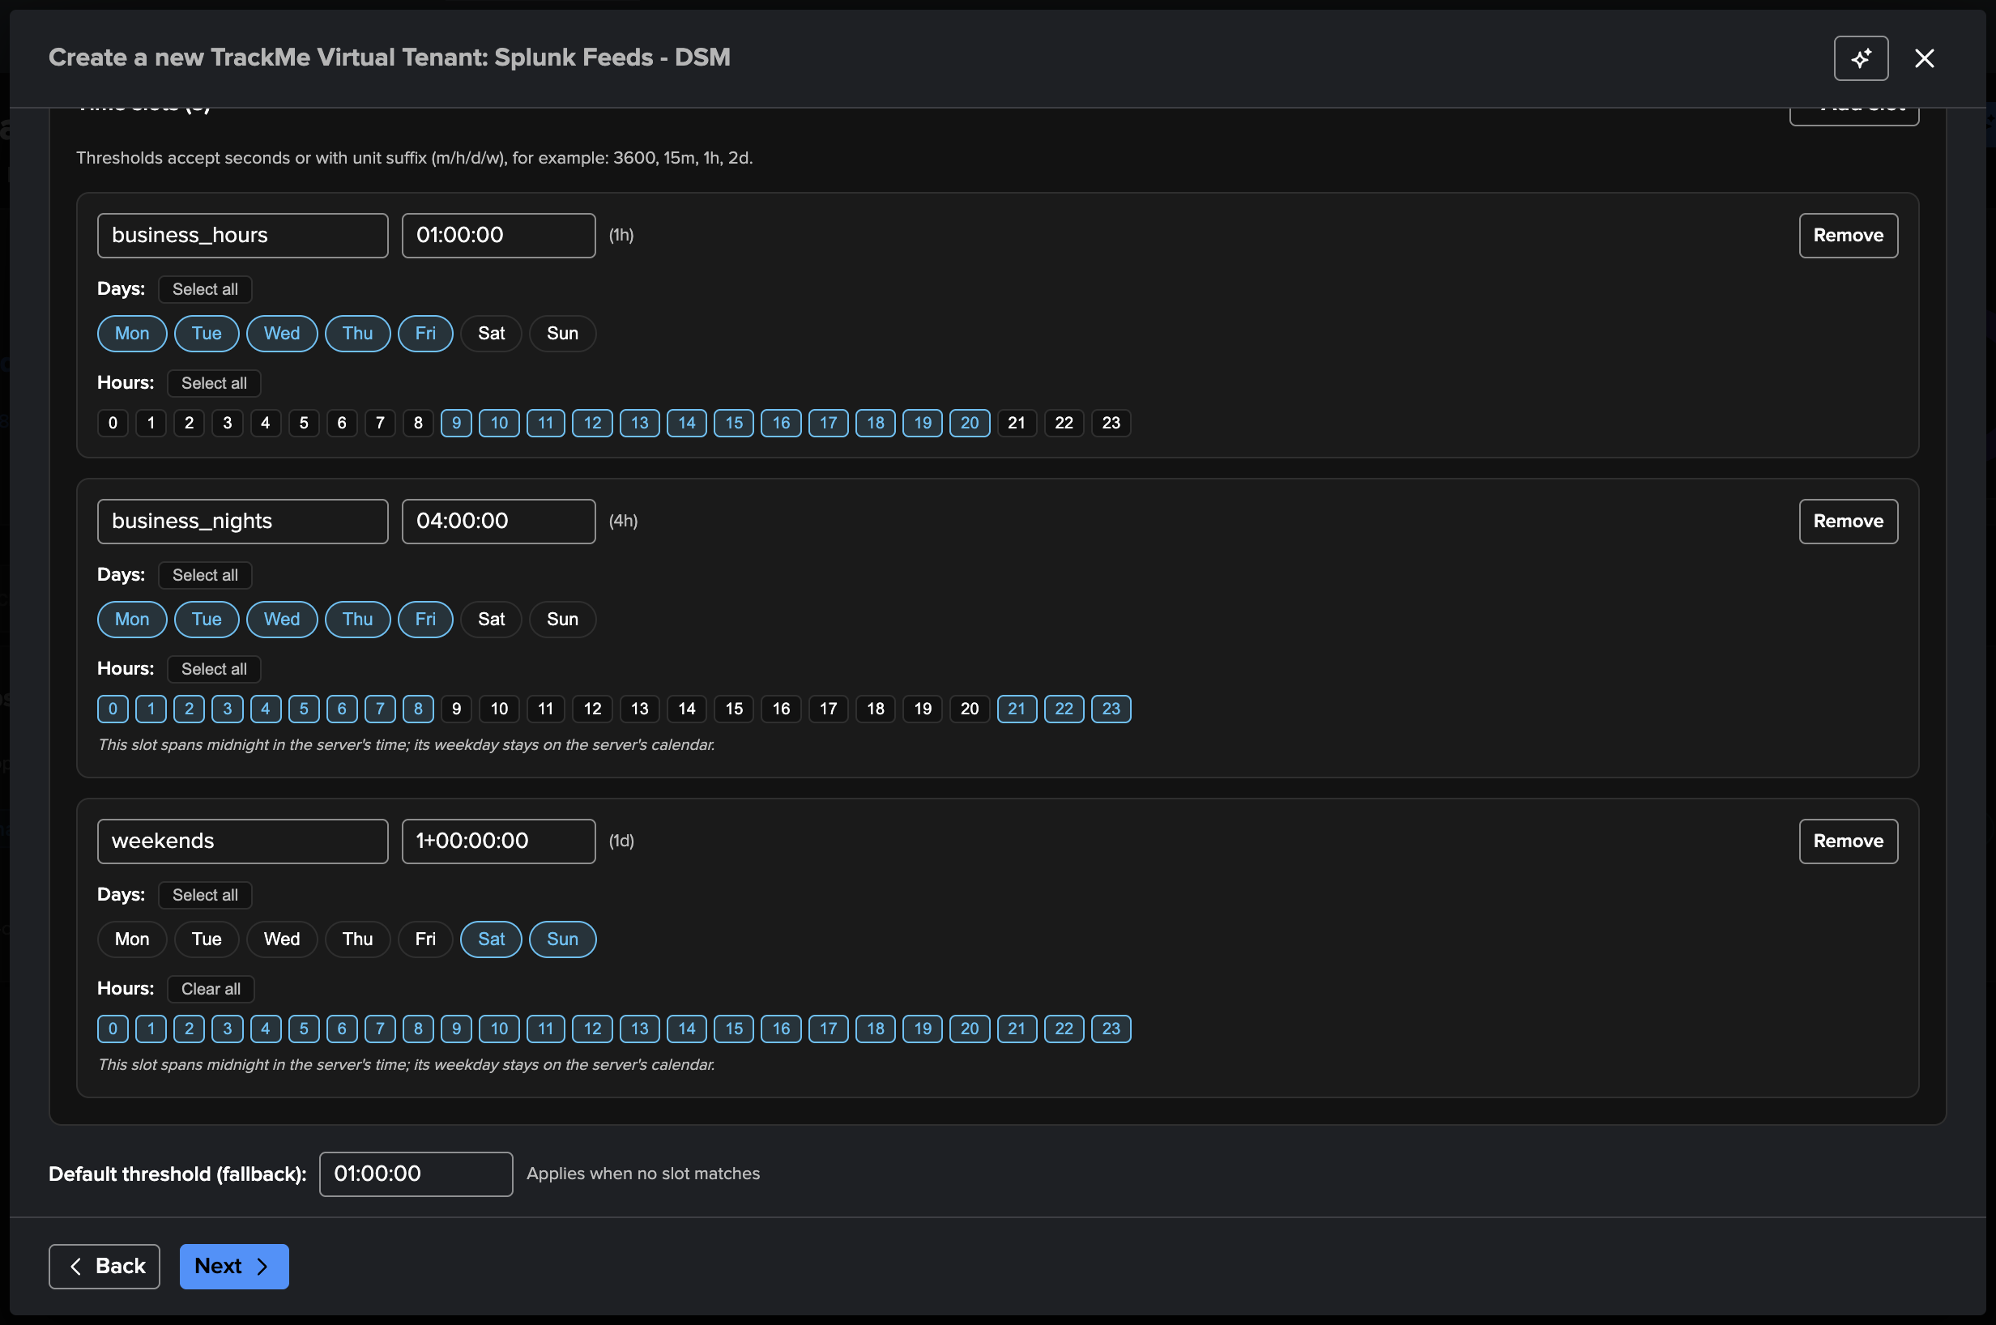
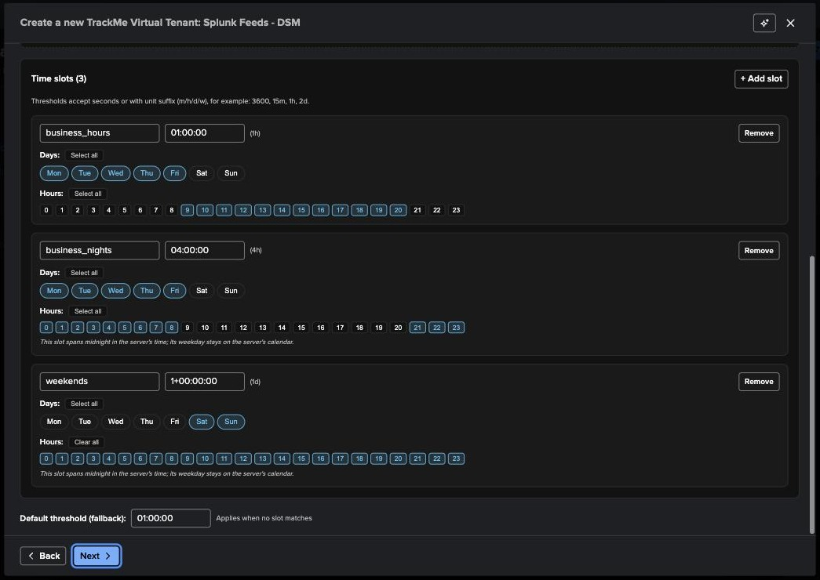
WIZARD 3 / 6
Step 3 — Default delay: what “late” means for this tenant
1
business_hours — 1h
Mon–Fri, 09–20: a feed silent for more than an hour is late.
1
2
business_nights — 4h
Mon–Fri, 21–08: more tolerance while batch jobs and low traffic are expected.
2
3
weekends — 1 day
Sat–Sun, all hours.
4
Fallback — 1h
3
Applies when no slot matches.
Static vs variable
4
Static: one limit, always. Variable: limits by day and hour. The quick template “Business hours vs. off-hours” pre-fills three slots; hours are shown in your browser time and stored in server time. This is the tenant default — every entity inherits it and can override it.
TrackMe for Splunk · Hands-on: your first DSM tenant
docs.trackme-solutions.com
Notes:
Delay is the core DSM metric: time since the last event was indexed, compared to a threshold. The variable-threshold default is what makes TrackMe quiet at night and on weekends without a rule per feed. The timezone notice matters for customers with distributed teams: slots are evaluated in the Splunk server's local time.

Slide 8
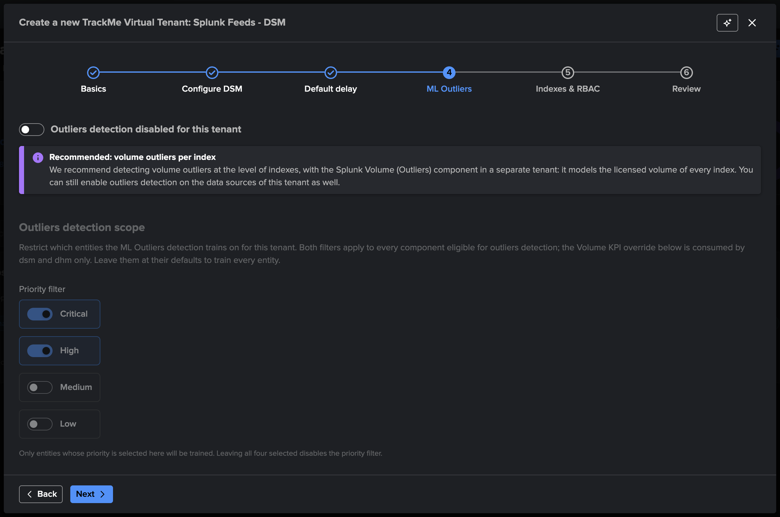
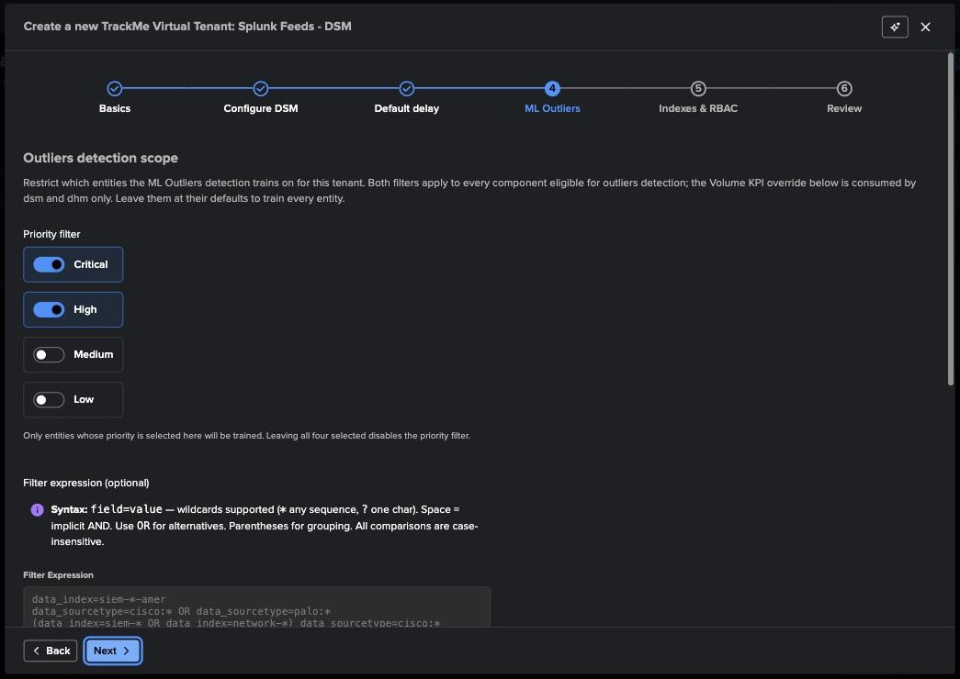
WIZARD 4 / 6
Step 4 — ML Outliers: off by default, volume belongs to VOL
1
Disabled for this tenant
Outliers detection on data sources starts off. The banner recommends volume outliers per index with the Splunk Volume (Outliers) component, in its own tenant.
1
2
If you enable it: the scope
A priority filter (critical + high by default) and a filter expression in the Virtual Groups DSL narrow training to the feeds where anomalies are meaningful.
2
Why this default
VOL models the licensed volume of every index — the right grain for drops and spikes. Per-feed models cost search time and add 36 to the score per breach: a focused opt-in, not a fleet-wide switch.
TrackMe for Splunk · Hands-on: your first DSM tenant
docs.trackme-solutions.com
Notes:
Nothing to change here for a first tenant. In 2.4.18 per-feed outliers start disabled, and the wizard recommends the Volume (Outliers) component for volume anomalies per index. When a team does want per-feed models, the scope keeps them focused: critical and high priorities by default, plus an optional filter expression — which is why classification with policies matters.

Slide 9
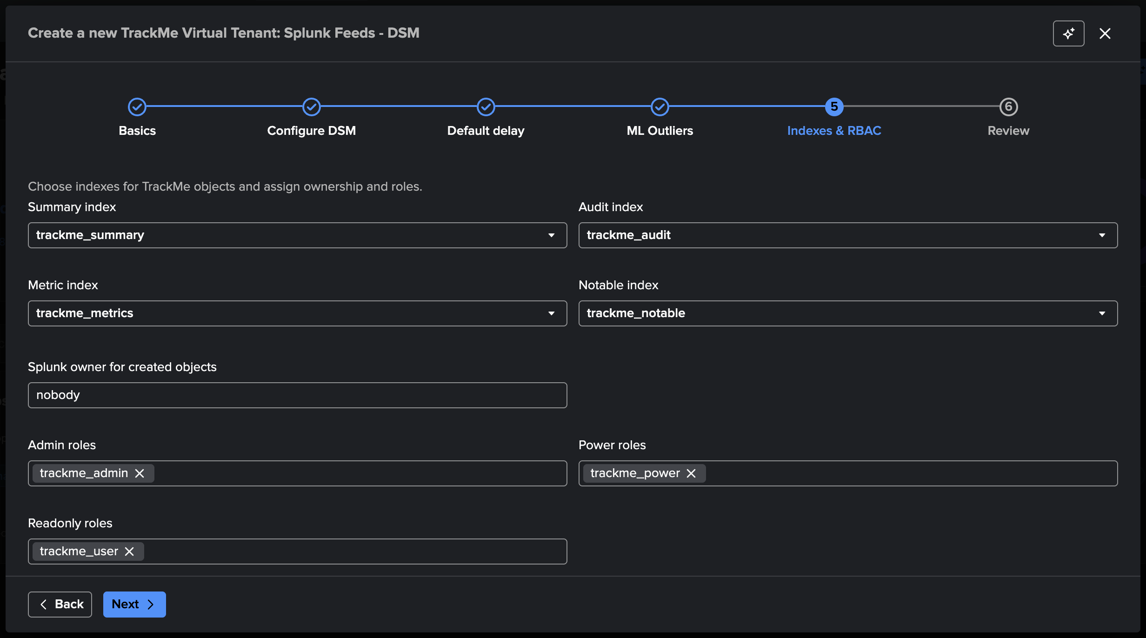
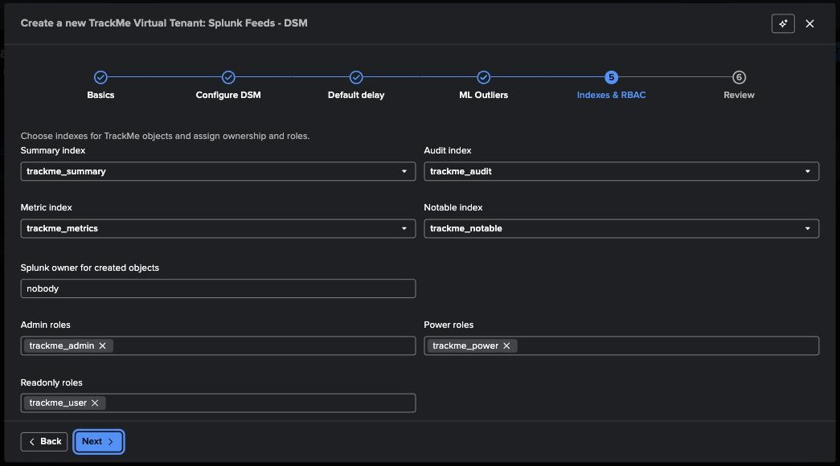
WIZARD 5 / 6
Step 5 — Indexes & RBAC: where the tenant writes, who can see it
1
Four indexes
summary (state events), audit (who changed what), metrics (KPIs over time), notable (alert output). Defaults are the trackme_* indexes; large estates often dedicate indexes per tenant.
1
2
Owner
The Splunk user the tenant’s objects belong to and its trackers run as — “nobody” keeps them app-scoped.
2
3
Roles
3
Admin, power and read-only roles per tenant. This is how team A never sees team B’s entities.
RBAC is per tenant and enforced at the REST boundary — the UI, the API and the AI Assistant all go through it.
TrackMe for Splunk · Hands-on: your first DSM tenant
docs.trackme-solutions.com
Notes:
This is the step that maps to your organisation: which Splunk roles get admin, power and read-only on the SecOps tenant. Indexes: keep the defaults unless retention or access requirements differ per tenant.

Slide 10
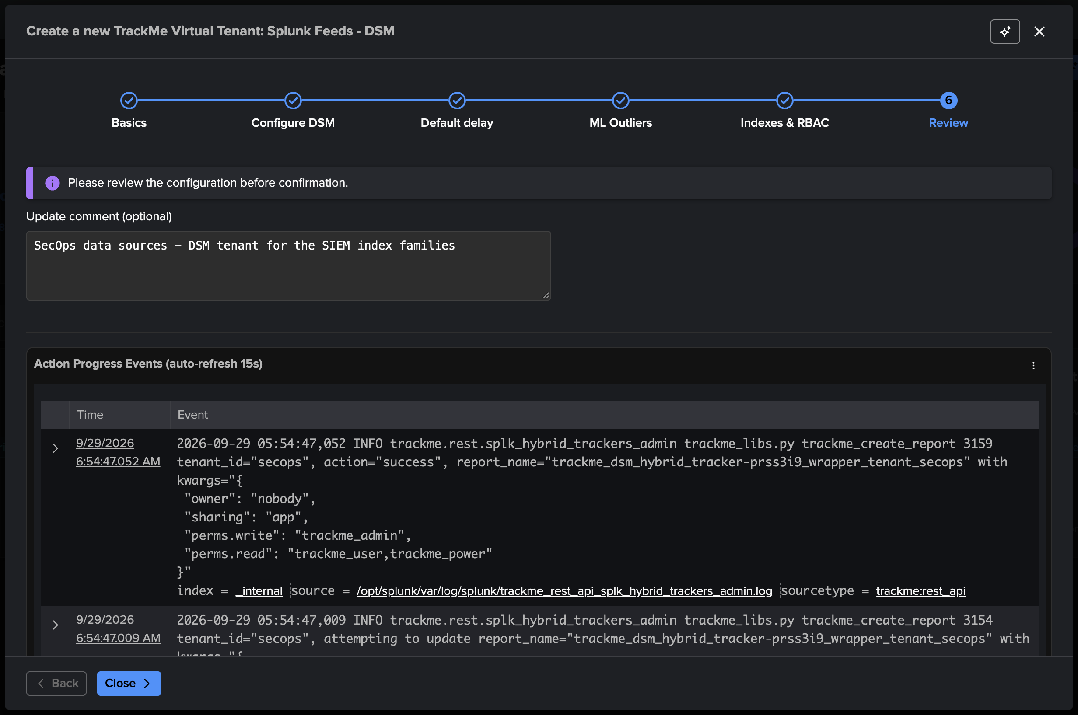
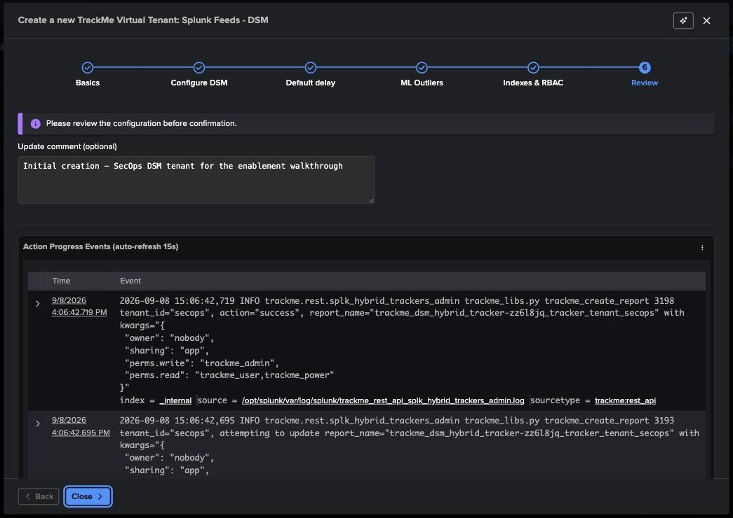
WIZARD 6 / 6
Step 6 — Review, then watch TrackMe build the tenant
1
Update comment
Free text stored in the audit trail with this creation — useful months later.
2
Action progress events
1
The wizard streams the REST log live: KV collections and transforms created per feature (outliers, sampling…), then the hybrid tracker report with its ACL — owner nobody, sharing app, write trackme_admin, read trackme_user + trackme_power.
2
What now exists
• the tenant record and its per-tenant KV Store
• a scheduled report: trackme_dsm_hybrid_tracker-<id>_tracker_tenant_secops
• the wrapper report the tracker executor calls
…and zero entities, until the tracker runs.
TrackMe for Splunk · Hands-on: your first DSM tenant
docs.trackme-solutions.com
Notes:
Creation takes seconds. The progress panel is the same log an admin would grep in the TrackMe REST API logs — nothing hidden. Note the tracker report name pattern; you will see it again in the scheduler and in WLK if you monitor TrackMe with TrackMe.

Slide 11
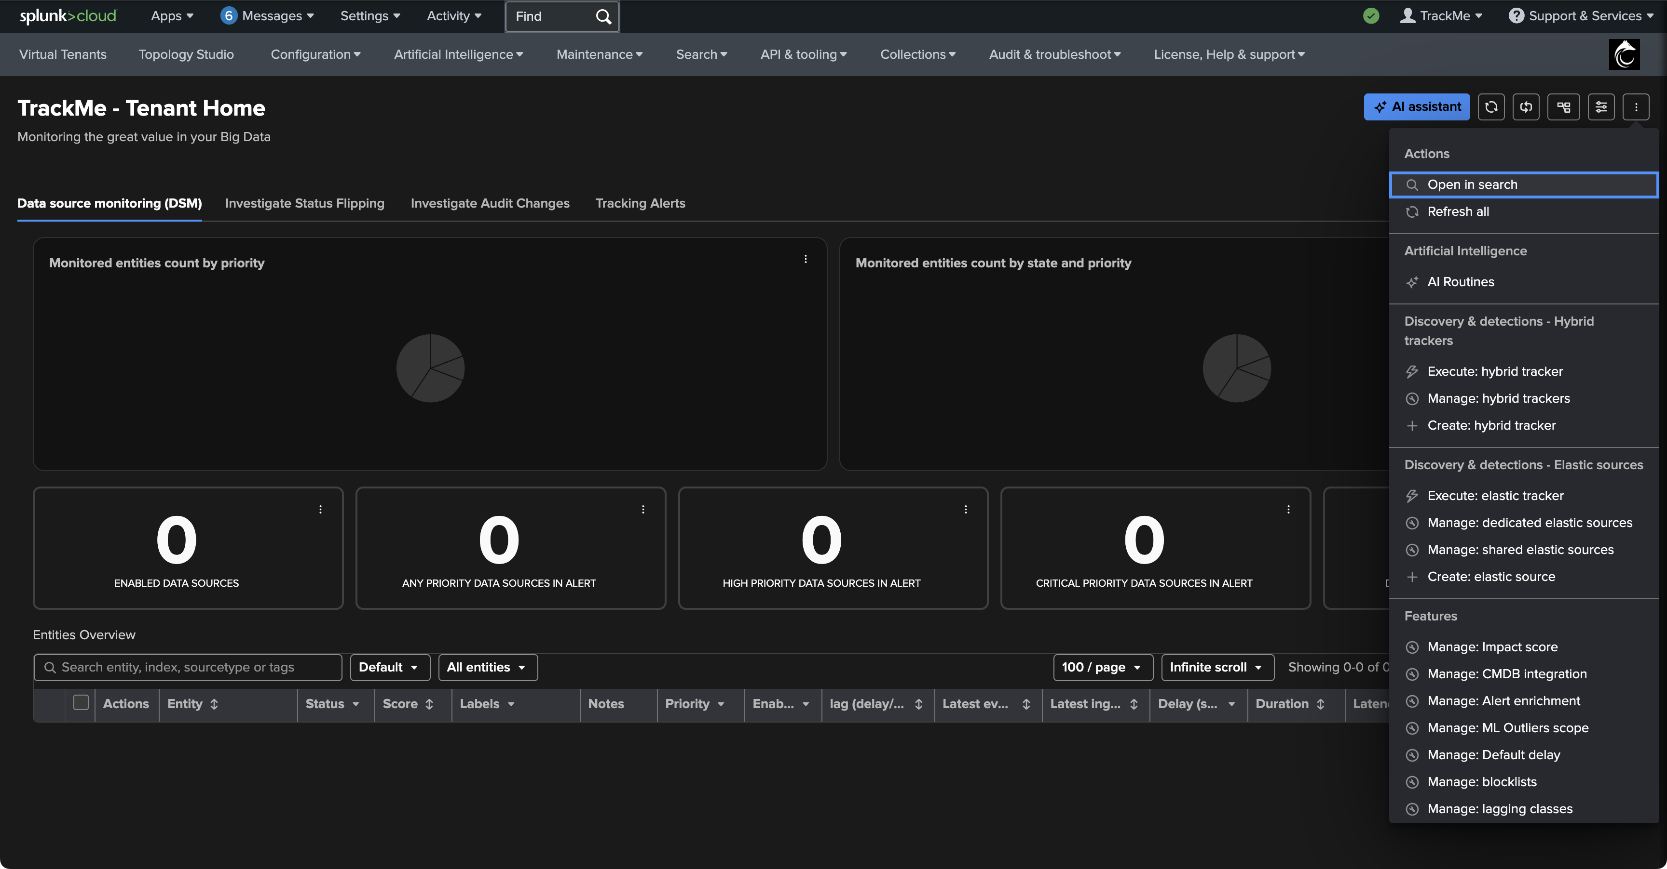
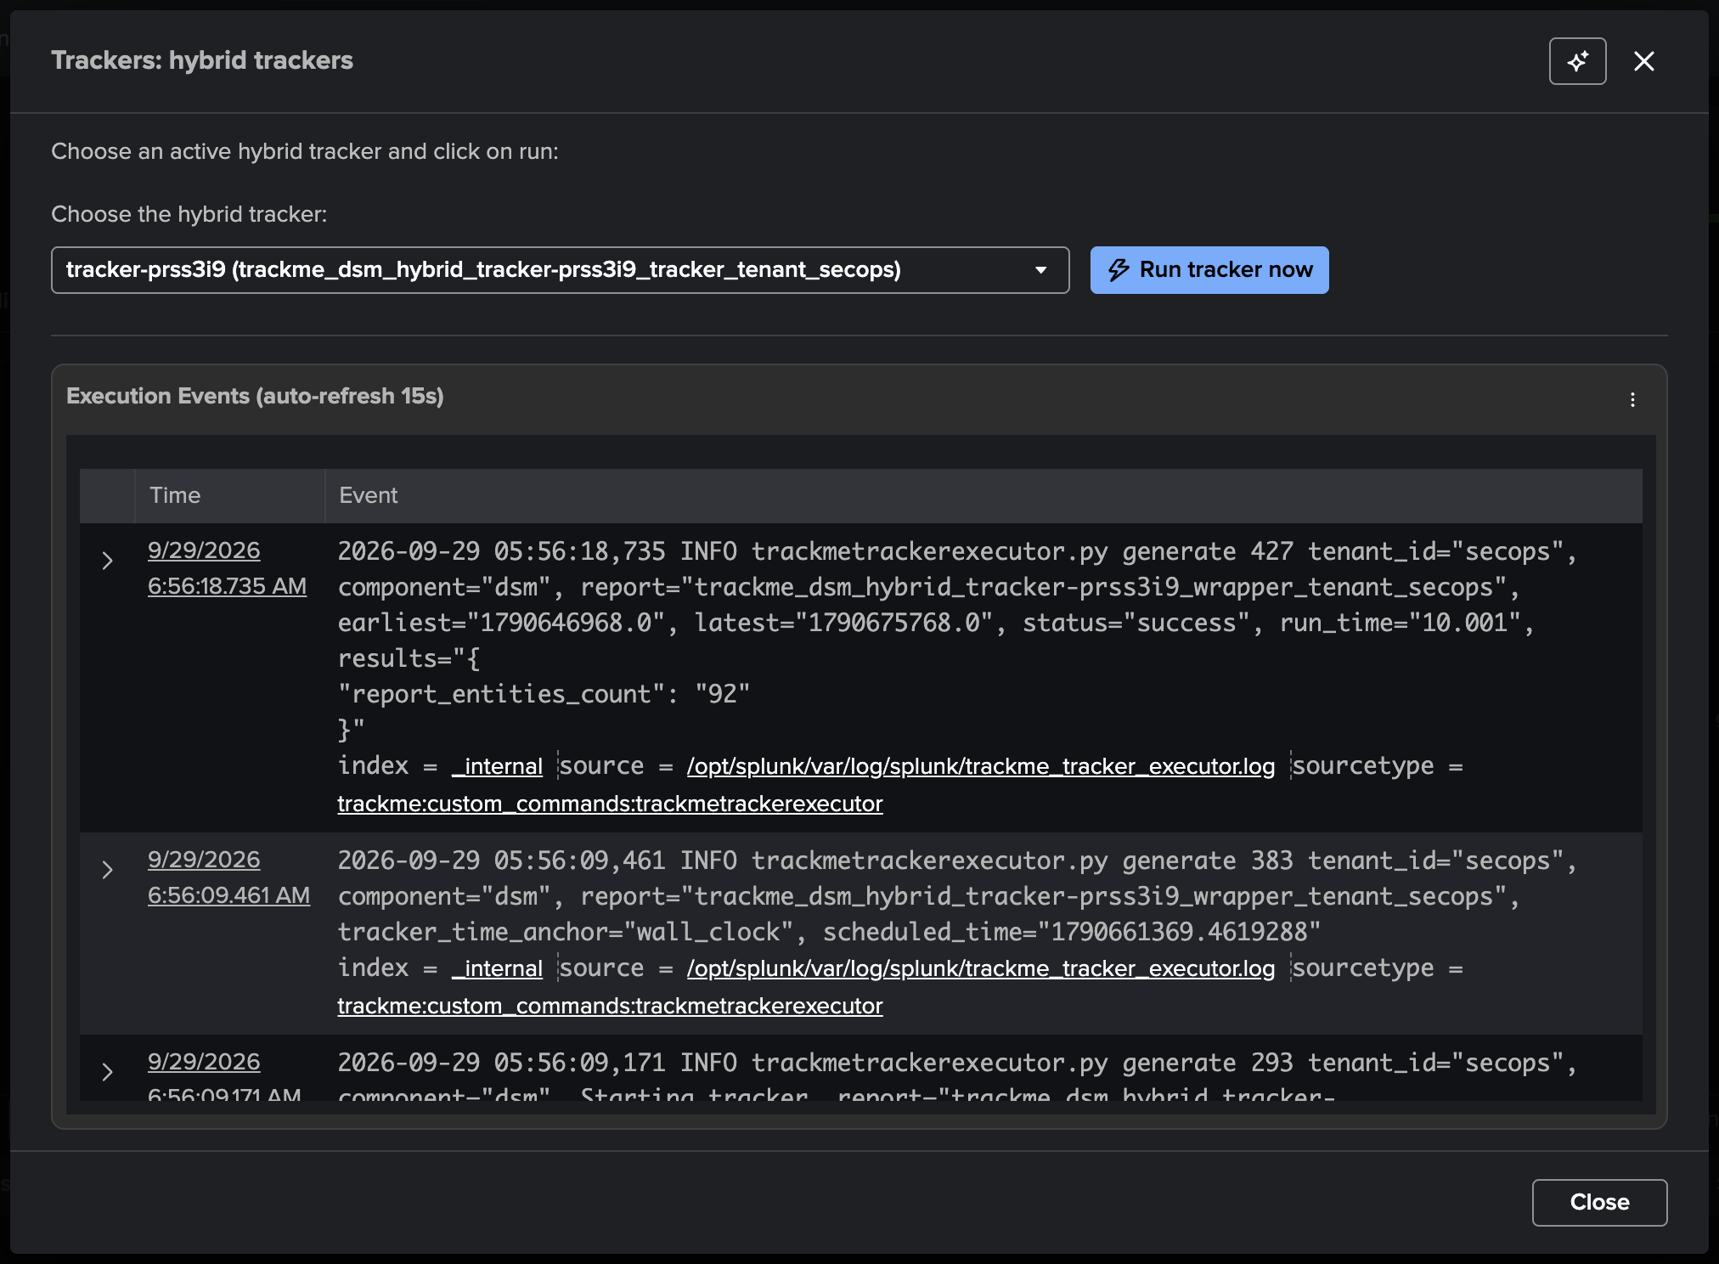
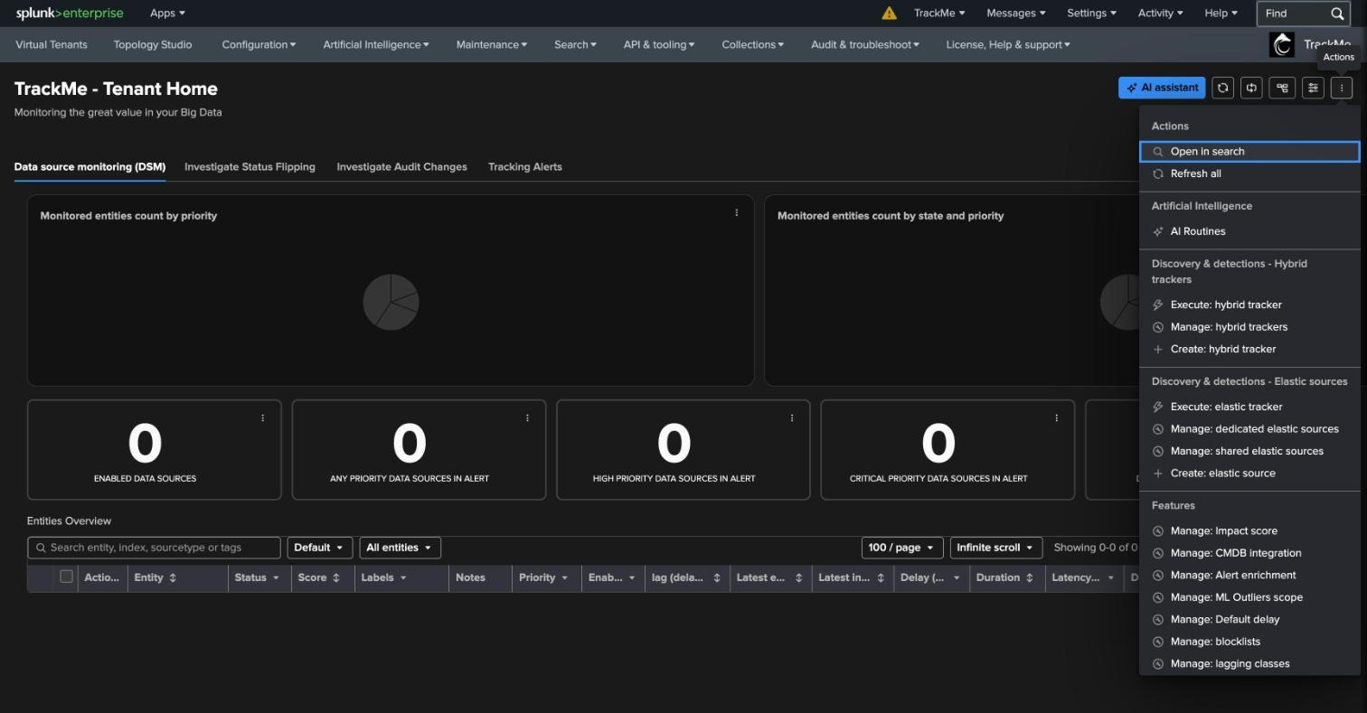
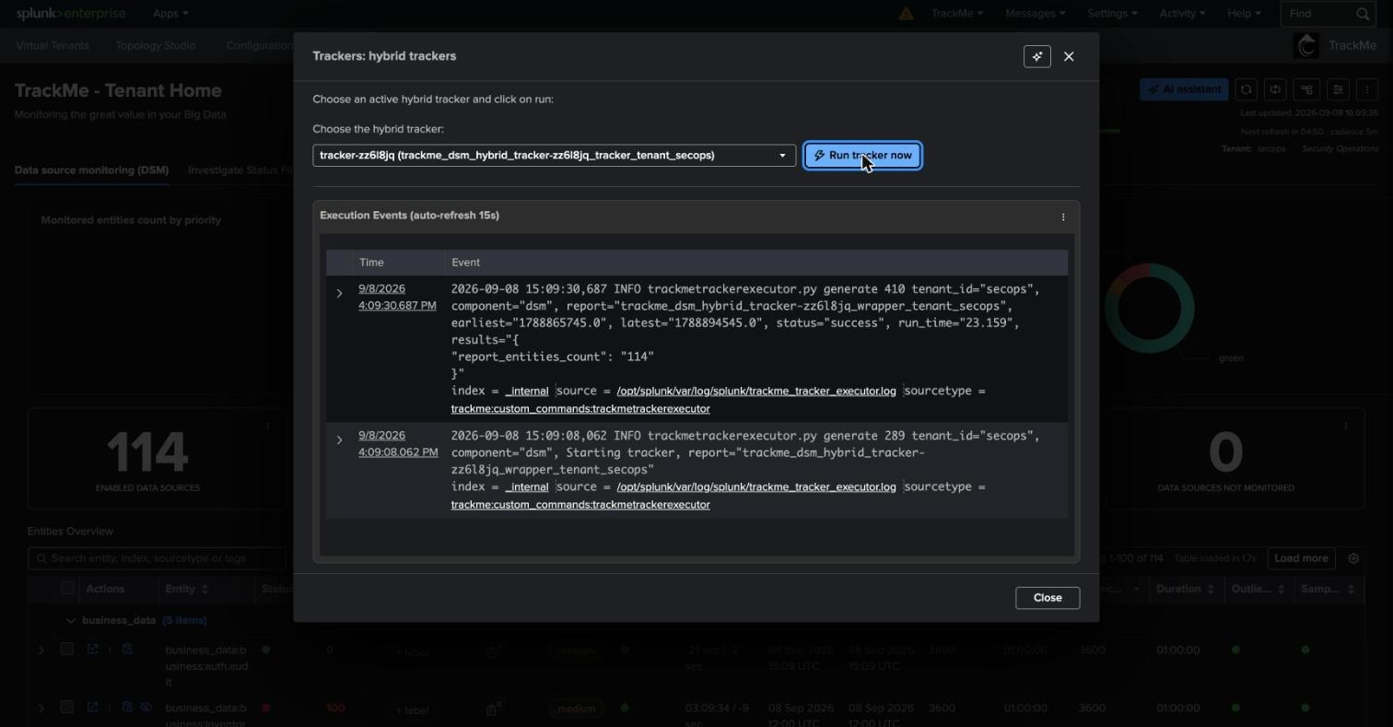
DISCOVERY
Run the hybrid tracker once — or wait five minutes
1
2
3
1
Tenant Home → Actions
2
Execute: hybrid tracker
3
One run, every data source
The ⋮ menu at the top right of Tenant Home groups everything tenant-scoped: hybrid trackers, elastic sources, impact score, CMDB, alert enrichment, ML scope, default delay, blocklists, lagging classes.
Pick the tracker created by the wizard and “Run tracker now”. The same modal streams the executor log.
report_entities_count over earliest/latest of the last 8 hours. From here on the scheduler runs it every 5 minutes.
TrackMe for Splunk · Hands-on: your first DSM tenant
docs.trackme-solutions.com
Notes:
Nothing appears in Tenant Home until a tracker has run — TrackMe is not a live dashboard. Rather than waiting for the 5-minute schedule, execute the tracker from the Actions menu. The execution panel shows the run time and the entity count, which is also what you look at when troubleshooting a tracker that finds nothing.

Slide 12
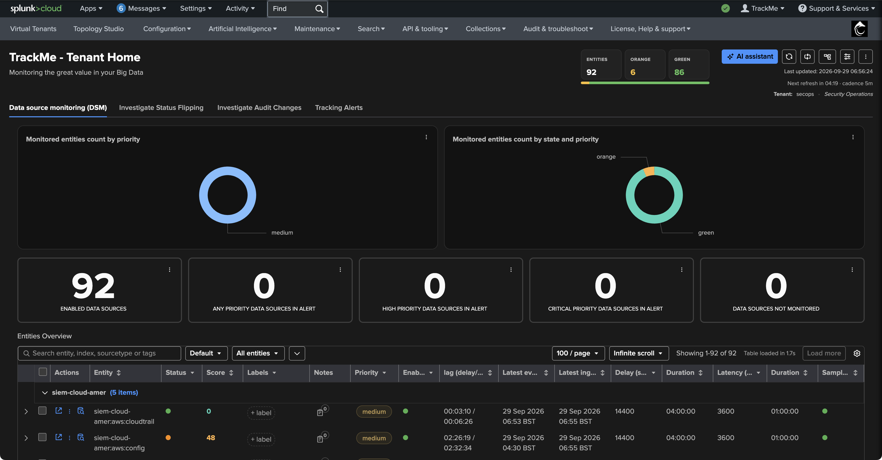
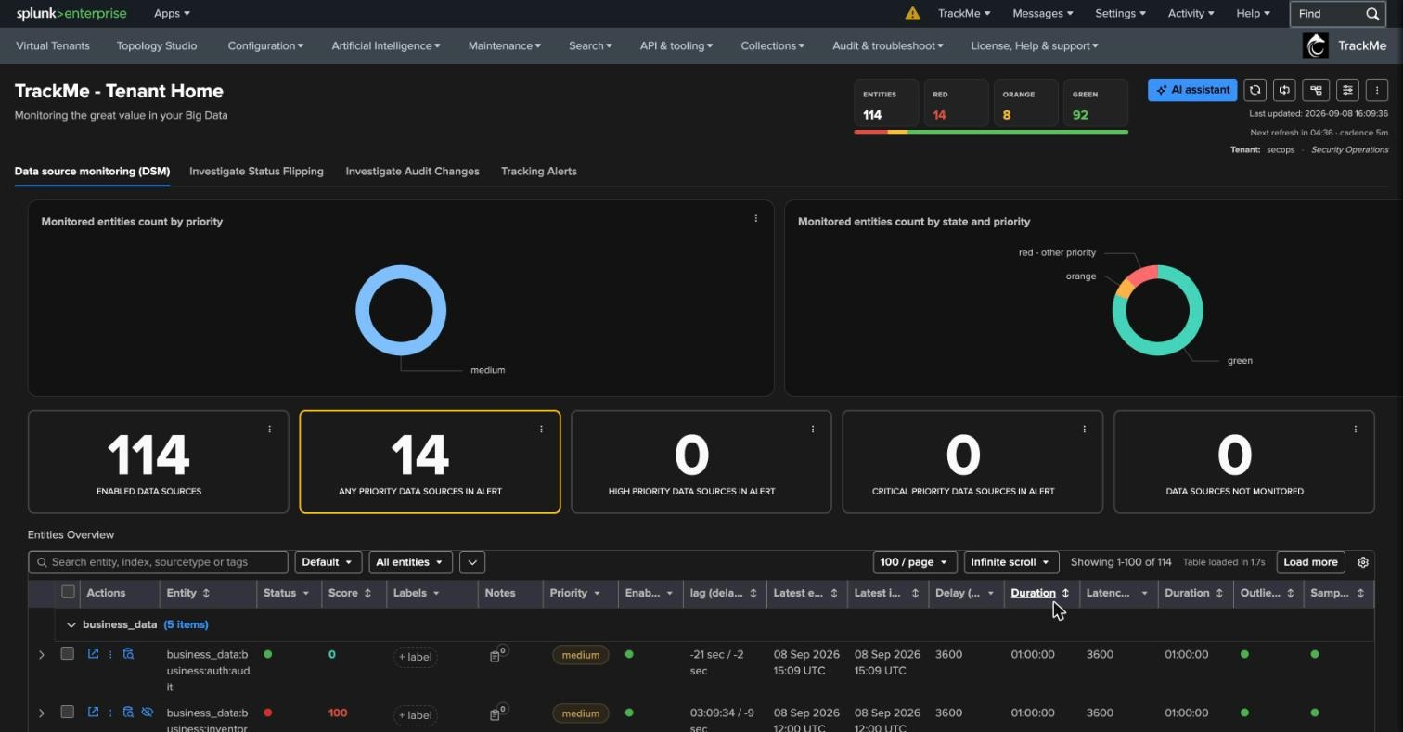
FIRST LOOK
Tenant Home — every data source, already scored
1
Health strip
1
Entities per state — computed by the decision maker on the tracker run we just made.
2
2
State × priority donut
Everything is medium priority for now: discovery does not know what matters yet — that is what policies bring.
3
3
Single-stat drilldowns
Click a tile — or a state in the health strip — and the table filters. Every number on the page is a filter.
4
4
Entities table
One row per (index, sourcetype): state, score, labels, priority, lag (delay / latency), last event, last ingest, thresholds, outliers, sampling.
TrackMe for Splunk · Hands-on: your first DSM tenant
docs.trackme-solutions.com
Notes:
This is the screen every TrackMe user lives in. Four tabs across the top: the component view, status flipping, audit changes and tracking alerts. The health strip, the two donuts and the five single-stats are all drilldown filters on the table below. Note the refresh countdown and cadence at the top right: the page refreshes itself as the trackers run.

Slide 13
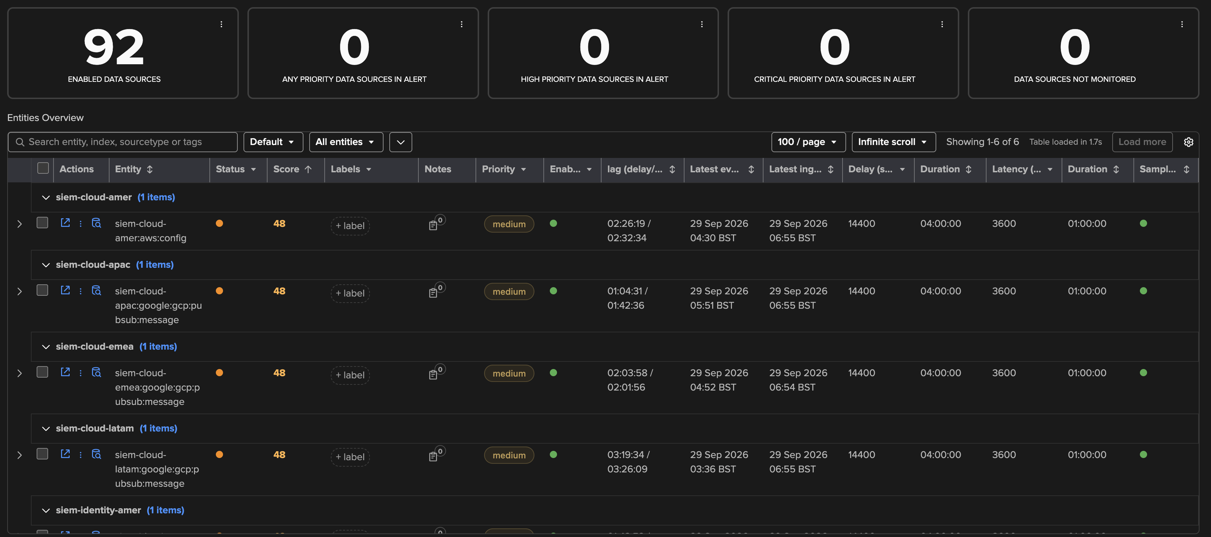
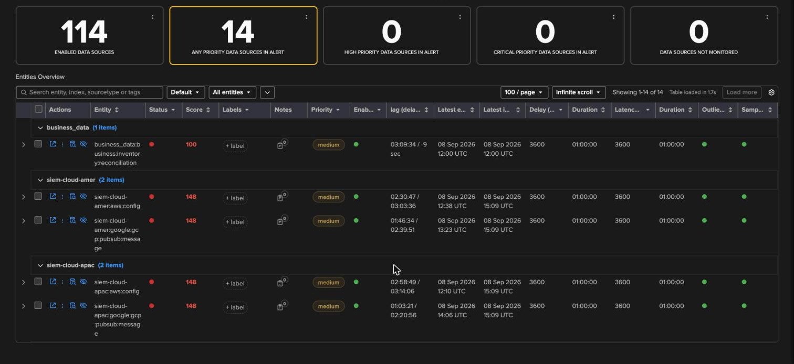
FIRST LOOK
Reading the table — why are these orange?
1
Score 48 = latency only
48 is below 100: orange. Add a delay breach (100) and the same entity turns red at 148 — additive, exactly as configured in step 1.
4
2
lag = delay / latency
1
2
02:26:19 / 02:32:34: last event 2h26 ago, indexed 2h32 after its timestamp. Latency is what breached.
3
3
Thresholds inline
Delay 14400 · duration 04:00:00 — the business_nights slot applied at run time. Latency 3600.
4
Grouped by index
The default grouping folds rows per index; here the table is filtered on orange from the health strip.
TrackMe for Splunk · Hands-on: your first DSM tenant
docs.trackme-solutions.com
Notes:
Read one row out loud: siem-cloud-amer:aws:config, orange, score 48, medium, lag 02:26:19 / 02:32:34, delay threshold 14400 from the night slot, latency threshold 3600. The score column is the fastest way to see how many anomalies overlap: 48 is one soft signal, 148 would mean latency plus delay. Sort by score to see it at a glance.

Slide 14
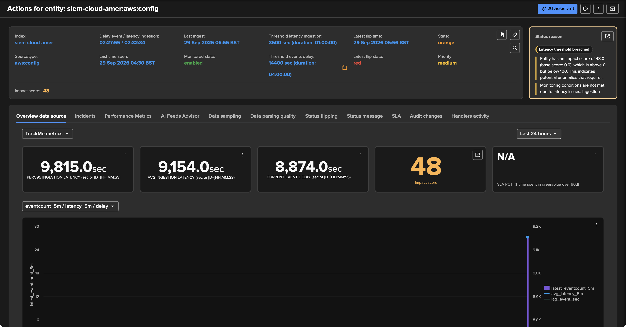
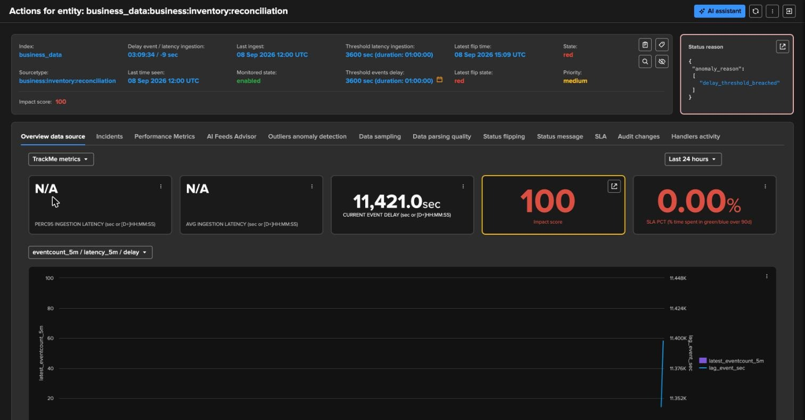
FIRST LOOK
One entity — everything TrackMe knows about it
1
Delay 02:27:55 / latency 02:32:34
1
2
3
Last event seen 04:30, last ingest 06:55 — the events arrive, but late.
2
Thresholds
4
Latency 3600 s, delay 14400 s — the calendar icon opens the variable-delay editor for this entity.
5
3
Status reason
Latency threshold breached, with the score explained. No guessing.
4
Tabs
Overview, incidents, performance, AI Feeds Advisor, sampling, parsing quality, flipping, status message, SLA, audit, handlers.
5
Impact score 48
KPIs over 24 h: p95/avg latency, current delay, score, SLA % — one chart per metric.
TrackMe for Splunk · Hands-on: your first DSM tenant
docs.trackme-solutions.com
Notes:
The entity view is the same for every component; only the KPIs differ. The header is the decision maker’s output; the status reason on the right is the explanation. The chart is nearly empty because the tenant is minutes old — by tomorrow it shows 24 hours of delay, latency and event count.

Slide 15
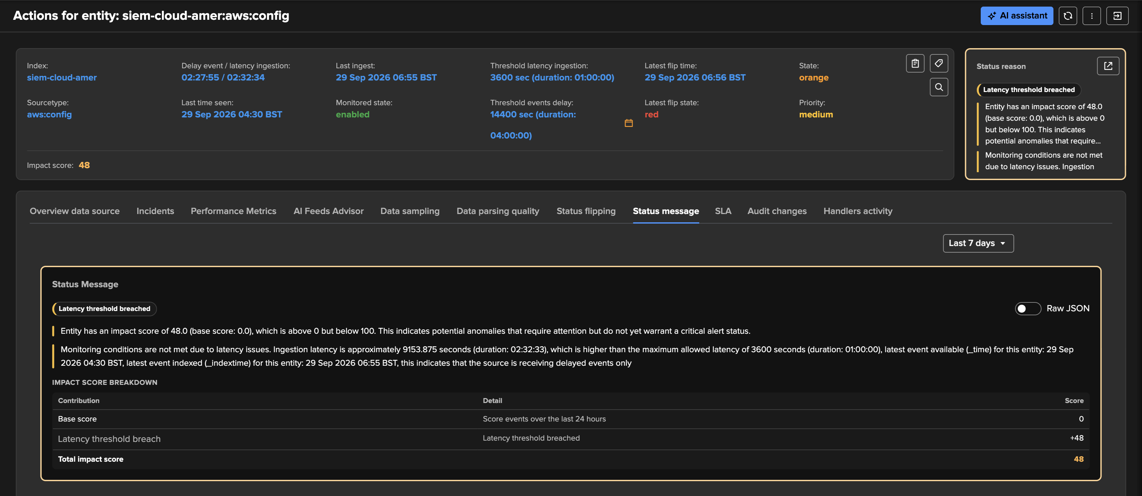
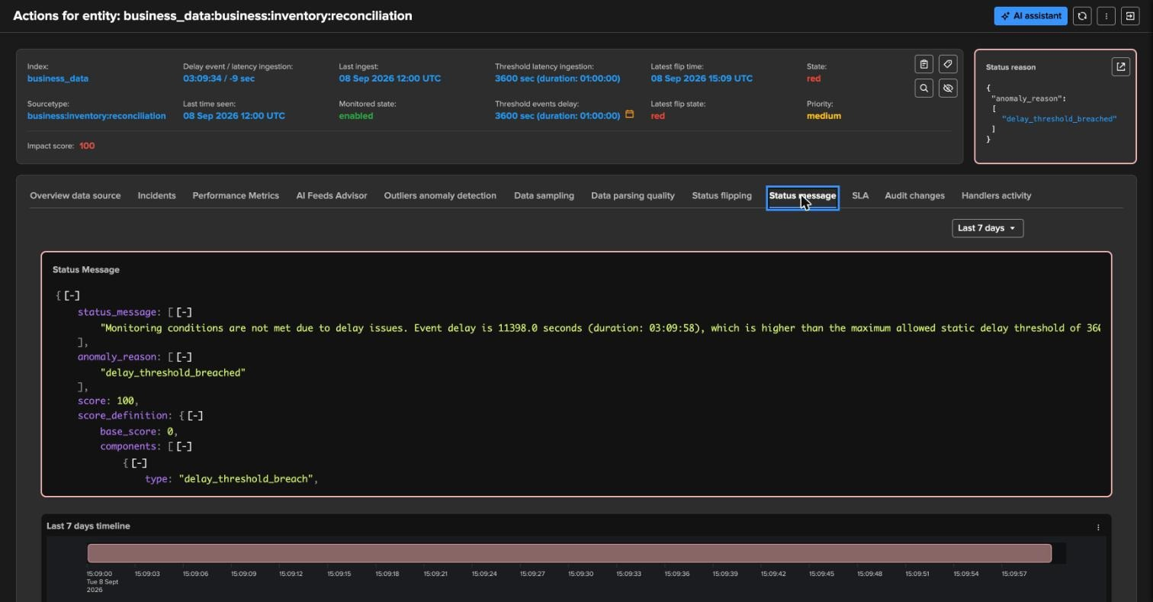
FIRST LOOK
Explainable by design — the status message
1
Status message
“Monitoring conditions are not met due to latency issues. Ingestion latency is approximately 9153 seconds (02:32:33), higher than the maximum allowed latency of 3600 seconds.” Human-readable, and what goes into the alert email.
2
Impact score breakdown
3
Base score 0 + latency threshold breach 48 = total 48. The arithmetic behind the colour, per entity, per cycle.
1
2
3
Raw JSON
One toggle shows the structured status behind the view — the same document the AI Assistant and the alerts consume.
TrackMe for Splunk · Hands-on: your first DSM tenant
docs.trackme-solutions.com
Notes:
This is the answer to “why is it orange?” — and it is the same structure the AI Assistant and the alert emails consume. Nothing in TrackMe changes state without a reason string and a score breakdown. Below it, the 7-day timeline fills in as the tenant ages: over weeks this is how you spot flapping.

Slide 16
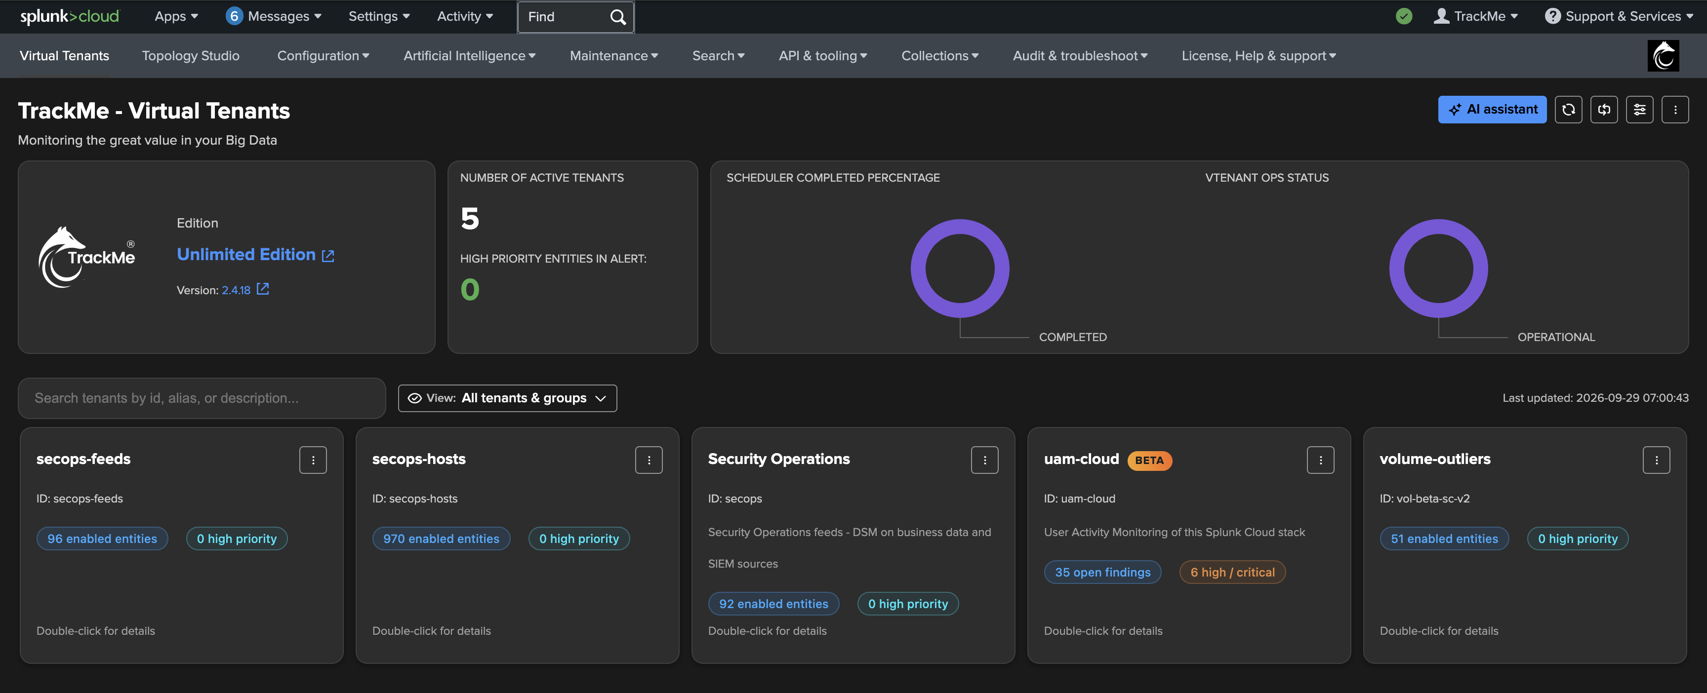
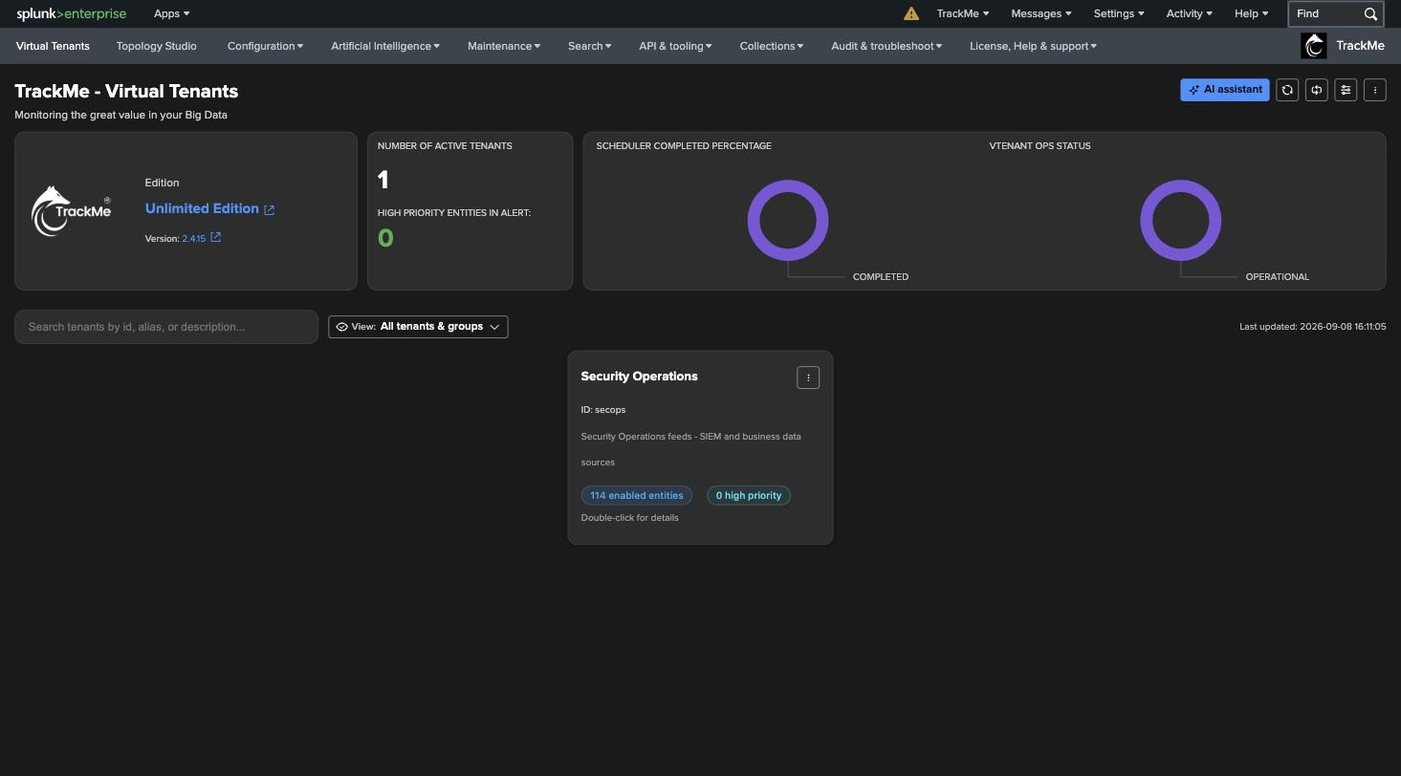
RECAP
Where we are
In this part
Created
the secops tenant with DSM and its hybrid tracker, in one wizard
Discovered
every data source of the SIEM index families — no manual list
Decided
a state, a score and a reason for every entity, from the first run
Read
one entity end to end: latency vs threshold, score breakdown, status message
What made it work
Auto-discovery
Tenant defaults
Explainable state
The hybrid tracker finds every index × sourcetype pair in scope — nothing to declare, nothing to maintain.
Impact weights and variable delay are set once in the wizard, inherited by every entity, overridable per entity.
Every colour carries a score, a breakdown and a sentence — the same text an alert will use.
TrackMe for Splunk · Hands-on: your first DSM tenant
docs.trackme-solutions.com
Notes:
Recap the cycle: discover, measure, decide — all three on a fresh tenant with no configuration beyond an index pattern. The new tenant sits on the Virtual Tenants page next to the others. Every entity is medium priority because nothing has been classified yet: priority is what policies bring.

