Slide 1

HANDS-ON WALKTHROUGH · PART 3
Stateful alerting
One alert on the tenant, scoped to critical and high. Then we break one entity on purpose and follow the incident: opened, emailed, recorded, closed.
TrackMe 2.4.18 · tenant secops from Parts 1 & 2
Notes:
Part 3: step 6 of the cycle — ALERT. The tenant's entities are classified since Part 2. We create one stateful alert, restrict emails to critical and high, then force a healthy critical entity into red with a manual score influence, and watch the incident open, notify, and close. Everything in this deck was captured live.

Slide 2
THE MODEL
Stateful alerting in a nutshell — one incident per problem
Classic alerts fire every cycle an entity is red. TrackMe keeps one incident record per problem and only speaks on transitions — with the whole context attached.
OPENED
UPDATED
CLOSED
entity enters an alerting state
still alerting, something changed
entity back to a non-alerting state
new email thread · stateful event · optional notable / ingest / command
reply in the same thread · event · command
closure reply · event · command
What feeds it
Persisted, keyed, threaded
trackme:flip
state transitions — the source of opened / closed
Each incident has an incident_id, lives in the KV Store with its embedded charts, and writes trackme:stateful_alerts events to the summary index. The email carries a Message-ID; updates and closure are In-Reply-To — one thread per incident in your mailbox or ticketing tool. Suppression (60 min on event_id by default) stops repeats within an incident.
trackme:state
each cycle’s state and score per entity
trackme:notable
the notable events TrackMe writes for anomalies
trackme:sla_breaches
SLA breaches, when SLA classes are used
TrackMe for Splunk · Hands-on: stateful alerting
docs.trackme-solutions.com
Notes:
This is the introduction's step 6, now concrete. The important design point: TrackMe is quiet because it only speaks on transitions, and it is useful because the message carries the full context — status reason, 24 h charts, optional AI summary, drilldown link. The four sourcetypes are the inputs; trackme:stateful_alerts is the output you can search.

Slide 3
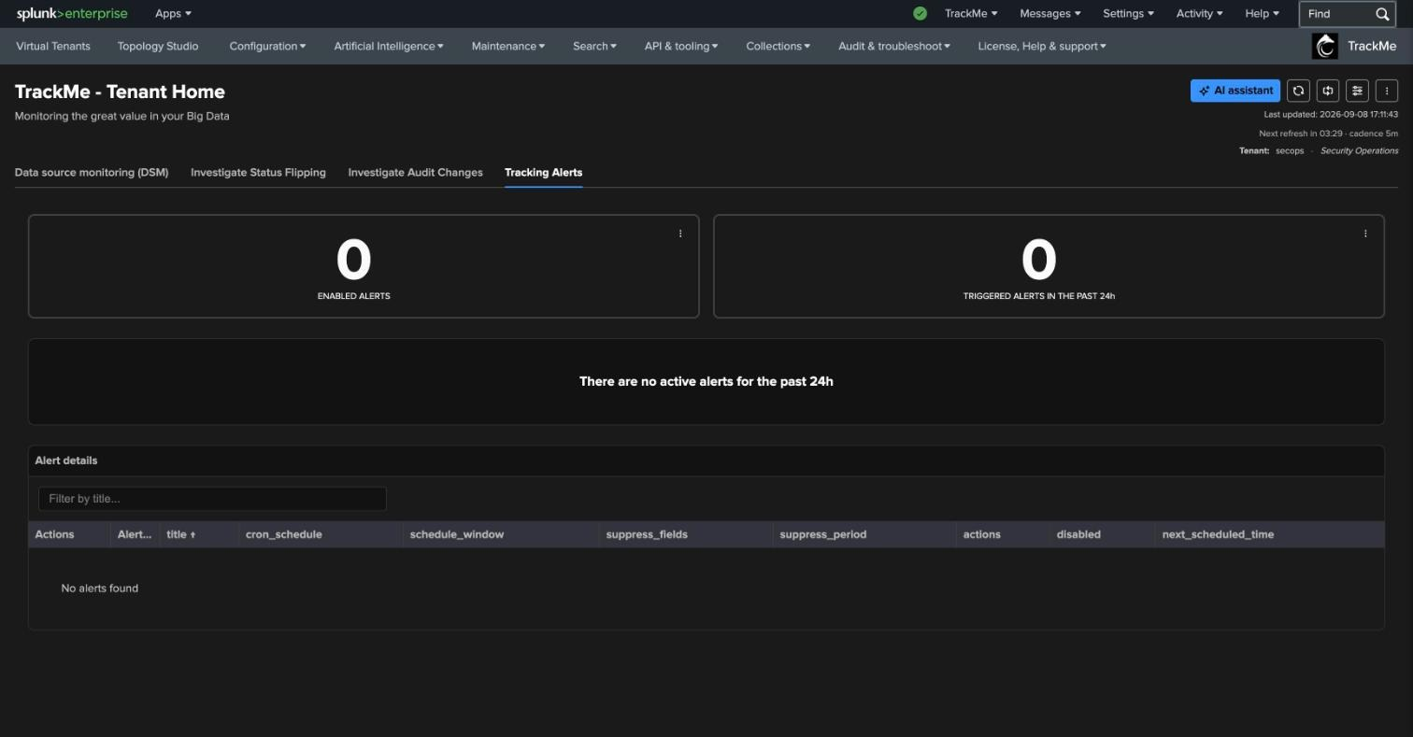
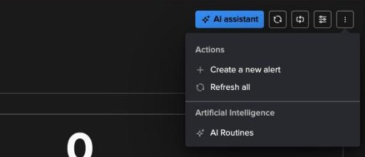
CREATE THE ALERT
Where — Tracking Alerts → Actions → Create a new alert
4
1
2
1
Tracking Alerts tab
Fourth tab of Tenant Home — alerts are tenant-scoped like everything else.
3
2
Two counters
Enabled alerts · triggered in the past 24 h. Both 0 on a fresh tenant.
3
Alert details table
Cron, schedule window, suppress fields / period, actions, next scheduled time.
The alert lives in the Splunk scheduler as a saved search named “TrackMe alert tenant_id:<tenant> - <name>” — visible in Settings → Searches, reports and alerts like any other.
4
Actions → Create a new alert
Opens the assisted alert wizard. AI Routines also live here.
TrackMe for Splunk · Hands-on: stateful alerting
docs.trackme-solutions.com
Notes:
Alerts are created per tenant from the Tracking Alerts tab. What the wizard produces is a normal Splunk saved search with TrackMe alert actions — nothing proprietary in the scheduler, which matters for customers who manage saved searches through CI/CD.

Slide 4
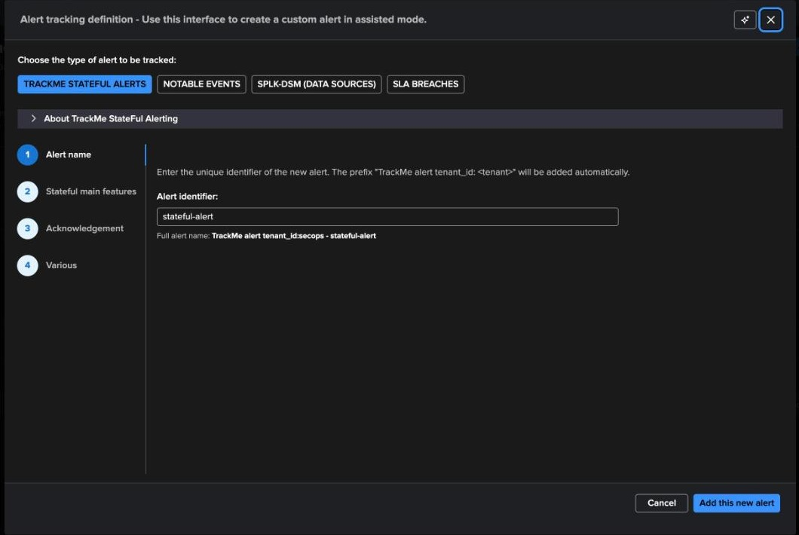
CREATE THE ALERT · WIZARD
Step 1 — Pick the alert type, name it
1
Four alert types
TrackMe stateful alerts (the modern path, used here) · Notable events (classic ES-style) · SPLK-DSM data sources · SLA breaches.
1
2
2
About TrackMe stateful alerting
The expander explains the model in the product — worth opening once in a session.
3
3
Alert identifier
stateful-alert → full name “TrackMe alert tenant_id:secops - stateful-alert”. Four wizard steps: name, stateful features, acknowledgement, various.
One alert per tenant is usually enough: the priority filter and suppression do the routing. Several alerts make sense when different teams want different recipients or channels.
TrackMe for Splunk · Hands-on: stateful alerting
docs.trackme-solutions.com
Notes:
Stateful alerting is the type to use for new deployments. Notable events remain for customers whose workflow is Enterprise Security: TrackMe writes notables and ES correlates them. The name is prefixed automatically with the tenant id.

Slide 5
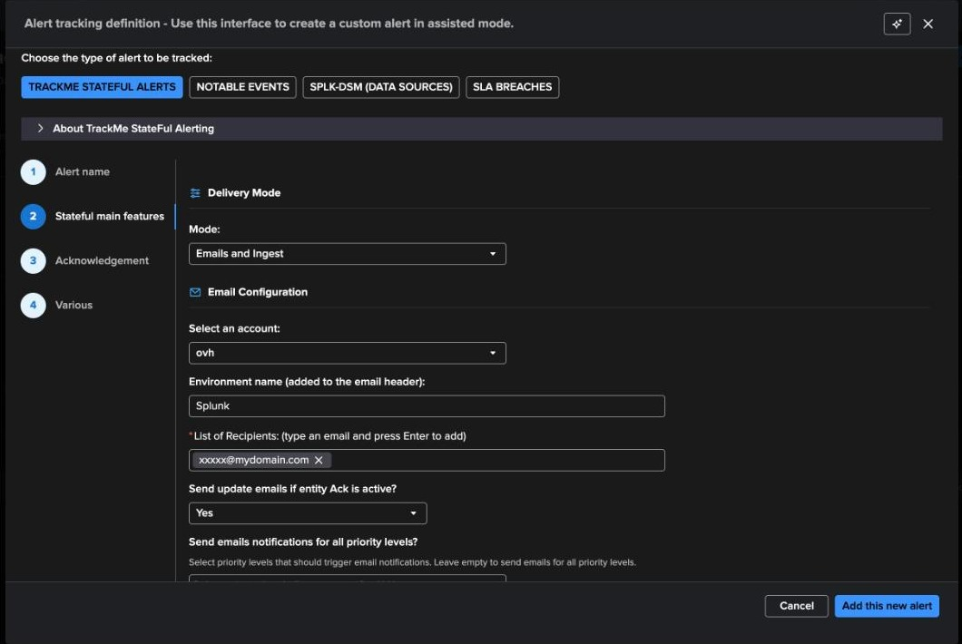
CREATE THE ALERT · WIZARD
Step 2 — Delivery mode and email configuration
1
Mode: Emails and Ingest
Deliver by email and write the stateful event to the summary index. Other modes: emails only, ingest only, plus notable / command actions.
2
Email account
An SMTP account configured once in TrackMe. Environment name goes in the subject / header.
1
3
Recipients
Chips — type and press Enter. A distribution list or a ticketing inbox is typical.
2
4
Update emails if ACK is active
3
Whether an acknowledged entity keeps sending updates.
4
TrackMe for Splunk · Hands-on: stateful alerting
docs.trackme-solutions.com
Notes:
Delivery mode decides where the incident goes. Emails and Ingest is the usual choice: humans get the thread, Splunk keeps the record. The email account is defined once under Configuration; the wizard just picks it. Environment name is what distinguishes prod from preprod in a shared inbox.

Slide 6
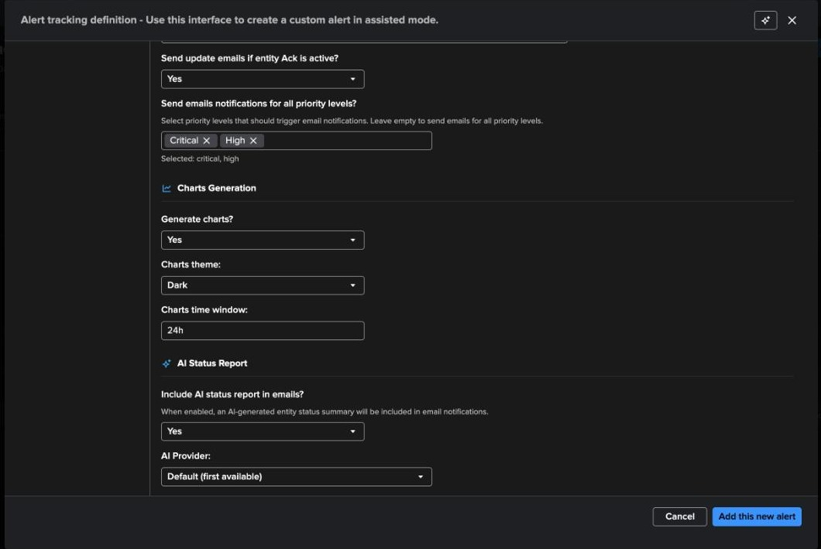
CREATE THE ALERT · WIZARD
Step 2 — Who gets emailed, charts, AI status report
1
Priority levels for email
Critical + High. Everything is still tracked and ingested; only these priorities generate email. This is where Part 2’s classification pays off — no policy, no filter.
1
2
Charts generation
Yes · dark theme · 24 h window. Latency, delay, volume, hosts, incidents, flipping and state charts are rendered and embedded in the email.
2
3
AI status report
Optional LLM summary in the email, using the configured AI provider — entirely opt-in; the alert works without it.
3
Steps 3 (acknowledgement) and 4 (various: cron, suppression, throttling) were left on their defaults.
TrackMe for Splunk · Hands-on: stateful alerting
docs.trackme-solutions.com
Notes:
The priority filter is the single most important setting for a quiet on-call: the low and medium feeds still get their incidents recorded, but nobody is paged for them. Charts make the email self-sufficient: the recipient sees 24 hours of context without opening Splunk. The AI status report is opt-in and provider-dependent.

Slide 7
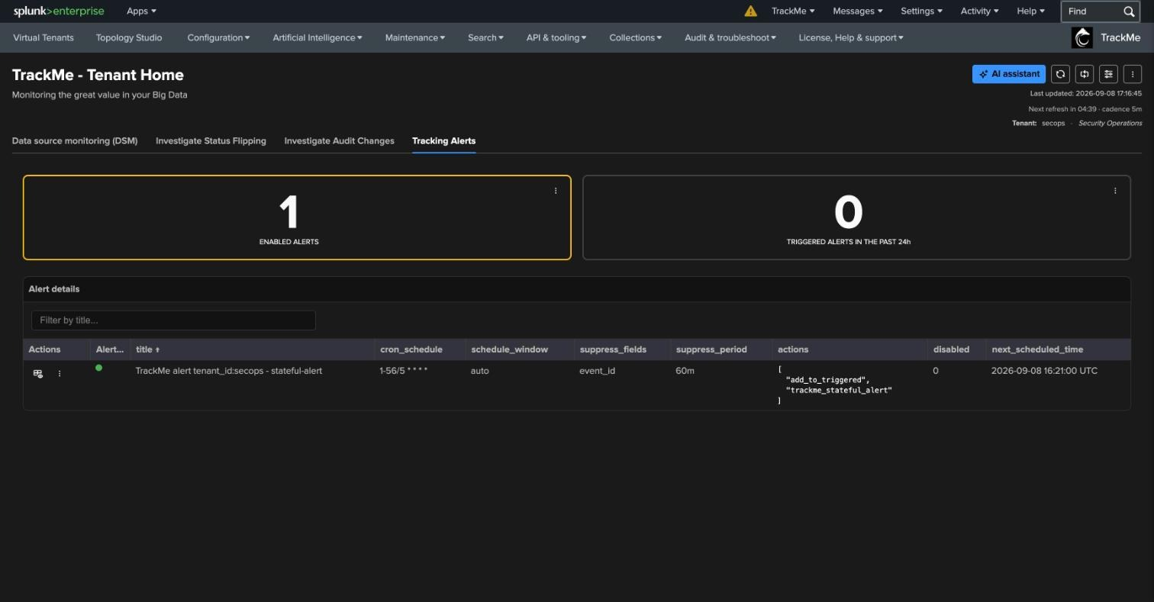
CREATE THE ALERT · RESULT
The alert exists — a scheduled search with TrackMe actions
1
1 enabled alert
Green status dot. Triggered in the past 24 h still 0 — nothing critical or high is red yet.
2
cron 1-56/5 * * * *
1
Every 5 minutes, offset from the trackers so it evaluates fresh state.
3
suppress event_id · 60m
Splunk-side throttling on the incident event id — a safety net on top of the stateful logic.
2
3
4
4
actions
add_to_triggered + trackme_stateful_alert — the TrackMe alert action that opens, updates and closes incidents.
The pencil / ⋮ in the Actions column edits or disables the alert; the same definition is editable in Splunk’s alert page.
TrackMe for Splunk · Hands-on: stateful alerting
docs.trackme-solutions.com
Notes:
Note the cron: 1-56/5 rather than */5, so the alert runs one minute after the trackers. trackme_stateful_alert is the alert action doing the work; add_to_triggered keeps Splunk's triggered-alerts list in sync. From here on we do nothing to the alert — we make an entity red.

Slide 8
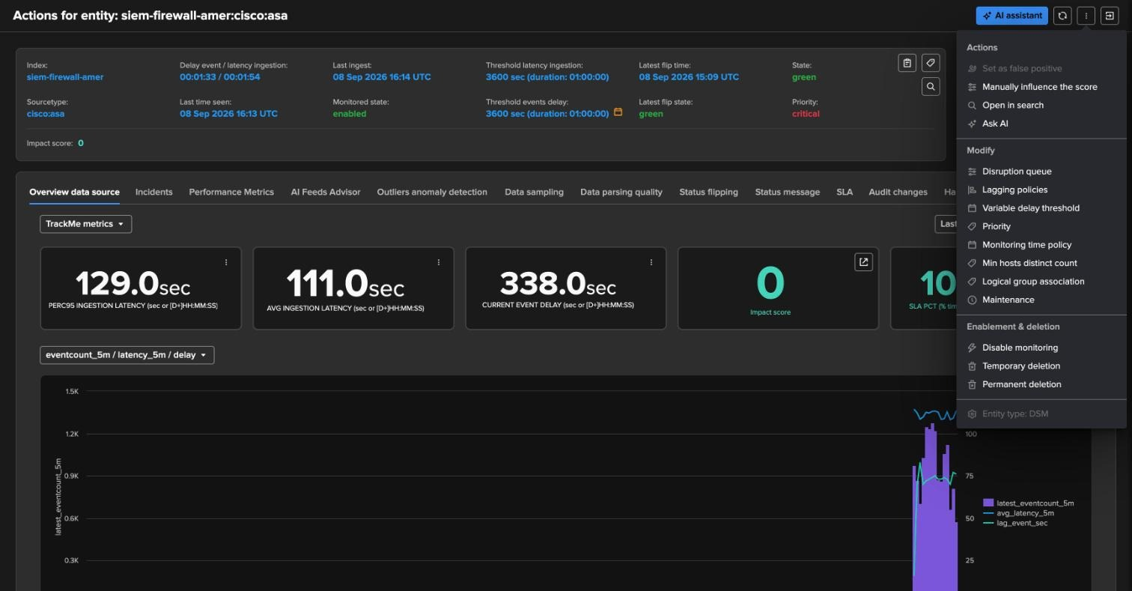
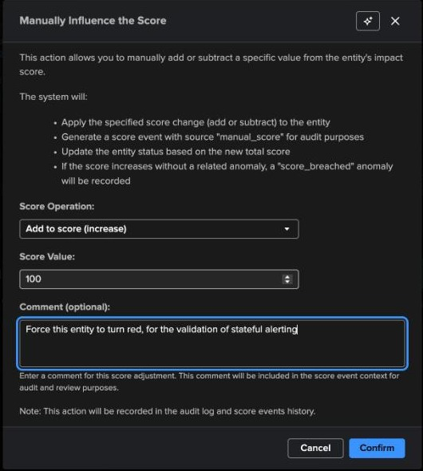
TRIGGER
Provoke an incident — manually influence the score
1
Entity ⋮ menu
2
1
Manually influence the score, false positive, disruption queue, lagging classes, priority, maintenance…
2
A healthy critical entity
3
siem-firewall-amer:cisco:asa — green, score 0, priority critical from the CMDB policy.
3
Add 100 to the score
With a comment. Audited as a manual_score event; a score_breached anomaly is recorded.
Why this is a good demo device
It shows a real feature — operators use score influence to force attention on an entity, or to soften one — and it produces a deterministic red state on a healthy feed without touching data or thresholds. Because the entity is critical, it passes the alert’s email filter. Every step is in the entity’s audit trail, and the AI status report will even say it was a manual override.
TrackMe for Splunk · Hands-on: stateful alerting
docs.trackme-solutions.com
Notes:
Manual score influence adds or subtracts a value from the impact score. Add 100 and the entity crosses the red threshold with anomaly_reason score_breached. The action is written to the audit log with the comment, and the status message will show the manual component in score_definition. We chose a critical entity so the email filter lets it through.

Slide 9
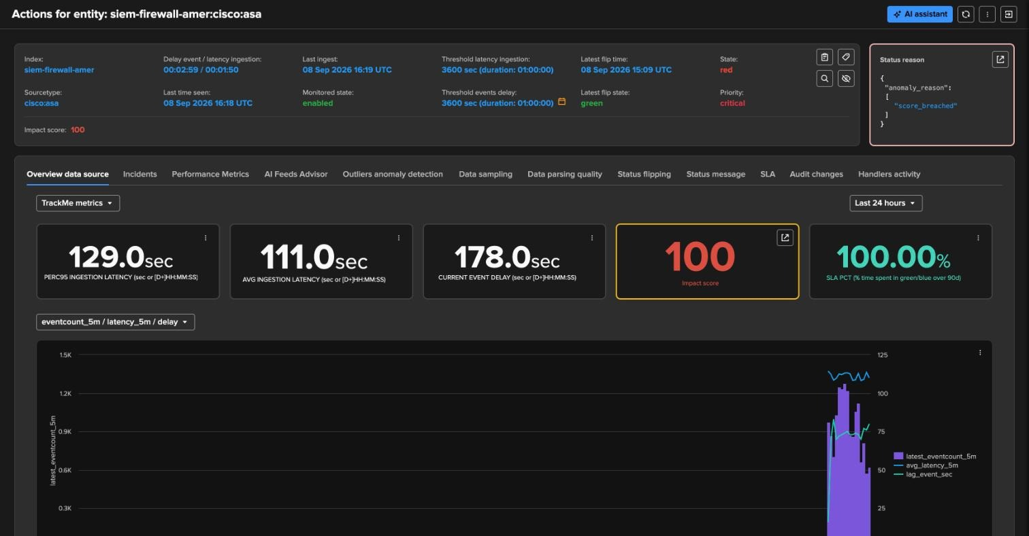
TRIGGER
Red by decision, not by data — score_breached
1
Metrics still healthy
Delay 02:59, latency 01:50, thresholds 3600 — nothing wrong with the feed.
1
2
3
2
State: red
Latest flip 16:24 UTC, priority critical.
3
anomaly_reason: score_breached
4
The status reason names the manual influence — no false “delay” story.
4
Impact score 100
= manual component. score_definition in the Status message tab shows it.
The next alert run (every 5 minutes) sees a critical entity in red with no open incident — and opens one.
TrackMe for Splunk · Hands-on: stateful alerting
docs.trackme-solutions.com
Notes:
Read the header: metrics green, state red, reason score_breached. This is the honesty of the scoring model — the reason is always the real one. Now we wait for the alert's next cron slot.

Slide 10
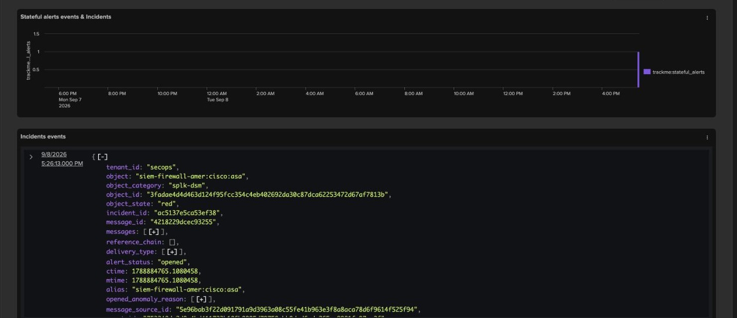
LIFECYCLE · OPENED
Incident opened — the Incidents tab of the entity
1
Stateful alerts events
One bar at 17:26 — the alert run that opened the incident.
1
2
incident_id · message_id
ac5137e5ca53ef38 is the incident key; message_id is the email Message-ID.
3
alert_status: opened
2
With object_state red, ctime = mtime, delivery_type listing email + ingest.
3
4
opened_anomaly_reason
4
score_breached — what was wrong when the incident opened, kept for the closure.
Everything on this tab is the trackme:stateful_alerts event — the same document that is in the KV Store and the summary index.
TrackMe for Splunk · Hands-on: stateful alerting
docs.trackme-solutions.com
Notes:
The Incidents tab of the entity shows the incident record as TrackMe stores it. The ids matter: incident_id ties every event of the incident together; message_id is what makes the email a thread; message_source_id points at the flip event that caused it.

Slide 11
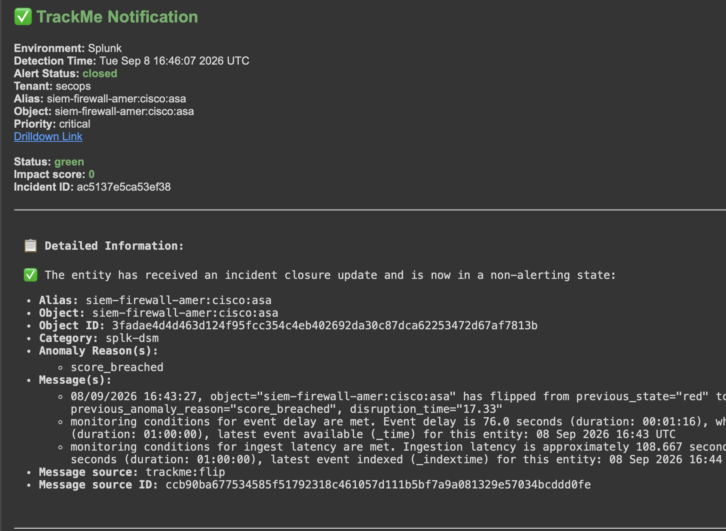
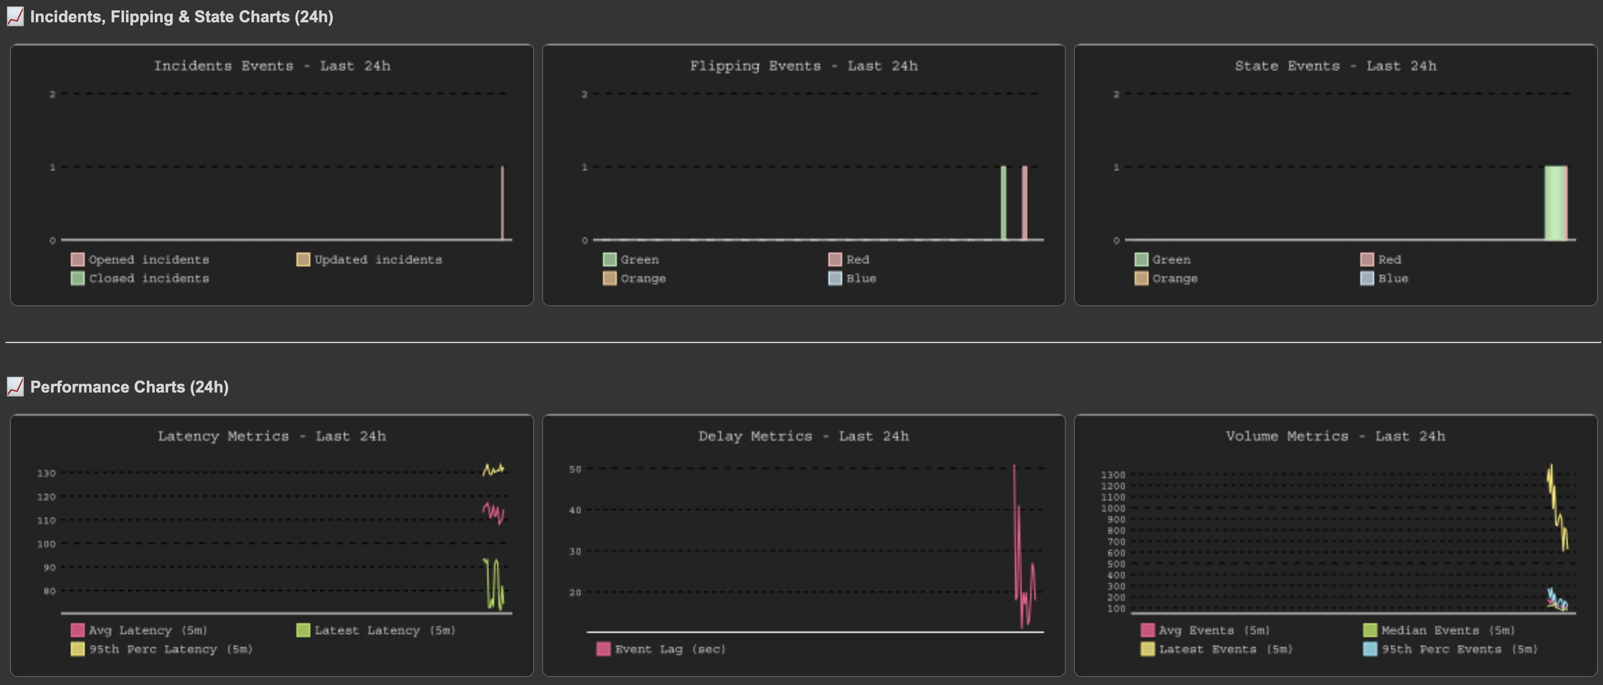
LIFECYCLE · NOTIFICATION
The email — opened, with the reason and 24 h of context
Incidents, flipping and state charts + latency, delay, volume and hosts — last 24 h, rendered by TrackMe
Subject “[TrackMe Incident-ID: <id>] Entity <object>” · environment, detection time, alert status, tenant, alias, priority, drilldown link · status, impact score, incident id · the flip message and the score explanation verbatim · then the AI status report and the charts. Replies land in the same thread.
Header, status, detailed information (closure email shown — the opened email has the same layout with status opened / red / 100)
TrackMe for Splunk · Hands-on: stateful alerting
docs.trackme-solutions.com
Notes:
Walk the email top to bottom: who, what, why, how bad, link to the entity. The message block is the flip event text — the same sentence the Status message tab shows. Below it the AI report if enabled, then the charts. Recipients do not need Splunk access to understand the incident; the drilldown link is there when they want it.

Slide 12
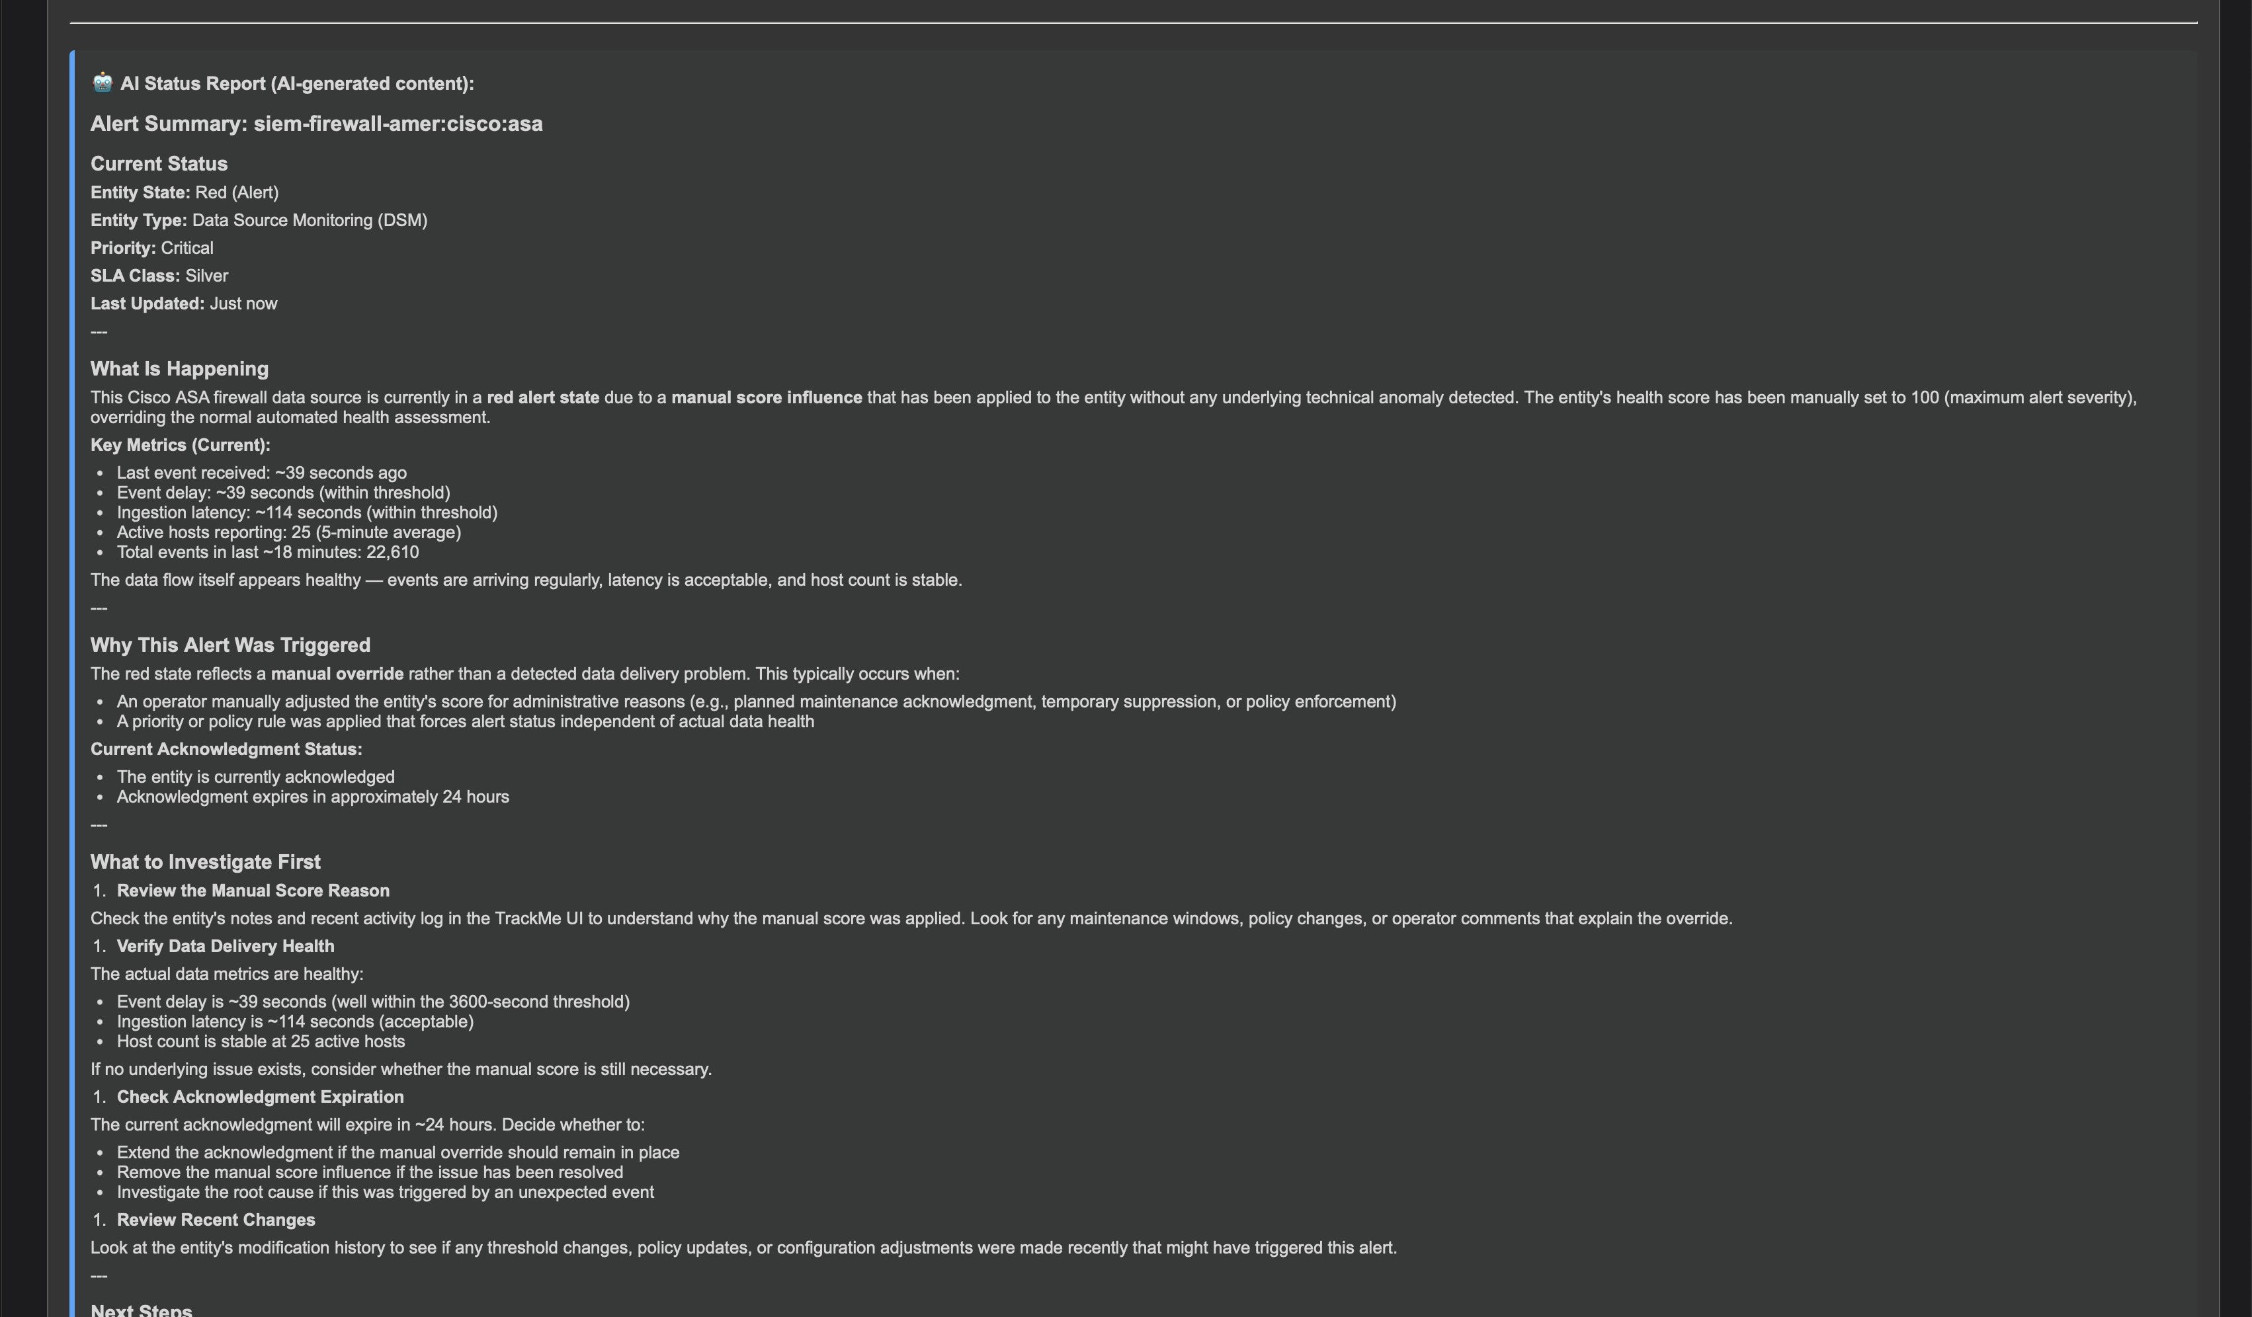
LIFECYCLE · NOTIFICATION
The AI status report — optional, and honest about the cause
1
Current status
State, entity type, priority, SLA class, last updated — structured header.
2
What is happening
Identifies the manual score influence as the cause and confirms the data flow itself is healthy: delay ~39 s, latency ~114 s, 25 hosts.
3
What to investigate first
Ordered steps: review the manual score reason, verify delivery health, check the acknowledgment, review recent changes.
Grounded in TrackMe’s data, not free prose: the report reads the entity’s metrics and audit context through the same tools the AI Assistant uses. Opt-in per alert, provider configured once.
TrackMe for Splunk · Hands-on: stateful alerting
docs.trackme-solutions.com
Notes:
Show this to make the AI story concrete without a chat demo: the report correctly says the red state is a manual override and that the feed is healthy. That is the trust principle from the introduction — the agent does not invent state. The report is opt-in per alert; the email is complete without it.

Slide 13
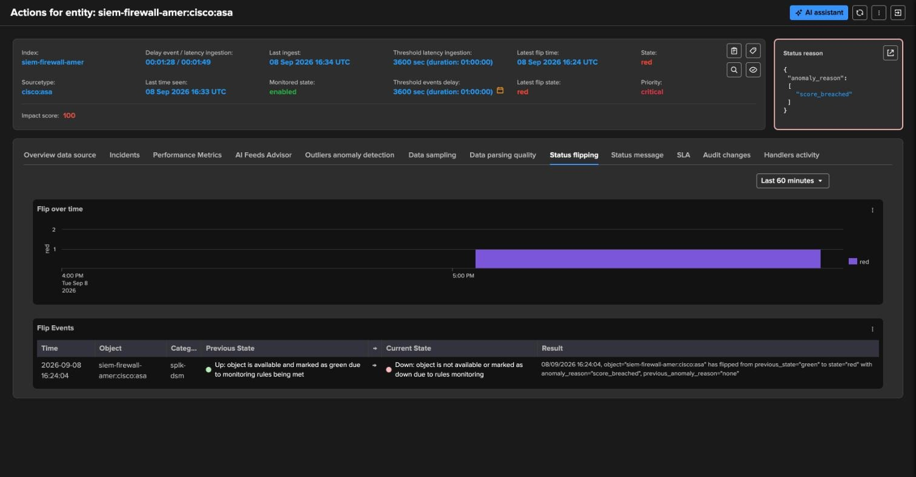
LIFECYCLE · THE RECORD
Status flipping — every state change is recorded
1
Flip over time
Red since 16:24 — the timeline of the entity’s states.
2
Flip events
16:24:04 · previous state green (Up) → current state red (Down).
3
Result
1
“has flipped from previous_state=green to state=red with anomaly_reason=score_breached, previous_anomaly_reason=none” — the trackme:flip event.
2
3
Flip events are the raw material of stateful alerting: the incident opened because of this flip, and will close on the next one. They are also what the Investigate Status Flipping tab of Tenant Home aggregates.
TrackMe for Splunk · Hands-on: stateful alerting
docs.trackme-solutions.com
Notes:
The Status flipping tab is where you see that state changes are events with a history — this is how flapping entities are found later, and it is the source that the stateful alert consumed. Same sentence in the email, same sentence here.

Slide 14
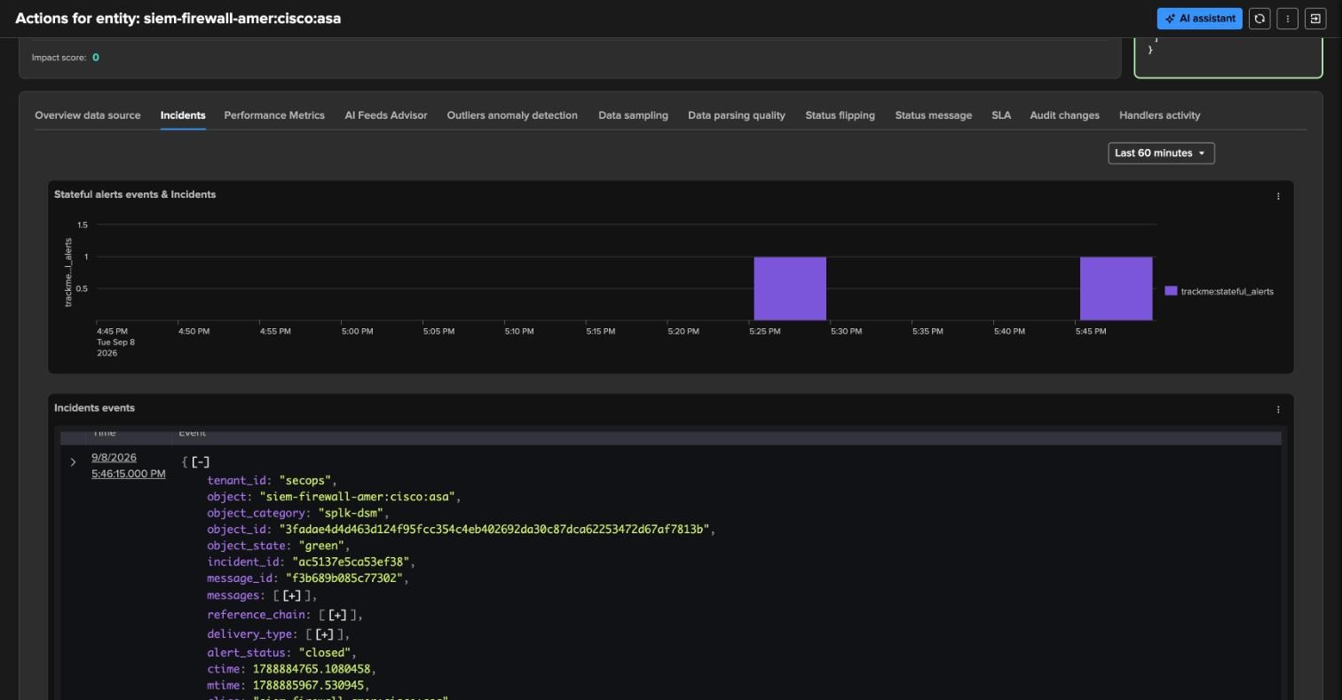
LIFECYCLE · CLOSED
Incident closed — score removed, entity green, one closure email
3
1
4
2
1
Two stateful events
2
Closure record
3
Closure email
17:26 opened, 17:46 closed — same incident_id ac5137e5ca53ef38, alert_status closed, object_state green.
mtime updated, new message_id — the closure email is a reply in the original thread.
✅ green header, status closed, impact score 0; the flip message red → green with disruption_time 17.33 min, delay and latency back within thresholds.
TrackMe for Splunk · Hands-on: stateful alerting
docs.trackme-solutions.com
Notes:
Subtract the 100 points, the entity goes green on the next tracker run, the alert's next run sees an open incident on a green entity and closes it. The closure email quotes the recovery flip and the disruption time — 17 minutes here — which is also what SLA reporting uses. The AI recovery summary confirms the entity is healthy.

Slide 15
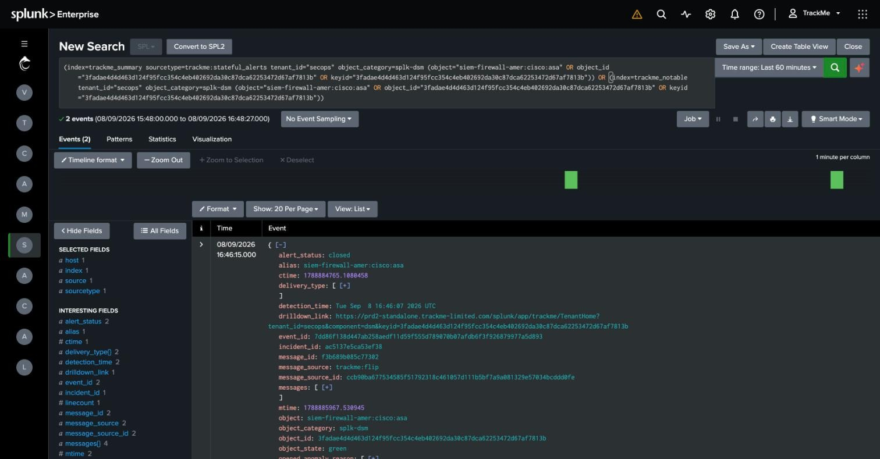
LIFECYCLE · THE DATA
Under the hood — it is all Splunk events
1
Open in search
From the entity’s Incidents panel ⋮ — the SPL over index=trackme_summary sourcetype=trackme:stateful_alerts (and trackme_notable) for this object.
1
2
2
2 events
opened and closed, in the last 60 minutes.
3
Fields
3
alert_status, detection_time, drilldown_link, event_id, incident_id, message_id, message_source, object_state… ready for a dashboard, a ticketing integration, or a report on incidents per team.
Because incidents are events, anything Splunk can do with events applies: MTTR by priority, incidents per tag, forwarding to ITSM, correlation in ES.
TrackMe for Splunk · Hands-on: stateful alerting
docs.trackme-solutions.com
Notes:
The point for a Splunk team: no black box. Two events, one per transition, with every id you need. Customers build their own incident dashboards or feed ServiceNow from here; the drilldown_link brings the ticket back to the entity.

Slide 16
RECAP
Where we are
In this part
Created
Provoked
Followed
Verified
one stateful alert: emails + ingest, critical & high only, charts, AI report
a red state on a healthy critical entity with a manual score influence
the incident: opened → email with reason and charts → flip recorded → closed with disruption time
the trail as Splunk events — two trackme:stateful_alerts events with every id
What made it work
One incident per problem
Classification pays off
Everything is a Splunk event
opened, updated, closed — one record and one email thread, speaking only on transitions
the priority filter from the policies decides who gets emailed; every incident is still recorded
incidents are searchable, reportable and forwardable — MTTR, dashboards, ITSM, Enterprise Security
TrackMe for Splunk · Hands-on: stateful alerting
docs.trackme-solutions.com
Notes:
Recap the cycle one last time: discover (Part 1), classify (Part 2), alert (Part 3). One stateful alert, scoped by the priority the policies assigned, opened, emailed and closed one incident — one record and one thread — and left its whole trail as Splunk events that can be searched, reported on and forwarded.

